Slide 1
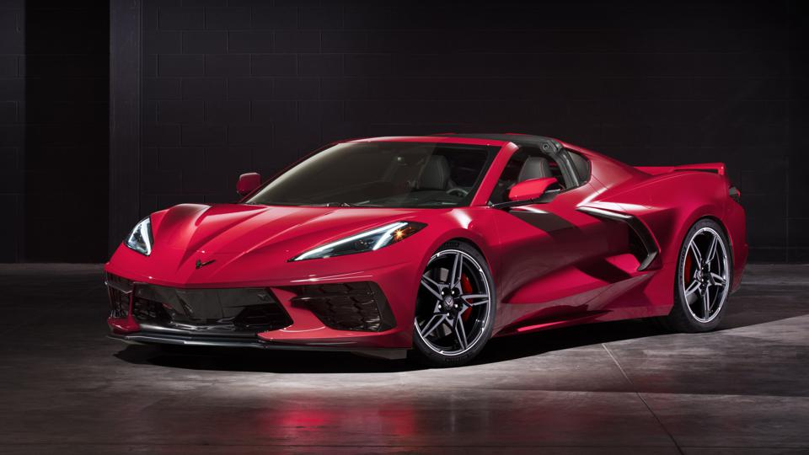
Cars4U

Slide 2
Objective
Contents
Huge demand for used cars in the Indian Market
Sales of new cars have slowed down in the recent past
Demand is shifting towards the pre-owned market.
Used cars are very different beasts with huge uncertainty in both pricing and supply.
Pricing scheme of these used cars becomes important in order to grow in the market.
Explore and visualize the dataset.
Build a linear regression model to predict the prices of used cars.
Generate a set of insights and recommendations that will help the business.

Slide 3
Business Problem Overview and Solution Approach
Cars4U is a budding tech start-up that aims to find footholes in this market
Linear Regression Model we shall use , to predict the price of used cars
Help the business in devising profitable strategies using differential pricing
Liner Regression Model will help to understand the independent variables required to predict the price.

Slide 4
Data Overview
- S. No. : Serial Number
- Name : Name of the car which includes Brand name and Model name
- Location : The location in which the car is being sold or is available for purchase Cities
- Year : Manufacturing year of the car
- Kilometers driven : The total kilometers driven in the car by the previous owner(s) in KM.
- Fuel Type : The type of fuel used by the car. (Petrol, Diesel, Electric, CNG, LPG)
- Transmission : The type of transmission used by the car. (Automatic / Manual)
- Owner : Type of ownership
- Mileage : The standard mileage offered by the car company in kmpl or km/kg
- Engine : The displacement volume of the engine in CC.
- Power : The maximum power of the engine in bhp.
- Seats : The number of seats in the car.
- New Price : The price of a new car of the same model in INR Lakhs.(1 Lakh = 100, 000)
- Price : The price of the used car in INR Lakhs (1 Lakh = 100, 000)
Key Points –
In the data set we have 7253 rows and 13 columns
In the given dataset we do not have duplicate values
We do have null values in the dataset
Data Preprocessing is required for couple of variables.
Out layers are supposed to be processed.

Slide 5
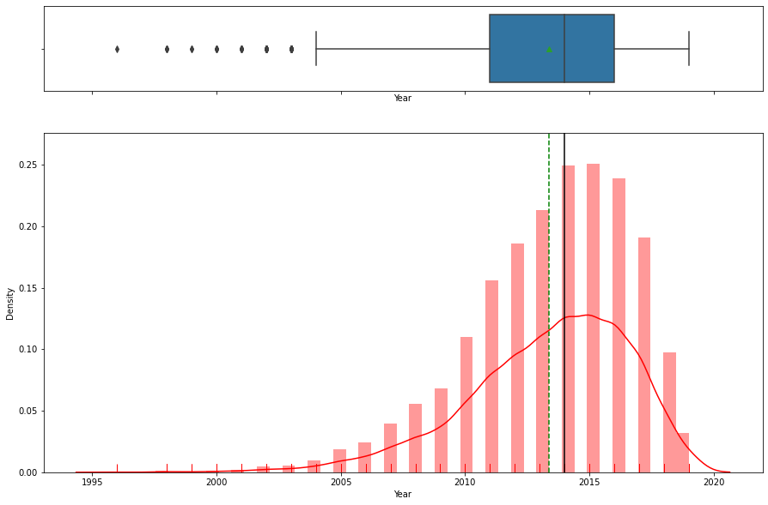
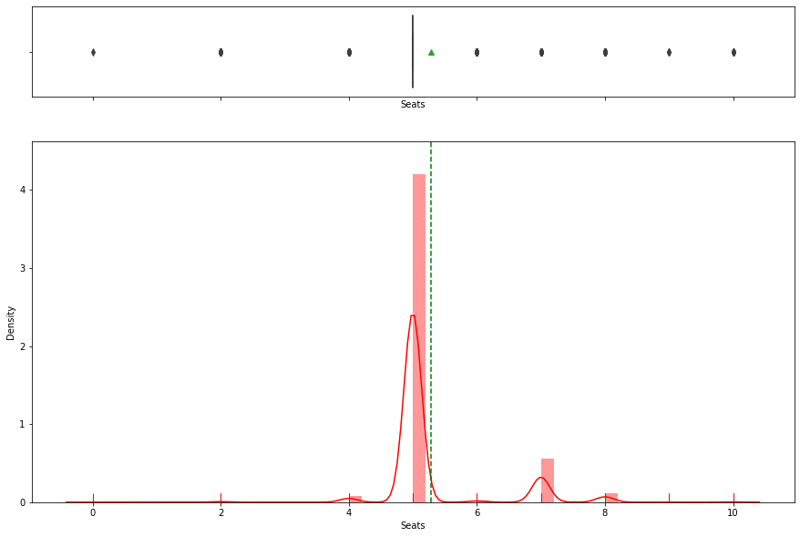
Exploratory Data Analysis Year Seats
- Majority of the cars are from 2014 and 2015
- Year has left skew , lot of data points are towards the left side.
- Data transformation is required
- Distribution of the data looks very normal.
Majority of the cars has 5 seats
It looks like we do have 2 seat cars , some may be are sports cars

Slide 6
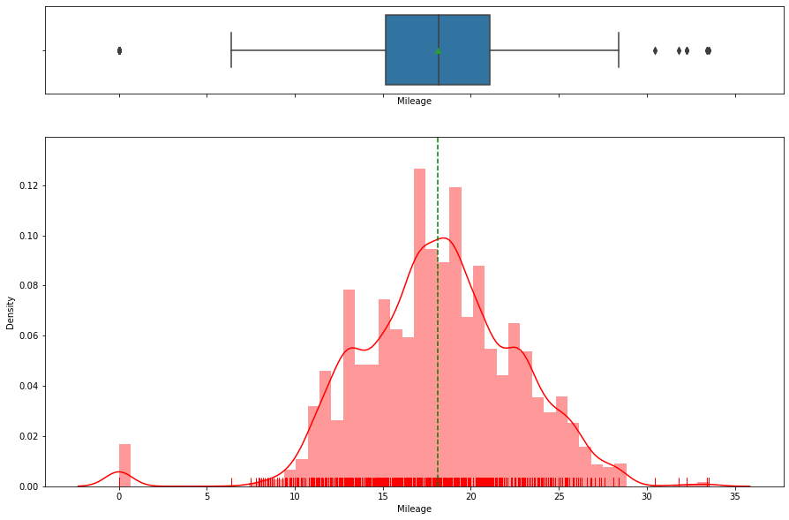
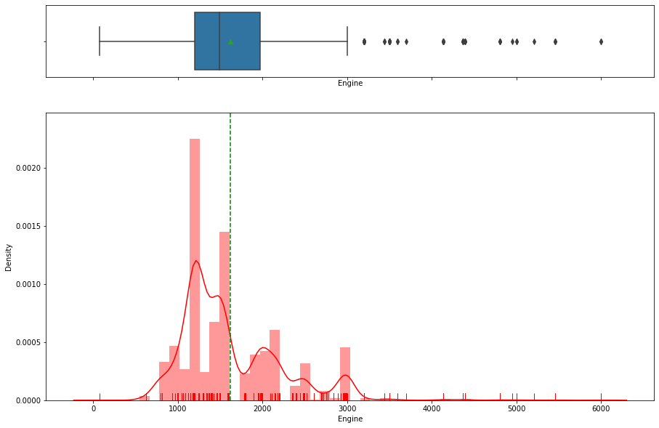
Exploratory Data Analysis Mileage Engine
Mileage looks normal distribution.
Engine do have right skew data

Slide 7
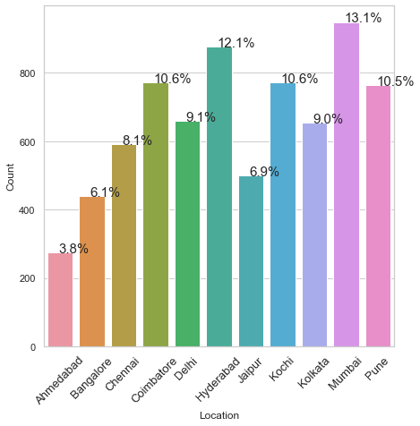
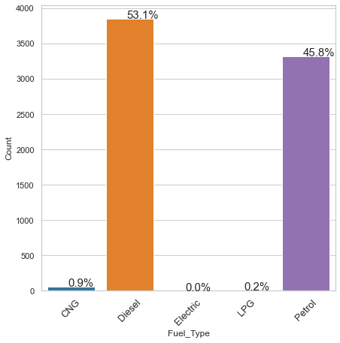
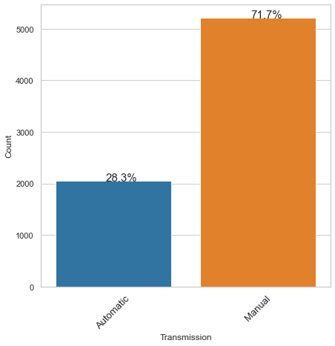
Exploratory Data Analysis Location Fuel Type Transmission
Mumbai has highest number of cars and Ahmedabad has lowest
Majority of the cars belongs to Diesel and Petrol.
Manuals cars are double when compared to Automatic cars

Slide 8
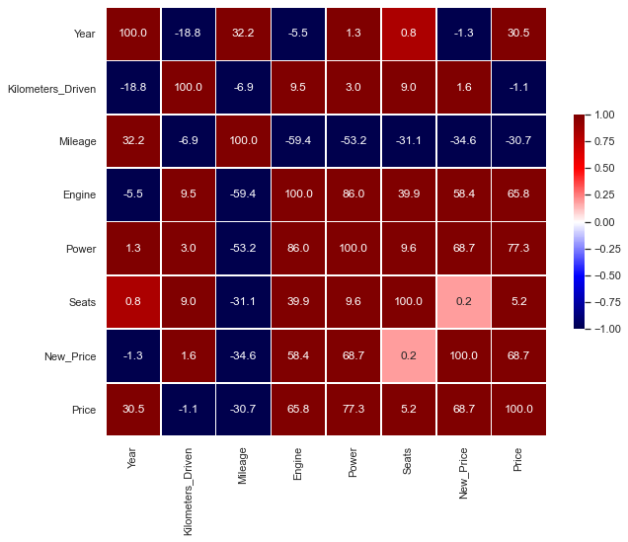
Exploratory Data Analysis - Correlation
- Majority of the variables are not correlated.
- Power and New Price are correlated. Maybe one variable can be removed.
- Power and Engine has correlation value of 86% , which means to say they are correlated.

Slide 9
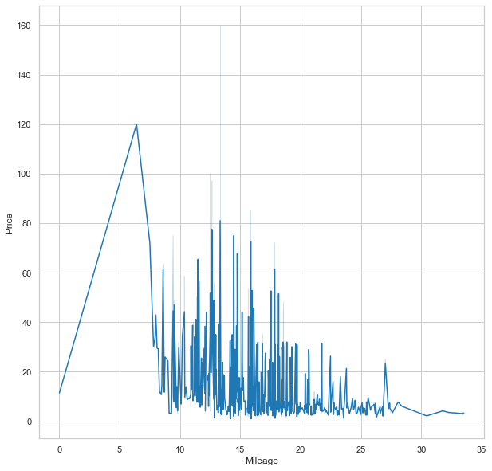
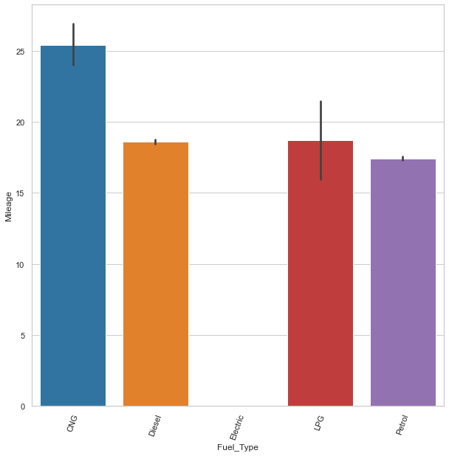
Exploratory Data Analysis Price vs Mileage Fuel Type vs Mileage
- Less the mileage of the car , more price
- For majority of the cars , mileage is from 10 to 30.
- Only for couple of car's mileage is more than 30
- We do have incomplete values in the dataset , due to that couple of cars has 0 mileage
- CNG cars have more mileage when compared to all others.
- LPG and Diesel has almost same mileage
- Petrol has less mileage when compared to other fuel types

Slide 10
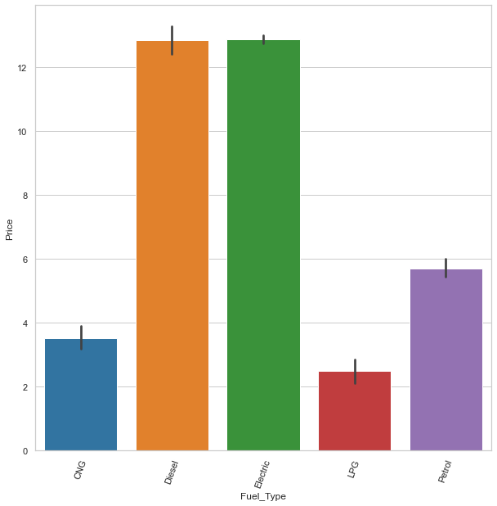
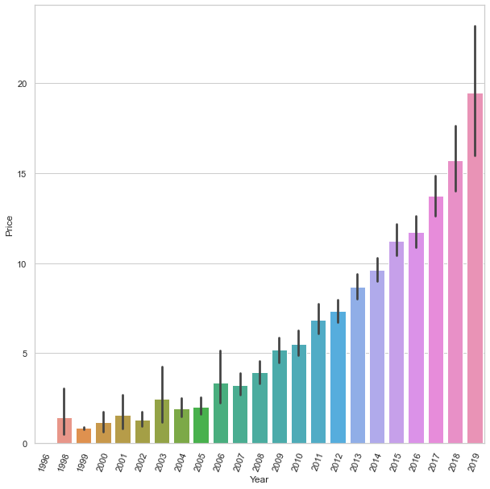
Exploratory Data Analysis Fuel Type vs Price Year vs Price
- Diesel and Electric cars are bit costly when compared to other cars.
- LPG is less when compared to all other.
- High the year , more the price of the car.
- 2019 cars has highest price in the given dataset.

Slide 11
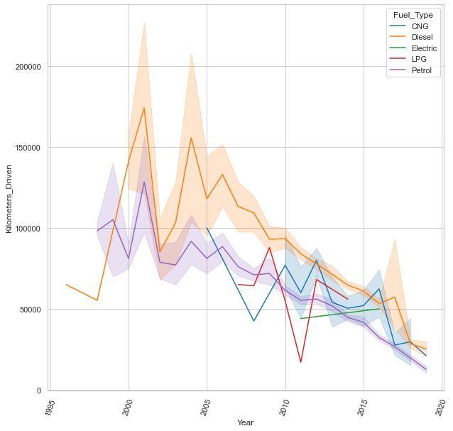
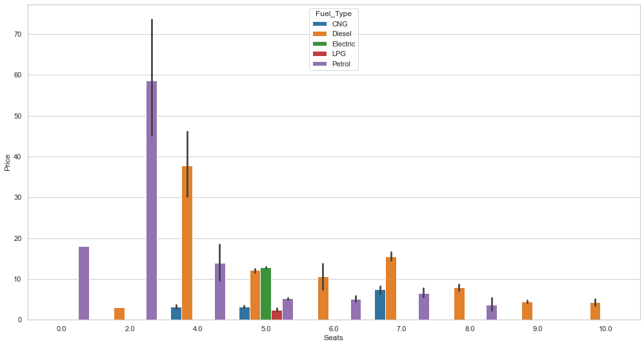
Exploratory Data Analysis Year vs Kilometer driven Price vs Seats
- Cars with 2015 and greater , drove less miles when compared to others.
- Diesel cars drove more miles when compared to all other cars
- Petrol cars with 2 seats are costly when compared to all others , maybe these are sports cars.
- Diesel cars with 4 seats are next in line.

Slide 12
Conclusion
Car Price come out to be very significant, as expected. variables - New Price and Name of the car is not required to predict the price of the car.
Higher the mileage , Price of the car is less.
Year 2015 and high has less number of kilometers when compared to others as expected.
Less the mileage of the car , more price
For majority of the cars , mileage is from 10 to 30 just for few cars mileage is more than 30
CNG cars have more mileage when compared to all others , after that LPG and Diesel has almost same mileage when compare to all other Petrol has less mileage.
Diesel and Electric cars are a bit costly, LPG is less when compared to all others.
Cars with 2015 and greater year, drove less miles when compared to others.
Diesel cars drove more miles when compared to all other cars
Petrol cars with 2 seats are costly when compared to all others , maybe these are sports cars. Diesel cars with 4 seats are next in line.
Power and New Price are correlated. Maybe one variable can be removed.
Power and Engine has correlation value of 86% , which means to say they also correlated.
Less number of Years , less mileage cars has more value.

Slide 13
Model Performance Summary
Linear regression attempts to model the relationship between two variables by fitting a linear equation to observed data. Regression Model was performed on the data provided with assumptions of Linear Model
Missing values were replaced with Median.
Out layers were treated to get better accuracy
Data was split into 70 and 30 percent ratio.
Root Mean Square error of the model is 0.11 with Absolute mean value of 0.08
Highest accuracy of the model so far is 74% , Using R² accuracy was evaluated.
1. Mean of residuals is ZERO
2. Linearity of variables
3. Normality of error terms
4. No Heteroscedacity
Accuracy on Training Data | 71%
Accuracy on Test Data | 74%

Slide 14
Business Insights and Recommendations
Using model we can predict car price for almost 74% accuracy.
Rather then Linear Regression , random forest model might have provided some more high accuracy.
Coefficients of the equation are: [ 6.12289782e-04 4.80148904e+02 -1.36196508e-01 -1.22280577e-01 -3.09944308e-02 -1.21222387e-02 9.28298060e-01 1.16250943e+00 -2.40227134e-04 -1.21375435e-01]

