Slide 1
Cardio Good Fitness

Slide 2
Objective
Preliminary Data Analysis. Explore the dataset and practice extracting basic observations about the data. The idea is for you to get comfortable working in Python.
You are expected to do the following :
Come up with a customer profile (characteristics of a customer) of the different products
Perform uni-variate and multi-variate analyses
Generate a set of insights and recommendations that will help the company in targeting new customers

Slide 3
Data Information
Product - the model no. of the treadmill
Age - in no of years, of the customer
Gender - of the customer
Education - in no. of years, of the customer
Marital Status - of the customer
Usage - Avg. # times the customer wants to use the treadmill every week
Fitness - Self rated fitness score of the customer (5 - very fit, 1 - very unfit)
Income - of the customer
Miles- expected to run
Key Points –
In the data set we have 180 rows and 9 columns.
In the given dataset we do not have any duplicate values
No null values in the dataset
3 Unique treadmill data is available in the dataset.

Slide 4
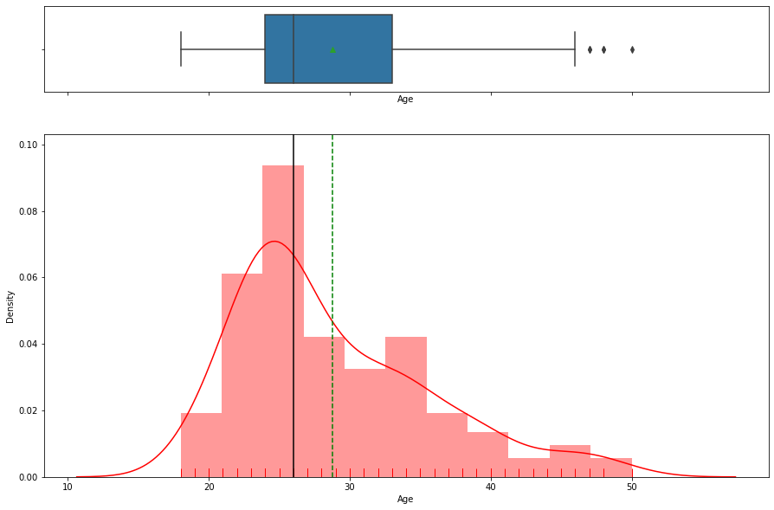
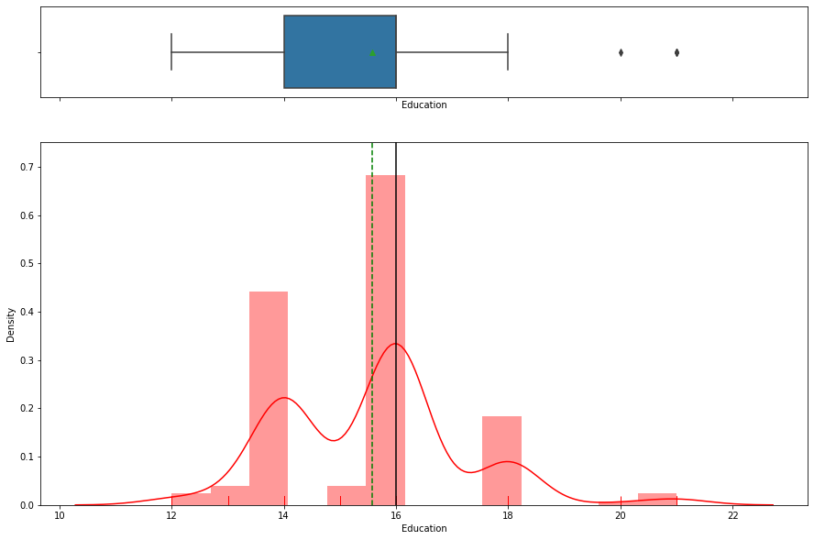
Exploratory Data Analysis Age Education
- Age has out layers , with positive skew
- Average Age of the customer is 29 , Median 26
- Maximum age is 50
- Minimum Education of the client is 12 and maximum is 21
- We do have out layers , indicates some customers are well educated

Slide 5
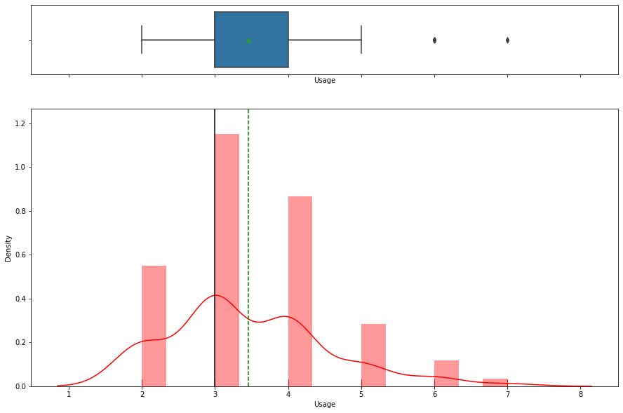
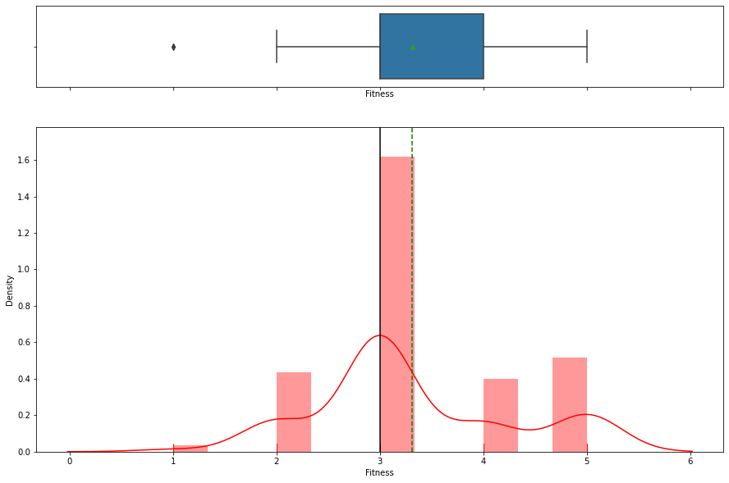
Exploratory Data Analysis Usage Fitness
- Minimum Fitness of the customer is 1 and maximum is 5
- We do have out layers which are less than 25% of the data, indicates some customers are not fit
- Minimum Usage of the treadmill by the client is 2 and maximum is 7
- We do have out layers , indicates some customers want to use treadmill very high

Slide 6
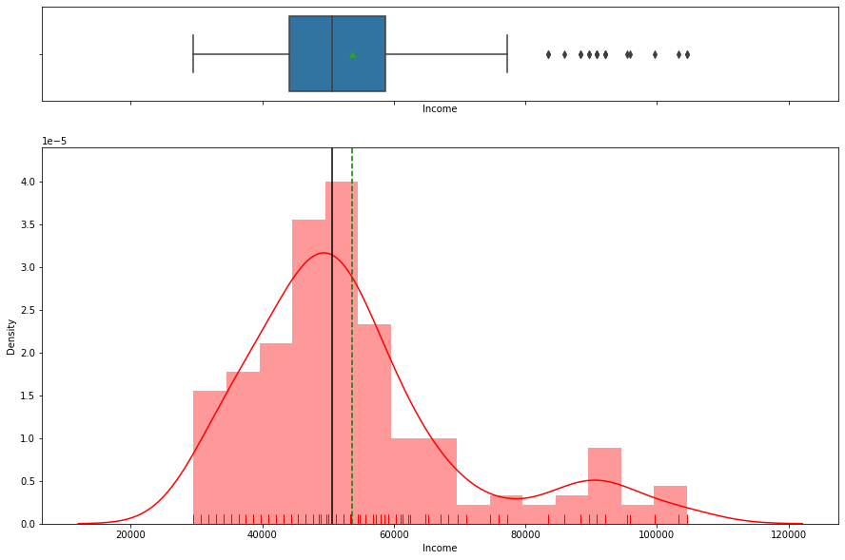
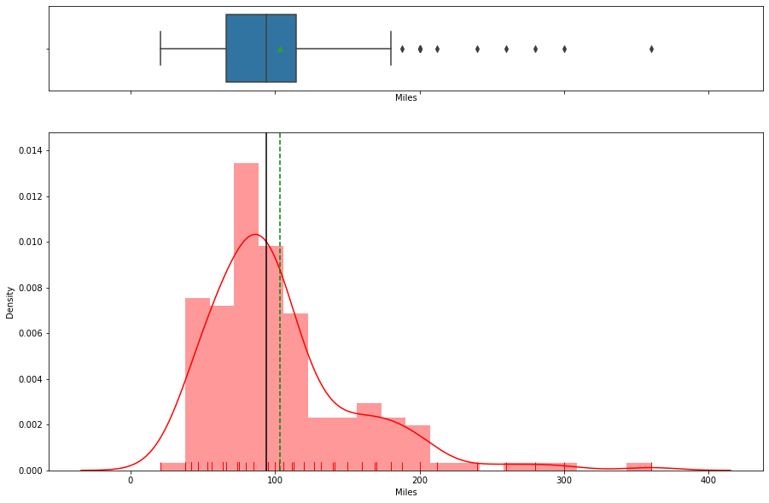
Exploratory Data Analysis Income Miles
- Minimum Income of the customer is 29K and maximum is 104K
- Average Income is 50K.
- We do have positive out layers , which means to say customer with high income are available
- Minimum miles customer want to run is 21 and maximum is 360.
- Average miles is 103.
- We do have positive out layers , average miles customer want to run is very high

Slide 7
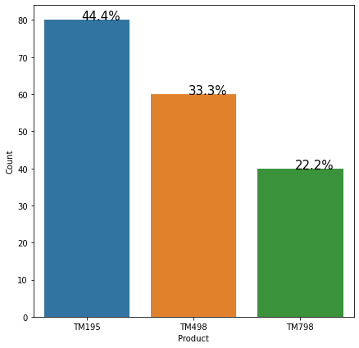
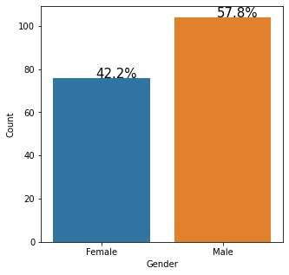
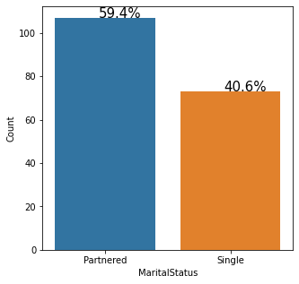
Exploratory Data Analysis Product Gender Martial Status
44% of the data is about TM195 , 33% is about TM498 and 22% is about TM798 product
42% of the data is talking about Female and 58% of the data is about Male
- In the data set we have 59% of Partnered people and 41% of Single

Slide 8
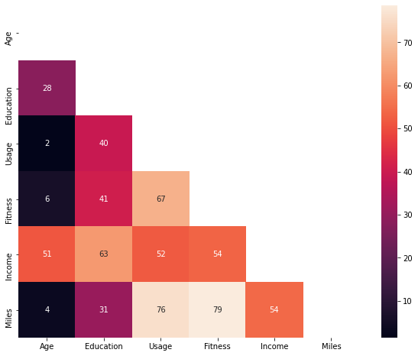
Exploratory Data Analysis - Corrrelation
As expected, Age and Miles has less correlation, people will high age may not be able to run more miles. This is in line with our intuitive understanding.
Miles and Usage has positive correlation
No negative correlation among the features
Miles and Fitness has positive correlation
There does not seems to be no high correlation between Miles, Usage and Fitness
Fitness and Usage has positive correlation

Slide 9
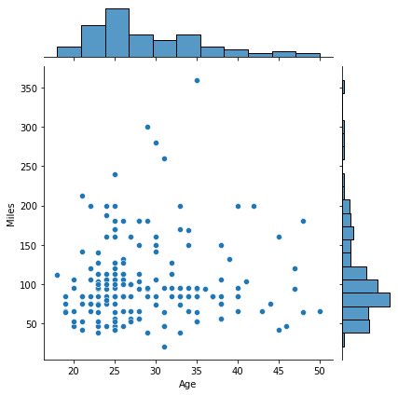
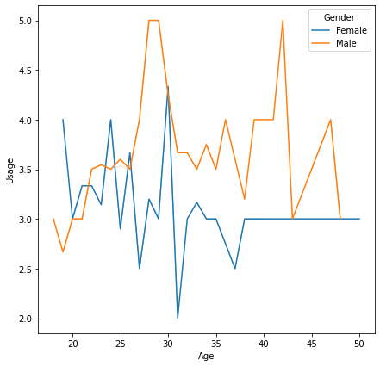
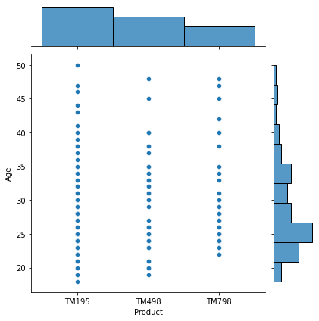
Exploratory Data Analysis Age vs Miles Age vs Usage Product vs Age
People with age less than 35 want to make lot of miles
People with age less than 20 , like product TM195 and TM498
Male want to use the treadmill more when compare to female

Slide 10
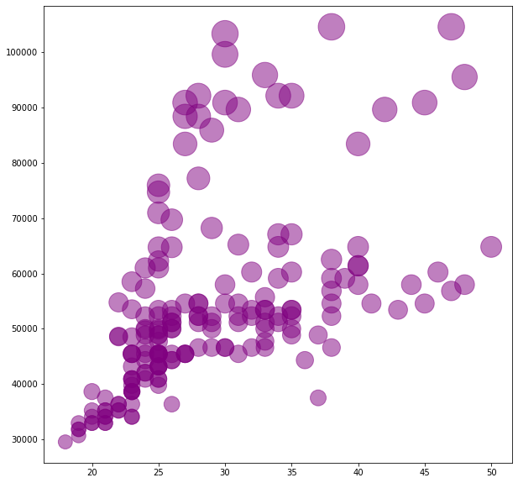
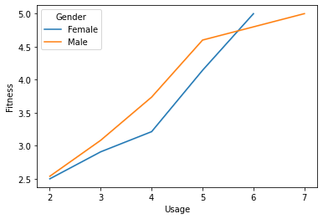
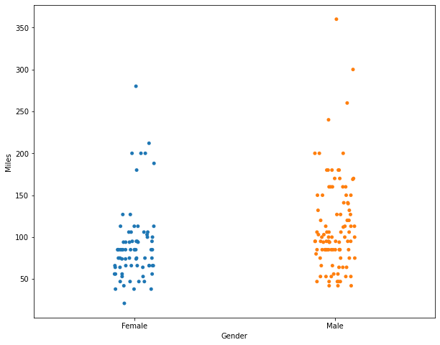
Exploratory Data Analysis Income vs Age Fitness vs Usage Gender vs Miles
As expected, Age increases, Income also increases until age of 50.
For majority of the People with Age greater than 30 , Income is more than 40K
Male want to make lot of miles

Slide 11
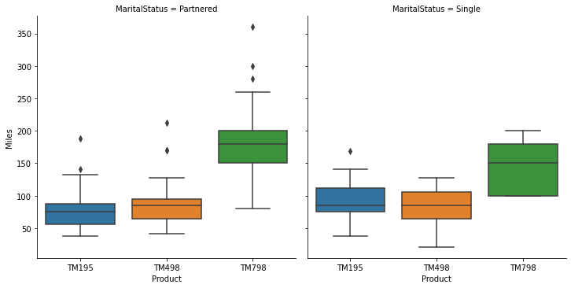
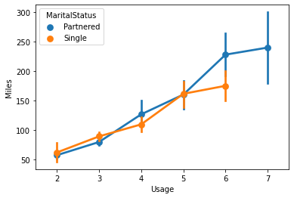
Exploratory Data Analysis Usage vs Miles Product vs Miles
Partnered martial status want to make more miles when compared to single

Slide 12
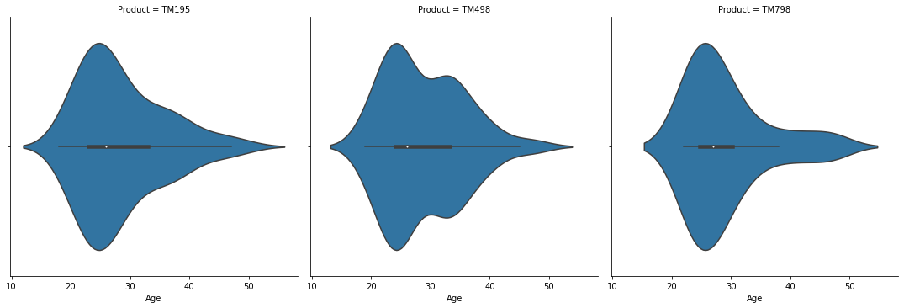
Exploratory Data Analysis
- Maximum usage of treadmill is by people from age 40 to 20

Slide 13
Conclusion We analyzed a dataset of 180 customers of the treadmill product(s) of a retail store. Data is spanned across all Ages of people with their Fitness and Usage levels. Using the income, Gender and Martial Status of people we can identify potential customers. Thus we determine the factors that affect treadmill product sale.
As expected, Age and Miles has less correlation, people will high age may not be able to run more miles. This is in line with our intuitive understanding.
Higher the Usage of treadmill , fitness of the person is high.
People with age less than 35 want to make lot of miles
People with age less than 20 , like product TM195 and TM498
Male want to use the treadmill more when compare to female , they have more fitness when compared to female
As expected, Age increases, Income also increases until age of 50.
For majority of the People with Age greater than 30 , Income is more than 40K
Married people has more income when compared to single
Married couple want to make more miles when compared to single
Product TM798 has more Fitness and Usage when compare to others
Average income of people who use TM798 is 75K , that means to say people with high income has TM798

Slide 14
Recommendations
Product TM195 is the popular product and has high potential , many people may be willing to buy this.
People with income more than 75K , might be interested to by TM798 product.
Male and Married people want to use treadmill more when compared to others.
Customers in the age group 40 to 20 has high potential to buy a treadmill
Married couple also has high potential to buy a product , Usage is more when compared to single.
People with income less than 50K , has TM195 and TM498

