Slide 1

Engineering Efficiency with AI Pair Programming
A Case Study of BzHub — One Product Owner, One Claude
AUTHOR
sunder-vasudevan
DATE
March 2026
VERSION
1.1 — with measured interaction time data
CLASSIFICATION
Technical Peers
© 2026 sunder-vasudevan. All rights reserved.

Slide 2
01 CONTEXT
The Challenge: Building a Full Product Alone Is Hard
TRADITIONAL SOLO DEVELOPER
THE QUESTION THIS STUDY ANSWERS
▸ Context-switches kill momentum
Can one Product Owner working with Claude as a full-session AI pair-programmer match the output of a traditional 3-person startup development team — in velocity, scope, and quality?
▸ Full-stack gaps slow delivery
▸ Documentation is always last
▸ Architecture decisions made alone
▸ Cognitive fatigue limits sprint length
SPOILER
▸ Hiring a team = 3–6 month delay + cost
Yes — 2–4x velocity multiplier confirmed by git data and measured logs: 105 mins of interaction → 6 production releases → 60–120x compression ratio.
BzHub Efficiency Case Study | March 2026 | Confidential

Slide 3
02 THE EXPERIMENT
BzHub: A Real Product, Built in 31 Days
31
~10
64
11
9
~15,800
Calendar days
Active coding days
Total commits
Production releases
Live modules
Net new LOC
ARCHITECTURE EVOLUTION
v1.0 Feb 10
v2.0 Feb 18
v4.0 Mar 10
Desktop App Tkinter / Python
→
Web + API Next.js + FastAPI + SQLite
→
Cloud SaaS Next.js + Supabase + Vercel
Each migration was deliberate, documented, and completed in a single sprint without breaking the deployed state.
BzHub Efficiency Case Study | March 2026 | Confidential

Slide 4
03 SCOPE
9 Live Modules. Full Stack. Cloud-Deployed.
DASHBOARD
OPERATIONS
KPI cards, trend chart, Smart Insights, customizable layout
Inventory, POS, Bills, Suppliers, Purchase Orders + approval
HR
CRM
Employees, Payroll, Goals, Appraisals, Skills, Leave + workflows
Contacts, Leads — List / Kanban / Funnel views, lead scoring
REPORTS
SETTINGS
Sales Report, Top Sellers, Inventory Report + CSV export
Company info, currency, industry templates, brand color, Custom Fields
HELP
EMPLOYEE SELF-SERVICE
In-app user guide for all modules
My Goals, My Appraisals, My Leave, My Skills
NOTIFICATIONS
Bell icon: pending leave / PO / appraisal / low-stock alerts
BzHub Efficiency Case Study | March 2026 | Confidential

Slide 5
04 VELOCITY
The 2-Day Sprint: 10 Releases, ~7,200 Lines
Release
Feature
LOC
IN 2 DAYS
v4.1.x–4.5.0
Cloud, Reports, HR, Approvals, Employee Portal (5 releases)
~4,372
10
v4.6.0
Notification Center, CSV Export, Global Search, Audit Log
1,267
v4.7.0 ●
Industry Templates [Session 2 — 25 min]
169
production releases
v4.7.1 ●
Dynamic brand color — 24 files [Session 3 — 35 min]
971
shipped to cloud
v4.8.0 ●
Smart Insights dashboard card [Session 3]
196
● = logged session
v4.9.x ●
CRM view switcher: List/Kanban/Funnel [Session 3]
264
TOTAL
10 releases · all layers · 2 calendar days
~7,239
Sessions 2 + 3 (60 mins combined interaction time) produced 7 of these 10 releases. A 3-person team would realistically require 3–6 two-week sprints for this scope. The AI-assisted pair compressed it to 2 calendar days.
BzHub Efficiency Case Study | March 2026 | Confidential

Slide 6
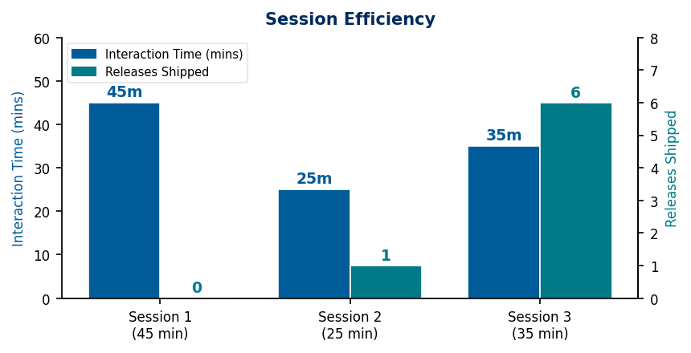
04B MEASURED TIME
105 Minutes of Interaction → 6 Production Releases
Session 1
Session 2
Session 3
TIME
TIME
TIME
~45 min
~25 min
~35 min
RELEASES
RELEASES
RELEASES
—
v4.7.0
v4.7.1 – v4.9.2 (6 releases)
OUTPUT
OUTPUT
OUTPUT
Efficiency whitepaper, doc generators
Industry Templates (FEAT-038)
Brand color, Smart Insights, CRM List/Kanban/Funnel
TOTAL: ~105 mins interaction → 6 production releases → ~1,600 net LOC
Session 3: 35 mins → 6 releases ≈ 3–6 engineer-weeks of traditional work → 60–120x compression ratio on interaction time
BzHub Efficiency Case Study | March 2026 | Confidential

Slide 7
05 COMPARISON
1 Product Owner + Claude vs. 3-Person Team
Dimension
1 PO + Claude (31 days)
3-Person Team (31 days est.)
Major releases shipped
11 (v1.0 → v5.0.0)
3–5 (1–2 per 2-week sprint)
Architecture migrations
3 full paradigm shifts
Likely 1 (dedicated project)
Live modules delivered
9
4–6
Documentation
Per-feature (project rule)
Varies — often deferred
Deployment pipeline
Fully automated (Vercel CI)
2–5 days setup for a team
Measured PO interaction
~105 mins (3 logged sessions)
N/A — team always staffed
Handoff overhead
Zero
15–25% of sprint capacity
* 3-person team estimates based on conventional startup sprint norms, not empirical benchmarks.
Key finding: One Product Owner + Claude approximates the feature throughput of a 3-person startup team. Velocity multiplier: 2–4x at project level. Session 3 alone demonstrates a 60–120x compression ratio on interaction time.
BzHub Efficiency Case Study | March 2026 | Confidential

Slide 8
06 MECHANISM
Where the Gains Come From: 4 Structural Advantages
1
Zero Handoff Overhead
2
Persistent Cross-Session Context
Full-stack features are conceived, designed, and implemented in a single session. No PRs, Slack threads, or standup latency.
Structured NOTES.md + memory files preserve full project state. Claude resumes with context a new hire would take 1–2 weeks to acquire.
3
On-Demand Full-Stack Competency
4
Documentation as a Side-Effect
Competent first-draft implementations across Next.js, Supabase, Recharts, and Tailwind — eliminating the "look this up for 45 minutes" tax.
Release notes, help page, and memory files updated after every feature — a discipline that is rare solo and hard to sustain in teams under pressure.
BzHub Efficiency Case Study | March 2026 | Confidential

Slide 9
07 QUALITY
Speed Did Not Come at the Cost of Quality
QUALITY SIGNALS IN THE GIT HISTORY
INTENTIONAL DEBT — TRACKED, NOT HIDDEN
▸ Each architecture migration preceded by a documented decision commit
Known Gap
Planned Fix
▸ Every migration left codebase in stable, deployed state before the next began
Hardcoded auth (admin/admin123)
FEAT-036: Supabase Auth (Phase 3)
▸ Known technical debt explicitly logged — not hidden — with a resolution plan
Open RLS policies (no user filter)
Tightens when auth ships
▸ Per-feature documentation enforced as a hard project rule (5-step checklist)
▸ Intentional debt (hardcoded auth, open RLS) acknowledged with planned fix dates
No organization_id on tables
FEAT-037: Multi-Tenancy (Phase 3)
"This reflects the discipline of an experienced Product Owner, not the output of unchecked code generation. Architecture was never sacrificed for speed."
BzHub Efficiency Case Study | March 2026 | Confidential

Slide 10
08 CONCLUSION
The Verdict
One Product Owner + Claude ≈ 3-Person Startup Dev Team
11 releases · 9 modules · 3 architecture migrations · 31 calendar days · 105 mins measured interaction time. Session 3: 35 mins → 6 releases → ~60–120x compression ratio on human direction time.
Zero handoff latency
Persistent cross-session context
On-demand full-stack competency
Documentation as a side-effect
The gains are structural — not simply "Claude writes code faster."
© 2026 sunder-vasudevan. All rights reserved.

Slide 11
09 RECOMMENDATIONS
How to Apply This Model to Your Team
1
Invest in context management
2
Treat Claude as a full-session collaborator
A live NOTES.md session-start document eliminates the 15–30 min catch-up cost at the start of every AI session. This is the single highest-leverage practice.
Piecemeal queries do not capture the compounding gains. Sustained sessions where Claude holds architectural context are where the multiplier lives.
3
Keep the Product Owner in the architecture seat
4
Log interaction time from day one
Define what to build and why before asking Claude to help build it. Product direction and quality gate remain the human's responsibility.
This project only began logging at v4.7.0. A complete log from the start would make the efficiency analysis definitive. Use a simple markdown table per session.
BzHub Efficiency Case Study | March 2026 | Confidential

