Slide 1
A-RiA · ARIA Personal
"Real Intelligence for Every Client" · "Your Money Intelligence"
Two fintech products. One shared platform. Real intelligence for every investor.
PRODUCTS
A-RiA (Advisor Workbench) · ARIA Personal (Consumer App)
AUTHOR
Sunny Hayes (sunder-vasudevan)
DATE
March 2026
STACK
FastAPI · Supabase · React + Vite · Tailwind · Render · Vercel
Made with ❤️ in Hyderabad | © 2026 Sunny Hayes. All rights reserved.

Slide 2
01 THE PROBLEM
Wealth Advisory Is Broken for Most Indians
THE ADVISOR PROBLEM
THE SELF-DIRECTED INVESTOR PROBLEM
▸ No actionable intelligence — data in spreadsheets
▸ Data without intelligence — no probability engine
▸ Reactive, not proactive — calls clients after market moves
▸ No personalised guidance — generic content only
▸ Goal tracking is manual — no real-time probability
▸ Life event blind spots — decisions in isolation
▸ Meeting prep = 15–30 mins of manual work per client
▸ The advisor gap — cannot afford or do not want one
▸ Urgency is invisible — high-risk clients blend in
▸ No answer to: "Will I actually reach my goal?"
ARIA addresses both groups with purpose-built products on a shared intelligent platform.
A-RiA · ARIA Personal | March 2026 | Made with ❤️ in Hyderabad

Slide 3
02 THE PRODUCTS
Two Products. One Shared Platform.
A-RiA
ARIA Personal
Advisor Relationship Intelligence Assistant
Consumer App for Self-Directed Investors
"Real Intelligence for Every Client"
"Your Money Intelligence"
▸ Client book with urgency scoring
▸ Register / Login with JWT auth (consumer-grade)
▸ Client 360 — full profile + portfolio + goals
▸ Dashboard — portfolio, goals, life events
▸ Goal probability (Monte Carlo, inflation-adj.)
▸ Goals with Monte Carlo probability pills
▸ What-if scenario — SIP sliders, reverse calc
▸ What-if v2 — SIP + inflation + return sliders
▸ AI copilot (Claude API) — natural language
▸ Life events — home, education, retirement
▸ Morning briefing — daily urgent client digest
▸ Ask ARIA — Claude API copilot, user-scoped
▸ Audit logs for compliance
▸ Mobile-first layout
A-RiA · ARIA Personal | March 2026 | Made with ❤️ in Hyderabad

Slide 4
03 ARCHITECTURE
One Backend. Two Frontends. Shared Intelligence.
a-ria.vercel.app
aria-personal.vercel.app
A-RiA Advisor Frontend React 18 + Vite + Tailwind
ARIA Personal Frontend React 18 + Vite + Tailwind
↓
↓
aria-advisor.onrender.com — FastAPI Backend
/clients/* routes (Advisor API)
/personal/* routes (Consumer API + JWT)
urgency scoring · goal probability client 360 · copilot
auth · goals · life events copilot · portfolio
Shared: simulation.py (Monte Carlo) · Claude API (Copilot) · JWT auth
↓
Supabase PostgreSQL (pooler :6543)
clients · portfolios · holdings · goals · life_events · PersonalUser · PersonalCopilotLog
A-RiA · ARIA Personal | March 2026 | Made with ❤️ in Hyderabad

Slide 5
04 A-RIA ADVISOR
A-RiA: Know Before They Call
Client Book + Urgency Scoring
Client 360
Clients ranked by algorithmic urgency — portfolio drift, goal probability, missed SIP, life events, interaction recency. The RM sees immediately who needs attention today.
Full-page view: profile, portfolio, goals with probability pills, life events, urgency flags — everything needed for a meeting in one screen.
Goal Probability — Monte Carlo
What-If Scenario Engine
1,000-simulation engine. Target inflated for real purchasing power. Probability pills: green ≥70%, amber 40–70%, rose <40%.
Mode 1: "Will I achieve it?" — SIP sliders + inflation rate + real vs nominal corpus. Mode 2: "What SIP do I need?" — binary-search to 80% probability.
AI Copilot (Claude API)
Morning Briefing + Audit Logs
Natural language interface. Context-aware: reads client data, drafts meeting notes, surfaces anomalies, answers questions in plain language.
Daily digest of urgent clients and pending actions. Full compliance trail on all advisor actions.
A-RiA · ARIA Personal | March 2026 | Made with ❤️ in Hyderabad

Slide 6
05 ARIA PERSONAL
ARIA Personal: Your Money Intelligence
JWT Authentication
Goals + Monte Carlo Probability
Email + password register/login. python-jose + passlib, 7-day tokens, localStorage persistence. Production-grade consumer auth from day one.
Set goal name, target ₹, date, monthly SIP. On save: Monte Carlo runs, probability pill appears. Real vs nominal corpus displayed. What-if v2 sliders for instant scenario replay.
What-If v2 Sliders
Life Events
SIP, inflation rate, and expected return sliders with debounced auto-run. See in real time: +₹5,000/month SIP raises probability from 45% to 72%.
Log planned milestones: home purchase, education, marriage, retirement, custom events. Linked to goals for full context in AI copilot.
Ask ARIA — AI Copilot
Mobile-First Design
Claude API, user-scoped context. "Your retirement goal has 52% probability. To reach 80%, increase SIP by ₹8,400/month or extend timeline by 3 years."
375px viewport first. Thumb-friendly navigation, cards, and forms. Safari-compatible date inputs. India's investors are mobile-first.
A-RiA · ARIA Personal | March 2026 | Made with ❤️ in Hyderabad

Slide 7
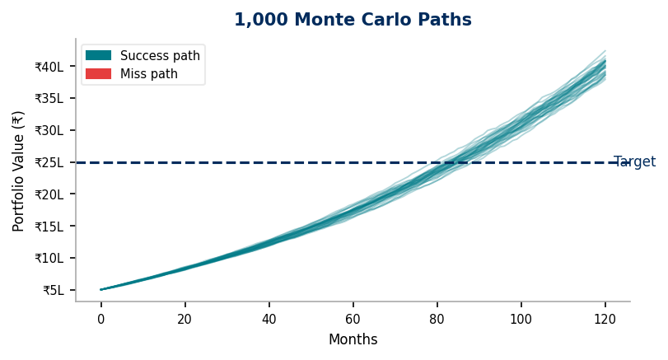
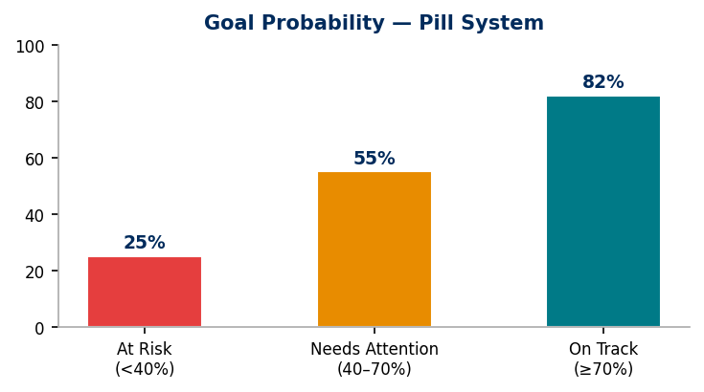
06 SIMULATION ENGINE
Monte Carlo Goal Probability — The Analytical Core
HOW IT WORKS
1. Inflation-adjust target: real_target = amount × (1 + rate)^years
2. For each of 1,000 paths, step month-by-month:
r ∼ N(annual_rate/12, 0.05/√12) [Gaussian return]
value = value × (1 + r) + monthly_SIP
3. Count successes: final_value ≥ real_target
4. Return probability_pct + median corpus (nominal & real)
FIND_REQUIRED_SIP
Binary-search over SIP range. 30 iterations → precision within ₹1. Rounded to nearest ₹100. Powers: "What SIP do I need for 80% probability?"
Why inflation-adjustment? A corpus of ₹50 lakh in 2045 ≠ ₹50 lakh today. ARIA always shows a real-purchasing-power probability.
A-RiA · ARIA Personal | March 2026 | Made with ❤️ in Hyderabad

Slide 8
07 DESIGN SYSTEM
One Design Language. Two Products.
#1D6FDB
#002B5C
#007A87
#E88C00
#E53E3E
#F2F4F7
Brand Blue
Dark Navy
Teal
Amber
Rose
Slate
Primary actions, links
Login panels, headers
On-track pills
Needs-attention pills
At-risk pills
Card backgrounds
KEY DESIGN DECISIONS
Probability Pills
Login Layout
Three-state teal/amber/rose system is the primary data visualisation. Consistent semantics: green = on track, amber = review needed, red = intervene.
Split-screen: left dark navy panel (tagline + stats), right slate-50 panel (form). Premium first impression, fast mobile load.
Logo Components
Mobile-First
ARiALogo.jsx (advisor) and ARIALogo.jsx (personal) — dotless-i with round blue dot. Consistent wordmark across both products.
375px viewport first. All navigation, cards, and interactive elements are thumb-friendly. India's investors are on mobile.
A-RiA · ARIA Personal | March 2026 | Made with ❤️ in Hyderabad

Slide 9
08 ENGINEERING STORY
One Product Owner + Claude Built Two Fintech Apps Simultaneously
A-RiA and ARIA Personal were designed, architected, coded, debugged, and deployed in a single build window by one person with Claude as a persistent full-session AI pair-programmer.
KEY TECHNICAL CHALLENGES SOLVED IN THE SAME SESSION
Challenge
Fix
Lesson
NameError: models.Goal / models.LifeEvent in clients.py
Corrected model imports in clients.py
FastAPI lazy eval — import errors don't surface until first call
Safari <input type="date"> not firing onChange
Replaced with month + year <select> elements, state lifted to parent
Test on Safari. India's mobile users = iOS = Safari.
FastAPI 204 delete routes returning 500
Return explicit Response(status_code=204)
Always be explicit on status-only responses.
NOT NULL constraint — personal_user_id on shared tables
Nullable FK + explicit query filters in both route namespaces
Nullable FKs with explicit filters = clean dual-product schema.
Two codebases. One context. When the Safari bug was found in the advisor app, it was fixed in the personal app in the same turn — no ticket, no second PR, no risk of inconsistency.
A-RiA · ARIA Personal | March 2026 | Made with ❤️ in Hyderabad

Slide 10
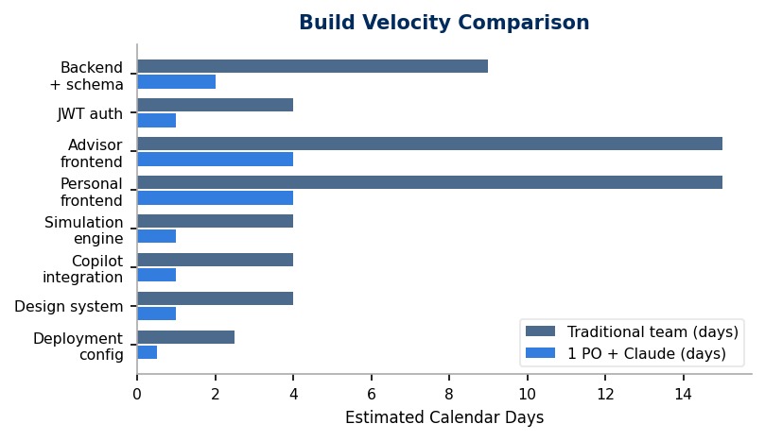
09 VELOCITY
Build Velocity: One PO + Claude vs. Traditional 3-Person Team
2
3
1
35–50
20–40x
Production apps shipped
Cloud services configured
Shared simulation engine
Features across both products
Est. compression ratio
Workstream
Traditional Team (est.)
1 PO + Claude
FastAPI backend + Supabase schema
1–2 weeks
Single session
JWT auth system
3–5 days
Same session
Advisor frontend (full feature set)
2–3 weeks
Same session
Personal frontend (full feature set)
2–3 weeks
Same session
Monte Carlo simulation engine
3–5 days
Same session
TOTAL
~8–14 weeks
1 build window
A-RiA · ARIA Personal | March 2026 | Made with ❤️ in Hyderabad

Slide 11
10 ROADMAP
What's Next
A-RiA ADVISOR — PHASE 2
ARIA PERSONAL — PHASE 2
FEAT-503
In design
FEAT-P001
Not started
What-If Scenario v2
Portfolio add/edit UI
FEAT-301
Not started
FEAT-P002
Not started
Book-level copilot
Onboarding risk questionnaire
FEAT-302
Not started
Recommendation cards + approve/reject
FEAT-201
Not started
Live NAV fetch (MFAPI.in)
FEAT-202
PLATFORM — FUTURE
Not started
Rebalancing proposal engine
▸ Multi-currency (USD, AED — NRI segment)
FEAT-101
Not started
▸ WhatsApp notification integration
Edit client data (read-only now)
▸ Open banking data ingestion (AA API)
▸ React Native mobile app
A-RiA · ARIA Personal | March 2026 | Made with ❤️ in Hyderabad

Slide 12
11 CALL TO ACTION
Build With Us · Invest · Partner
A-RiA and ARIA Personal are live. The Monte Carlo engine is running. The copilot is answering questions. What's next depends on who comes to the table.
For Advisors & Banks
For Investors
Pilot A-RiA with your RM team. We'll show you "know before they call" in your own client book.
Try ARIA Personal. Set a goal. See your probability. Ask the copilot what it would take to improve it.
For Founders & Engineers
For Investors
This is what one PO + Claude can build. Talk to us about the model, the stack, or the approach.
Two products live. A simulation engine that's correct. A design system that's consistent. The foundation is built.
GitHub: github.com/sunder-vasudevan/aria-advisor · github.com/sunder-vasudevan/aria-personal
Live: https://a-ria.vercel.app · Backend: https://aria-advisor.onrender.com
Made with ❤️ in Hyderabad | © 2026 Sunny Hayes (sunder-vasudevan). All rights reserved.

