Slide 1

Title: Adjust the Water Level: Ecosystem Project
Subtitle: A Mobile-Based Web Game to Restore River Habitats
Presented By: Sundesh Kumar
Tech Stack: React + Vite
SUNDESH KUMAR
GAME PROGRAMMING

Slide 2
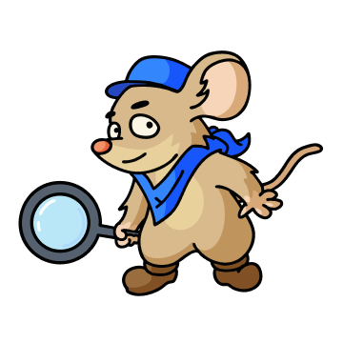
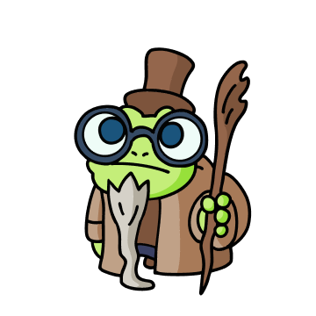

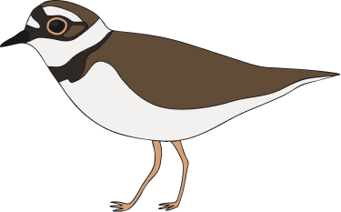
1. Introduction & Mission:
Overview: A mobile-Base web game built with React and Vite. Join Frowin (the Frog), Ela (the Lizard), and Milo (the Mouse) on a mission to restore the river habitat for the Little Ringed Plover (Flussregenpfeifer).
The Mission: Restore the habitat for the Little Ringed Plover (Flussregenpfeifer).
Objective: Save the bird's nesting ground from flooding.
Meet the Team:
Milo (The Mouse)
Frowin (The Frog)
Ela (The Lizard)
Bird
SUNDESH KUMAR
GAME PROGRAMMING

Slide 3

2. Game Overview:
The goal of the game is to adjust the river's water level to the perfect range to save the bird's nesting ground.
Story Mode: Engaging Intro and Outro slideshows telling the story of the river ecosystem.
Gameplay: A skill-based slider mini game. The water level fluctuates automatically.
Objective: Click the slider to stop the water between level 20 and 30.
Mechanics:
You have 3 Attempts.
Win: Stop in the green zone to find the magical ufergras.
Lose: Miss 3 times and the habitat is flooded.
SUNDESH KUMAR
GAME PROGRAMMING

Slide 4



3. Win & Lose Conditions:
Winning the Game:
Stop the water in the green zone (20-30).
And the bird will come to drink water on the sea shore.
Reward: You discover the magical Ufergras (Bank Grass) needed for the ecosystem.
Losing the Game:
Miss the target 3 times.
Consequence: The habitat is flooded, and the nesting ground is lost.
SUNDESH KUMAR
GAME PROGRAMMING

Slide 5



4. Technical Features:
Mobile-First Design: Fully optimized for smartphones but scales perfectly for desktop screens.
Responsive UI: The layout adapts automatically to different screen sizes.
Tech Stack:
React.js
Vite
CSS3
SUNDESH KUMAR
GAME PROGRAMMING

Slide 6
5. Project Structure:
src/App.jsx: Main controller. Manages state between Intro, Game, and Outro screens.
src/WaterLevelGame.jsx: Core gameplay logic (slider movement, collision detection, win/loss state).
src/IntroScreen.jsx: The storytelling slideshow component.
src/OutroScreen.jsx: Handles the ending sequence based on the game result.
public/images/: Stores assets like character art, backgrounds, and items.
SUNDESH KUMAR
GAME PROGRAMMING

Slide 7
6. Future Work & Handover (Next Semester):
Update Slider UI Asset (Design & Dev Task)
Context: The current slider visual is designed for a 0-80 range (based on the original 9 background images).
Current Status: Since one background image was removed, the game logic has already been updated to a 0-70 range.
Action Required:
Designer: Needs to create a new slider bar image that visually matches the shortened 0-70 scale.
Developer: Simply needs to replace the old slider image file in the project folder (the code logic is already finished).
SUNDESH KUMAR
GAME PROGRAMMING

Slide 8
6. Future Work & Handover (Next Semester):
2. QR Code Integration:
Goal: Implement a feature to launch the game via a QR Code Scanner.
Action Required: Ensure the game initializes correctly when a specific QR code is scanned (e.g., at the river location).
SUNDESH KUMAR
GAME PROGRAMMING

Slide 9
6. Live Deployment:
Hosting Platform: Netlify
Status: Live & Playable
Link: https://leafy-pasca-5ff979.netlify.app/
SUNDESH KUMAR
GAME PROGRAMMING

Slide 10
7. Getting Started Locally:
Prerequisites: Node.js must be installed.
Step 1: Installation
Clone the repository: Bash git clone
https://gitlab.rlp.net/game_ws2526/adjust-water-level-1/-/tree/my-game?ref_type=heads
Install dependencies: Bash npm install
Step 2: Running the Game
Start the server:
Bash npm run dev
Open Browser: http://localhost:5173/
SUNDESH KUMAR
GAME PROGRAMMING

Slide 11

Credits:
Supervised by: Dennis Mendoza
Development: Sundesh Kumar
Artwork: Clarissa Haag & Team
Concept: Adjust Water Level (Ecosystem)
SUNDESH KUMAR
GAME PROGRAMMING

Slide 12
THANK YOU FOR YOUR ATTENTION…!!!
SUNDESH KUMAR
GAME PROGRAMMING

