Slide 1
RESUMIO
AI Resume Screening & Recruitment Portal
DBMS Project Presentation
26 Tables
3NF
8 Phases
100% FK
Relational Schema
Fully Normalized
Development
Integrity
Submitted by: M. Sundhip Manhooj

Slide 2
Project Overview
What is Resumio?
About the Project
Key Metrics
Resumio is a full-stack AI-powered Recruitment Portal.
Candidates can:
- Create profiles, upload resumes, apply to jobs
- View AI match scores, skill gap analysis
- Track applications and interview schedules
Recruiters can:
- Post jobs and manage applicant pipelines
- View AI-ranked candidates with match scores
- Schedule interviews and send notifications
Built across 10 development phases.
Database: SQLite with 26 relational tables in 3NF.
26
Relational Tables
3
User Roles: Candidate, Recruiter, Admin
8
Development Phases
10
Phase Test Suites (All Passing)
100%
FK Referential Integrity
3NF
Full Database Normalization
0
FK Violations on Startup
Resumio — AI Resume Screening & Recruitment Portal | DBMS Project

Slide 3
Technology Stack
Technologies used to build Resumio
Frontend
Backend
Database
AI Layer
React 19 + TypeScript
Node.js + Express 4
SQLite (resumio.db)
Google Gemini API
Vite 8 (Build Tool)
better-sqlite3 v11
26 Tables, 3NF
Resume Parser (NLP)
Tailwind CSS 4
JWT Authentication
PRAGMA foreign_keys ON
Match Scoring Engine
React Router v7
bcryptjs (Passwords)
B-Tree Indexes (11)
Skill Gap Analysis
Lucide Icons
Multer (File Uploads)
ACID Transactions
SHA-256 Duplicate Detection
Resumio — AI Resume Screening & Recruitment Portal | DBMS Project

Slide 4
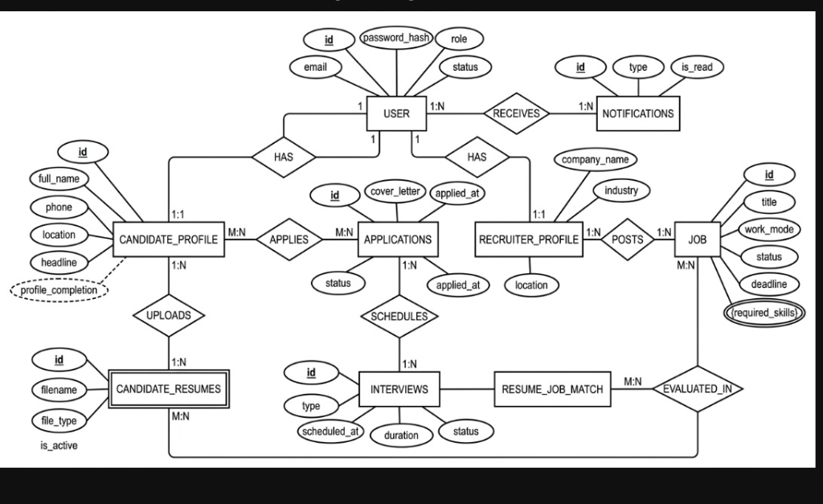
Entity-Relationship (ER) Diagram
Chen's Notation — Entities, Relationships, Attributes & Cardinalities
Rectangle = Entity
Double Rect = Weak Entity
Diamond = Relationship
Ellipse = Attribute
Underlined = Primary Key
Dashed Ellipse = Derived Attr.
Resumio — AI Resume Screening & Recruitment Portal | DBMS Project

Slide 5
Relational Schema — Part 1
Phase 1: Core Authentication & Candidate Profiles
TABLE 1: USERS (Strong Entity)
Attribute
Data Type
Constraint
[PK] id
CHAR(36)
PRIMARY KEY, NOT NULL, UNIQUE
email
VARCHAR(255)
NOT NULL, UNIQUE
password_hash
VARCHAR(255)
NOT NULL
role
VARCHAR(20)
NOT NULL, CHECK(candidate/recruiter/admin)
status
VARCHAR(20)
DEFAULT 'active'
created_at
TEXT
NOT NULL, DEFAULT datetime('now')
updated_at
TEXT
NOT NULL, DEFAULT datetime('now')
TABLE 2: CANDIDATE_PROFILES (Strong Entity)
Attribute
Data Type
Constraint
[PK] id
CHAR(36)
PRIMARY KEY, NOT NULL
[FK] user_id
CHAR(36)
FK -> USERS(id), ON DELETE CASCADE, UNIQUE
full_name
VARCHAR(100)
NOT NULL
phone
VARCHAR(20)
NULL
location
VARCHAR(100)
NULL
headline
VARCHAR(200)
NULL
bio
TEXT
NULL
profile_completion
INTEGER
DEFAULT 30 (derived — auto-calculated)
Resumio — AI Resume Screening & Recruitment Portal | DBMS Project

Slide 6
Relational Schema — Part 2
Phase 1: Recruiter Profiles | Phase 3: Job Postings
TABLE 3: RECRUITER_PROFILES (Strong Entity)
Attribute
Data Type
Constraint
[PK] id
CHAR(36)
PRIMARY KEY, NOT NULL
[FK] user_id
CHAR(36)
FK -> USERS(id), ON DELETE CASCADE, UNIQUE
full_name
VARCHAR(100)
NOT NULL
company_name
VARCHAR(150)
NOT NULL
industry
VARCHAR(100)
NULL
location
VARCHAR(100)
NULL
website
VARCHAR(200)
NULL
TABLE 4: JOBS (Strong Entity)
profile_completion
INTEGER
DEFAULT 40
Attribute
Data Type
Constraint
[PK] id
CHAR(36)
PRIMARY KEY, NOT NULL
[FK] recruiter_id
CHAR(36)
FK -> USERS(id), ON DELETE CASCADE
[FK] recruiter_profile_id
CHAR(36)
FK -> RECRUITER_PROFILES(id)
title
VARCHAR(150)
NOT NULL
company_name
VARCHAR(150)
NOT NULL
employment_type
VARCHAR(30)
NOT NULL, CHECK(Full-time/Part-time/Internship/Contract/Freelance)
work_mode
VARCHAR(20)
NOT NULL, CHECK(On-site/Hybrid/Remote)
salary_min / max
INTEGER
NULL
Resumio — AI Resume Screening & Recruitment Portal | DBMS Project
status
VARCHAR(20)
DEFAULT 'Draft', CHECK(Draft/Published/Closed)
deadline
TEXT
NULL

Slide 7
Relational Schema — Part 3
Phase 2: Candidate Resumes | Phase 4: Applications
TABLE 5: CANDIDATE_RESUMES (Weak Entity (double rectangle))
Attribute
Data Type
Constraint
[PK] id
CHAR(36)
PRIMARY KEY, NOT NULL
[FK] candidate_profile_id
CHAR(36)
FK -> CANDIDATE_PROFILES(id), ON DELETE CASCADE
original_filename
VARCHAR(255)
NOT NULL
stored_filename
VARCHAR(255)
NOT NULL
file_type
VARCHAR(10)
NOT NULL
file_size
INTEGER
NOT NULL
TABLE 6: APPLICATIONS (Relationship Entity (resolves M:N between Candidate & Job))
is_active
INTEGER
DEFAULT 1
Attribute
Data Type
Constraint
[PK] id
CHAR(36)
PRIMARY KEY, NOT NULL
[FK] candidate_id
CHAR(36)
FK -> USERS(id), ON DELETE CASCADE
[FK] candidate_profile_id
CHAR(36)
FK -> CANDIDATE_PROFILES(id)
[FK] job_id
CHAR(36)
FK -> JOBS(id), ON DELETE CASCADE
[FK] resume_id
CHAR(36)
FK -> CANDIDATE_RESUMES(id) [snapshot — no cascade]
cover_letter
TEXT
NULL
status
VARCHAR(30)
DEFAULT 'Applied', CHECK(Applied/Under Review/Shortlisted/Rejected/Withdrawn)
applied_at
TEXT
NOT NULL, DEFAULT datetime('now')
—
UNIQUE
UNIQUE(candidate_id, job_id) — prevents duplicate applications
Resumio — AI Resume Screening & Recruitment Portal | DBMS Project

Slide 8
Relational Schema — Part 4
Phase 7: Interviews & Notifications
TABLE 7: INTERVIEWS (Strong Entity)
Attribute
Data Type
Constraint
[PK] id
CHAR(36)
PRIMARY KEY, NOT NULL
[FK] application_id
CHAR(36)
FK -> APPLICATIONS(id), ON DELETE CASCADE
[FK] candidate_id
CHAR(36)
FK -> USERS(id), ON DELETE CASCADE
[FK] recruiter_id
CHAR(36)
FK -> USERS(id), ON DELETE CASCADE
[FK] job_id
CHAR(36)
FK -> JOBS(id), ON DELETE CASCADE
interview_type
VARCHAR(20)
NOT NULL, CHECK(Video/Phone/In Person)
scheduled_at
TEXT
NOT NULL
duration_minutes
INTEGER
DEFAULT 45
meeting_url
VARCHAR(300)
NULL
TABLE 8: NOTIFICATIONS (Strong Entity)
status
VARCHAR(30)
DEFAULT 'Scheduled', CHECK(Scheduled/Rescheduled/Completed/Cancelled)
Attribute
Data Type
Constraint
[PK] id
CHAR(36)
PRIMARY KEY, NOT NULL
[FK] user_id
CHAR(36)
FK -> USERS(id), ON DELETE CASCADE
type
VARCHAR(50)
NOT NULL, CHECK(application_status/interview_scheduled/...)
title
VARCHAR(200)
NOT NULL
message
TEXT
NOT NULL
related_entity_id
CHAR(36)
NULL
Resumio — AI Resume Screening & Recruitment Portal | DBMS Project
is_read
INTEGER
DEFAULT 0, CHECK(0/1)
created_at
TEXT
NOT NULL, DEFAULT datetime('now')

Slide 9
Relational Schema — Part 5
Phases 5–6: AI Parsing, Screening & Matching Engine
TABLE 9: RESUME_PARSED_DATA (1:1 with CANDIDATE_RESUMES — AI parsed extraction)
Attribute
Data Type
Constraint
[PK] id
CHAR(36)
PRIMARY KEY, NOT NULL
[FK] resume_id
CHAR(36)
FK -> CANDIDATE_RESUMES(id), UNIQUE, CASCADE
[FK] candidate_id
CHAR(36)
FK -> USERS(id), CASCADE
file_hash
VARCHAR(64)
NOT NULL (SHA-256 for duplicate detection)
status
VARCHAR(20)
DEFAULT 'Not Processed'
raw_text
TEXT
NULL
skills_json
TEXT
DEFAULT '[]'
education_json
TEXT
DEFAULT '[]'
TABLE 10: RESUME_JOB_MATCHES (AI Scoring Entity — resolves M:N between Resume & Job)
experience_json
TEXT
DEFAULT '[]'
Attribute
Data Type
Constraint
[PK] id
CHAR(36)
PRIMARY KEY, NOT NULL
[FK] resume_id
CHAR(36)
FK -> CANDIDATE_RESUMES(id), CASCADE
[FK] job_id
CHAR(36)
FK -> JOBS(id), CASCADE
[FK] application_id
CHAR(36)
FK -> APPLICATIONS(id), CASCADE
match_score
INTEGER
DEFAULT 0 (0-100 composite score)
required_skills_score
REAL
DEFAULT 0.0 (40% weight)
preferred_skills_score
REAL
DEFAULT 0.0 (20% weight)
Resumio — AI Resume Screening & Recruitment Portal | DBMS Project
experience_score
REAL
DEFAULT 0.0 (25% weight)
qualification_score
REAL
DEFAULT 0.0 (15% weight)
—
UNIQUE
UNIQUE(resume_id, job_id, algorithm_version)

Slide 10
Database Normalization
Demonstrating 1NF, 2NF, and 3NF compliance
1NF — First Normal Form
2NF — Second Normal Form
3NF — Third Normal Form
Every table has a PRIMARY KEY (id, CHAR 36 UUID).
All attributes contain ATOMIC values only.
No repeating groups or arrays within a column.
Multi-valued attributes decomposed into separate tables:
- Skills -> candidate_skills (not comma list in profiles)
- Education -> candidate_education
- Job required skills -> job_required_skills
All 1NF conditions satisfied.
All PKs are single-column surrogate UUIDs (CHAR 36).
No composite primary keys exist in any table.
Every non-key attribute is fully functionally
dependent on the complete primary key.
No partial dependencies present in any table.
All 2NF conditions satisfied.
No transitive dependencies present.
Company data is stored in recruiter_profiles,
NOT duplicated inside every jobs record.
Candidate details referenced via FK, not copied
into applications or resume_job_matches.
Match scores live in resume_job_matches only.
Resumio — AI Resume Screening & Recruitment Portal | DBMS Project

Slide 11
Key Features
What Resumio provides to each user role
CANDIDATE PORTAL
RECRUITER PORTAL
➡ Build profile (education, skills, experience, projects, certifications)
➡ Post, edit, publish and close job listings
➡ Upload resumes (PDF / DOCX), browse and apply to jobs
➡ View applicants ranked by AI match score
➡ View AI match score (0-100%) with skill breakdown
➡ Manage application pipeline: Applied -> Shortlisted -> Rejected
➡ Skill gap analysis — what skills are missing for the job
➡ Schedule video, phone, or in-person interviews
➡ Track application status pipeline with full audit timeline
➡ Natural language candidate search (AI-powered, Phase 8)
➡ View interview schedule, type, meeting link
➡ Auto-generate interview questions based on job + candidate resume
➡ In-app notifications for status changes and interviews
➡ Recruitment analytics dashboard
➡ Resume improvement suggestions (AI-generated section feedback)
➡ Duplicate resume detection (SHA-256 + text similarity)
Resumio — AI Resume Screening & Recruitment Portal | DBMS Project

Slide 12
Referential Integrity & Database Design
FK enforcement, cascade rules, and ACID compliance
FK Enforcement
Audit Trail
ACID Compliance
PRAGMA foreign_keys = ON executed on every DB connection. All FK relationships are actively enforced at database level.
application_status_history and interview_status_history are append-only. Every change is logged with changed_by user ID, timestamp, and note.
A — Atomicity
Multi-step operations (apply + log status + notify) roll back if any step fails.
C — Consistency
Cascade Delete
Unique Constraint
CHECK constraints, UNIQUE constraints, and FK enforcement maintain valid state.
Deleting a USER cascades through: candidate_profiles -> education/skills/resumes, AND recruiter_profiles -> jobs -> applications -> interviews.
UNIQUE(candidate_id, job_id) on applications prevents duplicate applications at database level, not just application layer.
I — Isolation
SQLite WAL mode — concurrent reads do not block writes.
Immutable Snapshot
Startup Verification
D — Durability
applications.resume_id has NO ON DELETE CASCADE — applications retain the exact resume snapshot even if candidate deletes that resume later.
verifyDatabaseIntegrity() runs on every server start — PRAGMA foreign_key_check + orphan record counts. Result: 0 violations.
All committed data persisted to resumio.db — survives restarts.
Resumio — AI Resume Screening & Recruitment Portal | DBMS Project

Slide 13
Thank You
RESUMIO — AI Resume Screening & Recruitment Portal
DBMS Project | M. Sundhip Manhooj
26 Relational Tables
100% FK Integrity
AI-Powered Matching
Full-Stack Platform
Fully designed in 3rd Normal Form (3NF)
across 8 development phases
Zero FK violations
All foreign keys enforced at DB level
Deterministic 0-100% match score
Skill gap analysis + resume improvement
React 19 + Express + SQLite
Production-ready architecture
GitHub Repository: github.com/sundhip/Resumio
github.com/sundhip/Resumio
Resumio — AI Resume Screening & Recruitment Portal | DBMS Project | M. Sundhip Manhooj

