Slide 1
sFlow & Benefits
Complete Network Visibility and Control
You cannot control what you cannot see

Slide 2
Today’s Hard Network Management Questions
Who is using the network?
  What are they using it for?
Are my security policies effective?
  How do I detect threats that have evaded the firewall?
Why is my application or server slow?
  Is it the network?
How many servers do I need?
  Where do I place them?
  Can a single server be used for several applications?
What impact will new applications have on the network?
  Is it possible to run VoIP?
Basic questions cannot be answered without network visibility

Slide 3


How Do You Achieve Complete Network Visibility?
Monitor every server and client?
  Scalability
  Complexity of heterogeneous systems
Monitor network traffic?
  Effective - all network system interaction is seen on the network
  But how do you monitor thousands of ports with speeds up to 10Gig?

Slide 4

Traditional Solution for Network Monitoring
…Partial Network Visibility
Probes, embedded counters:
  Deployed at perimeter or key locations
  Deployed on demand, in response to problems
  Local measurements, no end-end flow data
  Delayed, aggregated counts
  Poor scalability to gigabit speeds
  IP only
  Insufficient detail of network traffic
Partial visibility =
control decisions
based on guesswork
Cost, scalability, and network impact of traditional network traffic monitoring technology force compromises
guess
experiment

Slide 5

sFlow: The Industry Standard for Monitoring High-speed, Multi-layer Switched Networks
Cost effective:
Embedded in every port
Scalable:
Monitors traffic flow for all network ports
Effective at gigabit speeds
Does not impact network performance
Always-on:
Continuous monitoring
Robust under all network conditions
Complete visibility:
All devices = L2 – L7 flows end-end
Real-time and historical, detailed data

Slide 6
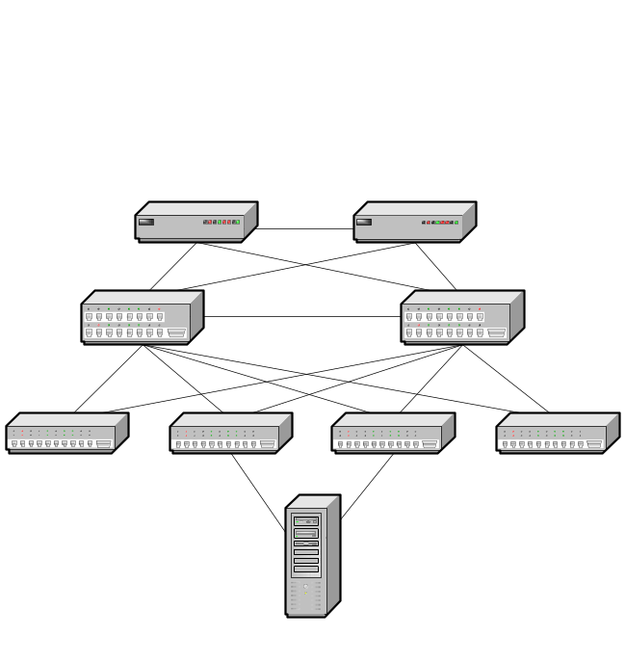

Complete Network Visibility Fundamentally Changes Network Management
sFlow
sFlow
sFlow
sFlow Collector/Analyzer
sFlow
Measurements from every port
Real-time, central collection
= data driven control from your chair

Slide 7
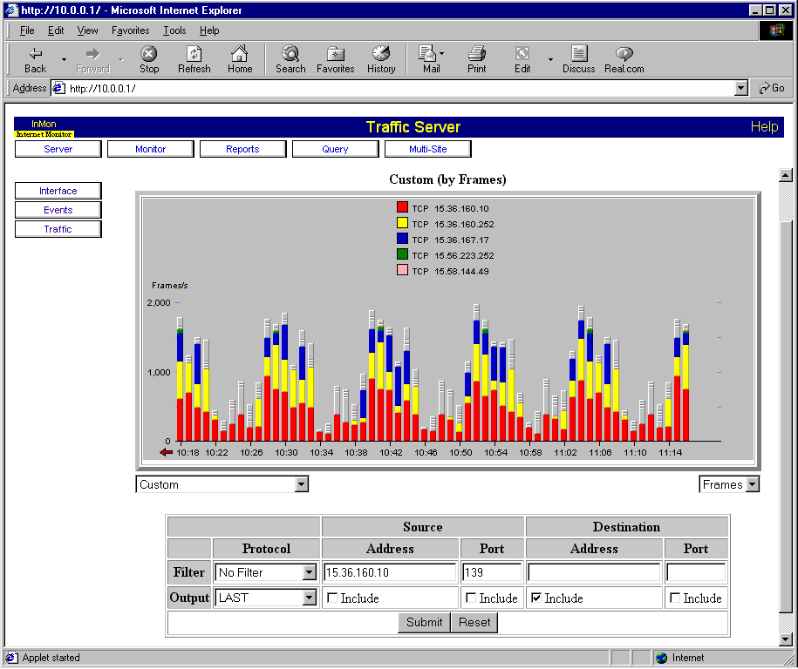

sFlow in Operation
Switch/Router
sFlow Datagram
forwarding tables
sFlow
agent
src/dst i/f
sampling parms
user ID
packet header
forwarding
URL
i/f counters
eg 128B
rate
pool
src 802.1p/Q
dst 802.1p/Q
next hop
src/dst mask
AS path
communities
localPref
src/dst
Radius
TACACS
interface counters
Switching
ASIC
1 in N sampling
sFlow Collector & Analyzer

Slide 8
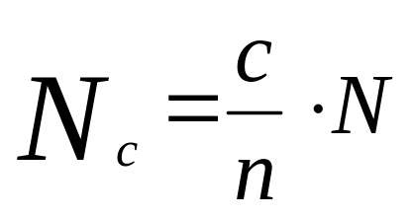
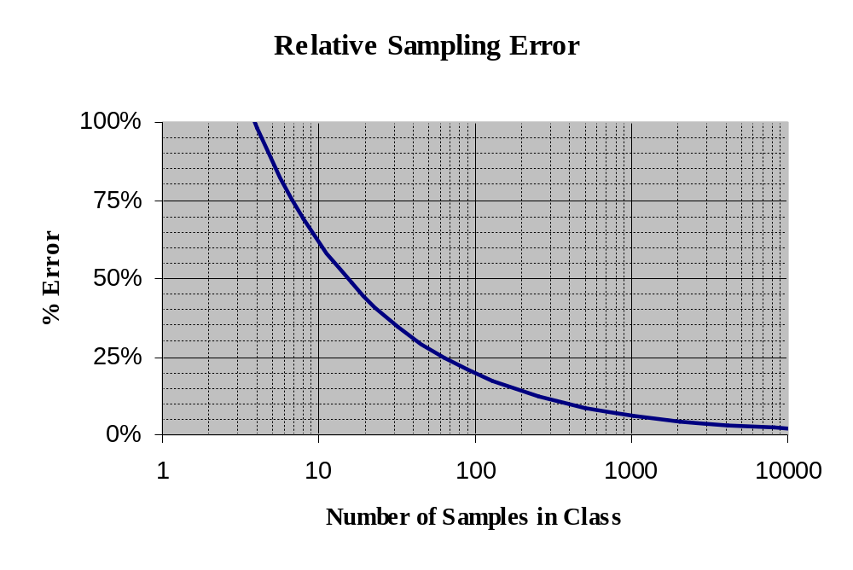

Statistical Model for Packet Sampling
Estimating Traffic per Protocol
Total number of frames = N
Total number of samples = n
Number of samples in class = c
Number of frames in the class estimated by:
Notes:
A key design criteria of sFlow was to provide quantitative data, which implies variances must be computable. The system was designed so that the measurements would conform to a statistical model which would allow measurement accuracy to be determined.
The statistical model allows estimates of traffic per class and associated error to be calculated:
Estimates are derived on a per agent basis using the following components of a sample:
N - sample_pool: the number of packets from which samples were taken.
n – total number of samples received
c – number of samples in a class.
This information is extracted from the sampled packet.
Analysis of a sampled packet will include extracting such information as IP source and destination addresses and TCP port numbers.
The decoded samples are then used to increment counters in a hash table keyed by whatever attributes are of interest. For example, to get an idea of the breakdown of TCP protocols, a table is constructed that is keyed by TCP protocol and contains counts of the number of samples in which the source or destination port matched the well know port number associated with the protocol. Applying the equation, gives the estimate of the total traffic that can be attributed to each protocol.
For example, suppose that over the period of a minute the difference in sample_pool was 1000, that 100 samples were received, and that 20 samples matched TCP port 80 (the well known port for HTTP). We can estimate that the total number of HTTP packets sent and received in that minute was 200. The relative error calculation gives a 95% confidence interval for the estimate of the number of HTTP packets as 200 ± 39.4%.
The lack of reliability in the UDP transport mechanism does not significantly affect the accuracy of the measurements obtained from an sFlow Agent.
If counter samples are lost then new values will be sent during the next polling interval.
The net effect of lost flow samples is a slight reduction in the effective sampling rate. The use of UDP reduces the amount of memory required to buffer data. UDP also provides a robust means of delivering timely traffic information during periods of intense traffic (such as a denial of service attack).
To understand the impact of losing samples, consider the case where 1000 samples are generated and there is a 5% loss rate so that 950 samples are received. % error changes from ± 6.20% when all samples are received to 6.36% when there is a 5% loss rate.

Slide 9
sFlow – Summary
Packet header (eg MAC,IPv4,IPv6,IPX,AppleTalk,TCP,UDP, ICMP)
Sample process parameters (rate, pool etc.)
Input/output ports
Priority (802.1p and TOS)
VLAN (802.1Q)
Source/destination prefix
Next hop address
Source AS, Source Peer AS
Destination AS Path
Communities, local preference
User IDs (TACACS/RADIUS) for source/destination
URL associated with source/destination
Interface statistics (RFC 1573, RFC 2233, and RFC 2358)
Switch/Router
sFlow
agent
sFlow Datagram
ASIC
HW Packet Sampling
Low cost
No impact to performance
Minimal network impact
Scalable
Quantitative measurements
Traffic
Notes:
sFlow provides a solution to the challenge of network-wide monitoring through the combination of some basic ideas:
Statistical sampling allows for detailed analysis of a representative subset of the traffic. Performing a full analysis of all packets is not practical. Sampling is inexpensive enough to implement on all switch ports and is very effective on high-speed links.
Accurate interface counters (such as bytes, packets and errors) are collected and allow link utilization to be accurately characterized. These counters are typically maintained by the interface hardware and so no additional overhead is involved in obtaining them.
Information about the forwarding decisions made by the switch is critical to interpreting the traffic measurements. By sampling forwarding decisions it is possible to capture detailed information such as input and output ports, VLAN, priorities and subnets that describe the forwarding decision. This additional information allows the flow of traffic through the network to be analyzed: priority traffic can be billed at a different rate, accounting by VLAN permits different customer’s traffic to be separated. Transit traffic and peering traffic can be analyzed by looking at subnet and AS information.
Instead of trying to analyze data on the switch, measurements are immediately forwarded to a central collector (eg InMon Traffic Server). This minimizes the load on the switch (both in terms of memory and CPU utilization) and further reduces the cost of the system.
A central collector (eg InMon Traffic Server) performs the traffic analysis. This reduces the workload on the switch and is a cost effective point to aggregate network wide data
How does sFlow provide better information than NetFlow?
NetFlow only provides traffic data for IP, TCP, UDP, ICMP (no L2, VLAN, or other L3 protocols)
NetFlow requires limited subsets of the routing information to be selected. If source/destination AS information is collected then peer information isn’t available. If peer information is selected then it cannot collect source/destination information. NetFlow is not able to monitor full AS path information.
NetFlow does not provide real-time information since it delays measurements on the router until the end of the flow (or a specified interval has passed).
Traffic characteristics (such as inbound or outbound counts) are essential to properly measure utilization and congestion on full-duplex switch ports. NetFlow does not address the issue of counter monitoring.
NetFlow does significant amounts of processing of each packet and tends to clip, dropping data under high loads. This leads to inaccurate data.
How does sFlow provide better information than RMON?
RMON was designed for shared networks where a single monitoring point would see all of the traffic.
In a switched environment, traffic is no longer visible from a single point. A switch directs packets to specific ports based on the packet’s destination. Every port on the switch needs to be monitored in order to obtain a complete picture of the network traffic. The use of point-to-point links makes it difficult to attach instruments and the large number of instruments that would be required to monitor all the switch ports ensures that such an approach would not be cost effective.
Since RMONII is a shared network technology it also does not provide any forwarding information (routing, switching, BGP, subnet etc) which is essential for controlling today’s point-point networks.
RMON data can be polled frequently to provide real-time top talker information but it is expensive to compute and often not done network-wide.
RMON does significant amounts of processing of each packet and tends to clip, dropping data under high loads. This leads to inaccurate data.

Slide 10
sFlow Benefits
Reduce Costs
Control network service costs
  Internet access
    Ensure internet traffic remains within SLA guidelines and CIR
  Allocate costs to departments
    Detailed usage information for individual users, applications, and organizational entities
    Each department can assess their usage and control costs.
  Optimize peering relationships
    Identify the ISPs that carry the most transit traffic and are therefore the optimal peers
Plan for cost effective upgrades
  Accurately forecast resource requirements by identifying the bottlenecks
  Apply traffic shaping and rate control to maintain network performance

Slide 11
sFlow Benefits
Minimize Network Downtime
Rapidly pin-point congestion problems
  Why is the network slow?
Troubleshoot network problems quickly
  System and network problems often first manifest themselves in abnormal traffic patterns
You can’t fix what you can’t see
  Detailed data enables rapid problem resolution, minimizing costly network downtime

Slide 12
sFlow Benefits
Protect your Assets with Security and Surveillance
Design and implement targeted security policies
  Determine traffic compartmentalization strategies
  Define firewall configuration
  Audit results
Identify access policy violations and intrusions
  Establish a baseline for normal network activity
  Raise alerts to deviations from the baseline
  Identify source and target of the intrusion
Distributed Denial of Service Detection and diagnosis
  Robust traffic profiling to highlight attacks (eg traffic targeted at a single host, port scanning etc.)
Identify worm-infected hosts and the spread of infections
  Infected hosts identified by signature recognition
  Identify significant changes in fan-out from every host

Slide 13
sFlow Benefits
Fund Upgrades or Increase Revenue
Account and bill for network usage
  Detailed data on network usage
    User
    Groups of users
    Application
    Source/destination of traffic
  Different tariffs for internal vs. external traffic, etc.
Charge for value added services
  VoIP
Develop new service revenue streams
  Understand customer service usage

