Slide 1


Accelerating Ceph Distributed File Sy-stem With RDMA
Dislab-QiuHaonan

Slide 2
Content
Background
Problem Statement
Related Work
Our Design
Evaluation
Conclusion

Slide 3
Background
Scalablity
Middle or Large cluster of Nodes,Scale out
Reliability
Replicas,Resources Migration,MDS(Metadata server)
Data recovery,Data balance
Fault tolerance by Erasure codes
Performance
Time for everything means efficiency
Monitor Cluster:
Paxos for consistency(Fast Convergence)
ClusterMap for clients(Fast Transmit enormous data and handle jillion connections)
SSD widely used,Storage I/O exceeds Network I/O in Linux Kernel TCP/IP
Fault tolerance by Erasure codes,enormous data means jillion Computing

Slide 4
Background
Scalability
Middle and large cluster
Reliability
Replicas for recovery
Migration for balance
Time count
Network BandWidth and Latency
CPU Utilization
Performance

Slide 5
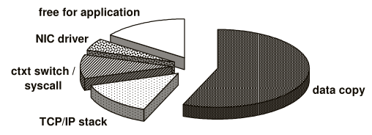
Problem Analysis
Ceph or HDFS etc use traditional Tcp/Ip as communi-cation method.
Kernel Tcp/Ip Analysis
Kernel eats too much cpu cycles
Less cpu cycles left to applications
Long haul networks(high latency)
Low bandwidth
Double copy from userspace to kernel and to NIC
Context switch leads to extra overhead

Slide 6
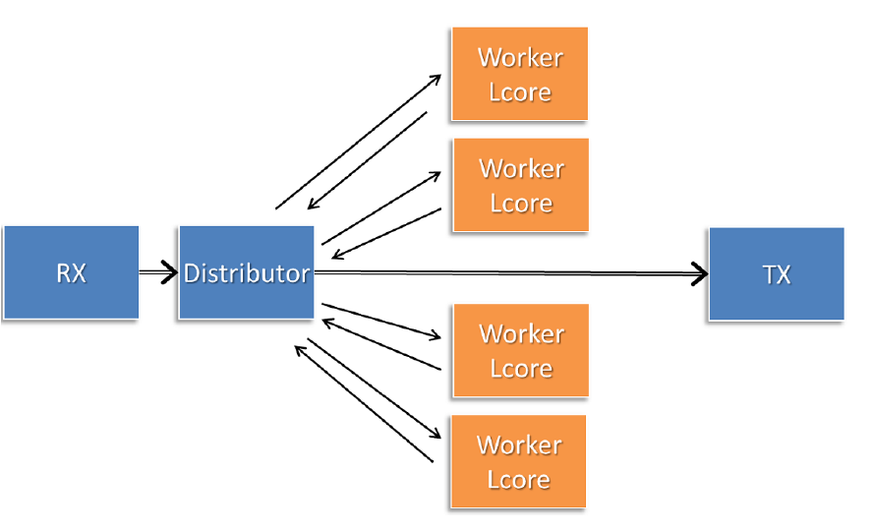
Problem Analysis
Later,Ceph try to use DPDK to accelerate itself.But…
DPDK Analysis
Polling Mode Driver
Derive data from NIC
100% CPU Utilization
UIO
Manul Network Stack
Software low efficiency
Need too much CPU resources
Data distribute mode
In-core communication leads to jillion overhead
Single-distributor may lead to single failure
Hardware limitation:mainly for X86 CPU now

Slide 7
Problem Statement
Low network bandwidth & high latency
Make room for “effecitive” CPU load
Ceph disk I/O speed up over network I/O due to SSD
Whatever,Time or Efficiency is most important.

Slide 8
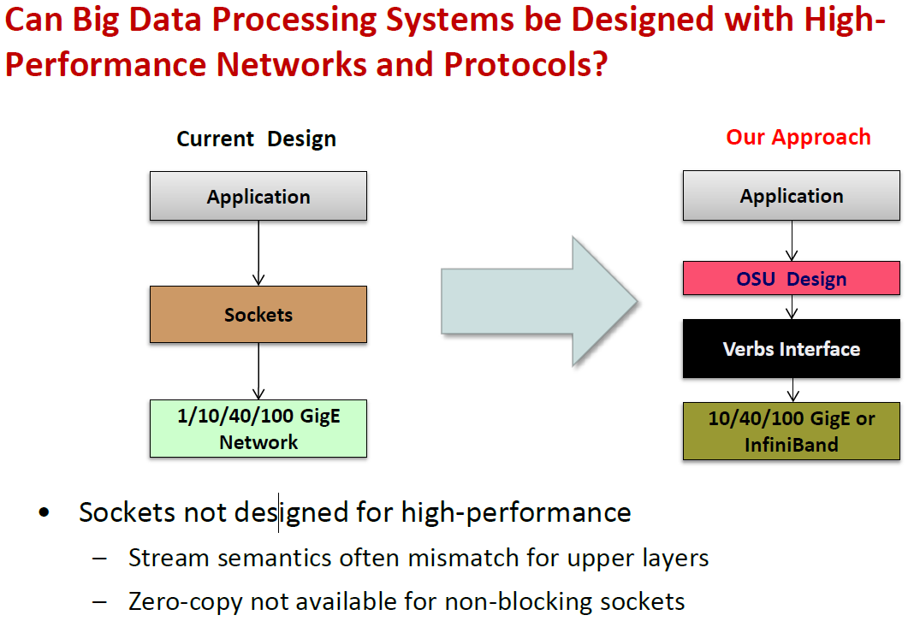
Related Work
Panda

Slide 9
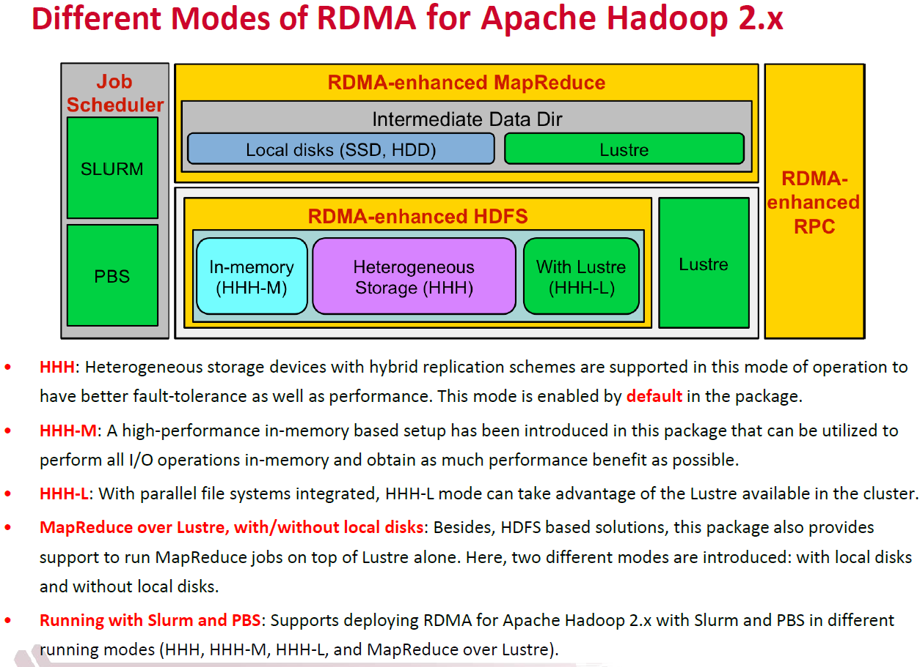
Hadoop Experience

Slide 10
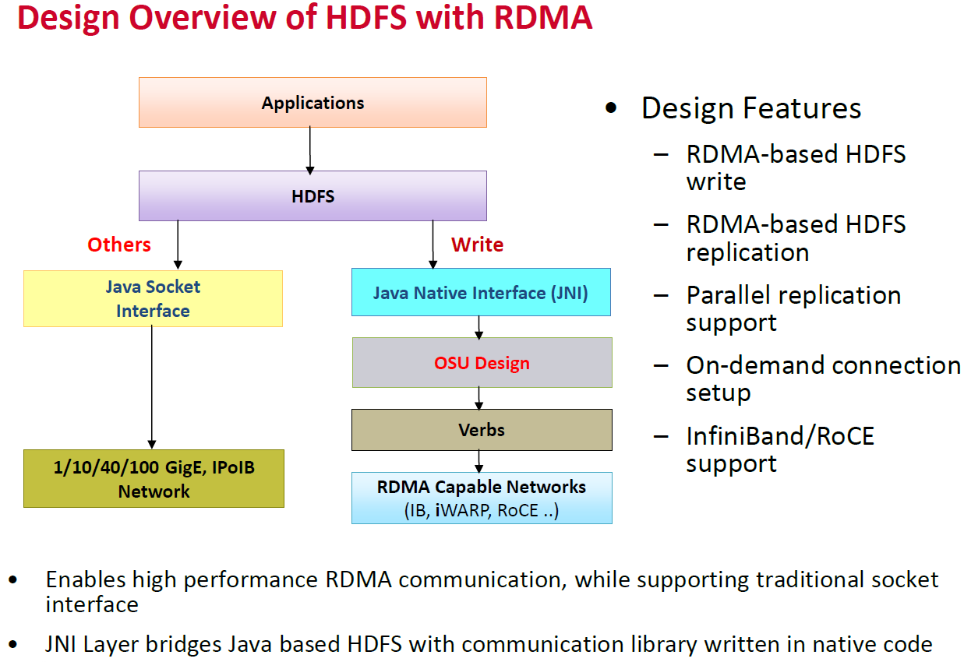
HDFS Design with RDMA

Slide 11
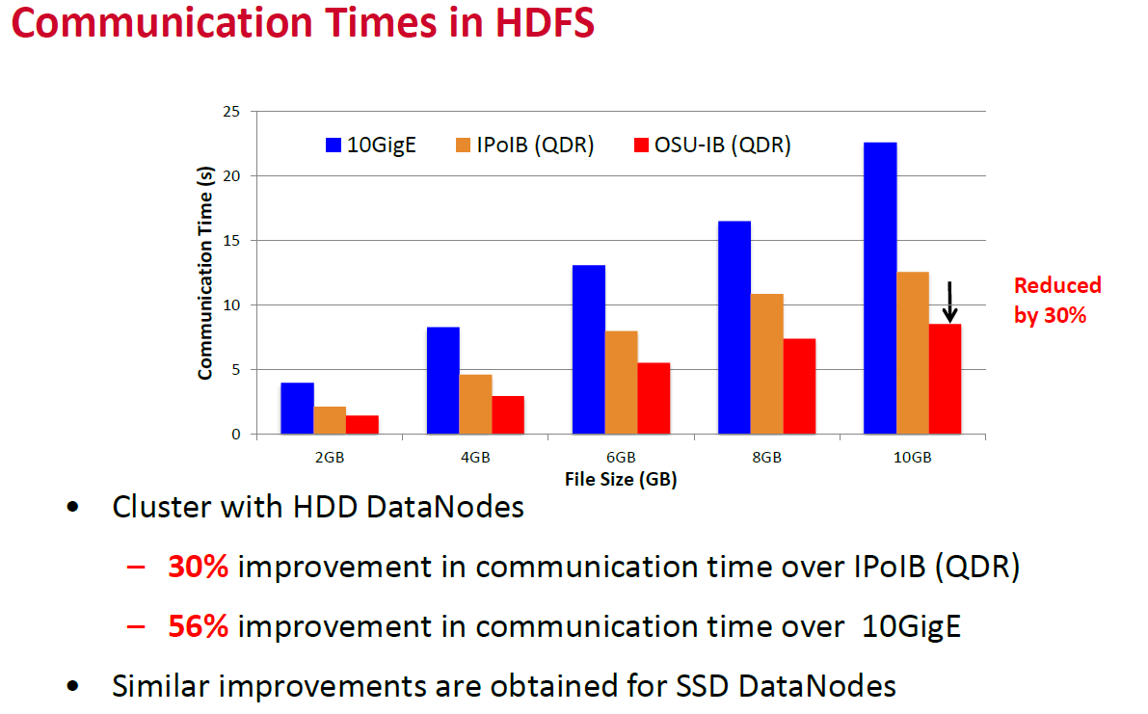
Improvement

Slide 12
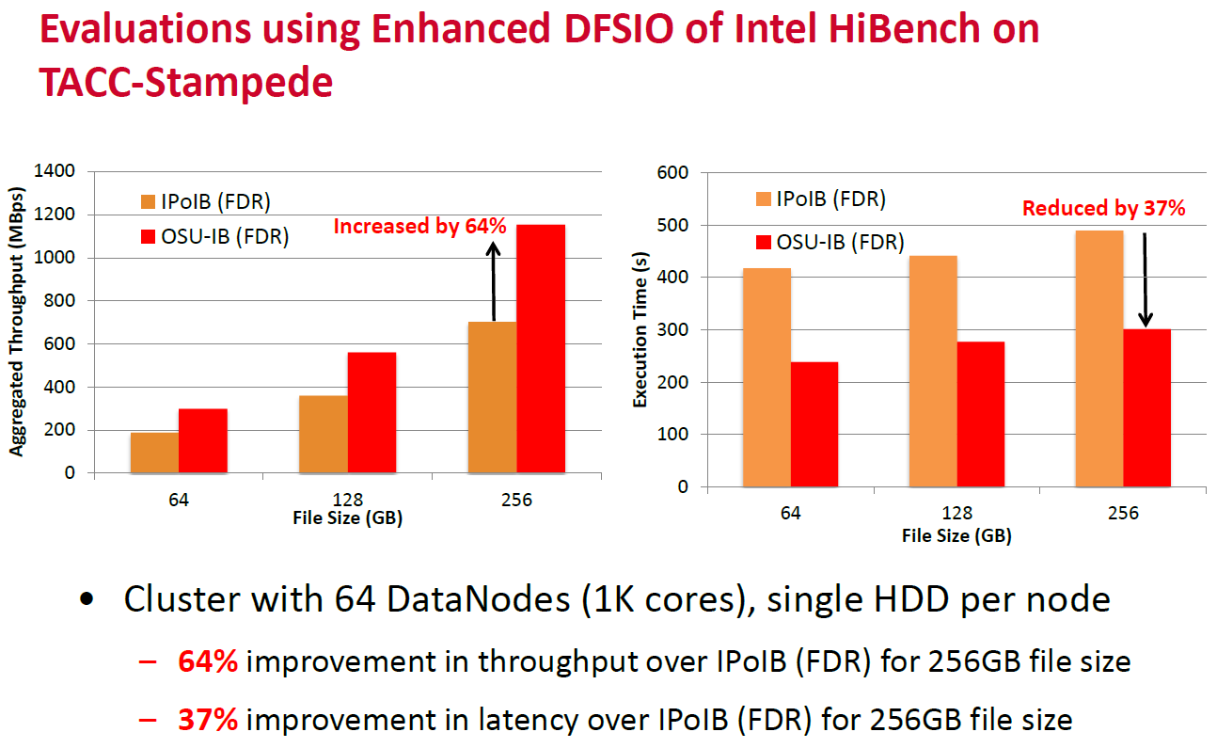
Evaluations

Slide 13
Design Analysis
Network
CPU
Memory
Utilization & Locality
BandWidth & Latency
Time Optimization
Utilization & Cache Locality

Slide 14
RDMA Feature
Remote CPU-bypass && Remote memory access
Effectively reduce the CPU cycles,make room for computing resources.
To the benefit of heavy-load servers
Protocol offload
Faster Execution in hardware(NIC)
Reduce computing resources,alleviate the CPU load

Slide 15
Our Contribution
Enable RDMA
NIC Memory Optimization
Resource Contend
CPU & Cache Optimization
CPU Utilization & Latency
Memory Management

Slide 16
NIC Memory Problem
Middle and large cluster consist of hundreds of nodes
Let N be number of nodes
Max connections can be N*N
Large size of data demand multiple even more page entries
Let P be number of pages for data D in main memory.
There will be P entries in NIC virtual-to-physical entries.
NIC memory will be run out,NIC data will be swapped out between main memory and NIC memory via DMA.

Slide 17
NIC Memory Optimization
Enable HugePage to alleviate NIC memory thrashing
Same size of data,smaller number of virtual-to-physical en-tries
Aim at enormous QPs existing in NIC
Aim at enormous Virtual-Physical address translation items
Enable Sharing QPs between moderate number of threads
Max QP number reduces to (N*N)/S.S is the sharing degree
Aim at enormous QPs existing in NIC
Better Scalability

Slide 18
Before optimization & after optimization
TO do

Slide 19
Resource Contend Problem
Multiple threads share single QP.
Data will be packaged and unpackaged.
Excessive lock contention cause nonnegligible latency
Lock require and release bring extra overhead
Continuously test lock or utilize request link complex the procedure.

Slide 20
Resource Contend Optimization
QP Multiplexing
Multiple threads share a QP
Solutions:
Lock-free Ring Buffer(Multiple producer-Multiple consumer)
Less Contend,Simple,One Atomic Operation
Single-Signal,Multiple-Commit
No Contend,Little Complex,Inherent Low CPU Utilization
Multiple QPs share a receive queue
Alleviate NIC Memory Limitation
Inherent NO Contend

Slide 21
Before optimization & after optimization
TO do

Slide 22
CPU & Cache Problem
Arbitrarily allocate thread to cores cause unbalanced l-oad
Some core too busy and frequent thread switching worse cache miss
Sharing QP between multiple threads
Each threads reside on different cores will lead to QP cache bouncing between different cores.

Slide 23
CPU & Cache Optimization
Binding Threads(Workers) to Core
Load Balancing Algorithm
Better CPU Utilization
Better local cache hitting,Less cache thrashing
No Cache Bouncing between Cores
Better exploiting local cache performance
Allow CPU Hardware Instruction optimization
NUMA-Friendly
NIC connected via bus to specific CPU
Polling Thread follow the NIC driver thread

Slide 24
Before optimization & after optimization
TO do

Slide 25
RDMA Memory Management
Unsuitable size of data lead to low memory utilization
Memory access has strong locality.
Lately accessed buffers’ size may be suitable for receiving data or sending data
Lately accessed buffers may still reside on cache, repeate-dely access bring less access time.

Slide 26
RDMA Memory Management
From Using Behaviour
Stacked Memory Mode
Hot Memory up, Cold Memory down,NUMA-Friendly
Approximate optimal memory size,better memory utilization
From Allocation Behaviour
Ceph-Journal-block-based size
Multiple Size Memory buffer
Better Memory Utilitzation
Adapt to complex demand

Slide 27
Before optimization & after optimization
TO do

Slide 28
CPU Efficiency & Latency
Two Strategies In Computing Resource and latency
Polling Mode
Dedicated Thread polls data,High Computing and low latency
Suitable for time-tight environment
Asynchronization Mode
Wait for signal,Low computing and High latency
Suitable for time-loose environment

Slide 29
Our solution
No single failure or hot spot in Ceph
Both Computing and Latency counts!
Sample-Deviation-Based Polling Mode
Set a fixed time duration for Polling and a initial time S for sleeping
Polling no result,record it,deviate the S
Each epoch,S approximates the optimal value
Balance the CPU Utilization and Lantency!
Context Switch swaps for low CPU Utilization.

Slide 30
Before optimization & after optimization
TO do

Slide 31
Whole Evaluation
Data recovery
CPU,Network,recovering time

Slide 32
Whole Evaluation
Data Balance
CPU,Network,Balancing Time

Slide 33
Whole Evaluation
Pressure Test
CPU,Network,Response Time

Slide 34
Conclusion
Poll 休眠问题，context switch性价比
启用大页，缓解NIC缓存问题
共享QP，缓解NIC缓存问题
共享QP，资源竞争问题
绑定worker到核，高效利用缓存，防止缓存弹跳问题
缓存大小，平衡利用率问题
内存管理，冷热内存，挖掘局部性问题
共享接受队列

