Slide 1





CherryPick: Tracing Packet Trajectory in Software-Defined Datacenter Networks
Praveen Tammana† Rachit Agarwal‡ Myungjin Lee†
†University of Edinburgh ‡UC Berkeley

Slide 2
Debugging datacenter networks
SDN-enabled datacenters
Flexible network management
Control plane policies to data plane rules
Debugging becomes more challenging
Ensuring data plane conforms with control plane
Notes:
.

Slide 3

Packet trajectory tracing
“Tracing” the path taken by the packet
Scalability: Switch flow rules, packet header space
Policy: All packets from 1 to 3 should go through 4
Checks whether packet followed route as defined in policy
Helps to localize network problems
Ex: misconfiguration, failures
4
5
6
mismatch
Actual path : 1 - 6 - 3
1
2
3

Slide 4


Enabling packet trajectory tracing
Challenge: Packets traversing non-shortest paths
Idea 1: Append link IDs at each hop
Insert
ingress link ID
Large packet header space
as path length increases
5
User packet
6
4
Src
Dst
1
2
3

Slide 5
Enabling packet trajectory tracing
Challenge: Packets traversing non-shortest paths
Idea 2: Maintain global path ID for each unique path
Path id 1
Path id 2
# Paths in 48-ary fat-tree
4 hops : 576 6 hops: 1.3 million !!
Need one flow rule for
each unique path id
# Switch flow rules ∝ # Paths that contain switch
Src
Dst

Slide 6
Existing approaches
Naïve approach
Switches append ingress link ID into the packet header
Large number of header bits
PathletTracer [HotSDN’14] and PathQuery [HotSDN’14]
Switches insert or update path information in packet header
Large number of switch flow rules
NetSight [NSDI’14]
Logs packet details at each hop
Need to collect large amount of data
Topology agnostic
Handles wide range of queries

Slide 7
CherryPick overview
Exploits the structure in data center topologies
(e.g., fat-tree)
Observation: A small subset of links sufficient to represent any end-to-end path
Scalability:
Minimal number of flow rules irrespective to path length
Packet header space requirement is close to state-of-the-art
Notes:
th

Slide 8
Selectively picking links
4 hops
Pick ingress link
id-1
Core
Only one shortest path from Core to Dst
Core
Picked link
Agg
All 4 hops: Pick 1 link
Agg
User packet
ToR
Src
Dst

Slide 9
Selectively picking links
6 hops
id-1
Only one shortest path between selected links
id-1
Picked link
Pick ingress link
id-2
All 6 hops: Pick 2 links
Agg
Picked link
ToR
Src
Dst
For more details, please refer to our paper

Slide 10
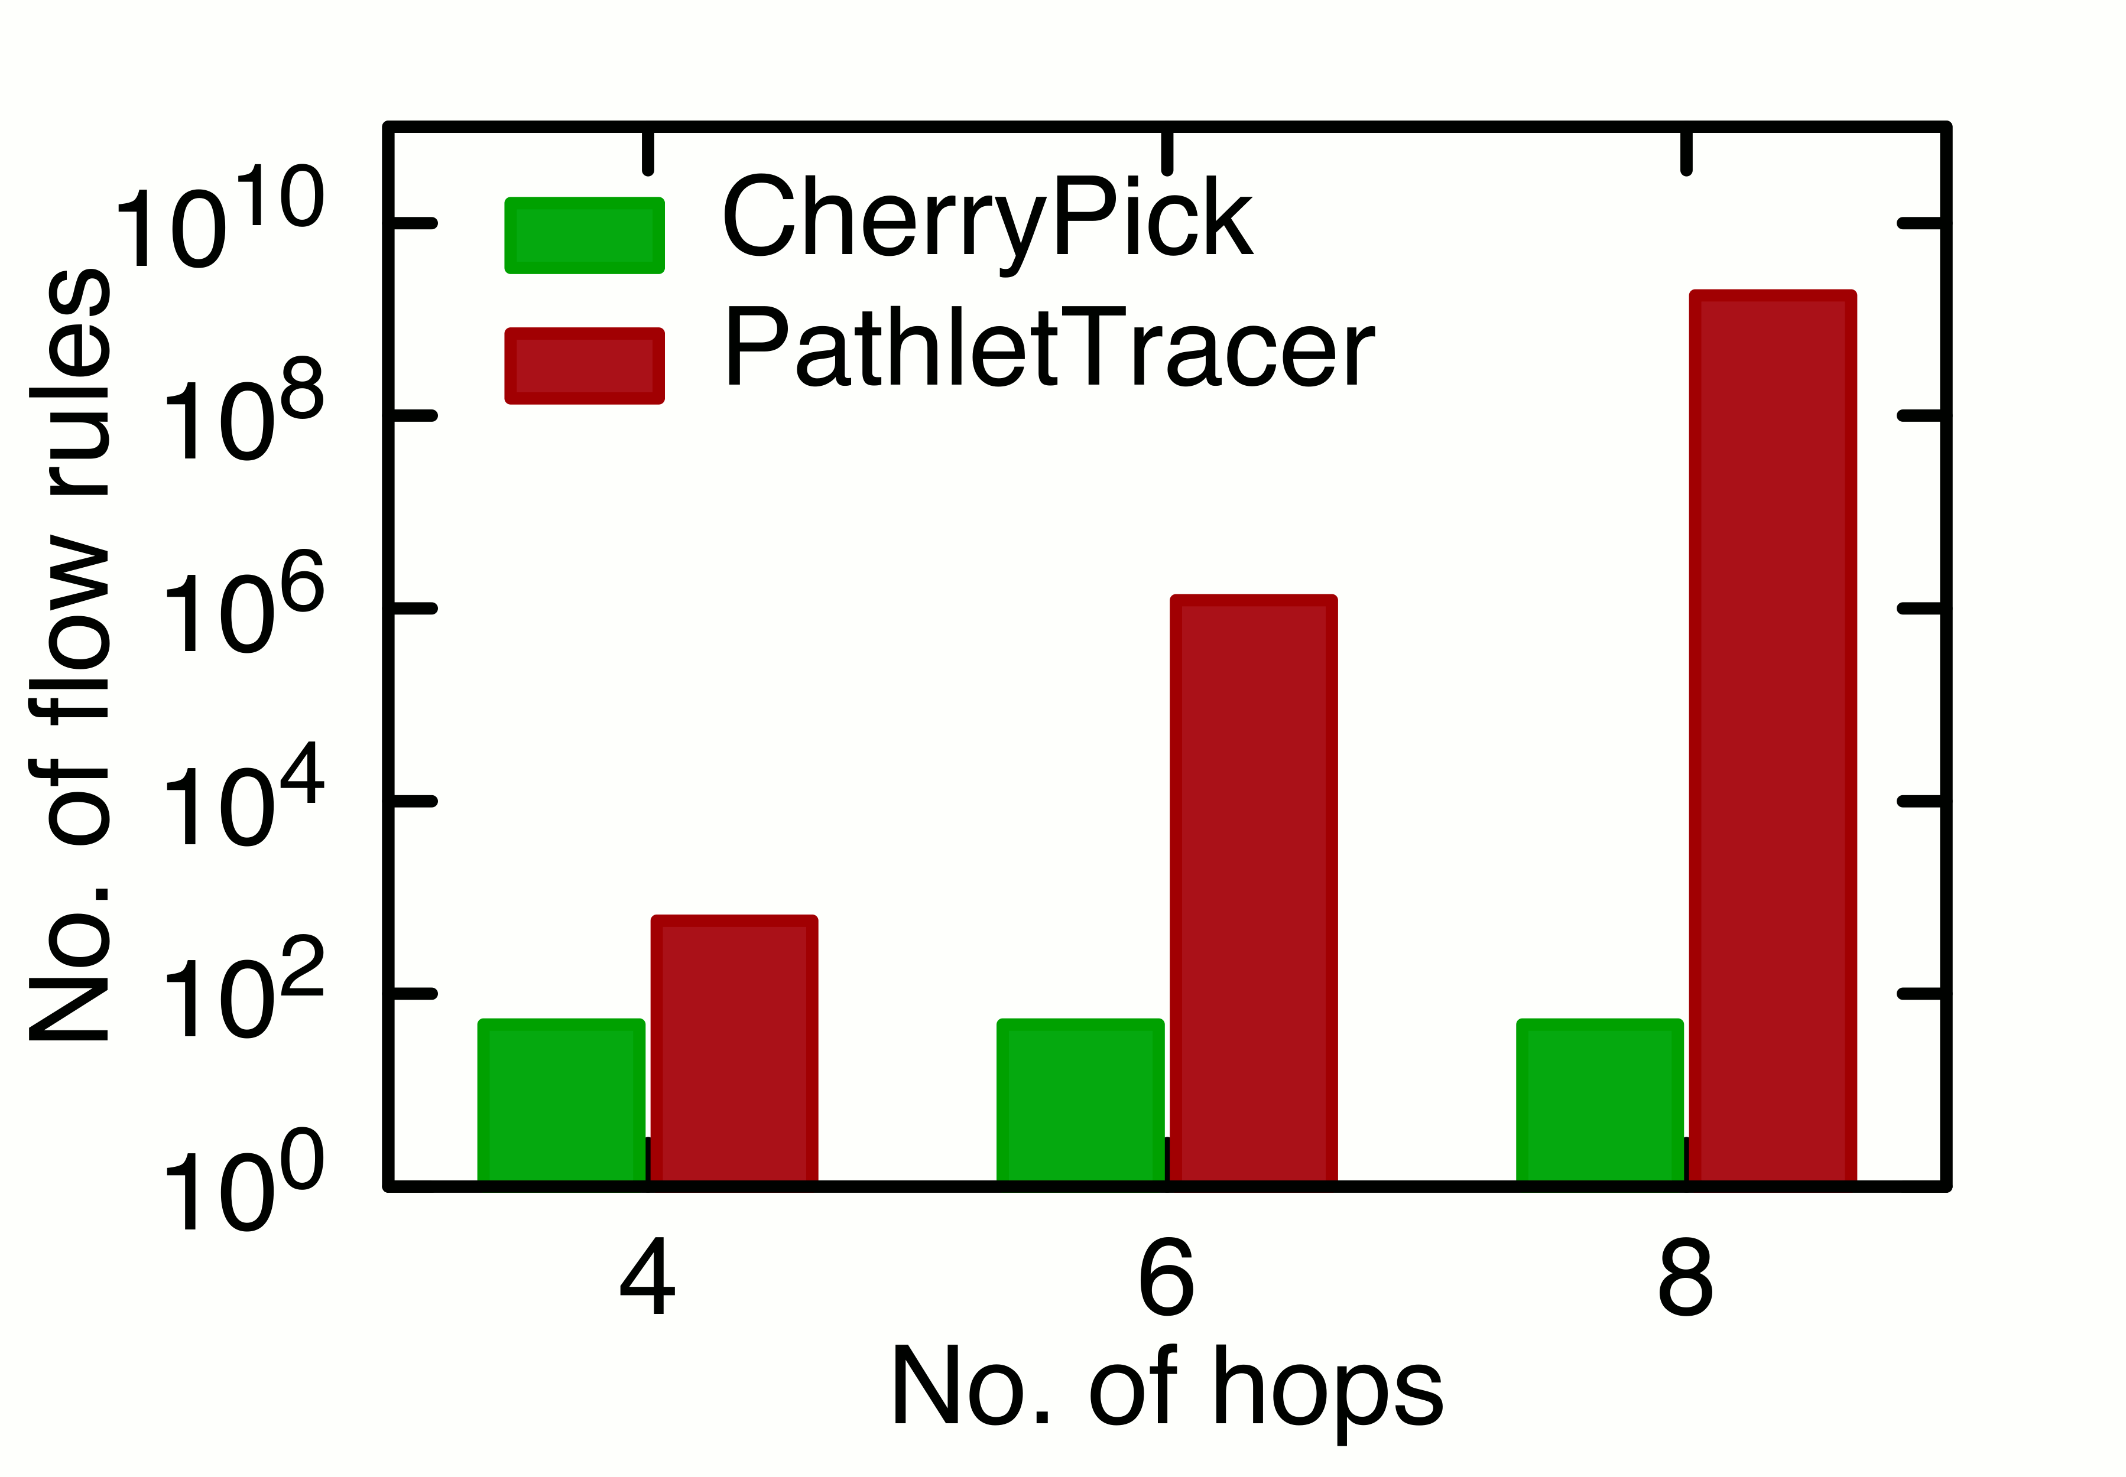
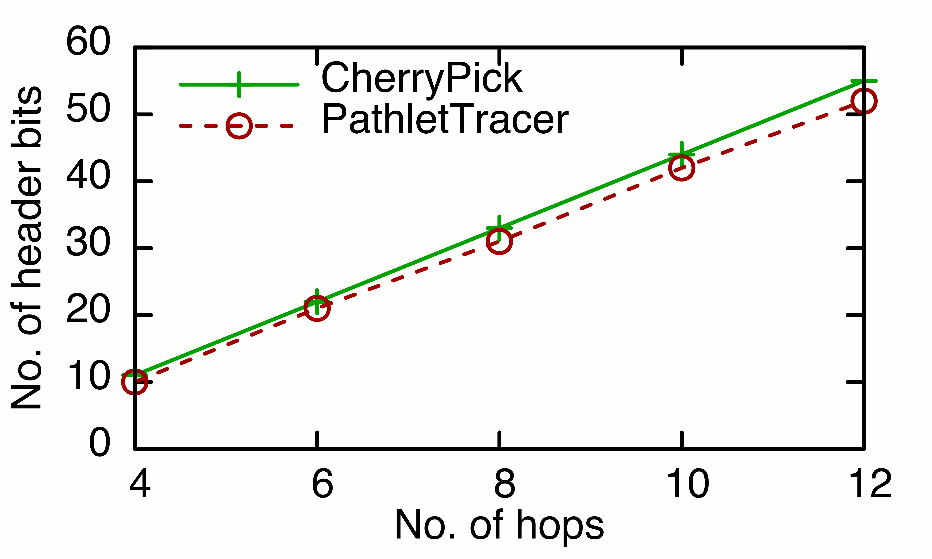
Evaluation results for 48-ary fat-tree
ToR Switch
Independent of
path length
Minimal number of switch flow rules
Header space requirement
is close to PathletTracer
10⁷
10⁵

Slide 11
Conclusion
CherryPick
Simple and scalable packet trajectory tracing technique
Demonstrate efficacy under fat-tree topology
Feasibility: Trace all 4- and 6-hop paths using double tagging
Low overhead: #OpenFlow rules = #Ports
Future work
Generalization to other datacenter topologies
Tracing trajectories of packets that do not reach destination

Slide 12
Thank You

Slide 13
Backup-slides
Notes:
Spend time on main slide -> more animations, prepare
Keep answer short
Talk & animation should be on sync
Screen wall far – don’t point
General framework :
Start making story and come to point directly

Slide 14
Selectively picking a minimum number of links
Pick ingress link
id-1
Pick ingress link
Pick ingress link
id-3
All 8 hops: Pick 3 links
Src
Dst
id-2
Notes:
Change diagram that embed id’s into pkt header (instead of showing just id’s)
Add bullet points describing technique
Title:
Exploits topology
Mention path reconstruction

