Slide 1

Indian Institute of Information Technology Vadodara
CS 545 Software Engineering
MCA Second Year
Autumn 2026-27
Project Presentation
on
Quizingo – Online Quiz Platform
Presented by: [Sundaram Tripathi : 20251651091]
[Abhinav Kumar Chandravanshi :20251651004]
[Akshay Kumar : 20251651012]
[Ankit kumar : 20251651022]
Guide: Rishabh Sir Department: MCA , IIITV

Slide 2
Problem and objectives
CURRENT PROBLEM
PROJECT OBJECTIVES
Creating and managing quizzes manually takes time.
Let teachers create and manage online quizzes.
Manual checking can slow down result generation.
Support student attempts and automatic grading.
Questions and quiz attempts can be difficult to organize.
Organize questions, classes, and results in one platform.

Slide 3
Proposed solution
Quizingo brings quiz creation, classroom management, and student attempts into one web platform.
01
02
03
Sign in
Choose quiz
Attempt quiz
Authenticate user account
Join a classroom or open a quiz
Submit answers and calculate score
Output: quiz results and attempt records for review

Slide 4
System architecture
Frontend requests flow through API routes to application logic and database models.
React frontend
Node.js / Express
MongoDB
→
→
Student and teacher pages
API routes, auth, quiz logic
Users, quizzes, questions, attempts
Flow: React UI → Express API → controllers/models → MongoDB. Authentication middleware protects relevant routes.

Slide 5
Technology and implementation
LAYER
TECHNOLOGY
PURPOSE
Frontend
React + Vite
Quiz, classroom, and dashboard UI
Backend
Node.js / Express
REST API, authentication, quiz operations
Database
MongoDB
Store users, quizzes, questions, classes, and attempts
Technical point: explain how quiz answers are submitted, graded, and saved as an attempt.

Slide 6
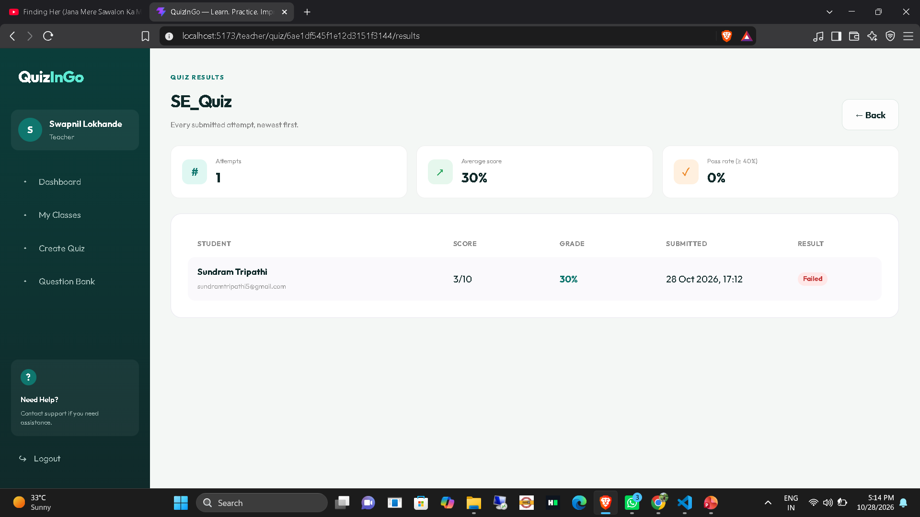
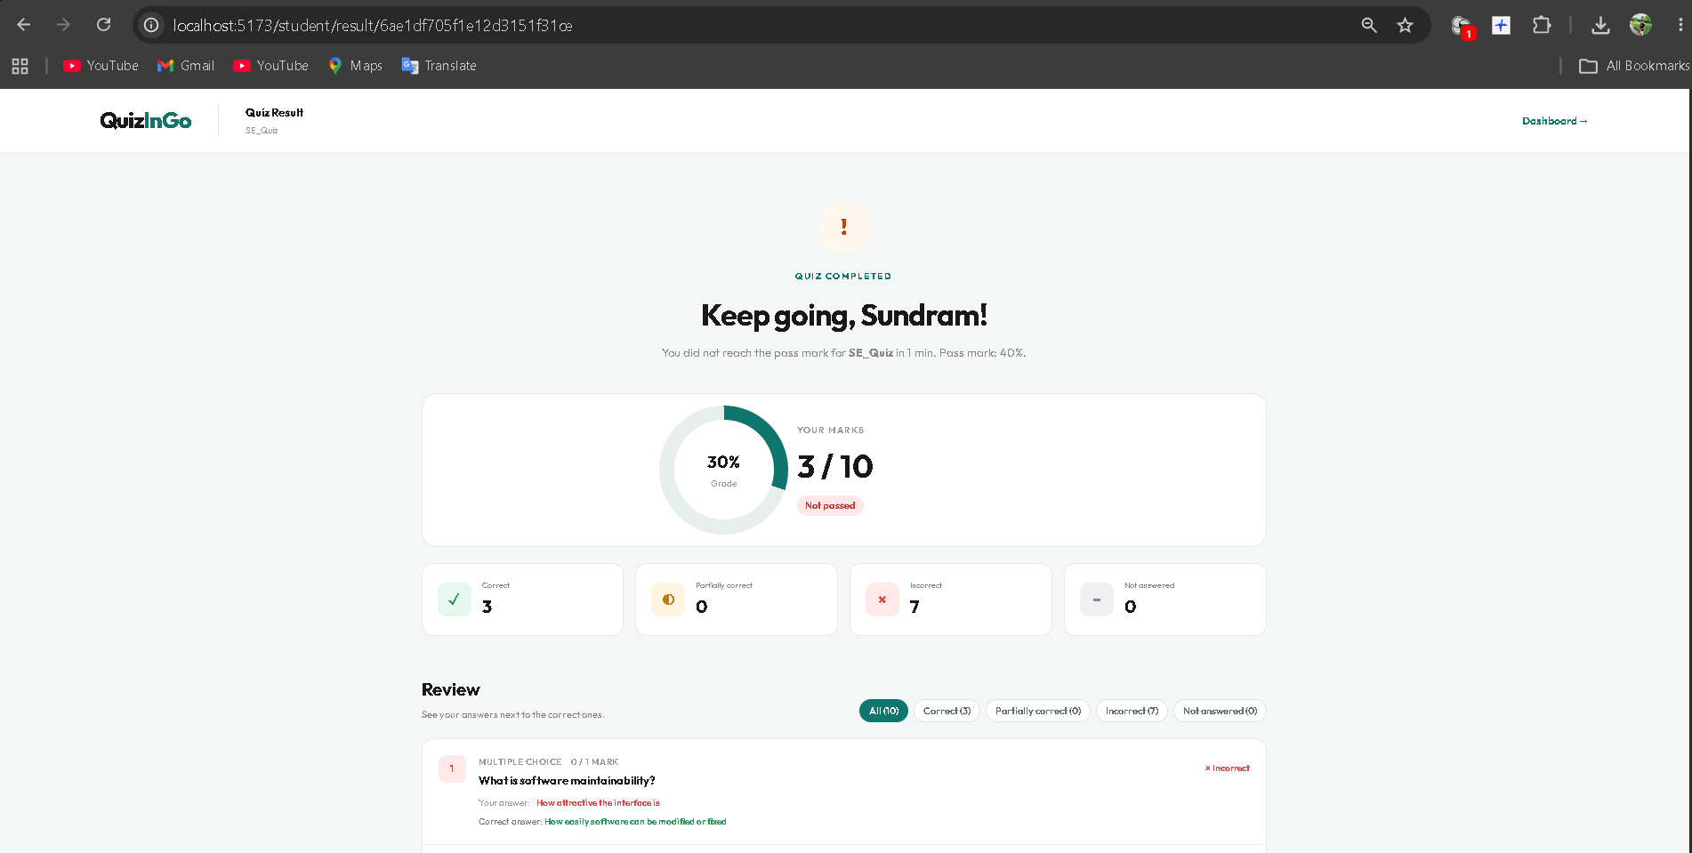
Screenshots and demonstration
Screenshots from the running Quizingo application;
01 Teacher dashboard / quiz creation
02 Attempt quiz / view result
Demo sequence: login → create/open quiz → answer questions → submit → review result

Slide 7
Testing and results
Use test evidence from the project; enter actual outcomes after running each test.
TEST CASE
EXPECTED BEHAVIOR
OBSERVED RESULT
User login / OTP
Valid verification permits account access
624587
Quiz grading
Submitted answers are graded and score is returned
30%
Classroom access
User can view/join available classroom content
6SYV9V
6SYV9V

Slide 8
Conclusion and next steps
Project scope
Next steps
Quizingo includes user authentication, quiz management, question-bank/import tools, classrooms, quiz attempts, and grading.
Run end-to-end tests, verify deployment configuration, and add further reporting or analytics as needed.

Slide 9
Thank you

