Slide 1
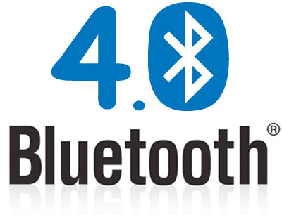
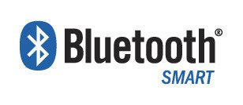
Bluetooth 4.0: Low Energy

Slide 2
How much energy does traditional Bluetooth use?
Traditional Bluetooth is connection oriented. When a device is connected, a link is maintained, even if there is no data flowing.
Sniff modes allow devices to sleep, reducing power consumption to give months of battery life
Peak transmit current is typically around 25mA
Even though it has been independently shown to be lower power than other radio standards, it is still not low enough power for coin cells and energy harvesting applications

Slide 3
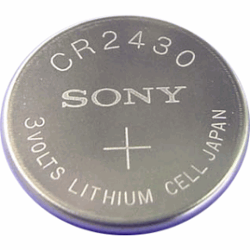
What is Bluetooth Low Energy?
Bluetooth low energy is a NEW, open, short range radio technology
  Blank sheet of paper design
  Different to Bluetooth classic (BR/EDR)
  Optimized for ultra low power
  Enable coin cell battery use cases
    < 20mA peak current
    < 5 uA average current

Slide 4
Basic Concepts of Bluetooth 4.0
Everything is optimized for lowest power consumption
  Short packets reduce TX peak current
  Short packets reduce RX time
  Less RF channels to improve discovery and connection time
  Simple state machine
  Single protocol
  Etc.

Slide 5
Bluetooth low energy factsheet
Range: | ~ 150 meters open field
Output Power: | ~ 10 mW (10dBm)
Max Current: | ~ 15 mA
Latency: | 3 ms
Topology: | Star
Connections: | > 2 billion
Modulation: | GFSK @ 2.4 GHz
Robustness: | Adaptive Frequency Hopping, 24 bit CRC
Security: | 128bit AES CCM
Sleep current: | ~ 1μA
Modes: | Broadcast, Connection, Event Data Models, Reads, Writes

Slide 6
Bluetooth low energy factsheet #2
Data Throughput
  For Bluetooth low energy, data throughput is not a meaningful parameter. It does not support streaming.
  It has a data rate of 1Mbps, but is not optimized for file transfer.
  It is designed for sending small chunks of data (exposing state)

Slide 7
Designed for exposing state
It’s good at small, discrete data transfers.
Data can triggered by local events.
Data can be read at any time by a client.
Interface model is very simple (GATT)
23.2˚C
60.5 km/h
12:23 pm
Gate 10 BOARDING
3.2 kWh
PLAY >>
Network Available

Slide 8
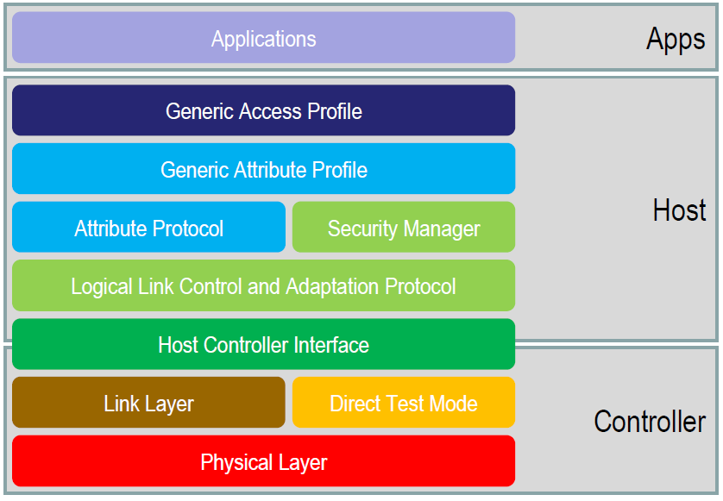
Bluetooth Low Energy Architecture

Slide 9
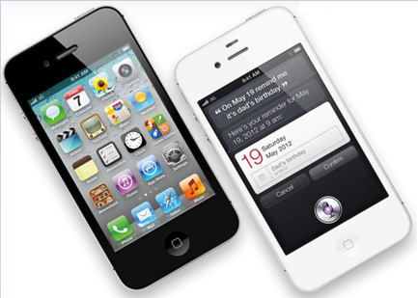
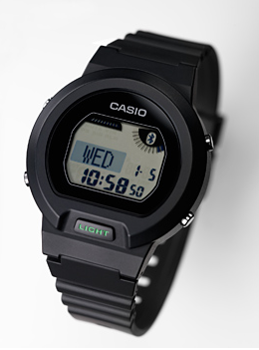
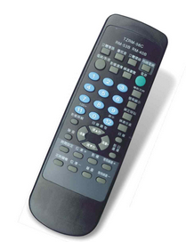
Device Modes
Dual Mode
  Bluetooth BR/EDR(Basic Rate/Enhanced Data Rate ) and LE
  Used anywhere that BR/EDR
  is used today
Single Mode
  Implements only Bluetooth low energy
  Will be used in
  new devices / applications

Slide 10
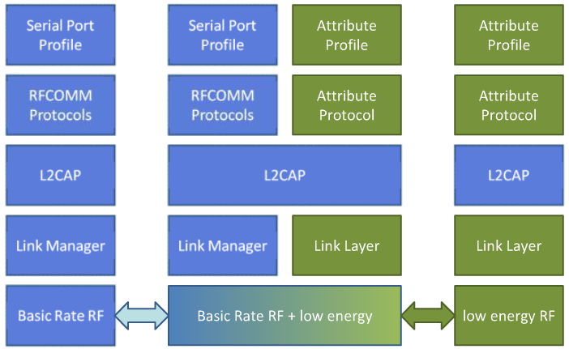
Device Modes
Dual mode + single modes
BR/EDR stack
Dual-mode stack
Single-mode stack

Slide 11
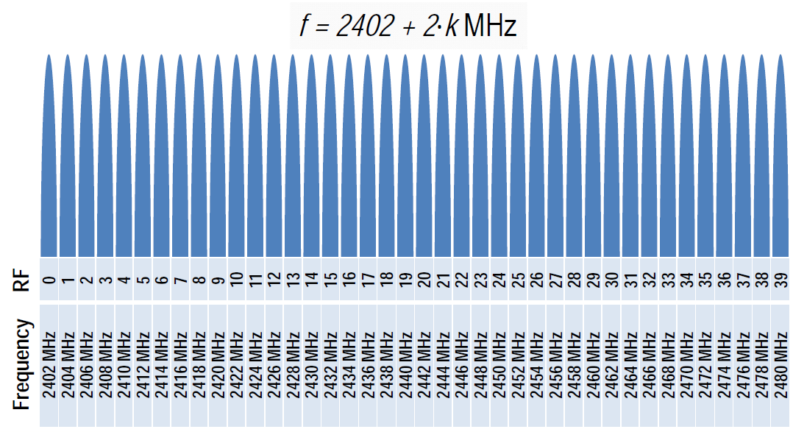
Physical Layer
2.4 GHz ISM band
1Mbps GFSK
  Larger modulation index than Bluetooth BR (which means better range)
40 Channels on 2 MHz spacing

Slide 12
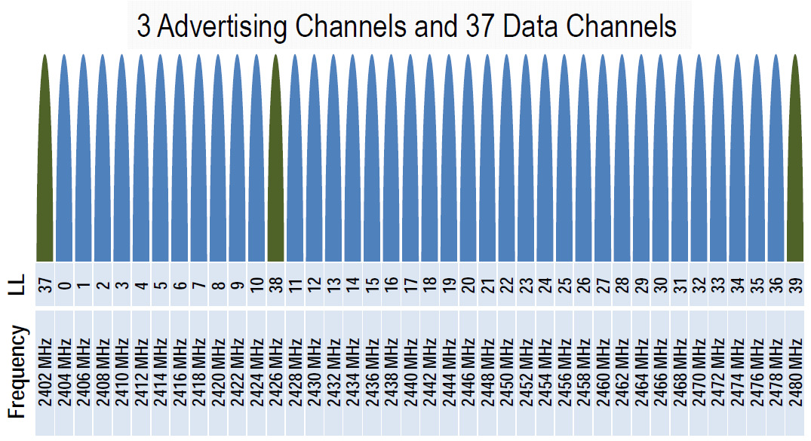
Physical Channels
Two types of channels

Slide 13
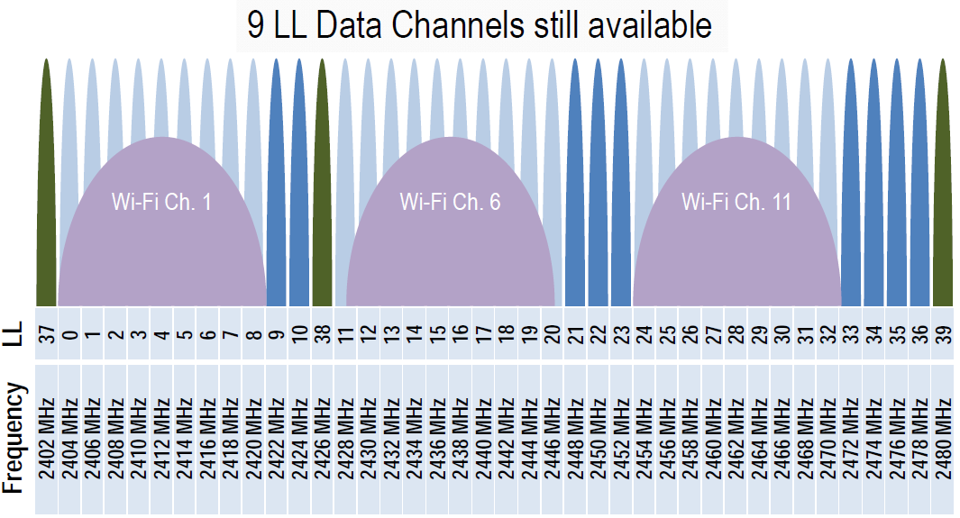
Physical Channels
Advertising channels avoid 802.11

Slide 14
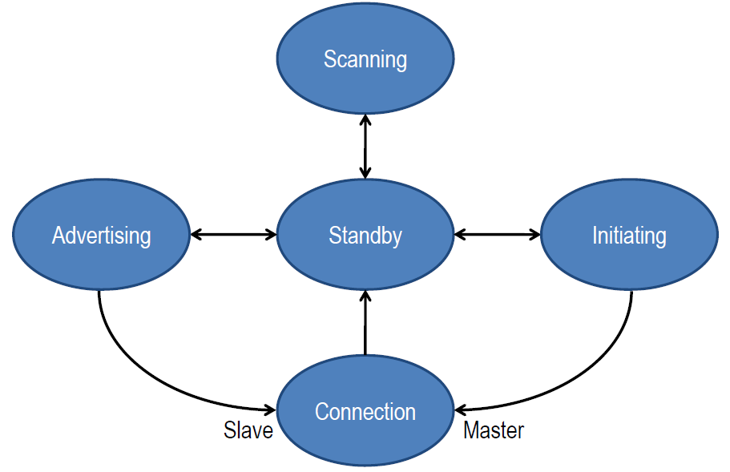
Link Layer
Link Layer state machine

Slide 15
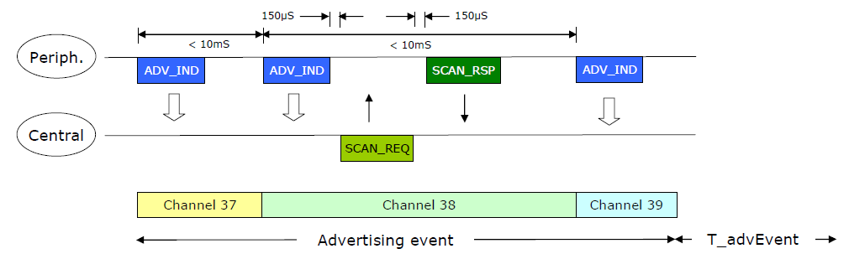
Advertising
Devices can advertise for a variety of reasons:
  To broadcast promiscuously
  To transmit signed data to a previously bonded device
  To advertise their presence to a device wanting to connect
  To reconnect asynchronously due to a local event

Slide 16
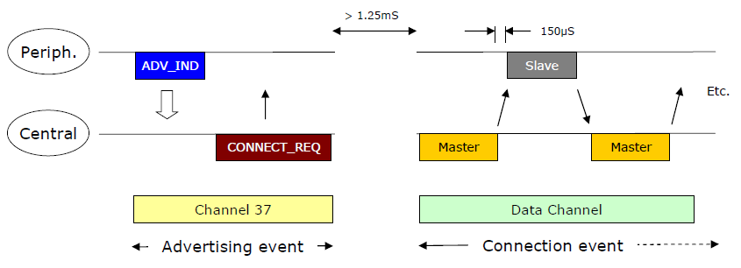
Data transactions
Once a connection is made:
  Master informs slave of hopping sequence and when to wake
  All subsequent transactions are performed in the 37 data channels
  Transactions can be encrypted
  Both devices can go into deep sleep between transactions

Slide 17
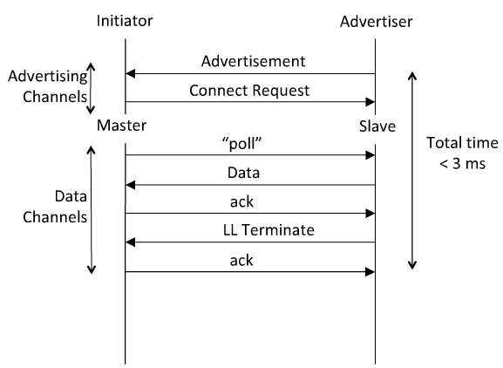
Link Layer Connection
Very low latency connection

Slide 18
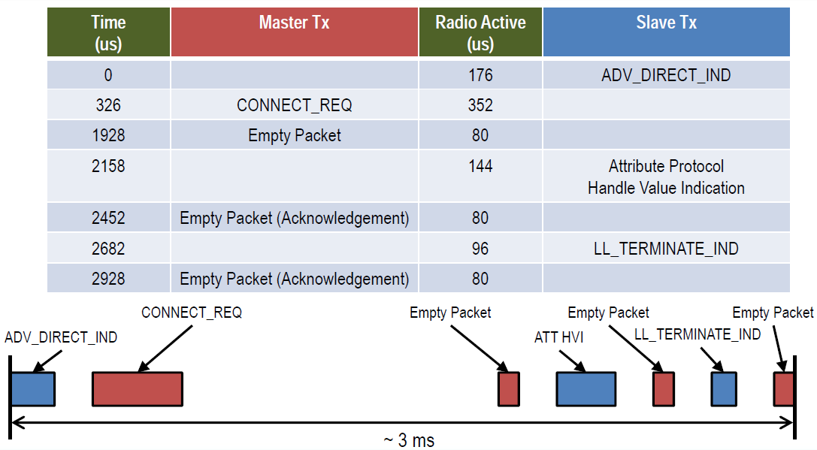
Time From Disconnected to Data ~ 3ms

Slide 19
How low can the energy get?
From the previous slide, calculate energy per transaction
  Assume an upper bound of 3ms per minimal transaction
  Estimated TX power is 15mW (mostly TX power amp for 65nm chips)
  For 1.5v battery, this is 10mA. 0.015W * 0.003 sec = 45 micro Joule
How long could a sensor last on a battery?
  An example battery: Lenmar WC357, 1.55v, 180mAh, $2-5
  180mAh/10mA = 18Hr = 64,800 seconds = 21.6M transactions
  Suppose this sensor sends a report every minute = 1440/day
  For just the BT LE transactions, this is 15,000 days, or > 40 years
  This far exceeds the life of the battery and/or the product
This means that battery will cost more than the electronics
  This sensor could run on scavenged power, e.g. ambient light

Slide 20
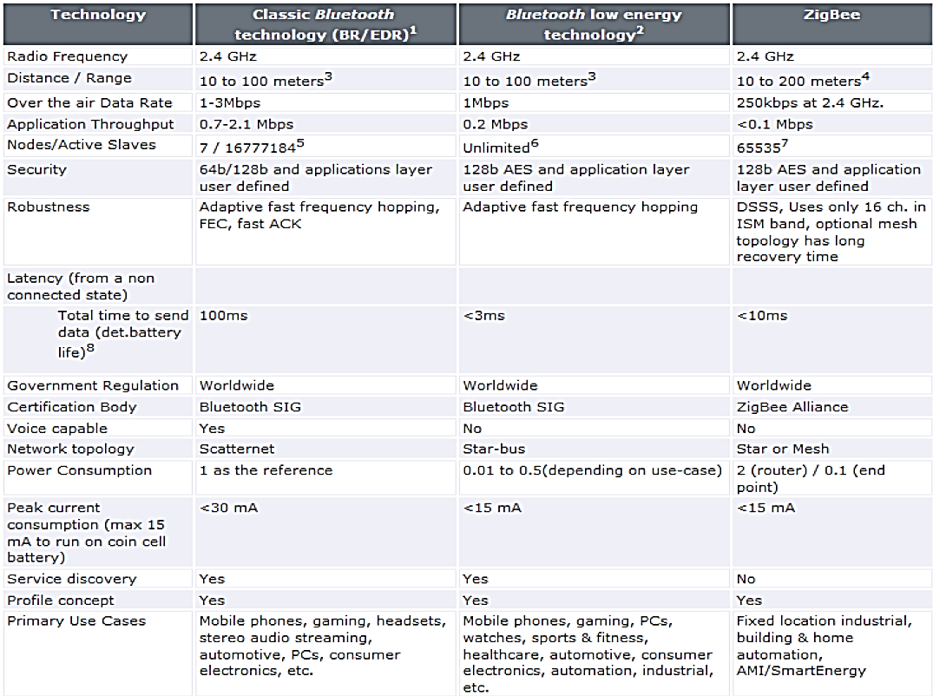
Competitive perspective

Slide 21
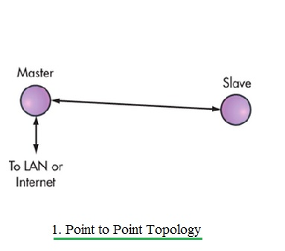
Basic topology of bluetooth

Slide 22
Point-to-Point
Point-to-point is a network topology used for establishing one-to-one (1:1) device communications.
The point-to-point topology available on Bluetooth Basic Rate/Enhanced Data Rate (BR/EDR) is optimized for audio streaming and is ideally suited for a wide range of wireless devices, such as speakers, headsets, and hands-free car kits.
The point-to-point topology available on Bluetooth Low Energy (LE) is optimized for data transfer and is well suited for connected device products, such as fitness trackers, health monitors, and PC peripherals and accessories.

Slide 23
Mesh
Mesh is a network topology used for establishing many-to-many (m:m) device communications.
The mesh topology available on Bluetooth LE enables the creation of large-scale device networks and is ideally suited for control, monitoring, and automation systems where tens, hundreds, or thousands of devices need to reliably and securely communicate with one another.

Slide 24
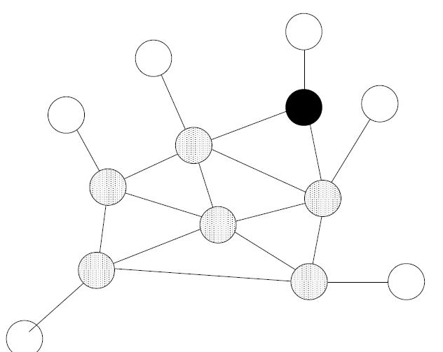
Mesh

Slide 25
Comparison
 | Bluetooth Low Energy (LE) | Bluetooth Basic Rate/
 |  | Enhanced Data Rate (BR/EDR)
Point-to-Point (1:1 device communication)
Optimized For... | Short burst data transmission | Continuous data streaming
Setup time | <6 ms | 100 ms
Max connections/ device (piconet) | Unlimited (implementation specific) | 7
Data rate | 125 Kb/s to 2 Mb/s | 1 Mb/s to 3 Mb/s​
Max payload size | 251 byte​ | 1,021 byte​
Security | 128-bit AES, user defined application layer​ | 64b/128b, user defined application layer​
Service definition | GATT Profiles​ | Traditional Profiles​
Broadcast (1:m device communication)
Max payload size | Primary Channel: 31 byte​ | Not Applicable
 | Secondary Channel: 255 byte​
 | Chaining of packets for larger messages
Security | User defined application layer
Service definition | Beacon Formats
 | (not specified by Bluetooth SIG)​
Mesh (m:m device communication)
Max nodes | 32,767 | Not Applicable
Max subnets | 4,096
Message addressing | Unicast, Multicast, Broadcast​
 | Up to 16,384 group addresses​
 | Supports publish/subscribe addressing​
Message forwarding | Managed flood
Max payload size | 29 byte payload
Security | 128-bit AES​
 | Device, network and application levels​
Service definition | Mesh Models, Mesh Properties

Slide 26
What are the USE CASES planned for BT 4.0?
Proximity
Time
Emergency
Network availability
Personal User Interface
Simple remote control
Browse over Bluetooth
Temperature Sensor
Humidity Sensor
HVAC
Generic I/O (automation)
Battery status
Heart rate monitor
Physical activity monitor
Blood glucose monitor
Cycling sensors
Pulse Oximeter
Body thermometer

Slide 27

Example use: proximity
It can enable proximity detection
  I’m in the car
  I’m in the office
  I’m in the meeting room
  I’m in the movie theater
It can enable presence detection
  Turn the lights on when I walk around the house
  Automatically locks the door when I leave home
  Turn the alarm off if I’m already awake

Slide 28


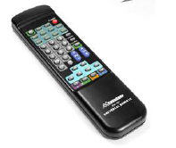
Everyday objects can become sensors
My pulse is …
My blood glucose is …
My temperature is …
… and monitor things unobtrusively

Slide 29
Generic Access Profile
it controls connections and advertising in Bluetooth.
GAP is what makes your device visible to the outside world, and determines how two devices can (or can't) interact with each other.

Slide 30
Device Roles
GAP defines various roles for devices, but the two key concepts to keep in mind are Central devices and Peripheral devices.
Peripheral(Mi Band) devices are small, low power, resource constrained devices that can connect to a much more powerful central device. Peripheral devices are things like a heart rate monitor, a BLE enabled proximity tag, etc.
Central(Mobile Phone) devices are usually the mobile phone or tablet that you connect to with far more processing power and memory.

Slide 31
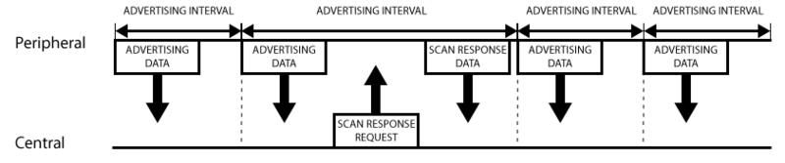
Advertising Process
While most peripherals advertise themselves so that a connection can be established and GATT services and characteristics can be used (which allows for much more data to be exchanged and in both directions), there are situations where you only want to advertise data.

Slide 32
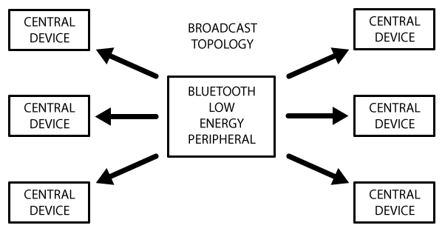
Broadcast Network Topology
The main use case here is where you want a peripheral to send data to more than one device at a time. This is only possible using the advertising packet since data sent and received in connected mode can only be seen by those two connected devices.
By including a small amount of custom data in the 31 byte advertising or scan response payloads, you can use a low cost Bluetooth Low Energy peripheral to sent data one-way to any devices in listening range, as shown in the illustration below. This is known as Broadcasting in Bluetooth Low Energy.

Slide 33
Generic Attribute Profile(GATT)
it defines the way that two Bluetooth Low Energy devices transfer data back and forth using concepts called Services and Characteristics.
It makes use of a generic data protocol called the Attribute Protocol (ATT), which is used to store Services, Characteristics and related data in a simple lookup table using 16-bit IDs for each entry in the table.

Slide 34
GATT Cont.
GATT comes into play once a dedicated connection is established between two devices, meaning that you have already gone through the advertising process governed by GAP.
The most important thing to keep in mind with GATT and connections is that connections are exclusive. What is meant by that is that a BLE peripheral can only be connected to one central device (a mobile phone, etc.) at a time! As soon as a peripheral connects to a central device, it will stop advertising itself and other devices will no longer be able to see it or connect to it until the existing connection is broken.

Slide 35
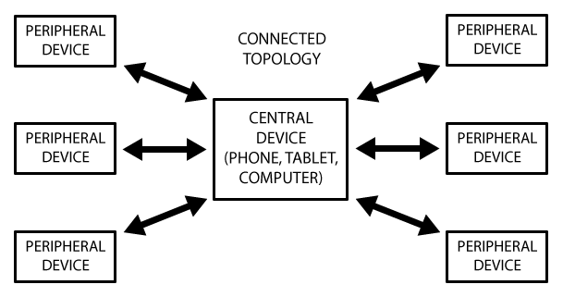
Connected Network Topology
A peripheral can only be connected to one central device (such as a mobile phone) at a time, but the central device can be connected to multiple peripherals.

Slide 36
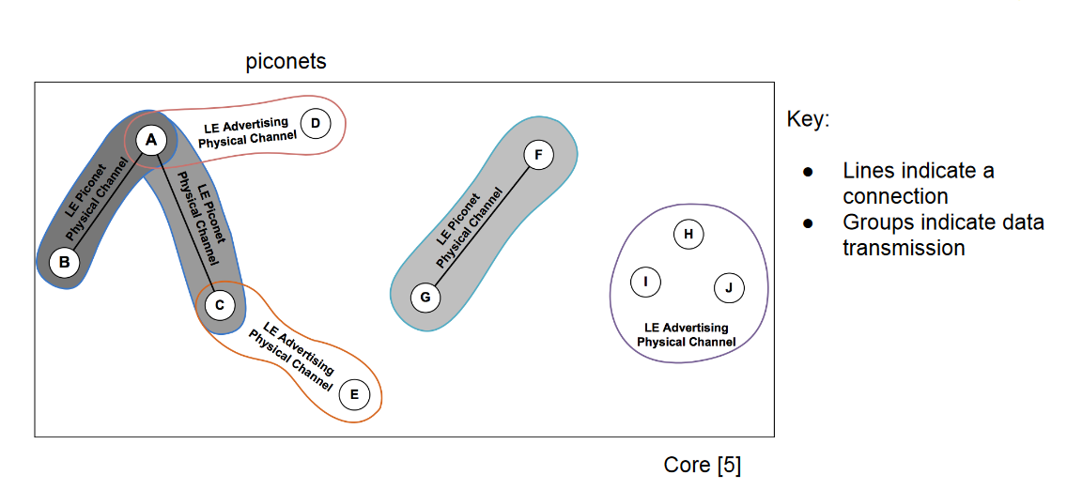
Topology 4.0

Slide 37
GATT Transactions
An important concept to understand with GATT is the server/client relationship.
The peripheral is known as the GATT Server, which holds the ATT lookup data and service and characteristic definitions, and the GATT Client (the phone/tablet), which sends requests to this server.
All transactions are started by the master device, the GATT Client, which receives response from the slave device, the GATT Server.

Slide 38
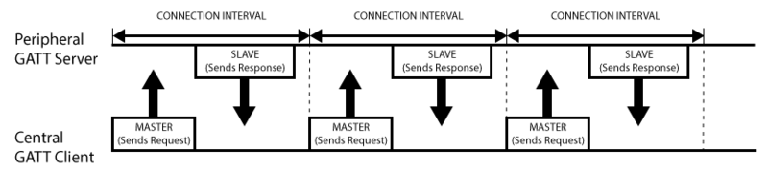
GATT Transactions Cont.

Slide 39
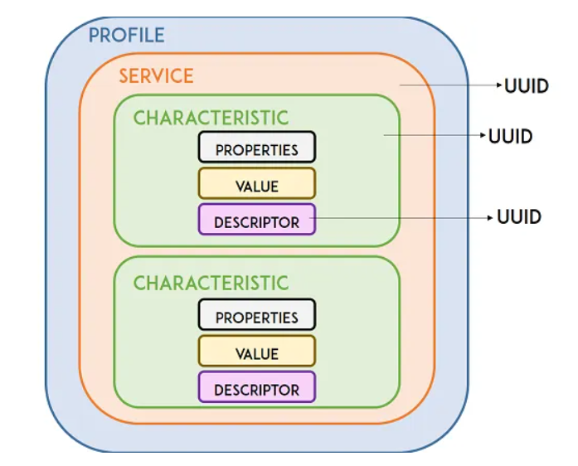
Services and Characteristics
GATT transactions in BLE are based on high-level, nested objects called Profiles, Services and Characteristics, which can be seen in the illustration below:

Slide 40
Profiles and Services
Profiles
It's simple a pre-defined collection of Services that has been compiled by either the Bluetooth SIG or by the peripheral designers. The Heart Rate Profile, for example, combines the Heart Rate Service and the Device Information Service.
Services
Services are used to break data up into logic entities, and contain specific chunks of data called characteristics. A service can have one or more characteristics, and each service distinguishes itself from other services by means of a unique numeric ID called a UUID, which can be either 16-bit or 128-bit .
Characteristics
The lowest level concept in GATT transactions is the Characteristic, which encapsulates a single data point (though it may contain an array of related data, such as X/Y/Z values from a 3-axis accelerometer, etc.).

Slide 41
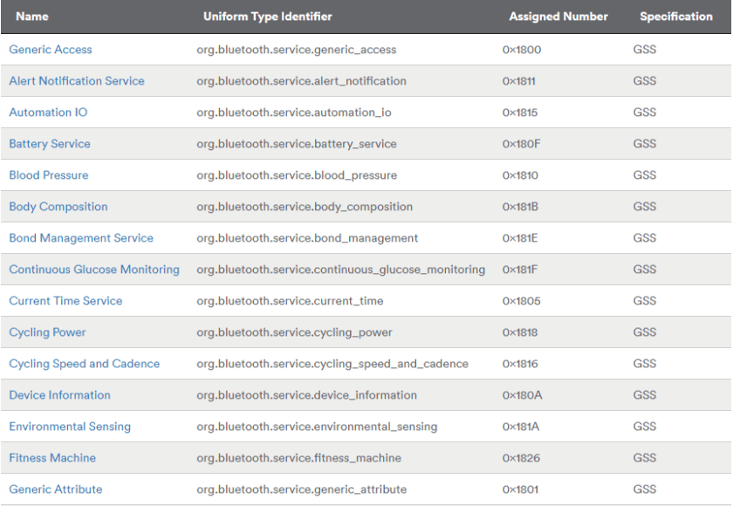
BLE Service

Slide 42
BLE Characteristic
The properties describe how the characteristic value can be interacted with. Basically, it contains the operations and procedures that can be used with the characteristic:
Broadcast
Read
Write without response
Write
Notify
Indicate
Authenticated Signed Writes
Extended Properties

Slide 43
Features of 4.1 Standard
Device supports multiple simultaneous roles (e.g. Peripheral and Central)!
Delay tolerant connections!
Devices can set up dedicated communication channel!
Low duty directed advertising!
Coexistence screening!
Bulk data transfer!

Slide 44
Bluetooth 4.1
L2CAP connection oriented channels –groundwork to enable more efficient data transfer (Bulk data transfer)and IPv6 over BLE
For example, through this new capability, sensors, which gathered data during a run, bike ride or swim, transfer that data more efficiently when the consumer returns home.
Link layer topology –slave can have multiple masters and simultaneous master and slave operation
With this new capability, a single device acts as both a Bluetooth Smart peripheral and a Bluetooth Smart Ready hub at the same time. For example, a smart watch acts as a hub gathering information from a Bluetooth Smart heart rate monitor while simultaneously acting as a peripheral to a smartphone — displaying new message notifications from the phone.
Limited discovery time –Device can be in limited discovery mode up to 180 seconds
LE ping –low latency ping
Low duty cycle directed advertising
Fast data advertising interval

Slide 45
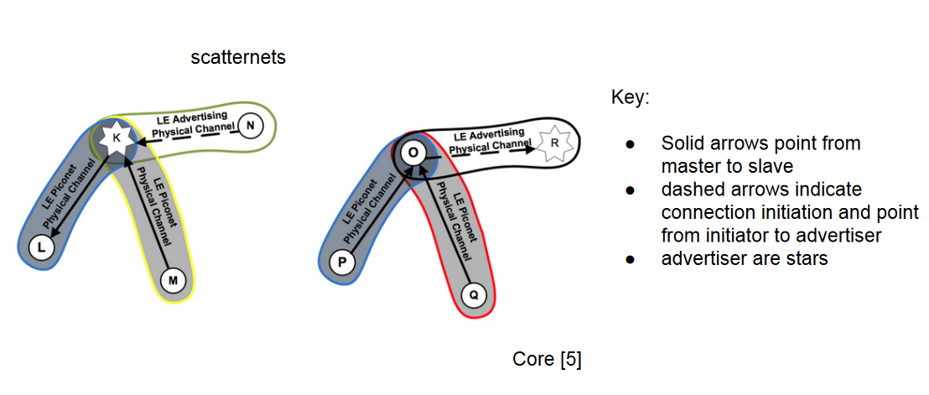
Topology 4.1

Slide 46
Bluetooth 4.2
Bluetooth 4.2 is an important update to the Bluetooth Core Specification with many new features and benefits designed specifically for Bluetooth Smart technology, and advantages when comparing Bluetooth 4.2 vs. Bluetooth 4.1 (also known as Bluetooth Low Energy or Bluetooth Smart).
Bluetooth 4.2 introduces several new features that improve speed and privacy over Bluetooth 4.1 but the main advantage is allowing chips to use Bluetooth over Internet Protocol version 6 (IPv6) for direct Internet access. With this, the possibilities expand beyond thoseof current designs and markets to include any type of Bluetooth device requiring speed and security in the IoT.

Slide 47
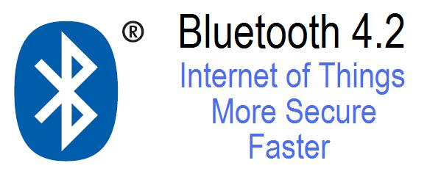
Bluetooth 4.2 for IOT
Why use BLE 4.2 instead of BLE 4.1? The Bluetooth SIG recommends implementing Bluetooth 4.2 in all new designs and requires the same qualification process as all other Bluetooth designs. Devices using Bluetooth Smart will be backward compatible with Bluetooth 4.0 or 4.1 devices that also implement the low energy features. Devices implementing the (BR/EDR) Core Configuration will be backward compatible to all adopted Bluetooth Core versions beginning with 1.1 that also implement Bluetooth BR/EDR.

Slide 48
Key Features 4.2
Key Bluetooth 4.2 Features Not Available with Bluetooth 4.1
IoT Capabilities:
• Low-power IP (IPv6/6LoWPAN)
• Bluetooth Smart Internet Gateways (GATT)
With BLE 4.2 Bluetooth Smart sensors can transmit data over the internet.
Security:
• LE Privacy 1.2
• LE Secure Connections
With new, more power efficient and highly secure features, BLE 4.2 provides additional benefits allowing only trusted owners to track device location and confidently pair devices.
Speed:
• 250% Faster
• 10x More Capacity
Compared to previous versions, BLE 4.2 enables 250% faster and more reliable over-the-air data transmission and 10x more packet capacity.
Designing with BLE 4.2 requires no mandatory features but, similar to previous versions, manufacturers are required to implement all errata applied in order to comply with the BLE 4.2 specifications.

