Slide 1

Chapter 11
User Datagram
Protocol
Objectives
Upon completion you will be able to:
Be able to explain process-to-process communication
Know the format of a UDP user datagram
Be able to calculate a UDP checksum
Understand the operation of UDP
Know when it is appropriate to use UDP
Understand the modules in a UDP package
TCP/IP Protocol Suite

Slide 2
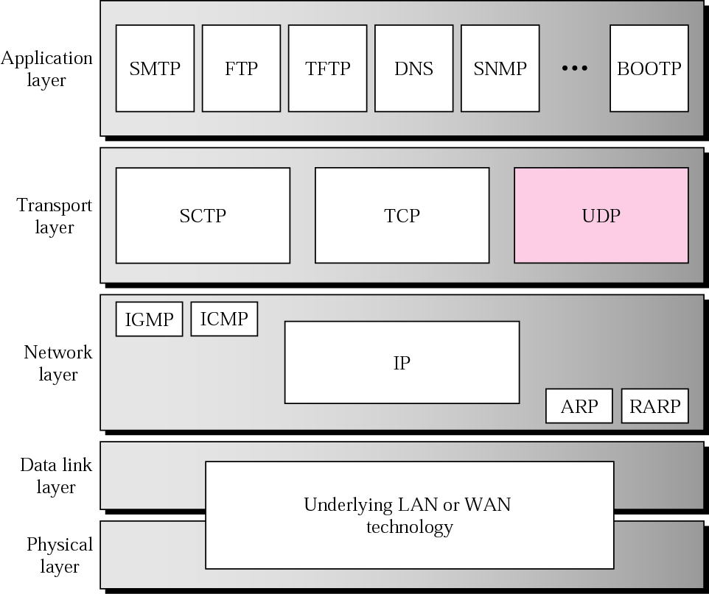
Figure 11.1 Position of UDP in the TCP/IP protocol suite
TCP/IP Protocol Suite

Slide 3
11.1 PROCESS-TO-PROCESS
COMMUNICATION
Before we examine UDP, we must first understand host-to-host communication and process-to-process communication and the difference between them.
The topics discussed in this section include:
Port Numbers
Socket Addresses
TCP/IP Protocol Suite

Slide 4
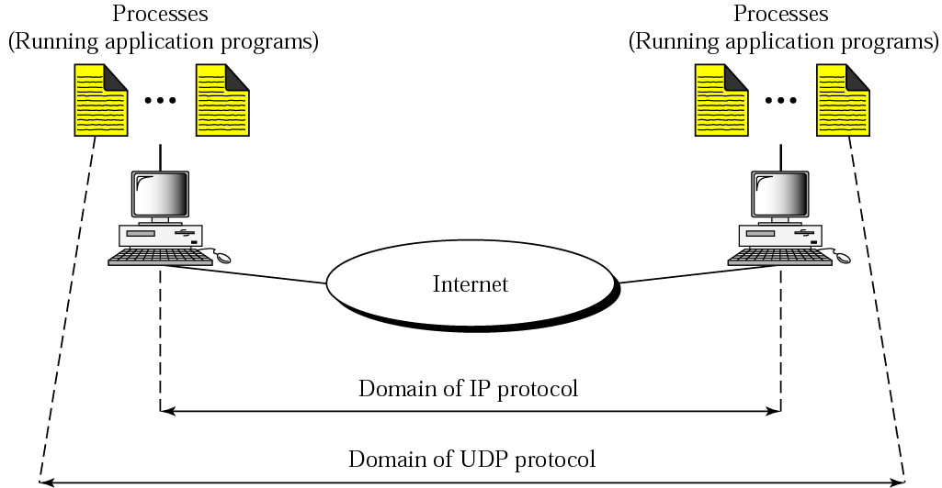
Figure 11.2 UDP versus IP
TCP/IP Protocol Suite

Slide 5
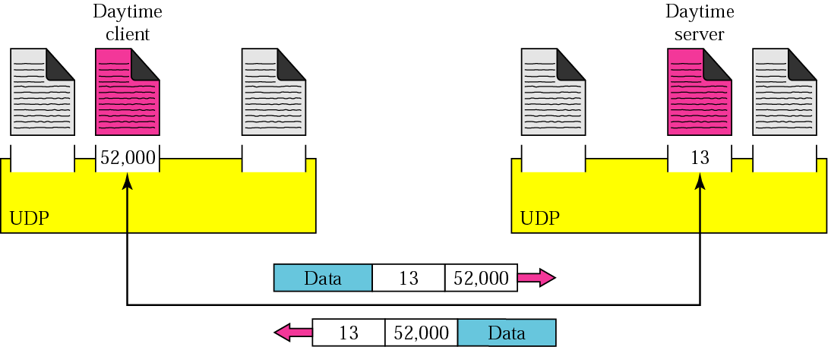
Figure 11.3 Port numbers
TCP/IP Protocol Suite

Slide 6
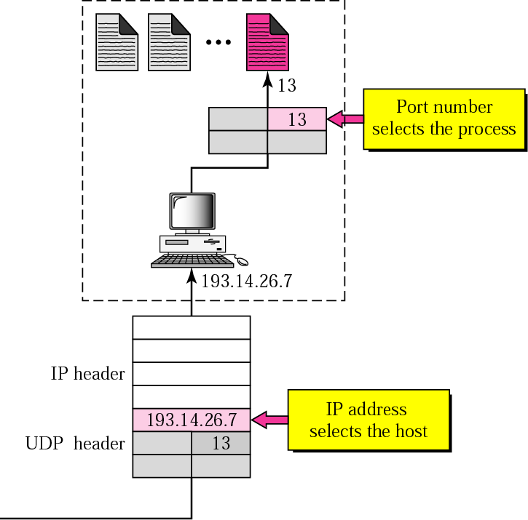
Figure 11.4 IP addresses versus port numbers
TCP/IP Protocol Suite

Slide 7
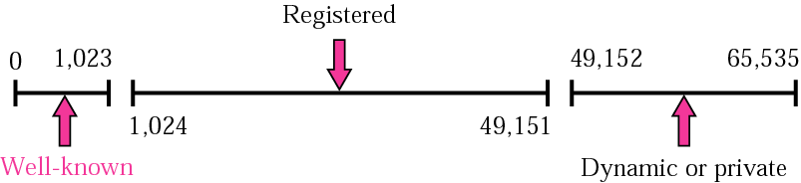
Figure 11.5 Port No ranges
TCP/IP Protocol Suite

Slide 8

Note:
The well-known port numbers are less than 1024.
TCP/IP Protocol Suite

Slide 9
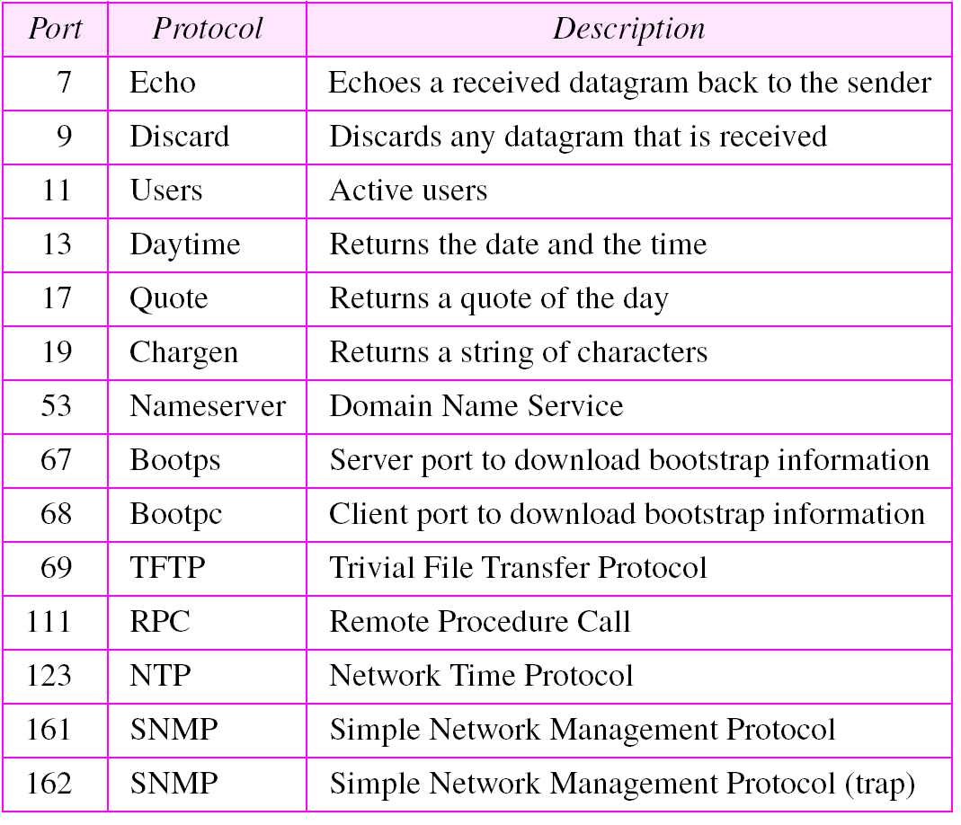
Table 11.1 Well-known ports used with UDP
TCP/IP Protocol Suite

Slide 10
Example 1
In UNIX, the well-known ports are stored in a file called /etc/services. Each line in this file gives the name of the server and the well-known port number. We can use the grep utility to extract the line corresponding to the desired application. The following shows the port for TFTP. Note TFTP can use port 69 on either UDP or TCP.
$ grep tftp /etc/services
tftp 69/tcp
tftp 69/udp
See Next Slide
TCP/IP Protocol Suite

Slide 11
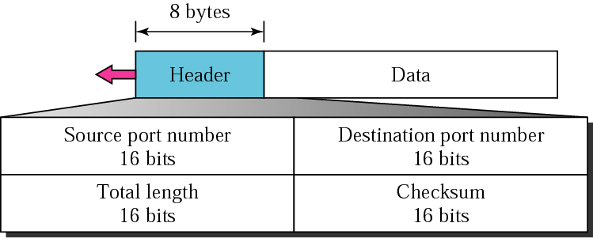
Figure 11.7 User datagram format
TCP/IP Protocol Suite

Slide 12
11.4 UDP OPERATION
UDP uses concepts common to the transport layer. These concepts will be discussed here briefly, and then expanded in the next chapter on the TCP protocol.
The topics discussed in this section include:
Connectionless Services
Flow and Error Control
Encapsulation and Decapsulation
Queuing
Multiplexing and Demultiplexing
TCP/IP Protocol Suite

Slide 13
UDP Operations
Connectionless services
Each datagram sent by UDP is an
independent datagram
UDP cannot chop a stream of data into
different related user datagrams
Each request must be small enough to
fit into one user datagram
Only processes sending short message
should use UDP
TCP/IP Protocol Suite

Slide 14
Flow Control
No flow control
No error control except for checksum
The sender does not know whether the message has been lost
When the receiver detects an error through checksum, it discards it silently
The process using UDP should provide flow and error control by itself
TCP/IP Protocol Suite

Slide 15
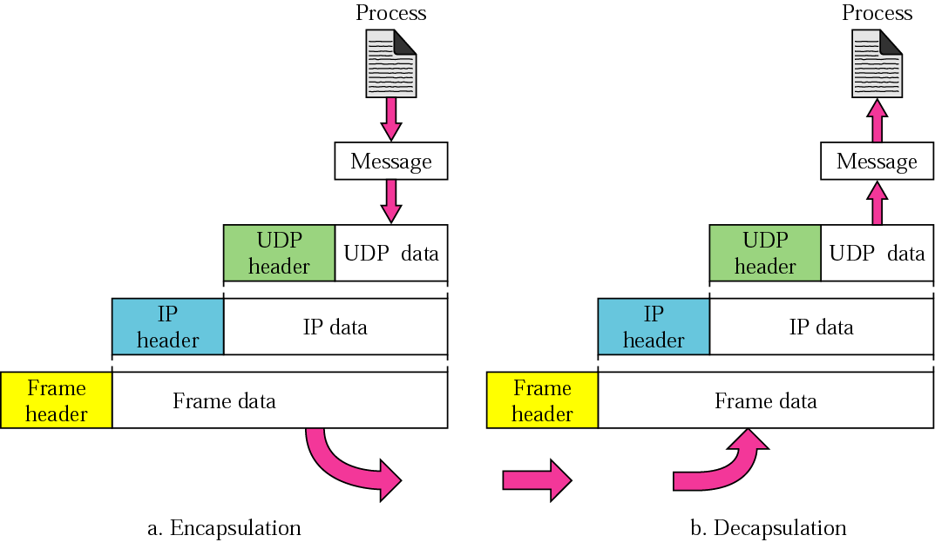
Figure 11.10 Encapsulation and decapsulation
TCP/IP Protocol Suite

Slide 16
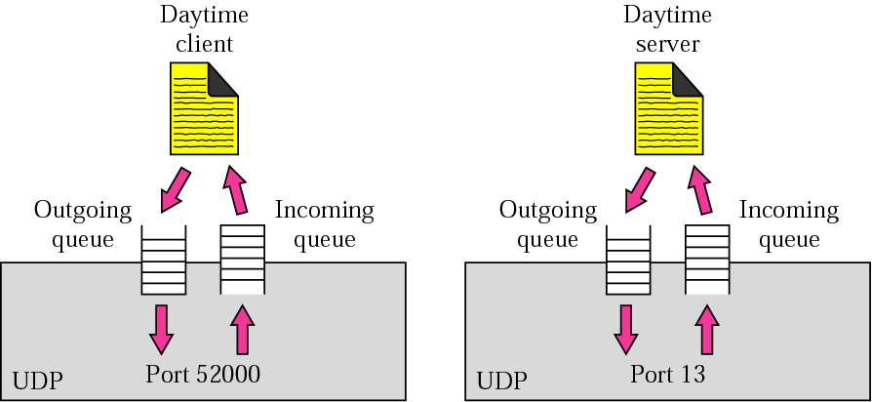
Figure 11.11 Queues in UDP
TCP/IP Protocol Suite

Slide 17
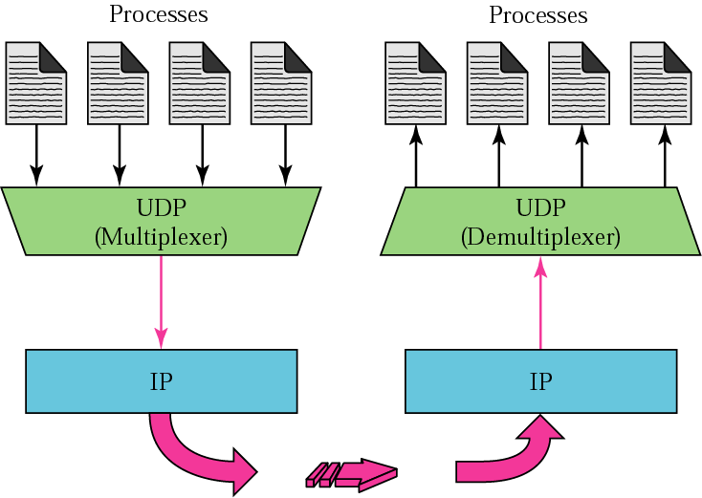
Figure 11.12 Multiplexing and demultiplexing
TCP/IP Protocol Suite

Slide 18
USE OF UDP
We discuss some uses of the UDP protocol in this section.
UDP: Anything where you don't care too much if you get all data always
Tunneling/VPN (lost packets are ok - the tunneled protocol takes care of it)
Media streaming (lost frames are ok)
Games that don't care if you get every update
Local broadcast mechanisms (same application running on different machines "discovering" each other)
TCP/IP Protocol Suite

