Slide 1
Project 2: Snippets
Microblogging app

Slide 2
Description
Snippets is a micro-blogging app that allows users share their thoughts in bite-sized entries.
App development phases
Phase 1:
Users to create accounts
Write, edit and delete blog entries
View own blog and other users’ blogs
Leave comments on blog entries.
Phase 2:
On each blog, entries can be sorted and viewed by date
Users allowed to tag their entries with category tags

Slide 3
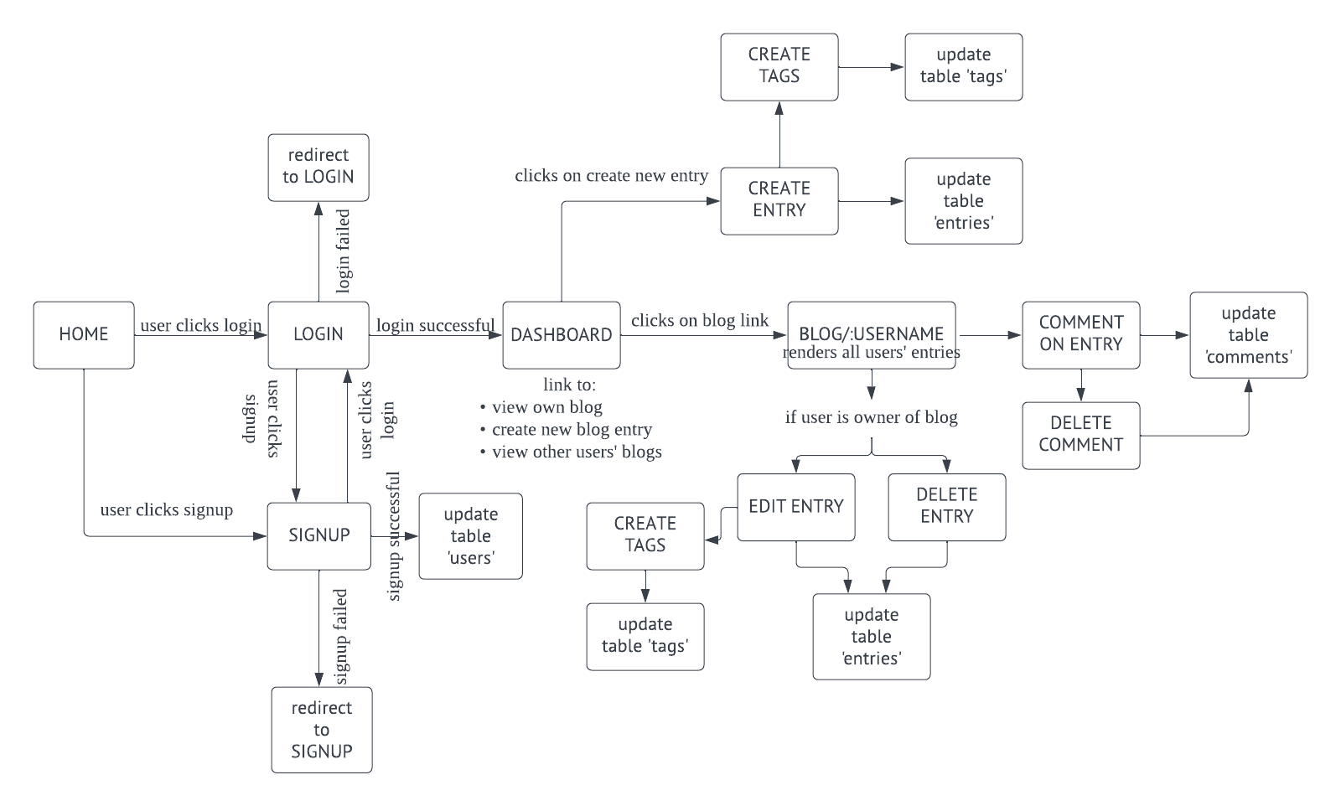
User flow

Slide 4
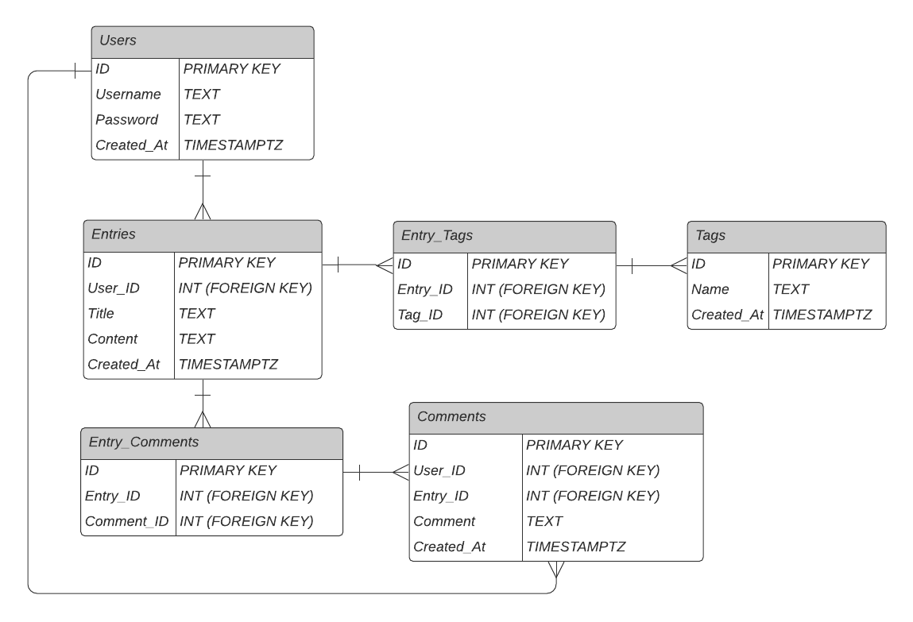
Database ER Diagram

Slide 5
CRUD Functionality
GET |  | POST |  | PUT |  | DELETE
/ | Main page. Welcome to snippets, a microblogging app where you can share your thoughts in bite-sized posts and comments. Sign up or Login to continue! | /entry | Create new entry | /entry/:id/edit | Edit entry | /entry/:id/delete | Delete entry Maybe add prompt “Are you sure you want to delete the entire entry?”
/dashboard |  | /entry/:id/comment | Create new comment | /entry/:id/comment/edit | Edit comment | /entry/:id/comment/delete | Delete comment
/signup | Signup for an account
/signupsuccessful | Sign up successful, please login to continue! Link to /login
/login | Have a small link below to link to /signup for “Don’t have an account?” If login successful, redirect to /dashboard If login unsuccessful, redirect to /loginerror
/loginerror | Login unsuccessful. (Error)
/blog/:username | Render out page with all entries from user. Use user id when query-ing but use username for url
/entry/:id | Render out entry with entry id
/entry | Page to create new entry. Redirect to /entrycreated
/entrycreated | Entry created! Click here to view your entry, click here to view your blog
Notes:
If logged in, will have Navbar appear on top with:
Dashboard | My Blog | Create New Entry | Logout

Slide 6



Wireframes
/
/login
Login
Sign Up
Login
Sign Up
Login to your account
Welcome to
Username:
This is a micro-blogging app that allows you to share your thoughts in bite-sized entries and comments.
Password:
Login
Let’s get started!
Don’t have an account?
Click Here to Sign Up
Login
Sign Up

Slide 7
Wireframes
/signup
/dashboard
Login
Sign Up
Dashboard
My Blog
New Entry
Log Out
Welcome, [username]!
Sign up for an account
You have written [number] entries so far.
Username:
Click here to view your blog
Password:
Click here to write a new entry
Sign Up
Below are links to blogs of other snippets users. Take a read if you’d like! ☺
Username
[username] | <Button to View Blog>

Slide 8
Wireframes
/entry
/entry/:id
Dashboard
My Blog
New Entry
Log Out
Dashboard
My Blog
New Entry
Log Out
Post a new entry:
[Entry title]
Title:
Content:
[Entry content]
Posted by: [username]
Date posted: [date]
Tags: #[tag], #[tag]
Tags:
Please separate each tag by a single comma (,)
Post Entry
Add comment
Submit comment

Slide 9



Wireframes
(when viewing own blog)
(when viewing other user)
/blog/:username
/blog/:username
Dashboard
My Blog
New Entry
Log Out
Dashboard
My Blog
New Entry
Log Out
[username]’s Blog
[username]’s Blog
[Entry title]
[Entry title]
[Entry content]
[Entry content]
Posted by: [username]
Posted by: [username]
Date posted: [date]
Date posted: [date]
Tags: #[tag], #[tag]
View
Edit
Delete
Tags: #[tag], #[tag]
[Entry title]
[Entry title]
[Entry content]
[Entry content]
Posted by: [username]
Posted by: [username]

Slide 10


Logo

