Slide 1
MYSQL DATABASE DESIGN • QUERY IMPLEMENTATION
EMPLOYEE LEAVE
MANAGEMENT SYSTEM
A Relational database solution for managing employee leave requests, approvals and reporting
CAPSTONE PROJECT PRESENTATION
Presented by: Tanuja Sundarapalli

Slide 2
EMPLOYEE LEAVE MANAGEMENT SYSTEM / MYSQL CAPSTONE
Problem Statement
Why a centralized leave database is needed
The Challenge
Project Objective
Organizations need a centralized system to manage employee leave requests, approvals and reporting. Manual or disconnected records can make leave information difficult to organize and retrieve.
Design and implement an Employee Leave Management System using MySQL to store leave information and support operational and analytical queries.
02

Slide 3
EMPLOYEE LEAVE MANAGEMENT SYSTEM / MYSQL CAPSTONE
Database Design
Five relational tables and their key fields
Departments
Employees
Managers
• department_id • PK
• department_name
• employee_id • PK
• department_id • FK
• employee_name, phone, email
• manager_id • PK
• manager_name
Leave_Types
Leave_Requests
• leave_type_id • PK
• leave_type_name
• leave_id • PK
• employee_id, manager_id, leave_type_id • FK
• start_date, end_date, total_days
• status, reason
PK = Primary Key • FK = Foreign Key
03

Slide 4
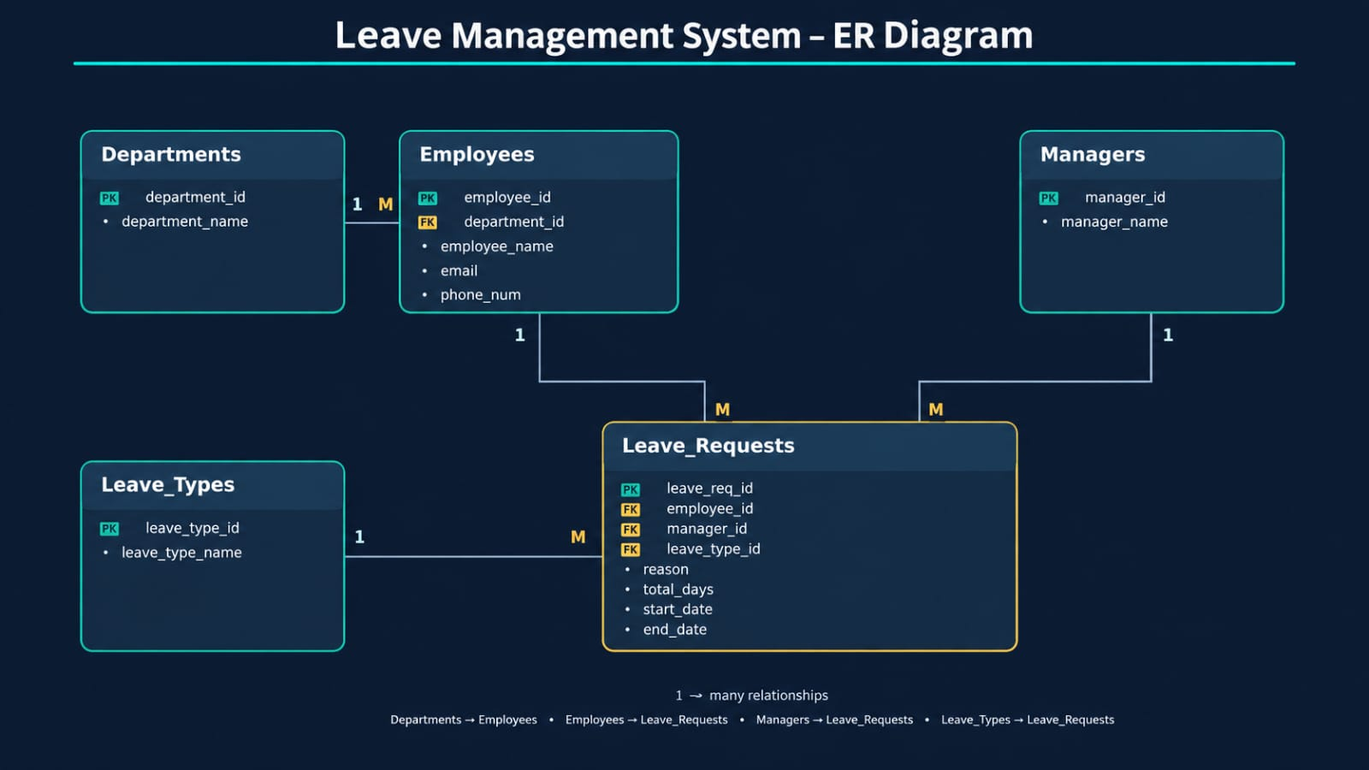
04

Slide 5
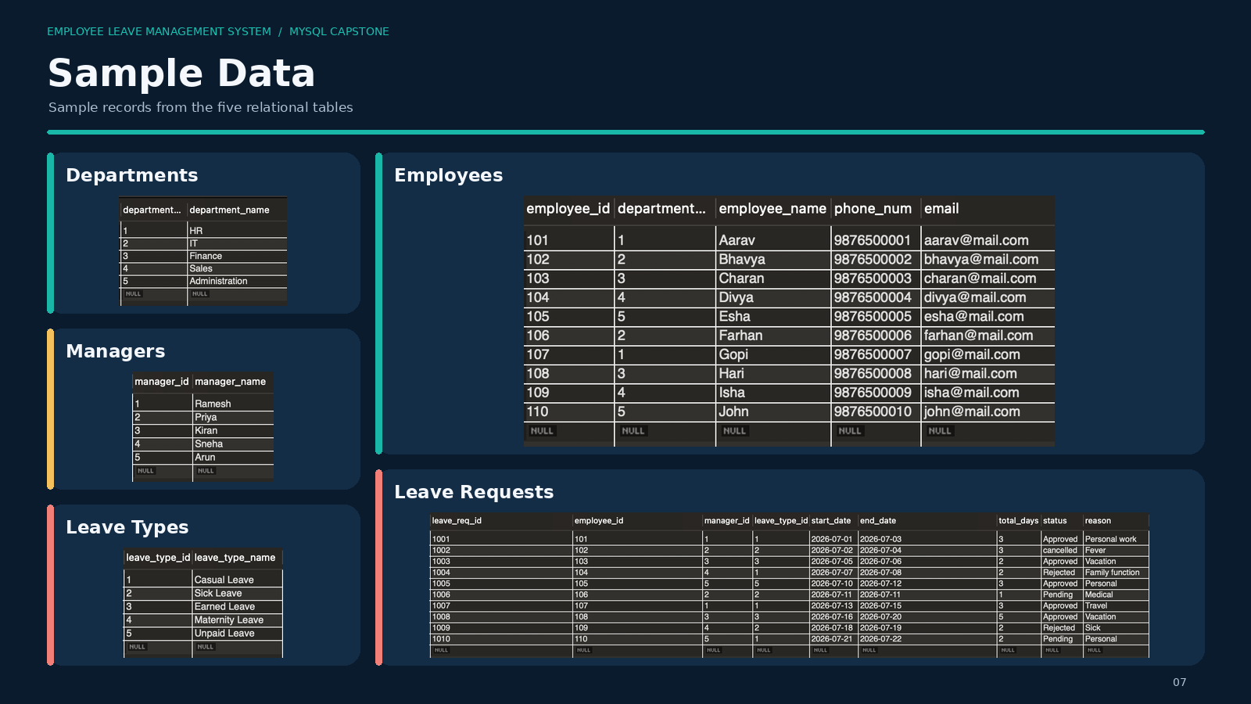
05

Slide 6
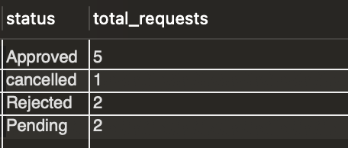
EMPLOYEE LEAVE MANAGEMENT SYSTEM / MYSQL CAPSTONE
Aggregate Functions
Calculations and summaries from leave records
Aggregate functions
• COUNT(), SUM(), AVG()
• MAX(), MIN()
＋
Examples from the project questions: count requests by status, average leave days by department, and identify maximum leave days.
06

Slide 7
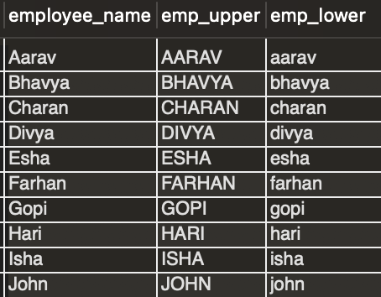
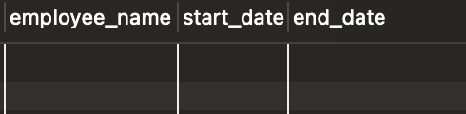
EMPLOYEE LEAVE MANAGEMENT SYSTEM / MYSQL CAPSTONE
String & Date Functions
Manipulating employee and leave text data
String Function groups
• Case: UPPER(), LOWER()
• Length: LENGTH(), CHAR_LENGTH()
• Extract: SUBSTRING(), LEFT(), RIGHT()
• Modify: REPLACE(), REVERSE(), INSERT()
• Join: CONCAT()
• Trim & search: TRIM(), LOCATE()
Date function groups
• Current date/time: CURDATE(), NOW(), CURTIME()
• Extract: YEAR(), MONTH(), DAY()
＋
07

Slide 8
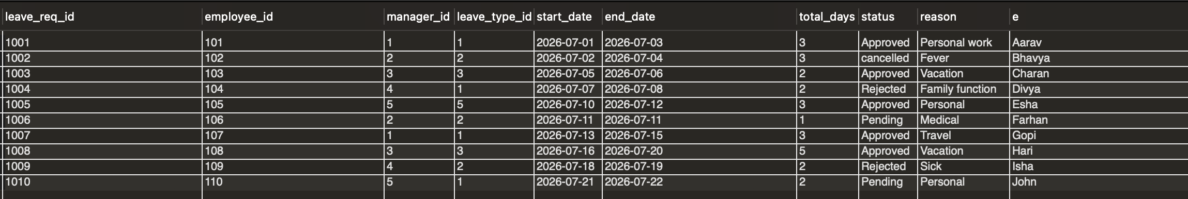
SQL Joins
Combining related employee, manager and leave information
Join operations
• INNER JOIN – matching related rows
• LEFT JOIN – all rows from left table
• RIGHT JOIN – all rows from right table
• SELF JOIN – a table joined to itself
ADD JOIN QUERY + RESULT SCREENSHOT
＋
Example: display leave requests with employee names, leave type, dates and status.
08

Slide 9
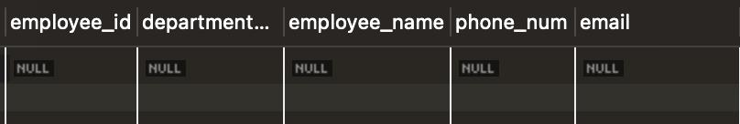
EMPLOYEE LEAVE MANAGEMENT SYSTEM / MYSQL CAPSTONE
SQL Subqueries
Using a query inside another query to retrieve related leave information
What is a subquery?
A subquery is an SQL query written inside another query. The inner query returns data used by the outer query.
Types of subqueries
• Single-row – returns one row
• Multiple-row – returns multiple rows
• Correlated – depends on the outer query
• Common operators: IN, ANY, ALL, EXISTS
Subqueries help filter records using the results of another query.
09

Slide 10
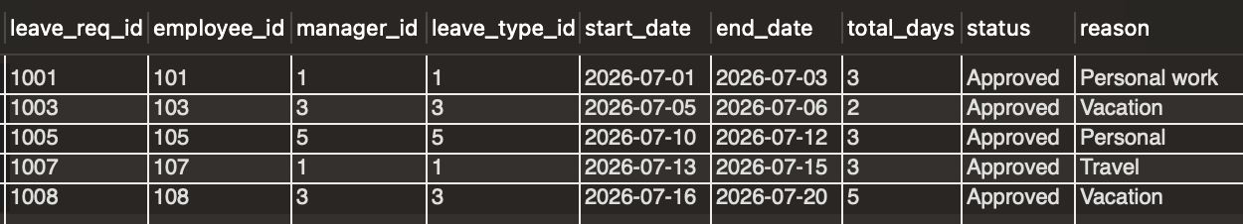
EMPLOYEE LEAVE MANAGEMENT SYSTEM / MYSQL CAPSTONE
Views
Reusable virtual tables for common leave reports
What is a view?
A VIEW is a virtual table created using an SQL query. It displays data from one or more existing tables without storing the data separately.
Views in this project
• Approved leave requests
• Pending leave requests
10

Slide 11

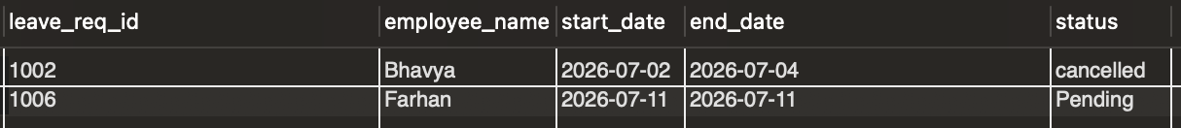
EMPLOYEE LEAVE MANAGEMENT SYSTEM / MYSQL CAPSTONE
Stored Procedures
Reusable SQL programs for leave-related tasks
Procedure concepts
• Stored SQL statements executed when required
• Without parameters
• IN parameter
• OUT parameter
• INOUT parameter
• CREATE PROCEDURE • CALL
Project procedures: show leave requests handled by a manager; calculate approved leave days for an employee.
11

Slide 12
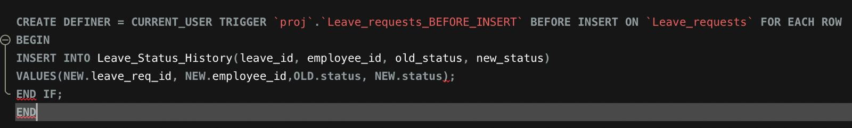
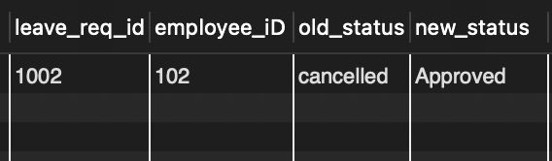
EMPLOYEE LEAVE MANAGEMENT SYSTEM / MYSQL CAPSTONE
Triggers
Automating log and status-history records
Trigger events
• BEFORE INSERT / AFTER INSERT
• BEFORE UPDATE / AFTER UPDATE
• BEFORE DELETE / AFTER DELETE
• Automatically execute when a table event occurs
＋
ADD TRIGGER + RESULT SCREENSHOT
Keep SQL query and result grid visible
Project trigger tasks: log newly inserted leave requests and record old/new status whenever a request status changes.
12

Slide 13
EMPLOYEE LEAVE MANAGEMENT SYSTEM / MYSQL CAPSTONE
Conclusion
A structured MySQL database for employee leave administration
What the project covers
Project outcome
• Five connected relational tables
• Primary and foreign key relationships
• Sample data for departments, employees, managers, leave types and requests
• CRUD, SQL functions, joins and subqueries
• Views, transactions, procedures and triggers
The project brief demonstrates how MySQL can organize leave information,
And support approval tracking and generate operational and analytical reports from a relational database.
THANK YOU
13

