Slide 1
CineBot Professor: Arya Rahgozar
prepared by: Andrew Adel Hussien Amin Phoebe Thabit Sandy Adel

Slide 2
Introduction
The CineBot Chatbot is an innovative and interactive solution designed to assist movie enthusiasts in effortlessly discovering their ideal film selections.
With CineBot by your side, you can easily inquire about the latest and upcoming movies available in the cinema.

Slide 3
Step 1 :use case
We aim to build an advanced and user-centric chatbot, our chatbot recommends a movie, that helps the user to know the available movies and choose the suitable one for him , also help the user to determine

Slide 4
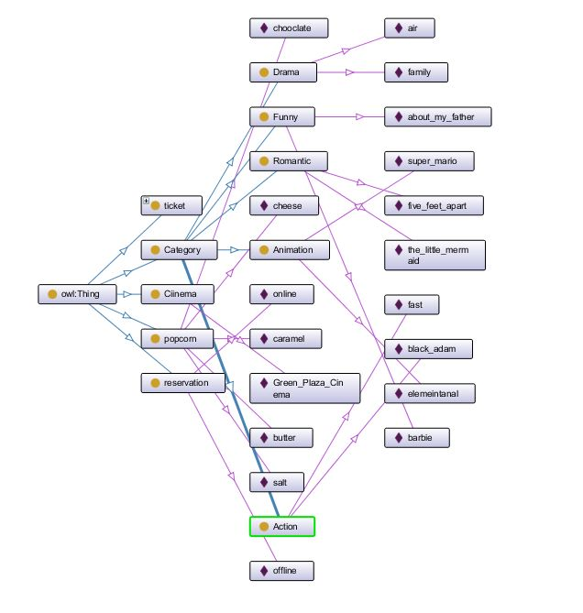
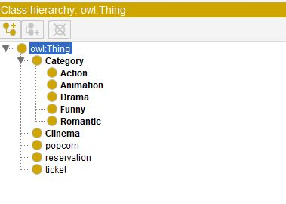
Step 2 : create the ontology using protégé:

Slide 5
Step 3: Prepare the entities and intents :
Entites :
Tickets
Popcorn
Reservation
movie_categories
party_time
Intent :
Welcome
Movies
End

Slide 6
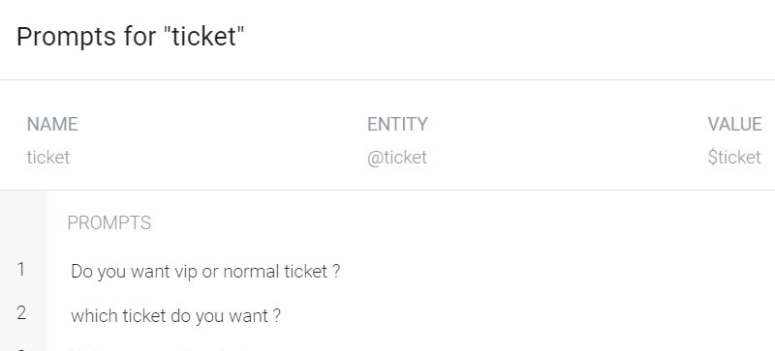
Step 4:prepare questions

Slide 7
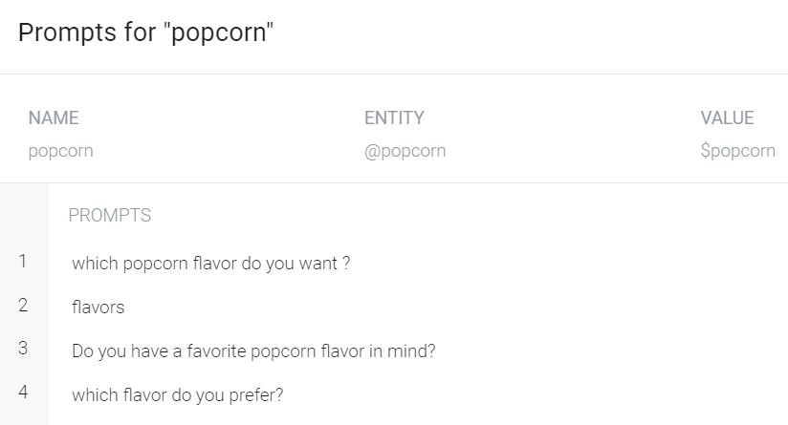

Slide 8
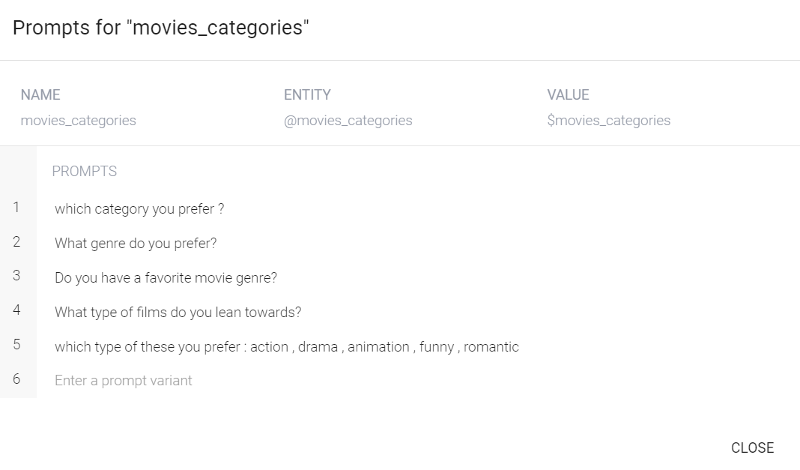

Slide 9
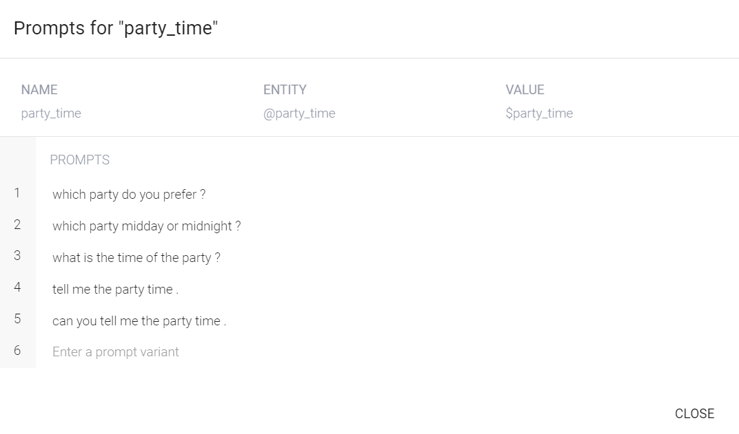

Slide 10
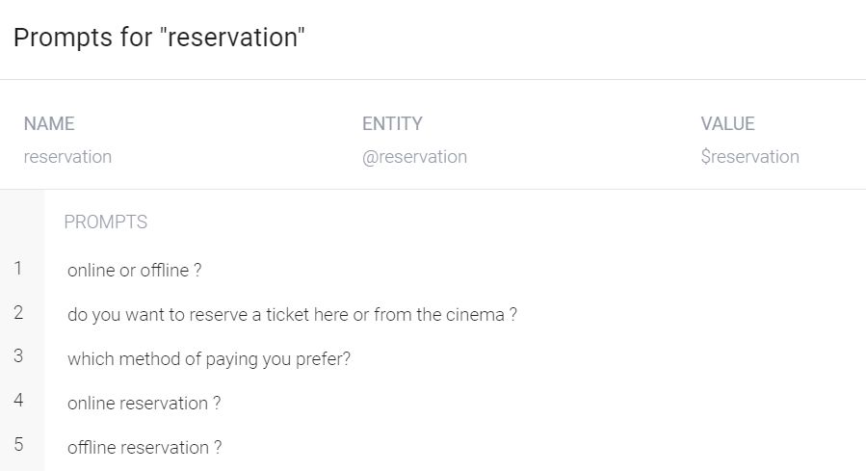

Slide 11
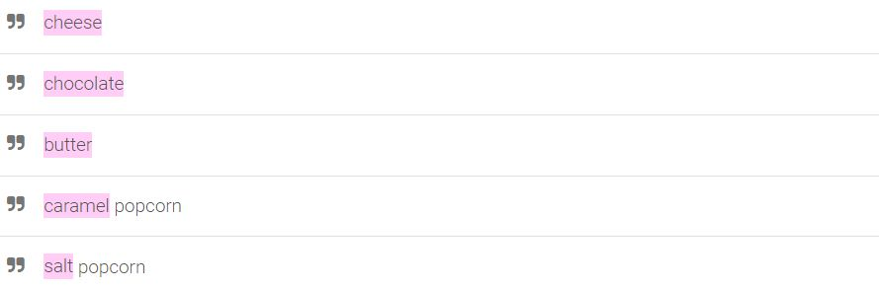
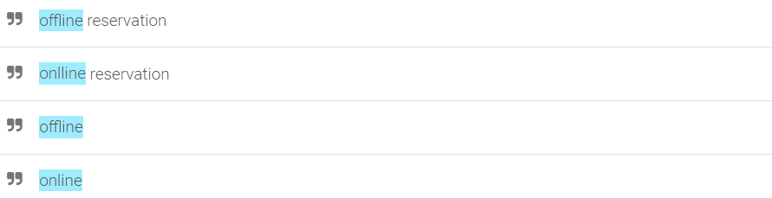
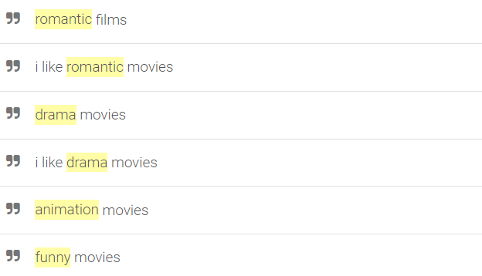
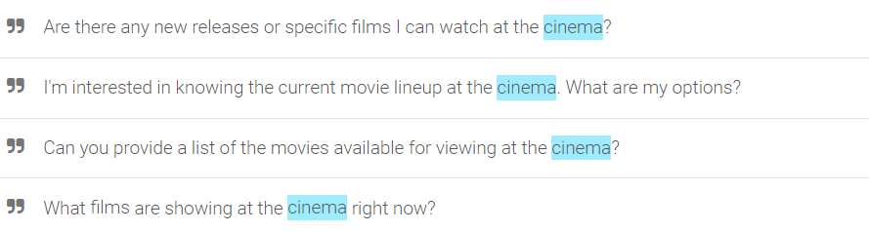
Step 5: Training Questions-Answers using Dialog Flow:

Slide 12
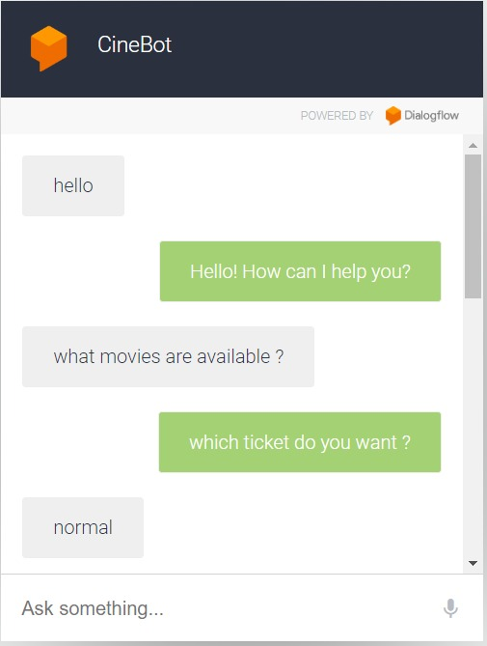
Step 6: veirfy and evaluate

Slide 13
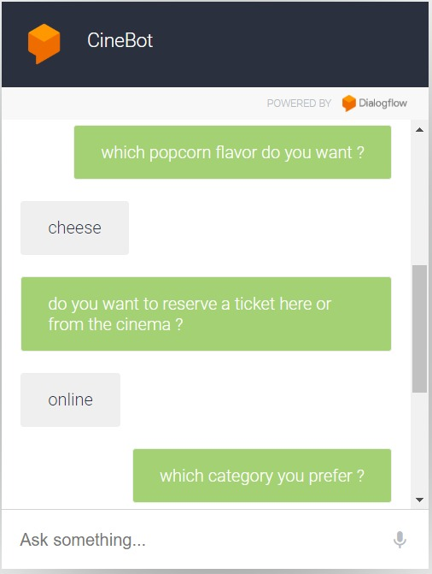

Slide 14
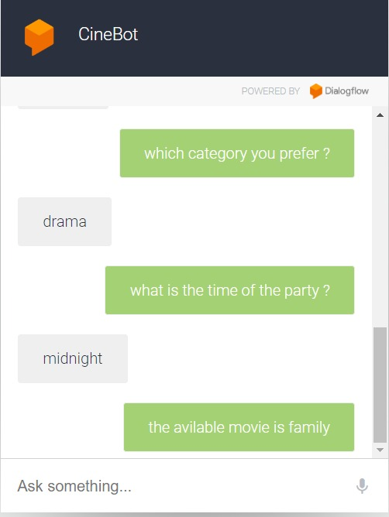

Slide 15
Thank you

