Slide 1

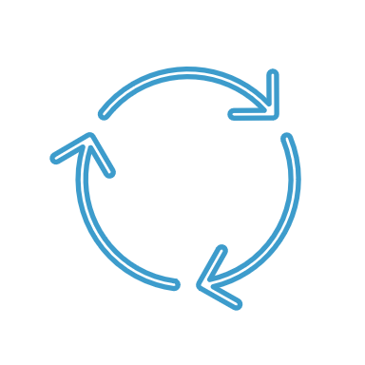
Recommendation System
Movie Recommender Chatbot

Slide 2

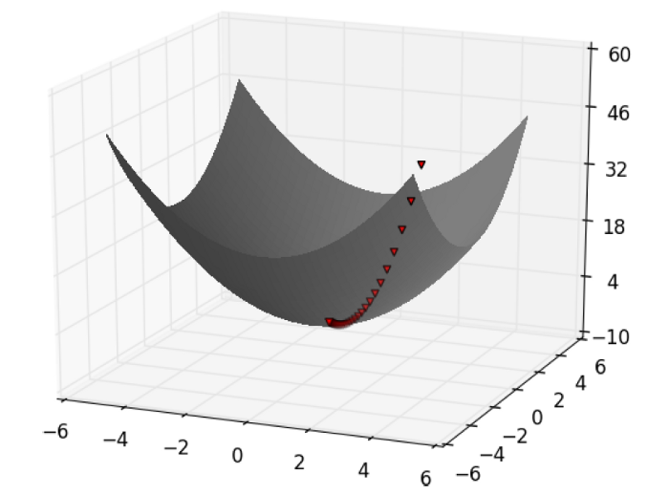
Problem Formulation
The movie chatbot recommendation problem aims to build an interactive chatbot that can engage in a conversation with users and recommend movies based on their preferences. The chatbot should be able to understand the user's movie preferences, ask relevant questions to gather necessary information, and provide a list of movie recommendations tailored to the user's tastes.

Slide 3
DataSet Description
We have two MovieLens datasets.
The Full Dataset: Consists of 26,000,000 ratings and 750,000 tag applications applied to 45,000 movies by 270,000 users. Includes tag genome data with 12 million relevance scores across 1,100 tags.
The Small Dataset: Comprises of 100,000 ratings and 1,300 tag applications applied to 9,000 movies by 700 users.

Slide 4
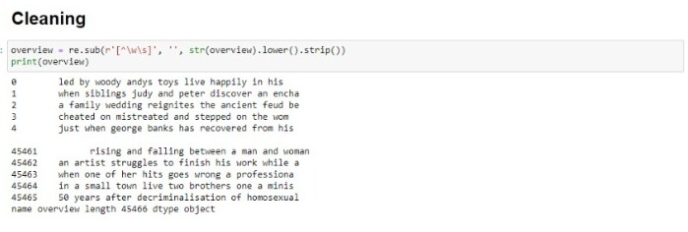
Data Preparation

Slide 5
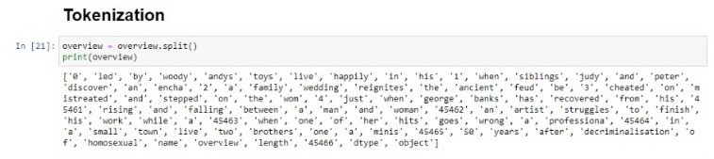
Data Preparation

Slide 6
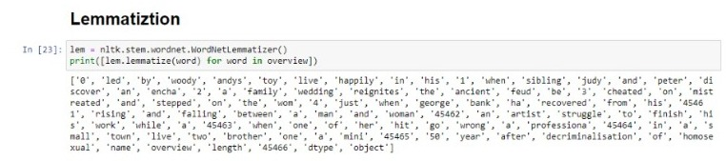
Data Preparation

Slide 7
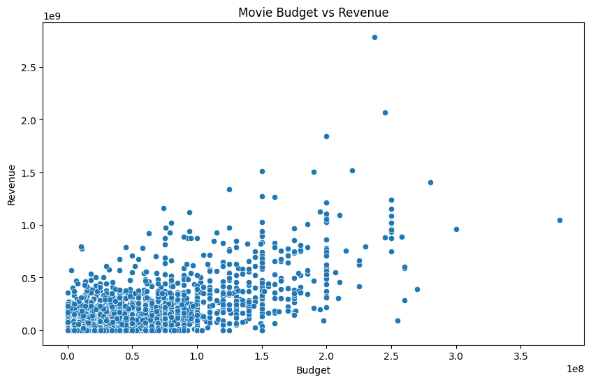
Data Visualization

Slide 8
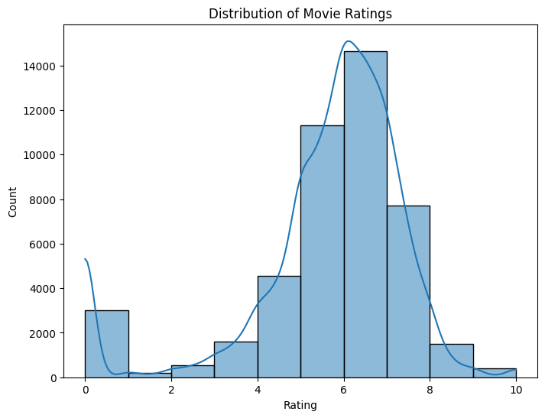
Data Visualization

Slide 9
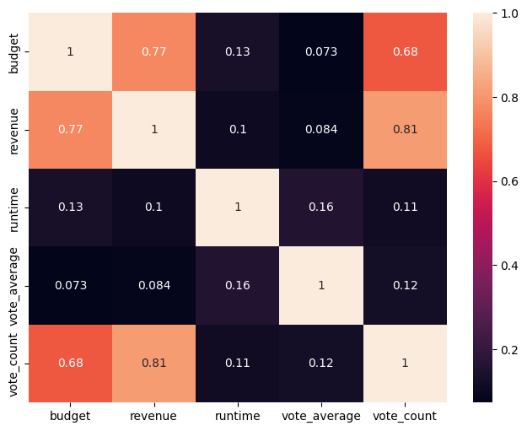
Data Visualization

Slide 10
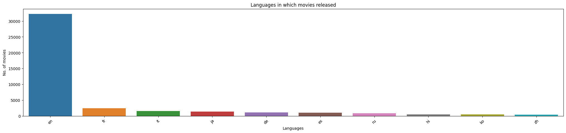
Data Visualization

Slide 11
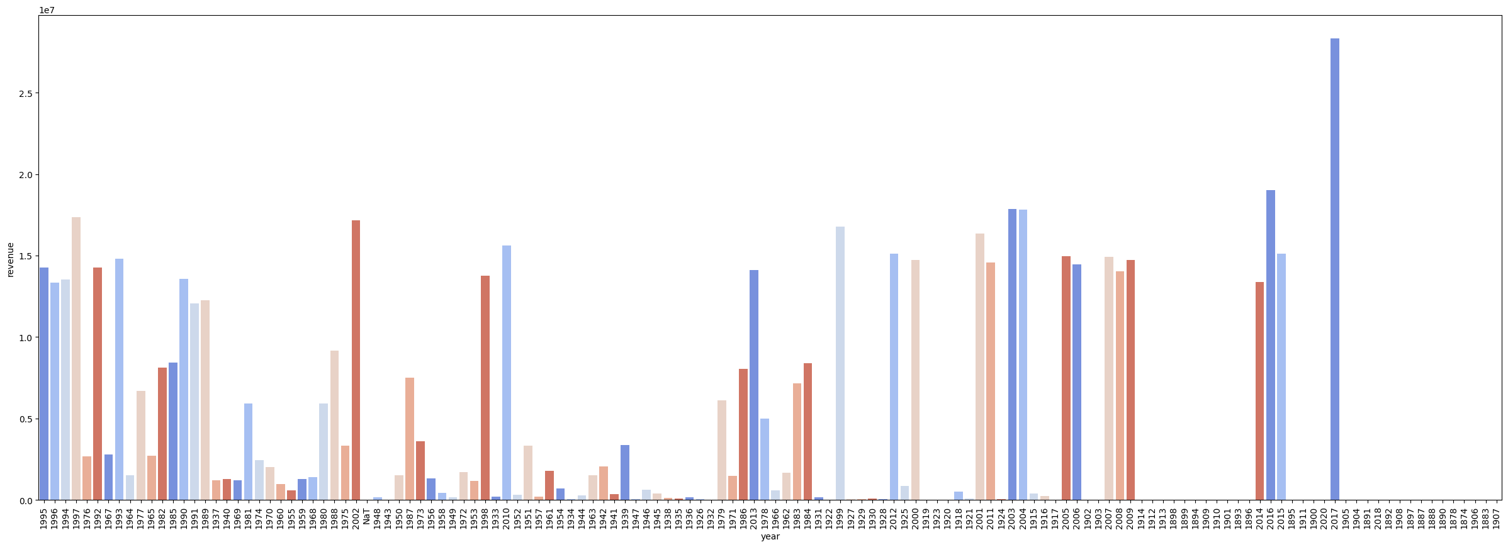
Data Visualization

Slide 12
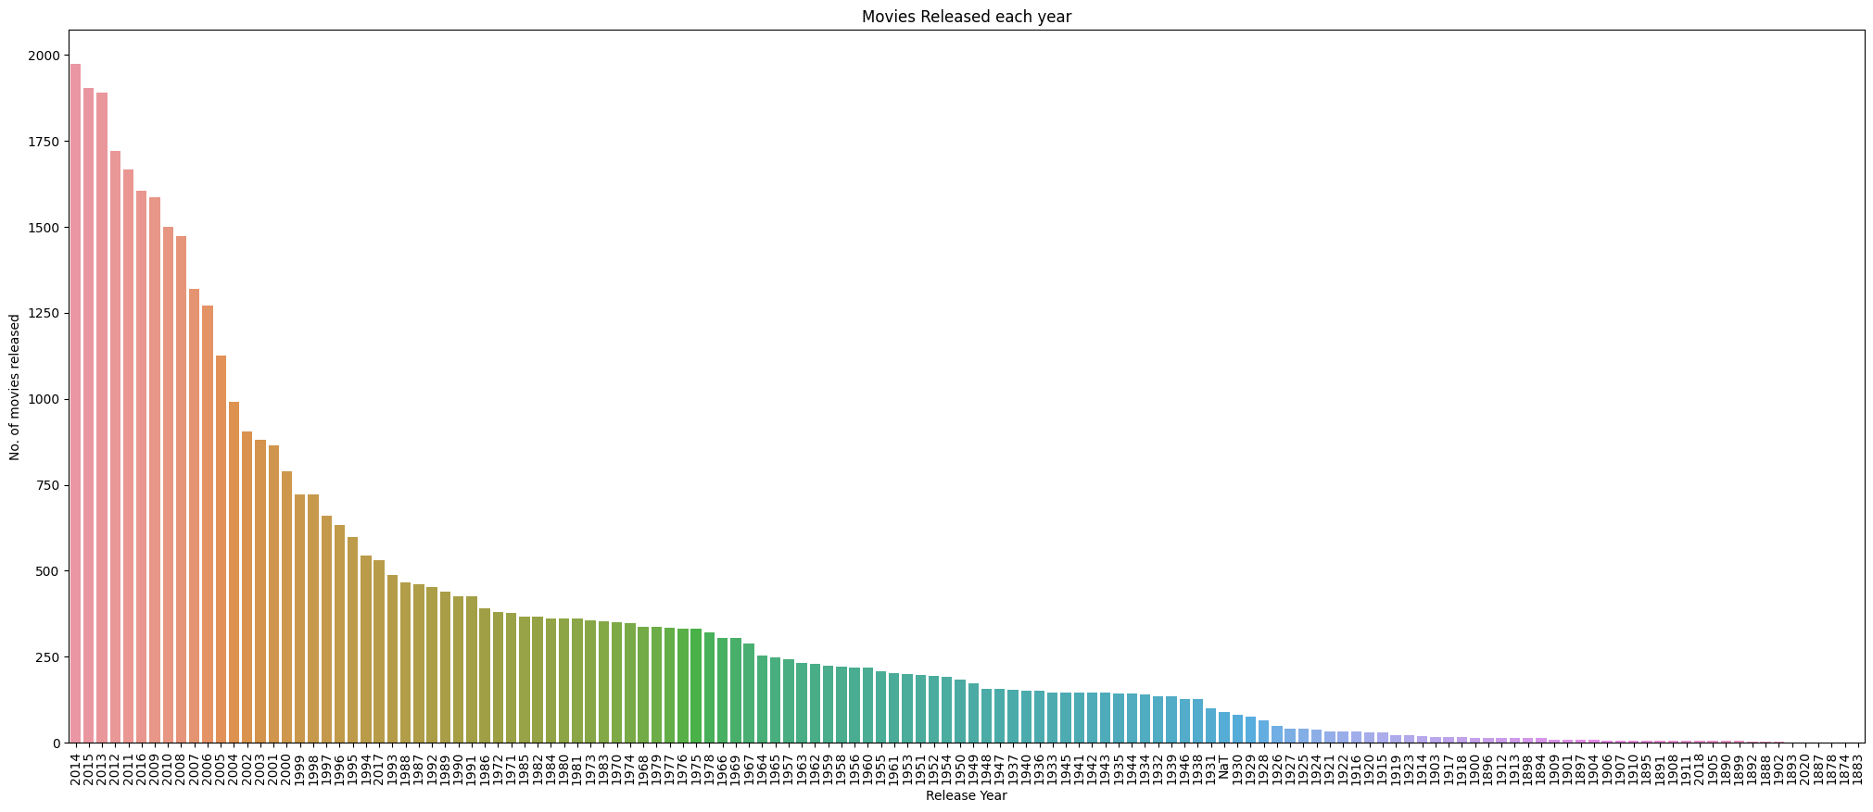
Data Visualization

Slide 13
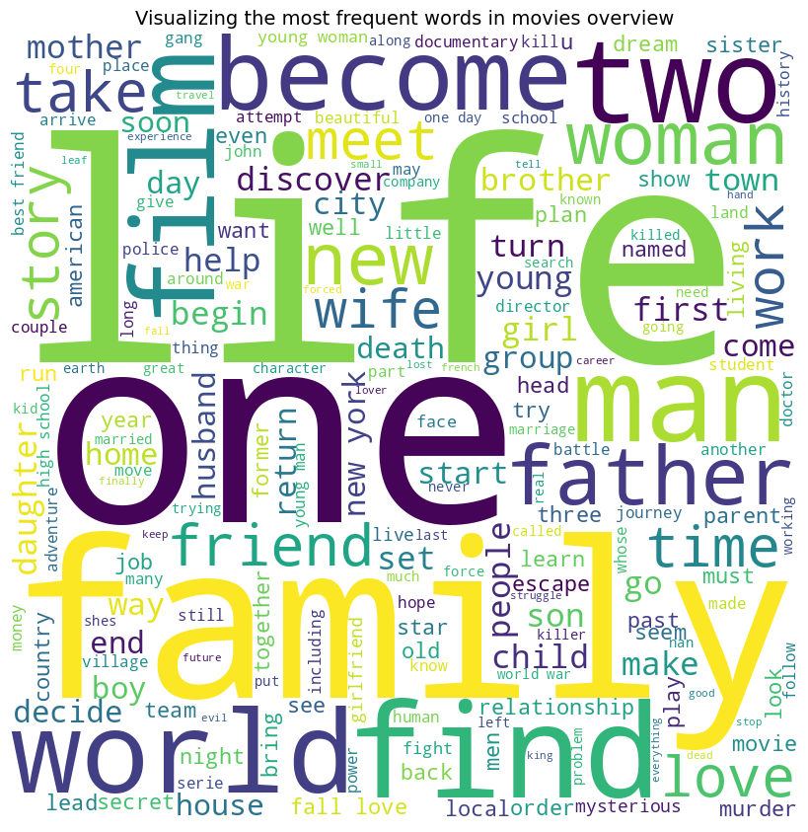
Data Visualization

Slide 14
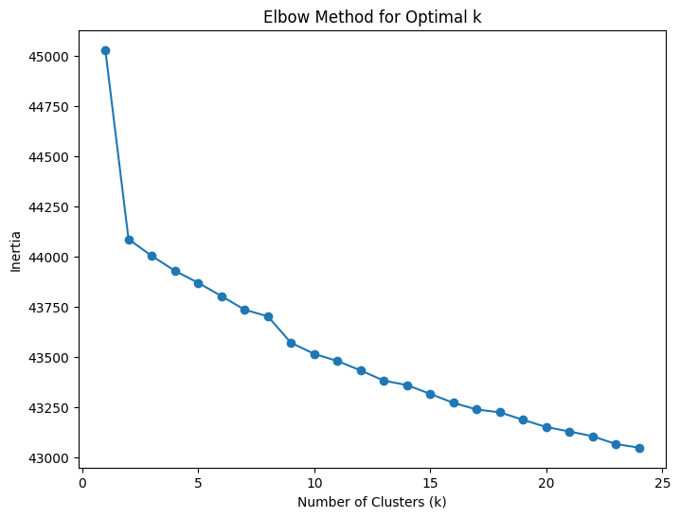
Error Analysis
& Evaluation
Error Analysis For Kmeans Clustering

Slide 15
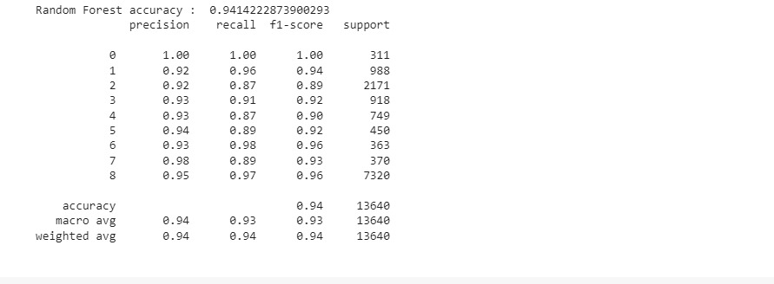
Error Analysis
& Evaluation
Classification (Random Forest)

Slide 16
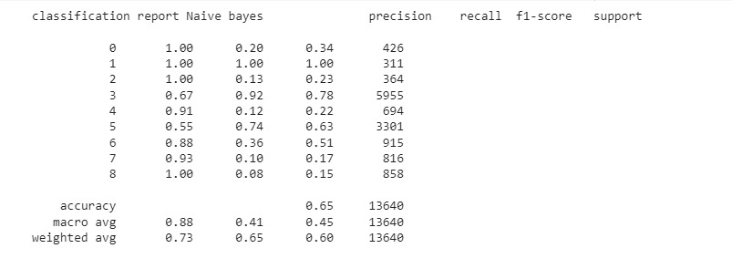
Error Analysis
& Evaluation
Classification (Naïve Bayes)

Slide 17
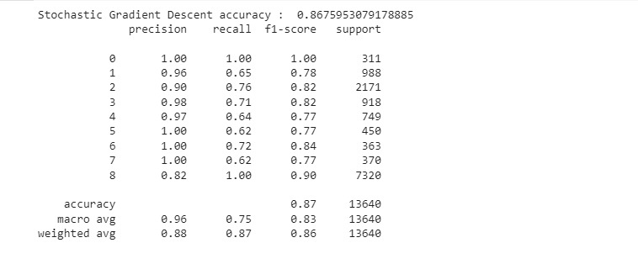
Error Analysis
& Evaluation
Classification (Stochastic Gradient Descent)
This Our Champion Model

Slide 18
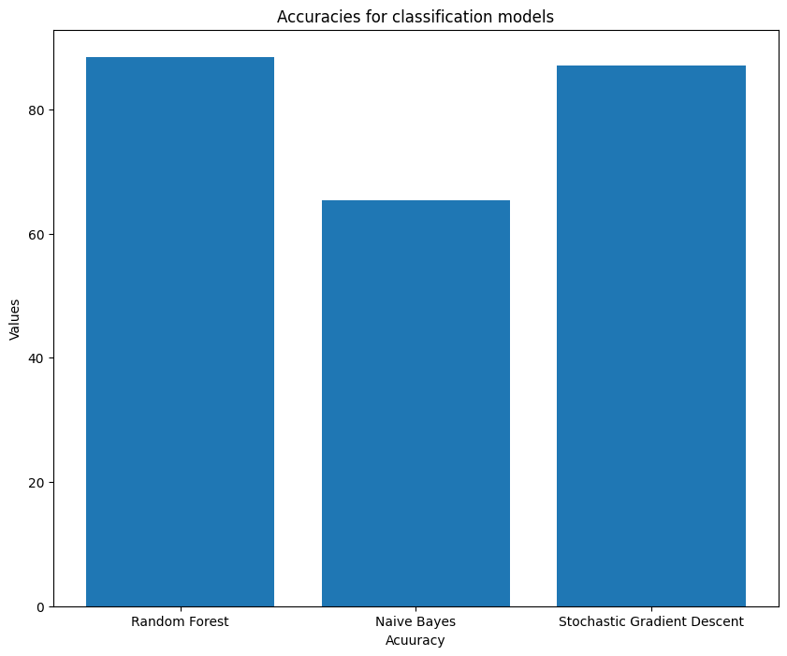

Slide 19
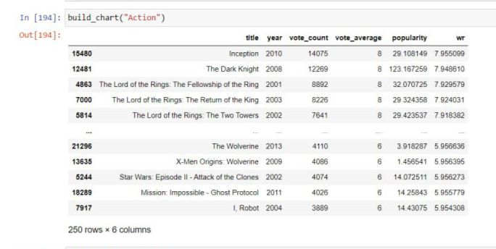
Type Based Recommendation

Slide 20
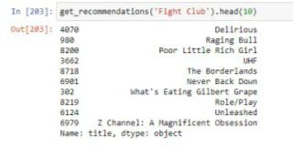
Content Based Recommendation

Slide 21
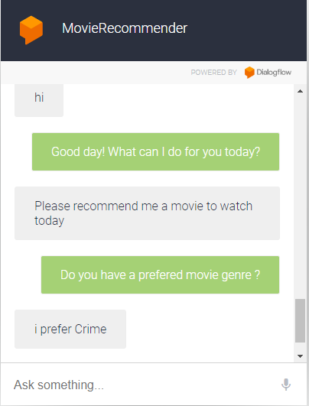
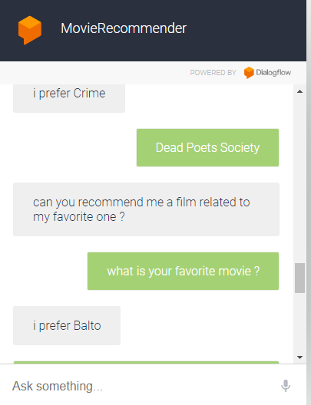
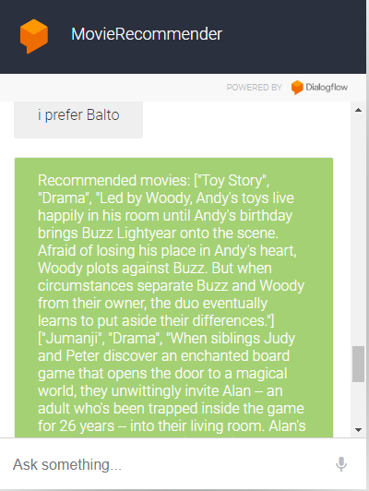

Slide 22



Any Questions

