Slide 1

Stock market predictions
Presented by:
Andrew Adel Labib.
Hussien Amin Abdelhafez.
Phoebe Thabit Wadea.
Sandy Adel Latef.

Slide 2



Summary
Business case
Data Preprocessing
Classification models
Evaluation
Voting model

Slide 3

Business case
In stock market, there is a significant need for predicting the future prices of certain stocks. The daily process on the stock exchange generates vast amounts of data, and the fluctuations within a day add to the existing volume of data. Analysing these changes and predicting the future price or market trends of certain company stocks has become a challenging task in this scenario.

Slide 4
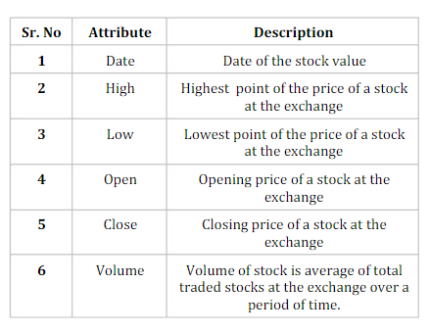
Dataset Description
This comprehensive dataset provides a detailed analysis of Microsoft Corporation's stock performance from 1986 to 2023. It encompasses various important parameters, including stock price, low price, high price, and trading volume, to provide a comprehensive overview of the company's market behavior throughout the years.
The dataset begins in 1986, marking the early years of Microsoft's presence in the stock market. The dataset captures the fluctuations and trends in the stock market, reflecting the company's journey from its inception to its position as a global tech giant.
The dataset covers a span of several decades, enabling users to analyze long-term trends, market cycles, and historical patterns that have shaped Microsoft's stock performance.

Slide 5
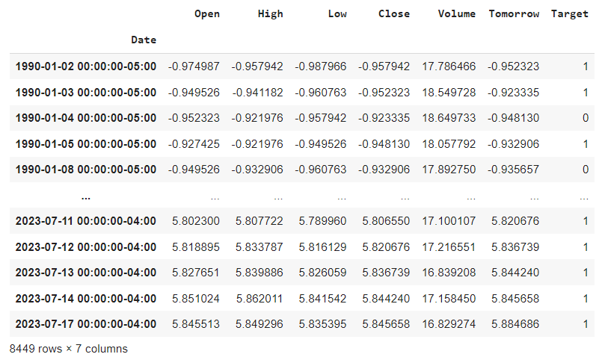
Data Preprocessing Results
The code essentially employs the Yahoo Finance API (Application Programming Interface) to fetch historical stock price data for the Microsoft (MSFT) stock.
The Yahoo Finance API allows users to access financial data, including historical price information, for various publicly traded securities.

Slide 6
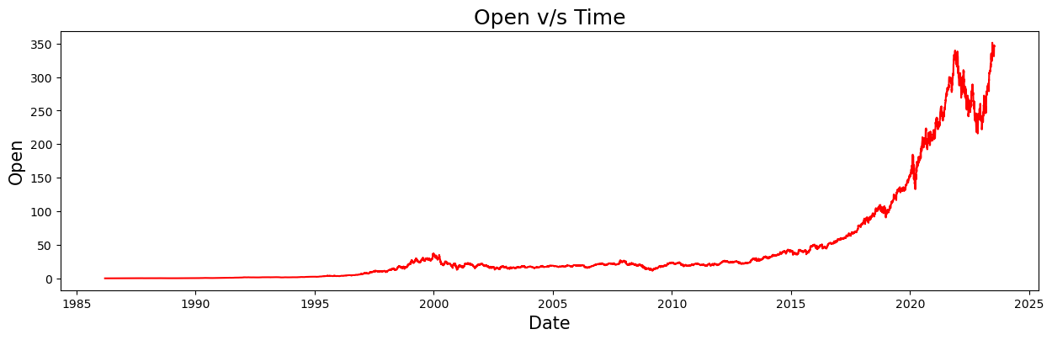
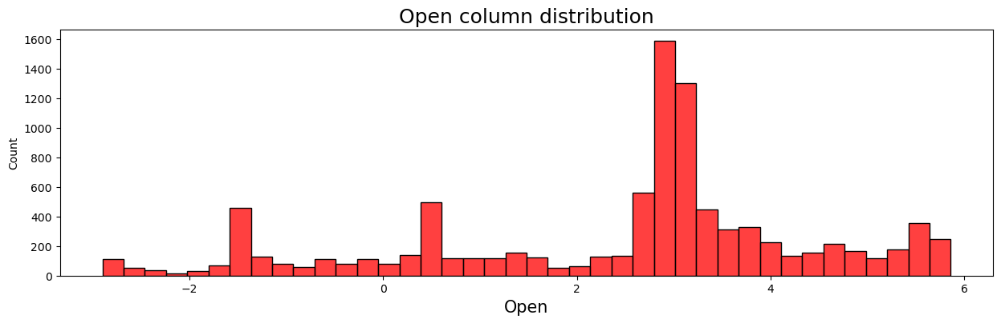
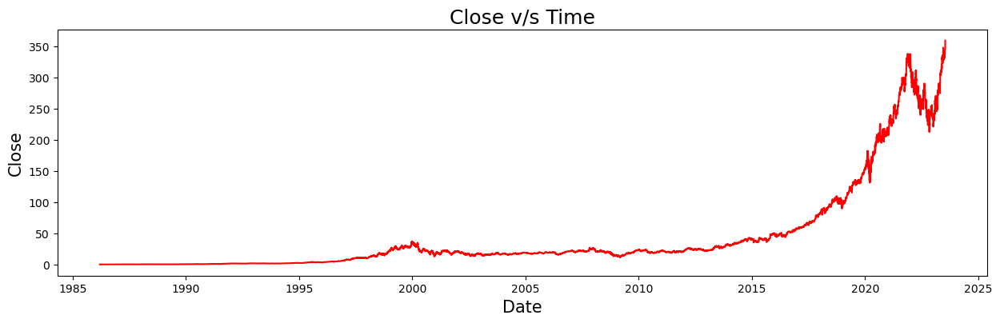
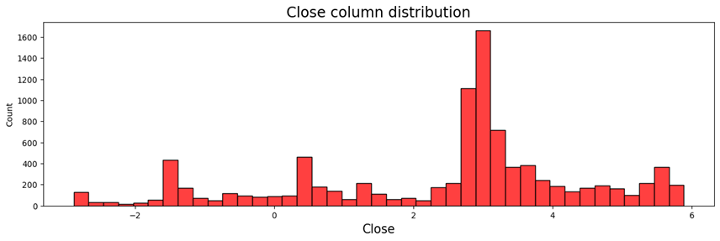
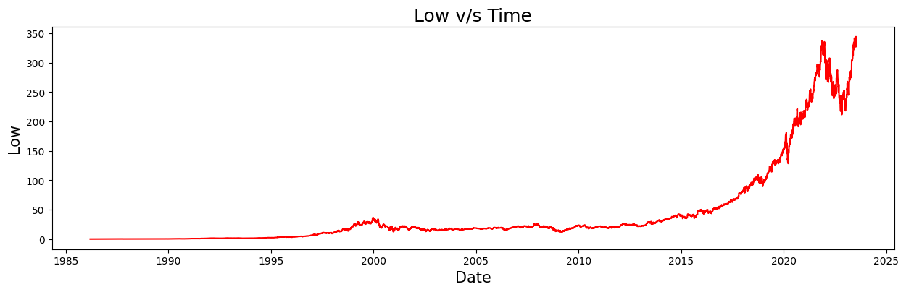

Data Preprocessing Results
To address skewness in the data, We applied Log Transformation which is applying a logarithmic transformation to compress the range of large values and reduce the impact of outliers, making the data more symmetrical.

Slide 7
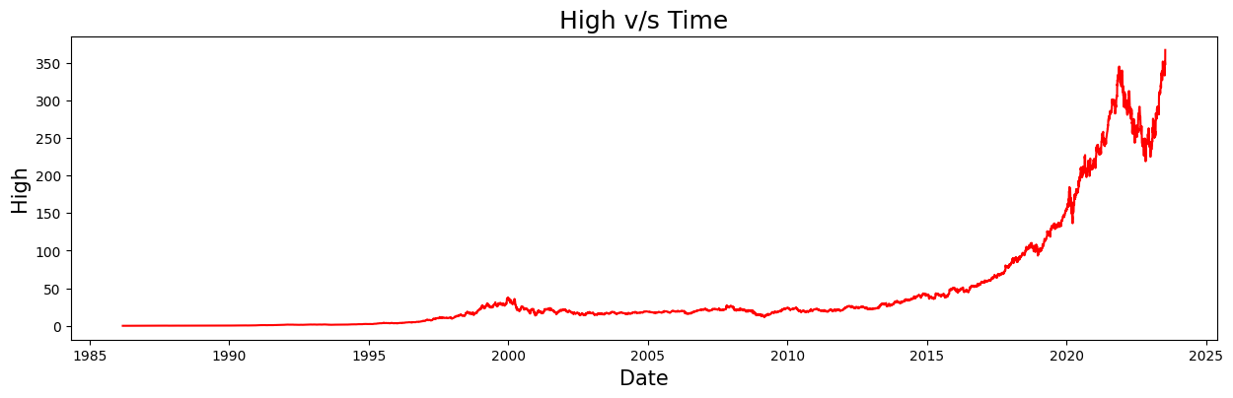

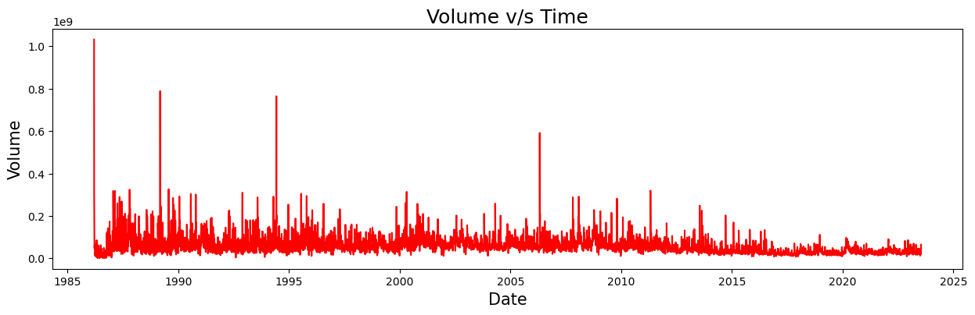
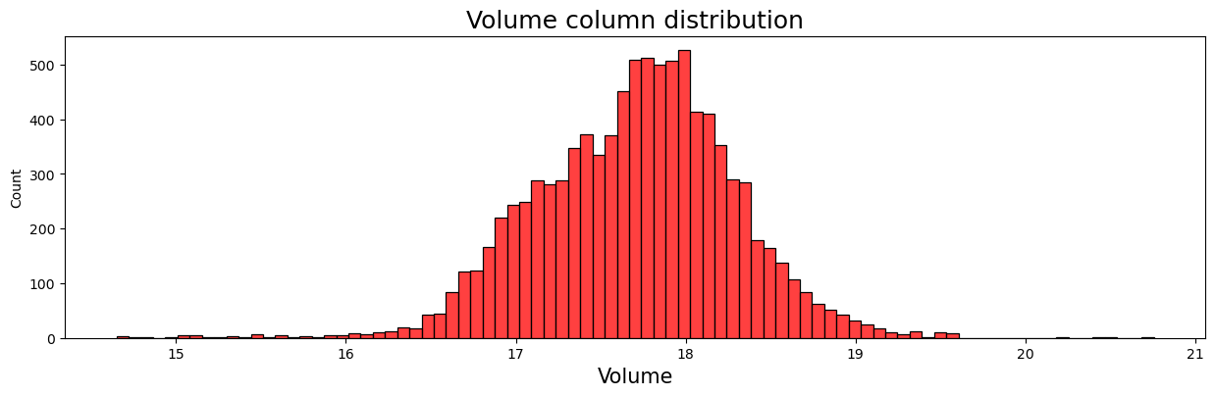
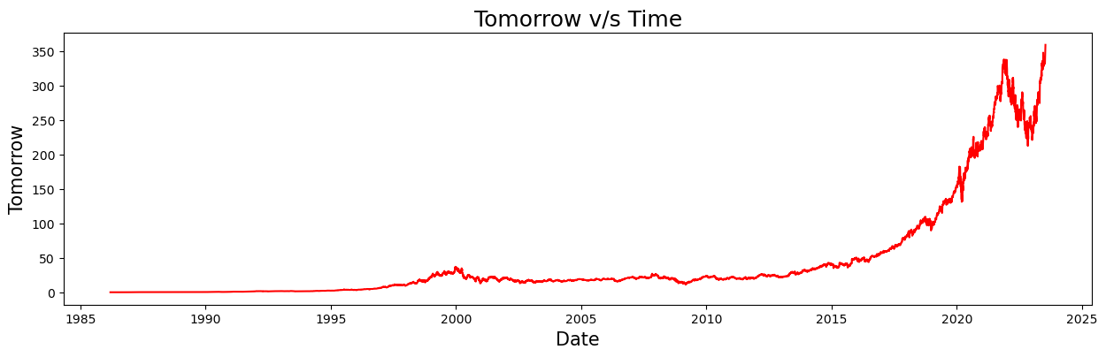

Data Preprocessing Results

Slide 8
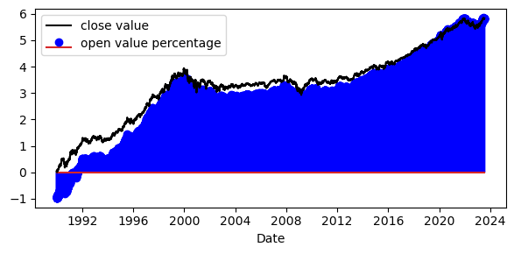
Compare between open and close values

Slide 9
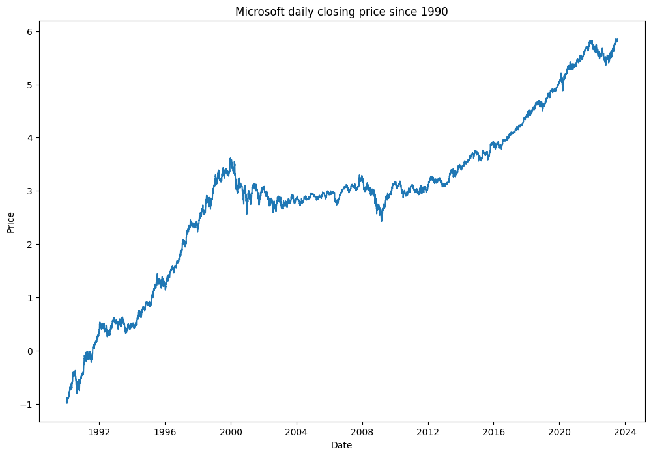
Daily closing price since 1990

Slide 10
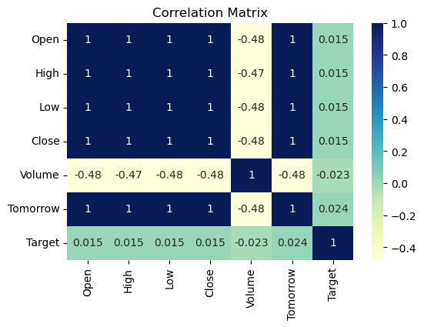
Data correlation matrix

Slide 11
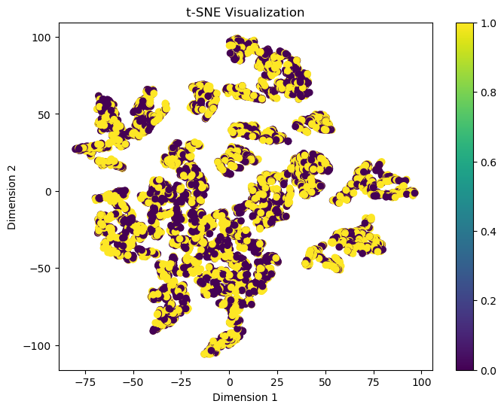
Data T-SNE Visualization

Slide 12

Classification models
Random Forest
SVM
KNN
Decision Tree
AdaBoost
Gradient Boosting
Naïve Bayes
Logistic Regression
LSTM

Slide 13
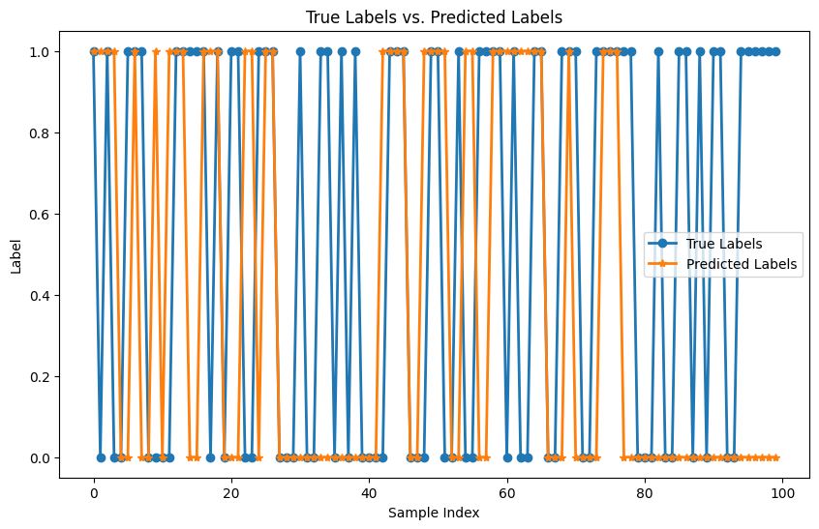
Random Forest
Accuracy = 53
Precision = 0.6053

Slide 14
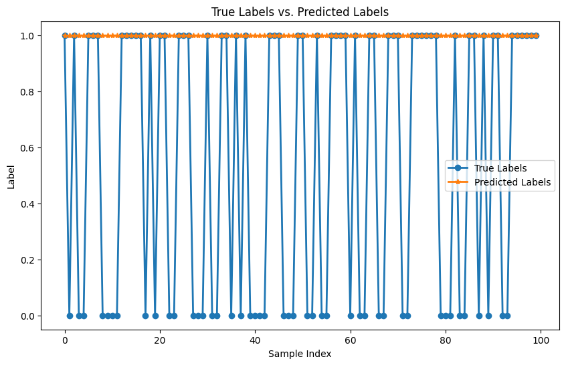
SVM
Accuracy = 55
Precision = 0.55

Slide 15
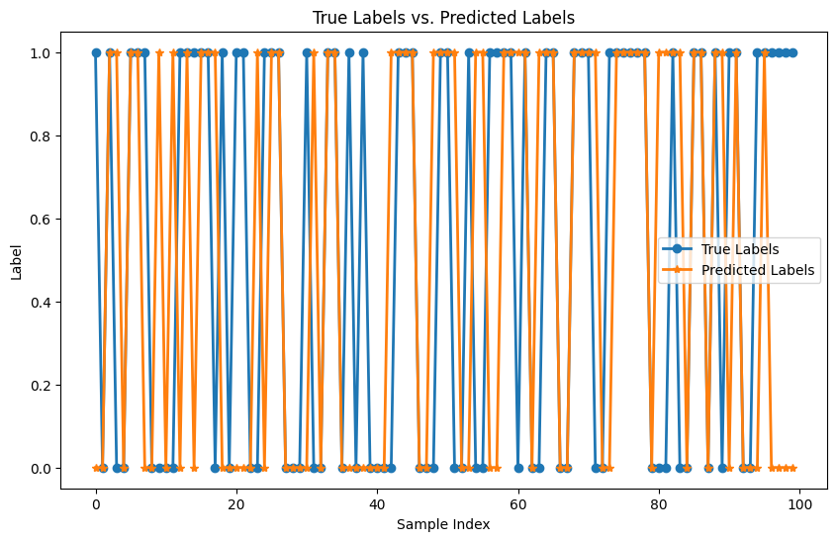
KNN
Accuracy = 61
Precision = 0.6538

Slide 16
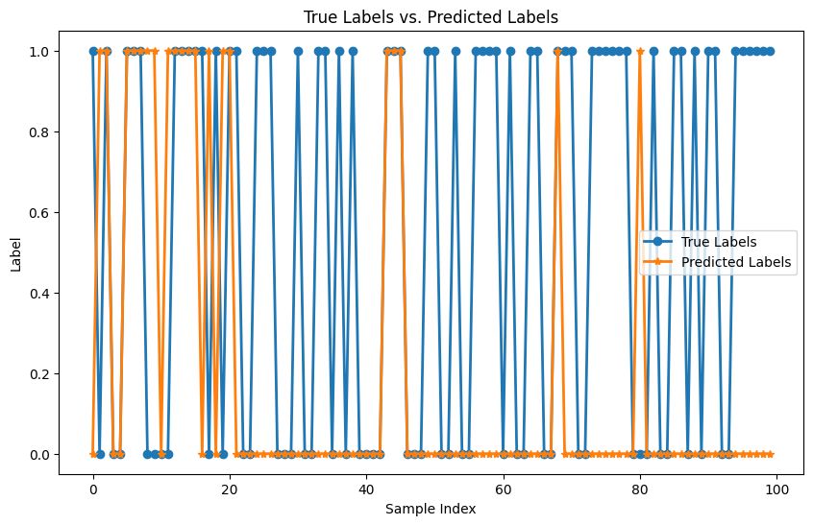
Decision Tree
Accuracy = 51
Precision = 0.65

Slide 17
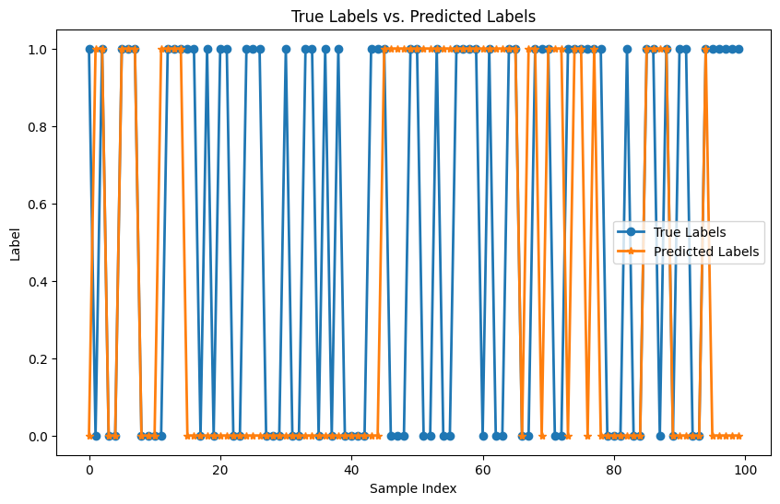
Ada Boosting
Accuracy = 56
Precision = 0.6279

Slide 18
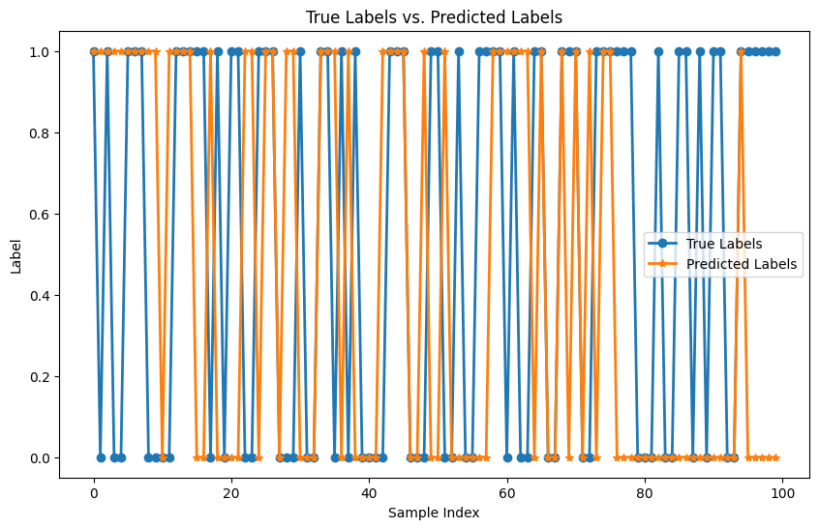
Gradient Boosting
Accuracy = 59
Precision = 0.5455

Slide 19
Gaussian Naive Bayes
Accuracy = 55
Precision = 0.55

Slide 20
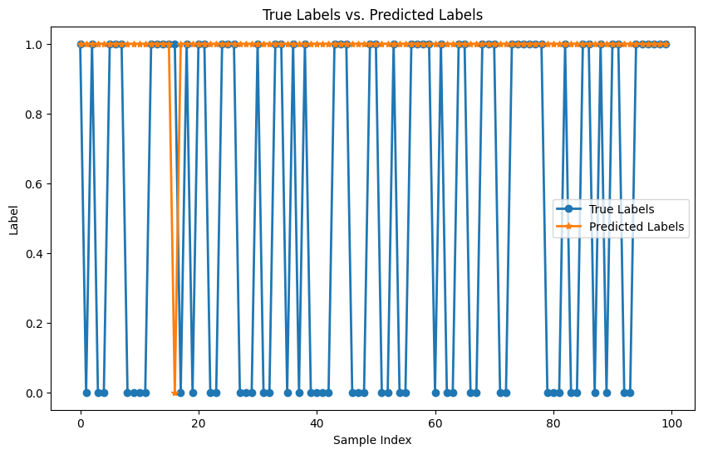
Logistic Regression
Accuracy = 54
Precision = 0.5455

Slide 21

Evaluation
Accuracy
Random Forest | SVM | KNN | Decision Tree | AdaBoost | Gradient Boosting | Naïve Bayes | Logistic Regression | LSTM
53 | 55 | 61 | 51 | 56 | 49 | 55 | 54 | 55
SUCCESS

Slide 22
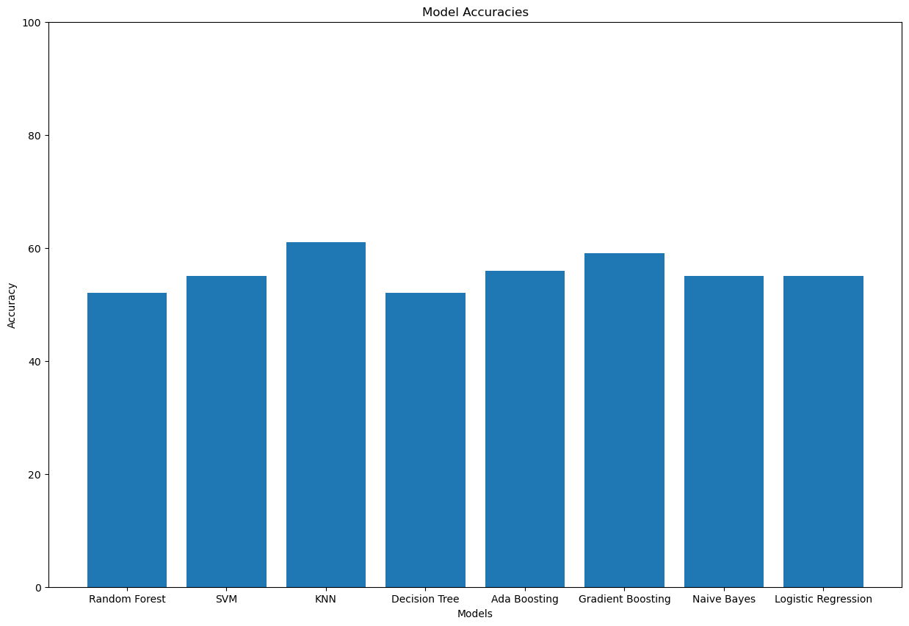
Models Evaluation (Accuracy)

Slide 23
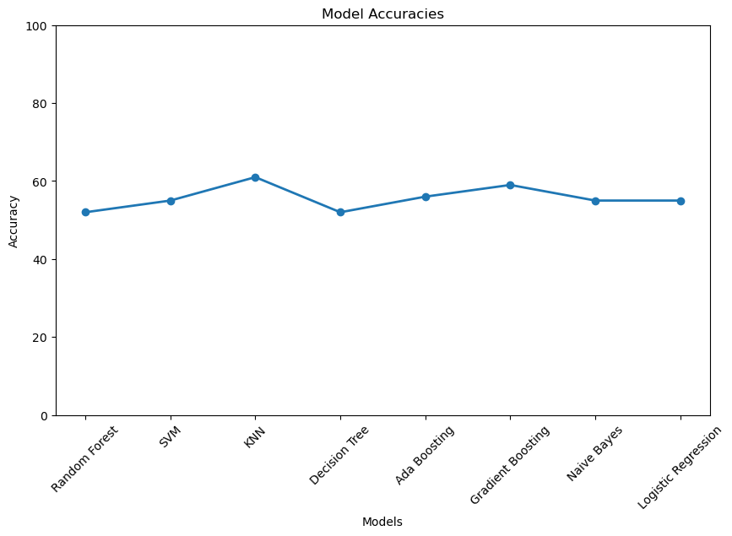
Models Evaluation (Accuracy)

Slide 24
Evaluation
Precision
Random Forest | SVM | KNN | Decision Tree | AdaBoost | Gradient Boosting | Naïve Bayes | Logistic Regression
0.6053 | 0.55 | 0.6538 | 0.65 | 0.6279 | 0.5455 | 0.55 | 0.5455
SUCCESS

Slide 25
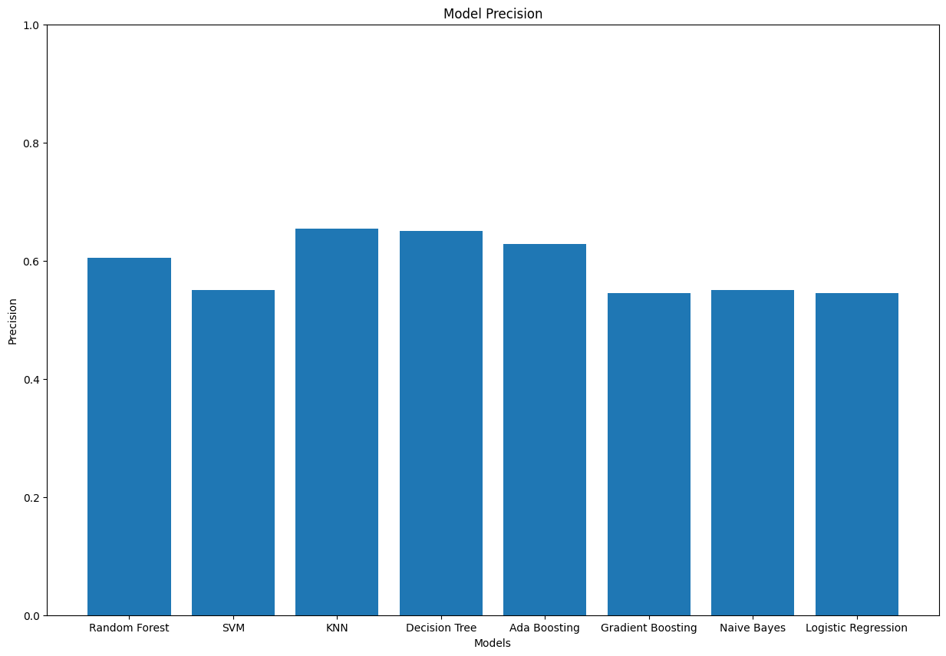
Models Evaluation (Precision)

Slide 26
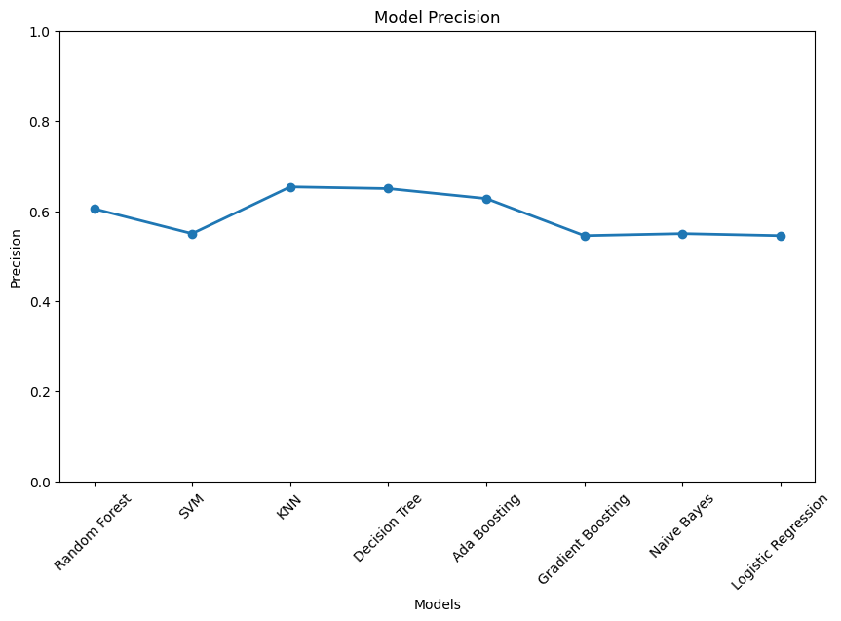
Models Evaluation (Precision)

Slide 27

THE Champion Model
The Champion Model is K nearest Neighbor (KNN)
The model with the highest accuracy is
K Nearest Neighbor
(KNN)
With accuracy = 61
The model with the highest Precision is
K Nearest Neighbor
(KNN) With
precision = 0.6538
Accuracy
Precision
The Champion Model

Slide 28
The Voting Model
The Voting Classifier combines the predictions of multiple individual classifiers to determine the final class label.
The Voting Classifier is particularly useful when the individual classifiers have diverse strengths and weaknesses.
By combining their predictions, the Voting model can often achieve better performance than any individual classifier alone.

Slide 29
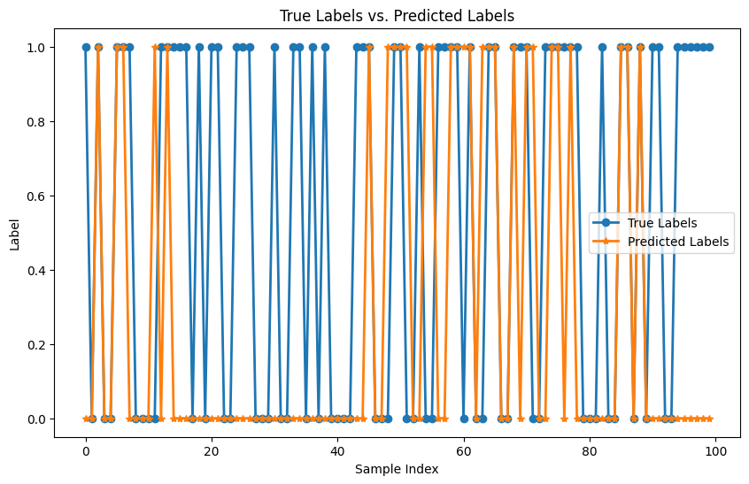
The Voting Model
Accuracy = 57
Precision = 0.7143

Slide 30

THANK YOU! Any questions

