Slide 1
Scalable Object Detection Accelerators on FPGAs Using Custom Design Space Exploration
Chen Huang and Frank Vahid
Dept. of Computer Science and Engineering
University of California, Riverside, USA
{chuang,vahid}@cs.ucr.edu
This work was supported in part by NSF CNS-1016792

Slide 2
Outline
Haar-feature based object detection algorithm
Custom design space exploration: Feature mapping problem
Experimental results

Slide 3
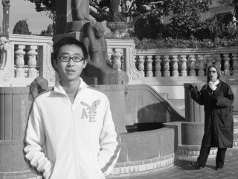

Haar-Feature based object detection algorithm
X axis
320
Original image
0
Scaled images
Y axis
Face found
20x20
sub- window
…
240
Faces detected on different scales
Movement of sub-window
(320 – 20) * (240 – 20) = 66,000 sub-windows

Slide 4

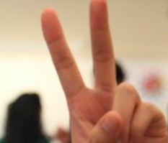
Face detection in sub-window
Original image
Integral Image
Facial Haar features
1 1 1
1 2 3
1 1 1
2 4 6
1 1 1
3 6 9
Pass
Stores Pixel sum of Rect(from top-left corner to this point)
Need 4 corner values
20 x 20 sub-window
p1
p2
P1
P2
R1
p3
p4
P3
P4
Fail
Pixel_Sum(R1) =
P4 - P2 - P3 + P1 = 4
Calculate Haar-feature value:
Pixel_Sum(Rect_W) – Pixel_Sum(Rect_B)
Constant time Pixel_Sum calculation

Slide 5
Cascade decision process
Frontal-face has 2000 features
Divided into multiple stages
S1
2 features
pass
S2
5 features
pass
S3
16 features
pass
S22
212 features
pass
……
Face detected
Fail
Reject
Fail any stage will reject current sub-window

Slide 6

Algorithm FPGA implementation
FPGA
Video out
(objects in rectangles)
Video in
20 x 20 Sub-window
Integral image
Frame grabber
Rectangle
drawer
Image scaler
Buffer controller
Classifier
Haar feature calculation/decision

Slide 7

Integral image and Classifier
Data delivery
a1 a2 a3 a4
b1 b2 b3 b4
c1 c2 c3 c4
Rect sum
Rect sum
Rect sum
0
Integral Image Buffer
(20 x 20 17-bit register file)
mux + multiply by constant
-1
x2
x2
x3
Video out
(objects in rectangles)
+(Feature sum)
Video in
Integral image
Feature threshold
>
Frame grabber
Rectangle
drawer
Left value
Right value
Feature value
Image scaler
Buffer controller
Classifier
Classifier

Slide 8
Communication bottleneck
400-to-1 17-bit MUX:
2300 LUTs
12 MUXes: 27,600 LUTs
40% of Virtex5 110T(69,120)
……
  400-to-1 mux
  20 x 20 Integral image
Drawbacks:
Does not scale well for multiple classifiers
Wire congestion problem
  A classifier port
General communication architecture

Slide 9
Custom communication architecture for multi-classifier
Integral image
  13 14 15 16
  9 10 11 12
Feature number
  5 6 7 8
  1 2 3 4
  CF1 CF2 CF3 CF4
Classifier number
400-1 mux
CF1
CF2
CF3
CF4
Multiple Classifiers

Slide 10
Custom communication architecture for multi-classifier
Integral image
  13 14 15 16
  9 10 11 12
Feature number
  5 6 7 8
  1 2 3 4
  CF1 CF2 CF3 CF4
Classifier number
16-1 mux
24-1 mux
9-1 mux
24-1 mux
Custom communication architecture
CF1_port1
CF2_port9
CF3_port7
CF4_port2
CF1
CF2
CF3
CF4
Multiple Classifiers

Slide 11
Feature mapping problem
Mapping 26 features into 4 Classifiers
CF1
CF2
CF3
CF4
  25 26
Stage and feature
  21 22 23 24
Object found
Stage 3
  17 18 19 20
  13 14 15 16
Stage n
Fail
  10 11 12
pass
  6 7 8 9
Stage 2
Stage 2
Reject
Fail
  5
pass
  1 2 3 4
Stage 1
Stage 1
Fail
  CF1 CF2 CF3 CF4
Classifier
Features

Slide 12
Feature mapping problem
Mapping 26 features into 4 Classifiers
CF1
CF2
CF3
CF4
Total wire number
Swap
#possible mapping grows exponentially with #features
Migrate
  25 26
Objective:
Min (Total stage delay * Total wire number)
Stage and feature
  21 22 23 24
Stage 3 Stage 2 Stage 1
  17 18 19 20
Total stage delay
  13 14 15 16
Performance
Size
  10 11 12
  6 7 8 9
  5
Simulated Annealing neighbor
  1 2 3 4
  CF1 CF2 CF3 CF4
1 million iterations (30 min)
Classifier

Slide 13
Automatic VHDL code generation
Integral Image
Scheduling:
5 24 46 92
24
5
92
46
2
1 2 3 4
Mux1: mux4 port map(II(5), II(24), II(46), II(92), select, dout);
C1: classifier port map(dout, …);
Bram1: bram generic map(2, 1, 4, 3, …) Port map(…., select);
MUX
1
Select
4
Feature mapping:
1, 4, 66, 3
(needs entry:
5, 24, 46, 92)
dout
3
Classifier 1
BRAM
Structural RTL code for communication components

Slide 14
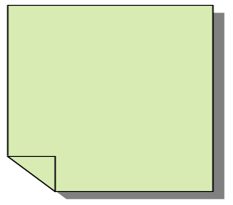
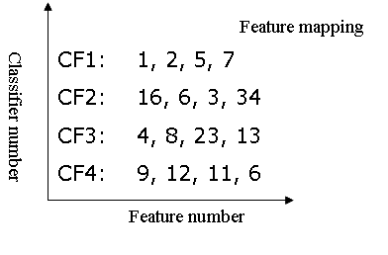
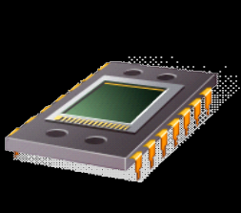
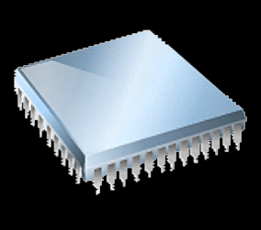
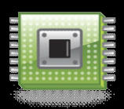
Review of custom design space exploration
Communication bottleneck
Program analysis
Object detection application
Custom design space exploration
400-1 mux
Design exploration
Feature mapping problem
Design generation
Execution time
Pareto design points
Different number of classifiers
Size
Resource constraints, performance requirements
Map to different FPGAs

Slide 15
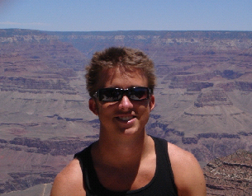
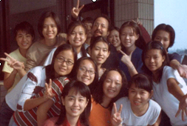
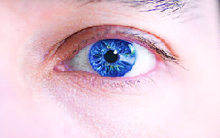
Experiment scenarios
12 ports
Classifier
Different implementations
  Desktop: Pentium4 3.0 GHz fixed-point C
  FPGA: 1 CF(1 mux), 1 CF(3 mux), 1 CF(6 mux), 1 CF, 2 CF, 4 CF, 8 CF, 16 CF on Xilinx Virtex LX 50T, LX110T, and LX155T
Feature sets
  Face: 2135 features
  Eye: 1066 features
Sample images
  Face(simple) Face(complex) Eye

Slide 16
Experiment: FPGA resource utilization
Map to different Xilinx Virtex5 FPGAs
LX155T.(97,000)
90000
80000
LX100T.(69,000)
Communication architecture
70000
60000
50000
Comms
Design size (number of LUTS)
40000
LX50T.(29,000)
Static
30000
20000
10000
0
1 CF
(1 mux)
1 CF
(3 mux)
1 CF
(6 mux)
1 CF
(12 mux)
2 CF
4 CF
8 CF
16 CF
Classifier number
General comm. architecture
Custom comm. architecture
400-1 mux
16-1 mux
24-1 mux
9-1 mux
24-1 mux

Slide 17
Components' timing info
Video out
(objects in rectangles)
Video in
Frame grabber
Integral image
Rectangle
drawer
Image scaler
Buffer controller
Classifier
Image scaler
Buffer controller
Classifier
Xilinx Virtex5 110T FPGA
130 Mhz
6 cycles/pixel
65 Mhz
11 cycles/window
65 Mhz
(3+examined features/#CF) cycles/window
201
Frame/sec
124
110
Performance upper bound (110 fps)
0.6
min
max
Performance of different components

Slide 18
Performance comparison
(determined by buffer controller)
120
Upper bound
100
FPGA implementations are
0.6 to 25X faster than desktop C
80
Face(complex)
60
Face(simple)
Performance (frame/sec.)
Eye
40
20
0
Desktop
1 CF
(1 mux)
1 CF
(3 mux)
1 CF
(6 mux)
1 CF
2 CF
4 CF
8 CF
16 CF
Pentium 4 3.0 GHz

Slide 19
Comparison to previous work
Compared to Cho’s [FPGA 09] implementation of the same algorithm with 320x240 pixels on the same FPGA.
 | Size(LUTs) | Performance(fps)
Cho's(1 CF) | 64,143 | 17.5
Ours(1 CF) | 45,713 | 19.3
Cho's(3 CFs) | 84,232 | 28.8
Ours(16 CFs) | 77,059 | 90.9
3x faster with 8% less LUTs
More scalable due to custom design space exploration

Slide 20
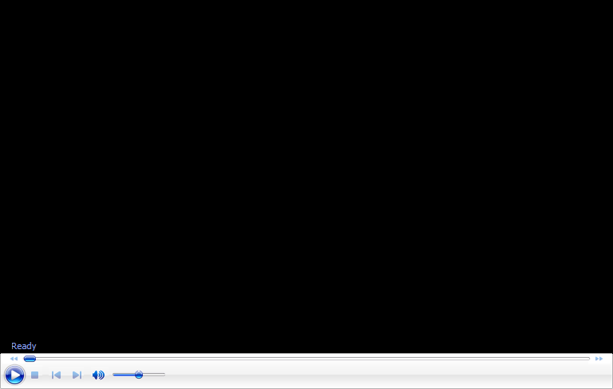
Video Demo
http://www.youtube.com/watch?v=gkQVanU5P5U

Slide 21
Conclusions
Effectively implemented object detection algorithm on a modern series of FPGAs
Custom design space exploration is necessary for complex applications
Future work: Implement more applications using custom search/optimization
Thank you!

