Slide 1

Airflow

Slide 2
Definition of airflow
Apache Airflow is a popular open-source platform used for orchestrating, scheduling, and monitoring workflows or data pipelines. It is designed to automate the execution of complex, data-driven workflows and ETL (Extract, Transform, Load) processes
Workflow Orchestration: Airflow allows you to define complex workflows as Directed Acyclic Graphs (DAGs), enabling you to organize tasks, set dependencies, and schedule the execution of these tasks in a structured manner.
Extensibility: Airflow is highly extensible and can be integrated with various systems and technologies through custom operators, sensors, and hooks. This makes it easy to incorporate new tools into your workflows.
Parallelism: Airflow supports parallel execution of tasks, which allows for efficient utilization of resources and faster data processing.
Monitoring and Logging: Airflow provides a user interface for monitoring the status of workflows and tasks, as well as extensive logging capabilities to help troubleshoot issues.
Reusability: With the ability to define workflows as code, Airflow promotes code reusability and modularity, making it easier to maintain and share workflows.
Scalability: Airflow can scale horizontally to handle large-scale workflows and can be deployed in distributed environments.

Slide 3
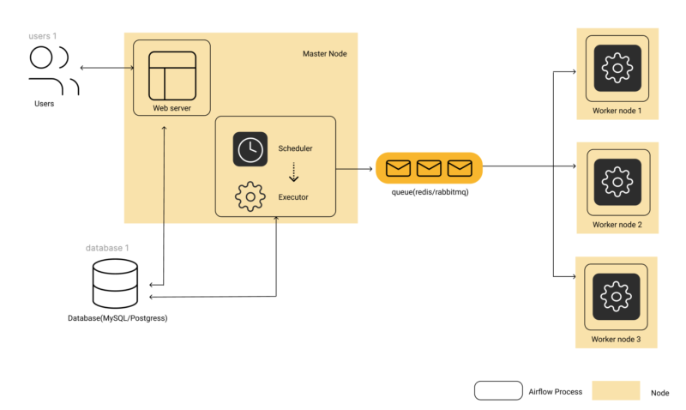

Slide 4
Explanation About Architecture
An Airflow installation generally consists of the following components:
A scheduler, which handles both triggering scheduled workflows, and submitting Tasks to the executor to run.
An executor, which handles running tasks. In the default Airflow installation, this runs everything inside the scheduler, but most production-suitable executors actually push task execution out to workers.
A webserver, which presents a handy user interface to inspect, trigger and debug the behaviour of DAGs and tasks.
A folder of DAG files, read by the scheduler and executor (and any workers the executor has)
A metadata database, used by the scheduler, executor and webserver to store state.
Workers:
Workers are the computing resources where the actual task execution takes place. They pull task instances from the queue and execute them based on the instructions provided by the Scheduler. Airflow supports distributed task execution across multiple workers for parallel processing.
Database:
Airflow uses a relational database to store metadata related to DAGs, tasks, task instances, execution history, and more. The metadata database is essential for maintaining the state of the workflow and providing features like task history, retries, and visualizations in the Airflow web interface.
Redis is often used with Apache Airflow for task queuing and caching purposes. It serves as the message broker for task execution and as a caching backend for task results and other data. Apache Airflow leverages Redis as part of its CeleryExecutor, which allows for distributed task execution across multiple workers

Slide 5
Core Airflow concepts​
To navigate Airflow resources, it is helpful to have a general understanding of the following core Airflow concepts:
DAG: Directed Acyclic Graph. An Airflow DAG is a workflow defined as a graph, where all dependencies between nodes are directed and nodes do not self-reference. For more information on Airflow DAGs, see Introduction to Airflow DAGs.
DAG run: The execution of a DAG at a specific point in time. A DAG run can be scheduled or manually triggered.
Task: A step in a DAG describing a single unit of work.
Task instance: The execution of a task at a specific point in time.
When authoring DAGs, you use operators. An operator is an abstraction over Python code designed to perform a specific action and takes the form of a function that accepts parameters. Each operator in your DAG code corresponds to one Airflow task.
The following are the primary operator categories:
Action operators: Execute a function. For example, the PythonOperator or the BashOperator.
Transfer operators: Move data from a source to a destination. For example, the S3ToRedshiftOperator.
Sensors: Wait for something to happen. For example, the ExternalTaskSensor or the HttpSensorAsync.
While operators are defined individually, they can pass information to each other by using XComs.

Slide 6
Providers
Operators used to interact with external systems are maintained separately to Airflow in provider packages.
Providers are packages that are maintained by the community and include all of the core operators, hooks, and sensors for a given service, for example:
Amazon provider
Snowflake provider
Google provider
Azure provider
Databricks provider
Fivetran provider
To view the available providers and operators, see the Astronomer Registry.

Slide 7
plugins
In the context of Apache Airflow, a "plugin" refers to a reusable component that extends the functionality of the Airflow framework. Plugins allow you to add new operators, hooks, executors, sensors, and other custom functionalities to Airflow without modifying its core codebase. This modular approach makes it easier to manage and organize your Airflow workflows while promoting code reusability.

Slide 8
Hooks
A hook is an abstraction of a specific API that allows Airflow to interact with an external system. Hooks are built into many operators, but they can also be used directly in DAG code.

Slide 9
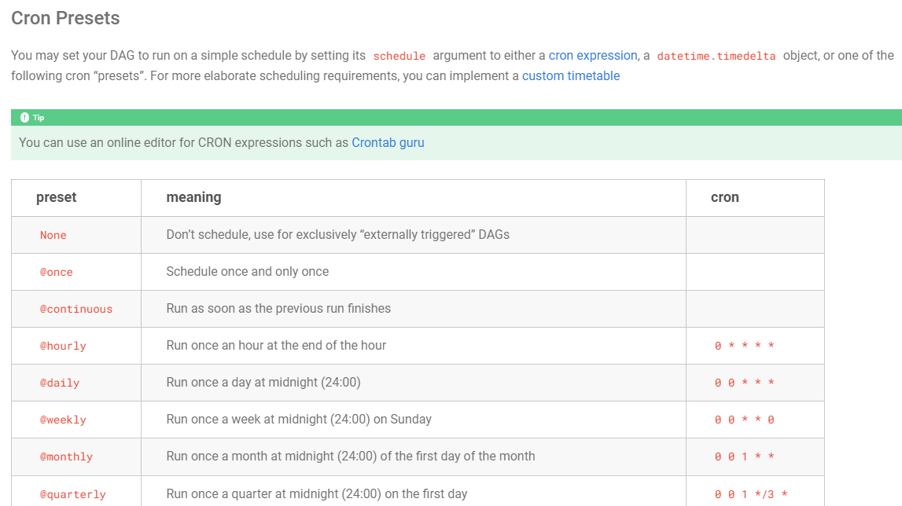

Slide 10
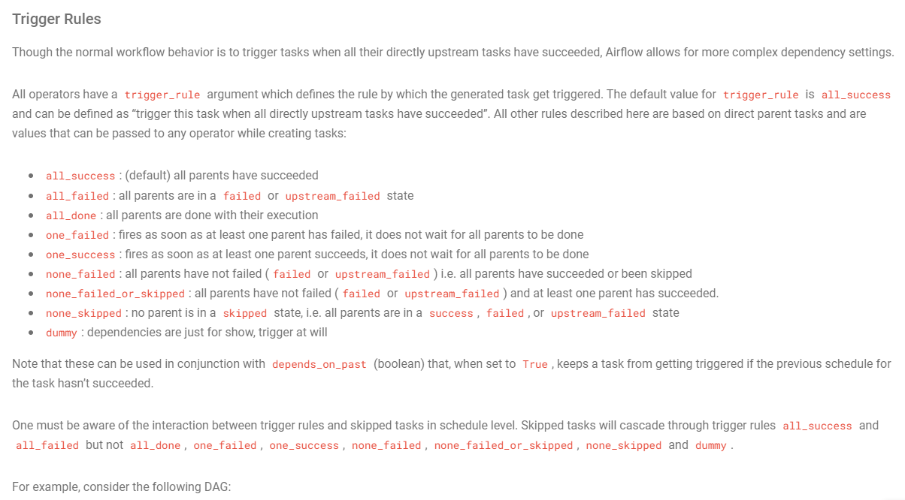

Slide 11
Sub Dag
A SubDAG is represented as a separate DAG that is created using the DAG constructor within a Python function. The tasks and dependencies defined within the SubDAG are executed as a single unit when the SubDAG task is triggered in the main DAG.
Code Reusability: By creating SubDAGs, you can encapsulate and reuse common task patterns or workflow components across different DAGs, promoting code reusability and reducing duplication.
Modularity: SubDAGs enable you to break down complex workflows into smaller, more manageable components, making it easier to understand and maintain large DAGs.
Visualization: When viewing the main DAG in Airflow's user interface, SubDAGs are shown as a single task, simplifying the DAG visualization.
Separation of Concerns: SubDAGs allow you to separate the definition of complex workflows from the main DAG, keeping the main DAG focused on high-level scheduling and orchestration.
https://github.com/suneetha123a/Airflow/blob/main/subsubdag.py

