Slide 1

INDIAN INSTITUTE OF TECHNOLOGY HYDERABAD
Professional Certification Program in Artificial Intelligence, IIIT Hyderabad
CAPSTONE PROJECT · FINAL PRESENTATION
Multi-Domain Agentic RAG Assistant
A LangGraph multi-agent, hybrid-retrieval question-answering system over five RAGBench domains, with evidence-grounded answers and a Safety Agent audit
Biomedical
Legal
Finance
Customer Support
General Knowledge
Group 2 · Professional Certification Program in Artificial Intelligence, IIIT Hyderabad
Suneel Jangam · Udumula Sreenivasa Reddy · Manojeet Dey · Arun Sarathy P B
Guide / Mentor: Lokesh Submission: November 14, 2026
LangGraph · Groq gpt-oss-20b · Chroma + BM25 · OpenFDA
Capstone Project · IIT Hyderabad
Notes:
Introduce the project: one assistant answering questions in five professional domains, grounded in retrieved evidence with citations, built as a multi-agent LangGraph workflow on low-cost infrastructure. The final version is v2.9: 25/30 correct on the 30-question test.

Slide 2
What our application does
You type a question in the browser. The Colab notebook's 5 agents find the evidence and write a cited, safety-checked answer. The web app is only the window; the notebook is the engine.
 | Front end — Web app | Back end — Colab notebook
Where | web_app/ folder: web_app.py (Python server) + static/index.html, app.js (chat page) | notebooks/MultiDomain_RAG_Agents_v2.9_final.ipynb
Job | Shows the chat page, sends your question, shows the answer, domain, sources and safety check | Does all the AI work with 5 agents: Router → Retrieval → Domain Check → Answer → Safety
Runs on | Your PC, opened in the browser (port 8000, optional password) | Google Colab, or loaded by the web app on your PC
Uses | Plain HTML + JavaScript; no AI code of its own | Groq gpt-oss-20b · MiniLM embeddings · Chroma + BM25 · OpenFDA
Data | None; it only displays what the notebook returns | RAGBench, 5 domains · 14,704 indexed chunks
How they connect: at start-up, MultiDomainAgent.py runs the notebook's code cells and gets the 5-agent assistant. Then for every question:
Browser → web_app.py (/api/chat) → assistant.invoke(question) → 5 agents → answer + sources → Browser

Slide 3
Technology stack
Layer | Technology
Dataset | RAGBench (galileo-ai/ragbench) via HuggingFace datasets: covidqa, cuad, finqa, techqa, hotpotqa
Chunking | Own splitter: 1,200 characters with 150 overlap → 14,704 chunks
Embedding model | sentence-transformers/all-MiniLM-L6-v2 (384 numbers, normalised) via langchain-huggingface
Dense retrieval | Chroma vector store (langchain-chroma), saved on disk, filtered by domain
Sparse retrieval | rank_bm25: BM25Okapi keyword search
Fusion | Reciprocal Rank Fusion, score 1 / (60 + rank); top 8 chunks (12 for a named contract)
Agent workflow | LangGraph StateGraph: Router → Retrieval → Domain Check → Answer → Safety
LLM | Groq openai/gpt-oss-20b via langchain-groq, temperature 0
Structured output | Pydantic schemas in JSON-schema mode (with_structured_output)
External tool | OpenFDA drug label API (api.fda.gov) for medicine checks
Notebook runtime | Google Colab (T4 GPU) + PyTorch; Groq key from Colab Secrets
Notebook UI | Gradio chat with a share link
Web app | Python ThreadingHTTPServer (web_app.py) + HTML / JavaScript chat page; key in .env
Evaluation | 30 questions (6 per domain) checked against RAGBench reference answers; results in Excel
Code storage | GitHub (private repositories)
Low-cost, mostly open-source stack: only the Groq LLM and OpenFDA calls go over the internet; embeddings, Chroma and BM25 run on the same machine as the notebook.

Slide 4




The problem: one assistant, five expert domains
Objectives
Hallucination
Wrong domain
Serve 5 domains from one citable knowledge base
Choose chunking, embeddings and retrieval by measurement
Orchestrate 5 agents (same for every domain) with LangGraph
Block fabricated citations; remove unsupported claims
Evaluate per domain, fix the weakest, re-test every version
Run on low-cost tools: Colab, Groq, open models
LLMs answer fluently without sources — risky in medicine, law and finance.
One index, five corpora: a misrouted question retrieves irrelevant evidence.
Look-alike documents
Domain safety
161 contracts share the same clause words; generic questions match all of them.
No dosing, legal or investment advice; emergencies must be escalated.
Notes:
Explain why a plain LLM is not enough and why a multi-domain RAG index creates new problems.

Slide 5
Objectives: what we set out to do
1
2
3
4
One assistant, five domains
Answer biomedical, legal, finance, customer-support and general questions from one knowledge base, routing each question to the right domain.
Grounded, cited answers
Every fact cites its source passage [RAG-xxxxx]. No invented citations; unsupported sentences are removed, not guessed.
Decide by measurement
Pick chunking, embedding model and retrieval method by testing the alternatives, then fix the weakest domain version by version.
Safe and low-cost
Domain safety rules (no dosing, legal or investment advice; escalate emergencies), on free Colab + Groq, with a public web demo.
MEASURED BY Routing accuracy
Result: 30/30 routed correctly
MEASURED BY Correct answers, 30 test questions
Result: 15/30 → 25/30 (83%)
MEASURED BY Answer passage retrieved
Result: 21/30 → 28/30
MEASURED BY Cost per question
Result: ≈ ₹0.25 on the free tier
Scope: 5 RAGBench domains · 200 rows per domain (14,704 chunks) · 5 LangGraph agents · every version judged on the same 30 test questions.

Slide 6





Five domains from RAGBench
Biomedical
Legal
Finance
Customer support
General
covidqa
cuad
finqa
techqa
hotpotqa
CORD-19 COVID-19 research-paper passages
Full commercial contracts from SEC EDGAR (CUAD)
Company annual reports (10-K) — text and tables
IBM technotes and security bulletins
Wikipedia paragraphs (multi-hop questions)
4.8%
57.3%
7.1%
25.2%
5.6%
of the index
of the index
of the index
of the index
of the index
713 docs
713 chunks
avg 599 chars/doc
161 docs
8,430 chunks
avg 54,338 chars/doc
568 docs
1,043 chunks
avg 1,393 chars/doc
973 docs
3,701 chunks
avg 3,601 chars/doc
796 docs
817 chunks
avg 487 chars/doc
Notes:
Only the documents field is indexed — never the benchmark question or answer. Legal contracts are 57% of the index by volume.

Slide 7
Domain-wise data representation
Domain | Config | Rows used (of train) | Unique docs | Avg chars / doc | Chunks | Share of index | Chunks / doc
Biomedical | covidqa | 200 of 1,252 | 713 | 599 | 713 | 4.8% | 1.0
Legal | cuad | 200 of 1,530 | 161 | 54,338 | 8,430 | 57.3% | 52.4
Finance | finqa | 200 of 12,502 | 568 | 1,393 | 1,043 | 7.1% | 1.8
Customer support | techqa | 200 of 1,192 | 973 | 3,601 | 3,701 | 25.2% | 3.8
General | hotpotqa | 200 of 1,883 | 796 | 487 | 817 | 5.6% | 1.0
Total |  | 1,000 | 3,211 |  | 14,704 | 100% | 4.6
Notes:
200 training rows per domain; each row brings several documents. Contracts are long (≈ 54k characters), so legal is 57% of all chunks although it has the fewest documents. Biomedical and general passages fit in one chunk each.

Slide 8
Ingestion and indexing pipeline
Download
Select rows
De-duplicate
Chunk
Tag metadata
Embed + index
galileo-ai/ragbench
5 configs
200 per domain
(1,000 rows)
skip repeated
passages
1,200 chars
150 overlap
RAG-id · domain
doc_key · title
MiniLM-L6 384-d
+ BM25 per domain
Domain | Unit of text | Chunks / doc | Retrieval challenge | How the system handles it (version)
Biomedical | paper passage | 1.0 | passage kept whole | hybrid search, domain-first (v2.0)
Legal | whole contract | 52.4 | 161 look-alike contracts | contract-scoped search (v2.2); 12 chunks of a named contract (v2.8)
Finance | report text + table | 1.8 | table stored as a separate document | report tables added (v2.5); values labelled by column (v2.6)
Customer support | technote page | 3.8 | error codes and product names | 2 extra BM25 matches for error codes (v2.5)
General | Wikipedia paragraph | 1.0 | answer needs two paragraphs | second-hop search for the missing fact (v2.8)
Notes:
Each chunk keeps its citation ID, domain, source, parent document key and (for contracts) a readable contract title. The table shows how each domain's shape of text was handled by the retrieval versions.

Slide 9
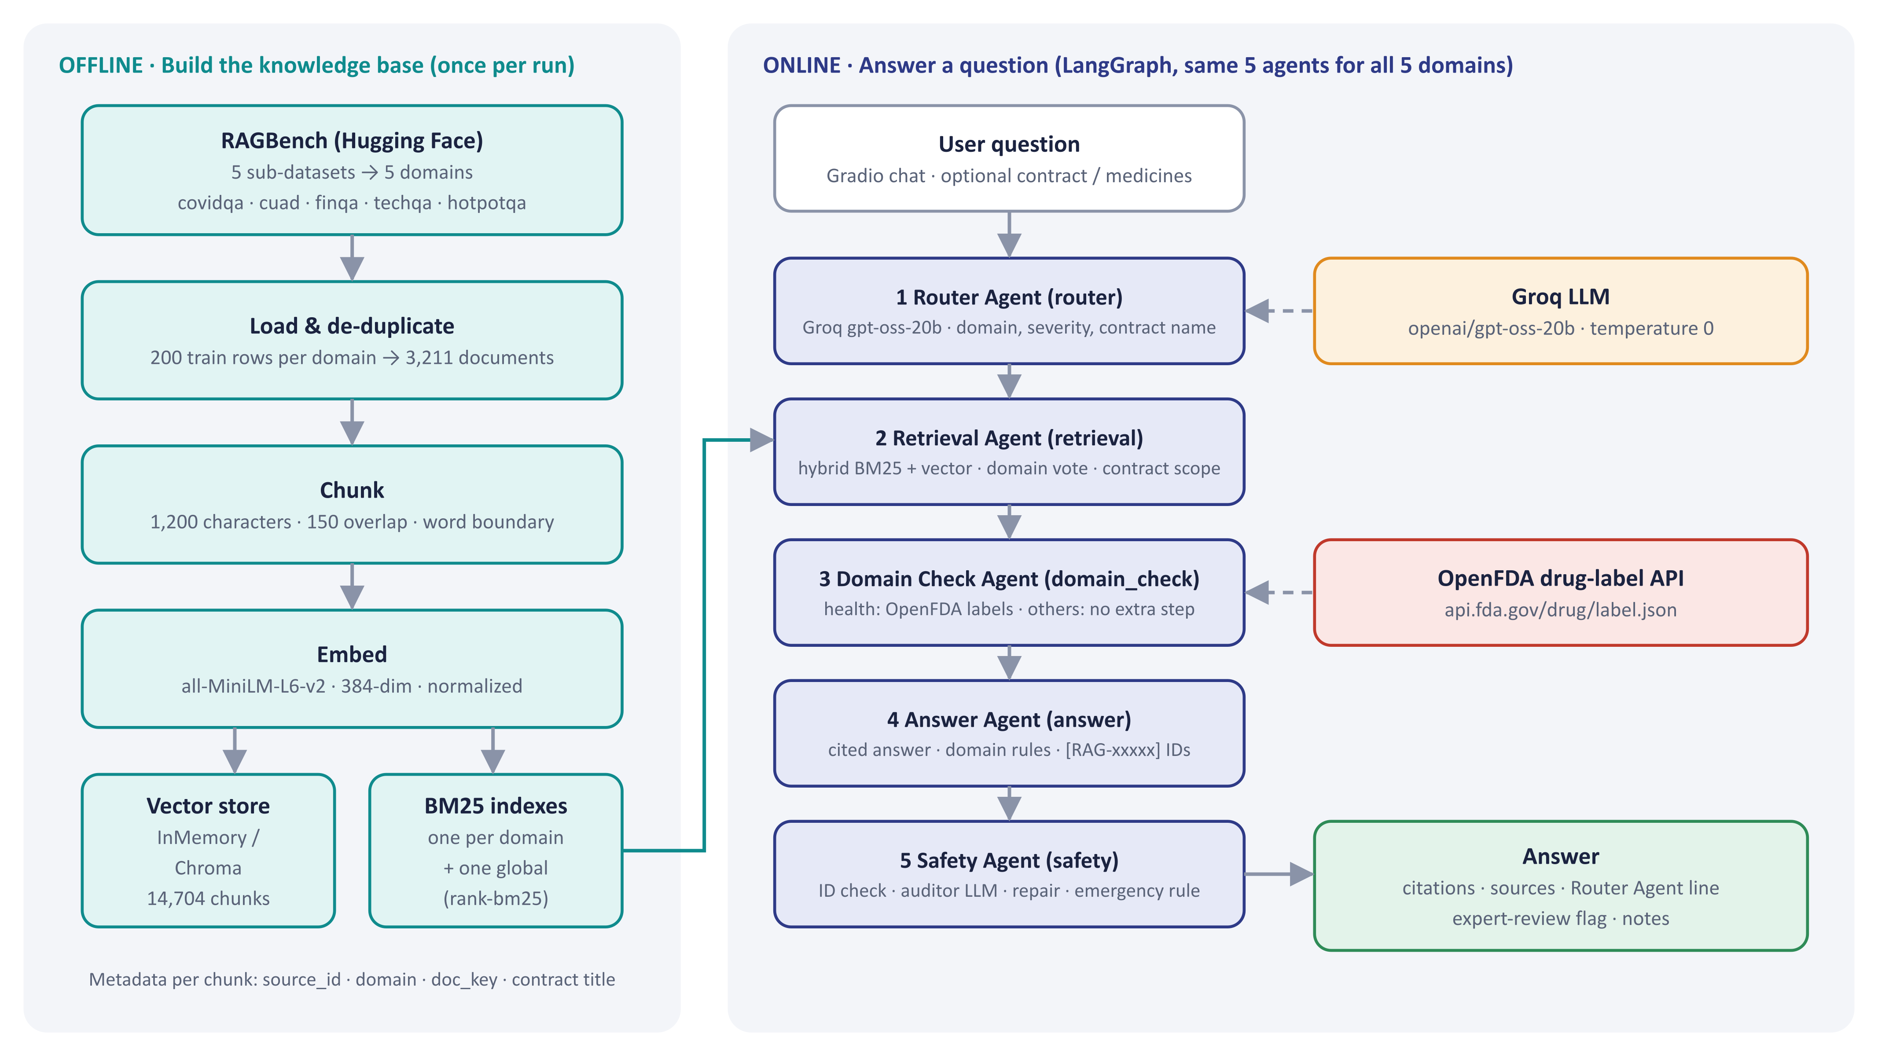
System architecture
Notes:
Left: offline indexing once per Colab session. Right: the five-agent LangGraph workflow per question (Router, Retrieval, Domain Check, Answer, Safety Agent) — the same 5 agents serve all 5 domains. Groq hosts the LLM (gpt-oss-20b; Developer plan for evaluation, free tier enough for a demo); OpenFDA is used only by the Domain Check Agent, only for health questions that mention medicines.

Slide 10
Retrieval in v2.9: hybrid search with smart routing
Question + Router Agent result
domain · contract name · medicines
Reciprocal Rank Fusion
score(d) = Σ 1 / (60 + rank)
Contract named or picked? YES
hybrid search inside that contract · 12 chunks (v2.2 · v2.8)
NO → Domain vote (v2.1)
≥ 3 of global top-5 from another domain → switch
merges dense + BM25 lists without calibrating their scores
top_k
Domain-first hybrid search
dense (MiniLM-L6 cosine) + BM25 → RRF k = 60 · top-8 (v2.4), incl. 2 global back-stop chunks
8 evidence chunks (v2.4)
LEGAL_TOP_K
12 for a named contract (v2.8)
GLOBAL_BACKSTOP
2 from all domains
Finance
+ up to 4 report-table chunks (v2.5)
Support
+ 2 error-code BM25 matches (v2.5)
General
+ 3 second-hop chunks (v2.8)
DOMAIN_VOTE_MIN
3 of global top-5
Contract match
token overlap ≥ 0.6
Evidence chunks with [RAG-xxxxx] IDs → Answer Agent
REPORT_TABLES / FOLLOW_UP_K
4 tables / 3 second-hop
Notes:
Walk through the flow: a named contract is searched on its own (12 chunks); otherwise the domain vote can correct the Router Agent, then domain-first hybrid search with a 2-chunk global back-stop fuses dense and BM25 lists with RRF into the top-8. Finance, support and general questions get a targeted add-on.

Slide 11
Embedding & retrieval system: v2.0 → v2.9
v2.0
v2.1
v2.2
v2.3
v2.4
v2.5
v2.6–2.7
v2.8
v2.9
Embedding & index
MiniLM-L6, 384 dims; 1,200 / 150 chunks
200 rows + de-dup → 14,704 chunks
·
GPU batch 256: index in ≈ 2–3 min
·
·
·
·
·
Retrieval
Hybrid dense + BM25, RRF k = 60, top-5, back-stop 2
Domain vote (3 of global top-5)
Contract-scoped legal search
·
top-k 5 → 8
Finance report tables; error-code BM25 extras
·
Named contract 12 chunks; 2nd-hop search
·
Generation & safety
Strict check: whole answer blocked
Citation normaliser; repair, not block
·
Gradio debug = False
Retry an empty answer
Unknown IDs removed, not blocked
Labelled table values; audit twice
·
Empty reply → low-effort retry
Measured
37.5% (34 Qs)
15/30 · hit 21
legal hit 0/6 → 6/6
runtime only
19/30 · hit 28
23/30
23 → 24/30
25/30
25/30 final
MiniLM-L6 embeddings and 1,200 / 150 chunks unchanged v2.0 → v2.9: accuracy 50% → 83% came from retrieval and checking logic
Notes:
Read the slide column by column. The embedding model and chunking never changed — every gain came from retrieval logic (what evidence reaches the LLM) and from the checking logic. The bottom row is the measured effect of each version.

Slide 12
Baseline (v2.0): where we started
Domain | Graded | Correct | Accuracy | Right doc | Safety gate | Retrieval | Answer model | Routing | Not run
Biomedical | 9 | 6 | 67% | 9/9 | 3 | 0 | 0 | 0 | 1
Legal | 9 | 1 | 11% | 1/9 | 1 | 6 | 1 | 0 | 1
Finance | 10 | 3 | 30% | 8/10 | 3 | 0 | 3 | 1 | 0
Customer support | 4 | 2 | 50% | 4/4 | 2 | 0 | 0 | 0 | 6
General | 0 | — | — | — | — | — | — | — | 10
Total | 32 | 12 | 37.5% | 22/32 | 9 | 6 | 4 | 1 | 18
Three readings
1. The safety gate was the biggest fault. 9 of 20 misses were good answers blocked by the strict citation check. v2.1 repairs instead of blocking.
2. Legal retrieval failed. The right contract was found for 1 of 9 questions among 161 look-alike contracts. v2.2 added named-contract search.
3. The LLM was rarely the problem. Only 4 of 20 misses were answer-model errors; routing caused 1.
10 questions planned per domain. Safety gate … Routing = cause of each miss. Not run = Groq free-tier daily quota ran out, or the judge failed. v2.0 used its own question set; from v2.1 every version uses the same 30 questions.
Baseline 37.5% (12 of 32) → final v2.9 83% (25 of 30). Most baseline misses came from pipeline rules and retrieval, so those are what each version fixed.

Slide 13
Five agents in one LangGraph workflow
1
2
3
4
5
Router Agent
Retrieval Agent
Domain Check Agent
Answer Agent
Safety Agent
router
retrieval
domain_check
answer
safety
LLM · TriageResult
no LLM (2nd hop: 1 call)
LLM only for health + medicines
LLM · text
LLM auditor + repair
domain, severity, emergency, contract name, medicines
hybrid BM25 + vector, contract scope, domain vote → top-8 + tables / 2nd hop
health: OpenFDA labels, finding kept only if the quote matches; other domains: nothing extra
answer first, domain rule, [RAG-xxxxx] after every fact
ID check, double audit, claim removal, emergency rule
Same 5 agents for all 5 domains — the Domain Check Agent only does extra work for health questions (OpenFDA medication labels).
Notes:
Each node reads the shared typed state (AssistantState) and adds its output. Structured agents return Pydantic models via JSON-schema output with 3 retries. The same 5 agents serve all 5 domains; the Domain Check Agent only does extra work for health questions (OpenFDA medication labels) and passes the other domains straight on.

Slide 14
What changed in each version
Version | What changed | Tested on | Correct (30) | Hit (30) | 18-set
v2.0 | Baseline: 100 rows/domain, top-5 hybrid search, strict citation check (whole answer blocked on any problem) | 34 of 50 (quota) | 37.5%* | — | —
v2.1 | Citation normaliser, safety repair (remove only bad statements), domain vote, 200 rows/domain, de-duplication | 30 of 30 | 15/30 (50%) | 70% | —
v2.2 | Contract-scoped legal search when the question names a contract | 6 legal (retrieval) | — | 90% | —
v2.3 | Colab speed: GPU embedding batches, progress bar, Gradio debug=False | runtime + 9 demo scenarios | — | — | —
v2.4 | top-k 5 → 8 evidence chunks; retry an empty answer | 30 of 30 | 19/30 (63%) | 93% | —
v2.5 | Finance: add each report's table; error codes get extra keyword matches; Safety Agent removes unknown citations instead of blocking | 30 + 18 | 23/30 (77%) | 93% | 13 + 2p
v2.6 | Finance tables shown with every value labelled by its column | 30 + 18 | 23/30 (77%) | 93% | 13 + 2p
v2.7 | Safety audit asked twice before removing a statement; computed numbers count as supported | 30 + 18 | 24/30 (80%) | 93% | 14 + 1p
v2.8 | Named contract: 12 chunks; general questions: second-hop search for the missing fact | 30 + 18 | 25/30 (83%) | 93% | 11 + 2p
v2.9 | Empty model reply retried with low reasoning effort (answer and repair) | 30 + 18 | 25/30 (83%) | 93% | 12 + 3p
v3.0 (120b) | Experiment: gpt-oss-120b instead of gpt-oss-20b — same score, 2× cost, so not adopted | 30 + 18 | 25/30 (83%) | 93% | 12 + 2p
* v2.0: 37.5% of 34 tested questions (quota ran out). v2.2: hit 90% = legal retrieval 0/6 → 6/6. 18-set: correct + partial (p). Highlighted = final version.
Notes:
Each version targeted the largest measured failure of the previous one. Percentages are of the same 30 questions; the 18-question in-dataset set was added from v2.5.

Slide 15
Evaluation metrics
SYSTEM QUALITY · one metric per pipeline stage, same 30 questions (6 per domain) for every version
Metric | Formula | Reads as | Component | v2.9 result
Routing ↑ | routed to the true domain ÷ 30 | Did the Router pick the right domain? | Router Agent | 30/30 · 100%
Retrieval hit ↑ | ≥ 1 chunk from the question's own source documents ÷ 30 | Did retrieval find the answer passage? | Retrieval Agent | 28/30 · 93%
Answered ↑ | answers released, not refused ÷ 30 | Did the system answer instead of refusing? | Safety Agent | 29/30 · 97%
Correct ↑ | judge verdict CORRECT ÷ 30 | Does the answer match the RAGBench reference? | Answer Agent (end to end) | 25/30 · 83%
How Correct is judged: an LLM judge (gpt-oss-120b) compares each answer with the RAGBench reference answer → CORRECT / INCORRECT / NOT_ANSWERED.
Reported three ways: raw 25/30 (83%) · 2 faulty references removed 25/28 (89%) · answerable only 25/26 (96%)
Deliverables
GitHub: https://github.com/suneel130588-art/IITH_MultiDomain_RAG_Agents_Project_Group_2
Back end: notebooks/MultiDomain_RAG_Agents_v2.9_final.ipynb (+ v2.0 – v2.8) Front end: web_app/
Documents: docs/ Report (PDF) · this presentation · RAG_Test_Report_v2.0_to_v2.9.xlsx · App_30Q_Check_Result.xlsx · indexed data · run guide

Slide 16
Correct answers by version and domain
Version | What changed | Bio | Legal | Finance | Support | General | Correct /30 | Hit /30
v2.1 | Safety repair, domain vote, 200 rows/domain | 3 | 2 | 1 | 4 | 5 | 15 | 21
v2.4 | + contract search (v2.2); top-k 5 → 8 | 4 | 5 | 1 | 5 | 4 | 19 | 28
v2.5 | Finance report tables; error-code matches | 5 | 6 | 2 | 5 | 5 | 23 | 28
v2.6 | Table values labelled by column | 4 | 6 | 2 | 6 | 5 | 23 | 28
v2.7 | Safety audit asked twice | 5 | 6 | 3 | 5 | 5 | 24 | 28
v2.8 | Contract 12 chunks; second-hop search | 4 | 6 | 3 | 6 | 6 | 25 | 28
v2.9 | Empty reply retried (final) | 4 | 6 | 3 | 6 | 6 | 25 | 28
v3.0 | gpt-oss-120b instead of 20b (test) | 4 | 6 | 3 | 6 | 6 | 25 | 28
Reading it
Legal moved most: 2 → 5 in one step with contract-scoped search and top-8; 6/6 since v2.5.
Finance is the hard domain: never above 3/6. Two questions name no company and one reference is garbled.
Document hit reached 28/30 in v2.4; v2.5 still added 4 by retrieving report tables, then answer and safety steps added 2 (23 → 25).
Biomedical moves 5 ↔ 4 with no biomedical change: run-to-run variation of the model.
v3.0: a 6× larger model gives an identical row.
Correct answers out of 6 per domain; same 30 questions in every version. Green = 6/6, red = 2 or fewer. v2.2 and v2.3 were not run on the 30 questions.
Retrieval fixes drove the big jumps (15 → 19 → 23): contract search, top-8 and report tables. After v2.5 each version added at most one question; finance data, not model size, is the remaining gap.

Slide 17
Every model we tried, and the two we chose
1 · Answer model (LLM) · writes the answer · scored on the 30 test questions
Why gpt-oss-20b (answers)
Same accuracy: the 6× larger 120b also scored 25/30; 4 of its 5 misses are the same questions.
Half the cost, 2–3× faster: about ₹0.25 per question; the free tier is enough for a demo.
Fits the agents: temperature 0 with JSON-schema output for the Router and Safety Agents.
Why all-MiniLM-L6-v2 (search)
Fastest and smallest: 163 s to embed on CPU vs 818 s for bge-small. Free Colab rebuilds the index every session.
Close enough: 84% vs 87% hybrid hit@5, i.e. 3 of 95 questions. bge-small is the upgrade when a GPU is guaranteed.
# | Model (on Groq) | Correct /30 | Answered | Cost per question | Answer time | Status
1 | openai/gpt-oss-20b | 25 · 83% | 29/30 | ≈ ₹0.25 (1×) | 1× | Chosen (v2.0 → v2.9)
2 | openai/gpt-oss-120b 6× larger | 25 · 83% | 30/30 | ≈ 2× | 2–3× | Tested (v3.0), not adopted
— | llama-3.3-70b | not tested | — | — | — | Not available on our key
2 · Embedding model · turns text into vectors for search · hit@5 on 95 retrieval questions
# | Embedding model | Hybrid hit@5 | Dense hit@5 | Max tokens | Embed time (CPU) | Status
1 | all-MiniLM-L6-v2 22.7 M params · 384-dim | 84% | 84% | 256 | 163 s (1×) | Chosen (v2.0 → v2.9)
2 | all-MiniLM-L12-v2 33.4 M params · 384-dim | 82% | 79% | 128 | 223 s (1.4×) | Tested, not adopted: 128-token limit
3 | bge-small-en-v1.5 33.4 M params · 384-dim | 87% | 85% | 512 | 818 s (5.0×) | Most accurate; upgrade on GPU
5 models tried, 2 chosen. Answer models were scored on the 30 test questions; embedding models on 95 retrieval questions over the same 1,200/150 chunks (4-core CPU, details on slide 33). llama-3.3-70b was not available on our Groq key, so it was not tested.

Slide 18
Accuracy ranked: every version and every model tried
v2.0 (37.5%) is not shown: it used a different question set and graded only 32 of its 50 questions.
Embed time on CPU: L6 163 s · L12 223 s · bge-small 818 s (5.0×).
Every model tried, ranked. Answers: gpt-oss-120b ties gpt-oss-20b at 83.3%, so the gains came from pipeline changes, not model size. Search: bge-small leads by 3 points but is 5× slower, so MiniLM-L6 stays. llama-3.3-70b was not tested (not on our Groq key).

Slide 19
Final results (v2.9): 25/30 correct
83%
25/30
Raw — all 30 questions
89%
25/28
Cleaned — 2 faulty references removed
96%
25/26
Answerable — also 2 no-company questions removed
12/18 + 3 partial
18 in-dataset questions (retrieval hit 16/18); 1 has a faulty reference
Totals: routing 30/30 · retrieval hit 28/30 · answered 29/30 · correct 25/30
Notes:
Raw 25/30 = 83%. Cleaned: BIO-03 and FIN-02 have faulty RAGBench reference answers → 25/28 = 89%. Answerable: FIN-01 and FIN-06 name no company and fit many of the 200 reports → 25/26 = 96%. 18 in-dataset questions: 12 correct + 3 partial. Routing 30/30, retrieval hit 28/30, answered 29/30.

Slide 20
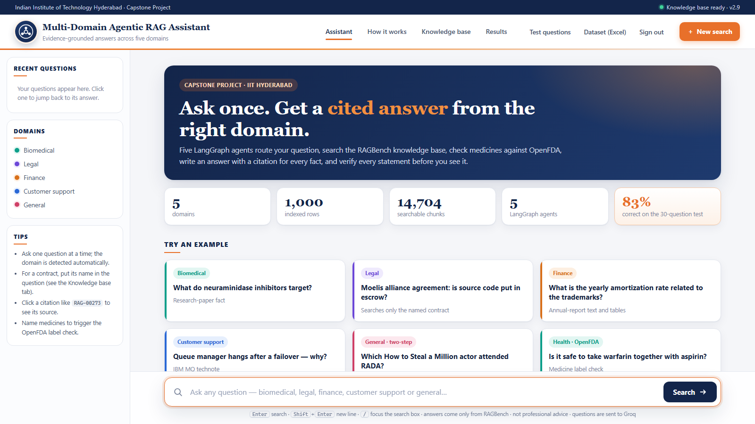
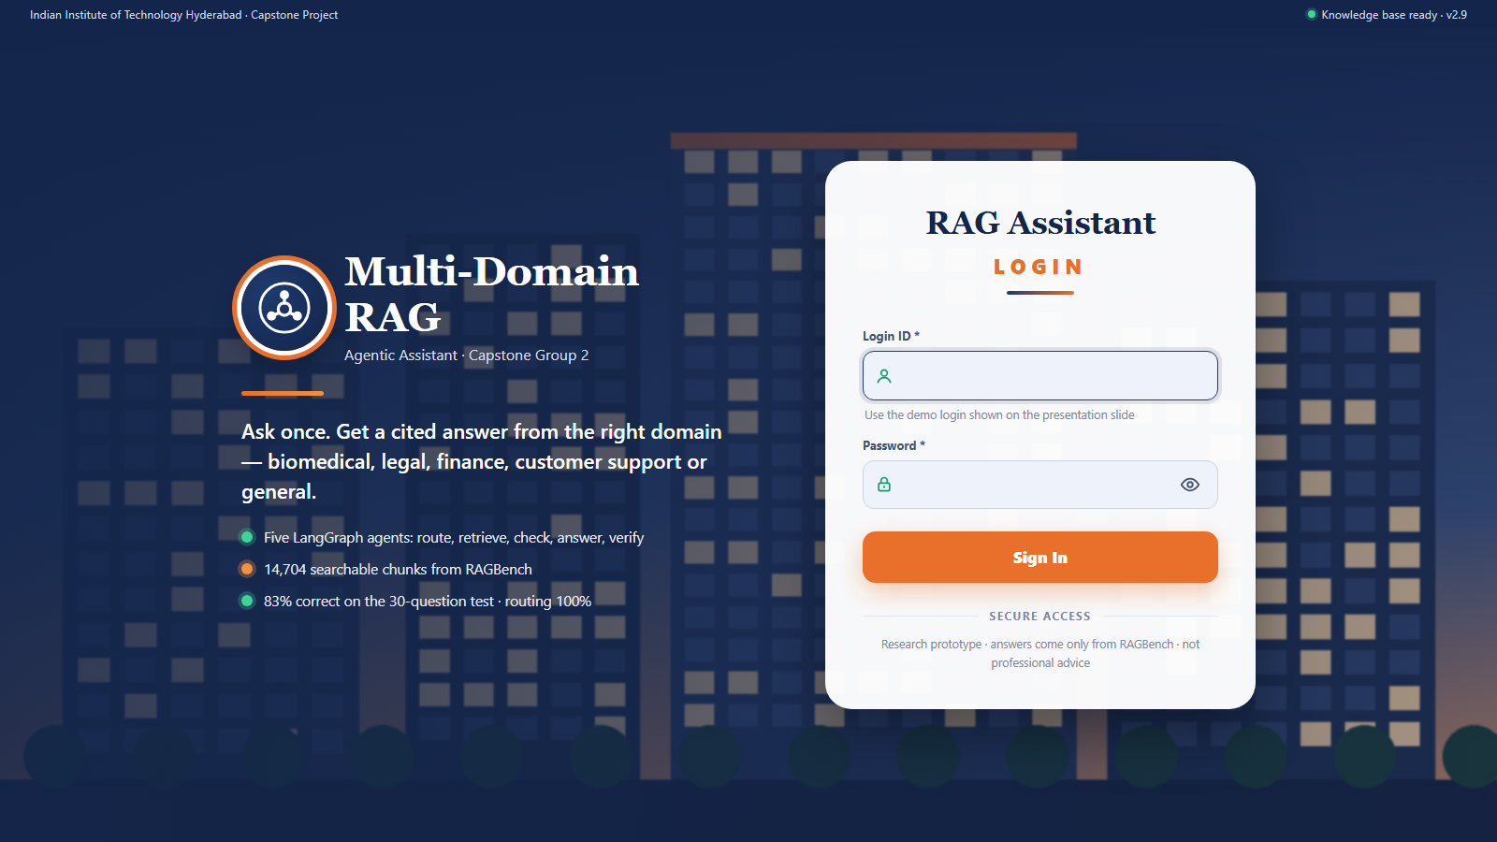

Live demo: try it yourself
Sign-in page (same colours as the app).
Try it now
Login ID: iith Password: Rag@Demo2026
Open the app
https://gilled-return-oasis.ngrok-free.dev/login
Test questions (30 · click Ask →)
https://gilled-return-oasis.ngrok-free.dev/questions
Loaded data (Excel) (200 rows × 5 domains)
https://gilled-return-oasis.ngrok-free.dev/dataset
Source dataset (RAGBench, Hugging Face)
https://huggingface.co/datasets/galileo-ai/ragbench
Fixed link · live while the demo PC is on · first visit: click “Visit Site”.
Assistant home: ask a question, see the five agents work, check every cited source.
Scan to open the app on your phone → sign in with the login on the right
How to test: 1 open the link and sign in 2 pick a question on Test questions, or type your own (for a contract, name it) 3 check the cited sources on the right of each answer 4 after signing in, download the dataset (Excel) and ask any question from its rows

Slide 21

Conclusion and future work
25/30
correct answers (83%), up from 15/30
96%
of answerable questions
100%
routing to the right domain
≈ ₹0.25
per question on Groq
What we concluded
1. Retrieval design beat model size. Every gain from 15/30 to 25/30 came from a pipeline change; a 6× larger model also scored 25/30.
2. Each domain needed its own fix. Contract scope for legal, tables for finance, keyword matches for support, a second hop for general.
3. Repair, don't block. Removing only unsupported sentences raised the answer rate from 74% to 97%, with no fabricated citation.
4. The remaining misses are data problems. 2 faulty RAGBench references and 2 finance questions that name no company.
Future work
→ Ask when the company is missing. A clarifying question or company filter for questions like FIN-01 and FIN-06.
→ Upgrade the embeddings. bge-small-en-v1.5 scored 3 points higher; switch on a GPU runtime.
→ Bigger, steadier evaluation. Hundreds of questions, several runs per version (scores vary ±1).
→ Clean the benchmark. Fix the faulty references and report cleaned scores.
→ Conversation memory. Answer follow-up questions in context.
Multi-Domain Agentic RAG · Capstone Project · IIT Hyderabad

Slide 22
MULTI-DOMAIN AGENTIC RAG ASSISTANT · GROUP 2
Thank you
Questions & answers
PRESENTED BY
Suneel Jangam
Udumula Sreenivasa Reddy
Manojeet Dey
Arun Sarathy P B
GUIDE / MENTOR
Lokesh
Professional Certification Program in Artificial Intelligence, IIIT Hyderabad
TRY THE LIVE DEMO
https://gilled-return-oasis.ngrok-free.dev/login
Login iith · Password Rag@Demo2026 · 30 test questions
Multi-Domain Agentic RAG · Capstone Project · IIT Hyderabad
November 14, 2026

