Slide 1

GEO-LOCATION CLUSTERING USING K-MEANS ALGORITHM
Project Members:
Revanth Reddy Bandaru group-2
Sai Priya Mallu group-2
Veera Venkat Sunil Kumar Seelam group-2
Preetam N Soni group-1

Slide 2
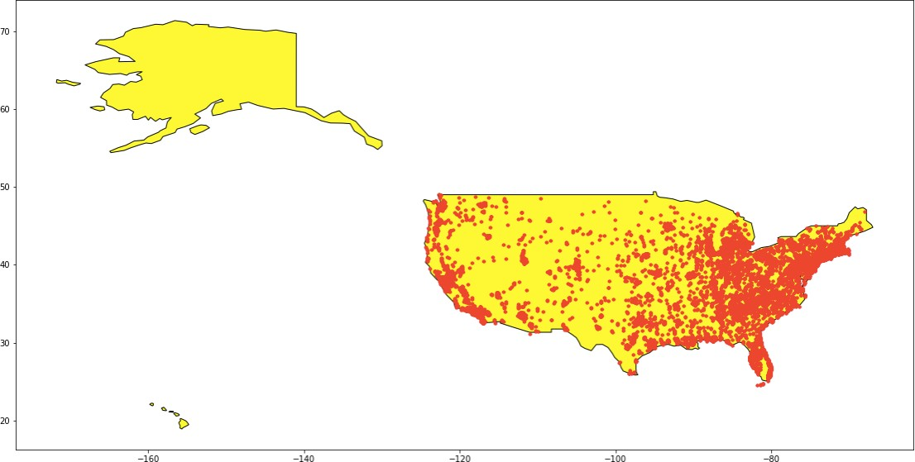
Introduction:
Clustering is the process of grouping a set of data points into k clusters
Clustering is used in applications such as Pattern recognition, Image analysis, Information Retrieval, Bioinformatics, Document classification, Logistics, Marketing, Computer graphics, Machine learning etc.

Slide 3
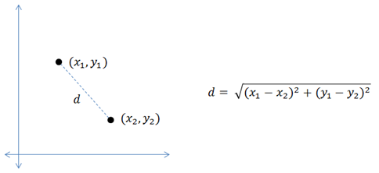
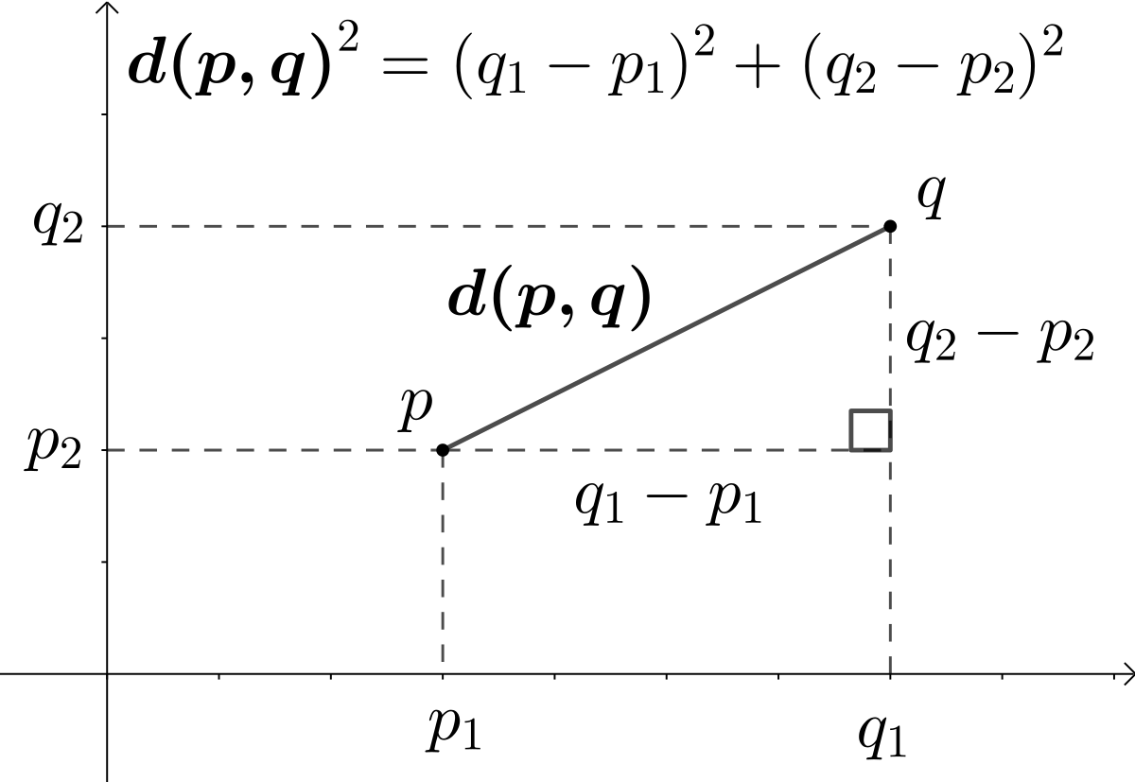
Distance function
To measure the distance between the geo-points, one of the two below distance measures are used. Here 𝑑 is the distance, 𝑅 is the radius of earth, 𝜃𝜃 is latitude and 𝜙𝜙 is longitude.
Notes:
Cluster size (k) �2 �+ cos 𝜃𝜃1 . cos 𝜃𝜃2 . 𝑠𝑠𝑠𝑛 ( 2 ) This parameter needs to be set according to the application or problem domain. Time taken to cluster the data points with respect to different dataset sizes, cluster sizes and distance measures is also analyzed in this project. Finally, a larger geolocation dataset is clustered on Amazon EMR. The datasets used for the analysis are devicestatus.txt, sample-geo.txt, lat-longs.txt. These datasets are stored on Amazon S3.

Slide 4
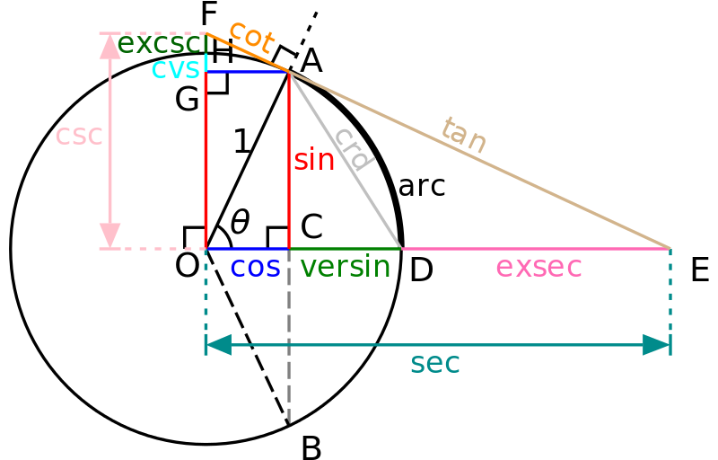
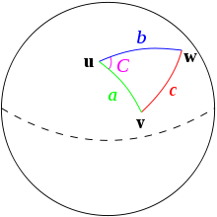
Haversine Distance
Haversine distance
ΔlatDifference = lat1 – lat2 (difference of latitude)
ΔlonDifference = lon1 – lon2 (difference of longitude)
R is radius of earth i.e 6371 KM or 3961 miles

Slide 5
Technology:
Python
Amazon AWS
S3
EC2
Spark
MatPlotLib
SkLearn

Slide 6
Data pre-processing and visualization
Data pre-processing is transforming raw data into an understandable format.
Figure 2: Visualization of cleaned Synthetic location data
Notes:
The above steps are carried out on a dataset with 9970 points. Similar preprocessing is done on the dataset and the resulting dataset is uploaded to Amazon S3. The below figure is the visualization of longitude and latitude pairs obtained from sample-geo.txt dataset

Slide 7
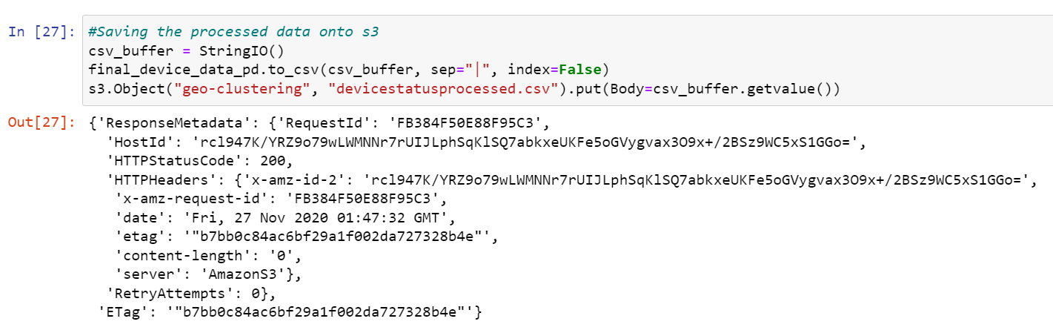
Device Status Dataset

Slide 8
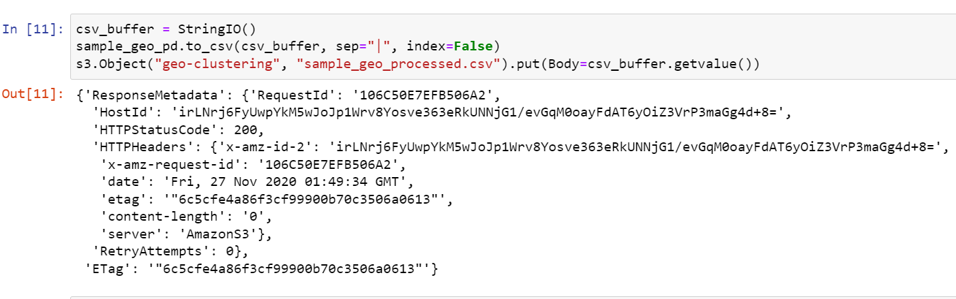
Sample-geo-Processed data

Slide 9
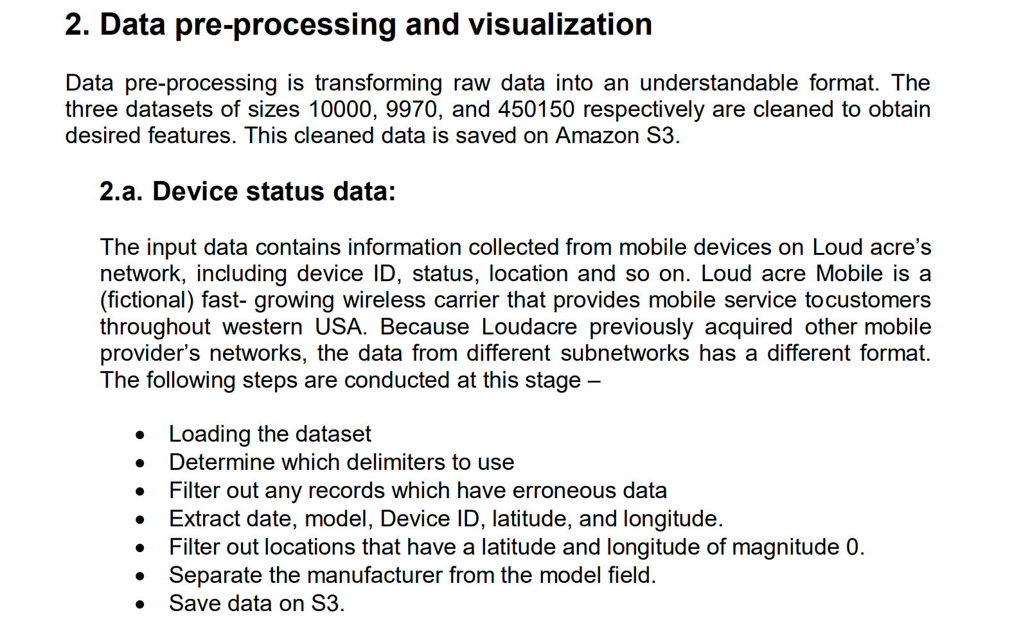

Slide 10
Implementation of the K-means algorithm
To initialize the iterative algorithm, a random sample of k centroids are taken from the data points
In every iteration, the data points are assigned to their nearest centroid. This is measured using either the Euclidian or Haversine distance. Next, mean of each of the k clusters is calculated.
Notes:
Given below is the pseudocode of geo-clustering using k-means algorithm. To initialize the iterative algorithm, a random sample of k centroids are taken from the data points. In every iteration, the data points are assigned to their nearest centroid. This is measured using either the Euclidian or Haversine distance. Next, mean of each of the k clusters is calculated. This becomes the new centroid. Iteration distance is calculated by adding all the distances from every data point to the centroid. The goal is to minimize this distance. The middle point is calculated again using the new centroid. This process is repeated until convergence. In this project, Apache Spark framework is used. Spark is especially useful for parallel processing of distributed data with iterative algorithms on big data workloads. The implementation of the k-means algorithm is done using PySpark, which is the Python API to support Apache Spark

Slide 11
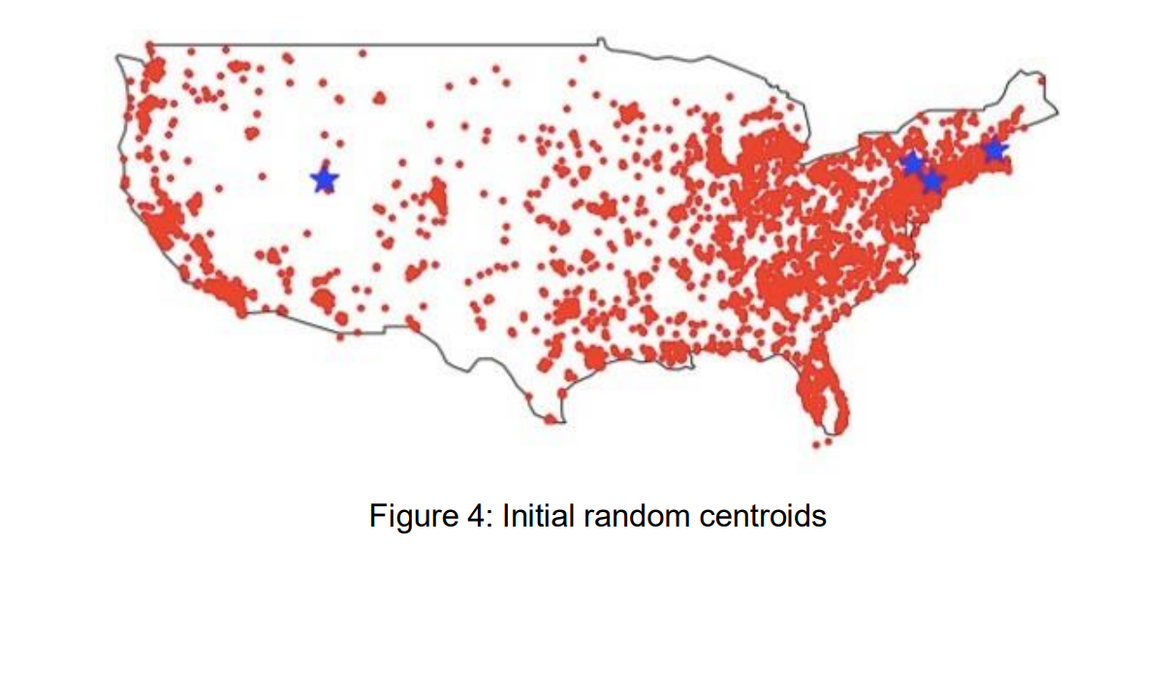
Implementing of K means

Slide 12
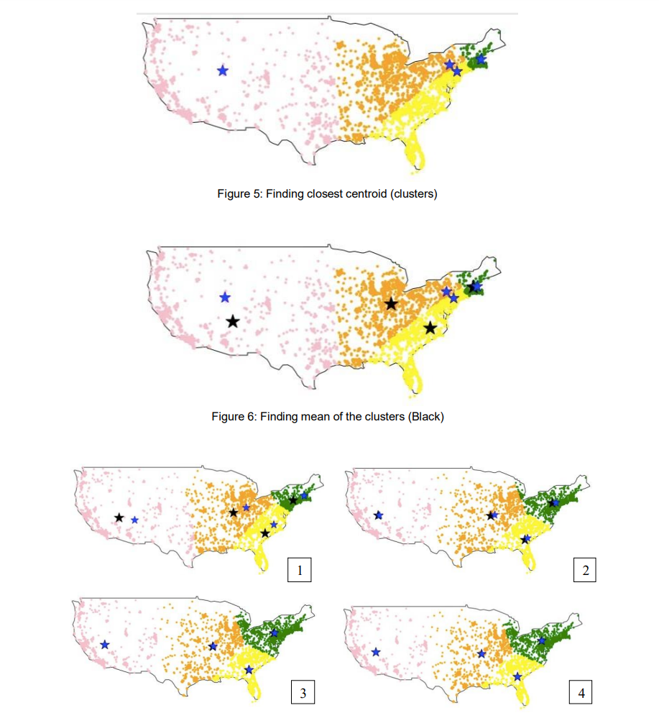
Implementing of K means

Slide 13
Runtime analysis
The algorithm is analyzed by setting different k values and distance measure type
<input-file-name> is the file name of the processed device status, synthetic and DBPedia data uploaded to S3.
<output-file-name> can be any name that we want our clusters to be outputted in a text file on Amazon S3.

Slide 14
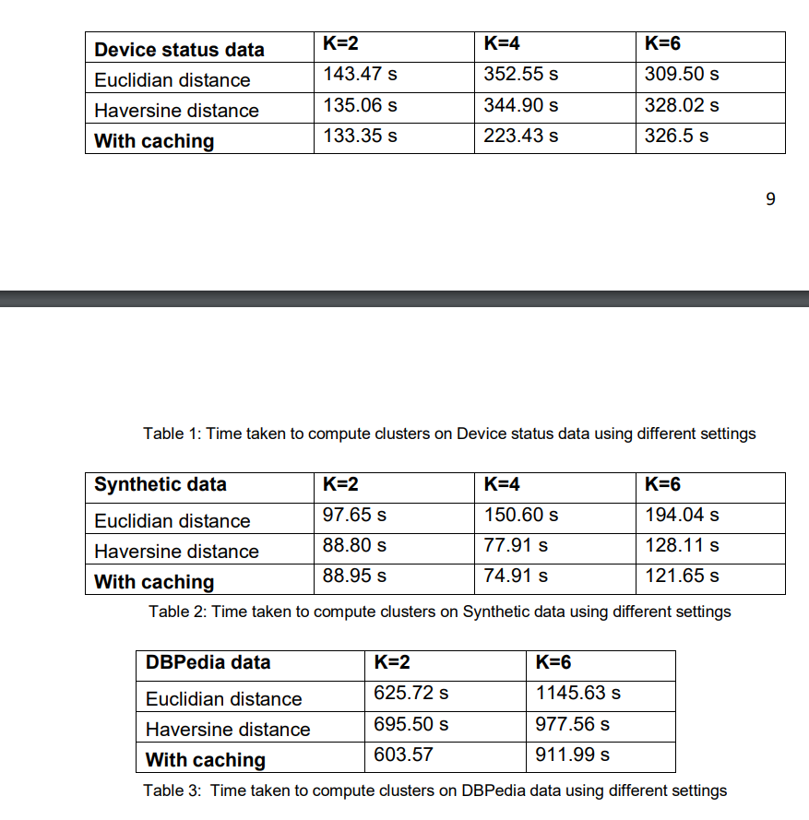

Slide 15
Conclusion
Geo-location clustering finds similar regions in space which can be used in a whole range of applications. In this project, different sizes of datasets were used to form special clusters of sizes k, using the Apache’s Spark framework. Spark is designed for in-memory processing. Spark achieves performance gains by caching the results of operations that repeatedly. The Spark Data frames which were used many times in the iteration of finding centroids were cached.

Slide 16
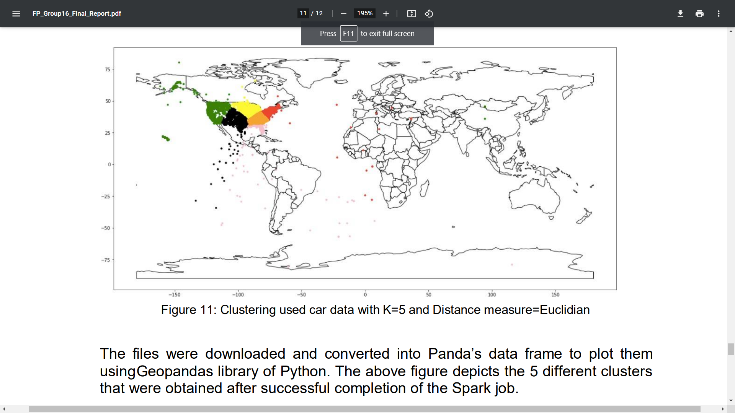

Slide 17
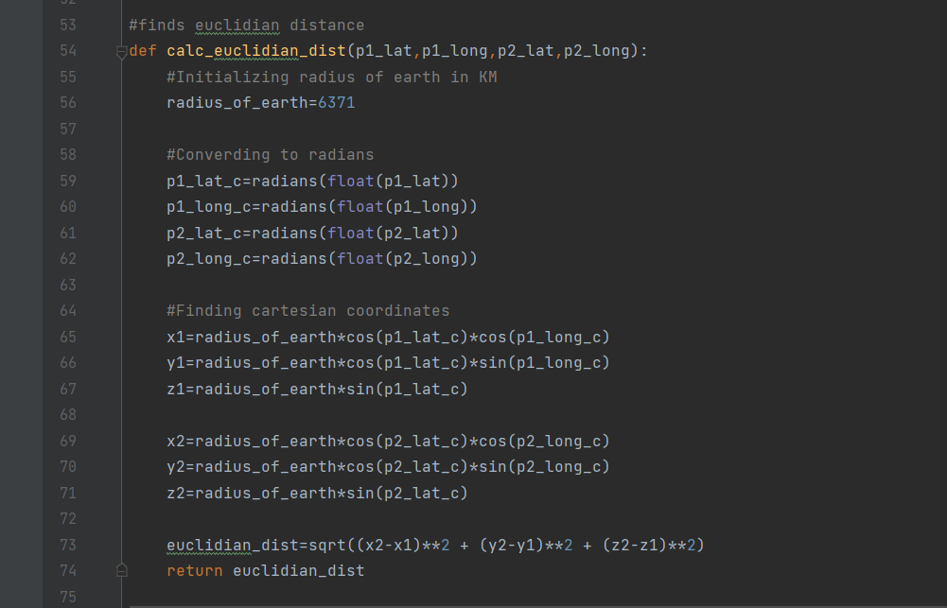
Calculating Euclidean distance- code
Calculating Euclidean distance

Slide 18
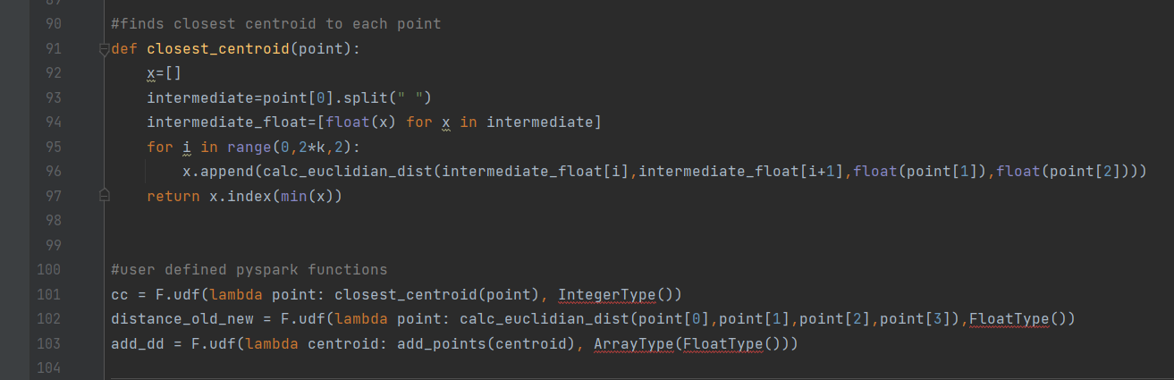
Finding closest Centroid into each point
Finding closest Centroid into each point

Slide 19
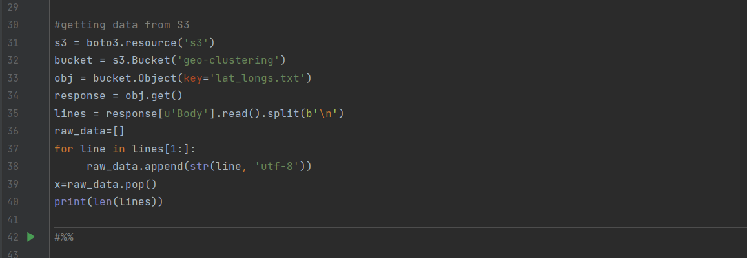
Getting data from s3
Getting data from s3

Slide 20
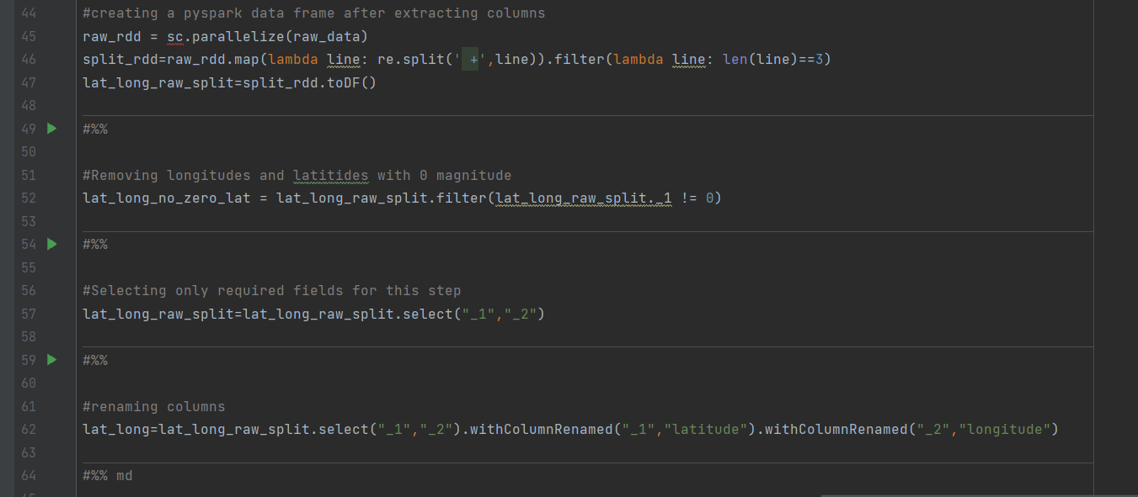
Preprocessing Data- removing longitude/latitude with 0 magnitude, selecting only required fields
Preprocessing Data

Slide 21
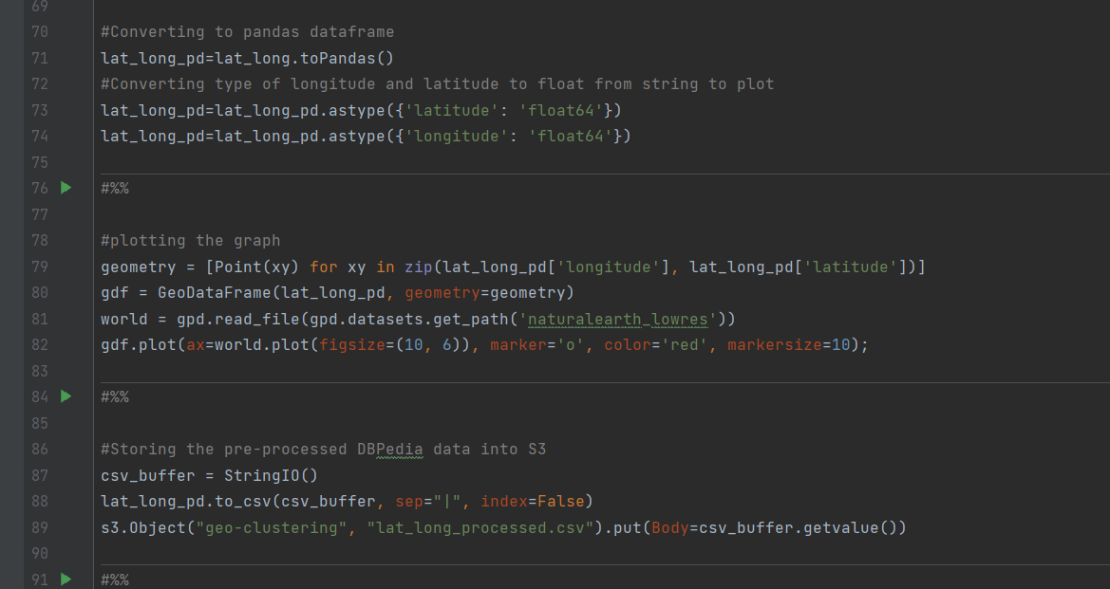
Plotting Functions for graph
Printing/Plotting the graph

Slide 22
Thank You

