Slide 1
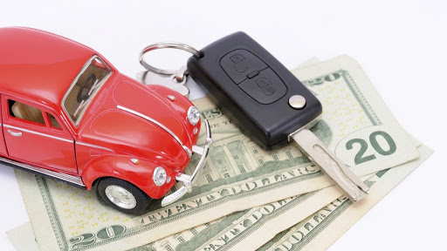
USED CAR PRICE PREDICTION
Under the Guidance of Professor
Vahid
By Suneel and Sowmya

Slide 2

Motivation
“Auto sales” is one of the major producers of domestic automobiles report sales.
Car price prediction especially when the car is used and not coming direct from the factory, is both a critical and important task.
There is a need of accurate price prediction mechanism for the used cars which can express the changes in economy precisely.
Prediction techniques of machine learning can be helpful in this regard.
It is common to lease a car in many countries rather then buying a new car.

Slide 3
Objectives
The main objective of our project is to predict the price of the used car data.
To compare the difference between the actual price and predicted price.
Using this difference, to improve our model close enough to the actual model.

Slide 4
Methodology
Dataset from Kaggle
Data Cleansing
EDA
Visualizations
Models

Slide 5
Dataset
Source of data :
https://www.kaggle.com
Datapoints: 370000
Years : 1923 to 2021

Slide 6
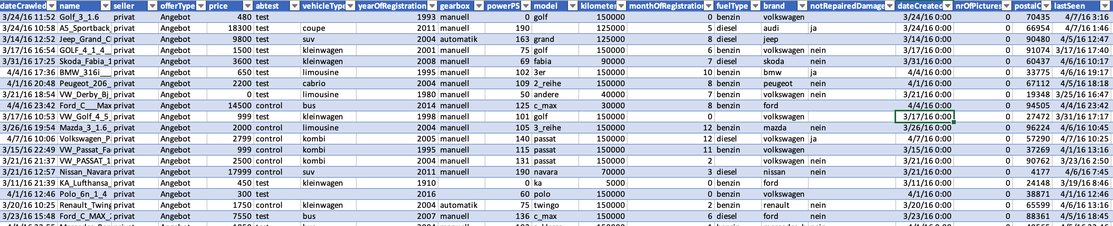

Sample Data Set View

Slide 7
Models Used
Linear Regression Model
K Nearest Neighbors Model
Artificial Neural Network – MLP Regressor
Decision Tree Regression Model
Random Forest Regression Model

Slide 8
Potential Uses and Application
Developing countries adopt lease culture instead of buying a car due to affordability.
There is a need for a used car price prediction system to effectively determine the worthiness of the car using a variety of features.

Slide 9
Evaluation Methodolgy
The most relevant features used for this prediction are price, year, Power_ps, and vehicle age by filtering out outliers and irrelevant features of the dataset.

Slide 10
Further Improvement
To collect data for more car details
More information of cars in the current dataset
To adjust model hyperparameters, by using Randomized Search CV

Slide 11
Deliverables
Environment File :
Project Implementation.py is the Environment class, Each method (function) of the class has a specific purpose.
File containing python code describing how good a model is working in analysing the predict the price of the used car data.
Fit or Train the training data for each model. Evaluate prediction accuracy score for each model.
Git hub Repository link for Project Code and Reports.
Project demonstration You tube Video Link.
Visualizing all the Models Graphs and explaining the differences.

Slide 12


