Slide 1


Slide 2
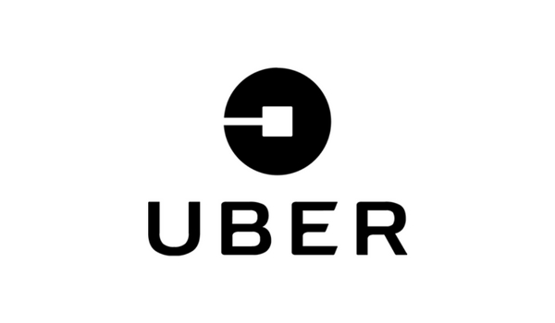
UBER Database Management System
Group 14-
Project by:
M MEHER SUNEEL 1215316234
E SRIJAN REDDY 1215316211
CH BIPINKRISHNA VARMA 1215316208
T ABHISHEK 1215316259

Slide 3
Abstract
This project is aimed at developing an Minicab Operator.Here, we mentioned Uber as Company. The Company pays for many advertising companies as shown. A Driver is identified by Driver Id while driving a car, has a constraint that he can only drive 4 people per ride. The Client includes Rate, Password, CP.no (client phone number), Client Id, Location (The Location of the Client).The Client adds a request for a ride, which is being sent to the Company. The Company sends back the request, which is being received by the Driver with specific Driver ID. Driver who drives a Car, maybe an Owner or Employee for the car. A Driver can be a Part-time or Contract Driver. This Driver when he accepts the request gets the trip details. Bill is paid by Client to Driver from Uber wallet, Paytm wallet, by adding Paytm balance to Uber wallet

Slide 4
Goals of our project
To provide anytime transportation service to the customer.
Make transportation as reliable as running water, everywhere, for everyone.
To increase the profit.

Slide 5
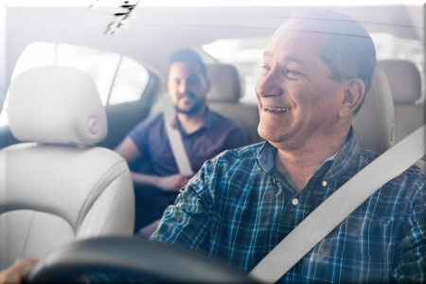
Purpose
Alternative Way instead of Taxi or Auto-Rickshaw.
Is Not to Operate Alongside Public Transit but to Replace It.

Slide 6
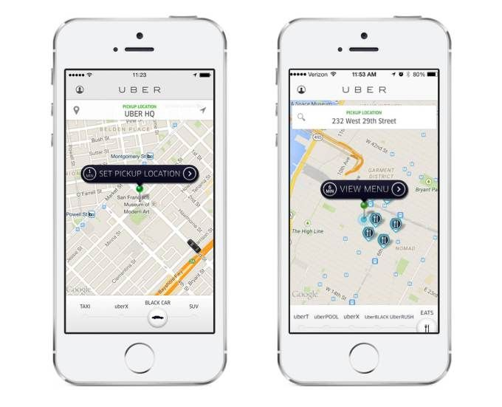
Features
User friendly Interface
Wait time & cancellation
Filtering the drivers as per highest rating
Can pay Online or Offline
Access from any location

Slide 7
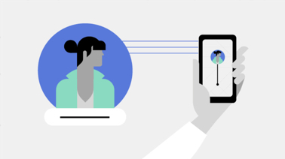
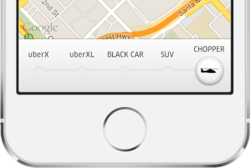
Can choose preferred vehicle
Sharing the Trip is Possible
Will be connected to nearest Vehicle possible

Slide 8
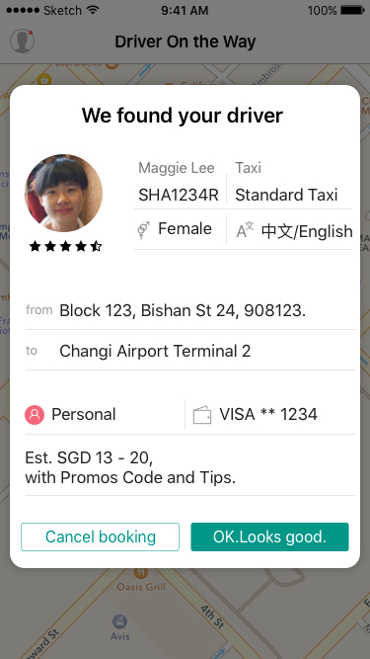
Driver consists of :
Driver ID
Driver Name
Phone Number
Rating
Gender

Slide 9
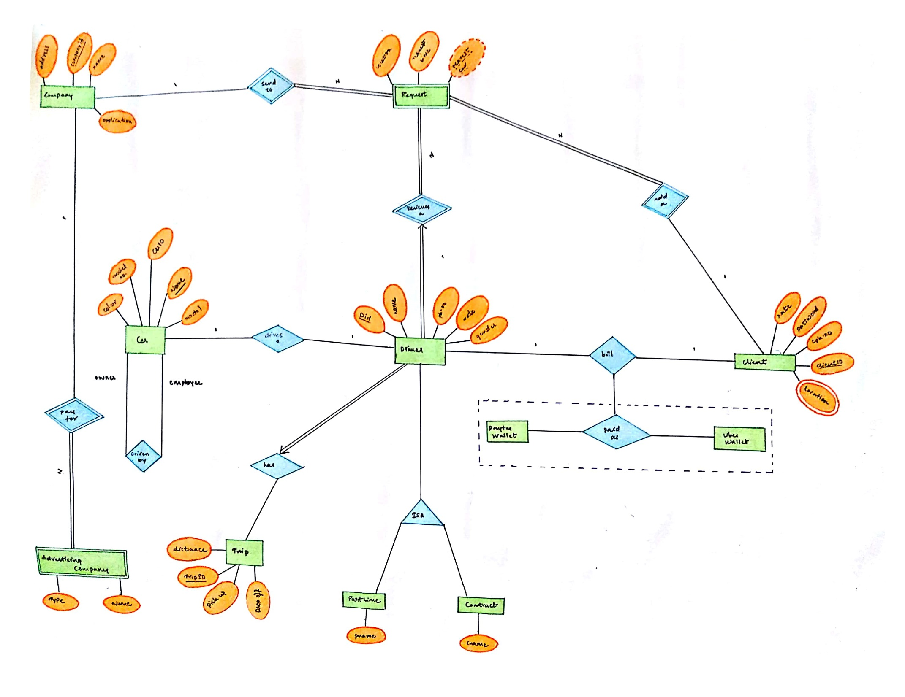
ER MODEL

Slide 10
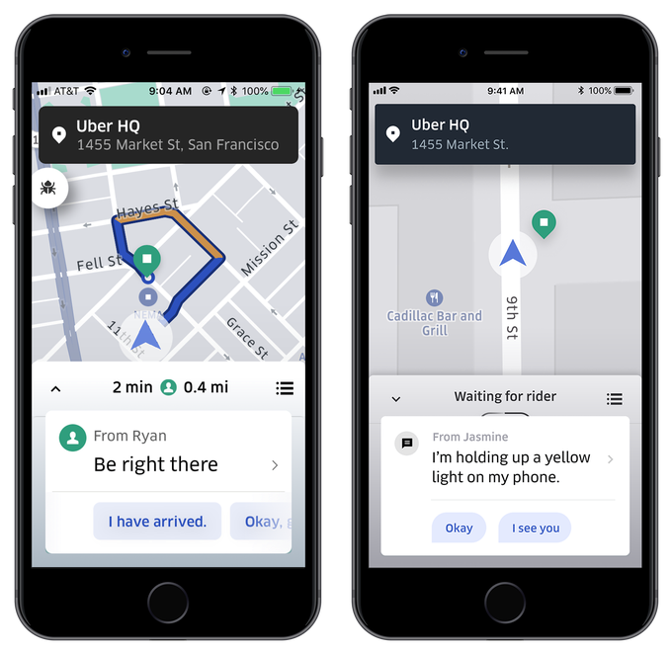
REQUIREMENT ANALYSIS
1.Driver :
Driver must have a car.
He must be at least owner or employee
for the car.
The Driver either will be Part time or a
contract driver.
Driver must accept the request
from the company.
Driver must accept the trip

Slide 11
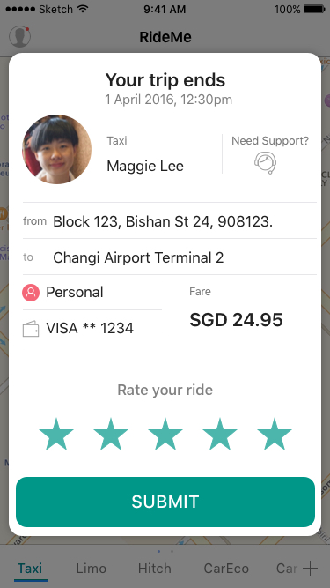
2.Client:
Client must add a request.
Client must pay the bill to the driver.
The bill must be paid by either Paytm wallet
or Uber wallet.

Slide 12
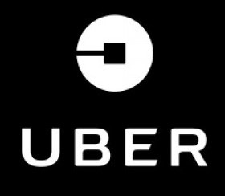
THANK YOU
By:
E SRIJAN REDDY

