Slide 1

AMAZON PRODUCT REVIEWS ( SPAM AND NON-SPAM )
Instructor: Jongwook Woo
Group – 4
Suneel Srikanta ( Team Lead, Big Data Developer ) Avinash Vallabhaneni ( Big Data Developer )
Shahadat Molla ( Big Data Developer )

Slide 2








AGENDA
Introduction
Cluster Specification
Project Workflow
Hive Tables for Visualizations
Analysis & Visualization
Challenges / Solutions
Dataset Details
Conclusion

Slide 3
Introduction
Information about Dataset
Dataset name: Amazon Product Review ( Spam and Non-Spam )
Dataset source URL: https://www.kaggle.com/datasets/naveedhn/amazon-product-review-spam-and-non-spam
Country: USA
Number of Files: 5
Dataset size: 2.4 GB

Slide 4

Introduction
Project Introduction
Examined spam and non-spam reviews within the United States.
Performed year-on-year growth analysis to further understand trends in both spam and non-spam reviews.
Conducted an analysis to determine the state generating the highest volume of spam reviews and identified trends specific to each category.
Utilized Tableau to conduct further analysis of the data.
Project GitHub link
https://github.com/suneelsrikanta/Hadoop_Spam-and-Non_spam_reviews

Slide 5
Server Specifications
Cluster version: Hadoop 3.3.3
Apache Hive (version 3.1.3)
Hive JDBC (version 3.1.3)
Beeline version 3.1.3 by Apache Hive
CPU speed: 1995.312 MHz
Remote Server IP address: 129.153.214.22
Number of CPU cores: 8
Number of nodes: 5 nodes, 2 Master, 3 Work
Memory size: 390.7G

Slide 6






Architecture & Workflow
Datasource
Data Cleaning and
Validation & Analysis
Download
Visualization
6

Slide 7
Analysis about Project Dataset
Spam review will be identified by 1 and Non-spam review will be identified by 0.
We commence our analysis of spam and non-spam data by delving into state-specific patterns within the USA, examining how review characteristics vary across different regions and also based on categories identifying trends in spam and non-spam activity.
Customer trust will be increased when the ecommerce platforms are able to recognize and respond to spam reviews. The legitimacy of ratings and recommendations for goods and service to the customer will be increased, customer start trusting the products online.
7

Slide 8
Data Queries Analyzed
Query to check Top 5 states which received highest reviews
Query to check total number of reviews received by each state
Query to check top five states which has received most spam reviews.
Query to check which state has received least spam reviews
Query to check top five states which has received most non-spam reviews.
Query to check top 3 categories which received spam reviews for the period from 2013, 2014, 2016 & 2019.
Query to check which one of the month from each year has received highest spam reviews and along with that for category.
8

Slide 9
Hive Queries
Initially, our dataset was in the format of Json file. Using python coding and library like pandas, we have successfully converted into CSV file.
Creating an external table in hive, first we have to read the dataset i.e csv and then has it to be uploaded DB. By using the SERDE function will create a table with all data types defaulted to the STRING data type
[
ROW FORMAT SERDE 'org.apache.hadoop.hive.serde2.OpenCSVSerde’
WITH SERDEPROPERTIES (
'separatorChar' = ',',
'quoteChar' = '“’,
'escapeChar' = '\\’ )
STORED AS TEXTFILE LOCATION '/user/ssrikan3/Group4_Term_Project/’
]

Slide 10
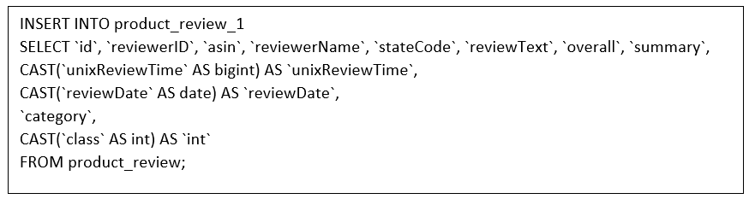
Hive Queries
3. Further, we have created one more table. By using cast function we can convert it into desired data type. Later which will be helpful when retrieving data.

Slide 11
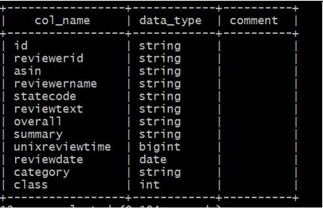
Table Information
CREATE EXTERNAL TABLE IF NOT EXISTS product_review(`id` string, `reviewerID` string, `asin` string, `reviewerName` string, `stateCode` string, `reviewText` string, `overall` string, `summary` string, `unixReviewTime` string, `reviewDate` string, `category` string, `class` string)
ROW FORMAT SERDE 'org.apache.hadoop.hive.serde2.OpenCSVSerde'
WITH SERDEPROPERTIES (
'separatorChar' = ',',
'quoteChar' = '"',
'escapeChar' = '\\' )
STORED AS TEXTFILE LOCATION '/user/ssrikan3/Group4_Term_Project/'
TBLPROPERTIES ('skip.header.line.count'='1');

Slide 12
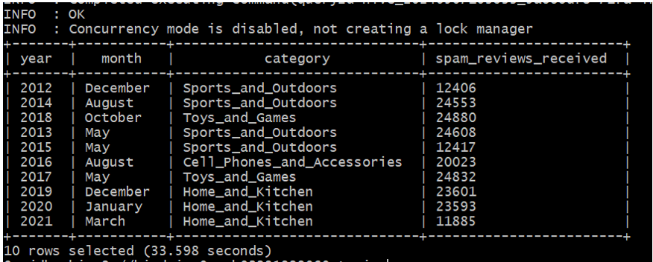
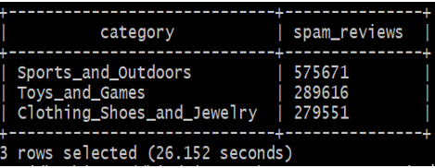
Queries used for analysis
Few important Query analysis
Query gives the result which one of the month from each year has received highest spam reviews and along with that for category during the period from 2012 to 2021.
Top 3 Category
Query gives the result of top 3 categories which received spam reviews for the period from 2015,2019,2020 & 2021.

Slide 13
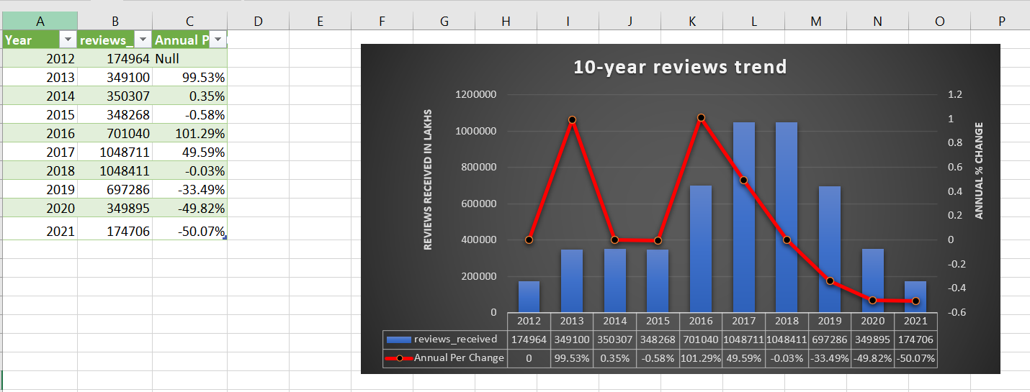
Visualization
Annual review per% change trend
The above analysis shows on total number of reviews received each year and along with that percentage change of reviews compared to previous year.

Slide 14
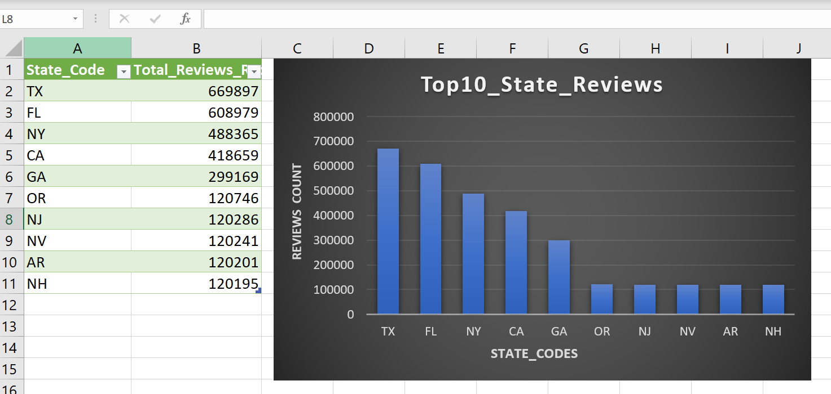
Visualization
Top 10 states reviews received
The above analysis shows on total number of reviews received by each state received.

Slide 15
Visualization
Top 3 categories with highest spam reviews
The above analysis shows on top three categories which has received most spam reviews. In that Clothing_Shoes and_Jewelry received more spam reviews.

Slide 16
Visualization
Top 3 category with highest non-spam reviews
The above analysis shows on top three categories which has received most non-spam reviews. In that Home_and_Kitchen received more non spam reviews.

Slide 17
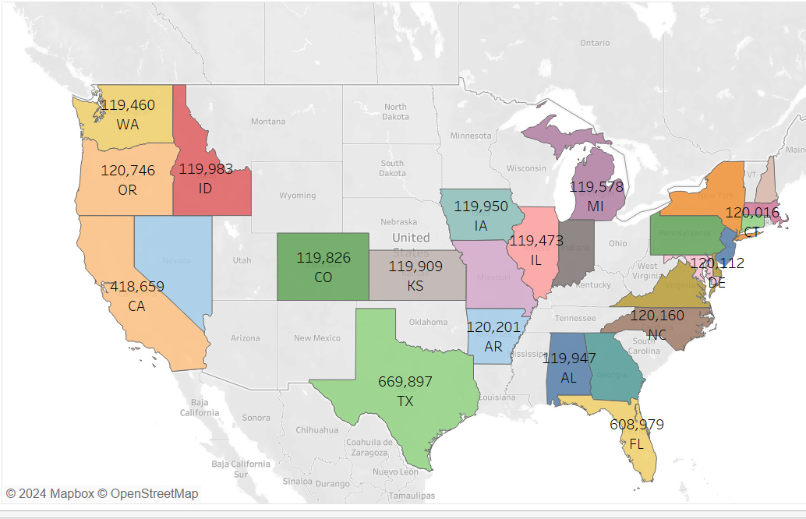
Visualization
Total Reviews Received by States
The above analysis on map it displays total number of states shows that total number of reviews received by each state

Slide 18
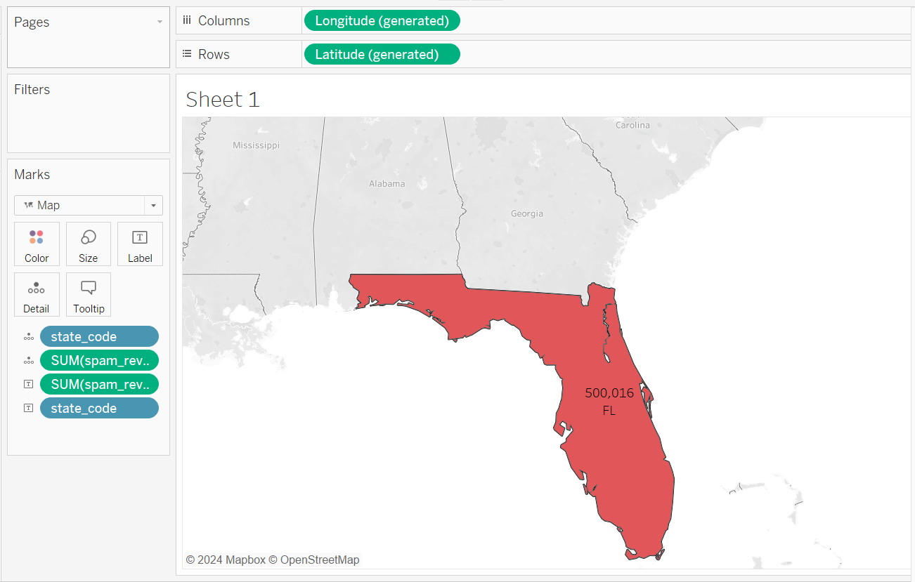
Visualization
Top 1 State Highest Spam Reviews
The above analysis on map it displays Florida is the number one state from which has received most spam reviews.

Slide 19
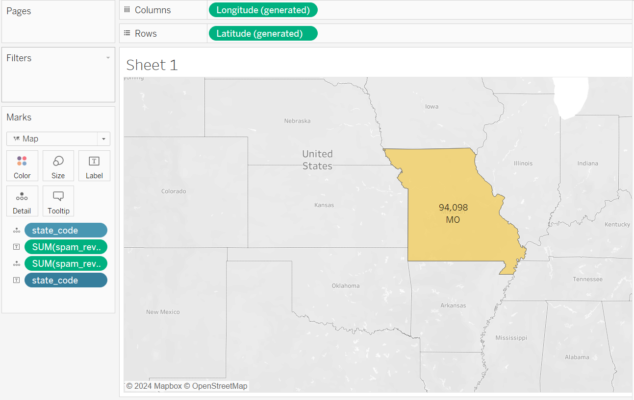
Visualization
Least State Spam Reviews
The above analysis on map it displays Missouri is the state from which has received least spam reviews

Slide 20
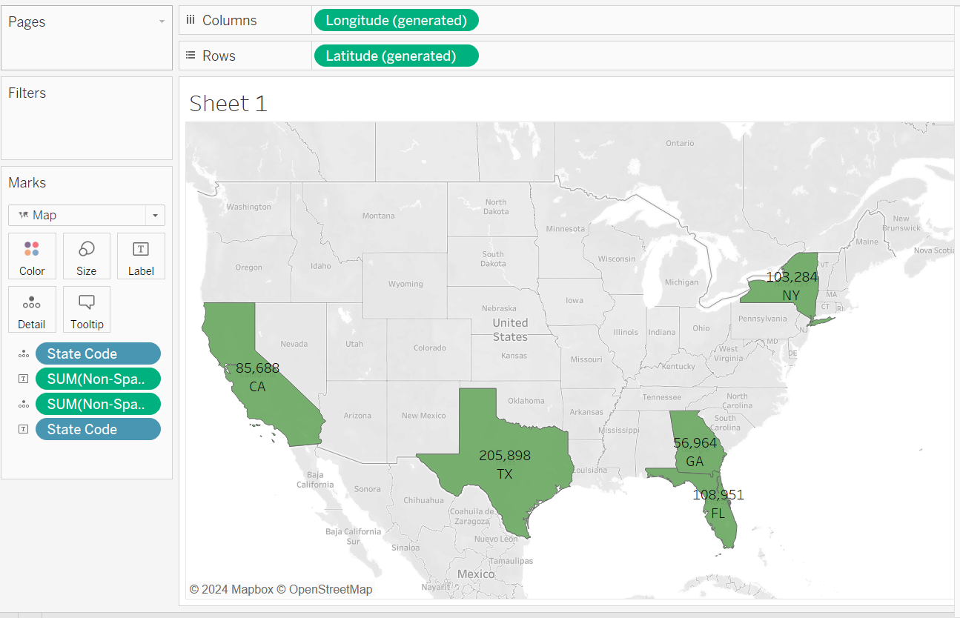
Visualization
Top 5 States Non-Spam Reviews
The above analysis on map it displays top five states from which has received most genuine reviews ( non-spam reviews )

Slide 21
Conclusions
Top 3 categories which has received spam reviews
Sports and Outdoor
Toys and Games
Clothing and Jewelry
Top five states which has received most spam reviews
FL, TX, NY, CA, GA

Slide 22
Reference
Data Source
https://www.kaggle.com/datasets/naveedhn/amazon-product-review-spam-and-non-spam
Github
https://github.com/suneelsrikanta/Hadoop_Spam-and-Non_spam_reviews

Slide 23
Thank you

