Slide 1





RCB – IPL Strategy & Performance Analysis
Present by – Sunil Thakur
August 2026
SQL-Based Data Analysis & Strategic Insights

Slide 2


Introduction
The IPL is one of the most popular and competitive T20 cricket leagues, where performance and strategy play a major role.
RCB is one of the most followed teams, known for its strong players and passionate fan base, but consistent team success has remained a challenge.
This project analyzes RCB's past performance to identify strengths, weaknesses, player contributions and key factors affecting results.
Focus: RCB Performance • Players • Strategy • Team Results

Slide 3
Problem Statement
RCB has produced strong individual performances, but consistent team success has remained a challenge. The key problem is to understand the factors affecting team performance and identify areas where strategy and player selection can be improved.
Performance Gaps
Identify seasons and situations where RCB struggled.
Player Contribution
Identify players who consistently influenced results.

Slide 4
Objective
The objective of this project is to analyze RCB's past IPL performance and identify key factors affecting team success. The analysis focuses on player contributions, team performance, match patterns and strategic areas for improvement using historical IPL data.
Analyze Team Performance
Evaluate RCB's performance across seasons and matches.
Identify Key Players & Strategy
Understand player contributions and use data-driven insights for better team decisions.

Slide 5
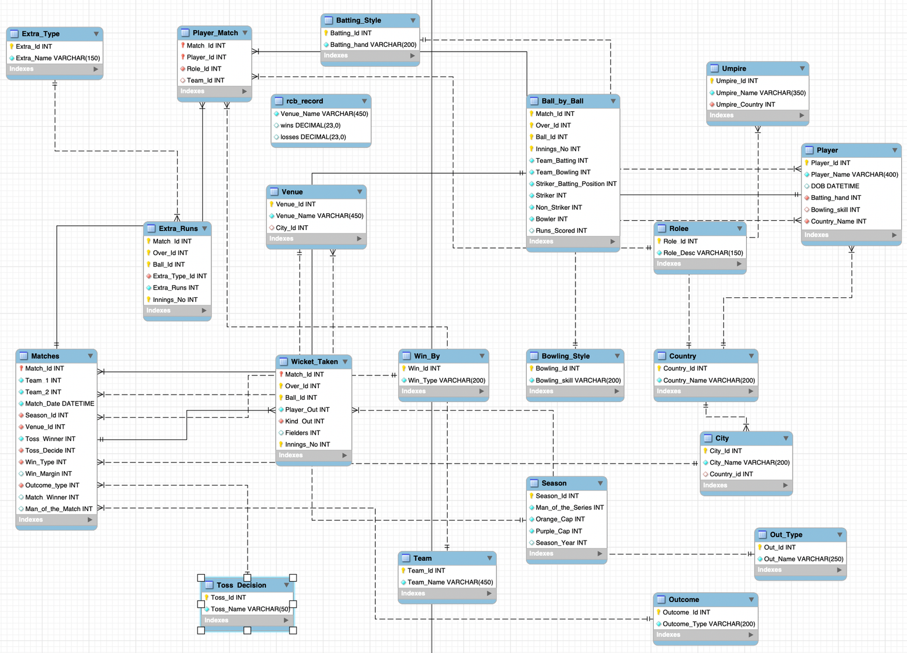
Database Schema

Slide 6
Analysis & Insights
Overall Team Performance Overview :
  RCB's performance varied across seasons in terms of wins, runs scored and wickets taken.
  2016 was RCB's strongest batting season, with the highest total runs and average runs per match.
  2014 was comparatively weaker, recording the lowest win percentage, total runs and average
wickets per match.
Consistency (Key Performers Across Seasons) :
  Batting strength has not always translated into consistent match results.
  Strong player contributions and balanced batting-bowling performance are important
for sustained success.
  Season-wise KPIs help identify performance gaps and guide better team strategy.

Slide 7
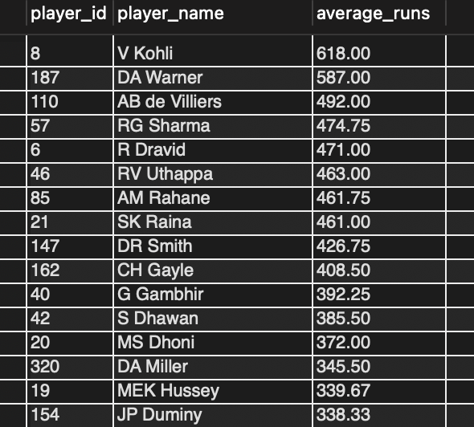
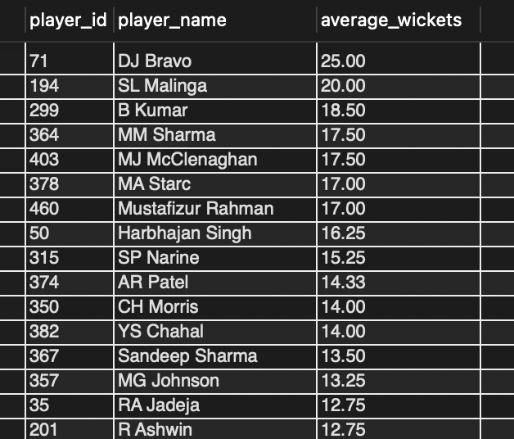
Analysis & Insights
Top Batsmen – Average Runs
Top Bowlers – Average Wickets

Slide 8
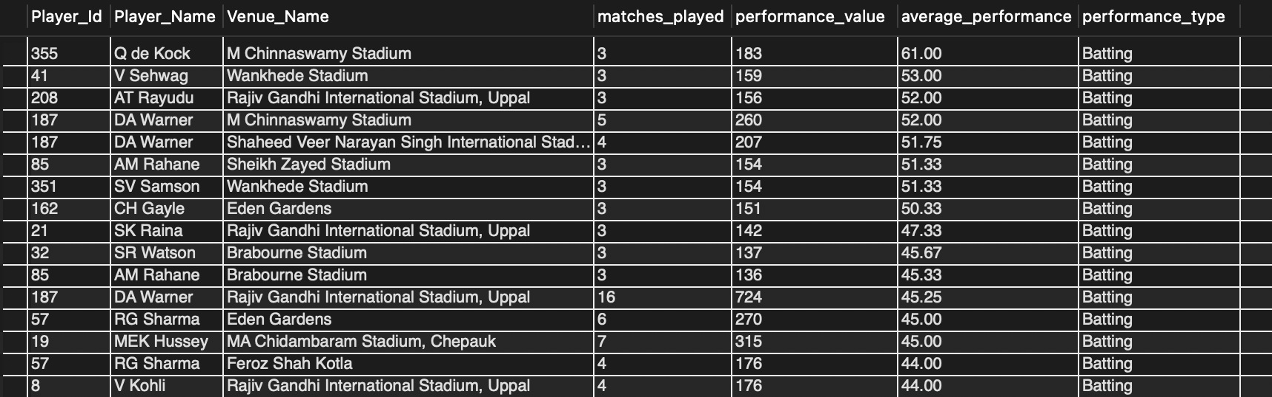
Analysis & Insights
Venue-Specific Performance
  Player performance can vary significantly across different venues.
  Batting performance is compared using average runs per match, while bowling performance is compared using average wickets per match.
  These patterns can support venue-specific player selection and match planning.

Slide 9
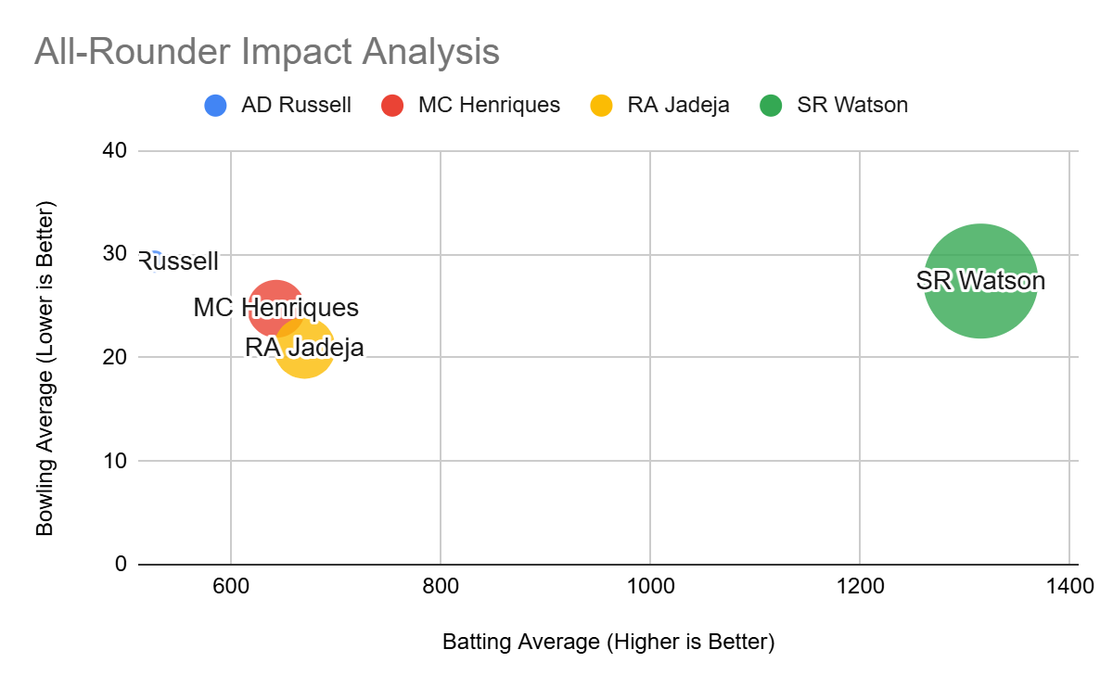
Analysis & Insights
All-Rounder Impact
  Identifies players performing above the overall
average in both batting and bowling.
  Highlights players who can contribute in multiple
areas and provide greater team flexibility.
  Useful for identifying versatile players during squad
selection and strategy planning.
Key Insight: Players above both overall averages demonstrate strong two-way performance.

Slide 10
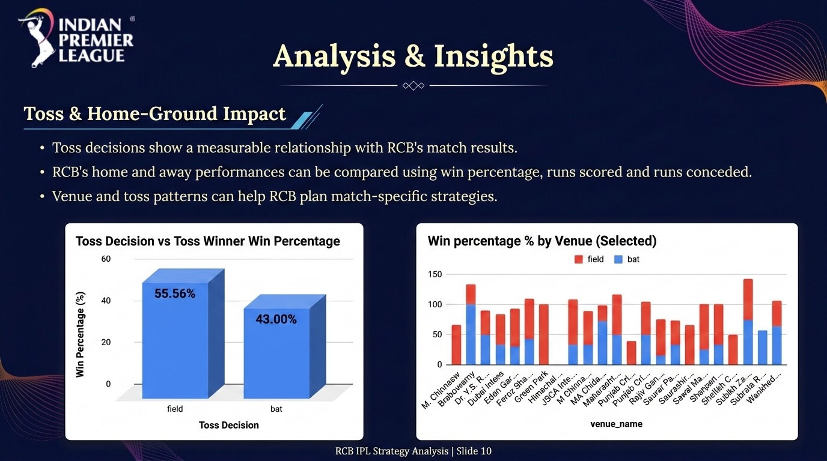

Slide 11
RCB Strategic Recommendations
  Prioritize consistent performers
Use season-wise runs, wickets and win percentage to identify reliable players.
  Build a balanced squad
Combine strong batsmen, wicket-taking bowlers and versatile all-rounders.
  Use venue-specific selection
Consider player performance across venues when planning the playing XI.
  Strengthen home-ground strategy
Use venue and toss patterns to adapt match planning and team composition.
  Follow data-driven player selection
Use performance trends, consistency and multi-skill contribution rather than relying only on reputation.

Slide 12


Conclusion
The analysis shows that RCB has produced strong individual and team performances across different seasons, but consistency remains a key challenge. Player performance, venue conditions, toss decisions and season-wise team KPIs provide useful insights for strategic planning. A balanced and data-driven approach to player selection and match strategy can help RCB improve future performance.

Slide 13
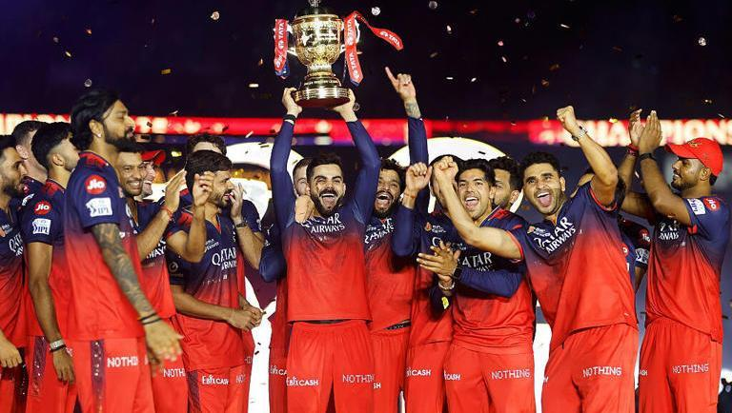
Thank You!

Slide 14




IPL Winner 2025-26
Royal Challengers Bangalore

