Slide 1

ZOMATO RESTAURANT ANALYTICS
Restaurant Performance Analysis
Data-Driven Business Insights
DASHBOARD
Data Cleaning
Business Insights
Sunil Thakur
AI & Data Science
Restaurant Analytics Project

Slide 2

PROBLEM STATEMENT & OBJECTIVES
Problem Statement
  Analyze ratings, votes & pricing trends.
  Study delivery & booking patterns.
  Generate actionable business insights.
Project Objectives
✓ Analyze restaurant ratings & customer votes
✓ Compare pricing across countries​
✓ Build an interactive dashboard

Slide 3
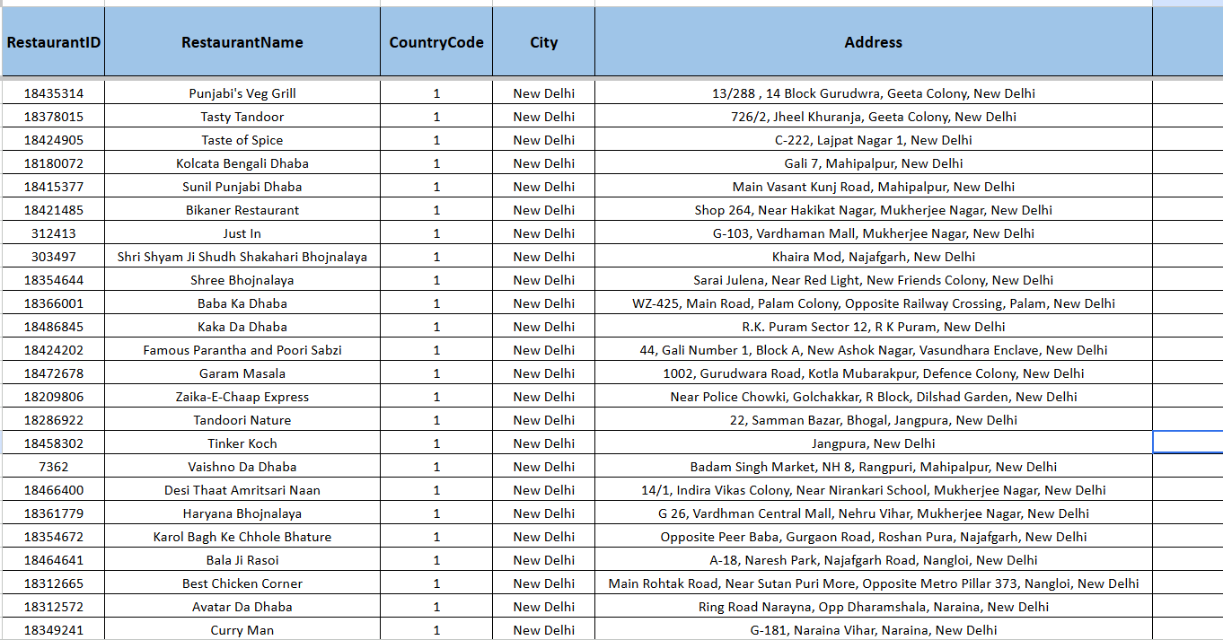
DATASET OVERVIEW
📊 Total Records: 9,551
📋 Total Columns: 21
🌍 Countries Covered: 15
🏙️ Cities Covered: 141
🍽️ Cuisines Covered: 1,800+

Slide 4


Data Processing Workflow
ANALYTICAL APPROACH
RAW DATASET
Methodology Used
↓
DATA CLEANING
↓
✓ Data Cleaning & Validation
PIVOT TABLES
✓ Pivot Table Analysis
↓
✓ Missing Value Handling
CHARTS
↓
✓ Dashboard Development
Dashboard

Slide 5
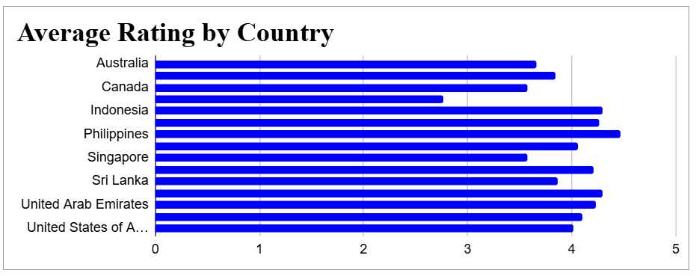
RESTAURANT RATINGS ANALYSIS
Key Insights
  Philippines has the highest average rating.
  Most countries maintain ratings above 3.5
  Overall average rating is 3.9

Slide 6
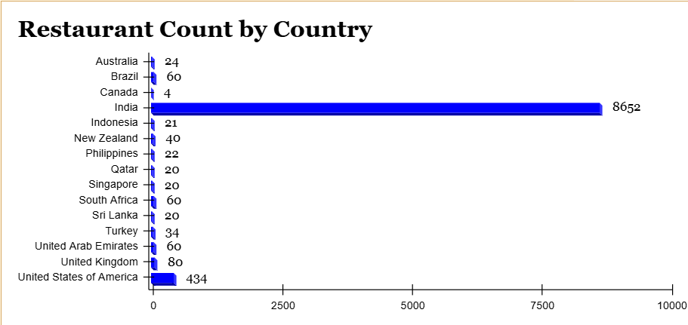
MARKET PRESENCE ANALYSIS
Key Insights
  India contributes the largest share
of restaurants in the dataset.
  Restaurant distribution is heavily concentrated in the Indian market.
  Other countries contribute only
a small portion of total restaurant
listings

Slide 7
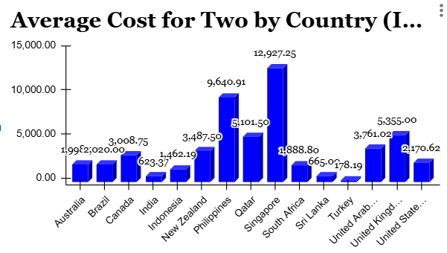
COST ANALYSIS
BY COUNTRY
Cost Insights
  Singapore has the highest average
dining cost.
  India remains one of the most affordable markets, while Philippines and Qatar are premium markets.

Slide 8
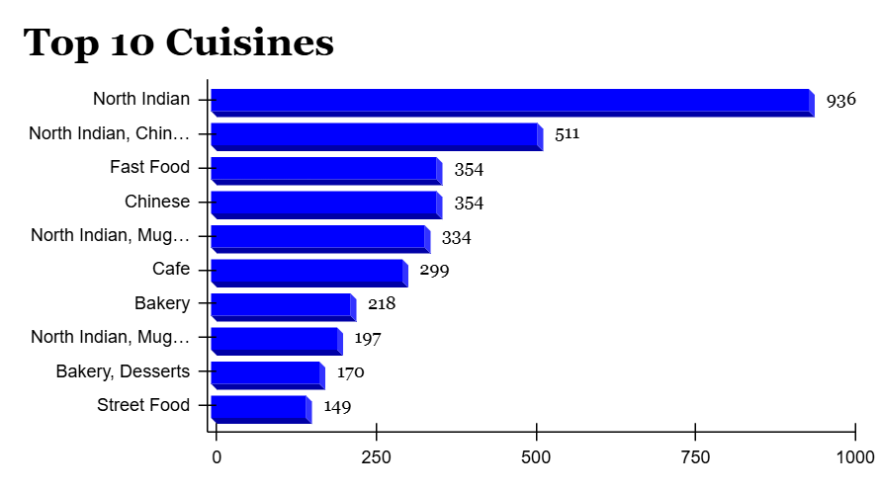
CUISINE POPULARITY ANALYSIS
Key Insights
  North Indian cuisine is the most popular cuisine category.
  Fast Food and Chinese cuisines also have strong restaurant presence.

Slide 9
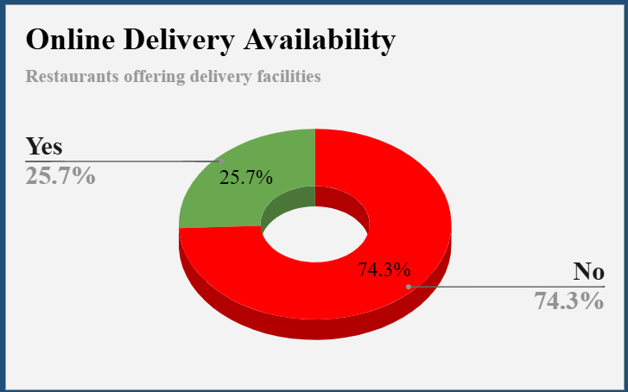
ONLINE DELIVERY ANALYSIS
Delivery Insights
  Only 25.7% restaurants provide online delivery.
  74.3% restaurants do not offer delivery.
  Online delivery remains a key competitive advantage.

Slide 10
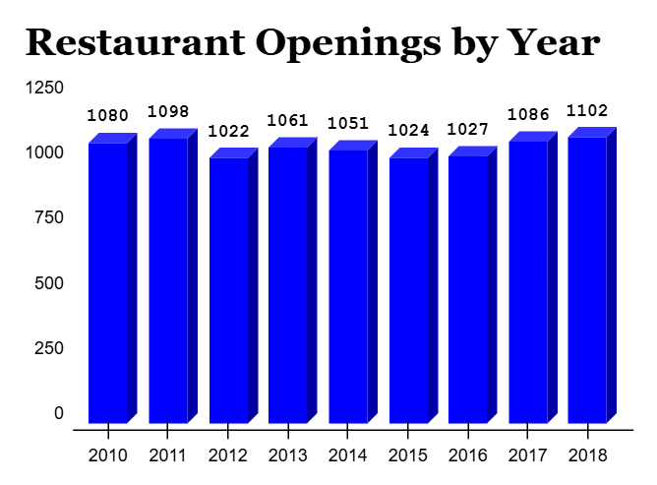
RESTAURANT OPENINGS BY YEAR ANALYSIS
Business Insights
  Restaurant expansion remained steady throughout the observed period.
  Opening activity increased after 2016, reaching its peak in 2018.

Slide 11
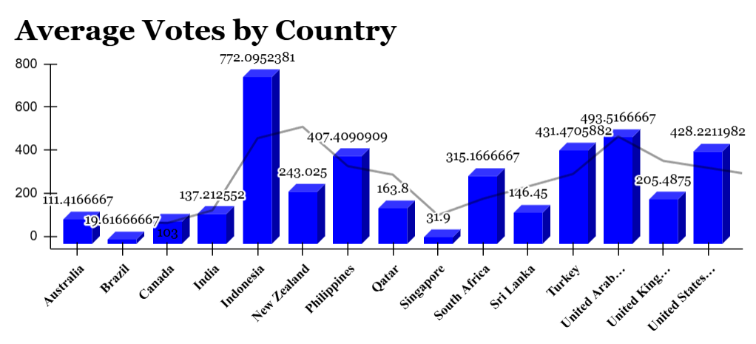
key Insights
  Indonesia records the
highest average customer
votes.
  Customer engagement
varies significantly across
countries.
CUSTOMER ENGAGEMENT ANALYSIS

Slide 12
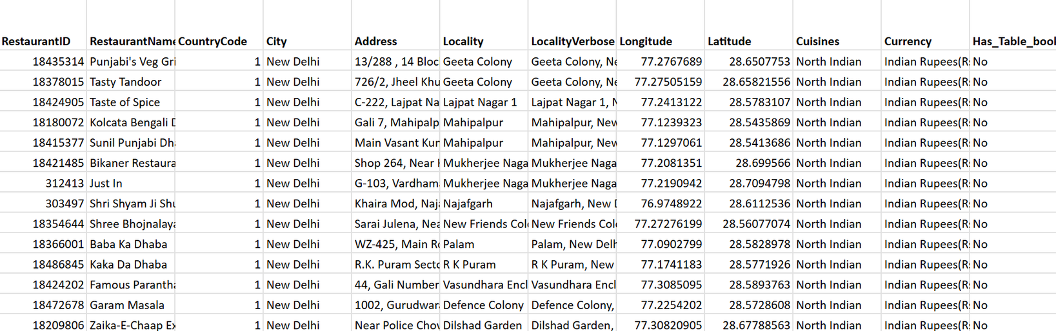
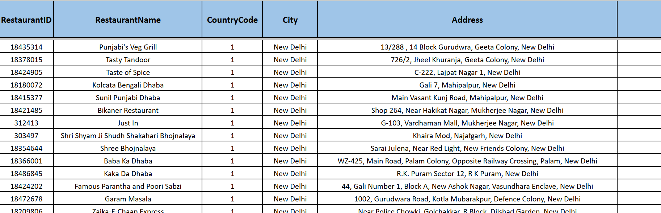
before cleaning ↓
DATA CLEANING
& PREPARATION
after cleaning
↓
Data Quality Improvements
✓ Removed Missing Values
✓ Standardized Country & City Names
✓ Prepared Dataset for Analysis

Slide 13
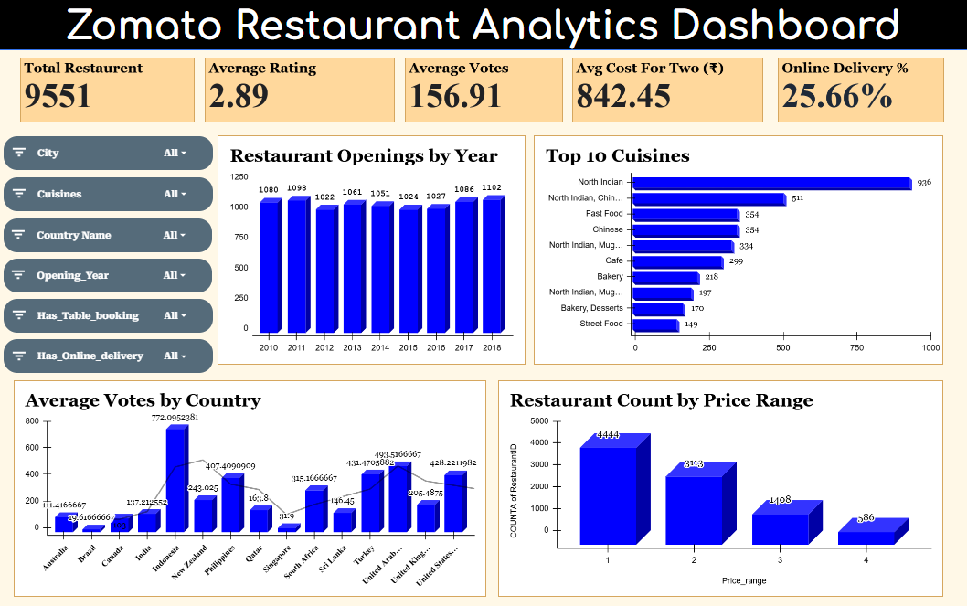
INTERACTIVE RESTAURANT ANALYTICS DASHBOARD
Visual dashboards transform complex restaurant data into clear and actionable business insights.

Slide 14
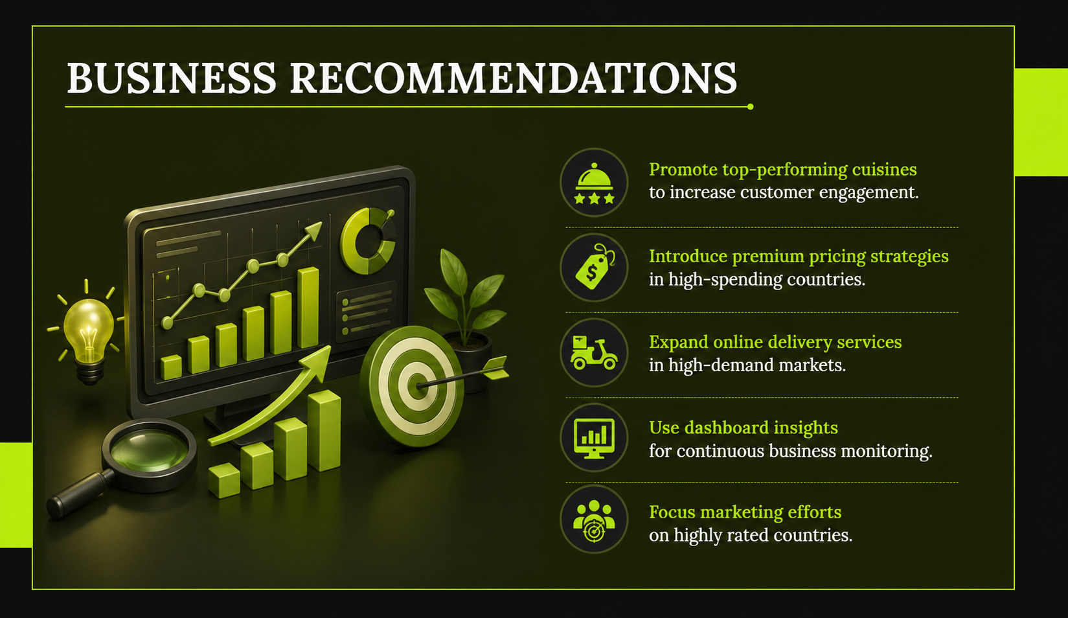

Slide 15

Key Insights
  Improved Data Quality
  Actionable Business Insights
CONCLUSION
📊 Project Summary
✅ Cleaned and standardized restaurant data
✅ Analyzed ratings, pricing and delivery trends
✅ Built an interactive analytics dashboard
Recommendations
✅ Focus on high-rated markets
✅ Expand online delivery services
✅ Track business performance using dashboard insights
Data-driven insights can support better restaurant business decisions.

Slide 16


