Slide 1
OTP Verification Project
Implemented Using Python and Google Colab
Name:suneetha

Slide 2
Project Objective
Goal: To build a Python-based OTP verification system that generates, sends, and verifies OTPs securely using Google Colab.
Features:
Generate 6-digit OTP.
Send OTP via email.
Verify user-entered OTP.
Provide a maximum of 3 attempts for verification.

Slide 3
What is OTP Verification?
A One-Time Password (OTP) is a security measure used for verifying user identity.
Commonly used for account verification, secure logins, and transaction approvals.
Why OTP Verification?
Enhances security by adding an additional layer of authentication.
Prevents unauthorized access.

Slide 4
Tools and Technologies
Development Environment:
Google Colab (Online Python IDE).
Programming Language:
Python.
Libraries Used:
random for OTP generation.
smtplib and email.message for sending OTP via email.

Slide 5
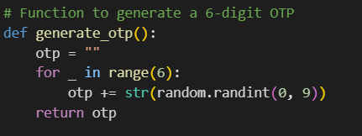
Function to generate a 6-digit OTP

Slide 6
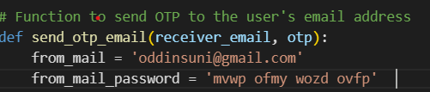
Sending OTP via Email:

Slide 7
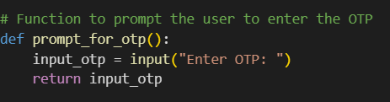
Prompting User for OTP:

Slide 8
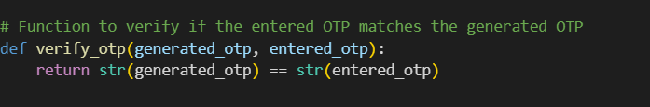
Verification Logic:

Slide 9
Workflow:
1. Input an email address in the provided text box.
2. Click 'Generate OTP’.
3. System validates the email format.
4. If valid, it generates and displays the OTP.
5. Enter the OTP in the input box and click 'Verify OTP’.
6. System checks and confirms if the OTP matches.

Slide 10
Conclusion
Successfully implemented an OTP verification system using Python and Google Colab.
Learned about email integration and secure authentication techniques.

Slide 11
Thank You
Thank You for Your Attention!

