Slide 1
CAMP CHALLENGE
Being an AI Detective
Can you spot what’s real, what’s weird, and what needs checking?
Notes:
Timing: 1 minute.
Ask: ‘Who has ever seen a picture or answer online that looked real but felt a little weird?’
Tell students they are joining an AI detective squad. Their job is curiosity, not catching people out.

Slide 2
A message can look confident and still be wrong
Your friend sends this:
What do you do?
“Camp is cancelled at 6:07. A squirrel stole the Wi-Fi.”
A Share it fast B Ask where it came from C Check with camp staff
6:07 is oddly specific. It still isn’t evidence.
2
Notes:
Timing: 2 minutes.
Have students vote A, B, or C with their hands. Accept B and C as detective moves; emphasize that checking the closest reliable source is strongest.
Let students react to the six-seven reference, then bring it back: a funny or oddly specific detail can make a rumor memorable without making it true.

Slide 3
AI can make convincing words, pictures, and voices
WORDS
PICTURES
SOUNDS
Stories Answers Messages
People Places Events
Voices Music Effects
Useful? Yes. Automatically true? No.
3
Notes:
Timing: 1.5 minutes.
Ask for one example students have seen in each column.
Clarify: AI-made does not always mean bad or false. It means we should know what we are looking at and check important claims.

Slide 4
Use four moves whenever something feels surprising
1
PAUSE
2
INSPECT
Don’t react or share yet.
Count the fingers. Six? Seven? Suspicious.
3
CHECK
4
DECIDE
Find the original and compare sources.
Trust it, question it, or ask an adult.
Pause • Inspect • Check • Decide
4
Notes:
Timing: 2 minutes.
Teach the four moves with hand motions: palm out for Pause, pretend magnifying glass for Inspect, two fingers comparing for Check, thumbs choice for Decide.
Have the group repeat the four words once.

Slide 5
Artifacts hide where details must stay consistent
HANDS + FACES
TEXT + SYMBOLS
Extra fingers, strange joints, uneven glasses
Warped letters, nonsense words, mixed numbers
LIGHT + REFLECTIONS
EDGES + OBJECTS
Shadows disagree; mirrors show the wrong thing
Objects melt, repeat, connect, or bend impossibly
One clue starts the investigation. Several clues make the case stronger.
5
Notes:
Timing: 1.5 minutes.
Introduce four places to scan. Have students point to their hands, pretend to read a sign, make a reflection pose, and trace an object edge.
Remind them that modern generators may avoid many of these errors, so checking the source still matters.

Slide 6
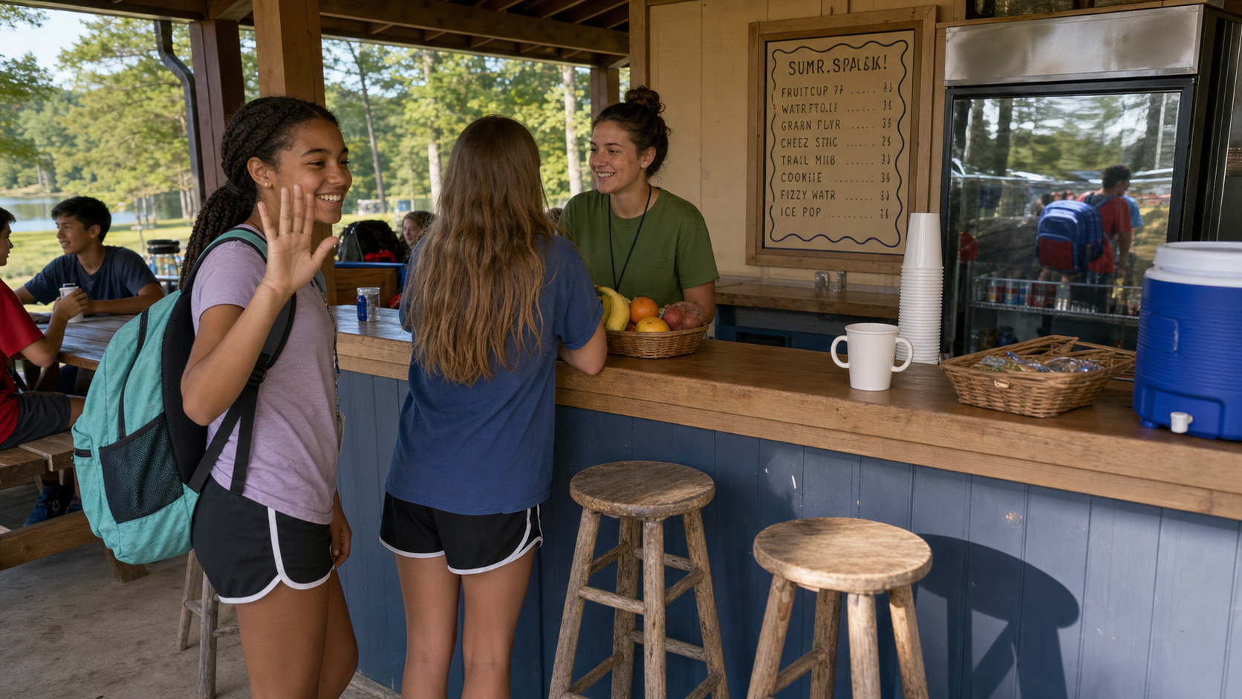
CASE #1: THE SNACK PAVILION
AI-GENERATED PRACTICE IMAGE • Find five suspicious details
Notes:
Timing: 1.5 minutes.
Give students 35 seconds to scan using the four categories. Ask each group to name one clue without repeating a previous answer.
Do not reveal answers yet; tell them to remember their strongest clue.

Slide 7
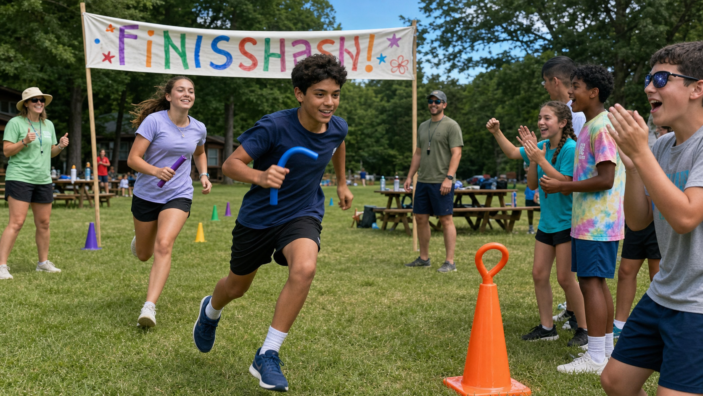
CASE #2: FIELD-DAY FINISH
AI-GENERATED PRACTICE IMAGE • Which clues are strongest?
Notes:
Timing: 1.5 minutes.
Give students another 35 seconds. Ask them to rank clues: strong, maybe, or weak.
Use the six-seven energy here if helpful: ‘Did anyone find six clues? Seven? The case only needs five.’

Slide 8
A pattern of clues is stronger than one weird pixel
SNACK PAVILION
FIELD DAY
1 Extra finger on the raised hand 2 Warped menu lettering 3 Cup with disconnected handles 4 Backpack color changes in reflection 5 Stool shadow points the wrong way
1 Two-left-shoe mix-up 2 Malformed finish banner 3 Rubber-bendy relay baton 4 Night-sky reflection in sunglasses 5 Cone with an impossible loop
Best answer: “I see several clues, so I’m going to check the source.”
8
Notes:
Timing: 1.5 minutes.
Reveal the intended artifacts. If a requested artifact rendered less clearly, use that as a teaching moment: not every suspected clue is equally strong.
Ask which clue was easiest and which required the most careful looking.

Slide 9
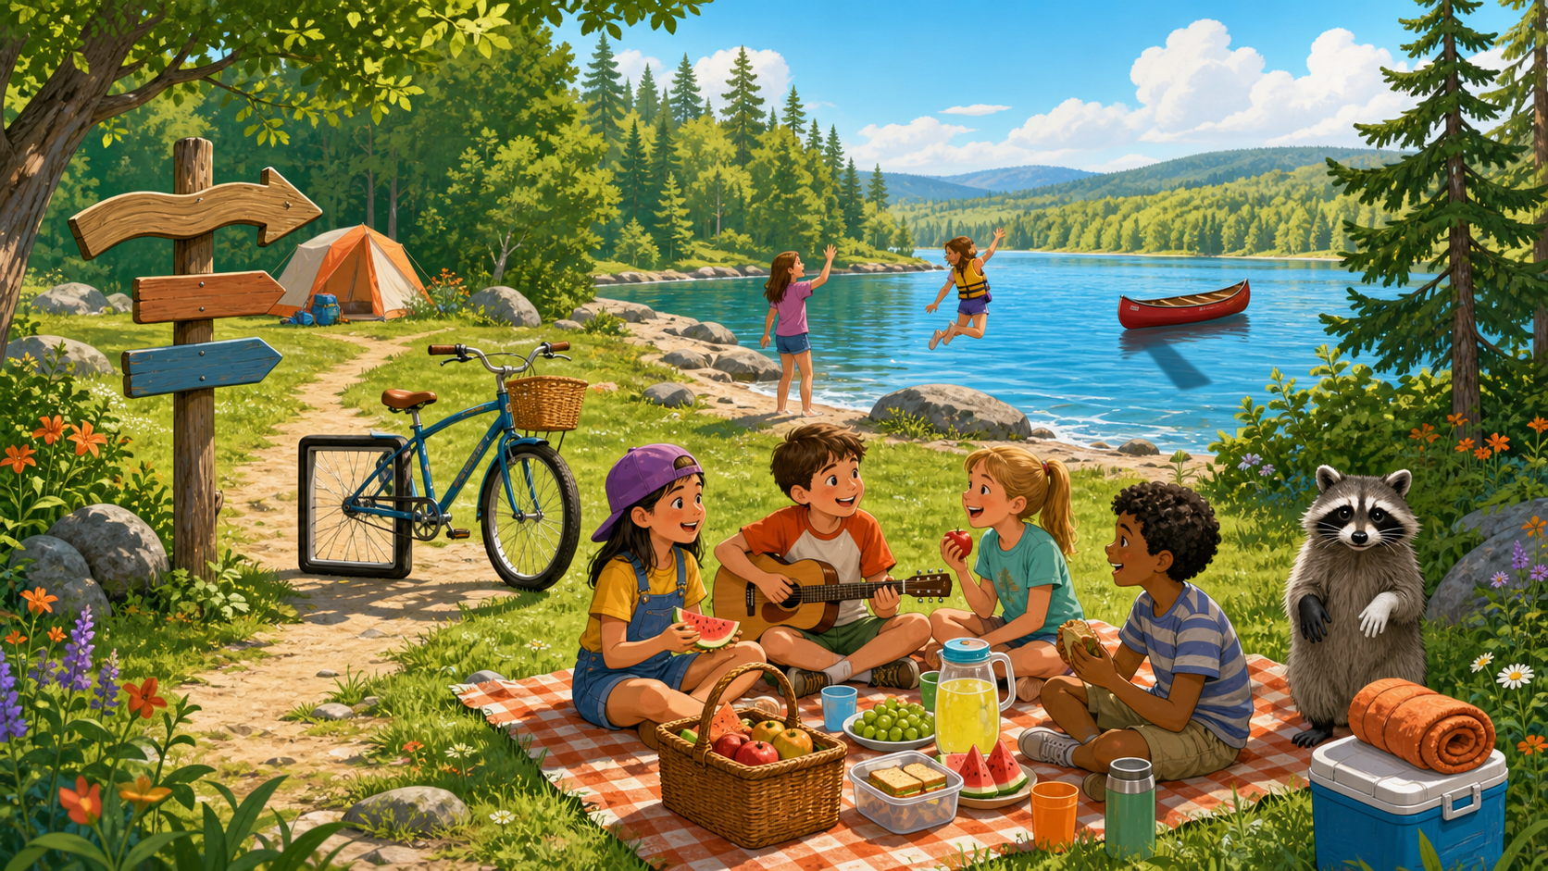
CASE #3: CARTOON ROUND
Look closely. What feels impossible or inconsistent?
Notes:
Timing: 2 minutes.
Give students 30–45 seconds of silent looking, then take answers. Do not reveal all clues until the next slide.
Reminder: One odd detail does not prove AI. It is a reason to inspect and check.

Slide 10
Odd details are clues—not automatic proof
THE FIVE CLUES
1 Six fingers. Or seven? Nice try. 2 A square bicycle wheel 3 An impossibly bent sign 4 Mismatched raccoon paws 5 A canoe shadow going the wrong way
Good detective thinking
“I noticed something odd.” “I need another clue.” “I’ll check before I claim.”
Real photos can look strange too—because of angles, edits, or mistakes.
10
Notes:
Timing: 1.5 minutes.
Reveal the five planned oddities. Praise observations even if students found other plausible details.
Stress the key distinction: clues start an investigation; they do not finish it.

Slide 11
CASE #4: A smooth answer can hide a false fact
Your detective moves
AI ANSWER
1 Circle the surprising claim 2 Ask: Who says so? 3 Check a trusted science source
“Penguins live at the North Pole, where they split 67 fish nuggets with polar bears.”
Verdict: Penguins live naturally in the Southern Hemisphere—not with polar bears in the Arctic.
11
Notes:
Timing: 2 minutes.
Ask students what words or ideas they would check. Then reveal the verdict.
Explain that AI often predicts a plausible-sounding next sentence; it does not automatically verify each fact.

Slide 12
The strongest check compares the claim with its source
FIND
COMPARE
ASK
Where did it first appear?
Do two reliable sources agree?
Can a trusted adult or expert help?
Best sources are close to the facts. A random group chat is not a science agency—even if it has 67 messages.
12
Notes:
Timing: 2 minutes.
Give quick examples and ask for the closest source: weather warning, camp schedule change, animal fact.
If devices are available, demonstrate opening a second trustworthy source. Otherwise keep it verbal.

Slide 13
A screenshot is a clue—not the original source
ZOOM
TRACE
COMPARE
ASK
Check hands, text, edges, and backgrounds.
Find the earliest post, full video, or full quote.
Look for two reliable sources that agree.
Bring important or harmful claims to a trusted adult.
Fast does not mean careless. A 30-second check can stop a false story from spreading.
13
Notes:
Timing: 1.5 minutes.
Demonstrate the four tools with a pretend screenshot. Ask: What information disappears when a post is cropped? Name, date, link, and context.
Students do not need advanced software. Careful looking and source comparison do most of the work.

Slide 14
Protect people while you investigate
DO
DON’T
✓ Keep private details private ✓ Ask before sharing someone’s image ✓ Tell an adult about scary or harmful content
× Upload faces, names, or locations × Use fake media to embarrass someone × Keep harmful content secret
Being a good detective also means being kind.
14
Notes:
Timing: 1.5 minutes.
Keep this practical and calm. Invite students to name a trusted adult at camp they can go to.
Emphasize: do not re-share harmful or embarrassing content as ‘evidence.’ Show it privately to an adult instead.

Slide 15
YOUR DETECTIVE PLEDGE
Pause. Look closely. Check before sharing.
Be curious • Be careful • Be kind
Final question: What is the first move an AI detective makes? (Not ‘ask the raccoon.’)
Notes:
Timing: 1 minute.
Ask the final question; the group answers ‘Pause!’ Then repeat the full method together: Pause, Inspect, Check, Decide.
Close with the pledge line. Optional: appoint everyone an official AI Detective for the day.

