Slide 1
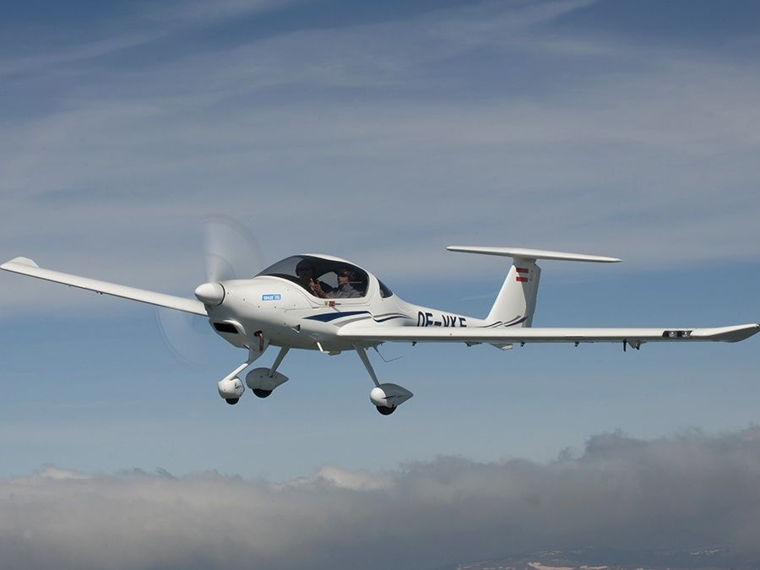
Atmosphere
Temperature
Pressure
Density
Measurement
Atmosphere
Performance
Air dynamics
Bernoulli’s equation
Continuity Equation
Euler’s equation
Propeller
Aircraft
Parts
Parameters (chord, span)
Force (Lift, Drag, Weight, Thrust)

