Slide 1
Introduction to Reinforcement Learning and its Applications in Robotics
Lin Zhang

Slide 2
Outlines
Markov Decision Process
Dynamic Programming
Q-Learning
Possible Solutions

Slide 3
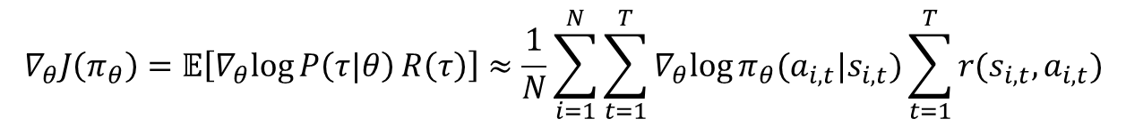
Review
$$∇_{θ}J\left(π_{θ}\right)=𝔼\left[∇_{θ}log{P\left(τ|θ\right)}R\left(τ\right)\right]≈\frac{1}{N}\sum_{i=1}^{N}{\sum_{t=1}^{T}{∇_{θ}log{π_{θ}(a_{i,t}|s_{i, t})}}}\sum_{t=1}^{T}{r(s_{i,t},a_{i,t})}$$
on-policy
high variance
Policy gradient can be sampled to approximate.
Discard old samples made by old policies is a waste and inefficient.
Vanilla policy gradient is with high variance (make up with reward-to-go, baselines, etc.).
Markov property is not required.
* inputs == states; outputs == actions; reward == cost; objective function == cost function; policy == control law;

Slide 4
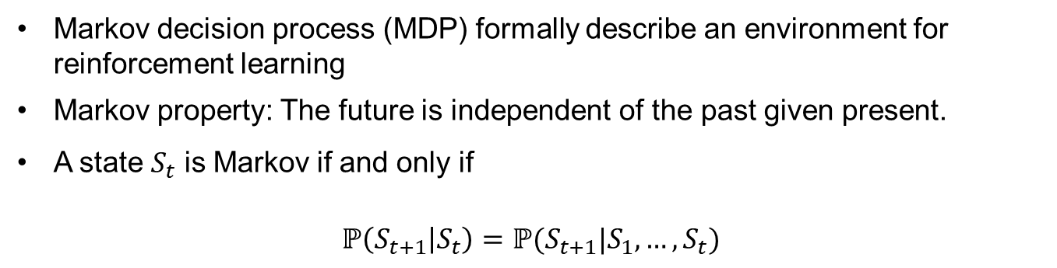
Markov Property
Markov decision process (MDP) formally describe an environment for reinforcement learning
Markov property: The future is independent of the past given present.
A state $S_{t}$ is Markov if and only if
$$ℙ\left(S_{t+1} | S_{t}\right)=ℙ(S_{t+1}|S_{1},…,S_{t})$$

Slide 5
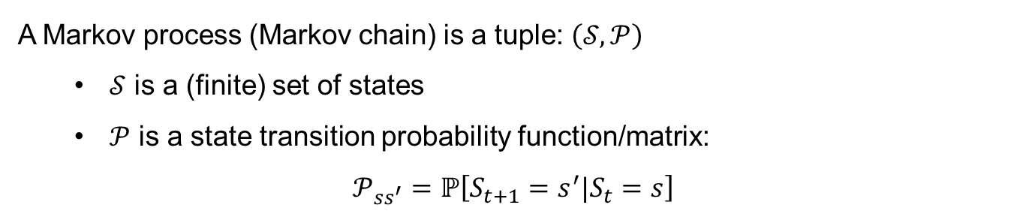
Markov Process
A Markov process is a memoryless random process, i.e. a sequence of random states $S_{1},S_{2}…$ with the Markov property
A Markov process (Markov chain) is a tuple: $\left(𝒮,𝒫\right)$
$𝒮$ is a (finite) set of states
$𝒫$ is a state transition probability function/matrix:
$$𝒫_{ss^{′}}=ℙ\left[S_{t+1}=s^{′}|S_{t}=s\right]$$

Slide 6
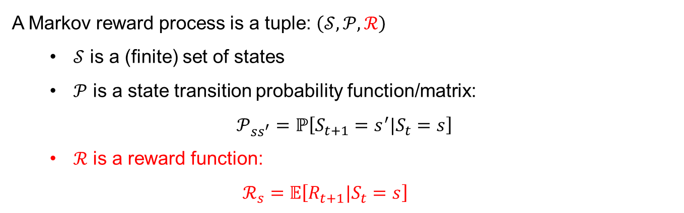
Markov Reward Process
A Markov reward process (MRP) is a Markov process with values assigned to each state
A Markov reward process is a tuple: $\left(𝒮,𝒫,ℛ\right)$
$𝒮$ is a (finite) set of states
$𝒫$ is a state transition probability function/matrix:
$$𝒫_{ss^{′}}=ℙ\left[S_{t+1}=s^{′}|S_{t}=s\right]$$
$ℛ$ is a reward function:
$$ℛ_{s}=𝔼\left[R_{t+1}|S_{t}=s\right]$$

Slide 7
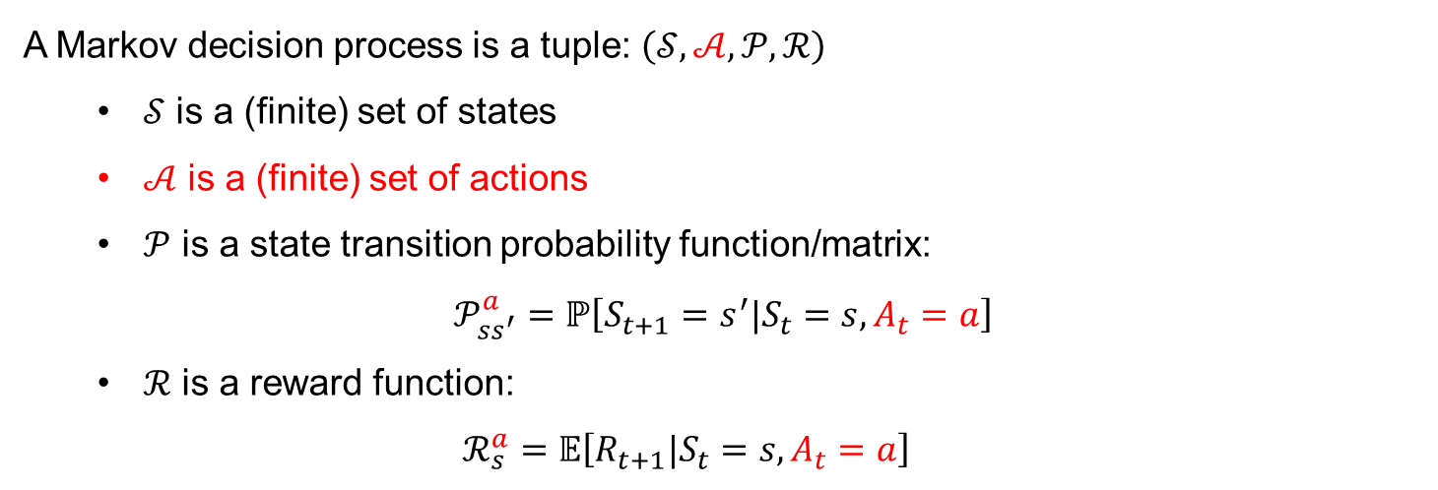
Markov Decision Process
A Markov decision process (MDP) is a Markov reward process with decisions/actions.
A Markov decision process is a tuple: $\left(𝒮,𝒜,𝒫,ℛ\right)$
$𝒮$ is a (finite) set of states
$𝒜$ is a (finite) set of actions
$𝒫$ is a state transition probability function/matrix:
$$𝒫_{ss^{′}}^{a}=ℙ\left[S_{t+1}=s^{′}|S_{t}=s,A_{t}=a\right]$$
$ℛ$ is a reward function:
$$ℛ_{s}^{a}=𝔼\left[R_{t+1}|S_{t}=s,A_{t}=a\right]$$

Slide 8
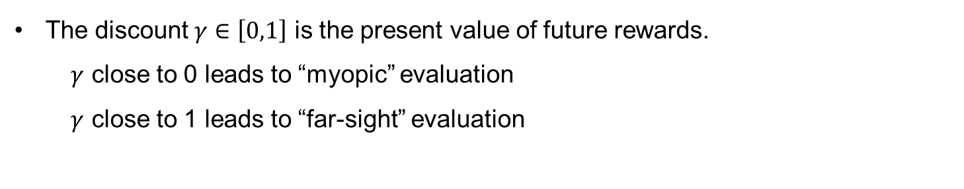
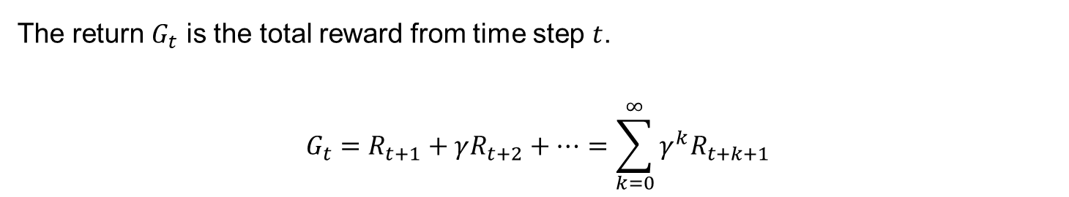
Return
The return $G_{t}$ is the total reward from time step $t$.
$$G_{t}=R_{t+1}+γR_{t+2}+…=\sum_{k=0}^{∞}{γ^{k}R_{t+k+1}}$$
The discount $γ∈\left[0,1\right]$ is the present value of future rewards.
$γ$ close to 0 leads to “myopic” evaluation
$γ$ close to 1 leads to “far-sight” evaluation

Slide 9
Why Discount?
In most cases, Markov rewards are discounted.
Mathematically convenient
Avoids infinite returns in infinite Markov processes. It is possible to use undiscounted rewards if Markov process is finite.
Animals/humans are impatient, impatience leads to preference for immediate reward
Discount rate reveals uncertainty

Slide 10
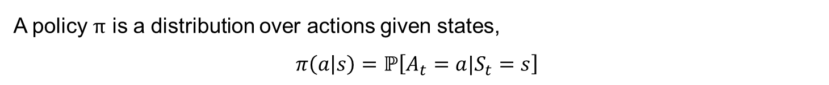
Policy
A policy $π$ is a distribution over actions given states,
$$π\left(a | s\right)=ℙ\left[A_{t}=a|S_{t}=s\right]$$
Reinforcement learning: policy; Control theory: control law.
A policy fully defines the behavior of an agent
MDP policies only depend on the current state

Slide 11
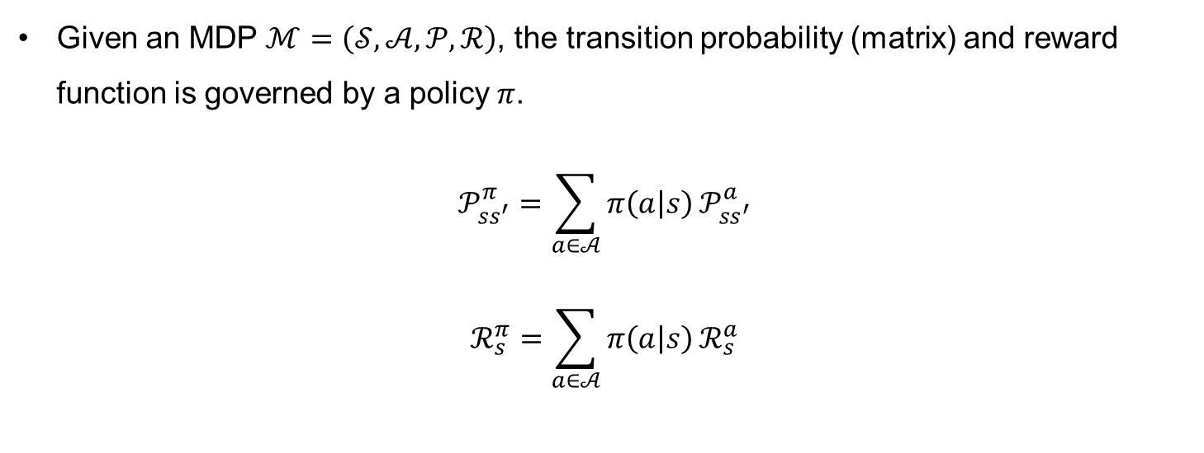
Policy
Given an MDP $ℳ=\left(𝒮,𝒜,𝒫,ℛ\right)$, the transition probability (matrix) and reward function is governed by a policy $π$.
$$𝒫_{ss^{′}}^{π}=\sum_{a∈𝒜}{π\left(a | s\right)}𝒫_{ss^{′}}^{a}$$
$$ℛ_{s}^{π}=\sum_{a∈𝒜}{π\left(a | s\right)}ℛ_{s}^{a}$$

Slide 12
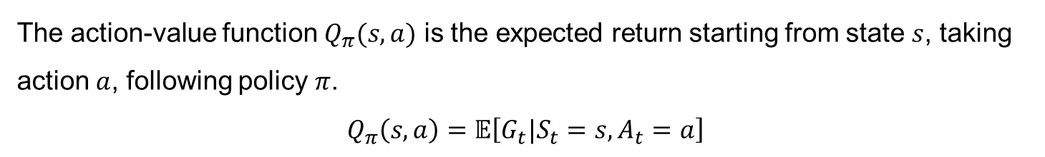
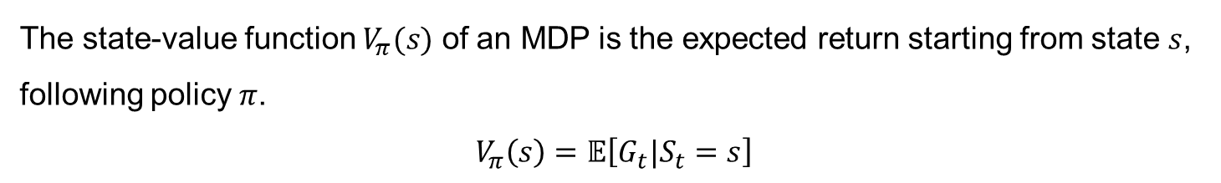
Value Function
The state-value function $V_{π}(s)$ of an MDP is the expected return starting from state $s$, following policy $π$.
$$V_{π}\left(s\right)=𝔼\left[G_{t}|S_{t}=s\right]$$
The action-value function $Q_{π}(s,a)$ is the expected return starting from state $s$, taking action $a$, following policy $π$.
$$Q_{π}\left(s,a\right)=𝔼\left[G_{t}|S_{t}=s,A_{t}=a\right]$$

Slide 13



Bellman Expectation Equation
$$V_{π}\left(s\right)=𝔼_{π}\left[G_{t}|S_{t}=s\right]$$
$$=𝔼_{π}\left[R_{t+1}+γR_{t+2}+γ^{2}R_{t+3}+…|S_{t}=s\right]$$
$$=𝔼_{π}\left[R_{t+1}+γ(R_{t+2}+γR_{t+3}+…)|S_{t}=s\right]$$
$$=𝔼_{π}\left[R_{t+1}+γG_{t+1}|S_{t}=s\right]$$
$$=𝔼_{π}\left[R_{t+1}+γV_{π}(S_{t+1})|S_{t}=s\right]$$
Similarly, for action-value function:
$$Q_{π}\left(s,a\right)=𝔼_{π}\left[R_{t+1}+γQ_{π}(S_{t+1},A_{t+1})|S_{t}=s,A_{t}=a\right]$$

Slide 14


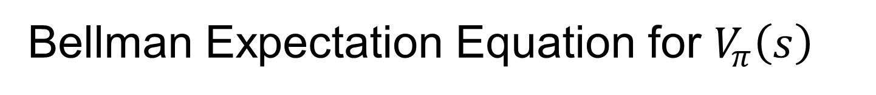
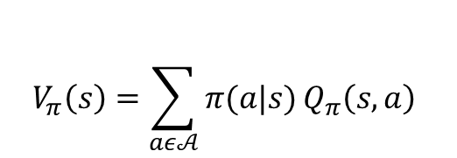
Bellman Expectation Equation for $V_{π}\left(s\right)$
$$s$$
$$a$$
$$V_{π}\left(s\right)=\sum_{aε𝒜}{π(a|s)}Q_{π}\left(s,a\right)$$

Slide 15
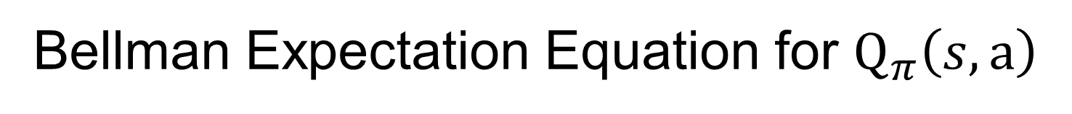
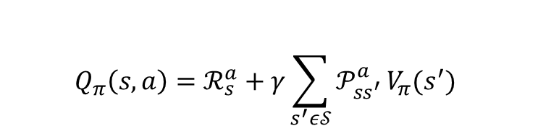



Bellman Expectation Equation for $Q_{π}\left(s,a\right)$
$$a$$
$$r$$
$$s^{′}$$
$$Q_{π}\left(s,a\right)=ℛ_{s}^{a}+γ\sum_{s^{′}ε𝒮}{𝒫_{ss^{′}}^{a}}V_{π}(s^{′})$$

Slide 16

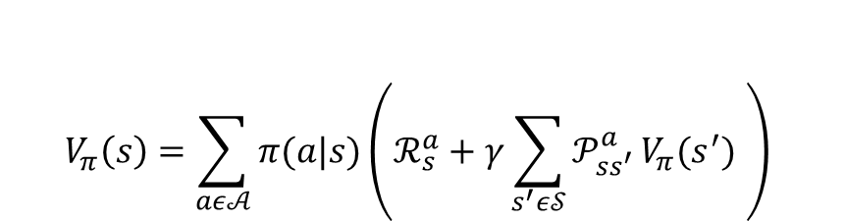

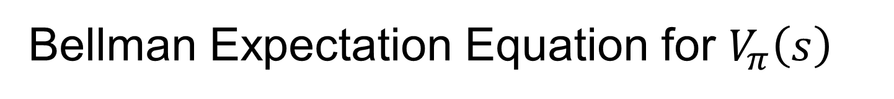



Bellman Expectation Equation for $V_{π}\left(s\right)$
$$s$$
$$a$$
$$r$$
$$s^{′}$$
$$V_{π}\left(s\right)=\sum_{aε𝒜}{π(a|s)}\left(ℛ_{s}^{a}+γ\sum_{s^{′}ε𝒮}{𝒫_{ss^{′}}^{a}}V_{π}(s^{′}) \right)$$
From $s$ to $s^{′}$

Slide 17

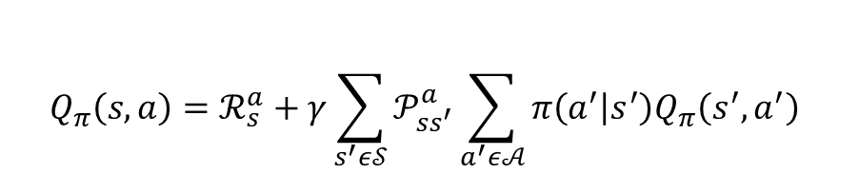

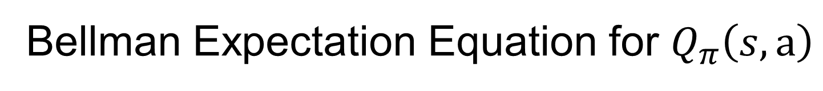



Bellman Expectation Equation for $Q_{π}\left(s,a\right)$
$$a$$
$$r$$
$$s^{′}$$
$$a^{′}$$
$$Q_{π}\left(s,a\right)=ℛ_{s}^{a}+γ\sum_{s^{′}ε𝒮}{𝒫_{ss^{′}}^{a}}\sum_{a^{′}ε𝒜}{π\left(a^{′} | s^{′}\right)Q_{π}\left(s^{′},a^{′}\right)}$$
From $a$ to $a^{′}$

Slide 18
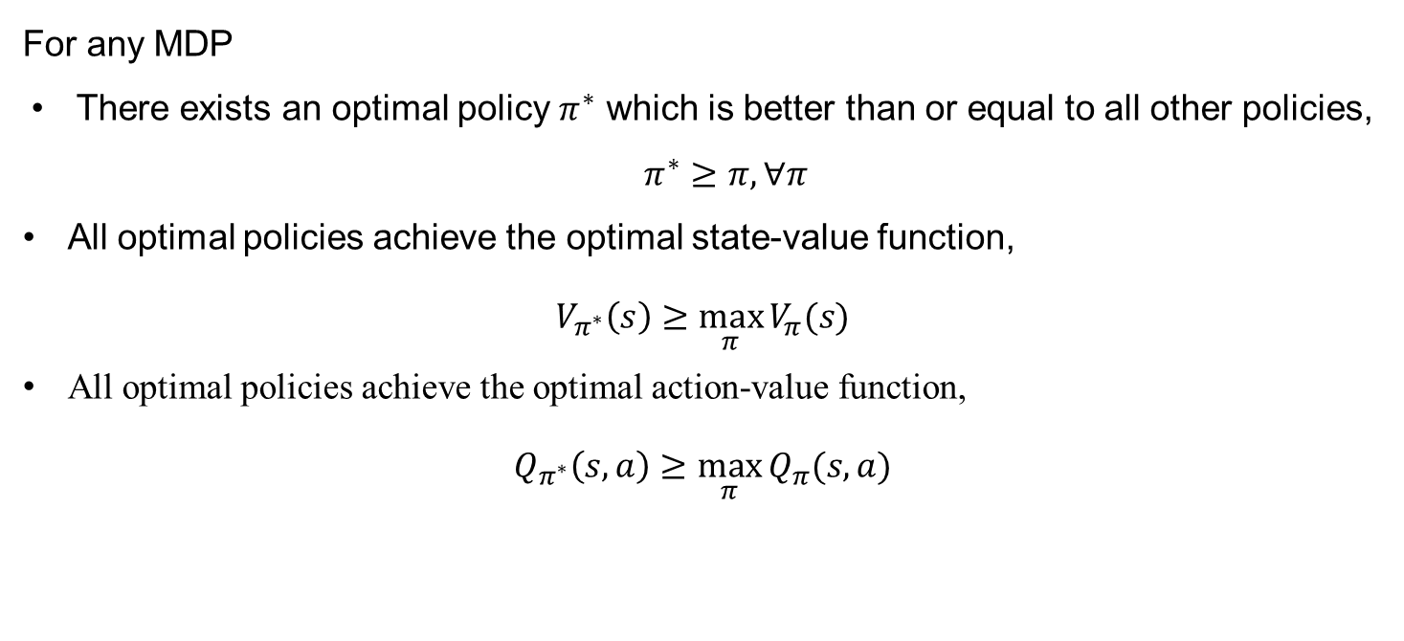
Optimal Policy
For any MDP
There exists an optimal policy $π^{∗}$ which is better than or equal to all other policies, $π^{∗}≥π, ∀π$
All optimal policies achieve the optimal state-value function,
$$V_{π^{∗}}\left(s\right)≥\max_{π}{V_{π}(s)}$$
All optimal policies achieve the optimal action-value function,
$$Q_{π^{∗}}\left(s,a\right)≥\max_{π}{Q_{π}(s,a)}$$

Slide 19
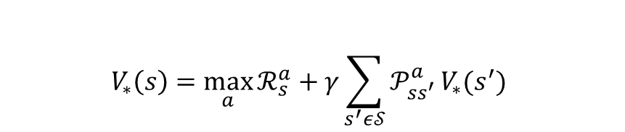

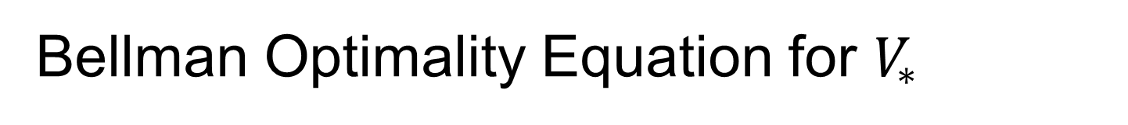



Bellman Optimality Equation for $V_{∗}$
$$s$$
$$a$$
$$r$$
$$s^{′}$$
$$V_{∗}\left(s\right)=\max_{a}{ℛ_{s}^{a}+γ\sum_{s^{′}ε𝒮}{𝒫_{ss^{′}}^{a}}V_{∗}(s^{′})}$$
An optimal first action, followed by an optimal policy from successor state.

Slide 20
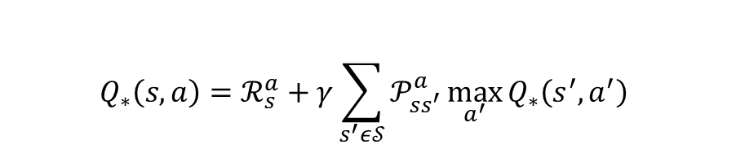
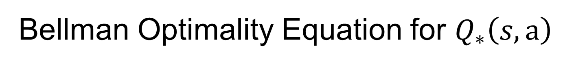
Bellman Optimality Equation for $Q_{∗}\left(s,a\right)$
$$a$$
$$r$$
$$s^{′}$$
$$a^{′}$$
$$Q_{∗}\left(s,a\right)=ℛ_{s}^{a}+γ\sum_{s^{′}ε𝒮}{𝒫_{ss^{′}}^{a}}\max_{a^{′}}{Q_{∗}\left(s^{′},a^{′}\right)}$$

Slide 21
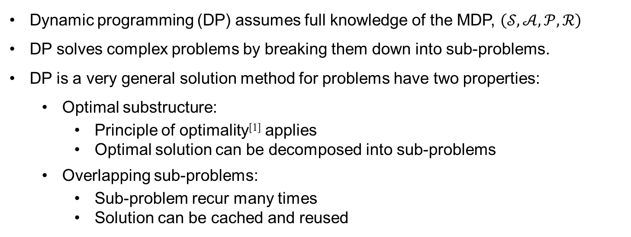
Planning by Dynamic Programming
Dynamic programming (DP) assumes full knowledge of the MDP, $\left(𝒮,𝒜,𝒫,ℛ\right)$
DP solves complex problems by breaking them down into sub-problems.
DP is a very general solution method for problems have two properties:
Optimal substructure:
Principle of optimality^{[1]} applies
Optimal solution can be decomposed into sub-problems
Overlapping sub-problems:
Sub-problem recur many times
Solution can be cached and reused
^{[1]} Bellman’s Principle of Optimality:
An optimal policy has the property that whatever the initial state and initial decision are, the remaining decisions must constitute an optimal policy with regard to the state resulting from the first decision

Slide 22


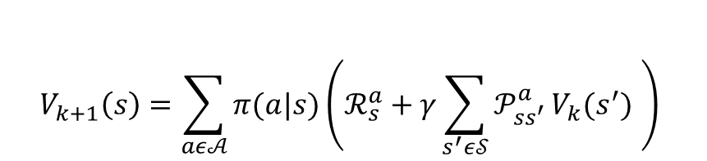




Iterative Policy Evaluation
$$s$$
$$V_{k+1}(s)$$
$$a$$
$$r$$
$$s^{′}$$
$$V_{k}(s^{′})$$
$$V_{k+1}\left(s\right)=\sum_{aε𝒜}{π(a|s)}\left(ℛ_{s}^{a}+γ\sum_{s^{′}ε𝒮}{𝒫_{ss^{′}}^{a}}V_{k}(s^{′}) \right)$$
Update present state-value function based on next time step:
$$V_{k+1}=𝓡^{π}+γ𝓟^{π}V_{k}$$

Slide 23
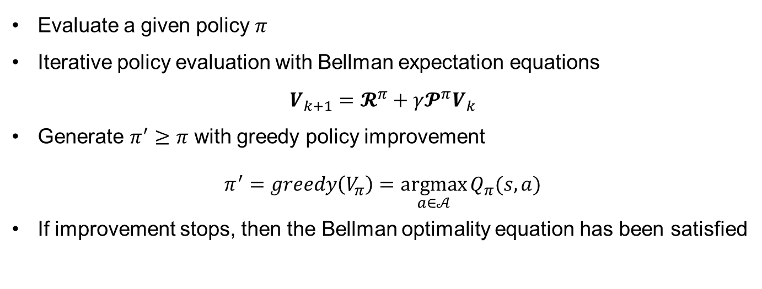
Policy Iteration
Evaluate a given policy $π$
Iterative policy evaluation with Bellman expectation equations
$$V_{k+1}=𝓡^{π}+γ𝓟^{π}V_{k}$$
Generate $π^{′}≥π$ with greedy policy improvement
$$π^{′}=greedy\left(V_{π}\right)=\underset{a∈𝒜}{argmax}{Q_{π}(s,a)}$$
If improvement stops, then the Bellman optimality equation has been satisfied

Slide 24
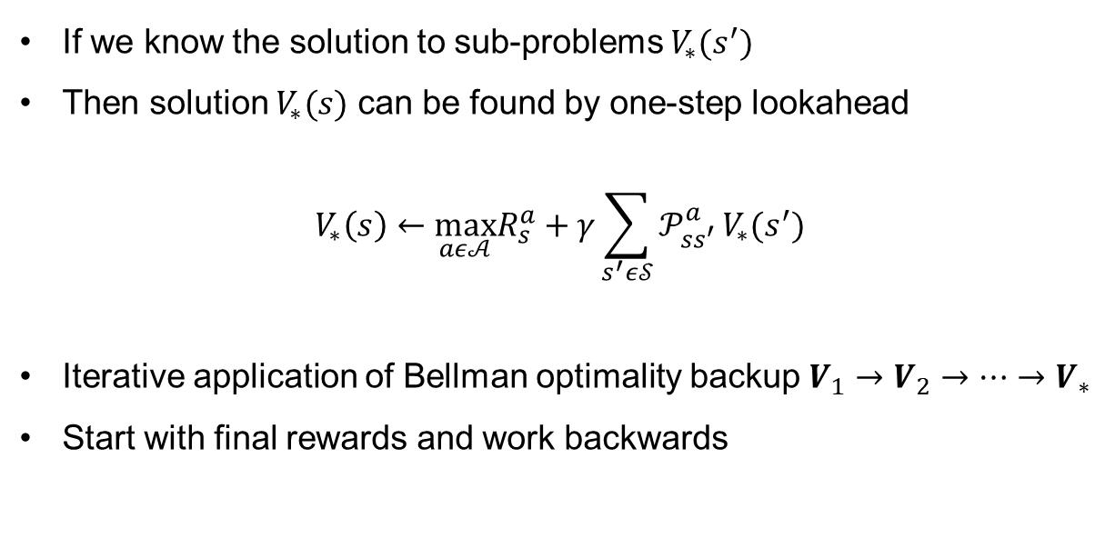
Value Iteration
If we know the solution to sub-problems $V_{∗}(s^{′})$
Then solution $V_{∗}(s)$ can be found by one-step lookahead
$$V_{∗}\left(s\right)←\max_{aε𝒜}R_{s}^{a}+γ\sum_{s^{′}ε𝒮}{𝒫_{ss^{′}}^{a}}V_{∗}(s^{′})$$
Iterative application of Bellman optimality backup $V_{1}→V_{2}→…→V_{∗}$
Start with final rewards and work backwards

Slide 25
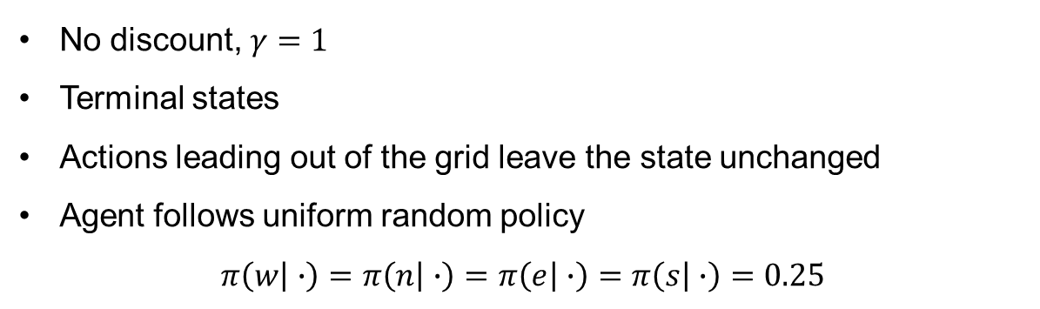

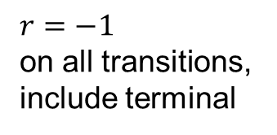



Policy Evaluation in Small Gridworld
 | 1 | 2 | 3
4 | 5 | 6 | 7
8 | 9 | 10 | 11
12 | 13 | 14
$$n$$
$r=−1$
on all transitions, include terminal
$$w$$
$$e$$
$$s$$
actions
states
No discount, $γ=1$
Terminal states
Actions leading out of the grid leave the state unchanged
Agent follows uniform random policy
$$π\left(w | ∙\right)=π\left(n | ∙\right)=π\left(e | ∙\right)=π\left(s | ∙\right)=0.25$$

Slide 26
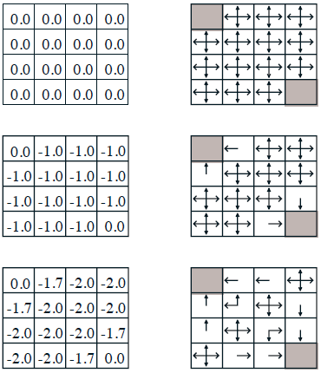
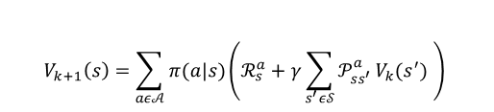







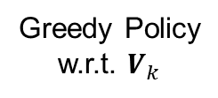

$$V_{k}$$
Greedy Policy
w.r.t. $V_{k}$
$$k=0$$
Random Policy
$$k=1$$
$$V_{k+1}\left(s\right)=\sum_{aε𝒜}{π(a|s)}\left(ℛ_{s}^{a}+γ\sum_{s^{′}ε𝒮}{𝒫_{ss^{′}}^{a}}V_{k}(s^{′}) \right)$$
$$V_{2}\left(S_{1}\right)=\frac{1}{4}\left(−1+1∙\left(1∙0+0∙\left(−1\right)+0∙\left(−1\right)+0∙(−1)\right)\right)$$
$$k=2$$
$$+\frac{1}{4}\left(−1+1∙\left(1∙\left(−1\right)+0∙0+0∙\left(−1\right)+0∙(−1)\right)\right)$$
$$+\frac{1}{4}\left(−1+1∙\left(1∙\left(−1\right)+0∙0+0∙\left(−1\right)+0∙(−1)\right)\right)$$
$$+\frac{1}{4}\left(−1+1∙\left(1∙\left(−1\right)+0∙0+0∙\left(−1\right)+0∙(−1)\right)\right)$$

Slide 27
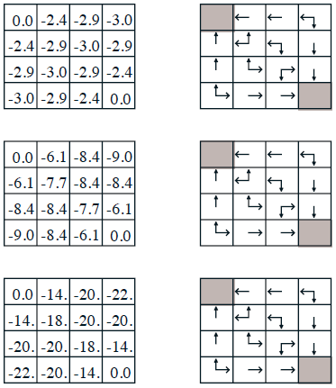



$$V_{k}$$
Greedy Policy
w.r.t. $V_{k}$
$$k=3$$
$$k=10$$
Optimal Policy
$$k=∞$$

Slide 28
But, what if transition matrix is unknown?

Slide 29
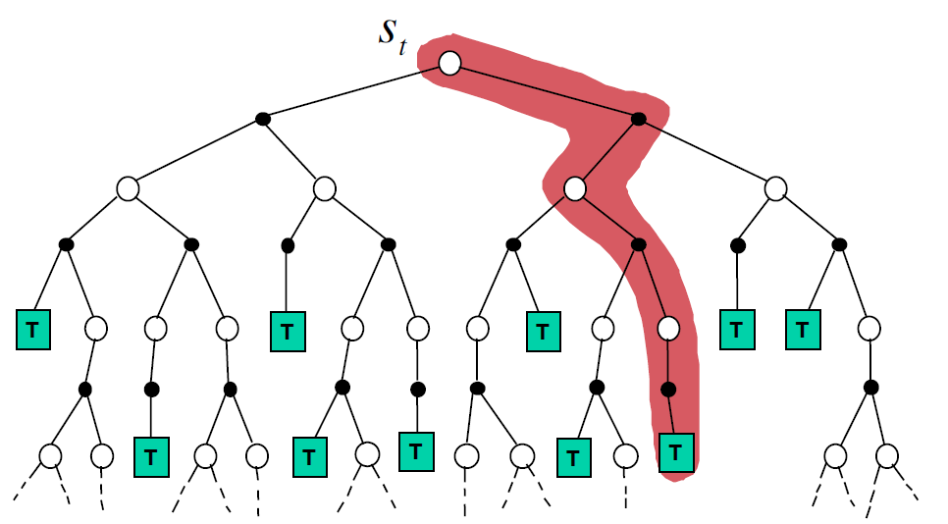
Monte-Carlo Estimation
$$V\left(S_{t}\right)←V\left(S_{t}\right)+α(G_{t}−V\left(S_{t}\right))$$

Slide 30
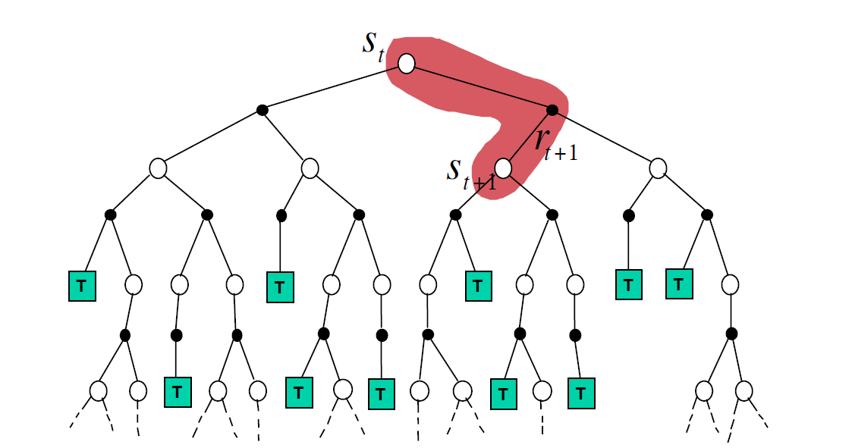
Temporal-Difference Estimation
$$V\left(S_{t}\right)←V\left(S_{t}\right)+α(R_{t+1}+γV\left(S_{t+1}\right)−V\left(S_{t}\right))$$

Slide 31
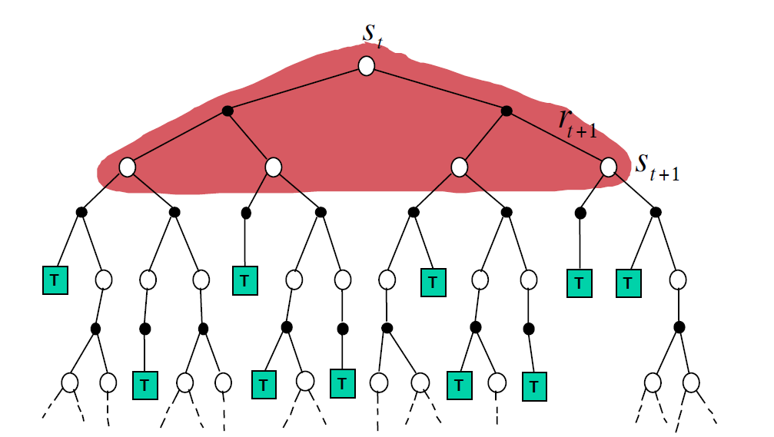
Dynamic Programming
$$V\left(S_{t}\right)←𝔼\left[R_{t+1}+γV\left(S_{t+1}\right)\right]$$

Slide 32
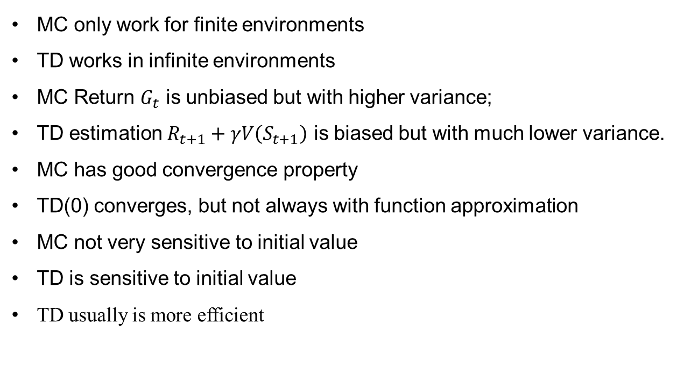
Compare MC and TD
MC only work for finite environments
TD works in infinite environments
MC Return $G_{t}$ is unbiased but with higher variance;
TD estimation $R_{t+1}+γV\left(S_{t+1}\right)$ is biased but with much lower variance.
MC has good convergence property
TD(0) converges, but not always with function approximation
MC not very sensitive to initial value
TD is sensitive to initial value
TD usually is more efficient

Slide 33
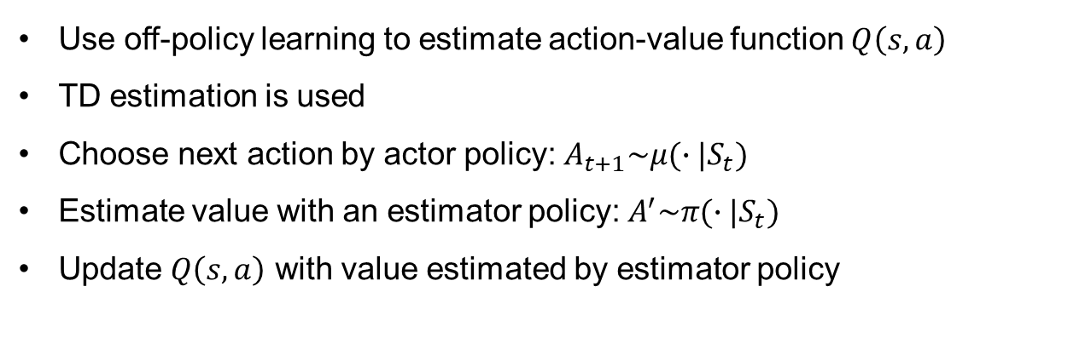
Off-policy Learning
Use off-policy learning to estimate action-value function $Q\left(s,a\right)$
TD estimation is used
Choose next action by actor policy: $A_{t+1}\sim μ(∙|S_{t})$
Estimate value with an estimator policy: $A^{′}\sim π(∙|S_{t})$
Update $Q\left(s,a\right)$ with value estimated by estimator policy
$$Q\left(S_{t},A_{t}\right)←Q\left(S_{t},A_{t}\right)+α\left(R_{t+1}+γQ\left(S_{t+1},A^{′} \right)−Q\left(S_{t},A_{t}\right)\right)$$

Slide 34
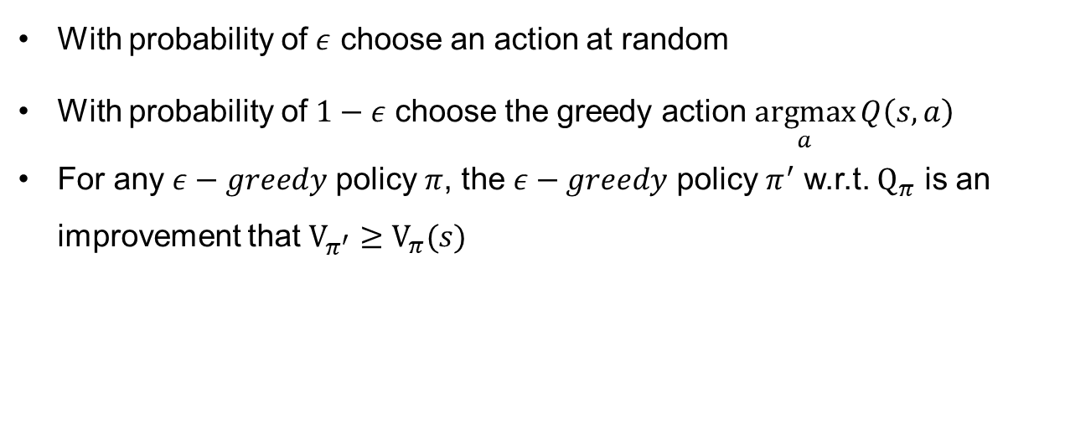
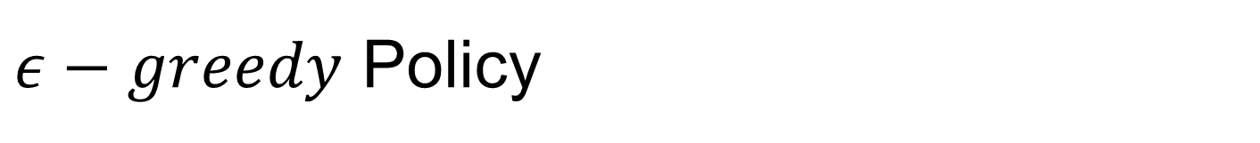
$ε−greedy$ Policy
With probability of $ε$ choose an action at random
With probability of $1−ε$ choose the greedy action $\underset{a}{argmax}{Q\left(s,a\right)}$
For any $ε−greedy$ policy $π$, the $ε−greedy$ policy $π^{′}$ w.r.t. $Q_{π}$ is an improvement that $V_{π^{′}}≥V_{π}(s)$

Slide 35
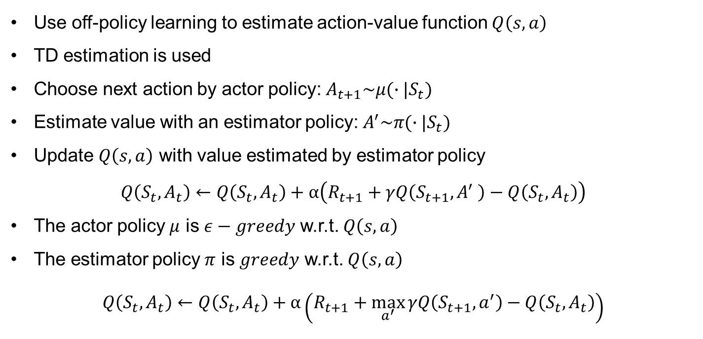
Q-learning
Use off-policy learning to estimate action-value function $Q\left(s,a\right)$
TD estimation is used
Choose next action by actor policy: $A_{t+1}\sim μ(∙|S_{t})$
Estimate value with an estimator policy: $A^{′}\sim π(∙|S_{t})$
Update $Q\left(s,a\right)$ with value estimated by estimator policy
$$Q\left(S_{t},A_{t}\right)←Q\left(S_{t},A_{t}\right)+α\left(R_{t+1}+γQ\left(S_{t+1},A^{′} \right)−Q\left(S_{t},A_{t}\right)\right)$$
The actor policy $μ$ is $ε−greedy$ w.r.t. $Q\left(s,a\right)$
The estimator policy $π$ is $greedy$ w.r.t. $Q\left(s,a\right)$
$$Q\left(S_{t},A_{t}\right)←Q\left(S_{t},A_{t}\right)+α\left(R_{t+1}+\max_{a^{′}}{γQ\left(S_{t+1},a^{′}\right)}−Q\left(S_{t},A_{t}\right)\right)$$

Slide 36
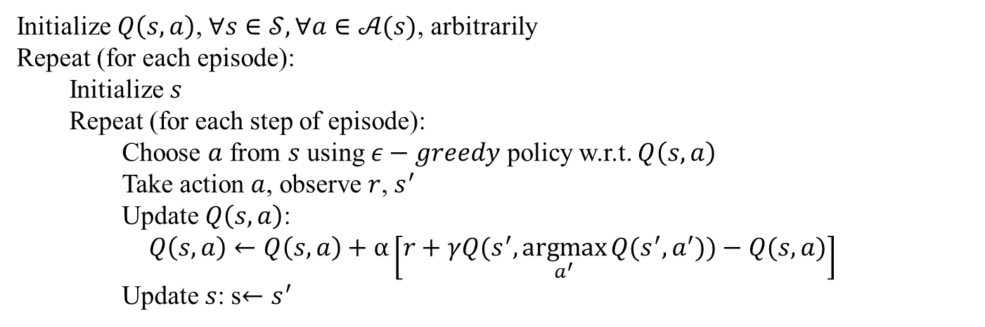
Q-learning
Q-learning algorithm (Tabular)
Initialize $Q\left(s,a\right)$, $∀s∈𝒮, ∀a∈𝒜(s)$, arbitrarily
Repeat (for each episode):
Initialize $s$
Repeat (for each step of episode):
Choose $a$ from $s$ using $ε−greedy$ policy w.r.t. $Q\left(s,a\right)$
Take action $a$, observe $r$, $s^{′}$
Update $Q\left(s,a\right)$:
$Q\left(s,a\right)←Q\left(s,a\right)+α\left[r+γQ(s^{′},\underset{a^{′}}{argmax}{Q(s^{′},a^{′}))}−Q(s,a)\right]$
Update $s$: s$←s^{′}$

Slide 37
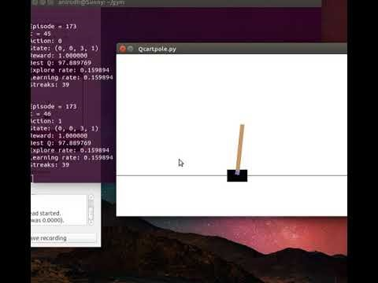
Q-learning Example

Slide 38
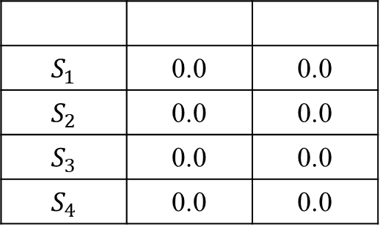
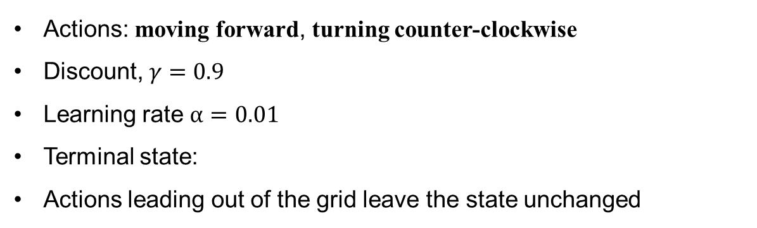
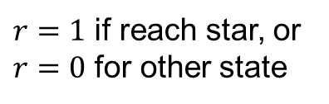
Q-learning Example
$$Q\left(s,a\right)←Q\left(s,a\right)+α\left[r+γQ(s^{′},\underset{a^{′}}{argmax}{Q(s^{′},a^{′}))}−Q(s,a)\right]$$
$$Q\left(S_{2},forward\right)←Q\left(S_{2},forward\right)+α\left[r+γQ(S_{1},\underset{a^{′}}{argmax}{Q(S_{1},a^{′}))}−Q(S_{2},forward)\right]$$
$$=0.0+0.01\left[1+0.9∙0.0−0.0\right]$$
1 | 2
3 | 4
$$S_{1}$$ | 0.0 | 0.0
$$S_{2}$$ | 0.0 | 0.0
$$S_{3}$$ | 0.0 | 0.0
$$S_{4}$$ | 0.0 | 0.0
0.01
$r=1$ if reach star, or $r=0$ for other state
Actions: moving forward, turning counter-clockwise
Discount, $γ=0.9$
Learning rate $α=0.01$
Terminal state:
Actions leading out of the grid leave the state unchanged

Slide 39
Q-learning Summary
Planning only works with knowledge of transition matrix.
Have to estimate values without knowledge of transition matrix
Q-learning is an off-policy learning algorithm. The policy you use for taking actions are not required to be the same to estimate returns.
Q-learning doesn’t learn policy explicitly.
Q-learning is more efficient compare to vanilla policy gradient.
Markov property is required, but usually this is just for the convenience of math
Basic Q-learning algorithm is limited to discrete states and actions, also suffers from curse of dimensionality
Deep Q-network (DQN) can take continuous states, Deep Deterministic Policy
Gradient (DDPG) evaluate continuous actions

Slide 40
Readings for Q-learning
Classic papers
Watkins CJ. Learning from delayed rewards (Doctoral dissertation, King's College, Cambridge). 1989
Riedmiller M. Neural fitted Q iteration–first experiences with a data efficient neural reinforcement learning method. InEuropean Conference on Machine Learning. 2005
Deep Learning based Q-learning
Lange S, Riedmiller M. Deep auto-encoder neural networks in reinforcement learning. InThe 2010 International Joint Conference on Neural Networks (IJCNN). 2010
Mnih V, et al. Human-level control through deep reinforcement learning. Nature. 2015
Gu S, et al. Continuous deep q-learning with model-based acceleration. InInternational Conference on Machine Learning 2016

Slide 41
Resources
Reference books
Sutton and Barto, Reinforcement Learning: An Introduction (http://incompleteideas.net/book/bookdraft2017nov5.pdf)
Szepesvári, Algorithms for Reinforcement Learning (https://sites.ualberta.ca/~szepesva/papers/RLAlgsInMDPs-lecture.pdf)
Online Classes
Silver, Introduction to Reinforcement Learning (http://www0.cs.ucl.ac.uk/staff/d.silver/web/Teaching.html)
Levine, CS294-112: Deep Reinforcement Learning (http://rail.eecs.berkeley.edu/deeprlcourse/)
Blogs & Tutorials
Berkeley Artificial Intelligent Research (BAIR): https://bair.berkeley.edu/blog/?refresh=1
Deepmind: https://deepmind.com/blog/
OpenAI: https://openai.com/blog/
Lil’Log: https://lilianweng.github.io/lil-log/
Spinning Up in Deep RL: https://spinningup.openai.com/en/latest/

Slide 42
Machine Learning based Projects Solutions

