Slide 1
Aerospace
Yufeng Sun 2019

Slide 2
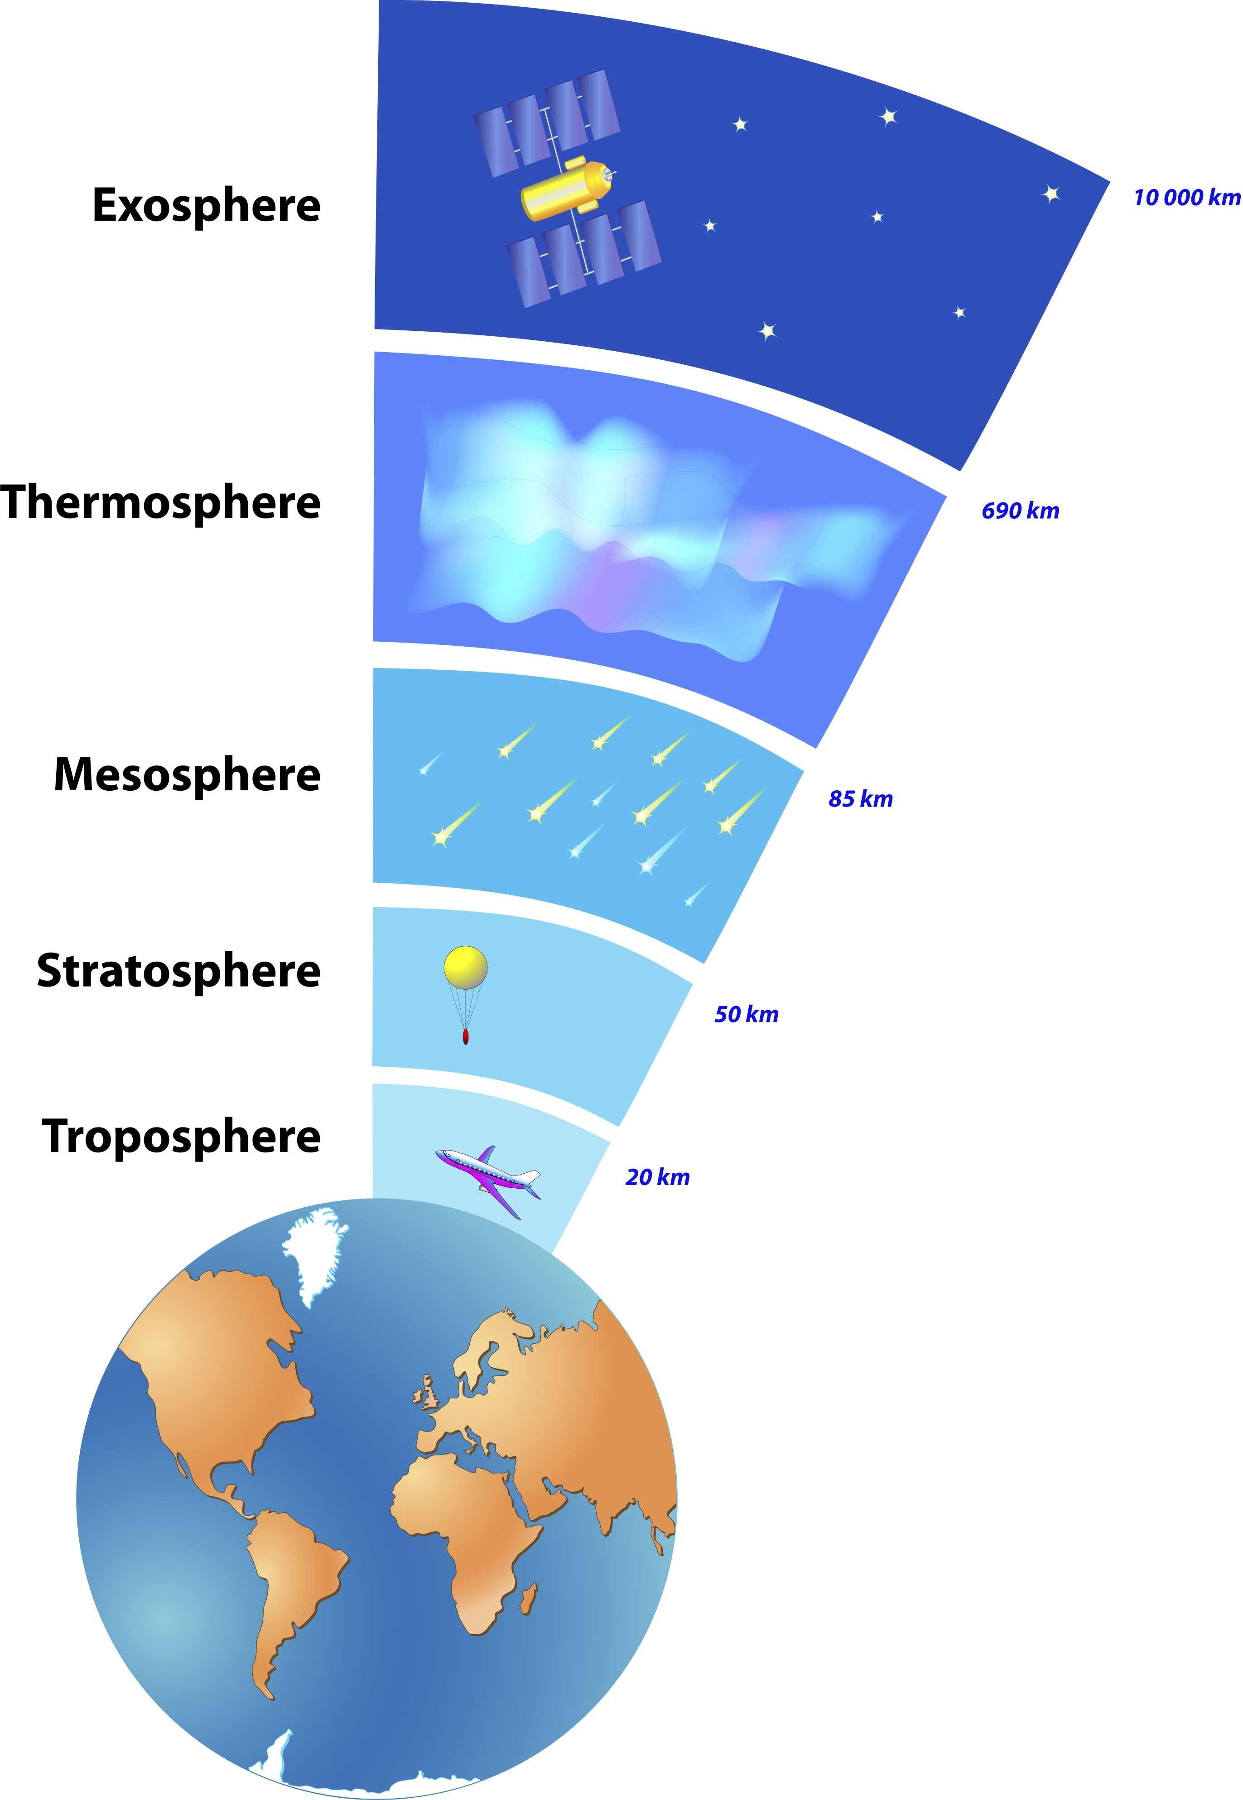
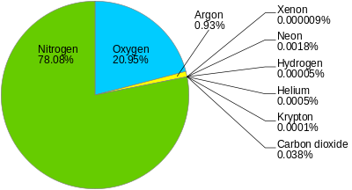
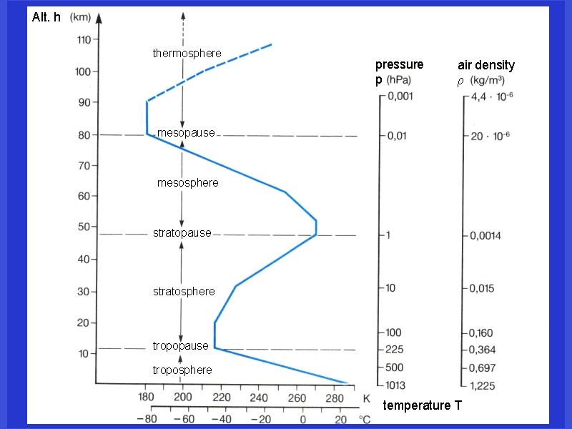
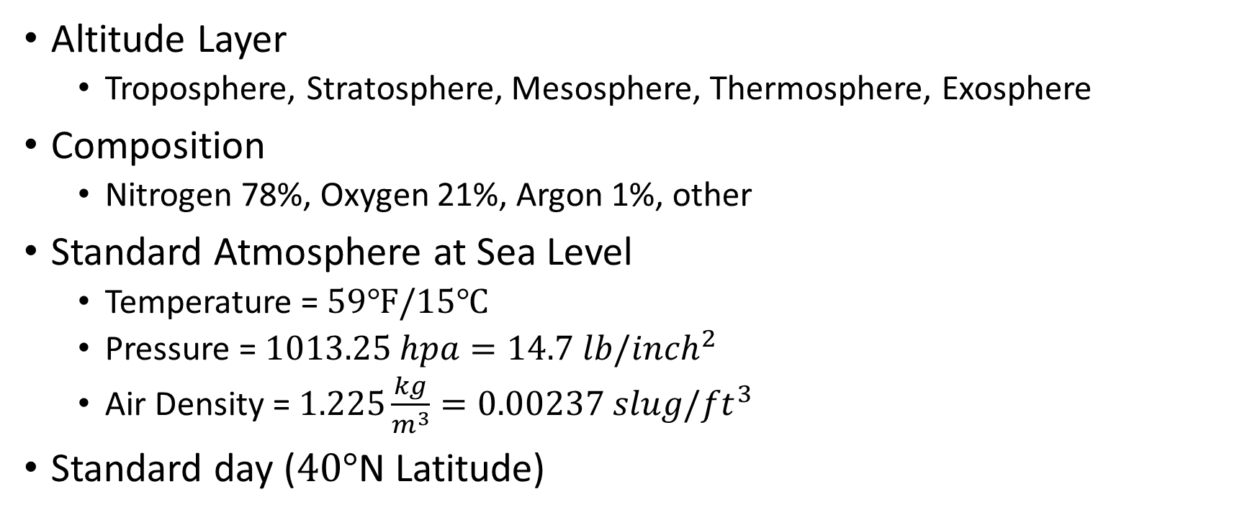
Atmosphere
Altitude Layer
Troposphere, Stratosphere, Mesosphere, Thermosphere, Exosphere
Composition
Nitrogen 78%, Oxygen 21%, Argon 1%, other
Standard Atmosphere at Sea Level
Temperature = $59℉/15℃$
Pressure = $1013.25 hpa=14.7 lb/{inch}^{2}$
Air Density = $1.225\frac{kg}{m^{3}}=0.00237 slug/{ft}^{3}$
Standard day ($40°$N Latitude)

Slide 3
Flight Test Planning
Society of Experimental Test Pilots
WHAT is being done
WHY it is being done
WHO is doing it
WHERE they will do it
HOW they will do it
What RESOURCE and HOW will the results reported to WHO

Slide 4
Test planning – Risk Management
System Safety
Safety hierarchy: clearly establish priorities within an organization
Hazard Analysis: Identify risks->Categorize risks->Implement mitigations (NASA risk matrix likelihood - severity)
Fault Tree Analysis: Investigate hazards and show how it causes other
FMEA: Failure Model and Effects Analysis for finding root failure causes
ROM (Operational Risk Management) 6 Steps:
Identify the Hazards
Assess the Risks
Analyze Risk Control Measures
Make Control Decision
Implement Risk Control
Supervise and Review

Slide 5
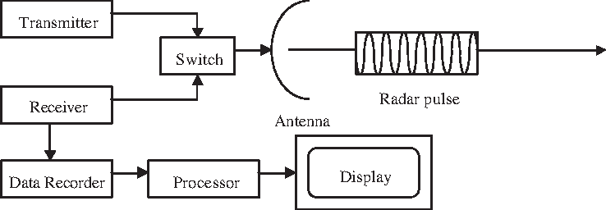
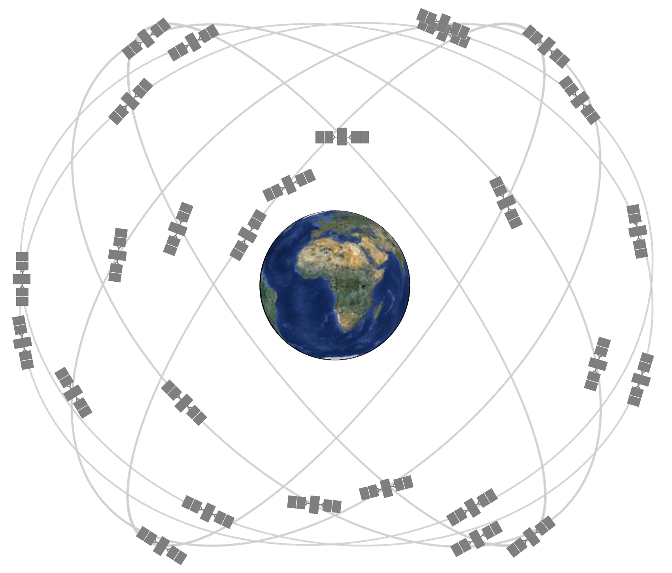
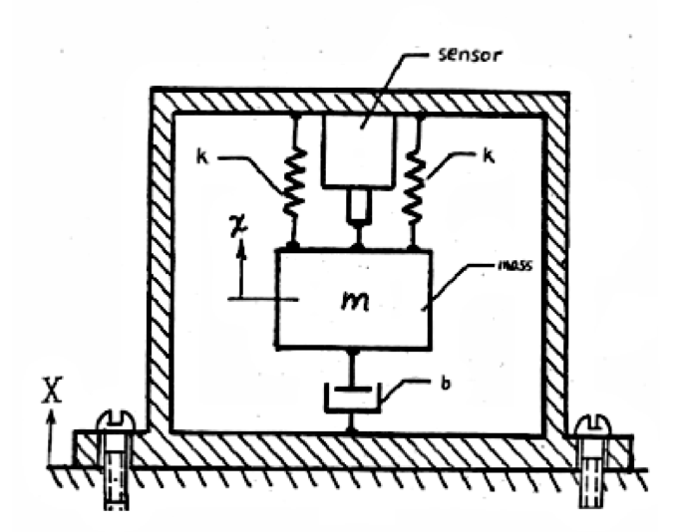
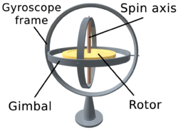
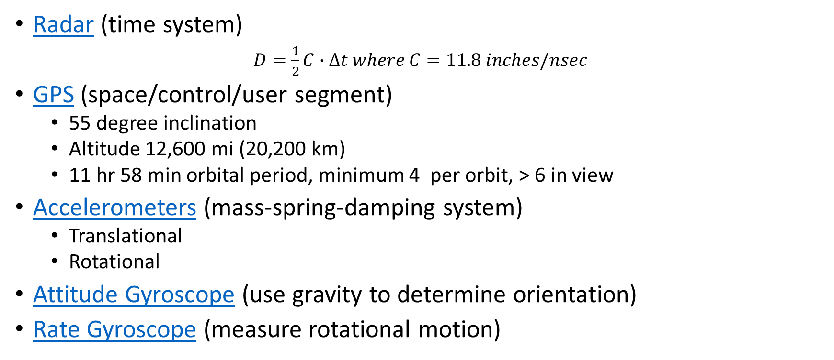
Instrumentation
Radar (time system)
$D=\frac{1}{2}C∙∆t where C=11.8 inches/nsec$
GPS (space/control/user segment)
55 degree inclination
Altitude 12,600 mi (20,200 km)
11 hr 58 min orbital period, minimum 4 per orbit, > 6 in view
Accelerometers (mass-spring-damping system)
Translational
Rotational
Attitude Gyroscope (use gravity to determine orientation)
Rate Gyroscope (measure rotational motion)

