Slide 1
Foundation in Robotics
Yufeng Sun 2019

Slide 2
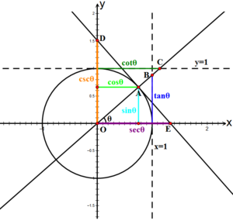
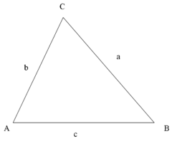

Trigonometrical
Pythagorean theorem
$$\sin^{2}x+ \cos^{2}x=1$$
$$\tan^{2}x+1=\sec^{2}$$
$1+\cot^{2}x=\csc^{2}$
Angle transformation formulae
$$sin⁡(A±B)=sinAcosB±cosAsinB$$
$$cos⁡(A±B)=cosAcosB∓sinAsinB$$
Law of sines, cosines
$$\frac{a}{\sin{A}}=\frac{b}{sinB}=\frac{c}{sinC}=2R=\frac{abc}{2∆}$$
$$c^{2}=a^{2}+b^{2}−2abcosC$$
Notes:
https://en.wikipedia.org/wiki/Trigonometric_functions

Slide 3
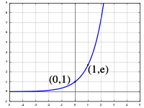

Exponential Function
Form
$$y=ab^{x}$$
Natural exponential function
$$y=e^{x}$$
Notes:
https://en.wikipedia.org/wiki/Exponential_function

Slide 4

Derivative and Differential
Derivative of function y(x) at x0
$$y_{x}^{,}\left(x_{0}\right)=\lim_{x→x_{0}}{\frac{y−y\left(x_{0}\right)}{x−x_{0}}}$$
Differential of function y(x) at x0
$$dy=y_{x}^{,}\left(x_{0}\right)dx$$
Sum rule
Products rule
Quotients rule
Chain rule
Sum rule
Products rule
Quotients rule
Chain rule
Notes:
https://www.quora.com/What-is-the-difference-between-derivative-and-differential

Slide 5
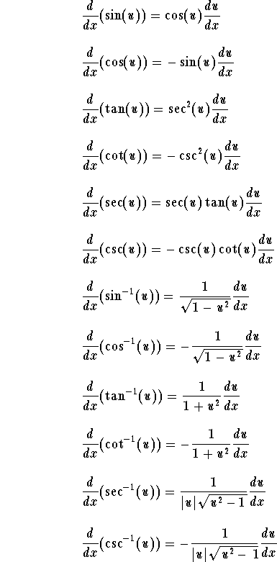
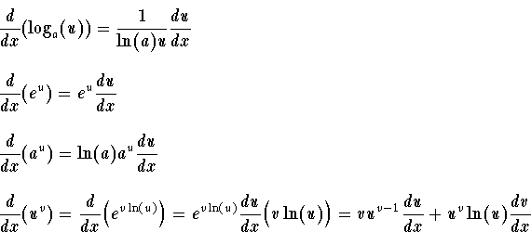
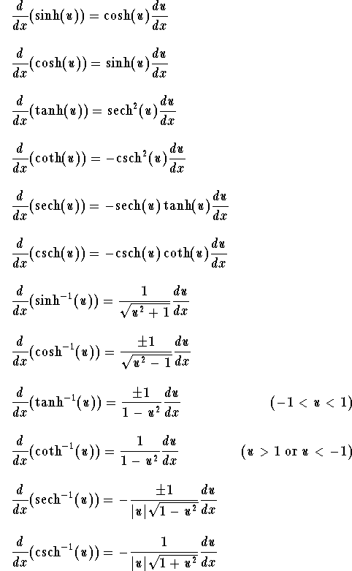
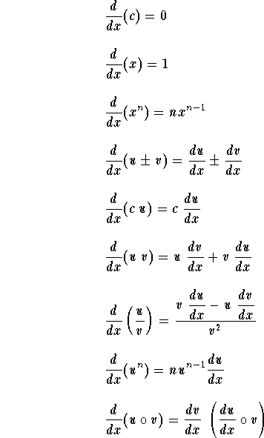


Table of Derivatives
Notes:
https://www.math24.net/derivatives-trigonometric-functions/
http://www.sosmath.com/tables/derivative/derivative.html

Slide 6

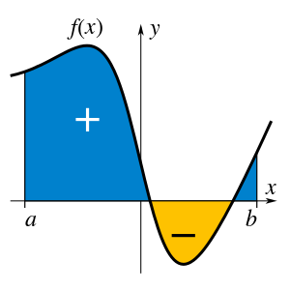

Integral
An integral is a mathematical object that can be interpreted as an area or a generalization of area. The function of f(x) over x from a to b
$$\int_{a}^{b}{f\left(x\right)dx}$$
Notes:
http://mathworld.wolfram.com/Integral.html

Slide 7
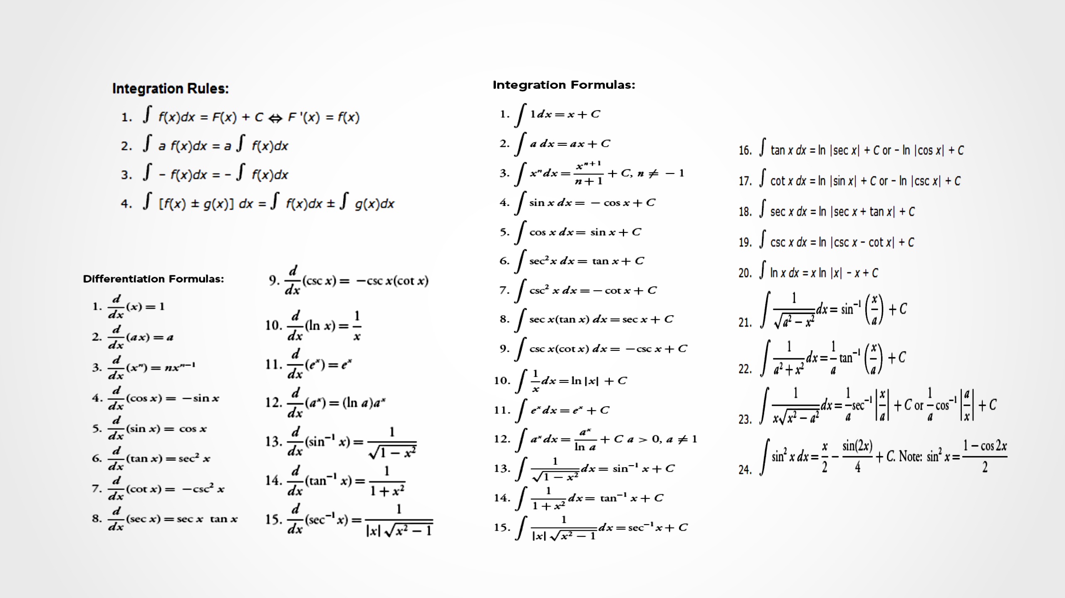
Table of Integral
Notes:
https://www.math.purdue.edu/~ssunshin/integral.gif

Slide 8
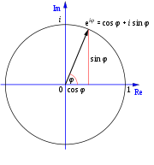
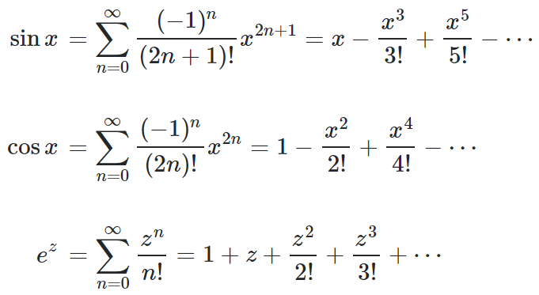
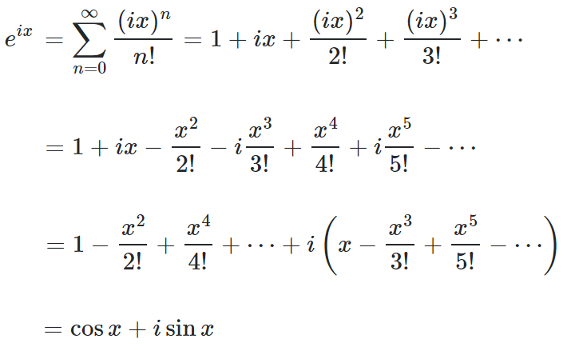
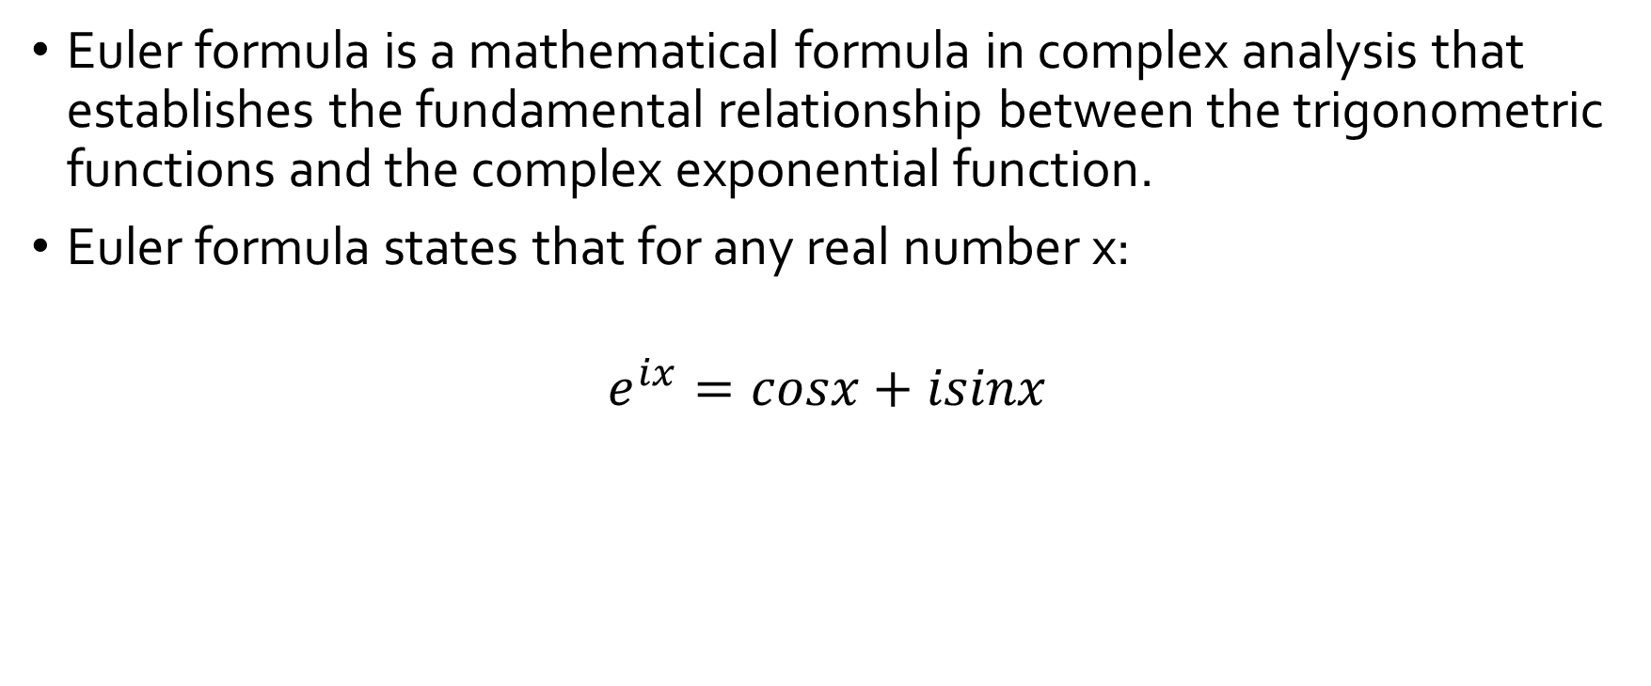
Euler Formula
Euler formula is a mathematical formula in complex analysis that establishes the fundamental relationship between the trigonometric functions and the complex exponential function.
Euler formula states that for any real number x:
$$e^{ix}=cosx+isinx$$
MacLaurin Series
z=ix
Notes:
https://en.wikipedia.org/wiki/Euler%27s_formula
https://math.stackexchange.com/questions/3510/how-to-prove-eulers-formula-ei-varphi-cos-varphi-i-sin-varphi

Slide 9
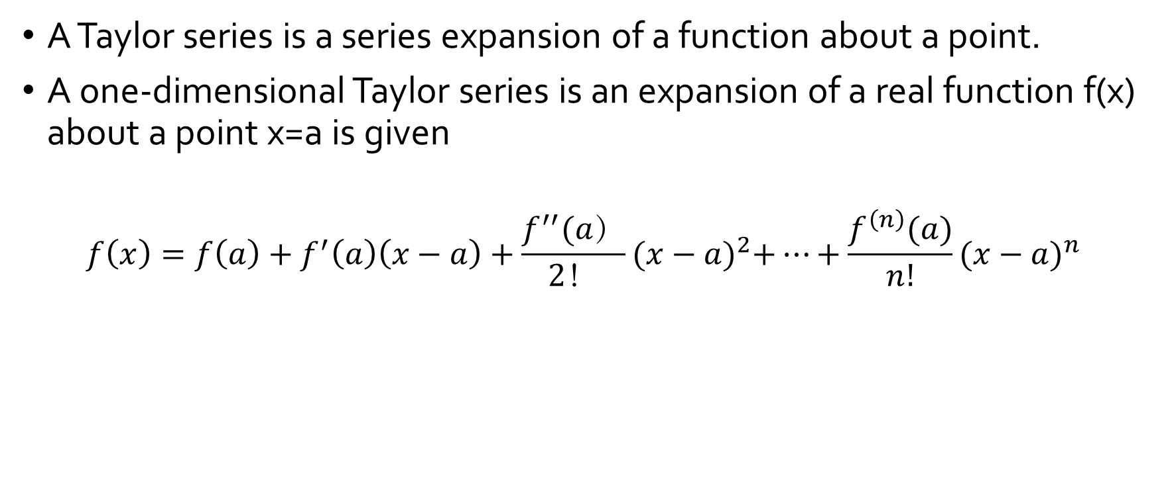
Taylor Series
A Taylor series is a series expansion of a function about a point.
A one-dimensional Taylor series is an expansion of a real function f(x) about a point x=a is given
$$f\left(x\right)=f\left(a\right)+f^{′}\left(a\right)\left(x−a\right)+\frac{f^{′′}(a）}{2！}{(x−a)}^{2}+…+\frac{f^{\left(n\right)}(a)}{n!}{(x−a)}^{n}$$
Notes:
http://mathworld.wolfram.com/TaylorSeries.html

Slide 10
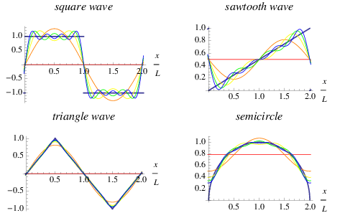
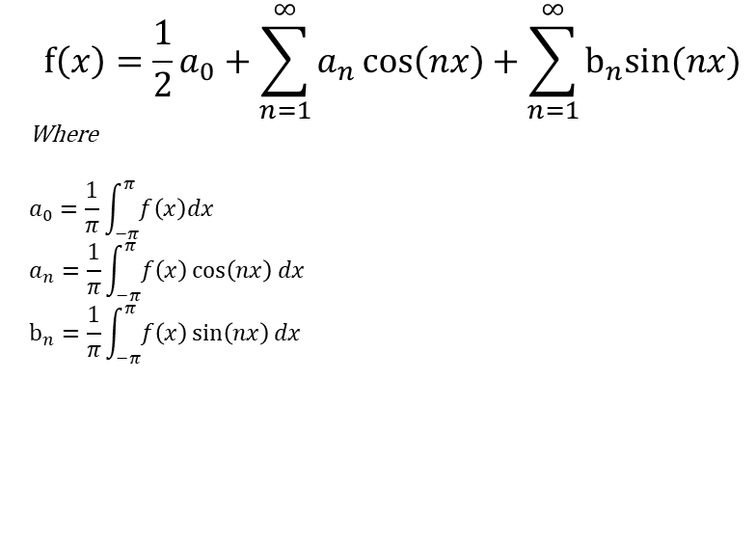
Fourier Series
A Fourier series is an expansion of a periodic function f(x) in terms of an infinite sum of sines and cosines.
Fourier series make use of the orthogonality relationships of the sine and cosine functions.
$$f\left(x\right)=\frac{1}{2}a_{0}+\sum_{n=1}^{∞}{a_{n}\cos\left(nx\right)+\sum_{n=1}^{∞}{b_{n}sin⁡(nx)}}$$
Where
$$a_{0}=\frac{1}{π}\int_{−π}^{π}{f\left(x\right)dx}$$
$$a_{n}=\frac{1}{π}\int_{−π}^{π}{f\left(x\right)\cos\left(nx\right)dx}$$
$$b_{n}=\frac{1}{π}\int_{−π}^{π}{f\left(x\right)\sin\left(nx\right)dx}$$
Notes:
http://mathworld.wolfram.com/FourierSeries.html
https://zhuanlan.zhihu.com/p/41455378
https://www.zhihu.com/question/34899574/answer/612923473

Slide 11
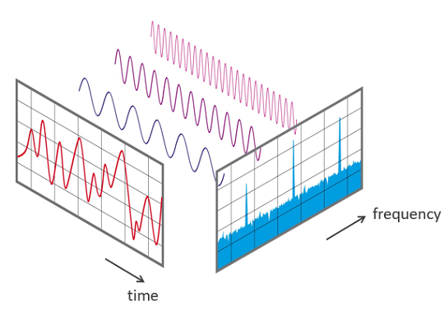
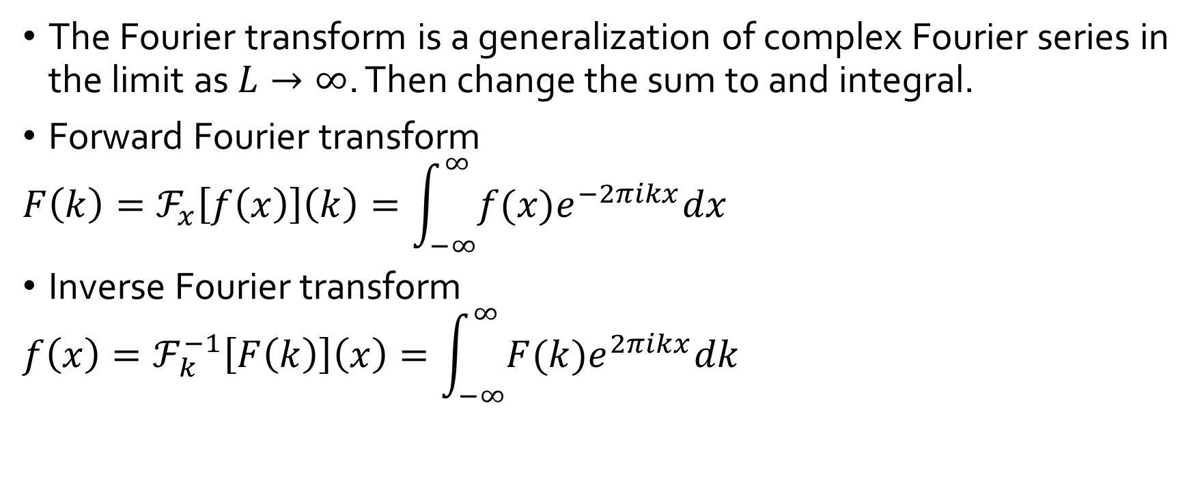
Fourier Transform
The Fourier transform is a generalization of complex Fourier series in the limit as $L→∞$. Then change the sum to and integral.
Forward Fourier transform
$$F\left(k\right)=ℱ_{x}\left[f\left(x\right)\right]\left(k\right)=\int_{−∞}^{∞}{f(x)e^{−2πikx}dx}$$
Inverse Fourier transform
$$f\left(x\right)=ℱ_{k}^{−1}\left[F\left(k\right)\right]\left(x\right)=\int_{−∞}^{∞}{F(k)e^{2πikx}dk}$$
Notes:
http://mathworld.wolfram.com/FourierTransform.html
https://www.zhihu.com/question/34899574/answer/612923473
https://tracholar.github.io/math/2017/03/12/fourier-transform.html

Slide 12
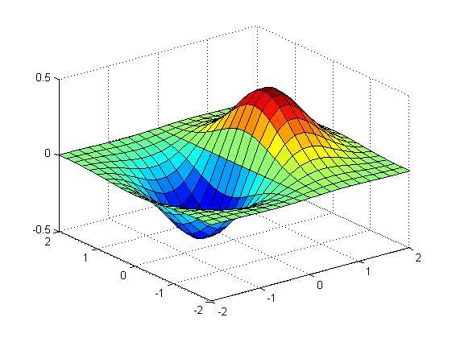
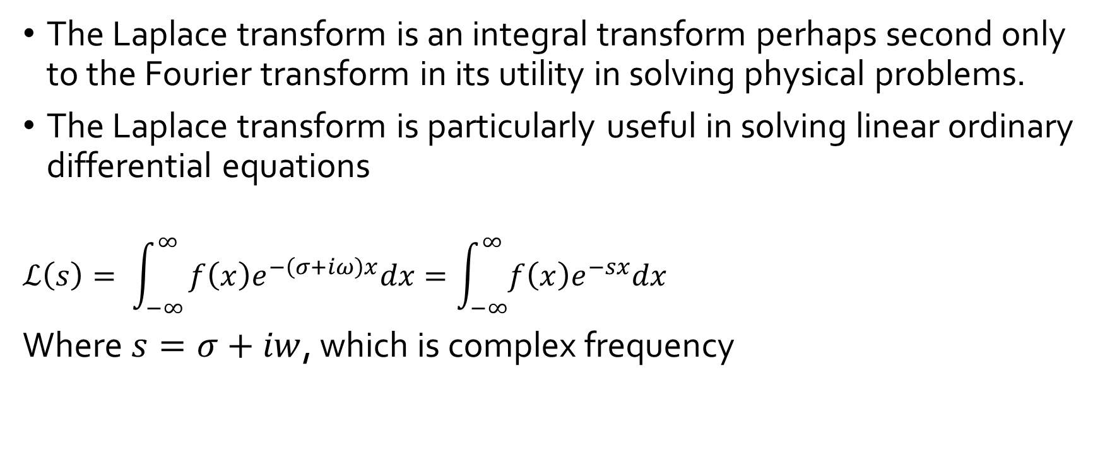
Laplace Transform
The Laplace transform is an integral transform perhaps second only to the Fourier transform in its utility in solving physical problems.
The Laplace transform is particularly useful in solving linear ordinary differential equations
$$ℒ\left(s\right)= \int_{−∞}^{∞}{f\left(x\right)e^{−\left(σ+iω\right)x}dx=\int_{−∞}^{∞}{f\left(x\right)e^{−sx}dx }}$$
Where $s=σ+iw$, which is complex frequency
Notes:
http://mathworld.wolfram.com/LaplaceTransform.html
https://tracholar.github.io/math/2017/03/12/fourier-transform.html
https://www.zhihu.com/question/22085329

Slide 13
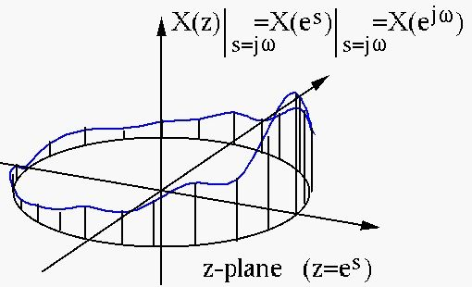
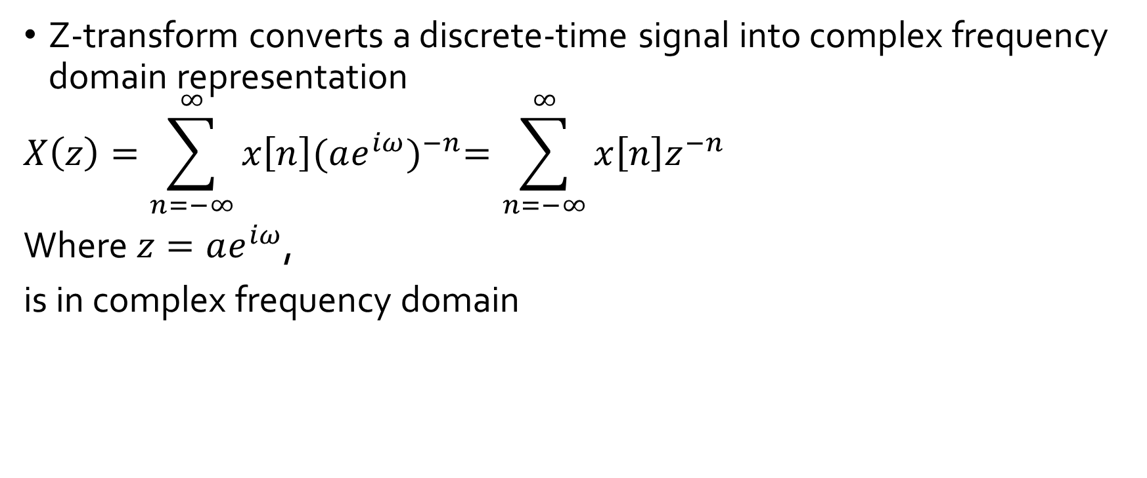
Z Transform
Z-transform converts a discrete-time signal into complex frequency domain representation
$$X\left(z\right)=\sum_{n=−∞}^{∞}{x\left[n\right]{(ae^{iω})}^{−n}=\sum_{n=−∞}^{∞}{x\left[n\right]z^{−n}}}$$
Where $z=ae^{iω}$,
is in complex frequency domain
Notes:
https://en.wikipedia.org/wiki/Z-transform

Slide 14
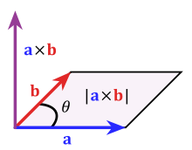
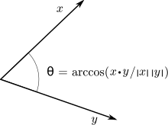

Vector
Cross product
$$a×b=\left(a2b3−a3b2\right)i+\left(a3b1−a1b3\right)j+\left(a1b2−a2b1\right)k$$
$$\left|\left|a×b\right|\right|=\left|\left|a\right|\right| \left|\left|b\right|\right| \left|sinθ\right|$$
Dot product
$$a∙b=a1b1+a2b2+a3b3$$
$$a∙b=\left|\left|a\right|\right|\left|\left|b\right|\right|cosθ$$
Notes:
https://en.wikipedia.org/wiki/Cross_product
https://en.wikipedia.org/wiki/Dot_product

Slide 15
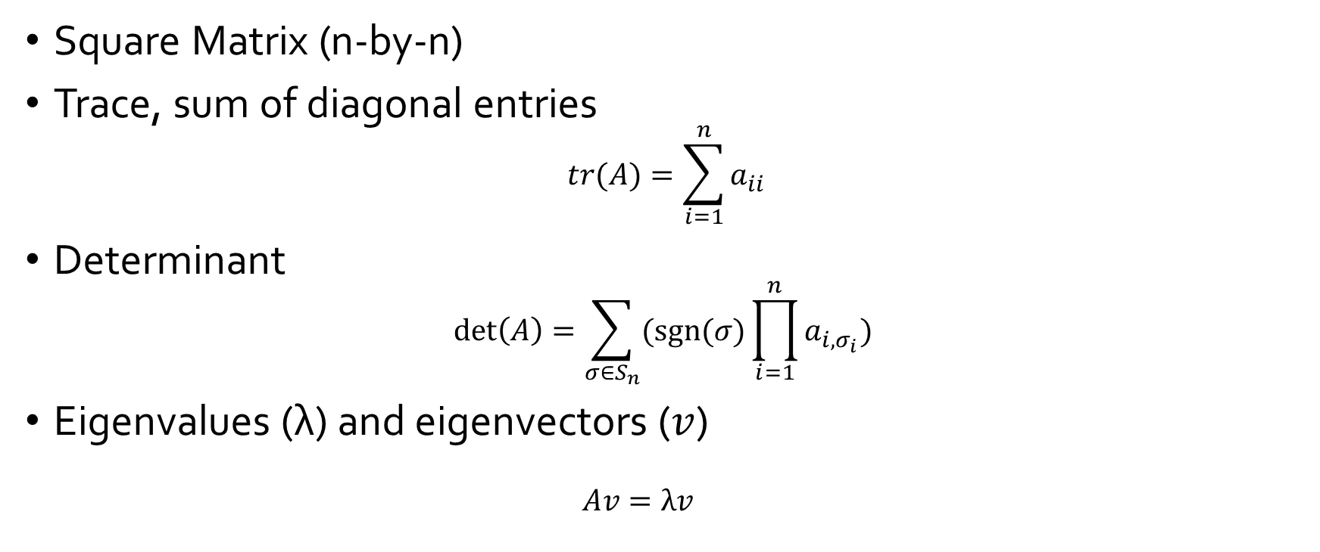
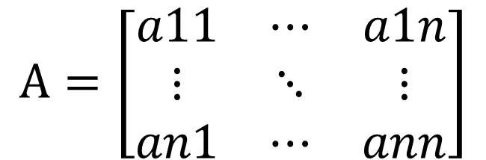
Matrix
$$A=\left[\begin{matrix}a11 & ⋯ & a1n \\ ⋮ & ⋱ & ⋮ \\ an1 & ⋯ & ann\end{matrix}\right]$$
Square Matrix (n-by-n)
Trace, sum of diagonal entries
$$tr(A)=\sum_{i=1}^{n}{a_{ii}}$$
Determinant
$$\det\left(A\right)=\sum_{σ∈S_{n}}{(sgn⁡(σ)\prod_{i=1}^{n}{a_{i,σ_{i}})} }$$
Eigenvalues (λ) and eigenvectors ($v$)
$$Av=λv$$
Notes:
https://en.wikipedia.org/wiki/Matrix_(mathematics)
https://en.wikipedia.org/wiki/Determinant
https://en.wikipedia.org/wiki/Eigenvalues_and_eigenvectors

Slide 16


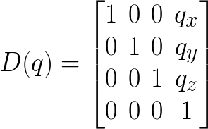
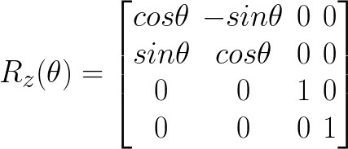

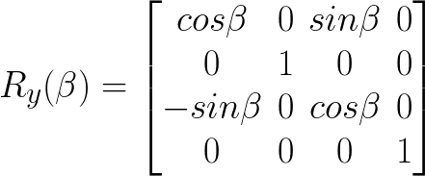

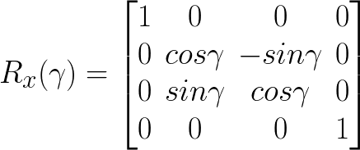


Transformation
Translate and Rotate P in frame {B} respect to frame {A}
Homogenous
Forward Transformation
Reverse Transformation

Slide 17





Transformation Inverse Solution
X-Y-Z Fixed angles transformation
Equivalent angle-axis representation

Slide 18


Newton’s Laws
1st Law: In an inertial frame of reference, an object either remains at rest or continues to move at a constant velocity, unless acted upon by a force.
2nd Law: In an inertial frame of reference, the vector sum of force on an object is equal to the mass of the object multiplied by the acceleration of the object.
3rd Law: When one body exerts a force on a second body, the second body simultaneously exerts a force equal in magnitude and opposite in direction on the first body.

Slide 19





Force
Cause an object with mass to change its velocity, has both magnitude and direction, making a vector quantity.
Trust, increase the velocity of an object
Drag, decrease the velocity of an object
Torque, produce changes in rotational speed of an object
Fundamental forces
Gravitational
Electromagnetic
Strong / Weak nuclear
Non-Fundamental forces
Normal force, repulsive forces f interaction between atoms at close contact.
Friction, a surface forces that opposes relative motion, static friction and kinetic friction
Tension
Elastic force, Hooke’s law
Centripetal force
Notes:
https://en.wikipedia.org/wiki/Force
https://en.wikipedia.org/wiki/Torque
https://en.wikipedia.org/wiki/Momentum
https://en.wikipedia.org/wiki/Kinetic_energy
https://en.wikipedia.org/wiki/Angular_momentum
https://en.wikipedia.org/wiki/Moment_of_inertia

Slide 20








Linear vs Angular
Linear momentum
Newton’s 2nd Law
Kinetic energy
Angular momentum
Newton’s 2nd Law
Kinetic energy
Kinematic integrals
Impulse, force accumulation on time
Work done, force accumulation on space
Notes:
Inertia, the resistance of a body to change its motion

Slide 21
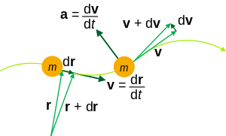



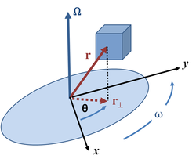


Kinematics
Kinematics describes motion of point, bodies and system of bodies.
Motion is the change of position of an object with time
Position
Trajectory
Linear Velocity
Speed
Linear Acceleration
Angular Velocity
Angular Acceleration
Notes:
https://en.wikipedia.org/wiki/Kinematicshttps://en.wikipedia.org/wiki/Kinematics

Slide 22

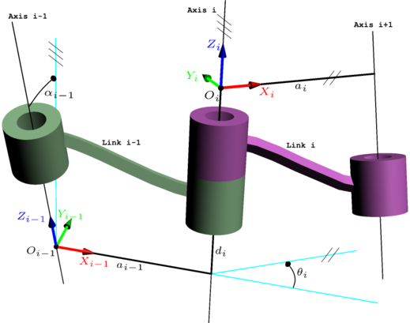
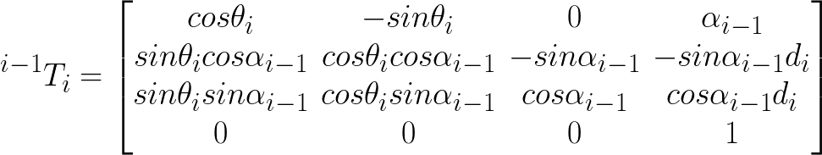
Denavit-Hartenberg Parameters
4 parameters
a_{i-1}, distance of Z_{i-1} to Z_{i} along X_{i-1}
α_{i-1}, angle between Z_{i-1} and Z_{i} about X_{i-1}
d_{i}, distance of X_{i-1} to X_{i} along Z_{i}
θ_{i}, angle between X_{i-1} and X_{i} about Z_{i}
Notes:
https://en.wikipedia.org/wiki/Denavit%E2%80%93Hartenberg_parameters
https://www.youtube.com/watch?v=rA9tm0gTln8

Slide 23
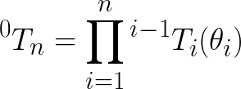
Forward Kinematic
use of the kinematic equations of a robot to compute the end-effector position from specific values of the joint parameters.
The kinematic equations of a serial chain of n links:
D-H matrix
Notes:
https://en.wikipedia.org/wiki/Forward_kinematics
https://en.wikipedia.org/wiki/Robot_kinematics

Slide 24
Inverse Kinematic
Specify end-effector location and compute the associated joint angles
Existence of solution
For a solution to exist, the specified goal point must lie
within the workspace (dexterous space – reachable workspace)
Multiple solutions
- Choose the closet the solution if possible
Analytic solution (closed-form) - Approximate solution (numerical)
The Jacobian inverse technique
Heuristic method
Algebraic - geometric
Notes:
https://en.wikipedia.org/wiki/Inverse_kinematics

Slide 25





Robotic Jacobian
Mapping joint velocity to end-effector velocity
Forward kinematic equation
Time derivative
Use of Jacobian
Notes:
https://robotics.stackexchange.com/questions/14749/understanding-the-robot-jacobian
https://studywolf.wordpress.com/2013/09/02/robot-control-jacobians-velocity-and-force/

Slide 26
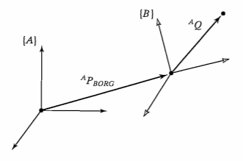
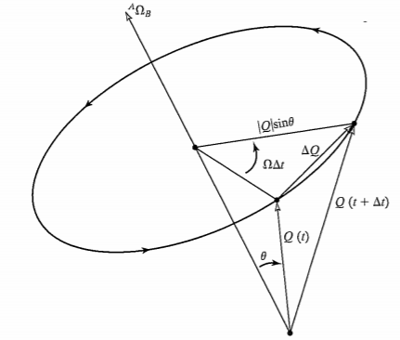
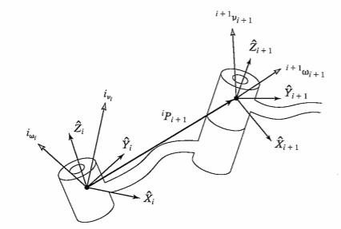
Velocity
Linear velocity
Rotational velocity
Simultaneous linear and rotational velocity
Velocity propagation

Slide 27
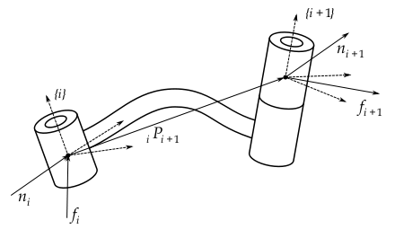
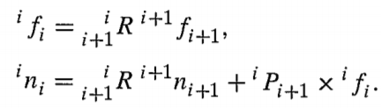
Dynamics
Static force propagation
Linear acceleration
Angular acceleration

Slide 28
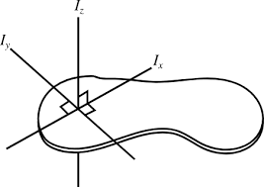
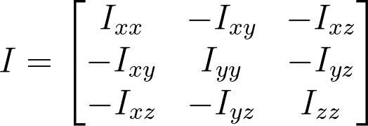
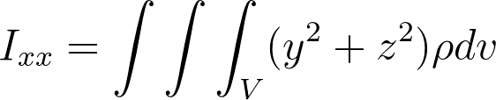
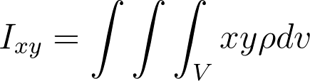




Mass distribution – Inertia tensor
Mass Inertia tensor
Mass moments of inertia and mass products of inertia
Inertia of point in the rigid body

Slide 29

Newton – Euler Equations
Newton-Euler equations
The state-space equation
nxn mass matrix
nx1 centrifugal and Coriolis terms
nx1 gravity terms

Slide 30




Lagrangian Equations
Kinetic energy of a link
Kinetic energy of a manipulator
Potential energy of a link
Lagrangian dynamic formulation

Slide 31

Dynamics
Joint space
Cartesian space
Simulation

Slide 32













Linear Control
Mass-spring-damper system
Laplace Transform
Control-Law Partitioning (no friction, no stiffness)
$$k$$
$$M\ddot{x(t)}+b\dot{x(t)}+kx(t)=F(t)$$
$$b$$
$$X\left(s\right)=\frac{\left(Ms+b\right)x_{0}}{Ms^{2}+bs+k}=\frac{\left(s+2ζω_{n}\right)x_{0}}{s^{2}+2ζω_{n}s+{ω_{n}}^{2}},$$
$ζ=\frac{b}{2\sqrt{kM}} is damping ratio,ζ$ < 1: underdamped; $ζ$ > 1: overdamped; $ζ$=1: critical damping
$$ω_{n}=\sqrt{k/M} is natural frequency$$
$solution:s_{1},s_{2}=−ζ$ $ω_{n}±ω_{n}\sqrt{ζ^{2}−1}$
$$f^{′}$$
+
$$f$$
-
∑
∑
system
-
+
$$\dot{x}$$
$$x$$
$$M\ddot{x}+b\dot{x}+kx=αf^{′}+β$$
$let α=M;β=b\dot{x}+kx; so that$ $\ddot{x}$ = $f^{′}$
$$let f^{′}=−k_{v}\dot{x}−k_{p}x$$
$$so \ddot{x}+k_{v}\dot{x}+k_{p}x=0 when k_{v}=2\sqrt{k_{p}}, the system is critical damping$$
$$k_{p}$$
$$k_{v}$$
$$b\dot{x}+kx$$

