Slide 1
Robot Control
Yufeng Sun 2019

Slide 2
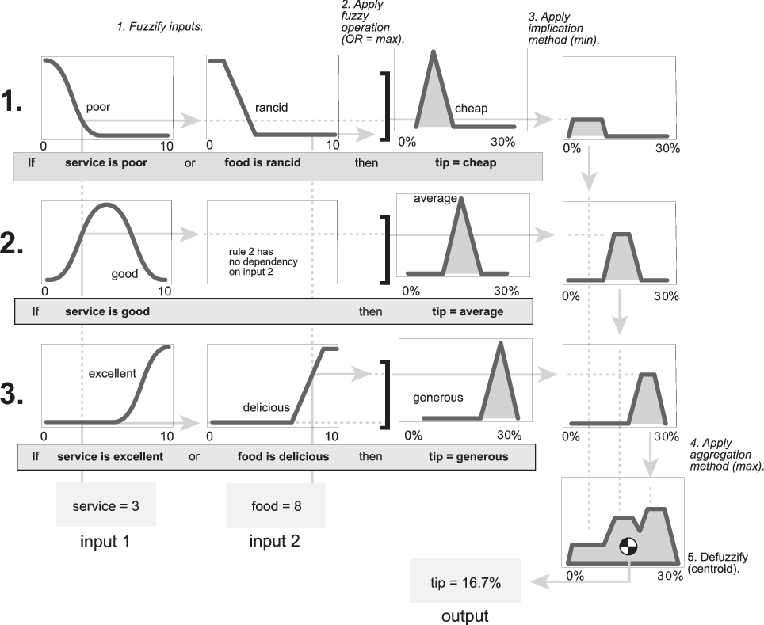
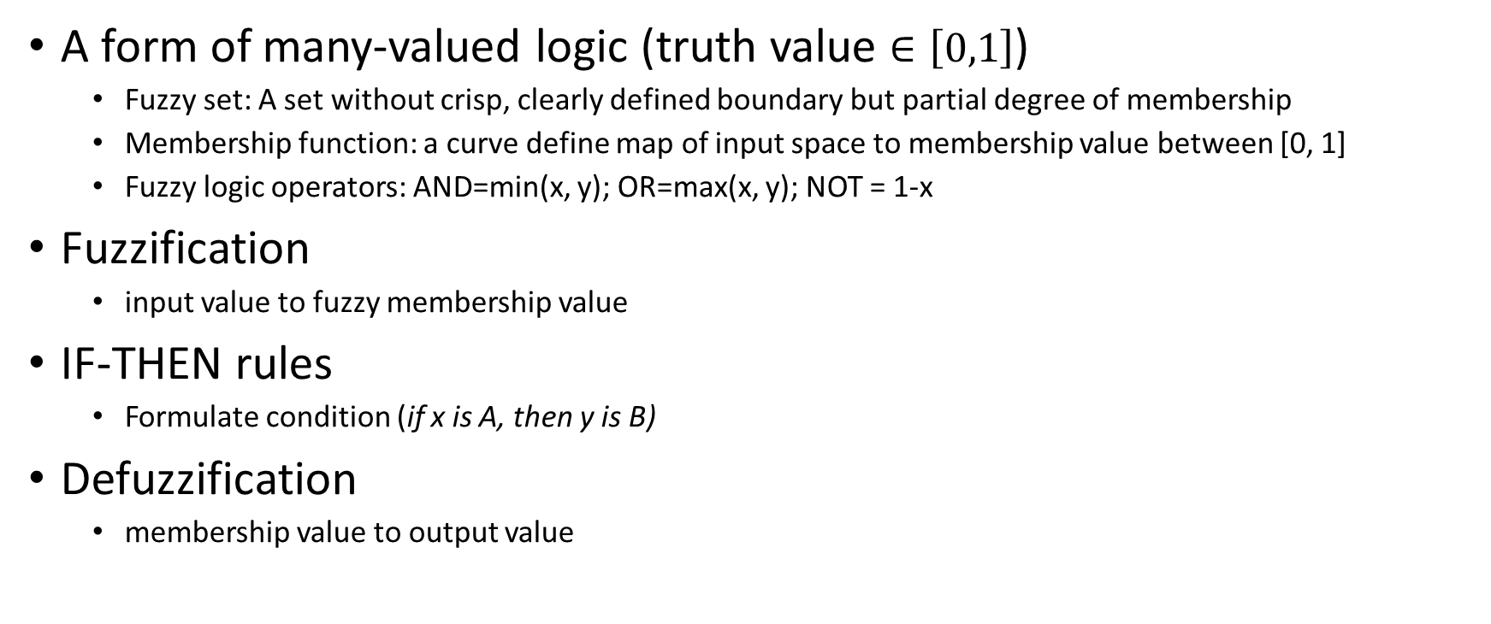
Fuzzy Logic
A form of many-valued logic (truth value $∈\left[0,1\right]$)
Fuzzy set: A set without crisp, clearly defined boundary but partial degree of membership
Membership function: a curve define map of input space to membership value between [0, 1]
Fuzzy logic operators: AND=min(x, y); OR=max(x, y); NOT = 1-x
Fuzzification
input value to fuzzy membership value
IF-THEN rules
Formulate condition (if x is A, then y is B)
Defuzzification
membership value to output value
Notes:
https://en.wikipedia.org/wiki/Fuzzy_logic

Slide 3
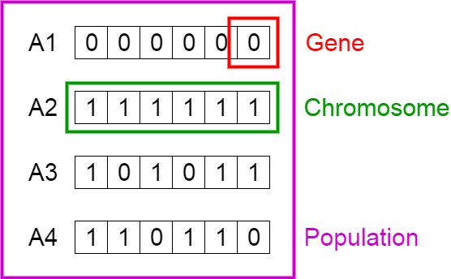
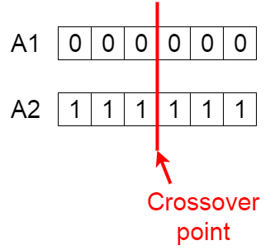
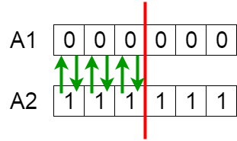
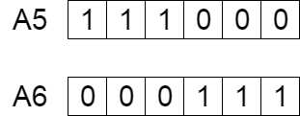
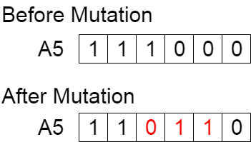
Genetic Algorithm
Initial Population
A set of individuals with each is a solution to the problem
Genes (variable/parameter) and Chromosome (solution)
Fitness function
Fitness score to each individual
Selection
Select fittest individuals and pass their genes to next generation
Crossover
Crossover point: at random within genes
Offspring: exchange the genes of parents among themselves before crossover point and add to the population
Mutation
Some of offspring’s genes can be mutated with a low random probability
Maintaining diversity and prevent premature convergence
Notes:
https://towardsdatascience.com/introduction-to-genetic-algorithms-including-example-code-e396e98d8bf3

Slide 4

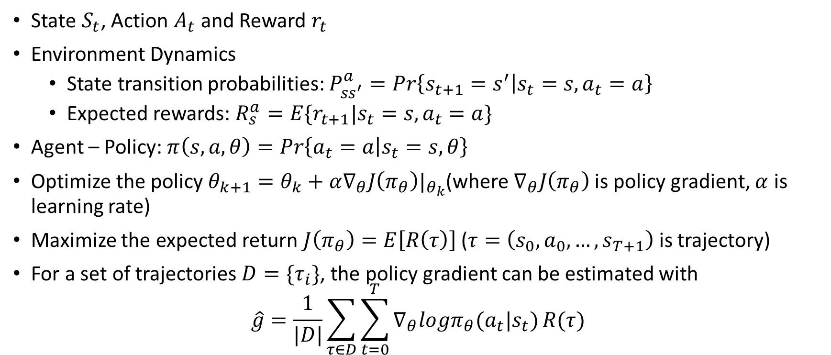
RL-Policy Gradient
State $S_{t}$, Action $A_{t}$ and Reward $r_{t}$
Environment Dynamics
State transition probabilities: $P_{ss^{′}}^{a}=Pr\left\{s_{t+1}=s^{′} | s_{t}=s,a_{t}=a\right\}$
Expected rewards: $R_{s}^{a}=E\{r_{t+1}|s_{t}=s,a_{t}=a\}$
Agent – Policy: $π\left(s,a,θ\right)=Pr\left\{a_{t}=a | s_{t}=s, θ\right\}$
Optimize the policy $θ_{k+1}=θ_{k}+α∇_{θ}J\left(π_{θ}\right)|_{θ_{k}}$(where $∇_{θ}J\left(π_{θ}\right)$ is policy gradient, $α$ is learning rate)
Maximize the expected return $J\left(π_{θ}\right)=E\left[R\left(τ\right)\right]$ ($τ=\left(s_{0}, a_{0},…,s_{T+1}\right)$ is trajectory)
For a set of trajectories $D=\{τ_{i}\}$, the policy gradient can be estimated with
$$\hat{g}=\frac{1}{|D|}\sum_{τ∈D}{\sum_{t=0}^{T}{∇_{θ}logπ_{θ}(a_{t}|s_{t})}R(τ)}$$
Notes:
http://spinningup.openai.com/en/latest/spinningup/rl_intro3.html

