Slide 1

CAR RENTAL COMPANY
DATABASE DESIGN
Introduction to Database
Comp122
Created by Tristin, Jeff, Sunesh, Becca

Slide 2
PROJECT OVERVIEW
The goal of this project is to design and implement a relational database system for a modern car rental company. The database manages customers, vehicles, reservations, payments, maintenance, and business reporting.

Slide 3


STAKEHOLDERS
Customers
  Create accounts
  Reserve vehicles
  Make payments
Rental Agents
  Process check-ins/check-outs
  Record Vehicle Conditions
Managers
  View Reports
  Monitor fleet usage
Mechanics/Suppliers
  Support Vehicle
  maintenance

Slide 4

REQUIREMENTS
This Photo by Unknown Author is licensed under CC BY-SA
Functional Requirements
Register Customers
Search Available Vehicles
Manage reservations
Process Payments
Track vehicle Maintenance
Non-functional Requirements
Fast payment processing
Data security
System Availability
Support Many Users

Slide 5

USE CASE WORKFLOWS
Reserve Vehicle
Customer:
Logs in
Searches Vehicles
Selects vehicles
Provides payment information
Reservation
Return Vehicle
Customer:
Returns Vehicle
Agent inspects vehicle
System Calculates Fees
Payment Processed
Vehicle becomes available

Slide 6


The ERD represents the conceptual database model and shows the relationships between major entities.
Customers
Vehicle
Reservation
Payment
Branch

Slide 7
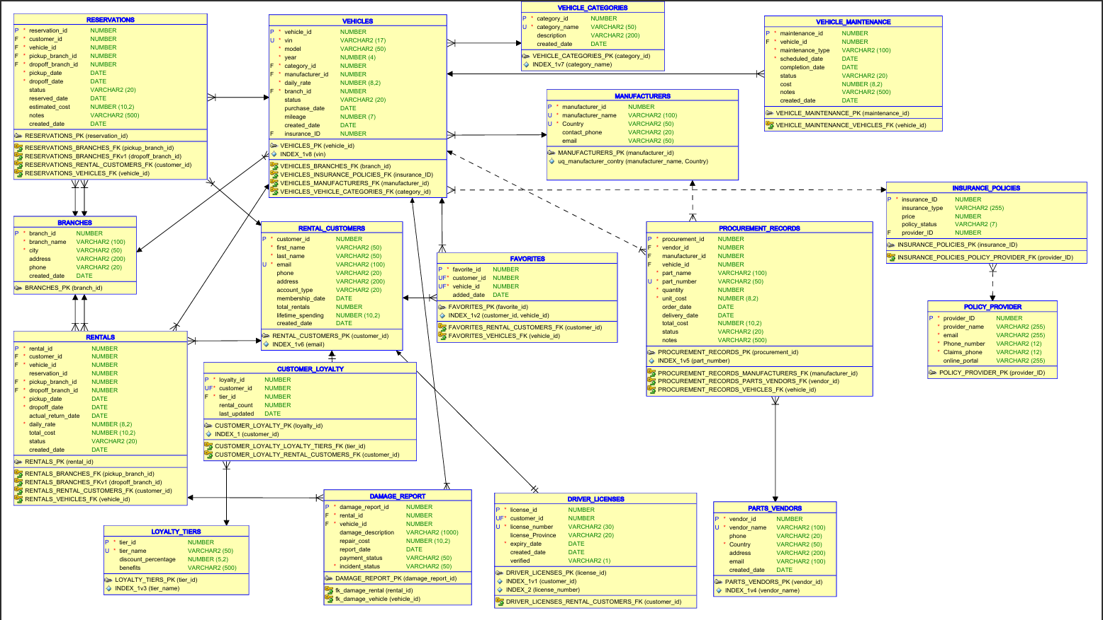

Slide 8
DATA BASE TABLES / LOGICAL DESIGN
EXPLAIN HOW ERD BECAME TABLES
Tables created:
Customer
Vehicle
Reservation
Maintenance
Damage Report
Supplier

Slide 9
DATABASE IMPLEMENTATION
Screen shots of sql developer
Create tables
Inserted data
Mention:
ddl scripts create table
Dml scripts populate data
Constraints enforce integrity

Slide 10

BUSINESS QUERIES
Vehicle Discovery
Executive Reporting
Customer Segmentation
Find available SUVs under a daily rental price.
Calculate monthly rental revenue.
Identify VIP customer based on rental history.

Slide 11


CONCLUSION
Designed a complete relational database.
Create ERD and normalized tables
Implemented database in Oracle
Created business inquiries for decision-making.

