Slide 1
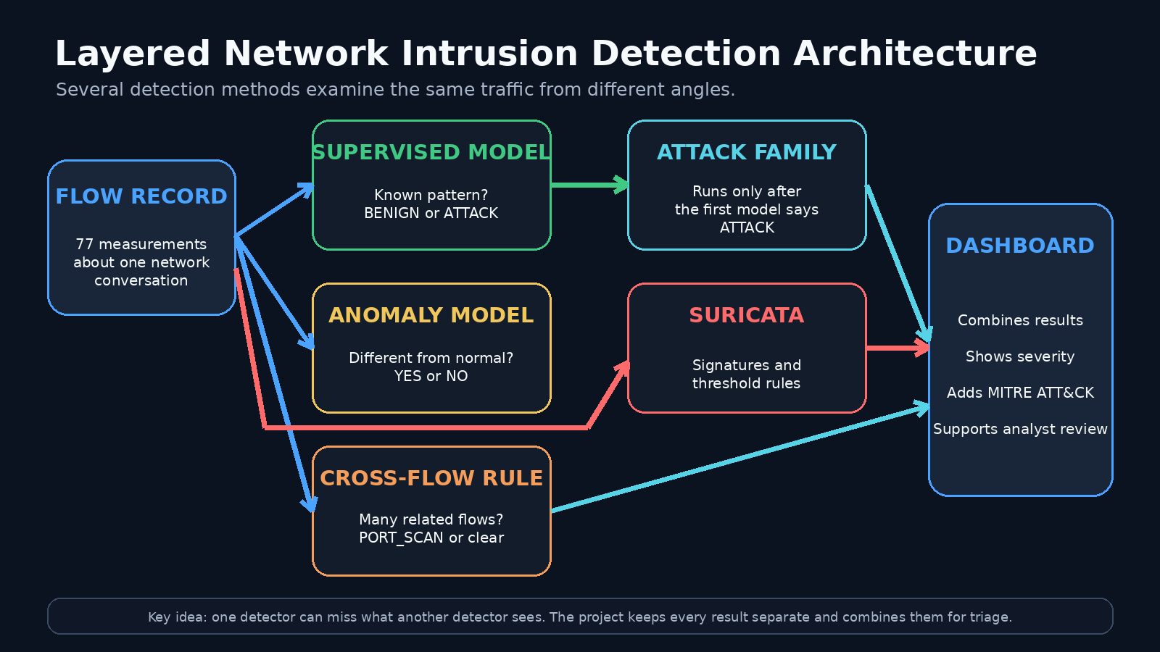
NIDS
AI-POWERED NETWORK
INTRUSION DETECTION SYSTEM
How the project was built, tested, and improved
Machine Learning | Suricata | VMware Lab | MITRE ATT&CK | Streamlit
Sunday Esumike
August 2026

Slide 2
OVERVIEW
The project in plain language
A security checkpoint for network traffic.
Every network conversation is turned into a flow record. Several detectors then ask different questions about the same traffic.
1
2
3
4
5
MEASURE
CLASSIFY
CHECK
CORRELATE
REVIEW
Turn traffic into 77 numeric features
BENIGN or ATTACK
Unusual behavior or Suricata rule match
Connect many related flows
Show evidence on a SOC dashboard
Key idea: one detector can miss what another detector sees.

Slide 3
ARCHITECTURE
What was built
A layered design rather than one all-purpose detector.

Slide 4
DATA
Data preparation created a consistent model population
The raw files were checked, cleaned, aligned, and preserved.
VALID FLOW RECORDS
PREDICTIVE FEATURES
ML FILES
CONTEXT FILES
DUPLICATE REMOVED
2,830,743
77
8
8
1
Fwd Header Length.1
PREPROCESSING PIPELINE
Raw CSV files
Align row counts
Clean infinity values
Keep missing values
Write feature manifest
Preserved
Verified
4,376 replaced
Train-only imputation
Exact 77-field order
The original raw files were not modified.

Slide 5
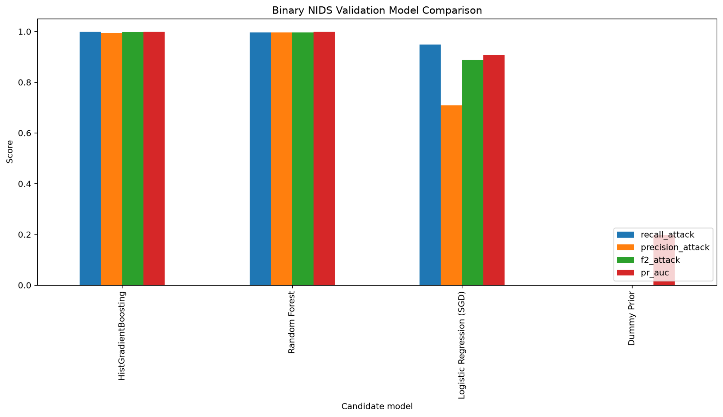
MODELING
Four binary models were compared fairly
HistGradientBoosting was selected by attack-focused F2 score.
SELECTED MODEL
HistGradientBoosting
ATTACK RECALL
99.92%
ATTACK F2
99.82%
Strong on familiar attack patterns.

Slide 6
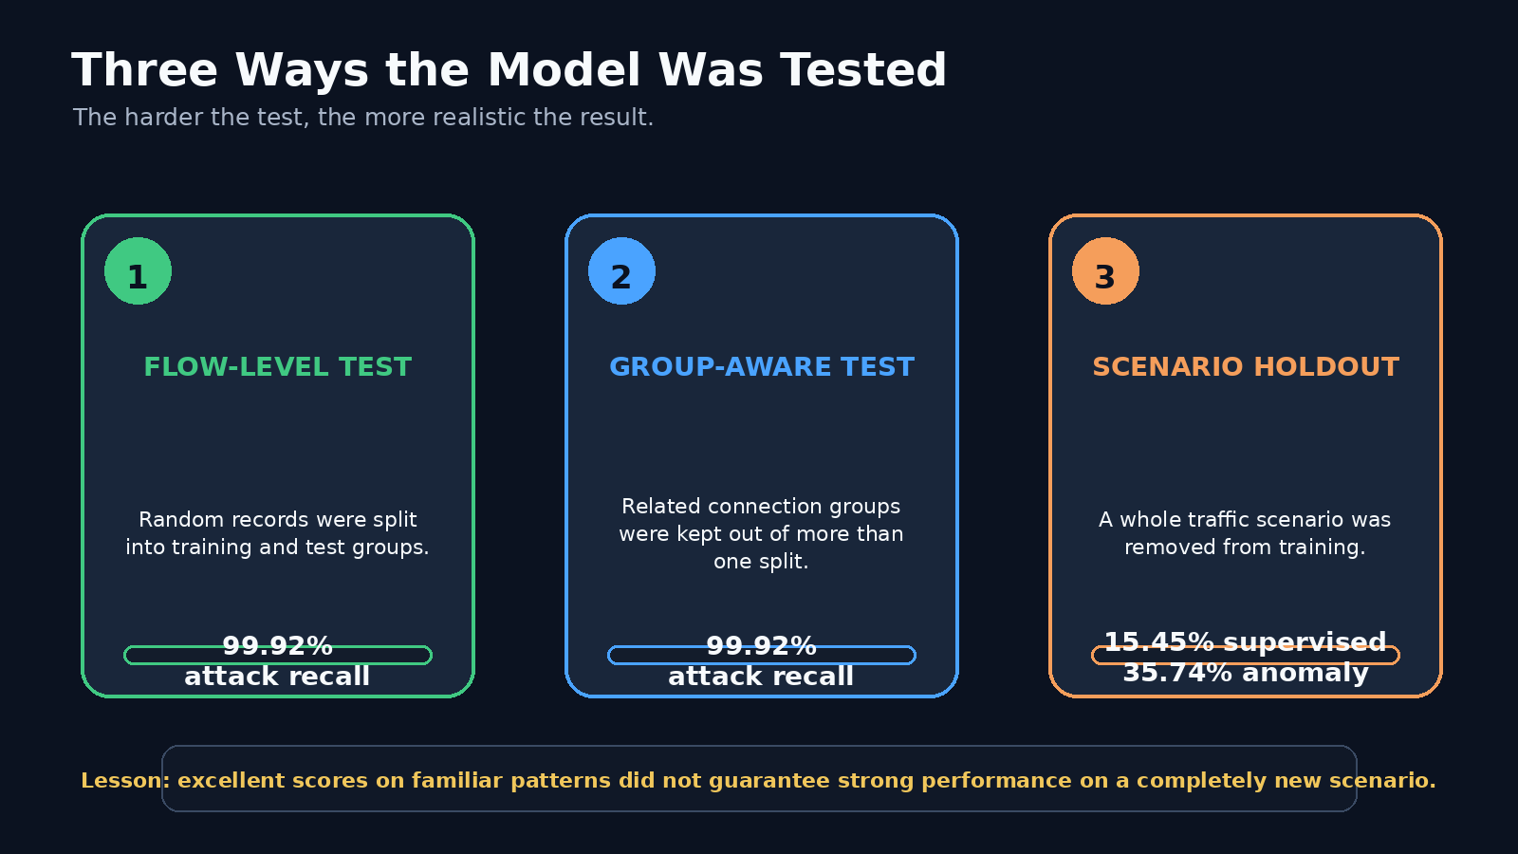
EVALUATION
Harder testing changed the story
The model was strong on familiar patterns but much weaker on a new scenario.

Slide 7
DETECTION LAYERS
Two extra model layers added context
The attack-family model and anomaly model served different purposes.
FLOW RECORD
BINARY MODEL
ATTACK FAMILY
ANOMALY MODEL
77 features
BENIGN or ATTACK
Runs only after ATTACK
Different from normal?
ATTACK-FAMILY OUTPUT
IMPORTANT LIMITATIONS
Denial of Service
Port Scan
If Stage 1 says BENIGN, the family model does not run.
An unusual flow is not automatically malicious.
Neither layer solved the new-scenario problem by itself.
Brute Force
Web Attack
Other Malicious

Slide 8
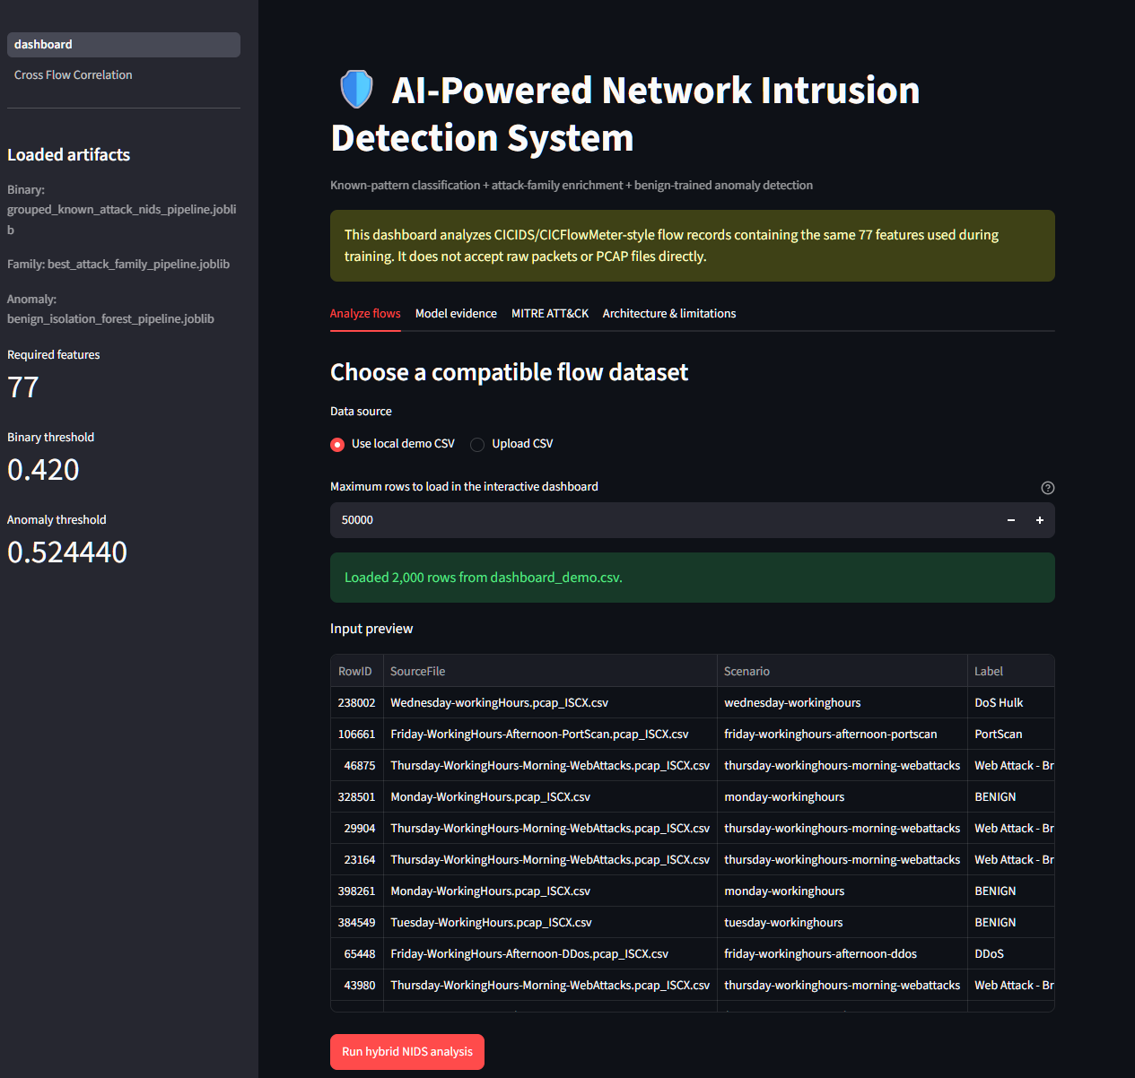
DASHBOARD
The dashboard turned model output into analyst evidence
Streamlit provided file upload, model results, alert queues, and drill-down.
Checks the required 77 features
Shows BENIGN or ATTACK decisions
Displays anomaly scores and flags
Summarizes attack families and severity
Adds MITRE ATT&CK context
Supports one-flow inspection
Exports a complete prediction ledger

Slide 9
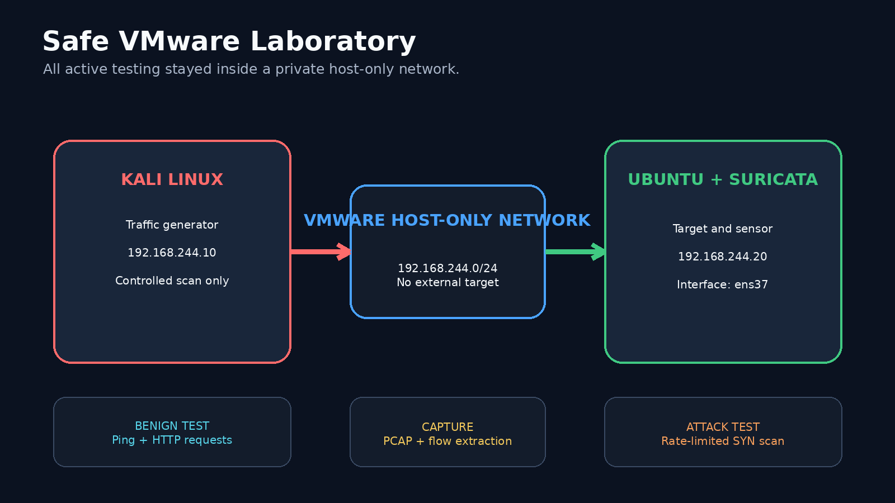
LIVE LAB
A safe VMware lab was used for active testing
Kali generated traffic only against an Ubuntu VM owned and controlled in the lab.

Slide 10
BENIGN TEST
The benign baseline remained clear
Normal ping and HTTP activity established a safe reference point.
SUPPORTED HTTP FLOWS
ATTACK PREDICTIONS
ANOMALY FLAGS
CROSS-FLOW RESULT
SURICATA RECORDS
5
0
0
CLEAR
34
NO_SCAN_PATTERN
informational
WHAT THE 34 SURICATA RECORDS MEANT
4
ICMP ping notices
5
Python HTTP server-banner notices
25
TCP checksum decoder records
These records were informational or decoder-related. No malicious activity was intentionally generated.

Slide 11
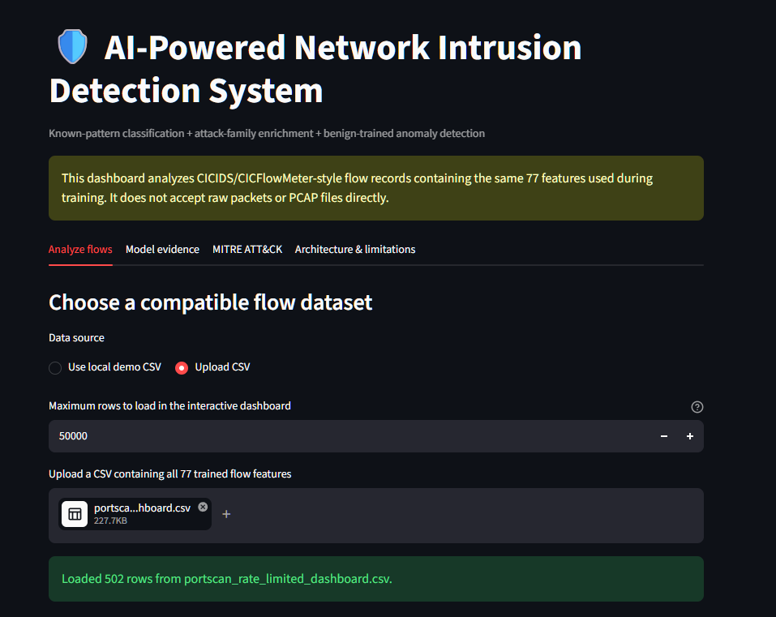
ATTACK TEST
The controlled port scan created a clear aggregate pattern
The same PCAP was used for Suricata replay and model inference.
SYN PROBES
DESTINATION PORTS
502
502
A port scan is like trying hundreds of door handles to find out which doors are open.
Ground truth: PORT SCAN

Slide 12
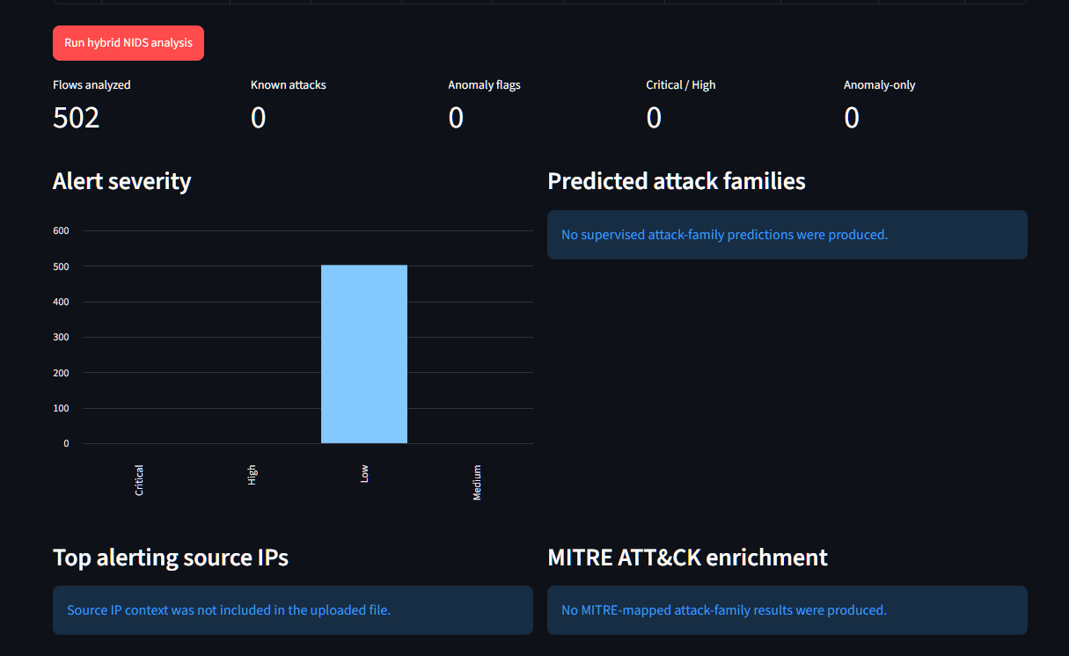
FAILURE ANALYSIS
Every original per-flow layer missed the scan
The miss was far below the saved decision thresholds.
SUPERVISED MODEL
Highest attack probability
0.011319
Threshold: 0.420000
ANOMALY MODEL
Highest anomaly score
0.380098
Threshold: 0.524440
502 BENIGN
0 ANOMALIES
Default Suricata also emitted 0 scan alerts.

Slide 13
SURICATA
A tuned Suricata threshold rule detected the same scan
The rule added a laboratory-specific view of repeated SYN activity.
NOTIFICATIONS
SEPARATE ATTACKS
LAB RULE
24
1
20 SYN packets
from one source
within 10 seconds
same scan
not 24
SURICATA MODE
ACTION
IDS
ALLOWED
logged, not blocked
The 24 records were repeated threshold notifications during one controlled scan. They were not 24 different attacks.

Slide 14
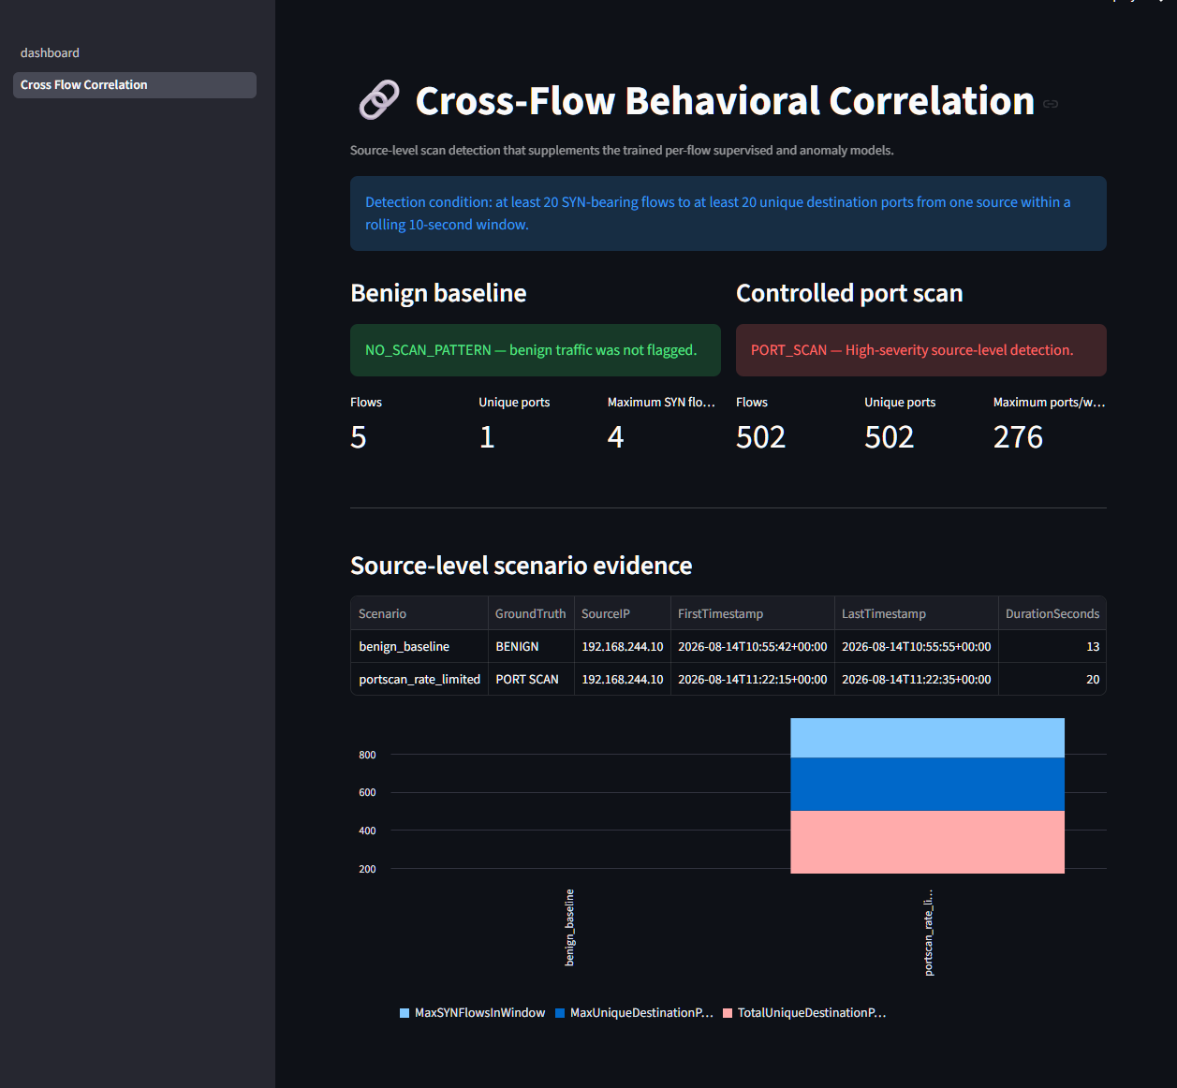
CORRELATION
Cross-flow correlation supplied the missing context
It grouped related flows from one source inside a rolling time window.
DETECTION CONDITION
At least 20 SYN-bearing flows
to at least 20 unique ports
from one source
within 10 seconds
BENIGN: NO_SCAN_PATTERN
SCAN: PORT_SCAN
MAX PORTS / WINDOW
FINAL ALERTS
276
1
High severity

Slide 15
COMPARISON
Final detection-layer comparison
The strongest result came from using several layers together.
Detection layer
Benign baseline
Controlled scan
Analyst result
Events
Default Suricata
Informational records
No emitted alert
MISSED
0
Tuned Suricata
Not used
Threshold matched
DETECTED
24
Supervised ML
5 of 5 BENIGN
502 of 502 BENIGN
MISSED
0
Attack-family model
Not invoked
Not invoked
MISSED
0
Isolation Forest
0 anomaly flags
0 anomaly flags
MISSED
0
Cross-flow correlation
NO_SCAN_PATTERN
PORT_SCAN
DETECTED
1
Machine learning, rules, anomaly detection, and correlation each covered a different weakness.

Slide 16
LESSONS
What the project proved
The failures were as useful as the successful detections.
High familiar-pattern scores are not enough
Context changes the decision
1
2
A model can perform near 100% on known patterns and still miss a simple new laboratory scenario.
One flow looked harmless. Hundreds of related flows from one source showed a clear scan.
Layered detection is stronger
Honest negative results matter
3
4
Supervised models, anomalies, Suricata, and correlation each cover different blind spots.
The project kept the misses visible, investigated why they happened, and improved the design.

Slide 17
NEXT STEPS
The prototype is complete, but production work remains
The correct claim is a working portfolio-grade prototype, not a production sensor.
CURRENT LIMITATIONS
RECOMMENDED NEXT STEPS
Historical training data from one dataset family
Small benign live-lab baseline
Per-flow binary gate can block family classification
Cross-flow and Suricata thresholds are lab-specific
Capture-to-alert workflow is not fully automated
No validation yet on current enterprise traffic
Automate capture, flow extraction, inference, and refresh
Collect a broader benign baseline
Test newer datasets and enterprise-like traffic
Add feature and model drift monitoring
Tune suppression and deduplication
Add analyst feedback and controlled retraining

Slide 18
CLOSE
A 30-second explanation of the project
Use this version for a class, interview, or portfolio walkthrough.
“I built a hybrid network intrusion detection prototype. It converts network communications into 77 measurable features and uses machine learning to decide whether each flow is normal or an attack. It also uses an attack-family model, an anomaly detector, Suricata, MITRE ATT&CK mapping, and a Streamlit dashboard. During testing, the original per-flow models and default Suricata rules missed a controlled 502-port scan. I added a tuned Suricata rule and a cross-flow correlation layer that examined many related connections together. Both detected the scan while the benign baseline remained unflagged. The main lesson was that effective detection needs several layers and realistic testing on new traffic.”
FINAL STATUS: PORTFOLIO-GRADE HYBRID NIDS PROTOTYPE

