Slide 1
Poster Template Guidelines
You may use any of the three templates given in this document.
You may use as many info frames for your descriptions & images as you wish, as long as it fit in a 90X120 cm poster.
Us the info frames for your images also.
The bottom (corner) frames will appear as off-sided. This was done on PURPOSE and should be left this way. The idea is that when printed, the bottom and outer edges of this frame shouldn´t appear.
You may move the frames around the template and add as much as you wish. The given ones are just to serve as reference.
Don´t change the template colors.
You should use the FOCO font. In case you don´t have it in your PC, you may find it in the CONEIX under : Documents->Others-> CVCBusinessCards and install it in your PC.
The slides are dimension for a 90x120 cm poster.

Slide 2



Title
Author1, Author2, Author3, etc.
Computer Vision Center (CVC)
E-mail
Subtitle
Info & Images
Subtitle
Subtitle
Info & Images
Info & Images
Subtitle
Info & Images
Relevant Info (sponsors, partners, projects, acknowledgments, etc)
[1] Reference 1
[2] Reference 2
…

Slide 3

Title
Author1, Author2, Author3, etc.
Computer Vision Center (CVC)
E-mail
Subtitle
Subtitle
Subtitle
Info & Images
Info & Images
Info & Images
Subtitle
Info & Images
Relevant Info (sponsors, partners, projects, acknowledgments, etc)
[1] Reference 1
[2] Reference 2
…

Slide 4

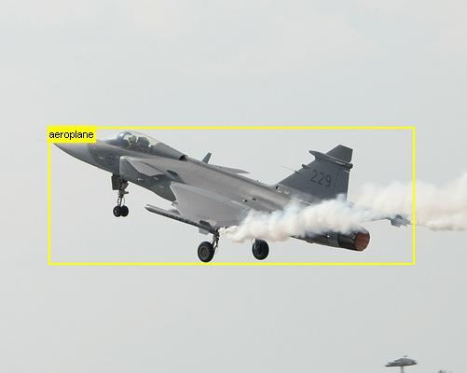

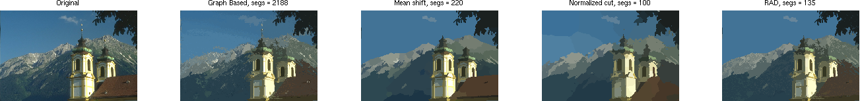
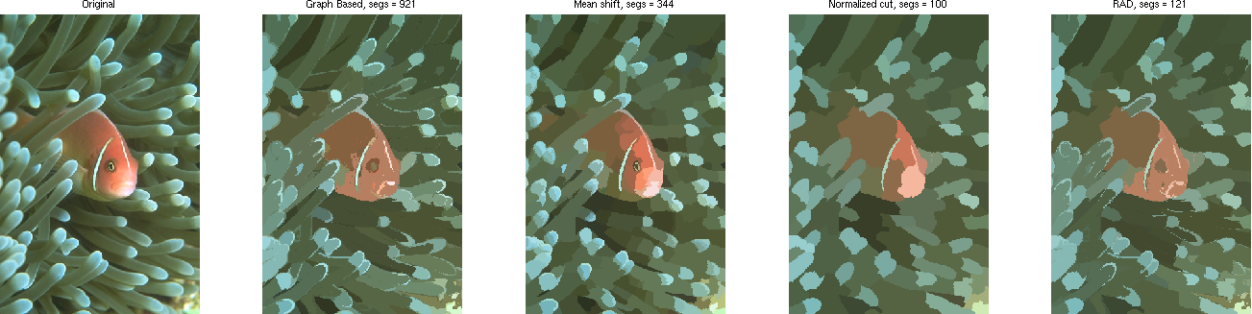
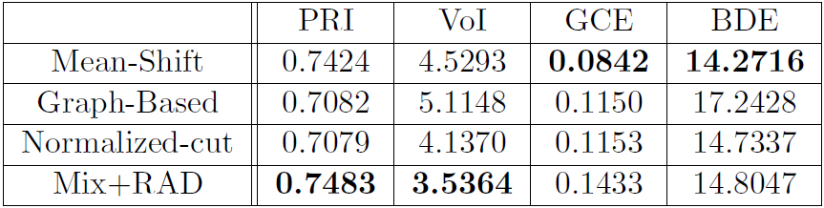
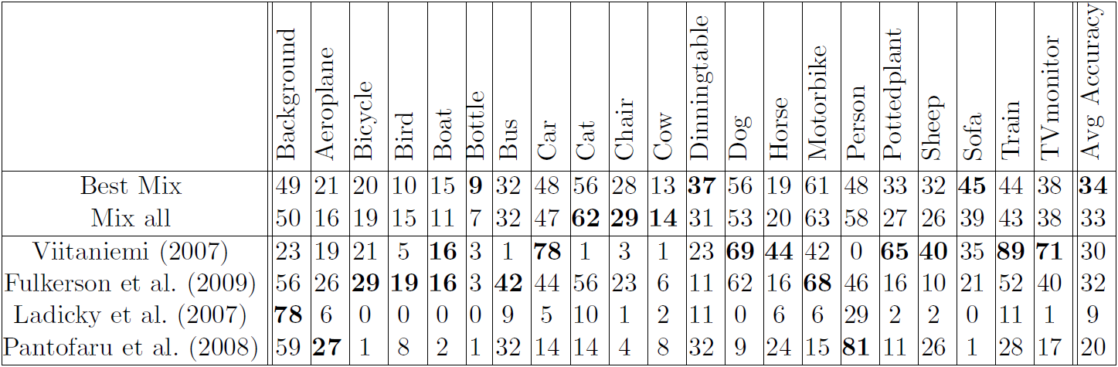

What is a good segment?
Object localization enhancement by multiple segmentations fusion
Ahmed Gad, Ramon Baldrich
Computer Vision Center (CVC)
{amounir,ramon}@cvc.uab.es
Image segmentation
Object localization
Object class segmentation
Background
Plane
Subtitle
General framework
Proposed framework
Bottom-up process
Top-down process
Bottom-up process
Top-down process
Segmentation
Segmentation
Classification
Image
Segmentation
Classification
Confidence
Map
Image
Segmentation
Classification
Combine Confidence
results
CRF
Segmentation
Classification
Segmentation
Top-down process
Original
GB
MS
NC
RAD
Classification
Combine Confidence
results
CRF
Segmentation
Classification
Classification
Original
GB
MS
NC
RAD
Segmentation
Evaluating segments goodness
Color distribution
Unimodality test
RAD
Alternate segmentation
Top-down process
Bottom-up process
Segmentation
Classification
.
.
Segmentation
Classification
Combine Confidence
results
Segmentation
Classification
CRF
 | C₁ | C₂ | ... | C_{K}
S₁ | p₁₁ | p₁₂ | ... | p_{1K}
. . . . . . | . . . . . . | . . . . . . | . . . . . . | . . . . . .
S_{N} | p_{N1} | p_{N2} | ... | p_{NK}
S₁ | p'₁₁>p'₁₂>...>p'_{1k}
. . . . . . | . . . . . .
S_{N} | p'_{N1}>p'_{N2}>...>p'_{Nk}
 | C₁ | C₂ | ... | C_{K}
S₁ | w₁₁ | w₁₂ | ... | w_{1K}
. . . . . . | . . . . . . | . . . . . . | . . . . . . | . . . . . .
S_{N} | w_{N1} | w_{N2} | ... | w_{NK}
Sum
Sort
Assign values
Based on
Position
 | C₁ | C₂ | ... | C_{K}
S | W₁ | W₂ | ... | W_{K}
Conclusions
[1] Caroline Pantofaru, Cordelia Schmid, and Martial Hebert. Object recognition by integrating multiple image segmentations. In European Conference on Computer Vision, volume III, pages 481–494, 2008.
[2] B. Fulkerson, A. Vedaldi, and S. Soatto. Class segmentation and object localization with superpixel neighborhoods. In Proc. ICCV, 2009.
Relevant Info (sponsors, partners, projects, acknowledgments, etc)
A novel approach for combining different segmentations to obtain a better segmentation
A novel approach for combining classification results from several segments to better recognize objects.
Superpixels don't provide the best level of representation of the objects.

