Slide 1
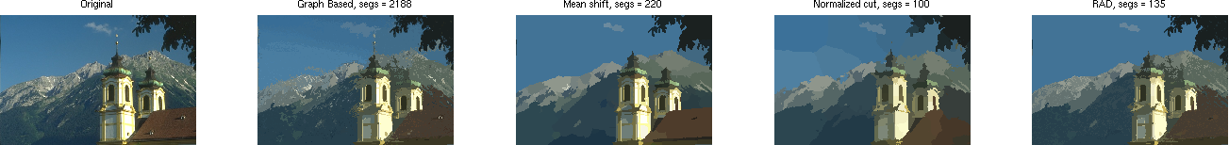
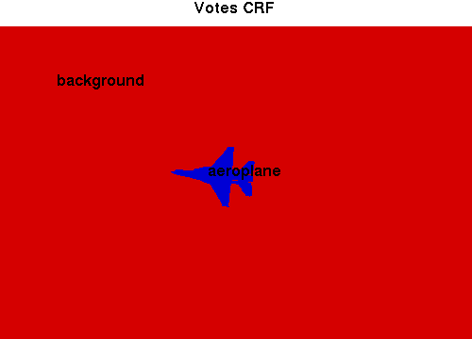
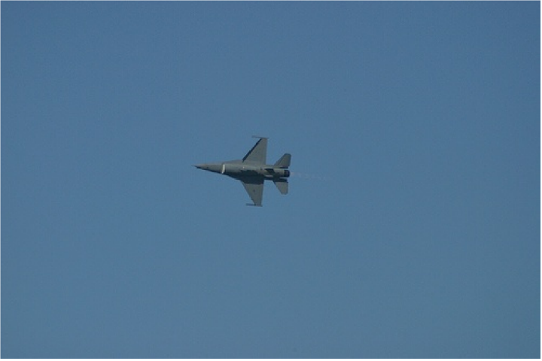
Object Localization Enhancement by Multiple Segmentations Fusion
Ahmed Gad, Ramon Baldrich
Combine segmentations in a bottom-up way.
Combine all different segmentations for a better localization.
Original
GB, Segs = 2188
MS, Segs = 220
NC, Segs = 100
Mix, Segs = 135

