Slide 1


Object localization enhancement by multiple segmentations fusion
Presented by: Ahmed Mounir Gad
Advisor: Ramon Baldrich

Slide 2
Agenda
Introduction
  Segmentation
  Object localization
Related work
  Multiple segmentations
  Segments neighborhood
Core approach
  Generating multiple segmentations
  Building an improved segmentation
  Describing and classifying segments
  Combining regions classifications
  Refining with a CRF
Experiments and results
Conclusions
Future work

Slide 3
Introduction
Image segmentation?
Object localization?
Segmentation
Object localization

Slide 4
Image segmentation
The process of partitioning an image into a set of non-overlapping regions.

Slide 5
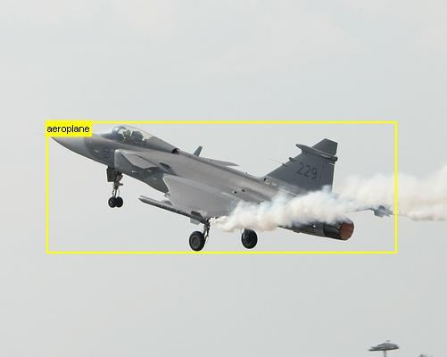

Object localization
It's the process of recognizing an object inside an image and locating it's exact position

Slide 6
Object class segmentation
It's the process of producing a pixel-level segmentation of the input image.

Slide 7
General framework
Top-down process
Bottom-up process
Top-down process
Bottom-up process
Segmentation
Classification
Segmentation
Classification
Confidence
Map
Image
Confidence
Map
Image

Slide 8
Related work
We discuss two techniques that we found useful for our work
  Using multiple segmentations
  Segments neighborhood

Slide 9
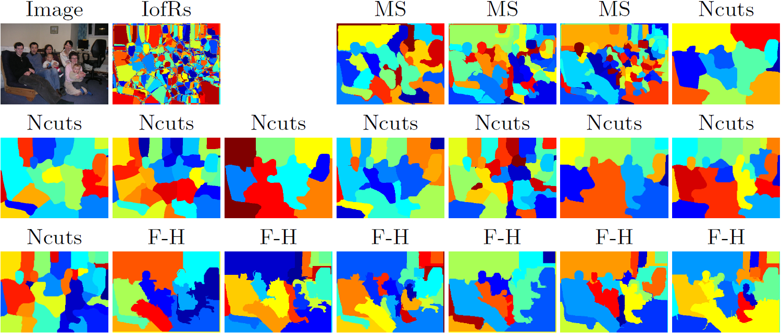
Integrating multiple image segmentations for object recognition
Introduced by Pantofaru et al. (2008)
Segments from a single segmentation aren't trustable.
Create Intersection of Regions (IofRs) by intersecting multiple segmentations
Segmentation
Segmentation
Classification
Classification
.
.
.
.
Average Confidence
results
Image
Average Confidence
results
Image
Classification
Segmentation
Classification
Segmentation

Slide 10
Segments neighborhood
Introduced by Fulkerson et al.(2009)
Create
Superpixels
Sum neighboring
Histograms
Classification
CRF
Image

Slide 11
Segments neighborhood (Cont.)
We performed the same neighborhood operation on superpixels and segments from several image segmentation algorithms.
On increasing the neighborhood, it means considering a larger segment.
Average segments count:
Graph-Based: 2444
Superpixels: 1201
Mean-shift: 393
Normalized-cut: 100

Slide 12
Observations
Superpixels aren't well descriptive for the objects (Case of absent neighborhoods).
At a certain limit, the neighborhood operator fails to give a better performance and results start decreasing.

Slide 13
Our framework
Our framework is based on the VLBLOCKS by Fulkerson et al. (2009)
Bottom-up process
Top-down process
Segmentation
Classification
Image
.
.
Combine Confidence
results
CRF
Segmentation
Classification
Segmentation
Classification

Slide 14
Our framework
Bottom-up process
Top-down process
Classification
Segmentation
Combine Confidence
results
CRF
Image
Classification
Segmentation
Classification
Segmentation

Slide 15
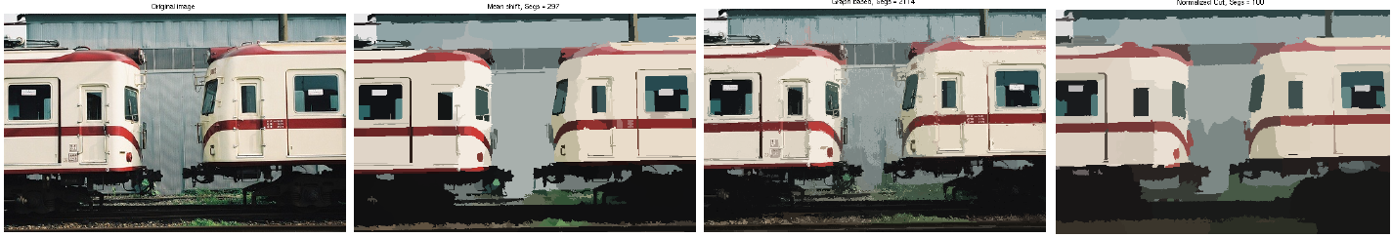
Generating multiple segmentations
We tried generating more than one segmentation with different methods.
We wanted to generates segmentation using a variety of techniques that use different cues.
We generated 1 Mean-Shift, 1 Graph-Based and 1 Normalized-cut segmentations.

Slide 16
Our framework
Bottom-up process
Top-down process
Classification
Segmentation
Combine Confidence
results
CRF
Image
Classification
Segmentation
Classification
Segmentation

Slide 17
Combining segmentations
Recall this figure
Average segments count:
Graph-Based: 2444
Superpixels: 1201
Mean-shift: 393
Normalized-cut: 100
Getting higher accuracy:
    Large segments
    Good segments

Slide 18
Combining segmentations

Slide 19
Good segments evaluation
Is this a good segment?
What do we mean by a good segment?

Slide 20
Good segments evaluation
Is this a good segment?
What do we mean by a good segment?
    The largest set of connected pixels that lie in the same class and are coherent in the colour distribution.

Slide 21
Good segments evaluation
Is this a good segment?
What do we mean by a good segment?

Slide 22
Good segments evaluation
Is this a good segment?
Normality test (Jarque-Bera test)
Unimodality test (Dip test)

Slide 23
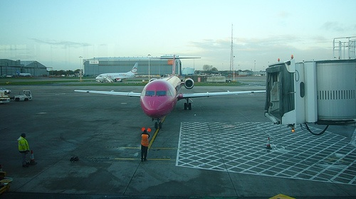
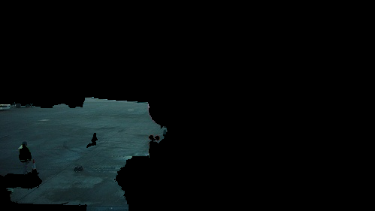
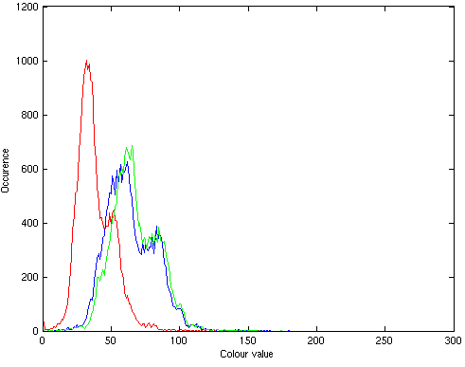
Good segments evaluation
Is this a good segment?
Normality test (Jarque-Bera test)
Unimodality test (Dip test)
Outliers detection, RAD, alternative segmentation

Slide 24
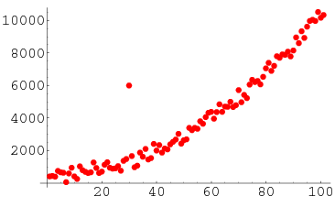
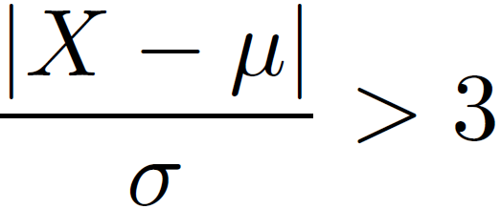
Evaluation using outliers detection
Outlier: An outlying ovservation is one that appears to deviate merkedly from other members of the sample in which it occurs.
We used the Z-test to detect outliers because of its simplicity.
A point is an outlier if:

Slide 25
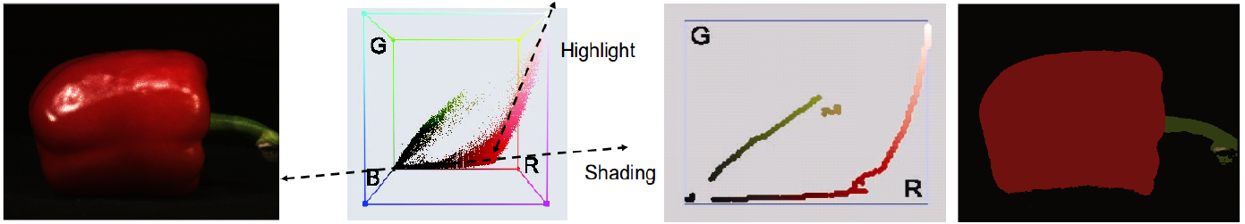

Evaluation using RAD
RAD segmentation introduced by Vazquez et al. (2008)
A good segment is a segment whose histogram follows only one ridge

Slide 26
Evaluation using alternate segmentation
Use an alternate segmentation that uses different cues to verify the goodness of the segment.
Example: To make sure a segment from Mean-Shift is a good segment, segment it using Graph-Based techniques.

Slide 27
Examples of results

Slide 28
Our framework
Bottom-up process
Top-down process
Segmentation
Classification
Image
.
.
Combine Confidence
results
CRF
Segmentation
Classification
Segmentation
Classification

Slide 29
Describing and classifying regions
We used the exact parameters in the VLBlocks framework by Fulkerson et al. (2009)
It extracts SIFT features from every pixel.
It uses bag of features framework for classification.
It quantizes our descriptor using K-means and aggregates them into an L1 histogram.
It trains one vs rest SVM with an RBF of chi squared.

Slide 30
Our framework
Bottom-up process
Top-down process
Segmentation
Classification
Image
.
.
Combine Confidence
results
CRF
Segmentation
Classification
Segmentation
Classification

Slide 31
Combining regions classifications
Recall the IofR concept by Pantufaro et al. (2008)
Instead of averaging the confidences, we use our votation technique.

Slide 32

Votations technique
For every IofR.
  We use the votation technique to determine which class it falls into
 | C₁ | C₂ | ... | C_{K}
S₁ | p₁₁ | p₁₂ | ... | p_{1K}
. . . . . . | . . . . . . | . . . . . . | . . . . . . | . . . . . .
S_{N} | p_{N1} | p_{N2} | ... | p_{NK}
 | C₁ | C₂ | ... | C_{K}
S₁ | w₁₁ | w₁₂ | ... | w_{1K}
. . . . . . | . . . . . . | . . . . . . | . . . . . . | . . . . . .
S_{N} | w_{N1} | w_{N2} | ... | w_{NK}
Sum
S₁ | p'₁₁>p'₁₂>...>p'_{1k}
. . . . . . | . . . . . .
S_{N} | p'_{N1}>p'_{N2}>...>p'_{Nk}
Sort
Assign values
Based on
Position
C_{X}
 | C₁ | C₂ | ... | C_{K}
S | W₁ | W₂ | ... | W_{K}
Max

Slide 33
Our framework
Bottom-up process
Top-down process
Segmentation
Classification
Image
.
.
Combine Confidence
results
CRF
Segmentation
Classification
Segmentation
Classification

Slide 34
Refining classifications with a CRF
We used the same framework from the VLBlocks framework by Fulkerson et al. (2009)
They need the results from the SVM to construct the unary potentials.
They need the difference of neighboring segments colors in the LUV colorspace to identify the pairwise edge potentials.

Slide 35
Experiments and results

Slide 36

Experimental setup
We worked for the PASCAL VOC 2007 segmentations dataset.
The dataset consists of 632 images. 422 images were used for training and 210 for testing.
The accuracy for each class is calculated as follows:

Slide 37
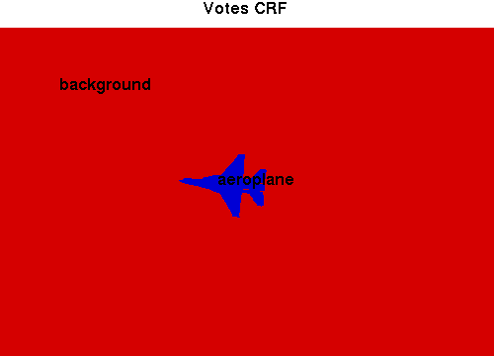
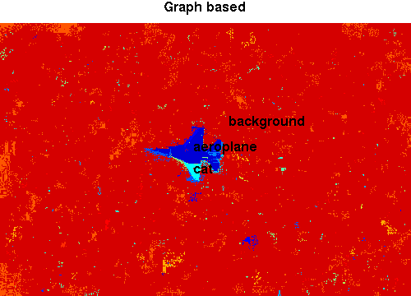
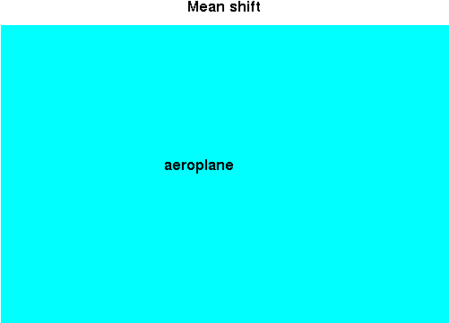
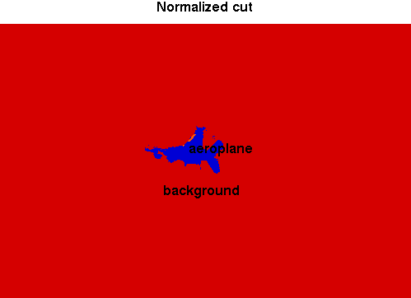
Qualitative results

Slide 38
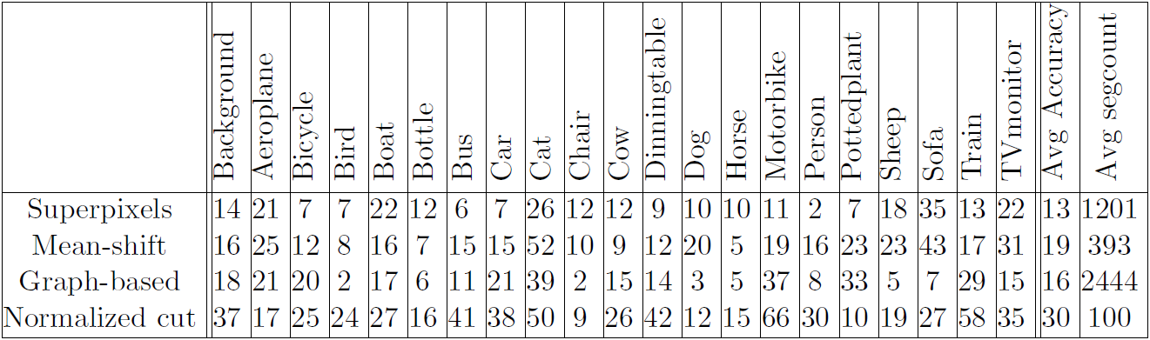
Superpixels VS meaningful segments
Bottom-up process
Top-down process
Image
Segmentation
Classification
CRF

Slide 39
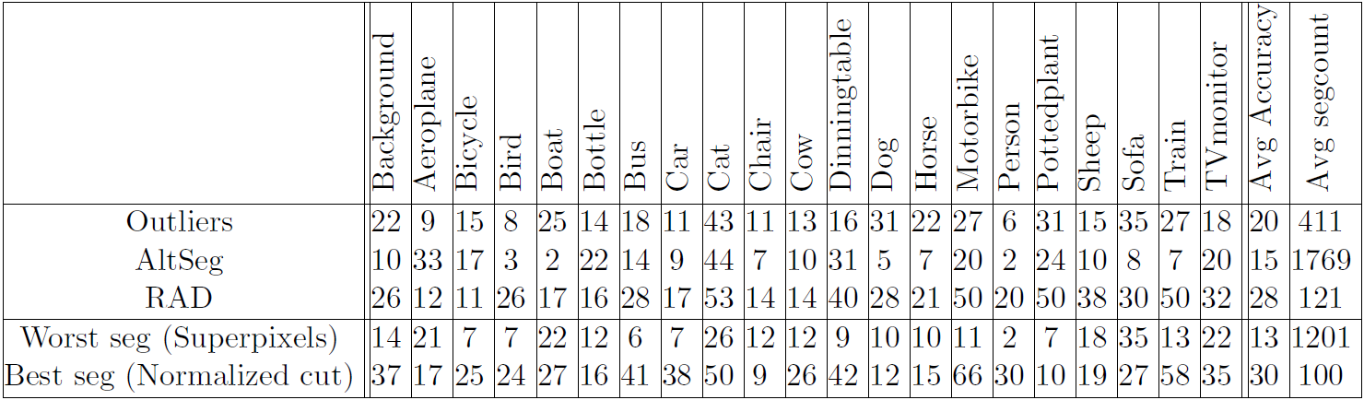
Our new segmentation method
Bottom-up process
Top-down process
Segmentation
Image
.
.
Segmentation
Classification
CRF
Segmentation

Slide 40
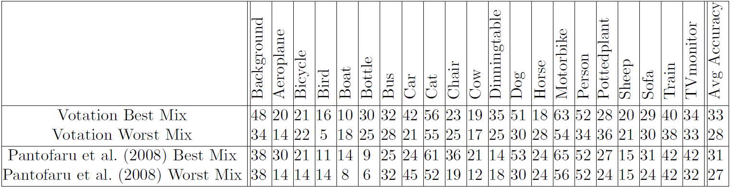
Votation with existing segmentations
Bottom-up process
Top-down process
Segmentation
Classification
Image
.
.
Combine Confidence
results
CRF
Segmentation
Classification

Slide 41
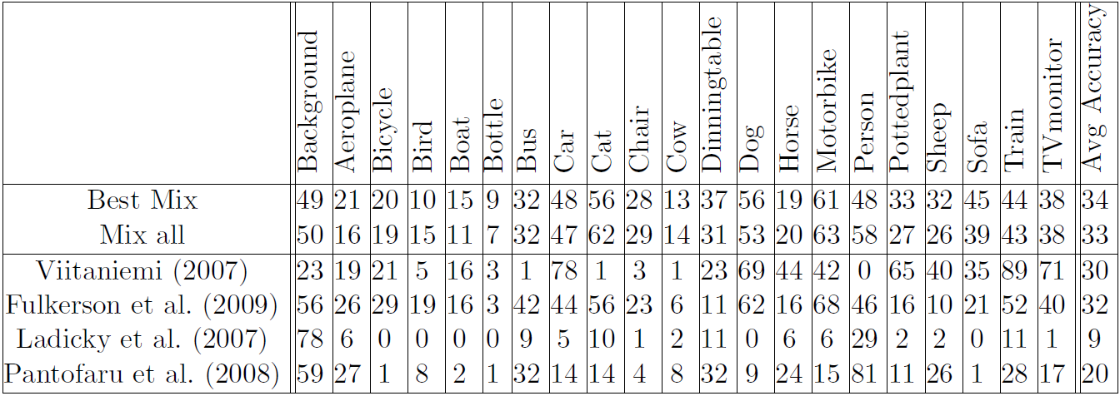
Combine all together
Bottom-up process
Top-down process
Segmentation
Classification
Image
.
.
Combine Confidence
results
CRF
Segmentation
Classification
Segmentation
Classification

Slide 42
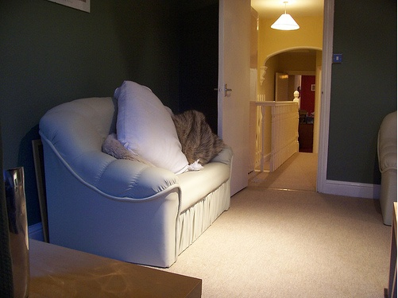
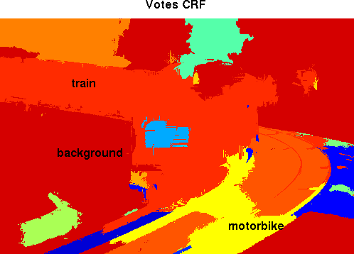
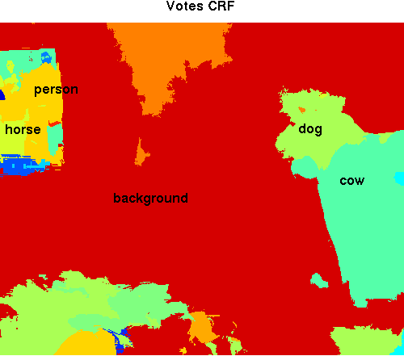
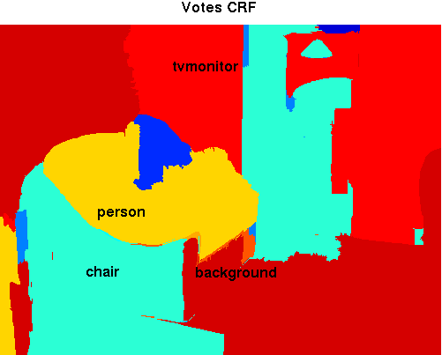
Bad qualitative results

Slide 43
Conclusions
We presented a novel approach for mixing different segmentations to obtain a better segmentation.
We presented a novel approach for combining classification results from several segments to better recognize objects.
We suggested a number of extensions and studied their benefits.
We added a higher complexity to the class segmentation process but in the end we got rewarded with an improved performance.

Slide 44
Future work
Adding a weight to each segmentation.
Incorporate image level priors.
Use object detection to guide segmentation.
Use other way for segments goodness measure.
    Color boosting
Create a better RAD segmentation.
    Investigate the reasons for undesired behavior (Creaseness operator?)
    Investigate in adding spatial locality to the dominant colors.
Investigate in the effect of mixing segmentations for a better segmentation accuracy (In progress).

Slide 45
Thank you

Slide 46
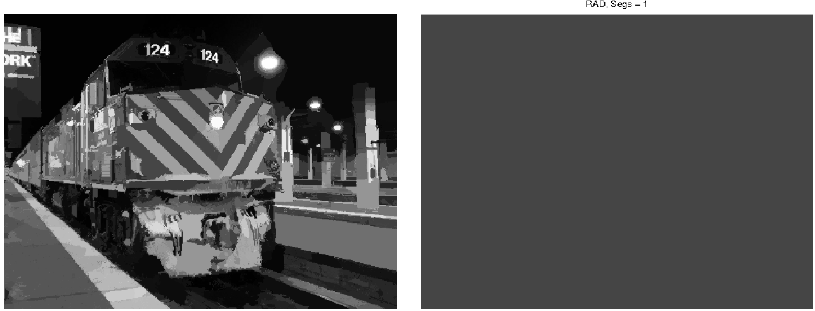
Segmentation without RAD
RAD fails in the absence of a large variation in colours in one of the images.

Slide 47
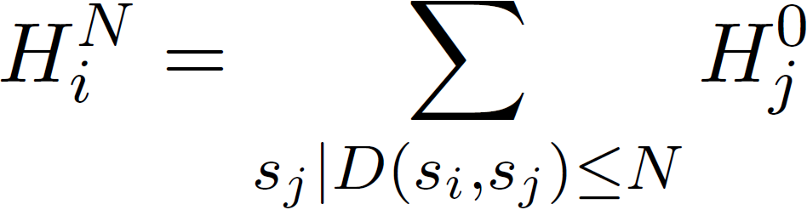
Segments neighborhood
Introduced by Fulkerson et al.(2009)
Approach:
  Extract superpixels from the image (Oversegmentation)
  Map the image as a Graph G(S, E).
  Sum histograms from each Superpixel (S) with others less than N nodes away in the graph.

Slide 48
Our framework
Our framework is divided into five main parts
  Generating multiple segmentations.
  Combining segmentations to get a better new segmentation.
  Describing and classifying regions.
  Combine classification results using the votation technique.
  Refining final results with a CRF.
Our framework is based on the VLBLOCKS by Fulkerson et al. (2009)

Slide 49
Introduction
We present an approach for enhancing image segmentation and object localization by combining segments from different segmentation algorithms.
Image segmentation?
Object localization?

