Slide 1


Object Localization Enhancement by Multiple Segmentations Fusion
Presented by: Ahmed Mounir Gad
Advisor: Ramon Baldrich

Slide 2
Content
Introduction
    Segmentation
    Object localization
Related work
    Multiple segmentations
    Segments neighborhood
Core approach
    Generating multiple segmentations
    Building an improved segmentation
    Describing and classifying segments
    Combining regions classifications
    Refining with a CRF
Experiments and results
Conclusions
Future work

Slide 3
Introduction
Segmentation
Object localization

Slide 4
Introduction
Image segmentation?
Object localization?
Segmentation
Object localization

Slide 5
Image segmentation
Partitioning an image into a set of non-overlapping regions.
Original Image
Normalized Cut, Seg No = 100

Slide 6
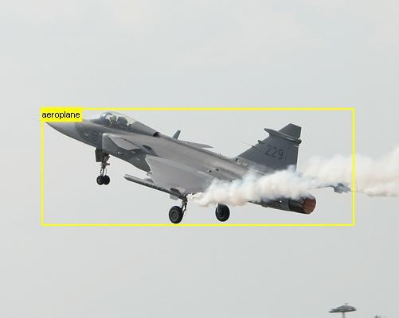

Object localization
Recognizing an object inside an image and locating it's exact position

Slide 7
Object class segmentation
Producing a pixel-level segmentation of the input image.

Slide 8
Basic framework
Bottom-up process
Top-down process
Segmentation
Classification
Image
Confidence
Map

Slide 9
Related work
We discuss two techniques that we found useful for our work
    Using multiple segmentations
    Segments neighborhood

Slide 10
Related work – Use of multiple segmentations
Introduced by Pantofaru and Schmid (2008)
Segments from a single segmentation aren't trustable.
Segmentation
Classification
Image
.
.
Average Confidence
results
Segmentation
Classification
ECCV 2008

Slide 11
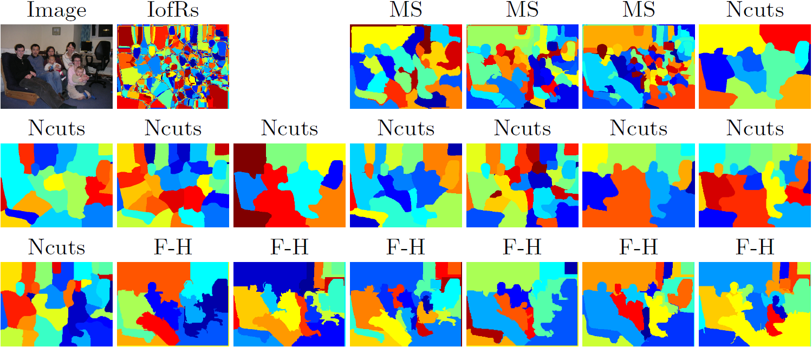
Related work – Use of multiple segmentations
Introduced by Pantofaru and Schmid (2008)
Segments from a single segmentation aren't trustable.
Create Intersection of Regions (IofRs) by intersecting multiple segmentations
Segmentation
Classification
Image
.
.
Average Confidence
results
Segmentation
Classification
ECCV 2008

Slide 12
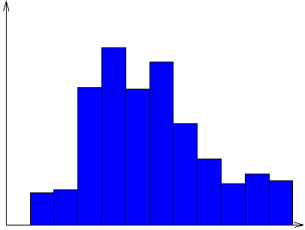
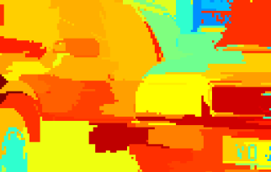
Related work – Segments neighborhood
Introduced by Fulkerson et al.(2009)
Create
Superpixels
Sum neighboring
Histograms
Classification
CRF
Image
ICCV 2009

Slide 13
Related work – Segments neighborhood
Apply on segments instead of superpixels.
On increasing the neighborhood, it means considering a larger segment.
Average segments count:
Graph-Based: 2444
Superpixels: 1201
Mean-shift: 393
Normalized-cut: 100
ICCV 2009

Slide 14
Related work – Segments neighborhood
Apply on segments instead of superpixels.
On increasing the neighborhood, it means considering a larger segment.
Observations
Superpixels aren't well descriptive for the objects.
At a certain limit, the neighborhood operator fails to give a better performance and results start decreasing.
Average segments count:
Graph-Based: 2444
Superpixels: 1201
Mean-shift: 393
Normalized-cut: 100
ICCV 2009

Slide 15
Our framework
Our framework is based on the VLBLOCKS by Fulkerson et al. (2009)
Bottom-up process
Top-down process
Segmentation
Classification
Image
.
.
Combine Confidence
results
CRF
Segmentation
Classification
Segmentation
Classification

Slide 16
Our framework
Bottom-up process
Top-down process
Classification
Segmentation
Combine Confidence
results
CRF
Image
Classification
Segmentation
Classification
Segmentation

Slide 17
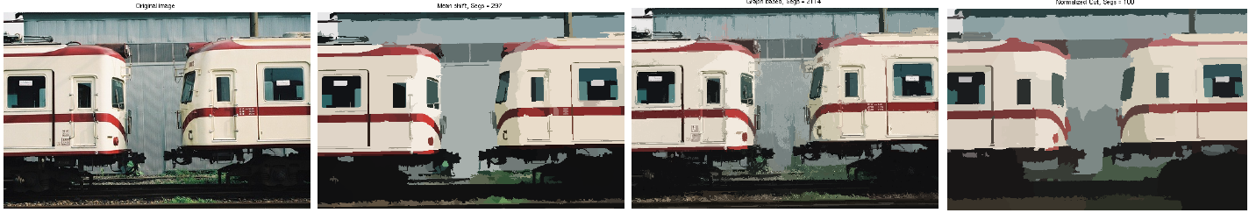
Generating multiple segmentations
Generate multiple segmentations that use different cues.
Original Image
Mean shift, segs = 297
Graph-based, segs = 2114
Normalized cut, segs = 100

Slide 18
Our framework
Bottom-up process
Top-down process
Classification
Segmentation
Combine Confidence
results
CRF
Image
Classification
Segmentation
Classification
Segmentation

Slide 19
Combining segmentations
Recall this figure
Average segments count:
Graph-Based: 2444
Superpixels: 1201
Mean-shift: 393
Normalized-cut: 100

Slide 20
Combining segmentations
Recall this figure
Average segments count:
Graph-Based: 2444
Superpixels: 1201
Mean-shift: 393
Normalized-cut: 100
Getting higher accuracy:
    Large segments
    Good segments

Slide 21
Combining segmentations

Slide 22
Combining segmentations

Slide 23
Combining segmentations

Slide 24
Good segments evaluation
Is this a good segment?
What do we mean by a good segment?

Slide 25
Good segments evaluation
Is this a good segment?
What do we mean by a good segment?
  The largest set of connected pixels that lie in the same class and are coherent in color distribution.

Slide 26
Good segments evaluation
Is this a good segment?

Slide 27

Good segments evaluation
Is this a good segment?
Normality test (Jarque-Bera test)
Unimodality test (Dip test)

Slide 28
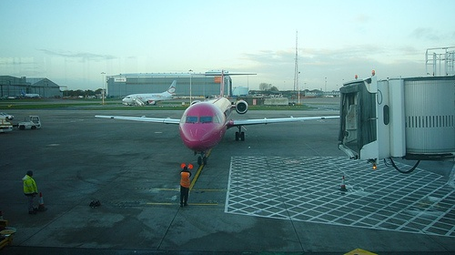
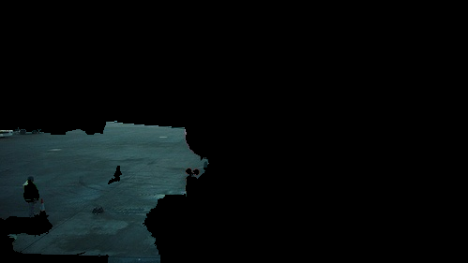
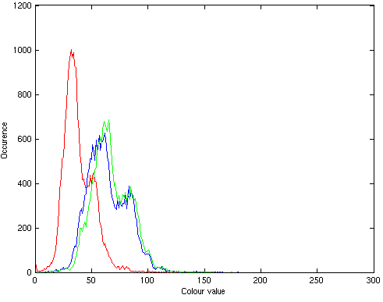

Good segments evaluation
Is this a good segment?
Normality test (Jarque-Bera test)
Unimodality test (Dip test)

Slide 29
Good segments evaluation
Is this a good segment?
Normality test (Jarque-Bera test)
Unimodality test (Dip test)
Outliers detection, RAD, alternative segmentation

Slide 30
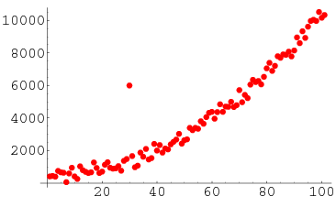
Evaluation using outliers detection
Outlier: Observation that deviates markedly from other members of the sample.
We used the Z-test to detect outliers

Slide 31
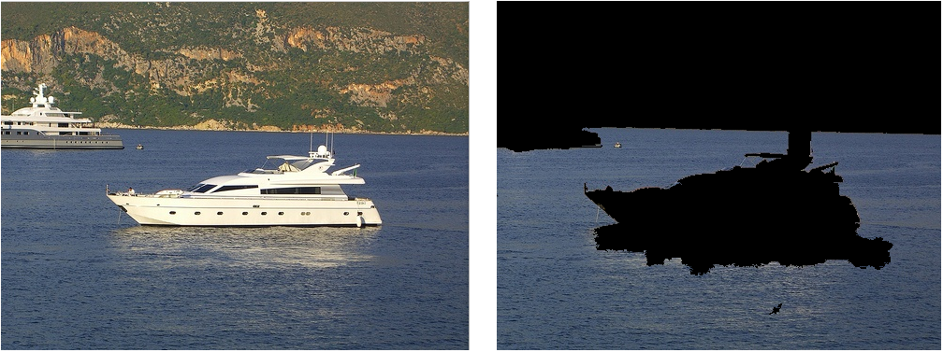
Problem: Shadows and illumination
Find another method robust to shadows and illumination

Slide 32
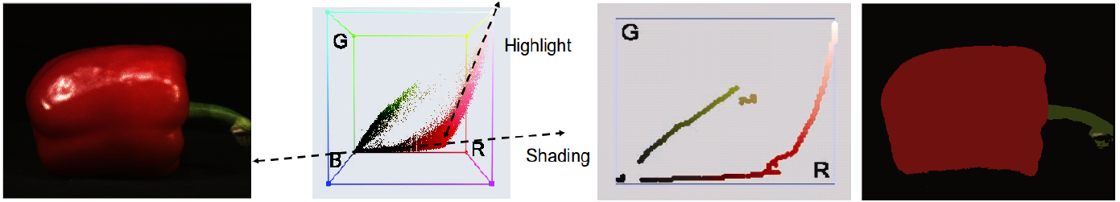

Evaluation using RAD
RAD segmentation introduced by Vazquez et al. (2008)
A good segment is a segment whose histogram follows only one ridge
ECCV 2008

Slide 33
Evaluation using alternate segmentation
Use alternate segmentations that use different cues to verify segment goodness.
Example: To make sure a segment from Mean-Shift is a good segment, segment it using Graph-Based techniques.

Slide 34
Examples of results
Original
RAD, segs = 106
Outliers, segs = 327
Altseg, segs = 641

Slide 35
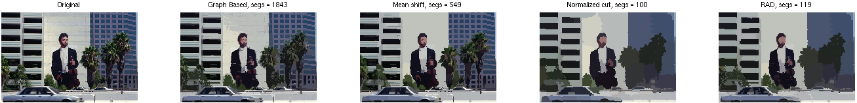
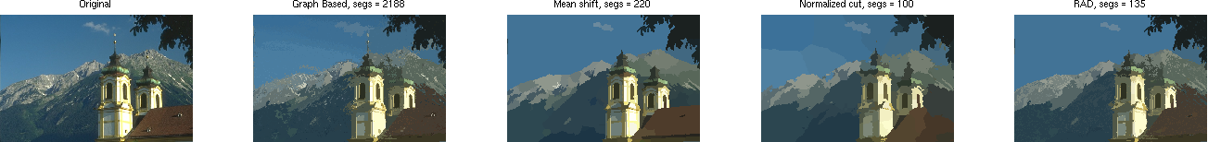
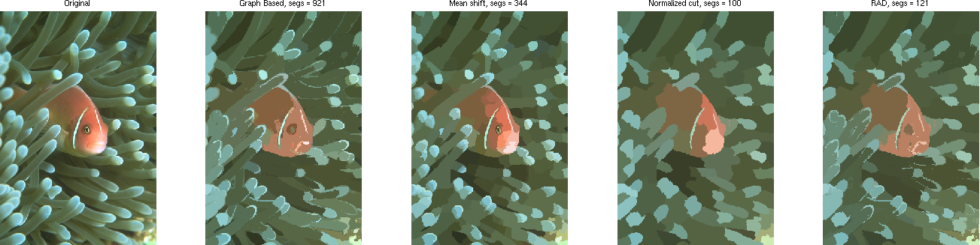
More results (Berkeley Dataset)
Original
GB, Segs = 1843
MS, Segs = 549
NC, Segs = 100
RAD, Segs = 119
Original
GB, Segs = 2188
MS, Segs = 220
NC, Segs = 100
RAD, Segs = 135
Original
GB, Segs = 921
MS, Segs = 344
NC, Segs = 100
RAD, Segs = 121

Slide 36
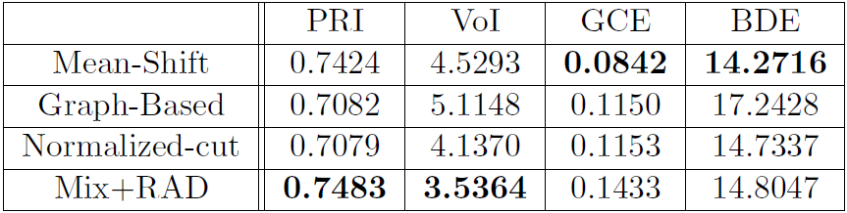
Berkeley Segmentation Dataset and Benchmark
100 images, compared to 5 human segmentations
Better results in 2 out of 4 benchmarks

Slide 37
Our framework
Bottom-up process
Top-down process
Segmentation
Classification
Image
.
.
Combine Confidence
results
CRF
Segmentation
Classification
Segmentation
Classification

Slide 38
Our framework
Bottom-up process
Top-down process
Segmentation
Classification
Image
.
.
Combine Confidence
results
CRF
Segmentation
Classification
Segmentation
Classification

Slide 39
Combining regions classifications
Recall the IofR concept by Pantufaro et al. (2008)
Instead of averaging the confidences, we use our proposed voting technique.

Slide 40

Voting technique
For every IofR.
 | C₁ | C₂ | ... | C_{K}
S₁ | p₁₁ | p₁₂ | ... | p_{1K}
. . . . . . | . . . . . . | . . . . . . | . . . . . . | . . . . . .
S_{N} | p_{N1} | p_{N2} | ... | p_{NK}

Slide 41
Voting technique
For every IofR.
 | C₁ | C₂ | ... | C_{K}
S₁ | p₁₁ | p₁₂ | ... | p_{1K}
. . . . . . | . . . . . . | . . . . . . | . . . . . . | . . . . . .
S_{N} | p_{N1} | p_{N2} | ... | p_{NK}
S₁ | p'₁₁>p'₁₂>...>p'_{1k}
. . . . . . | . . . . . .
S_{N} | p'_{N1}>p'_{N2}>...>p'_{Nk}
Sort

Slide 42
Voting technique
For every IofR.
 | C₁ | C₂ | ... | C_{K}
S₁ | p₁₁ | p₁₂ | ... | p_{1K}
. . . . . . | . . . . . . | . . . . . . | . . . . . . | . . . . . .
S_{N} | p_{N1} | p_{N2} | ... | p_{NK}
 | C₁ | C₂ | ... | C_{K}
S₁ | w₁₁ | w₁₂ | ... | w_{1K}
. . . . . . | . . . . . . | . . . . . . | . . . . . . | . . . . . .
S_{N} | w_{N1} | w_{N2} | ... | w_{NK}
S₁ | p'₁₁>p'₁₂>...>p'_{1k}
. . . . . . | . . . . . .
S_{N} | p'_{N1}>p'_{N2}>...>p'_{Nk}
Sort
Assign values
Based on
Position

Slide 43
Voting technique
For every IofR.
 | C₁ | C₂ | ... | C_{K}
S₁ | p₁₁ | p₁₂ | ... | p_{1K}
. . . . . . | . . . . . . | . . . . . . | . . . . . . | . . . . . .
S_{N} | p_{N1} | p_{N2} | ... | p_{NK}
 | C₁ | C₂ | ... | C_{K}
S₁ | w₁₁ | w₁₂ | ... | w_{1K}
. . . . . . | . . . . . . | . . . . . . | . . . . . . | . . . . . .
S_{N} | w_{N1} | w_{N2} | ... | w_{NK}
Sum
S₁ | p'₁₁>p'₁₂>...>p'_{1k}
. . . . . . | . . . . . .
S_{N} | p'_{N1}>p'_{N2}>...>p'_{Nk}
Sort
Assign values
Based on
Position
 | C₁ | C₂ | ... | C_{K}
S | W₁ | W₂ | ... | W_{K}

Slide 44
Voting technique
For every IofR.
 | C₁ | C₂ | ... | C_{K}
S₁ | p₁₁ | p₁₂ | ... | p_{1K}
. . . . . . | . . . . . . | . . . . . . | . . . . . . | . . . . . .
S_{N} | p_{N1} | p_{N2} | ... | p_{NK}
 | C₁ | C₂ | ... | C_{K}
S₁ | w₁₁ | w₁₂ | ... | w_{1K}
. . . . . . | . . . . . . | . . . . . . | . . . . . . | . . . . . .
S_{N} | w_{N1} | w_{N2} | ... | w_{NK}
Sum
S₁ | p'₁₁>p'₁₂>...>p'_{1k}
. . . . . . | . . . . . .
S_{N} | p'_{N1}>p'_{N2}>...>p'_{Nk}
Sort
Assign values
Based on
Position
C_{X}
 | C₁ | C₂ | ... | C_{K}
S | W₁ | W₂ | ... | W_{K}
Max

Slide 45
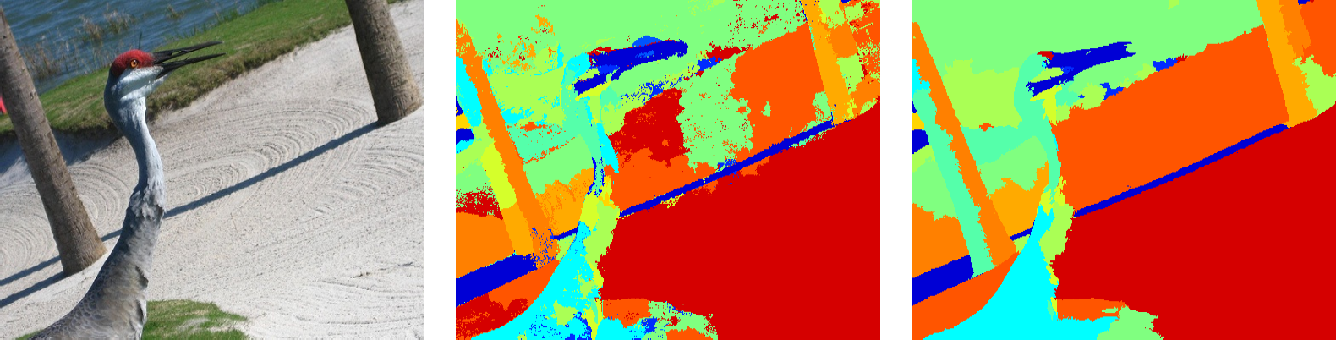
Our framework
Bottom-up process
Top-down process
Segmentation
Classification
Image
.
.
Segmentation
Combine Confidence
results
CRF
Classification
Segmentation
Classification

Slide 46
Experiments and results

Slide 47

Experimental setup
PASCAL VOC 2007 segmentations dataset.
632 images. 422 for training, 210 for testing.
Class accuracy:

Slide 48
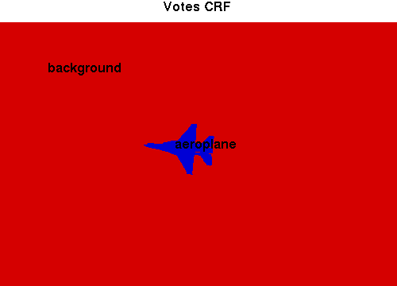
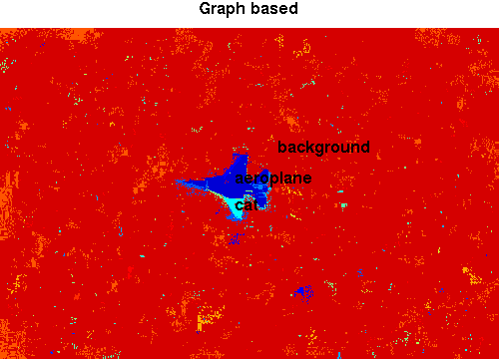
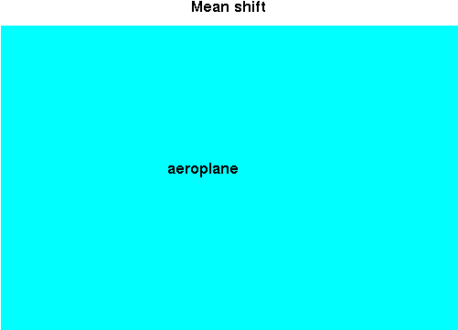
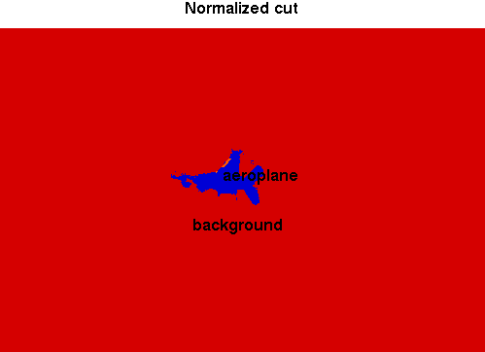
Qualitative results

Slide 49
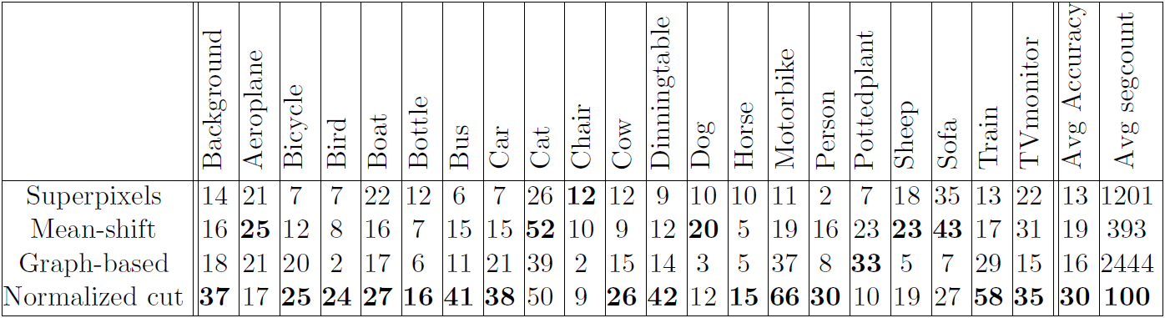
Superpixels versus meaningful segments
Bottom-up process
Top-down process
Image
Segmentation
Classification
CRF

Slide 50
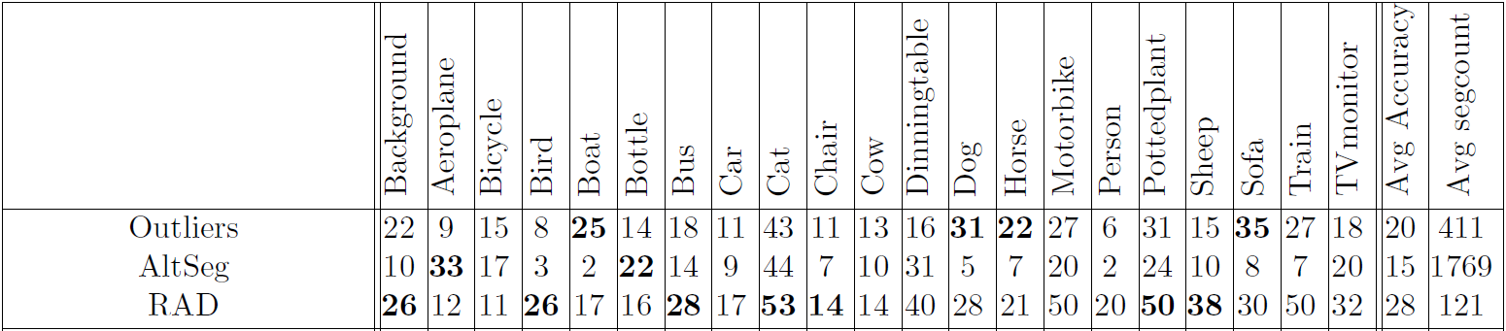
Our new segmentation method
Bottom-up process
Top-down process
Segmentation
Image
.
.
Segmentation
Classification
CRF
Segmentation

Slide 51
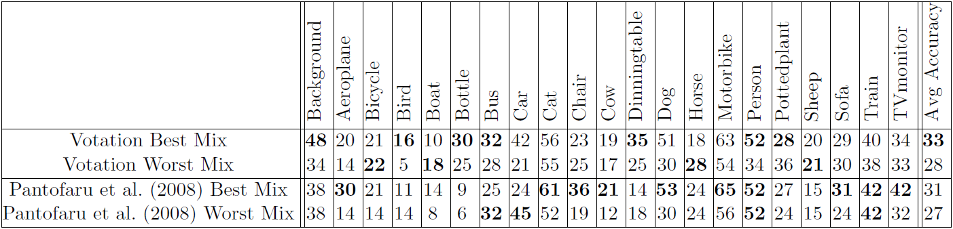
Votation with existing segmentations
Bottom-up process
Top-down process
Segmentation
Classification
Image
.
.
Combine Confidence
results
CRF
Segmentation
Classification

Slide 52
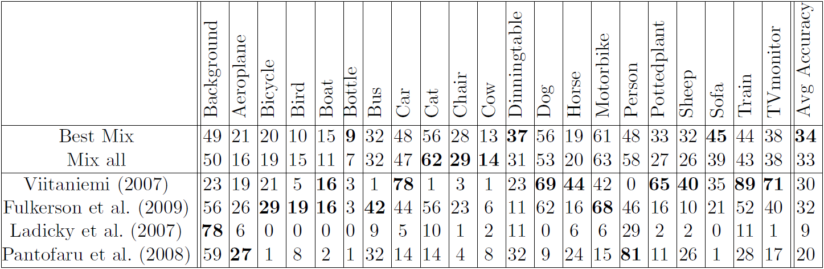
Combine all together
Bottom-up process
Top-down process
Segmentation
Classification
Image
.
.
Combine Confidence
results
CRF
Segmentation
Classification
Segmentation
Classification

Slide 53
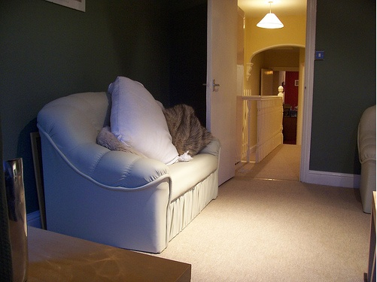
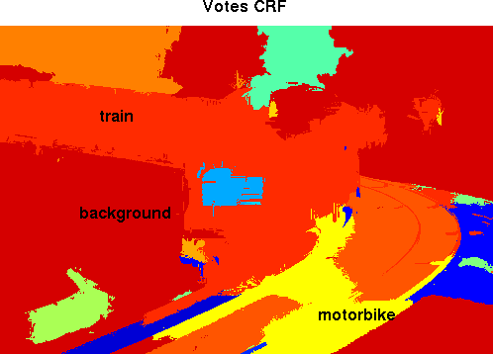
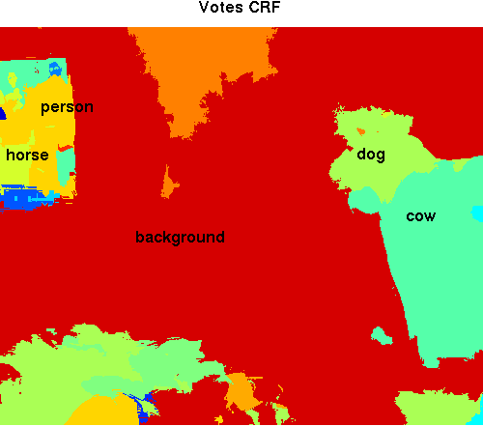
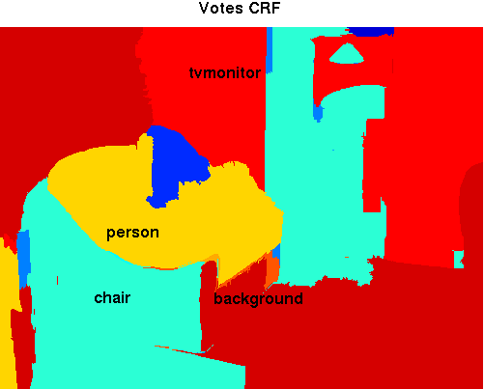
Method's drawbacks

Slide 54
Conclusions
A novel approach for combining different segmentations to obtain a better segmentation.
A novel approach for combining classification results from several segments to better recognize objects.
Superpixels don't provide the best level of representation of the objects.

Slide 55
Future work
Adding a weight to each segmentation.
Create a better RAD segmentation.
    Investigate in adding spatial locality to the dominant colors.
Introduce perceptual concepts and define appropriate operators to handle:
    Image level priors.
    Object detection to guide segmentation.
    Other way for segments goodness measure.

Slide 56
Thank you

Slide 57
RAD Segmentation undesired behavior
RAD fails in the absence of a large variation in colours in one of the images.

Slide 58
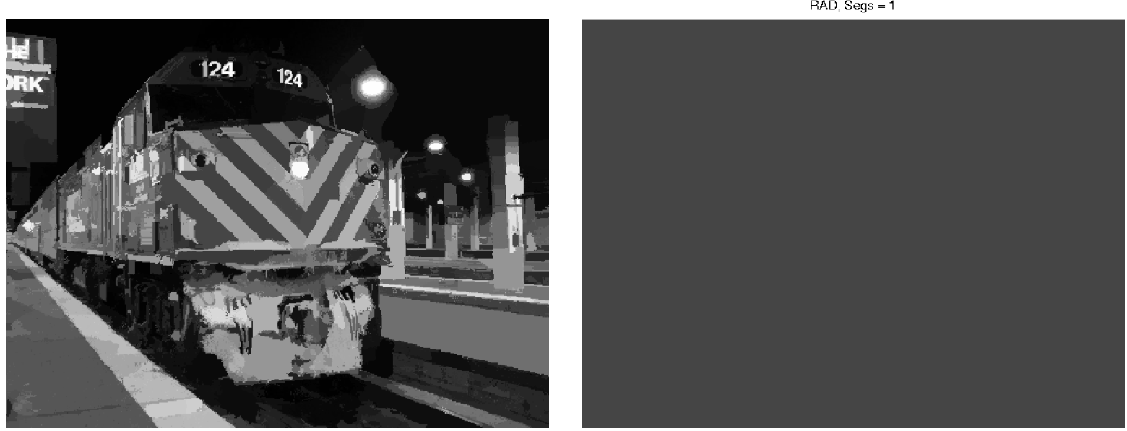
RAD Segmentation undesired behavior
RAD fails in the absence of a large variation in colours in one of the images.

Slide 59
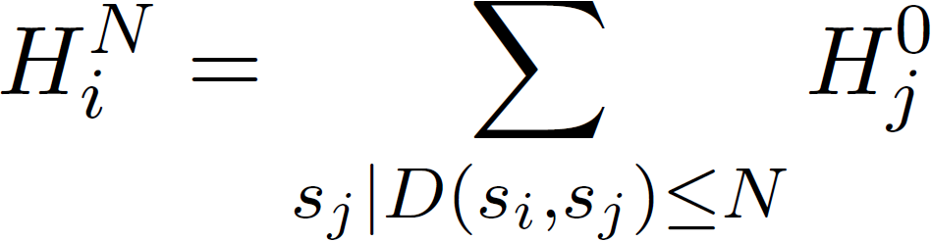
Segments neighborhood
Introduced by Fulkerson et al.(2009)
Approach:
  Extract superpixels from the image (Oversegmentation)
  Map the image as a Graph G(S, E).
  Sum histograms from each Superpixel (S) with others less than N nodes away in the graph.

Slide 60
Our framework
Our framework is divided into five main parts
  Generating multiple segmentations.
  Combining segmentations to get a better new segmentation.
  Describing and classifying regions.
  Combine classification results using the votation technique.
  Refining final results with a CRF.
Our framework is based on the VLBLOCKS by Fulkerson et al. (2009)

Slide 61
Describing and classifying regions
We used the exact parameters in the VLBlocks framework by Fulkerson et al. (2009)
It extracts SIFT features from every pixel.
It uses bag of features framework for classification.
It quantizes our descriptor using K-means and aggregates them into an L1 histogram.
It trains one vs rest SVM with an RBF of chi squared.

Slide 62
Refining classifications with a CRF
We used the same framework from the VLBlocks framework by Fulkerson et al. (2009)
They need the results from the SVM to construct the unary potentials.
They need the difference of neighboring segments colors in the LUV colorspace to identify the pairwise edge potentials.

Slide 63
Introduction
We present an approach for enhancing image segmentation and object localization by combining segments from different segmentation algorithms.
Image segmentation?
Object localization?

Slide 64
Segmentation error measures

