Slide 1


Object Localization Enhancement by Multiple Segmentations Fusion
Presented by: Ahmed Mounir Gad
Advisor: Ramon Baldrich

Slide 2
Content
Introduction
    Segmentation
    Object localization
Related work
    Multiple segmentations
    Segments neighborhood
Core approach
    Generating multiple segmentations
    Building an improved segmentation
    Describing and classifying segments
    Combining regions classifications
    Refining with a CRF
Experiments and results
Conclusions
Future work

Slide 3
Introduction
Segmentation
Object localization

Slide 4
Introduction
Image segmentation?
Object localization?
Segmentation
Object localization

Slide 5
Image segmentation
Partitioning an image into a set of non-overlapping regions.
Original Image
Normalized Cut, Seg No = 100

Slide 6
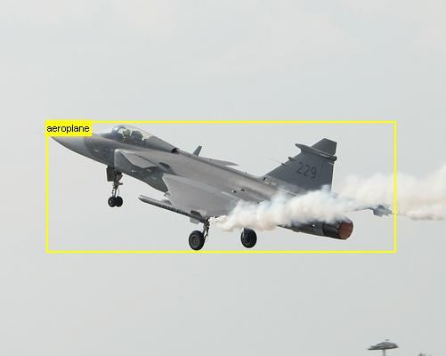

Object localization
Recognizing an object inside an image and locating it's exact position

Slide 7
Object class segmentation
Producing a pixel-level segmentation of the input image.

Slide 8
Basic framework
Bottom-up process
Top-down process
Segmentation
Classification
Image
Confidence
Map

Slide 9
Related work
We discuss two techniques that we found useful for our work
    Using multiple segmentations
    Segments neighborhood

Slide 10
Related work
Introduced by Pantofaru et al. (2008)
Segments from a single segmentation aren't trustable.

Slide 11
Related work
Introduced by Pantofaru et al. (2008)
Segments from a single segmentation aren't trustable.
Segmentation
Classification
Image
.
.
Average Confidence
results
Segmentation
Classification

Slide 12
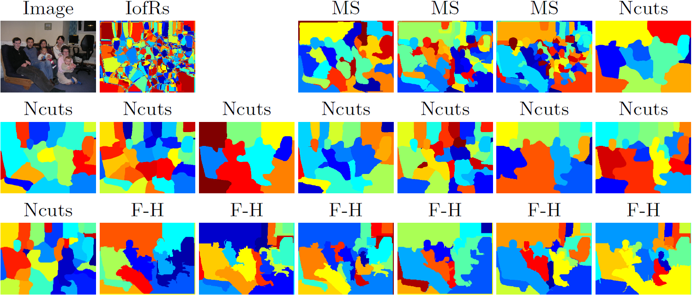
Related work
Introduced by Pantofaru et al. (2008)
Segments from a single segmentation aren't trustable.
Create Intersection of Regions (IofRs) by intersecting multiple segmentations
Segmentation
Classification
Image
.
.
Average Confidence
results
Segmentation
Classification

Slide 13
Segments neighborhood
Introduced by Fulkerson et al.(2009)
Create
Superpixels
Sum neighboring
Histograms
Classification
CRF
Image

Slide 14
Segments neighborhood (Cont.)
We performed the same neighborhood operation on superpixels and segments from several image segmentation algorithms.
On increasing the neighborhood, it means considering a larger segment.

Slide 15
Segments neighborhood (Cont.)
We performed the same neighborhood operation on superpixels and segments from several image segmentation algorithms.
On increasing the neighborhood, it means considering a larger segment.
Average segments count:
Graph-Based: 2444
Superpixels: 1201
Mean-shift: 393
Normalized-cut: 100

Slide 16
Observations
Superpixels aren't well descriptive for the objects (Case of absent neighborhoods).
At a certain limit, the neighborhood operator fails to give a better performance and results start decreasing.

Slide 17
Our framework
Our framework is based on the VLBLOCKS by Fulkerson et al. (2009)
Bottom-up process
Top-down process
Segmentation
Classification
Image
.
.
Combine Confidence
results
CRF
Segmentation
Classification
Segmentation
Classification

Slide 18
Our framework
Bottom-up process
Top-down process
Classification
Segmentation
Combine Confidence
results
CRF
Image
Classification
Segmentation
Classification
Segmentation

Slide 19
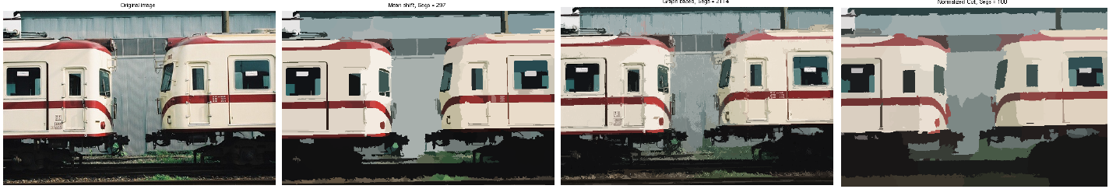
Generating multiple segmentations
We tried generating more than one segmentation with different methods.
We wanted to generates segmentation using a variety of techniques that use different cues.
We generated 1 Mean-Shift, 1 Graph-Based and 1 Normalized-cut segmentations.

Slide 20
Our framework
Bottom-up process
Top-down process
Classification
Segmentation
Combine Confidence
results
CRF
Image
Classification
Segmentation
Classification
Segmentation

Slide 21
Combining segmentations
Recall this figure
Average segments count:
Graph-Based: 2444
Superpixels: 1201
Mean-shift: 393
Normalized-cut: 100

Slide 22
Combining segmentations
Recall this figure
Average segments count:
Graph-Based: 2444
Superpixels: 1201
Mean-shift: 393
Normalized-cut: 100
Getting higher accuracy:
    Large segments
    Good segments

Slide 23
Combining segmentations

Slide 24
Combining segmentations

Slide 25
Combining segmentations

Slide 26
Combining segmentations

Slide 27
Combining segmentations

Slide 28
Combining segmentations

Slide 29
Good segments evaluation
Is this a good segment?
What do we mean by a good segment?

Slide 30
Good segments evaluation
Is this a good segment?
What do we mean by a good segment?
    The largest set of connected pixels that lie in the same class and are coherent in the colour distribution.

Slide 31
Good segments evaluation
Is this a good segment?

Slide 32

Good segments evaluation
Is this a good segment?
Normality test (Jarque-Bera test)
Unimodality test (Dip test)

Slide 33
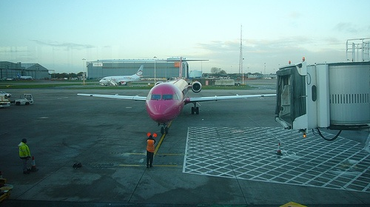
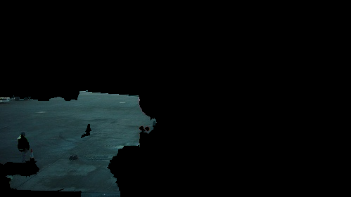
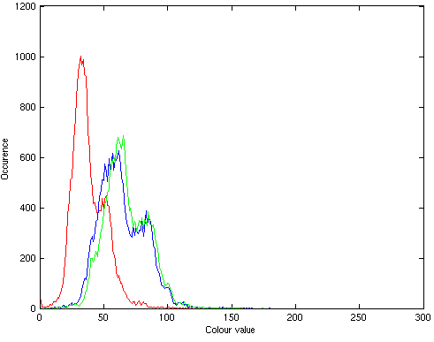

Good segments evaluation
Is this a good segment?
Normality test (Jarque-Bera test)
Unimodality test (Dip test)

Slide 34
Good segments evaluation
Is this a good segment?
Normality test (Jarque-Bera test)
Unimodality test (Dip test)
Outliers detection, RAD, alternative segmentation

Slide 35
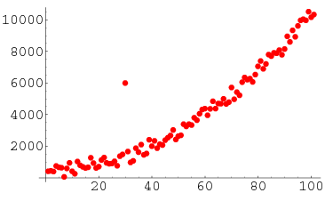
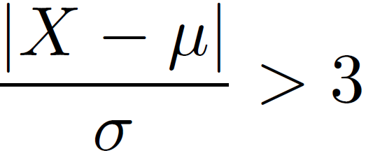
Evaluation using outliers detection
Outlier: An outlying ovservation is one that appears to deviate merkedly from other members of the sample in which it occurs.
We used the Z-test to detect outliers because of its simplicity.
A point is an outlier if:

Slide 36
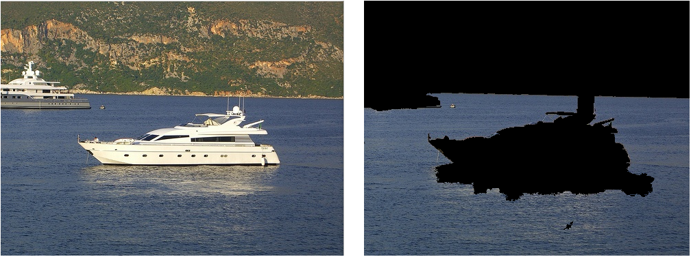
Problem: Shadows and illumination
Find another method robust to shadows and illumination

Slide 37
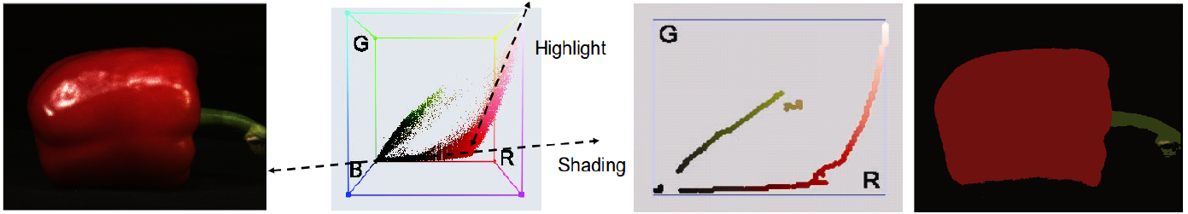

Evaluation using RAD
RAD segmentation introduced by Vazquez et al. (2008)
A good segment is a segment whose histogram follows only one ridge

Slide 38
Evaluation using alternate segmentation
Use an alternate segmentation that uses different cues to verify the goodness of the segment.
Example: To make sure a segment from Mean-Shift is a good segment, segment it using Graph-Based techniques.

Slide 39
Examples of results

Slide 40
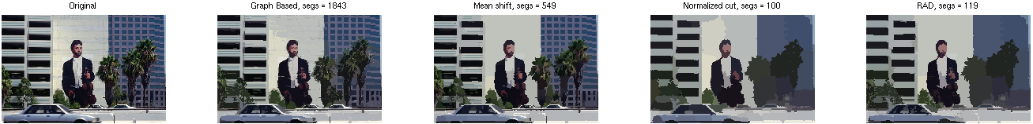
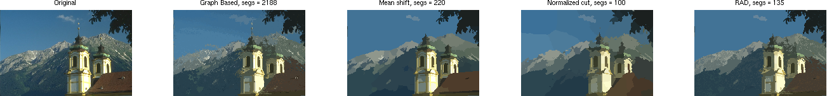
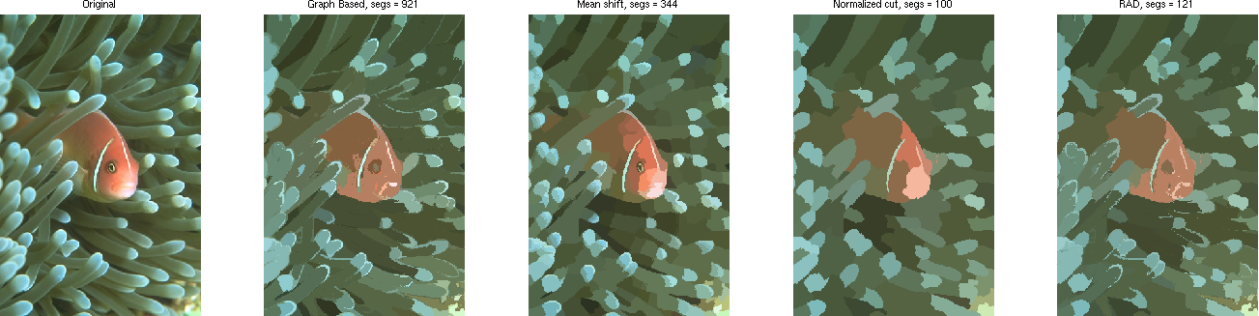
More results (Berkeley Dataset)

Slide 41
Our framework
Bottom-up process
Top-down process
Segmentation
Classification
Image
.
.
Combine Confidence
results
CRF
Segmentation
Classification
Segmentation
Classification

Slide 42
Describing and classifying regions
We used the exact parameters in the VLBlocks framework by Fulkerson et al. (2009)
It extracts SIFT features from every pixel.
It uses bag of features framework for classification.
It quantizes our descriptor using K-means and aggregates them into an L1 histogram.
It trains one vs rest SVM with an RBF of chi squared.

Slide 43
Our framework
Bottom-up process
Top-down process
Segmentation
Classification
Image
.
.
Combine Confidence
results
CRF
Segmentation
Classification
Segmentation
Classification

Slide 44
Combining regions classifications
Recall the IofR concept by Pantufaro et al. (2008)
Instead of averaging the confidences, we use our proposed voting technique.

Slide 45
Votations technique
For every IofR.
  We use the voting technique to determine which class it falls into

Slide 46

Votations technique
For every IofR.
  We use the voting technique to determine which class it falls into
 | C₁ | C₂ | ... | C_{K}
S₁ | p₁₁ | p₁₂ | ... | p_{1K}
. . . . . . | . . . . . . | . . . . . . | . . . . . . | . . . . . .
S_{N} | p_{N1} | p_{N2} | ... | p_{NK}

Slide 47
Votations technique
For every IofR.
  We use the voting technique to determine which class it falls into
 | C₁ | C₂ | ... | C_{K}
S₁ | p₁₁ | p₁₂ | ... | p_{1K}
. . . . . . | . . . . . . | . . . . . . | . . . . . . | . . . . . .
S_{N} | p_{N1} | p_{N2} | ... | p_{NK}
S₁ | p'₁₁>p'₁₂>...>p'_{1k}
. . . . . . | . . . . . .
S_{N} | p'_{N1}>p'_{N2}>...>p'_{Nk}
Sort

Slide 48
Votations technique
For every IofR.
  We use the voting technique to determine which class it falls into
 | C₁ | C₂ | ... | C_{K}
S₁ | p₁₁ | p₁₂ | ... | p_{1K}
. . . . . . | . . . . . . | . . . . . . | . . . . . . | . . . . . .
S_{N} | p_{N1} | p_{N2} | ... | p_{NK}
 | C₁ | C₂ | ... | C_{K}
S₁ | w₁₁ | w₁₂ | ... | w_{1K}
. . . . . . | . . . . . . | . . . . . . | . . . . . . | . . . . . .
S_{N} | w_{N1} | w_{N2} | ... | w_{NK}
S₁ | p'₁₁>p'₁₂>...>p'_{1k}
. . . . . . | . . . . . .
S_{N} | p'_{N1}>p'_{N2}>...>p'_{Nk}
Sort
Assign values
Based on
Position

Slide 49
Votations technique
For every IofR.
  We use the voting technique to determine which class it falls into
 | C₁ | C₂ | ... | C_{K}
S₁ | p₁₁ | p₁₂ | ... | p_{1K}
. . . . . . | . . . . . . | . . . . . . | . . . . . . | . . . . . .
S_{N} | p_{N1} | p_{N2} | ... | p_{NK}
 | C₁ | C₂ | ... | C_{K}
S₁ | w₁₁ | w₁₂ | ... | w_{1K}
. . . . . . | . . . . . . | . . . . . . | . . . . . . | . . . . . .
S_{N} | w_{N1} | w_{N2} | ... | w_{NK}
Sum
S₁ | p'₁₁>p'₁₂>...>p'_{1k}
. . . . . . | . . . . . .
S_{N} | p'_{N1}>p'_{N2}>...>p'_{Nk}
Sort
Assign values
Based on
Position
 | C₁ | C₂ | ... | C_{K}
S | W₁ | W₂ | ... | W_{K}

Slide 50
Votations technique
For every IofR.
  We use the voting technique to determine which class it falls into
 | C₁ | C₂ | ... | C_{K}
S₁ | p₁₁ | p₁₂ | ... | p_{1K}
. . . . . . | . . . . . . | . . . . . . | . . . . . . | . . . . . .
S_{N} | p_{N1} | p_{N2} | ... | p_{NK}
 | C₁ | C₂ | ... | C_{K}
S₁ | w₁₁ | w₁₂ | ... | w_{1K}
. . . . . . | . . . . . . | . . . . . . | . . . . . . | . . . . . .
S_{N} | w_{N1} | w_{N2} | ... | w_{NK}
Sum
S₁ | p'₁₁>p'₁₂>...>p'_{1k}
. . . . . . | . . . . . .
S_{N} | p'_{N1}>p'_{N2}>...>p'_{Nk}
Sort
Assign values
Based on
Position
C_{X}
 | C₁ | C₂ | ... | C_{K}
S | W₁ | W₂ | ... | W_{K}
Max

Slide 51
Our framework
Bottom-up process
Top-down process
Segmentation
Classification
Image
.
.
Combine Confidence
results
CRF
Segmentation
Classification
Segmentation
Classification

Slide 52
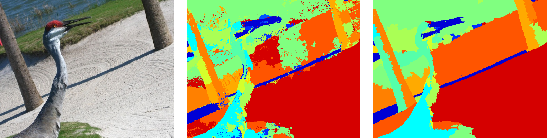
Refining classifications with a CRF
We used the same framework from the VLBlocks framework by Fulkerson et al. (2009)
They need the results from the SVM to construct the unary potentials.
They need the difference of neighboring segments colors in the LUV colorspace to identify the pairwise edge potentials.

Slide 53
Experiments and results

Slide 54

Experimental setup
We worked for the PASCAL VOC 2007 segmentations dataset.
The dataset consists of 632 images. 422 images were used for training and 210 for testing.
The accuracy for each class is calculated as follows:

Slide 55
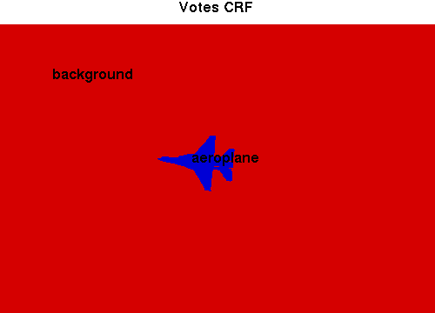
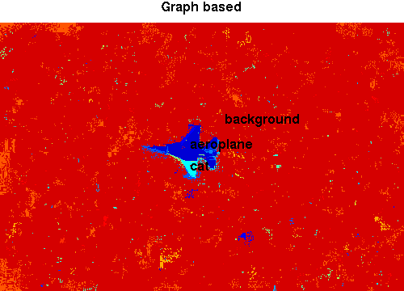
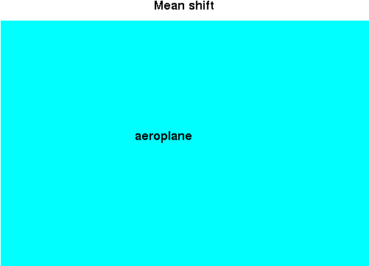
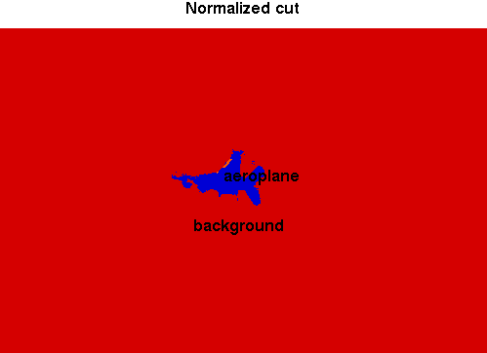
Qualitative results

Slide 56
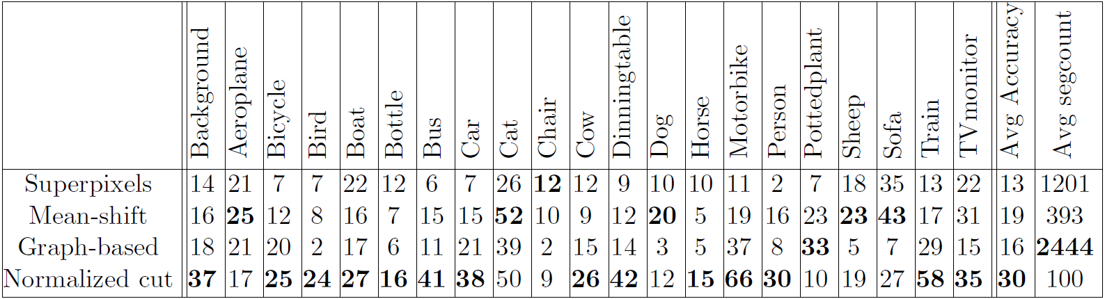
Superpixels versus meaningful segments
Bottom-up process
Top-down process
Image
Segmentation
Classification
CRF

Slide 57
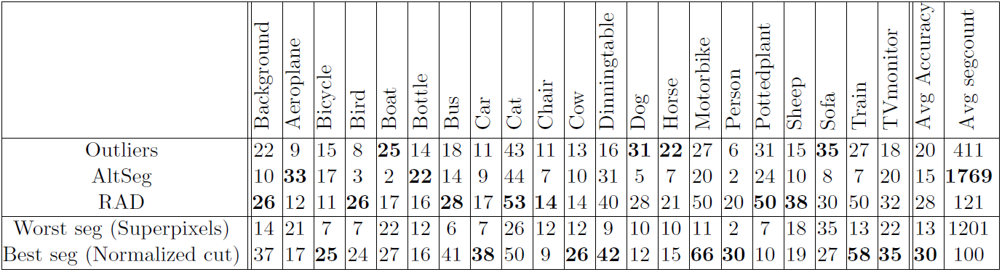
Our new segmentation method
Bottom-up process
Top-down process
Segmentation
Image
.
.
Segmentation
Classification
CRF
Segmentation

Slide 58
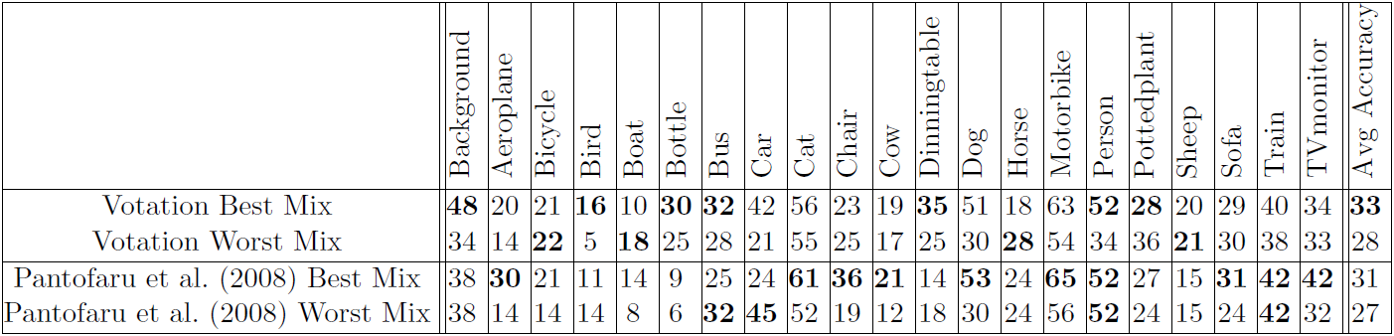
Votation with existing segmentations
Bottom-up process
Top-down process
Segmentation
Classification
Image
.
.
Combine Confidence
results
CRF
Segmentation
Classification

Slide 59
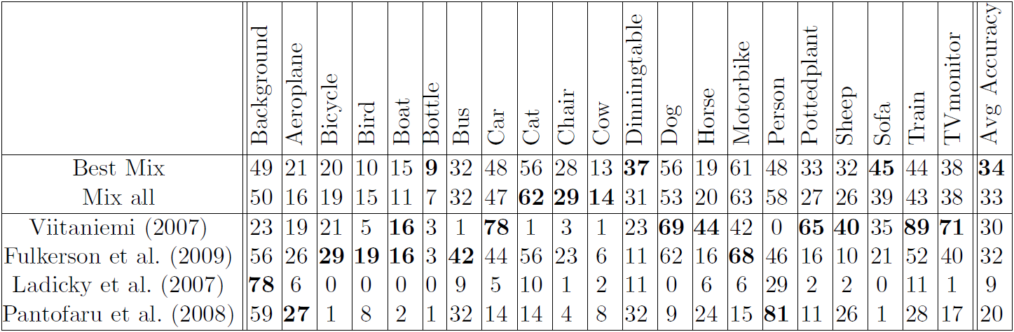
Combine all together
Bottom-up process
Top-down process
Segmentation
Classification
Image
.
.
Combine Confidence
results
CRF
Segmentation
Classification
Segmentation
Classification

Slide 60
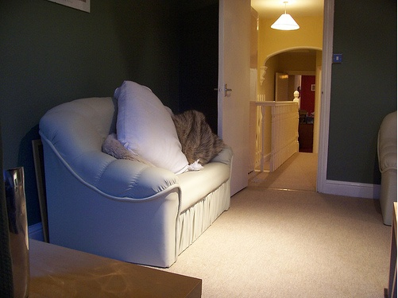
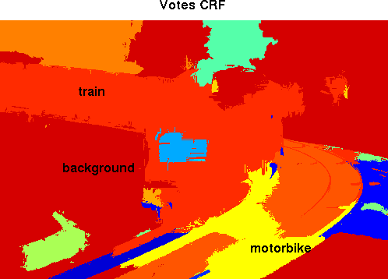
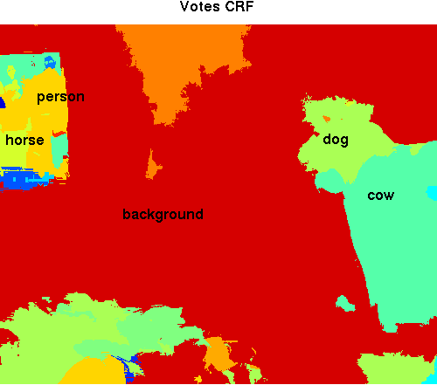
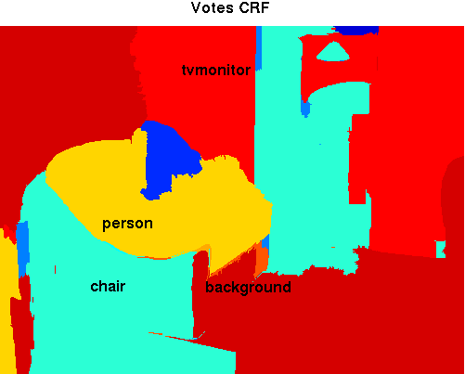
Bad qualitative results

Slide 61
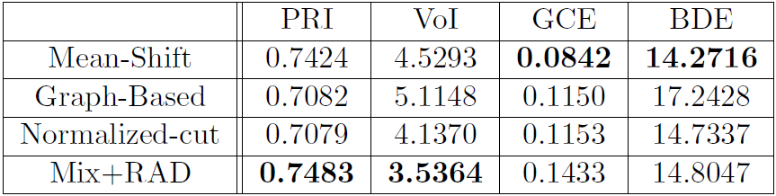
Berkeley Segmentation Dataset and Benchmark
100 images, compared to 5 human segmentations
Better results in 2 out of 4 benchmarks

Slide 62
Conclusions
We presented a novel approach for combining different segmentations to obtain a better segmentation.
We presented a novel approach for combining classification results from several segments to better recognize objects.
We suggested a number of extensions and studied their benefits.
We added a higher complexity to the class segmentation process but in the end we got rewarded with an improved performance.

Slide 63
Future work
Adding a weight to each segmentation.
Investigate in the effect of combining segmentations for a better segmentation accuracy.
Create a better RAD segmentation.
    Investigate the reasons for undesired behavior (Creaseness operator?)
    Investigate in adding spatial locality to the dominant colors.
Incorporate image level priors.
Use object detection to guide segmentation.
Use other way for segments goodness measure.
    Color boosting

Slide 64
Thank you

Slide 65
RAD Segmentation undesired behavior
RAD fails in the absence of a large variation in colours in one of the images.

Slide 66
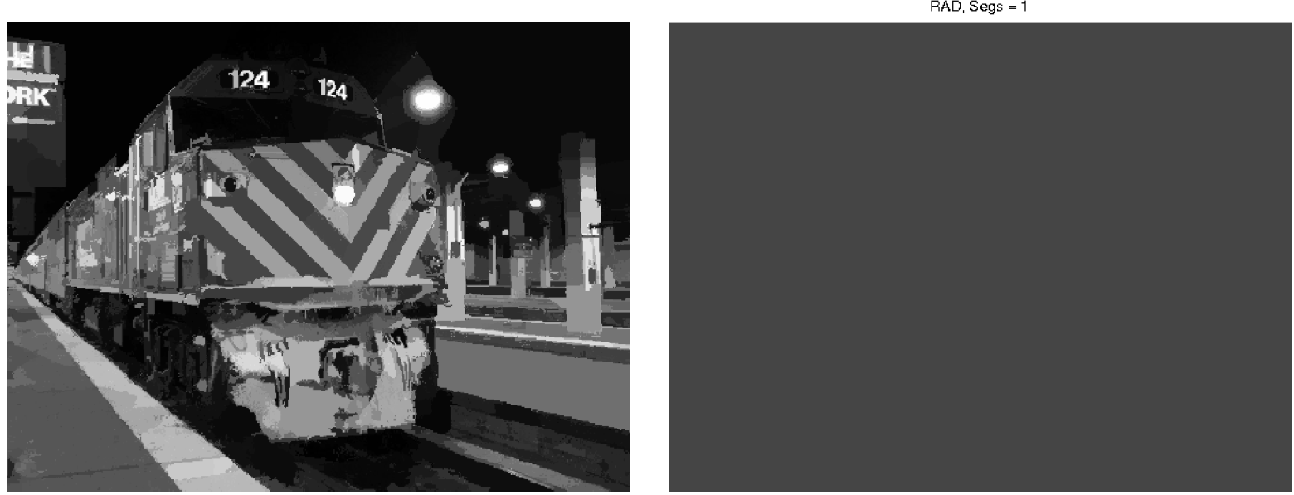
RAD Segmentation undesired behavior
RAD fails in the absence of a large variation in colours in one of the images.

Slide 67
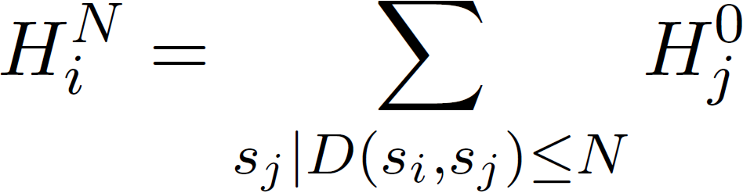
Segments neighborhood
Introduced by Fulkerson et al.(2009)
Approach:
  Extract superpixels from the image (Oversegmentation)
  Map the image as a Graph G(S, E).
  Sum histograms from each Superpixel (S) with others less than N nodes away in the graph.

Slide 68
Our framework
Our framework is divided into five main parts
  Generating multiple segmentations.
  Combining segmentations to get a better new segmentation.
  Describing and classifying regions.
  Combine classification results using the votation technique.
  Refining final results with a CRF.
Our framework is based on the VLBLOCKS by Fulkerson et al. (2009)

Slide 69
Introduction
We present an approach for enhancing image segmentation and object localization by combining segments from different segmentation algorithms.
Image segmentation?
Object localization?

