Slide 1
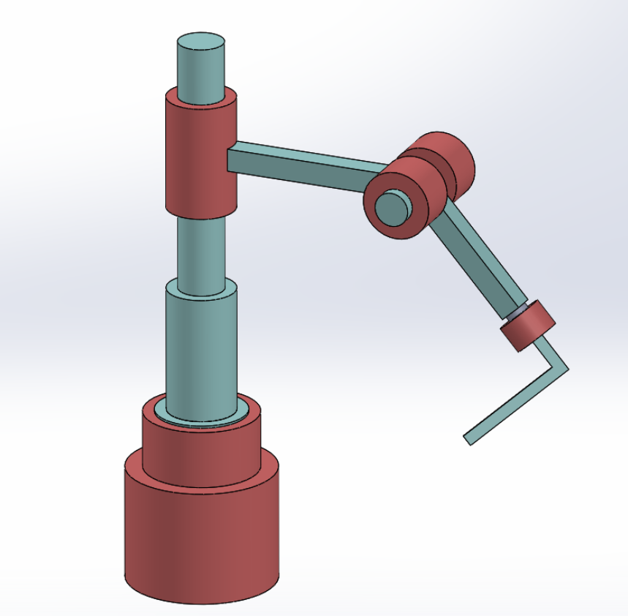
Joint 3
Joint 2
Joint 4
Joint 1

Slide 2
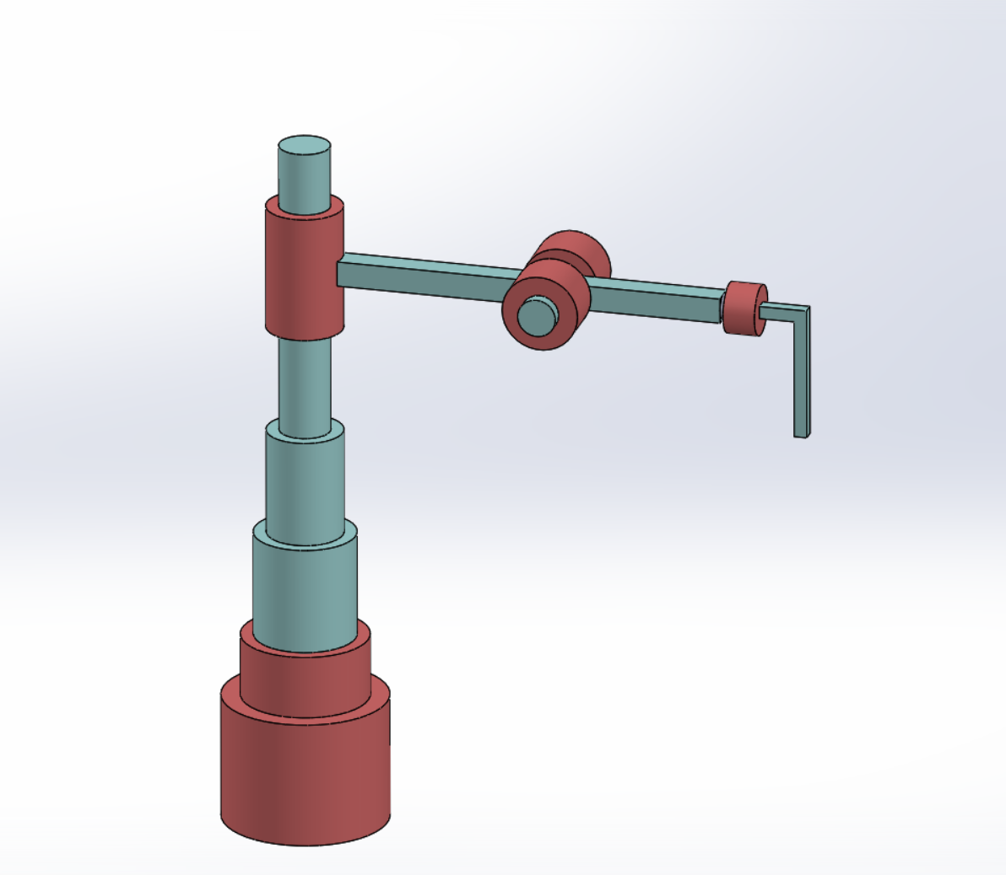






















$$θ_{2}$$
$$l_{2}$$
$$l_{3}$$
$$l_{4}$$
$$k_{1}=k_{2}$$
$$i_{3}$$
$$θ_{3}$$
$$i_{1}$$
$$i_{4}$$
$$j_{3}$$
$$k_{4}$$
$$i_{2}$$
$$θ_{4}$$
$$i_{e}$$
$$d_{1}$$
$$k_{3}$$
$$l_{e}$$
$$k_{e}$$
$$k_{0}$$
$$l_{0}$$
$$j_{0}$$
$$i_{0}$$

