Slide 1
CSE-372
High Performance Computing
Project : Group 9

Slide 2
Introduction
Scene classification of HRRS imagery is a fundamental task and very important for many practical remote sensing applications, such as land resource management, urban planning, and computer cartography. It aims to classify extracted subregions of HRRS images covering multiple land-cover types or ground objects into different semantic categories.
Generally, some identical land-cover types or object classes are frequently shared among different scene categories. Hence, such complexity of spatial and structural patterns in HRRS scenes makes scene classification a fairly challenging problem.

Slide 3
CNN
A Convolutional Neural Network (ConvNet/CNN) is a Deep Learning algorithm which can take in an input image, assign importance (learnable weights and biases) to various aspects/objects in the image and be able to differentiate one from another. The pre-processing required in a ConvNet is much lower as compared to other classification algorithms. While in primitive methods filters are hand-engineered, with enough training, ConvNets have the ability to learn these filters/characteristics.
The architecture of a ConvNet is analogous to that of the connectivity pattern of neurons in the human brain and was inspired by the organization of the Visual Cortex.
A ConvNet is able to successfully capture the Spatial and Temporal dependencies in an image through the application of relevant filters. The architecture performs a better fitting to the image dataset due to the reduction in the number of parameters involved and reusability of weights. In other words, the network can be trained to understand the sophistication of the image better.

Slide 4
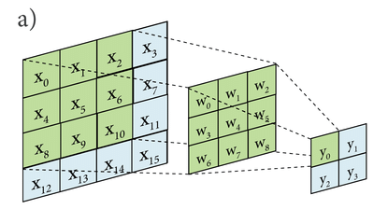
Convolution
The typical architecture of a CNN is composed of multiple cascaded stages. The convolutional layers and pooling layers construct the first few stages; a typical stage is depicted on the right. The convolutional layers output feature maps, each element of which is obtained by computing a dot product between the local region (receptive field) it is connected to in the input feature maps, and a set of weights (also called filters or kernels). In general, an elementwise non-linear activation function is applied to these feature maps.

Slide 5
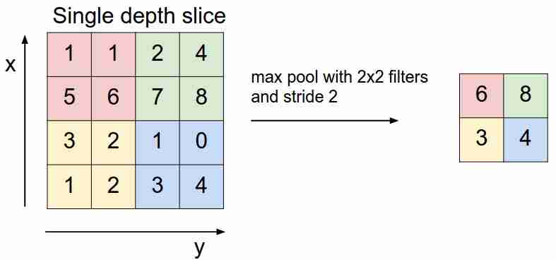
Pooling
The pooling layers perform a downsampling operation along the spatial dimensions of feature maps via computing the maximum on a local region. The fully-connected (FC) layers finally follow several stacked convolutional and pooling layers, and the last fully-connected layer is a Softmax layer that computes the scores for each defined class. CNNs transform the input image from original pixel values to the final class scores through the network in a feedforward manner.

Slide 6
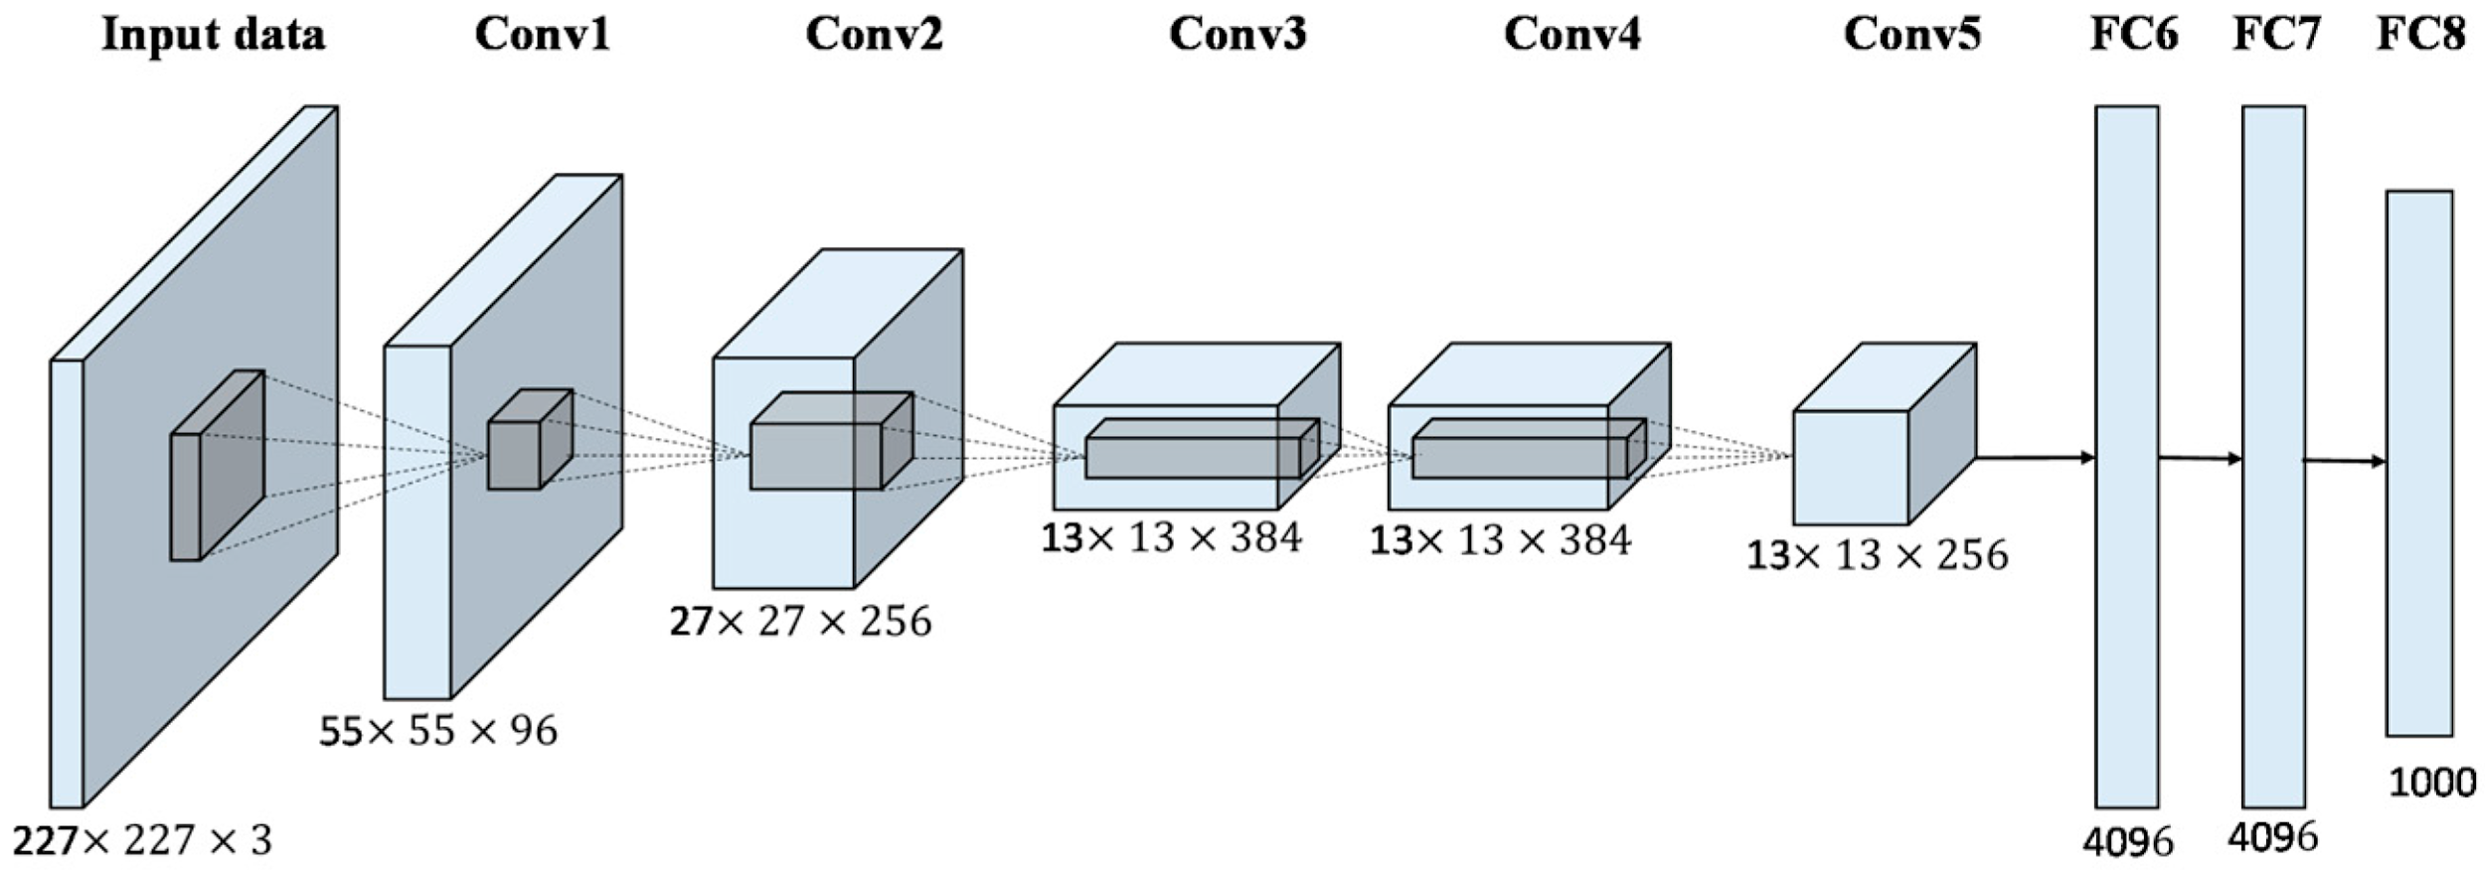
AlexNET
AlexNet, developed by Alex Krizhevsky, is a groundbreaking deep CNN architecture that won the 2012 ImageNet Large Scale Visual Recognition Challenge (ILSVRC-2012). In contrast to the early CNN models, AlexNet consists of five convolutional layers, the first, second and fifth of which are followed with pooling layers, and three fully-connected layers, as shown in Figure 2(insert image).

Slide 7
VGGNET
To evaluate the performance of different deep CNN models and compare them on a common ground, Chatfield developed three CNN architectures based on the Caffe toolkit, each of which explores a different speed/accuracy trade-off:
(1) VGG-F: The fast CNN architecture is similar to AlexNet. The primary differences from AlexNet are the smaller number of filters and small stride in some convolutional layers.
(2) VGG-M: The medium CNN architecture is similar to the one presented by Zeiler. It is constructed with a smaller stride and pooling size in the 1st convolutional layer. A smaller number of filters in the 4th convolutional layer is explored for balancing the computational speed.
(3) VGG-S: The slow CNN architecture is a simplified version of the accurate model in the OverFeat framework, which retains the first five convolutional layers of the six layers in the original accurate OverFeat model and has a smaller number of filters in the 5th layer.

Slide 8
The Dataset
The UC Merced Land Use Dataset (UCM), manually collected from large aerial orthoimagery, contains 21 distinctive scene categories. Each class consists of 100 images with a size of 256 × 256 pixels. Each image has a pixel resolution of one foot. Figure 4 shows two examples of each category included in this dataset. This dataset has very small inter-class diversity among some categories that share a few similar objects or textural patterns (e.g., dense residential and medium residential regions), which makes the UCM dataset a challenging one to segregate.

Slide 9

Keras
Keras is an open-source neural-network library written in Python. It is capable of running on top of TensorFlow, Microsoft Cognitive Toolkit, Theano, or PlaidML. Designed to enable fast experimentation with deep neural networks, it focuses on being user-friendly, modular, and extensible. It was developed as part of the research effort of project ONEIROS (Open-ended Neuro-Electronic Intelligent Robot Operating System).
Keras contains numerous implementations of commonly used neural-network building blocks such as layers, objectives, activation functions, optimizers, and a host of tools to make working with image and text data easier. In addition to standard neural networks, Keras has support for convolutional and recurrent neural networks, as well as other common utility layers like dropout, batch normalization, and pooling.
Keras allows users to productize deep models on smartphones (iOS and Android), on the web, or on the Java Virtual Machine. It also allows use of distributed training of deep-learning models on clusters of Graphics Processing Units (GPU) and Tensor processing units (TPU).

Slide 10
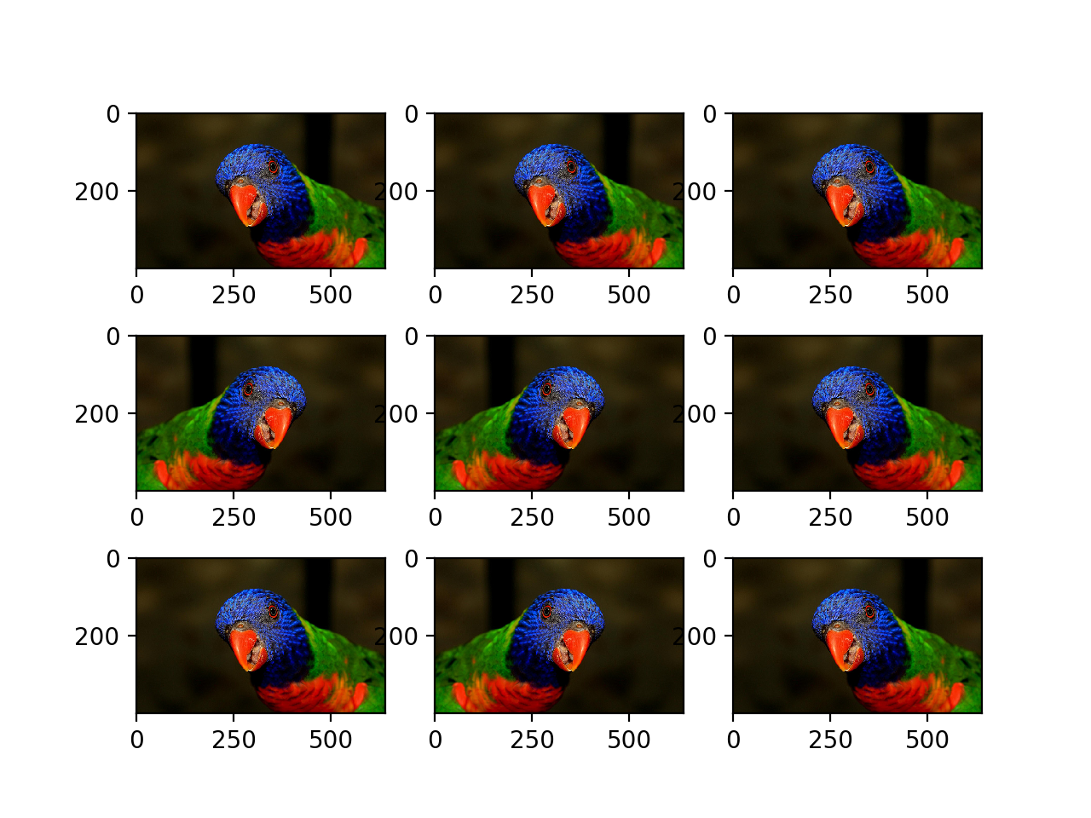
Augmentation
We have 2100 images in our UCM dataset. We apply augmentations to generate more input images and train the model for variations. The following augmentations were applied:
Horizontal Flip

Slide 11
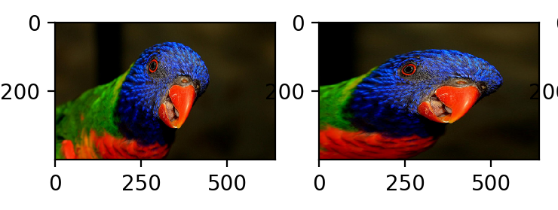
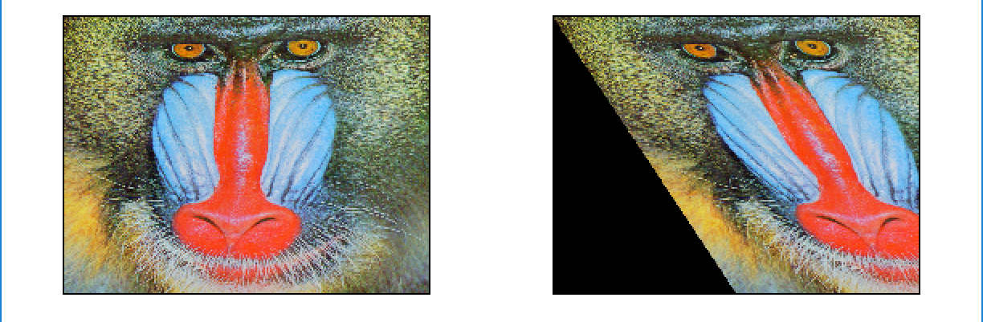
2) ZOOM Range(0.2)
3)Shear Range

Slide 12
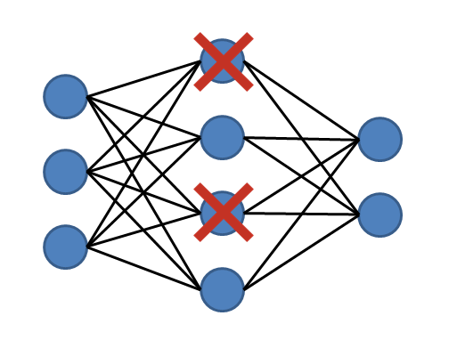
Reducing Overfitting
A fully connected layer is prone to overfitting as it occupies most of the parameters. One method to reduce overfitting is Dropout. At each training stage, individual nodes are either "dropped out" of the net with probability 1-p or kept with probability p, so that a reduced network is left; incoming and outgoing edges to a dropped-out node are also removed. Only the reduced network is trained on the data in that stage. The removed nodes are then reinserted into the network with their original weights.In the training stages, the probability that a hidden node will be dropped is usually 0.5; for input nodes, this should be much lower, intuitively because information is directly lost when input nodes are ignored. By avoiding training all nodes on all training data, dropout decreases overfitting and significantly improves training speed. This makes the model combination practical, even for deep neural networks. The technique seems to reduce node interactions, leading them to learn more robust features that better generalize to new data.

Slide 13


Reducing Overfitting
Regularization is a technique to discourage the complexity of the model by penalizing the loss function. This helps solve the overfitting problem.
L1 (Lasso) Regularization
L1 Regularization or Lasso Regularization adds a penalty to the error function. The penalty is the sum of the absolute values of weights.
L2 (Ridge) Regularization
L2 Regularization or Ridge Regularization also adds a penalty to the error function. But the penalty here is the sum of the squared values of weights.
p is the tuning parameter which decides how much we want to penalize the model.

Slide 14
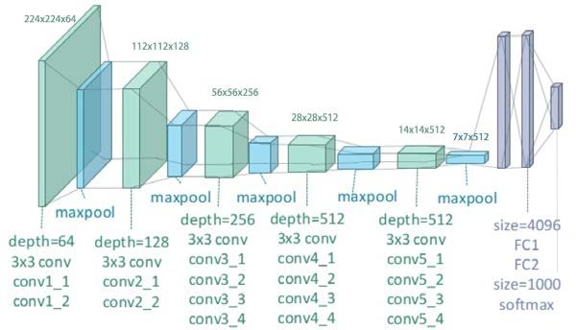
Model Structure
VGG19
VGG-19 is a convolutional neural network that is trained on more than a million images from the ImageNet database [1]. The network is 19 layers deep and can classify images into 1000 object categories, such as keyboard, mouse, pencil, and many animals. As a result, the network has learned rich feature representations for a wide range of images. The network has an image input size of 224-by-224.
The network has 47 layers. There are 19 layers with learnable weights: 16 convolutional layers, and 3 fully connected layers.

Slide 15
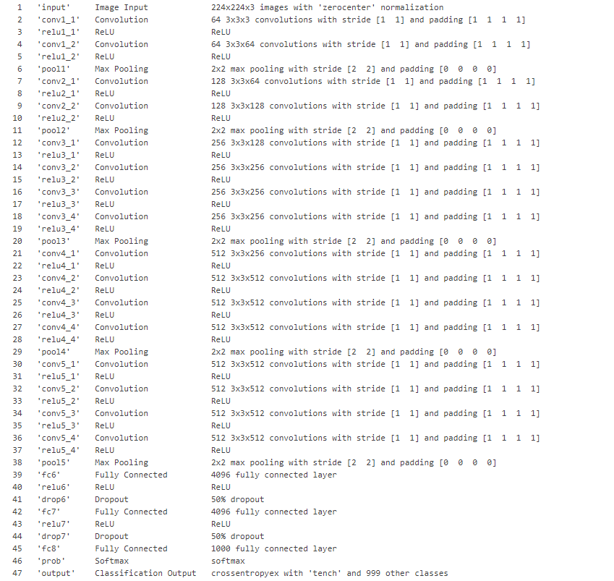

Slide 16
Specifications
In the regular VGG-19 Model we made slight changes, After Convolution and Pooling Operation When the layer is Flattened and fed to a neural network we added a dropout layer after every hidden layer and added L1 and L2 regularization to reduce overfitting and increase the speed of the process.
We then took output of last layer VGG-19 and after Flattening it we compiled it for 21 class output with softmax activation and Adam Optimizer.
Adam(lr=0.0001, beta_1=0.9, beta_2=0.999)
Number of Epochs = 10.

Slide 17

Parallelisation
In general, a distributed training process runs on multiple GPUs or on multiple nodes/machines. There are several techniques to perform distributed training, two of the most popular being data parallelism and model parallelism.
We employed data parallelism, where a single model is replicated but given different subsets of data. For neural networks this means using the same weights but different mini-batches for each processor. Further, the gradients need to be synchronized (concatenated) after each pass through a mini-batch. After every few iterations, all replicas synchronize, either with one another (all-reduce) or via a central server (parameter server). This scales up nicely and yields algorithmic speedup.

Slide 18


Parallelisation
In a multi-GPU setup, it’s often best to synchronously update the model by storing the weights on the CPU DRAM. But in a multi-machine setup, we often use a separate ‘parameter server’ that stores and propagates the weight updates. To run TensorFlow on multiple GPUs, one has to construct the model in a multi-tower fashion where each tower is assigned to a different GPU.
The process of creating a multi-GPU model on Keras/TensorFlow is to divide the inputs and replicate the model into each GPU. One can use CPUs to combine the results of each GPU into one model, with the caveat that the number of GPUs required to run the model must be an even number, as we split the incoming batch into equal chunks for each GPU. We used the TensorFlow implementation using 8 GPUs on a single machine instead of distributed GPUs, which, although it scales nicely, is inefficient at lower orders of magnitude.

Slide 19
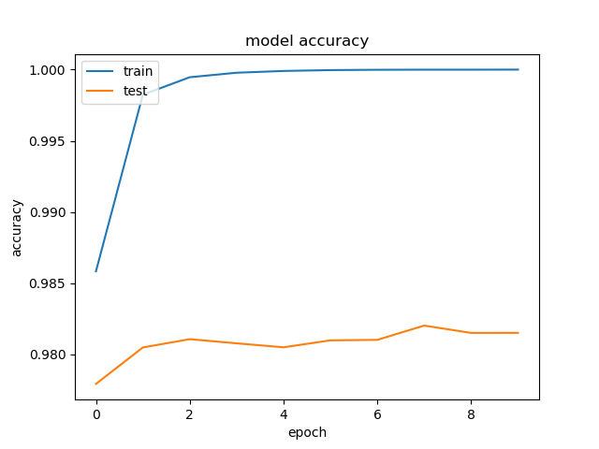
Results
Relative runtimes of parallel and sequential models were measured.
The Model was tested for 10 epochs, with a batch size of 32.
Model Accuracy = 98.15%
On running the model on one CPU sequentially, Sequential Runtime = 7103.0922 s
While running it parallely using TensorFlow, Parallel Runtime = 2209.7746 s
Speed up = 3.2 times

Slide 20
Conclusion
In general, training on a bunch of GPUs in a single machine is much more efficient. Empirically it takes more than 16 distributed GPUs to equal the performance of 8 GPUs in a single machine — but distributed training lets you scale to even larger numbers, and harness more CPU power.
We conclude that training the model using a sequential algorithm took 7103 seconds, whereas upon using multiple GPUs on a single machine yielded an algorithmic speedup of 3.2 times, which gives a runtime of nearly 2209 seconds without affecting model accuracy.

Slide 21
Thank You

