Slide 1
SRET Drift Rates Project

Slide 2
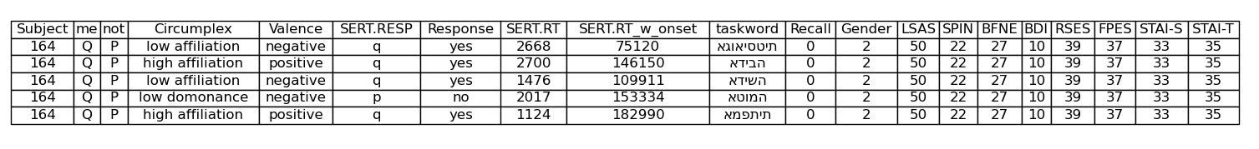
The Dataset
57 Participants
8 Depression/Anxiety Inidicies (Questionnaire Scores)
LSAS
SPIN
FPES
BFNE
BDI
RSES
STAI-S
STAI-T
Social anxiety
Social phobia
Fear of Positive Evaluation
Fear of Negative Evaluation
Depressive symptoms
Global Self Esteem
Current anxiety
Chronic anxiety
Valence (Positive)
Valence (Negative)
Circumplex
(High Affiliation)
Circumplex
(High Dominance)
Circumplex
(Low Affiliation)
Circumplex
(Low Dominance)
48 Adjective Words
Friendly, kind
Assertive, dominant
Cold, distant
Submissive, passive
Response
Reaction Time
Does this word describe me?
In miliseconds
…

Slide 3
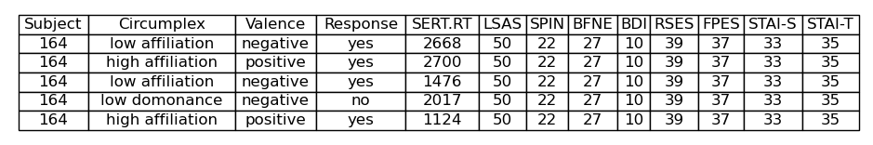
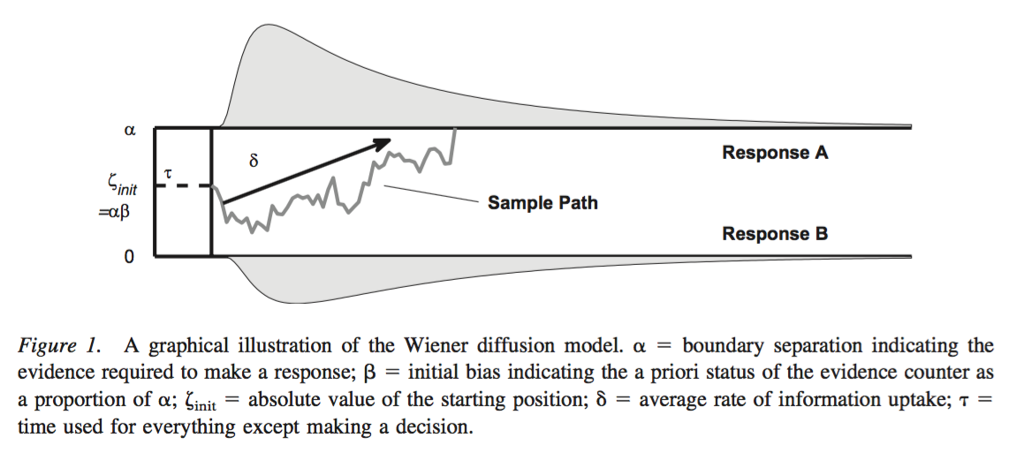
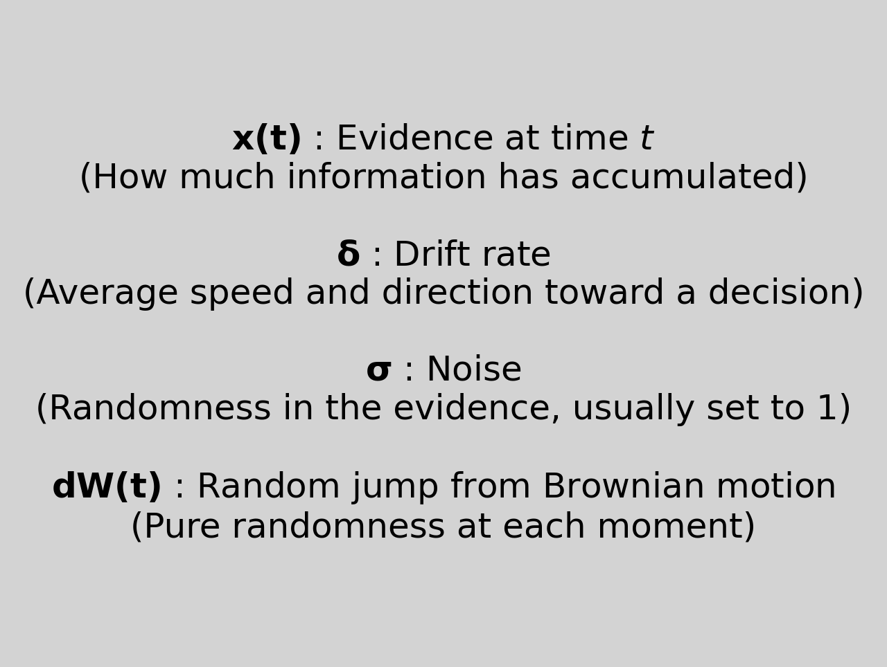

The Model (Theoretically)
Essentially you are taking multiple reactions time and choices within a certain binary response and fitting a drift rate over them.
Drift rates try to model the inferred aspects of a decision made gives outcome and time taken.
There are a few variables in the drift rate model which are calculated:
Drift rate (essentially velocity -speed with direction-)
Boundary separation (how far away the two choices are from each other dimensionally)
Non-decision time
Starting point bias
In this data, we focus only on calculating the drift rate, based on the following:
Vandekerchhove et al, 2010
We assume that the choices people make are not linear and straight forward. We assume that there is some uncertainty in their process to making their decision.
This uncertainty is assumed to follow a normal random distribution (Brownian motion), with the amplitude of that distribution dependent on the noise variable we set.

Slide 4
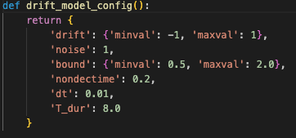
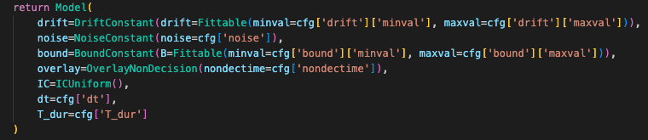
The Model (Applied and Assumptions)
Assumptions and Rationale
Assumption: Each person has different decision boundaries and drift rates for different types of words when it comes to whether or not they think these words refer to them or not.
Application of Assumption: Each participant has a separate model fitted for the 6 word groupings:
Positive
Negative
Positive + High affiliation
Positive + High dominance
Negative + Low affiliation
Negative + Low dominance
DECISION BOUNDARIES
Fitted, set arbitrary to minimum 0.5, maximum 2
DRIFT RATES
Fitted, set arbitrary to minimum -1, maximum 1
STARTING BIAS
Fixed, set to 0
Assumption: Each person starts making their decisions after 200ms (essentially saying that they are getting visually accustomed to the word before they start deciding). This is different to Beevers paper.
Assumption : No starting point bias (everyone has an equal chance of saying yes or no from the outset, irrespective of context). Fixed to 0.
Rationale : Following Beevers paper, the noise is fixed to 1
Rationale : Following Beevers paper, the decision boundaries and drift rates are fitted by the model (the boundaries are arbitrarily chosen)
NON-DECISION TIME
Fixed, set to 0.2
NOISE
Fixed, set to 1

Slide 5
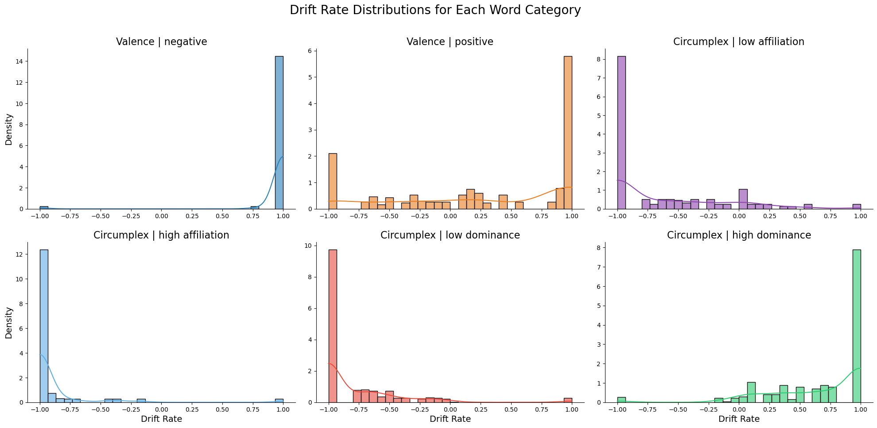
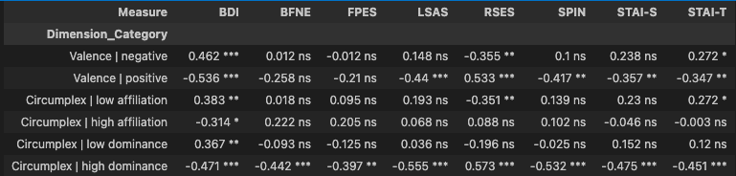
Drift Rate Outcomes
Notes:
It looks like the drift rates are being fitted with a lot of quick decisions from participants, skewing a lot of the drift rates to be at the extremes.
Positive adjectives seem to have a slightly wider spread than the rest.
Notes:
It looks like the scores higher on BDI have a relatively strong correlation with being non-self-referential to positive adjectives. Similarly for scores high in SPIN.
There’s actually a lot to unpick here, interestingly.

