Slide 1
SRET Drift Rates Project

Slide 2
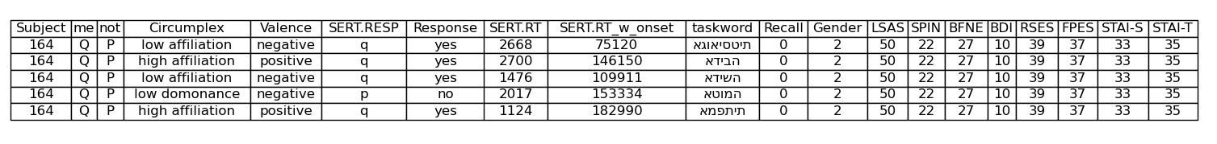
The Dataset
57 Participants
8 Depression/Anxiety Inidicies (Questionnaire Scores)
LSAS
SPIN
FPES
BFNE
BDI
RSES
STAI-S
STAI-T
Social anxiety
Social phobia
Fear of Positive Evaluation
Fear of Negative Evaluation
Depressive symptoms
Global Self Esteem
Current anxiety
Chronic anxiety
Social phobia
Valence (Positive)
Valence (Negative)
Postive adjectives
Negative adjectives
Circumplex
(High Affiliation)
Circumplex
(High Dominance)
Circumplex
(Low Affiliation)
Circumplex
(Low Dominance)
48 Adjective Words
Friendly, kind
Assertive, dominant
Cold, distant
Submissive, passive
Response
Reaction Time
Does this word describe me?
In miliseconds
…

Slide 3
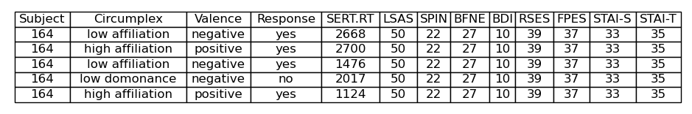
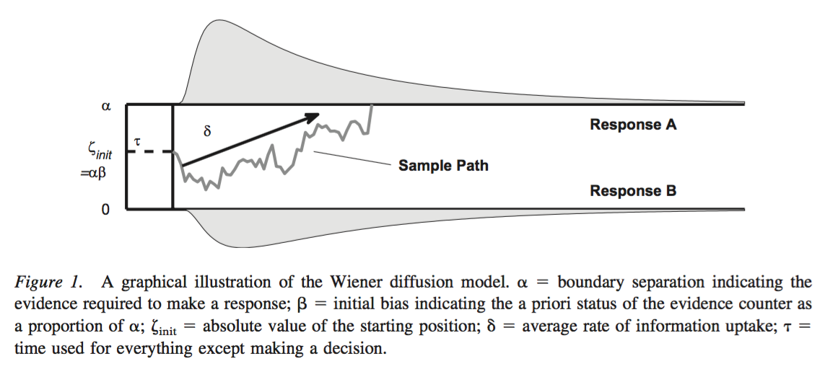
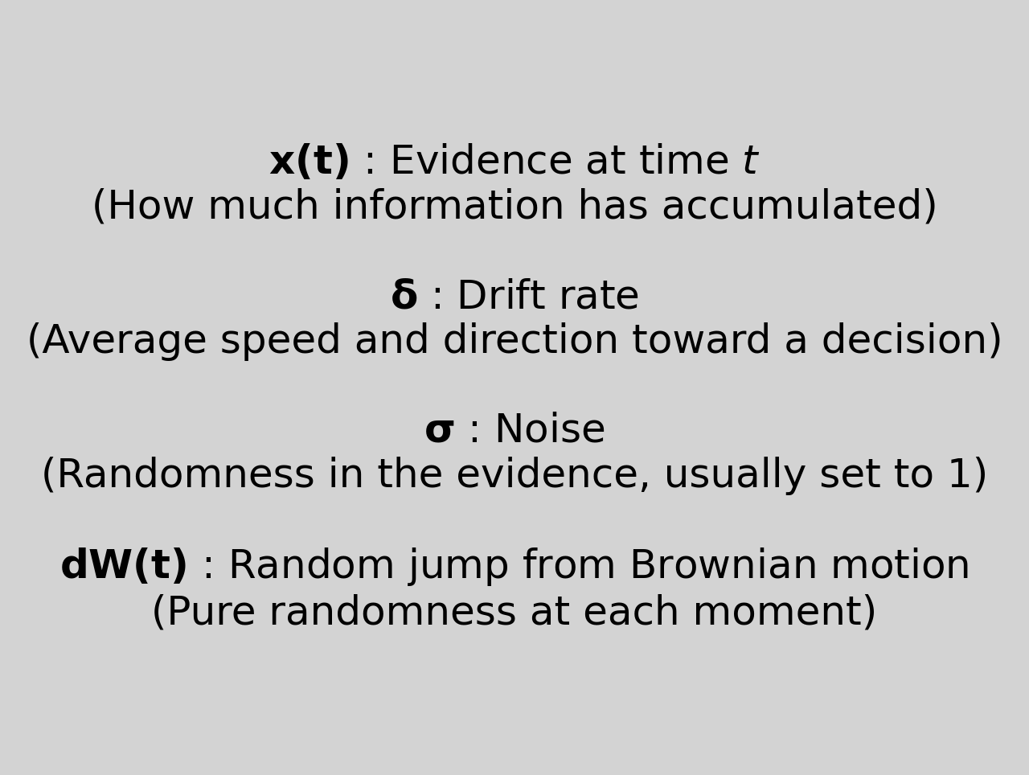

The Model (Theoretically)
Essentially you are taking multiple reactions time and choices within a certain binary response and fitting a drift rate over them.
There are a few variables in the drift rate model which are calculated:
Drift rate (essentially velocity -speed with direction-)
Boundary separation (how far away the two choices are from each other dimensionally)
Non-decision time
Starting point bias
In this data, we focus only on calculating the drift rate, based on the following:
Vandekerchhove et al, 2010

Slide 4
The Model (Applied and Assumptions)

Slide 5
Drift Rate Outcomes

