Slide 1
Do people with depression and anxiety think about themselves in different ways; can we figure out how?

Slide 2
Process
1
2
3
4
5
Evaluation, comparison to previous findings and conclusions
Operationalisation / measurement of behaviour
What pattern is our data showing?
What model is most appropriate to fit?
Do we need a different modelling approach?
Creation of new model
6
3a
3b
3c
Are the patterns we found consistent with those reported in earlier research?
What model parameters have been found previously?
Do the model parameters found predict/fit the actual data well?

Slide 3
Why this issue is worth looking into
Reasoning why this issue might be important to look into based on the amount of people who might suffer with anxiety and depression, and what ways we currently have to treat it and to identify it. There is an assumption of thinking of spectrum rather than a classification which comes into play here. Look at the answer of the question based on previous findings and put it here, so we can move on to a deeper questin in the next slide.
1
Operationalisation / measurement of behaviour

Slide 4
What kind of measurements can we take to accurately depict ‘self-perception’?
Talk about the SRET task and why and how its been used before
What kind of measurements can we take to accurately depict individual differences?
Talk about the clinical indices of depression and anxiety
1
Operationalisation / measurement of behaviour

Slide 5


The Set-Up
Participants go through 8 questionnaires which are indices for depression and anxiety
8 Depression/Anxiety Inidicies (Questionnaire Scores)
LSAS
SPIN
FPES
BFNE
BDI
RSES
STAI-S
STAI-T
--------------------------------------------------
Social anxiety
Social phobia
Fear of Positive Evaluation
Fear of Negative Evaluation
Depressive symptoms
Global Self Esteem
Current anxiety
Chronic anxiety
High Dominance (Positive)
Participants then are shown a word on a screen and are given a binary choice: does the word fit the self-perception of the participant or not?
The Model (based on previous findings) :
Findings have shown that changes in the dominance and affiliation spectrum affect SAD and depressed individual differently.
Possible model:
↑Depression = ↑ Negative Valence, ↓ Positive Valence
↑ SAD = ↑ Low Dominance, ↓ High Dominance
↑ Depression, ↑ SAD = ↑ Low Dominance, ↑ Low Affiliation, ↑ Negative Valence
SAD individuals more likely to endorse low-dominance and less likely to endorse high-dominance words (Gilboa-Schechtman et al, 2019)
When depression and SAD co-occurring, individuals more likely to endorse negative, low affiliation words and less likely to endorse positive-valence words.
Assertive
Can add a visual of where we have found people to be at on this graph
Dominant
SAD
Depression
Low Affiliation (Negative)
Distant
High Affiliation (Positive)
Kind
Cold
Friendly
SAD
Depression
There are 48 words split into domains, and axes which can be defined by:
Social Affiliation
Social Dominance
Valence
Passive
SAD
Submissive
Depression
Low Dominance (Negative)
Notes:
To set up understanding of what data is gathered and the experiment itself, we have 57 participants, who each answered 8 questionnaires that give scores for indices in reference to aspects of depression and anxiety. The participants were then shown adjectives on a screen, which they then had to classify as words which they would assign to themselves, or words that they would not assign to themselves.
The words themselves have been assorted as can be seen in the graphs above, where scaling of the valence (whether a word was positive or negative), affiliation (whether a word was relating to warmth and friendliness or not) and dominance (whether a word was refering to a high social standing or a lower one).

Slide 6
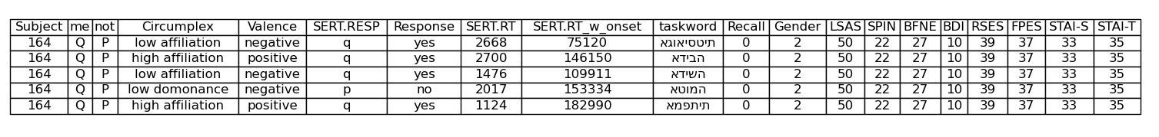
The Dataset Outputs
57 Participants
8 Depression/Anxiety Inidicies (Questionnaire Scores)
48 Adjective Words
Response
Reaction Time
Does this word describe me?
In miliseconds
Circumplex : Dominance or Affiliation
Valence : Negative or Positive
…
Notes:
This left us with a dataset that looked a little like this, whether the valence or the positive/ negative nature of an adjective interplayed with the circumplex (so dominance or affiliation). The self-referrential response of ‘yes’ or ‘no’ was also gather, the response time, and of course the score on the indices. The response time here refers to the time between the stimulus being shown on the screen and the click of the button of the keyboard that referred to either yes or no.

Slide 7
Is it the content of what we believe about ourselves or the process of how we decide that best reflects the impact of depression and anxiety?
Social Dominance – Social Affiliation Model
f( , )
Clinical Spectrums
Observed Behaviour
=
is there enough evidence to suggest a need for an extra dimension of modelling?
Clinical Spectrums
Social Dominance – Social Affiliation Model
Decision Making Model
Observed Behaviour
f( , , )
=

Slide 8
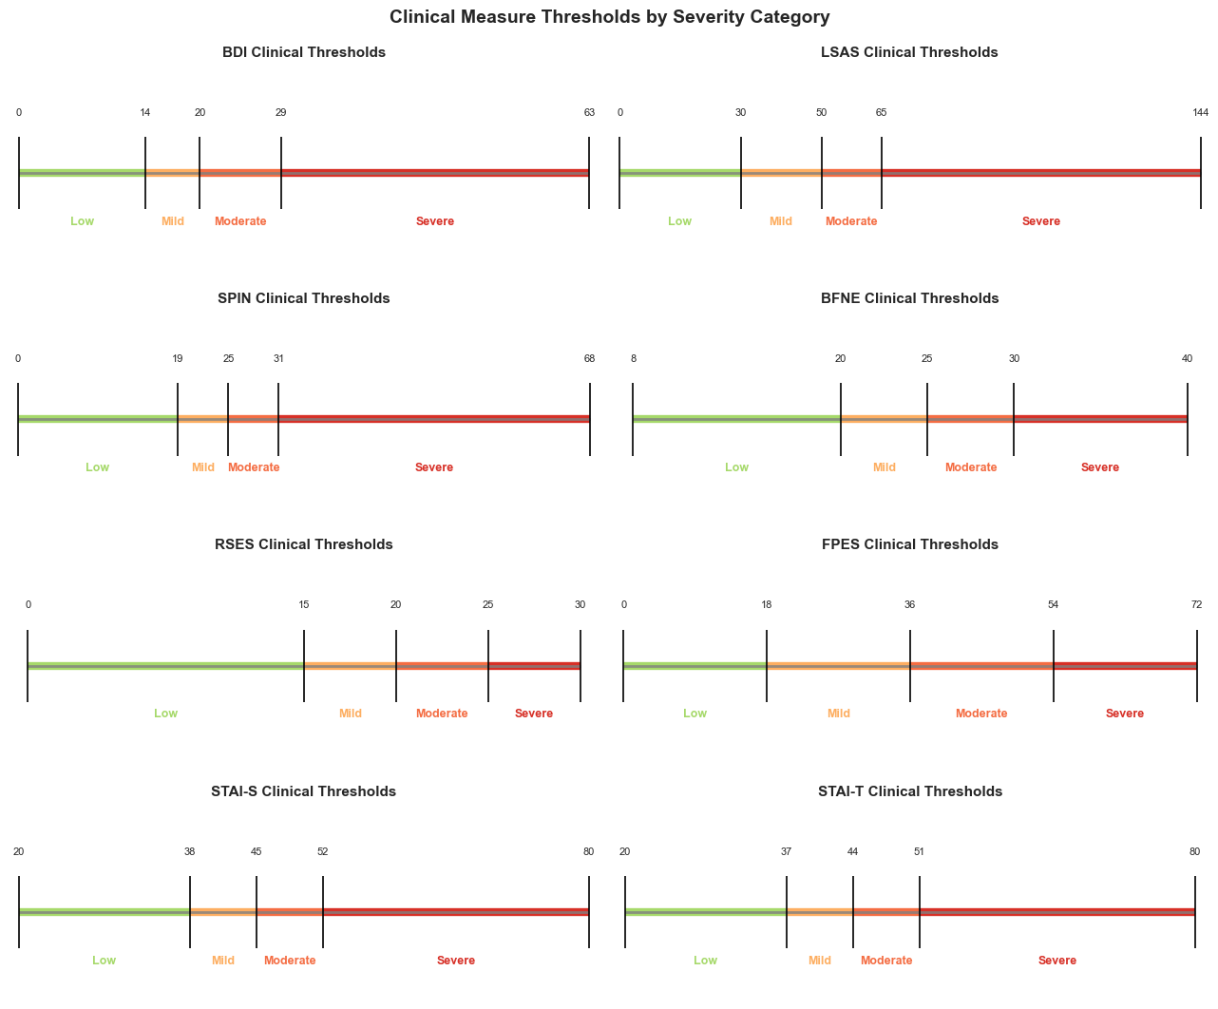
Here I am just setting up the scene for thresholds for later visualisations
2
What pattern is our data showing?

Slide 9
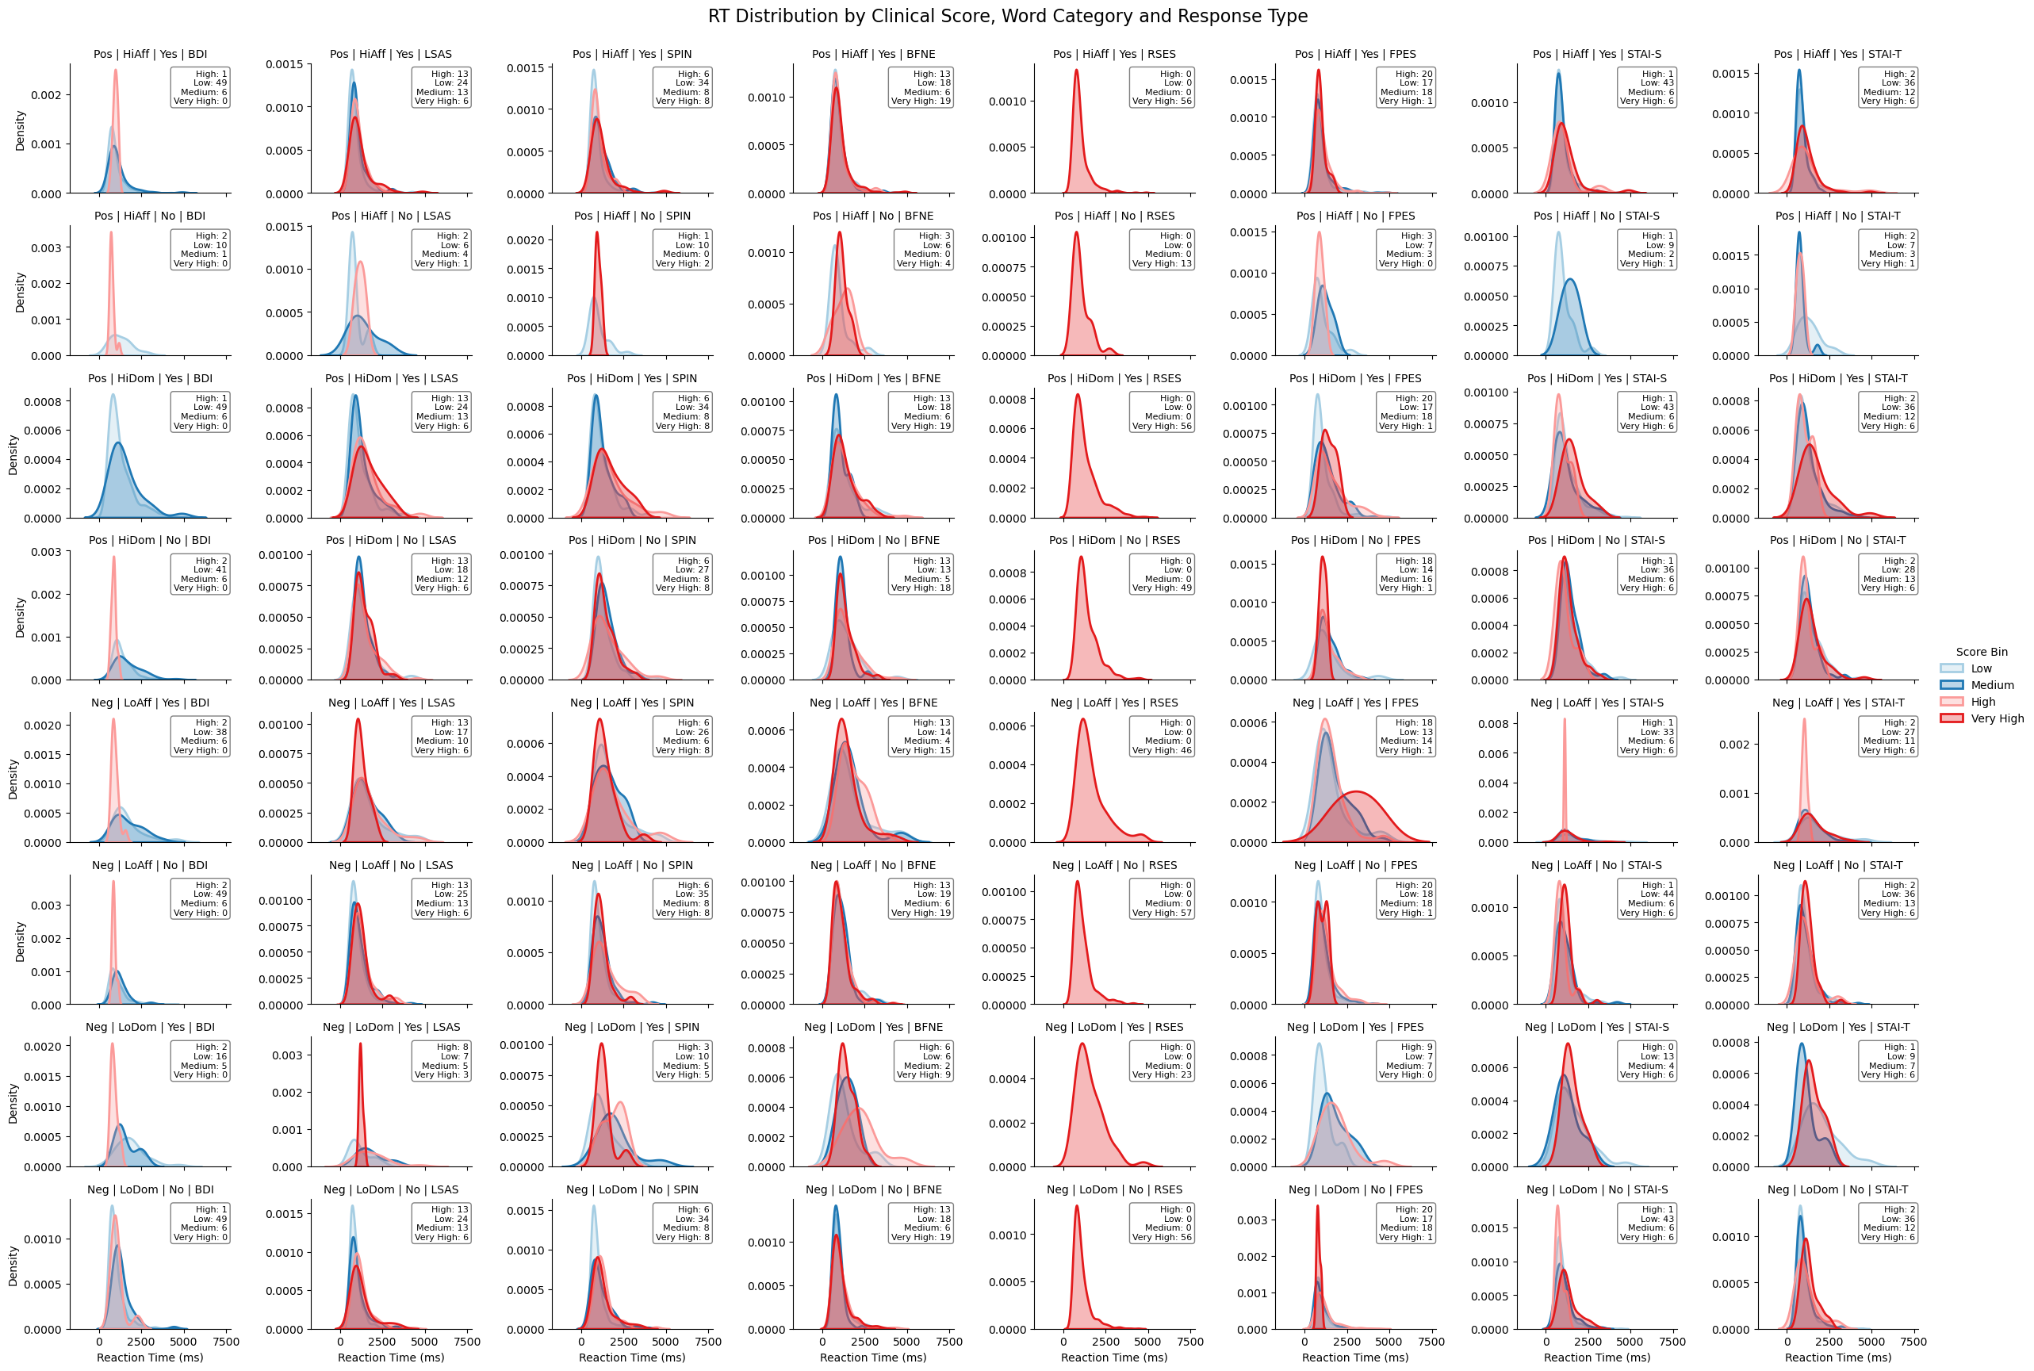
Reaction Score Distributions on a Granular Level
BDI
LSAS
SPIN
BFNE
RSES
FPES
STAI-S
STAI-T
High Affiliation
High Affiliation
High Dominance
High Dominance
Low Affiliation
Low Affiliation
Low Dominance
Low Dominance

Slide 10
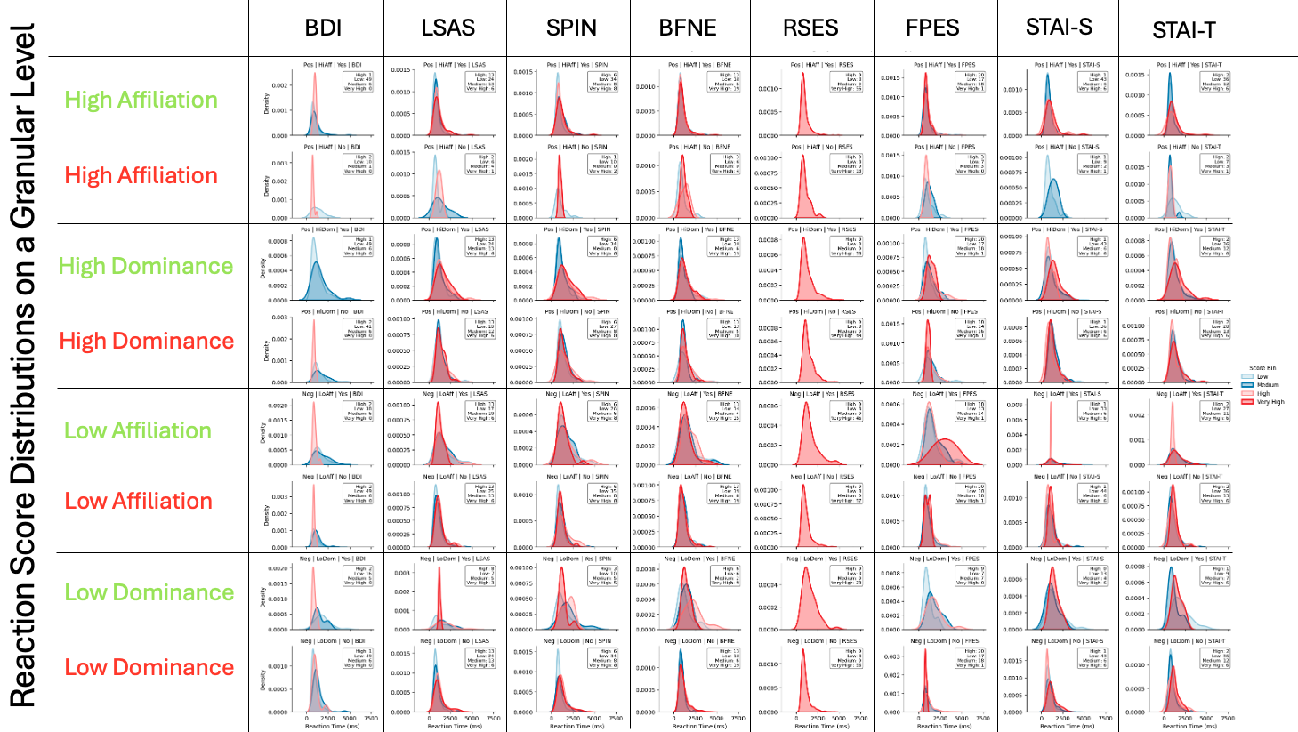
EDA Conlusions 1
There may not be enough variance within RSES to warrant keeping it as a measure.
Higher BDI seems to correspond to less variation and faster response times across all scenarios, apart from responding positively to high dominance (Where there are no responses for individuals with a higher BDI).
Seems like there are barely any participants who score higher on anxious traits which also say no to high affiliation. This is surprising, however highlights that it is the dominance circumplex which socially anxious individuals are more sensitive to. However, affirmative responses to low affiliation traits are very concentrated in high-scoring anxious individuals, signalling an a dichotomy?
2
What pattern is our data showing?

Slide 11
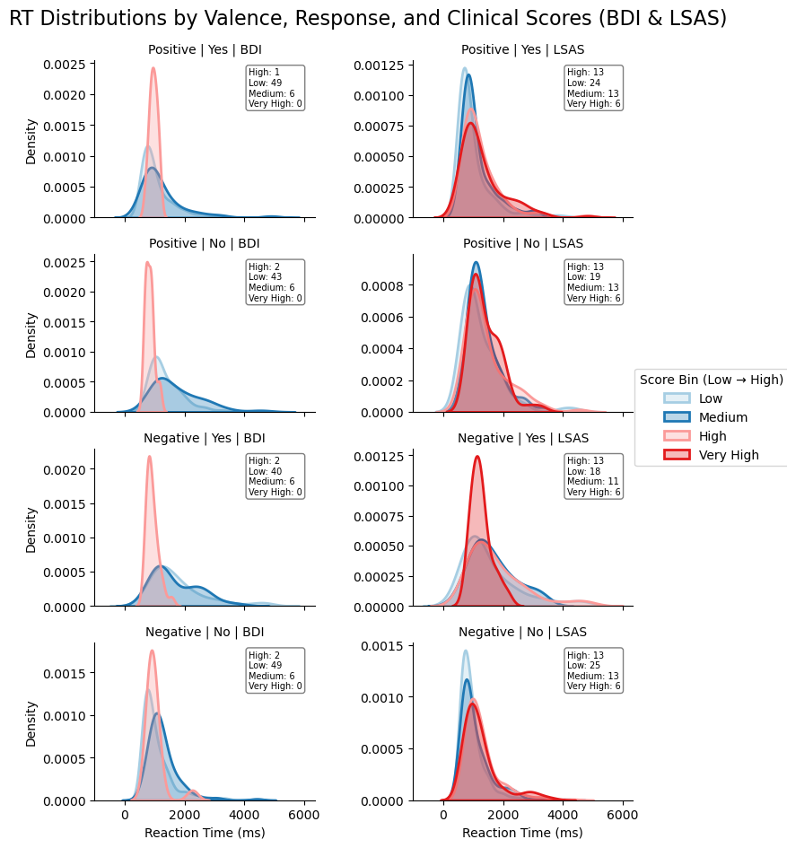
Reaction Times separated by Valence for BDI and LSAS
BDI
LSAS
Postive
State something about these comparisons you hace created. Are they saying something that we have already found in other paper’s conclusions about the valence of words and their effect on depression and anxiety?
Postive
Negative
2
What pattern is our data showing?
Negative

Slide 12
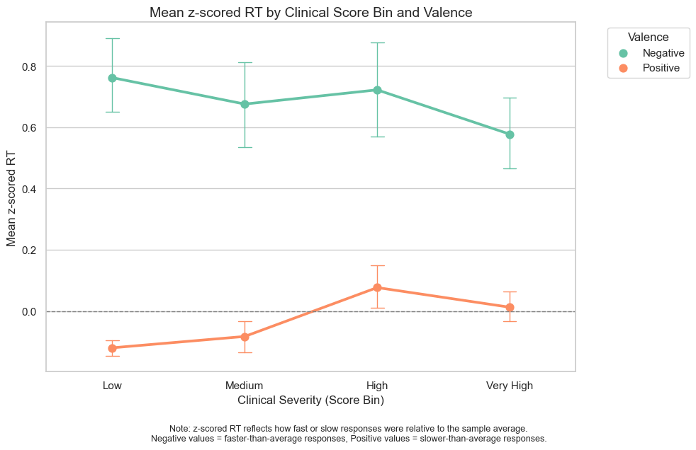
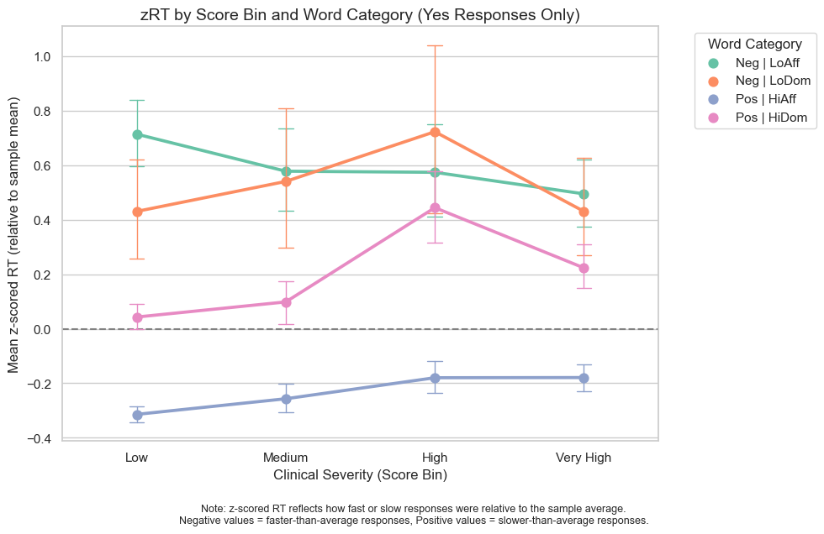
EDA Conlusions 2
Is there a linear relationship between clinical severity and reaction times (for ‘yes’ responses), with valence distinctions?
Is there a linear relationship between clinical severity and reaction times (for ’yes’ responses) , with more precise word category distinctions?
2
What pattern is our data showing?
No
No

Slide 13
Social Dominance – Social Affiliation Model
f( , )
Clinical Spectrums
Observed Behaviour
=
?
Clinical Spectrums
Social Dominance – Social Affiliation Model
Decision Making Model
Observed Behaviour
f( , , )
=
3
What model is most appropriate to fit?

Slide 14
Struggling with this, since words do not have variation of dominance and affiliation as ground truths on a spectrum.
Vectorized understanding / mathematical modelling of Valence as affiliation and dominance?

Slide 15
Underlying Cognitive Process
the individual (their psychological profile) the stimulus (type of self-refential adjective) the decision-making process itself.
{
We want to understand how this interaction works by modelling it
Why?
Don’t necessarily need this part
Clinical Spectrums
Social Dominance – Social Affiliation Model
Decision Making Model
Observed Behaviour
f( , , )
• Make changes in therapy solutions to support individuals better. • Potentially have more preventative solutions based on realitic models of prediction.
=
Theoretically How?
Restructure this to make it more simplistic from the beginning. Why are we trying to model? We are trying to model in order to introduce an understanding about underlying cognitive abilities etc.
We build on prior research that models each component independently:
• Individual Differences Modelled along the clinical spectrum of Social Anxiety Disorder (SAD) and Depression, using questionnaire scores and symptom indices.
• Stimulus Differences Based on the Social Dominance–Social Affiliation framework, which classifies words in the Self-Referential Encoding Task (SRET).
• Decision-Making Process Captured using the Drift Diffusion Model (DDM), which quantifies how decisions unfold over time.
Technically How?
3
What model is most appropriate to fit?
• We control two of the models and fit the third. We control the Individual Differences and Stimulus Differences, and fit parameters of the Decision-Making Process to understand how these models contribute jointly to self-referential decision-making.
• The outputs can then guide the development of ensemble methods that combine the separate models into a unified framework representing real-world complexity.

Slide 16
How have we tried to model it before?
Looking into other models, not just the drift rate model. Although this is the most popular, there should be a rationale built around why it has been selected logically.
3
What model is most appropriate to fit?

Slide 17
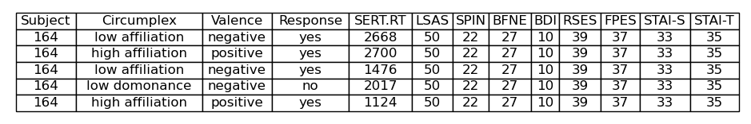
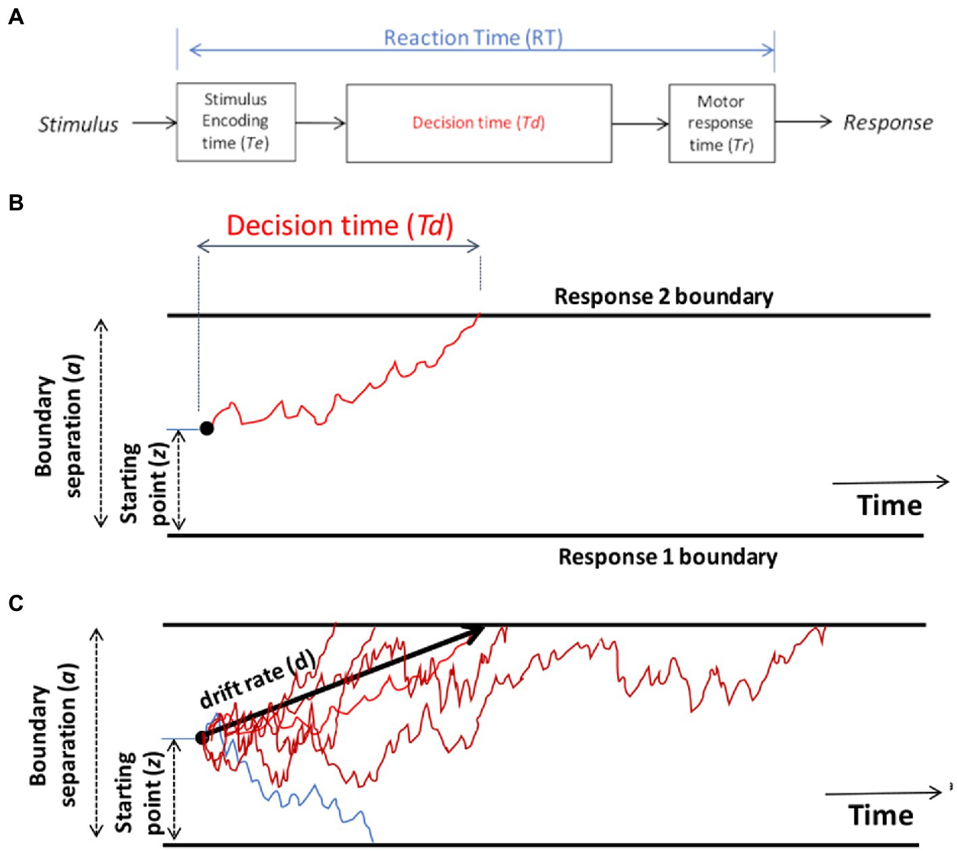
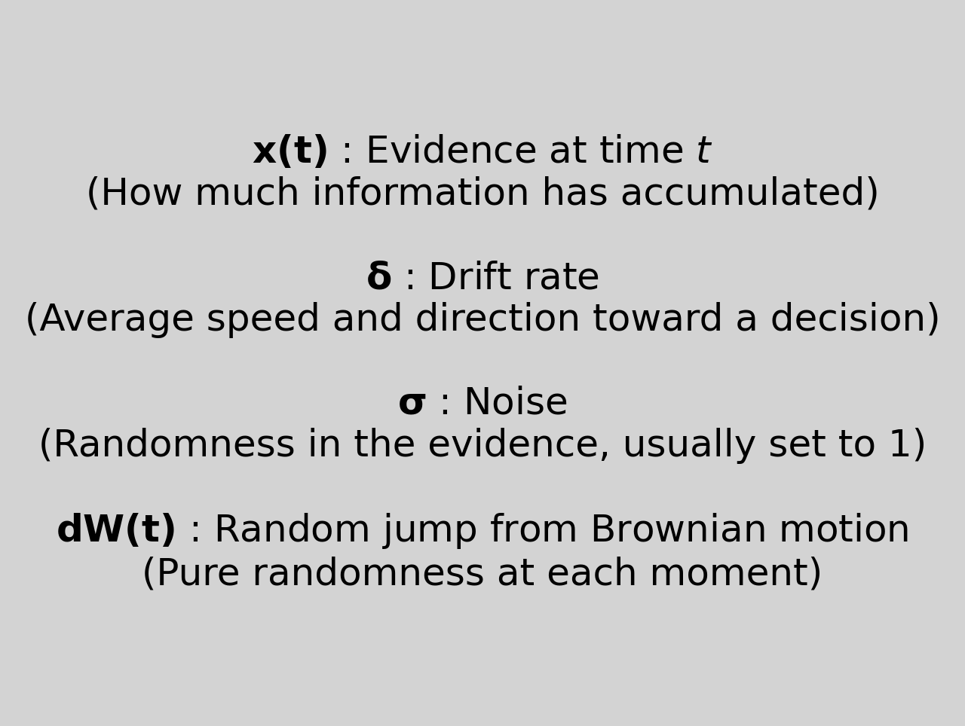

The Model (Theoretically)
multiple reactions time and choices within a certain binary response.
The Drift Rate Model is part of sequential sampling modelling. It works on the assumption that we do not make decisions instantaneously, but gathering information over time before making a decision. Using this assumption, it fits the following parameters:
Drift rate
Boundary separation
Non-decision time
Starting point bias
An average of the decision velocity, over trials, given stochastic information accumulation. In this case the information accumulation is assumed to be mental.
Models the Speed / Accuracy trade-off in decision making.
The time taken to encode information, as well as time taken to produce motor reaction.
Bias towards or against a certain binary decision
Myers, Interian and Moustafa, 2022
In modelling decision-making, we assume that choices are not made instantly or deterministically. Instead, individuals accumulate evidence over time until they reach a decision threshold.
This process includes uncertainty, which we model as random noise (Brownian motion). The amount of noise determines how variable this evidence accumulation is across time and trials. In our case, we assume the Brownian noise comes from stochastic neural firing as the evidence to support a decision is accumulated during the decision time.

Slide 18
Power analysis for the number of participants needed?
Or as shown in other papers, an understanding of how many ppts needed in each model depending on the amount of free parameters

Slide 19
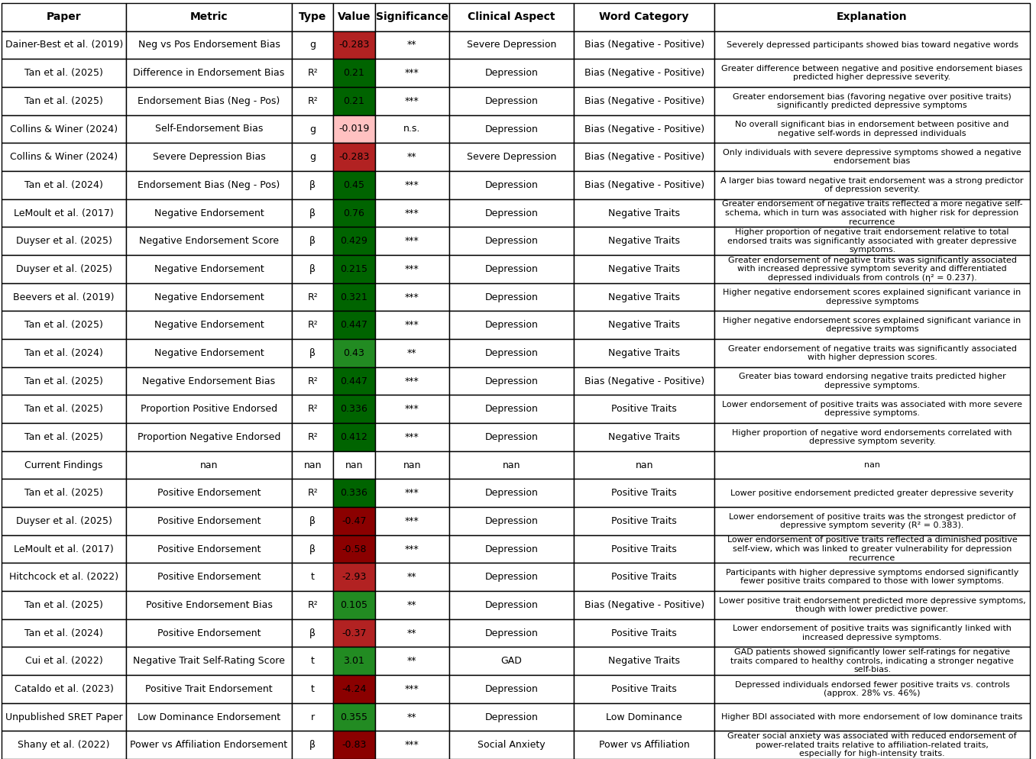
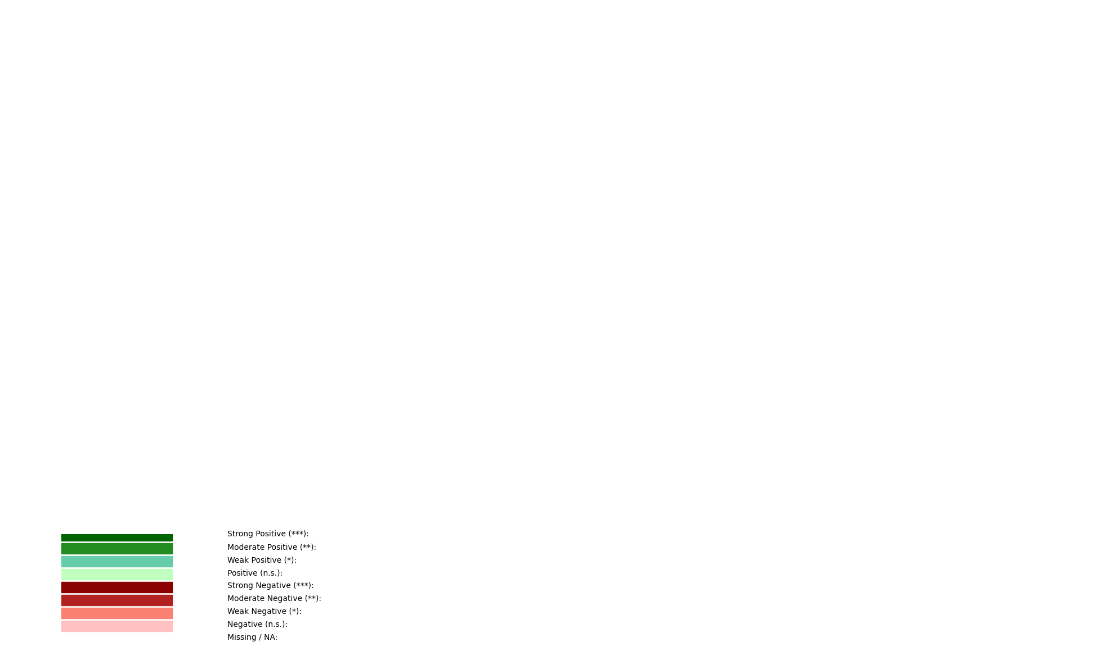
Back-
ground 1
3a
Are the patterns we found consistent with those reported in earlier research?
Looking at just the findings of reactions times across depression and anxiety indices. ”How consistent are endorsement bias metrics across studies examining depression-related language patterns?”
***Need to fix up these graphs

Slide 20
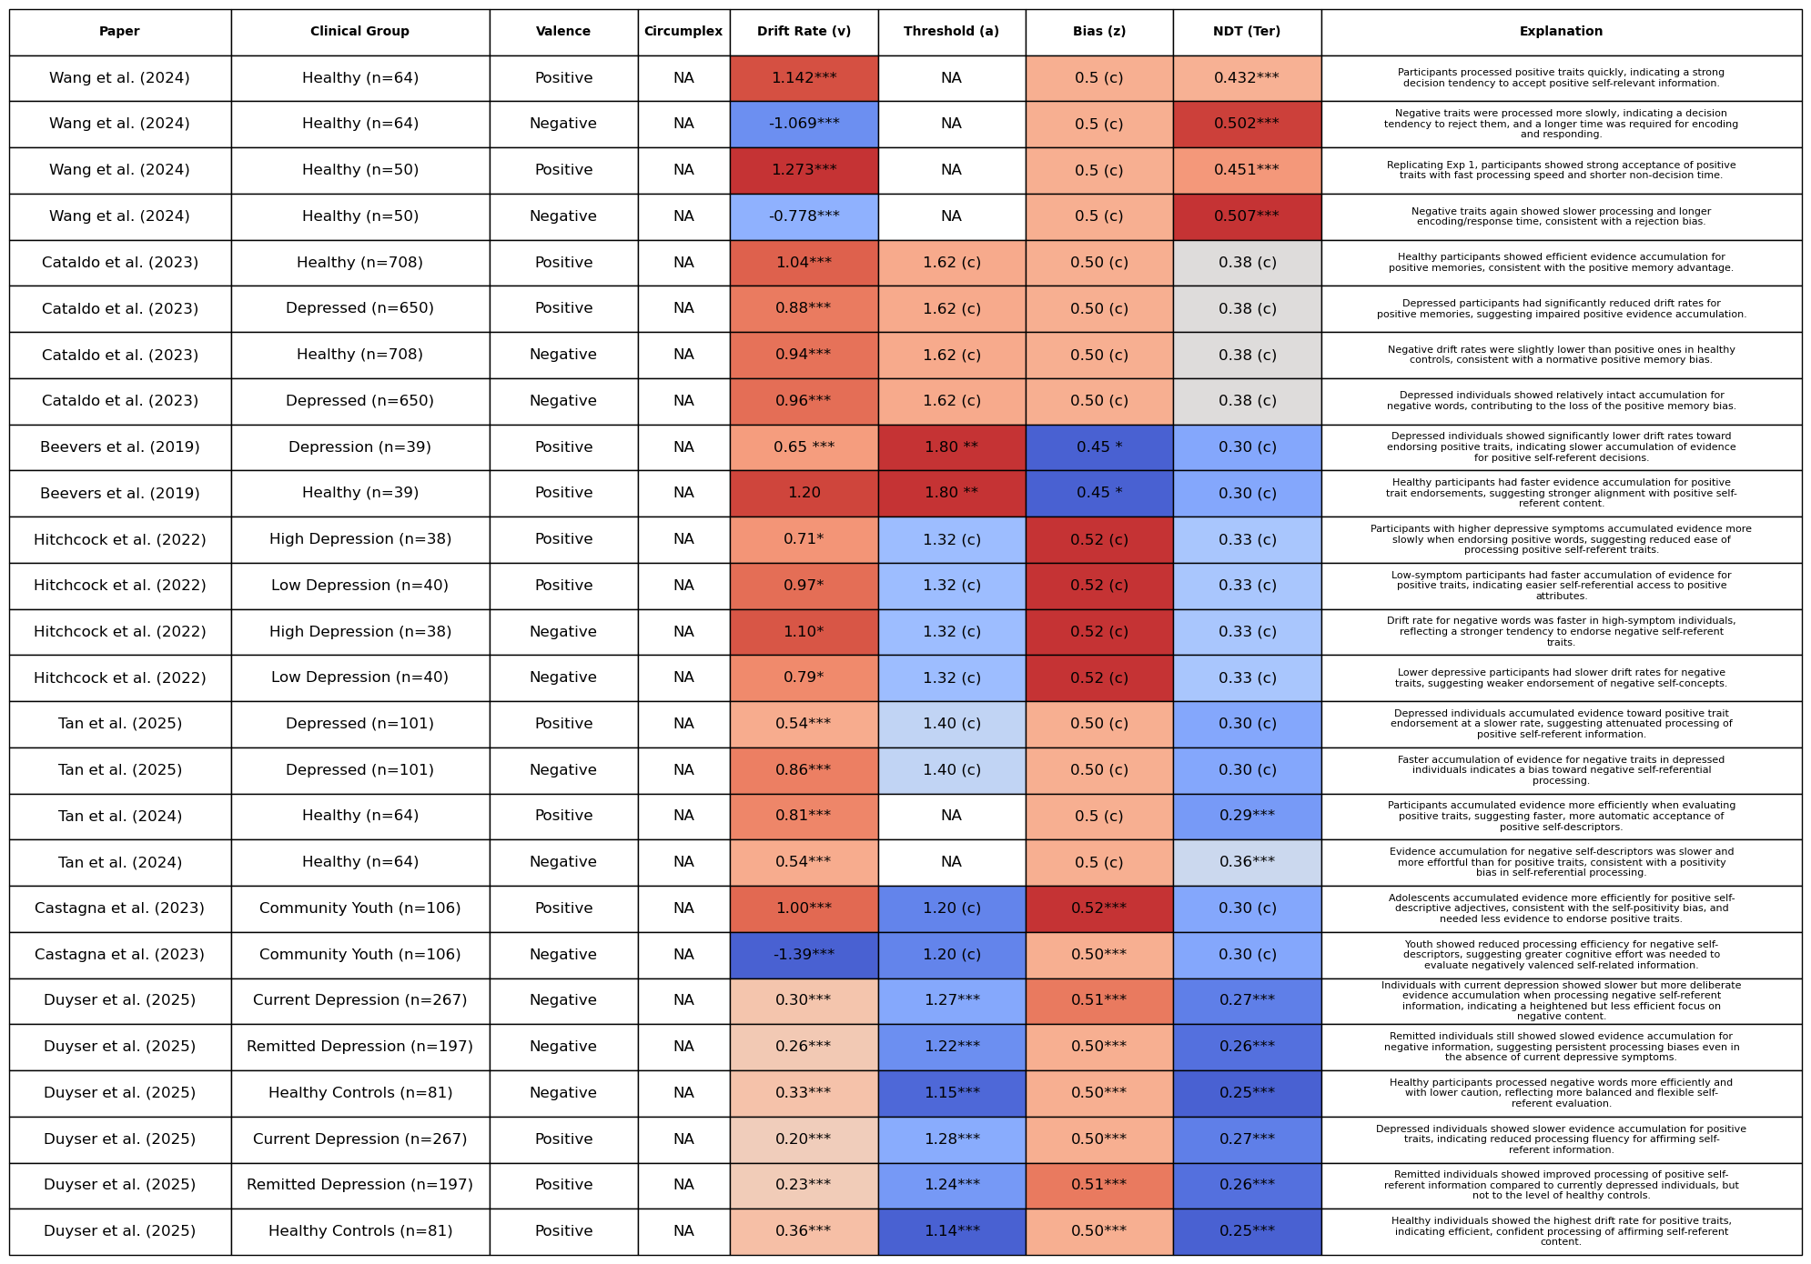
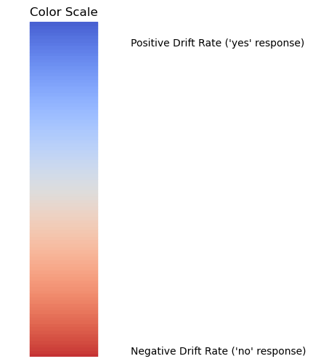
Back-
ground 2
3b
What model parameters have been found previously?
Looking at the drift model parameters across depression and anxiety indices.
***Need to fix up these graphs

Slide 21
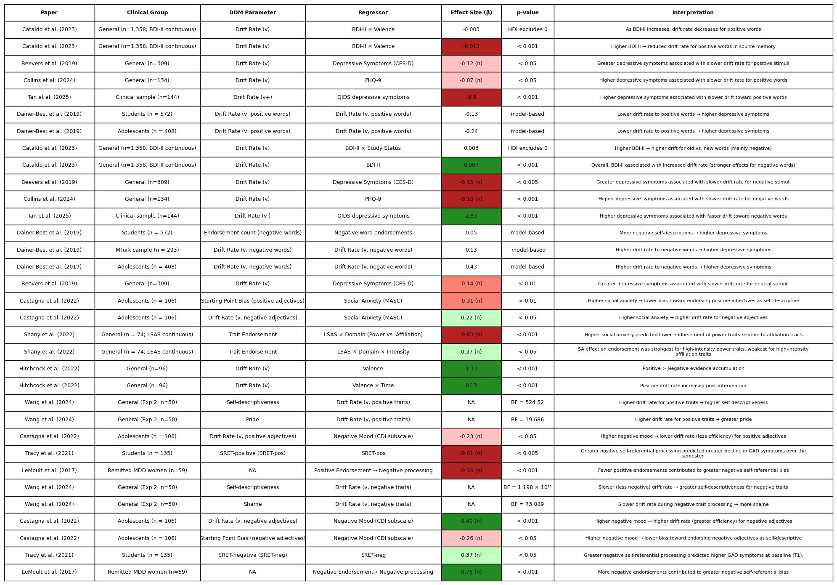
Back-
ground 3
3c
Do the model parameters found predict/fit the actual data well?

Slide 22
Expectations
Here, based on the parameters in the background, I want to create a model. Then I want to output data based on that model (fake data of reaction times and choices based on what the model would predict)
Then I want to cross compare the fake data to the real data. “Is our current model representative of the data we gathered, or do we need further exploration?”
TO DO:
Create a hardcoded model of these priors, and predict data based on this.
Compare outputs of the model to the actual data we have.
4
Do we need a different modelling approach?

Slide 23
TO DO:
Create a hardcoded model of these priors, and predict data based on this.
Compare outputs of the model to the actual data we have.

Slide 24
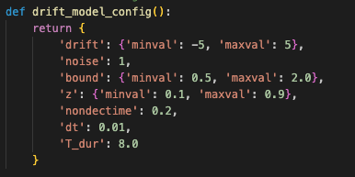
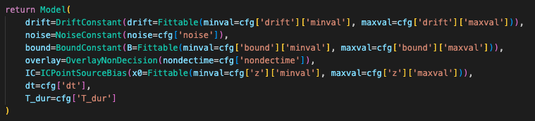
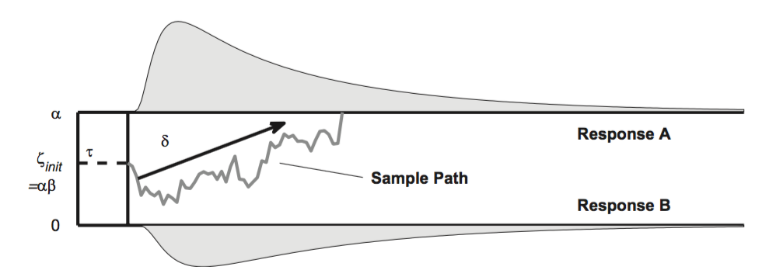
The Model (Applied and Assumptions)
TO DO:
Do a power analysis to figure out how many samples are needed in order to gain a high enough effect
Do an explained variance analysis on the amount of parameters which are being fitted in order to see what is the minimum needed
Look into coding a hierarchical ddm with bayesian inference
Assumptions and Rationale
Assumption: Each person has different decision boundaries and drift rates for different types of words when it comes to whether or not they think these words refer to them or not.
Application of Assumption: Each participant has a separate model fitted for the 6 word groupings:
Positive (24)
Negative (24)
High affiliation (12)
High dominance (12)
Low affiliation (12)
Low dominance (12)
DECISION BOUNDARIES
Fitted, set arbitrary to minimum 0.5, maximum 2
DRIFT RATES
Fitted, set arbitrary to minimum -5, maximum 5
STARTING BIAS
Fitted, set to minimum 0, maximum 1
Assumption: Each person starts making their decisions after 200ms (essentially saying that they are getting visually accustomed to the word before they start deciding as well as taking into account motor reaction time). This is standard according to Myers, Interian and Moustafa (2022).
Assumption : Fitting starting point bias between 0 and 1 as a coefficient of the decision boundary. This assumes that everyone can be equally fitted (however in a more complex model, we would build on this to incorporate assumptions of biases that have been found in certain clinical population more than others). This is standard according to Myers, Interian and Moustafa (2022).
Rationale : Following Beevers et al (2019) paper, the noise is fixed to 1. This is also standard according to Myers, Interian and Moustafa (2022).
Rationale : Following Beevers et al (2019) paper, the decision boundaries and drift rates are fitted by the model (the boundaries are chosen according to the standardisations proposed by Myers, Interian and Moustafa (2022). )
5
NON-DECISION TIME
Fixed, set to 0.2
NOISE
Fixed, set to 1
Creation of new model
Notes:
In the case of the data gathered, and the model which is coded-up that has outputted the drift rates and correlations that will be seen in the next slide, these are the configurations and assumptions that we have applied: Since the dataset is quite small, I have tried to limit the amount of parameters that need to be fitted, so that outliers do not skew the fittings. I’ve assumed that there is no starting bias for any of the participants, irrespective of how they score on the clinical indices and the categorisation of the words they see. I have also set the non-decision time to 0.2, to state that it takes at least 0.2 seconds for the person to actually percieve the word that is on the screen before the decision time starts. I have also set the gaussian noise of the decision path to 1, which is standard. What is fitted are the alpha and delta variables: the decision boundaries and the drift rates. This means that the thresholds at which a participant may respond ‘yes’ to a word may differ, one person may have a low threshold for saying yes than another. This interplays with the drift rate (which is between 1 and -1).
Finally, when fitting the model, there is a different model (with different threshold and dirft rate assumptions) for each category of word per person. (Assuming that a person will have the same threshold of choice, for example, for words that are all low dominance and negative, but may have a different threshold for words that have high dominance and positive). (6 words per category)

Slide 25
Drift Rate Outcomes
5
Creation of new model
Correlations

Slide 26
Decision Boundary Outcomes
5
Creation of new model
Correlations
Notes:
Notes from meeting with Eva: - Highlight what we are trying to do?
We are trying to model how people are thinking about themselves
What have people done and build up a theory of that to come up with WHAT WE WOULD EXPECT
Basically look into the literature and at the difference found.
Focus on the interpretability of the results. Do we want the starting bias as fixed?
Directly compare to outputs that Beevers got
Interpretability of graphs
Meaningful group difference (affiliation high to dominance high)
Make sure you understand exactly what the categories of the adjectives MEAN
What did Beevers set his priors to?
Change wording categories on the slides
There should be more recent papers than Beevers to tell us more about the fittings
Statistical analyses : Find out the lower bounds of how many words in each category would be optimal (amount of information needed?)
Do the decision boundaries (alpha) tell us about the amount of information needed? Can this be linked to entropy?
Since we have the data on recall, can we do some kind of correlation analysis or looking more into it?
Look into Beevers paper and previous papers to see their distributions in the beta and alpha parameters. What do they do?
Read over papers that Dan will send which will tell us more about affiliation and social rank.

Slide 27
Evaluation of Model)
TO DO:
SIM check, WAIC, Posterior fit
Adding recall to models to identify accuracy
Memory bias vs decision bias?
Accuracy
MLE
Baysian
Explained Variance for different amount of controlled parameters
Recall (Higher drift rate for higher recall accuracy?) (Some papers have done this already, so can model evluation techniques based on them)
Evaluation, comparison to previous findings and conclusions
6

Slide 28
Comparison of model outputs
TO DO:
- Cross-paper comparison of model fitting
Evaluation, comparison to previous findings and conclusions
6

