Slide 1
Hudup – A Framework of E-commercial Recommendation Algorithms
Prof. Loc Nguyen PhD, MD, MBA
Sunflower Soft Company, Vietnam
Email: ng_phloc@yahoo.com
Homepage: www.locnguyen.net

Slide 2
Abstract
Recommendation algorithm is very important to e-commercial websites when it can provide favorite products to online customers, which results out an increase in sale revenue. I propose the infrastructure for e-commercial recommendation solutions. It is a middleware framework of e-commercial recommendation software, which supports scientists and software developers to build up their own recommendation algorithms with low cost, high achievement and fast speed. This report is a full description of proposed framework, which begins with general architectures and then concentrates on programming classes. Finally, a tutorial will help readers to comprehend the framework.

Slide 3
Table of contents
Introduction
General description
Core classes and interfaces
Tutorial on Hudup
Conclusions

Slide 4
1. Introduction
You need to develop a recommendation solution for online-sale website. You, a scientist, invent a new algorithm after researching many years. Your solution is excellent and very useful and so you are very excited but:
You cope with complicated computations when analyzing big data and there are a variety of heterogeneous models in recommendation study.
It is impossible for you to evaluate your algorithm according to standard metrics.
There is no simulation environment or simulator for you to test feasibility of your algorithm.

Slide 5
1. Introduction
The innovative product Hudup supports you to solve perfectly three difficulties above and so following are your achievements:
Realizing your solution is very fast and easy.
Evaluating your solution according to standard metrics by the best way.
Determining feasibility of your algorithm in real-time applications.
Hudup proposes three solution stages for developing a recommendation algorithm:
Base stage builds up algorithm model and data model to help you to create new software with lowest cost.
Evaluation stage builds up evaluation metrics and algorithm evaluator to help you to assess your own algorithm.
Simulation stage builds up recommendation server (simulator), which helps you to test feasibility of your algorithm.
Moreover, Hudup has another preeminent function which is to provide two optimized algorithms so that it is convenient for you to assess and compare different solutions.

Slide 6
1. Introduction
There are now some open source softwares similar to my product, as follows:
Carleton (Lew and Sowell, 2007) is developed by Carleton College, Minnesota, USA. The significant feature of Carleton is to recommend courses to student based on their school reports. The schema of programming classes in Carleton is clear.
Cofi (Lemire, 2003) simply implements and evaluates some recommendation algorithms. It is written by Java language and it works on various platforms. This is the strong point of Cofi.
Colfi (Brozovsky, 2006) is developed by Professor Lukas Brozovsky, Charles University in Prague, Czech Republic. The recommendation server is simple and aims to research purposes. The prominent aspect of Colfi is to support dating service via client-server interaction.
Crab (Caraciolo et al., 2011) is recommendation server, developed at Muricoca Labs. The strong point of Crab is to build up a recommendation engine inside the server along with algorithm evaluation mechanism. Most of built-in algorithms are SVD algorithm and nearest-neighbor algorithms.
Duine (Telematica-Instituut, 2007) is developed by Telematica Institute, Novay. This is really a solid recommendation framework. Its architecture is very powerful and flexible. The strong point of Duine is to improve performance of recommendation engine.
easyrec (Smart-Agent-Technologies, 2013) is developed by IntelliJ IDEA and Research Studios Austria, Forschungsgesellschaft mbH. Strong points of easyrec are convenience in use, supporting consultancy via internet, and allowing users to embed recommendation engine into a website in order to call functions of easyrec from such website.
GraphLab (Dato-Team, 2013) is a multi-functional toolkit which supports collaborative filtering, clustering, computer vision, graph analysis, etc. It is sponsored by Office of Naval Research, Army Research Office, DARPA and Intel. GraphLab is very large and multi-functional.

Slide 7
1. Introduction
LensKit (Ekstrand et al., 2013) is developed by research group GroupLen, University of Minnesota, Twin Cities, USA. It works on various platforms. The strong point of LensKit is to support developers to construct and evaluate recommendation algorithms very well.
Mahout (Mahout-Team, 2013) is developed by Apache Software Foundation. It is a multi-functional toolkit which supports data mining and machine learning, in which some recommendation algorithms like nearest-neighbor algorithms are implemented.
MyMedia (Microsoft et al., 2013) is a software that recommends customers media products such as movies and pictures. The preeminent feature of MyMedia is to focus on multimedia entertainment data when implementing social network mining algorithms, recommendation algorithms, and personalization algorithms.
MyMediaLite (Gantner et al., 2013) is a small programming library which implements and evaluates recommendation algorithms. MyMediaLite is light-weight software but it implements many recommendation algorithms and evaluation metrics. Its architecture is clear.
recommenderlab (Hahsler, 2014) is developed by developer Michael Hahsler and sponsored by NSF Industry/University Cooperative Research Center for Net-Centric Software & Systems. The recommenderlab is statistical extension package of R platform, which aims to build up a recommendation infrastructure based on R platform.
SVDFeature (Chen et al., 2012), written by programming language C++, is developed by developers Tianqi Chen, Weinan Zhang, Qiuxia Lu, Kailong Chen, Zhao Zheng, Yong Yu. SVD is a collaborative filtering algorithm which processes huge matrix very effectively in recommendation task. SVDFeature focuses on implementing SVD algorithm by the best way.
Vogoo (Vogoo-Team and DROUX, 2008) implements and deploys recommendation algorithm on webpage written by web programming language PHP. It is very fast and convenient for developers to build up e-commercial website that supports recommendation function.

Slide 8
1. Introduction
After surveying 14 typical products, Hudup is the unique and most optimal if the function to support scientists and software developers through 3 stages such as algorithm implementation, quality assessment and experiment is considered most.
Moreover the architecture of Hudup is very flexible and highly customizable.
Evaluation metrics to qualify algorithms are standardized according to pre-defined templates so that it is possible for software developers to modify existing metrics and add new metrics.
The trial version of Hudup product is available at http://www.hudup.net

Slide 9
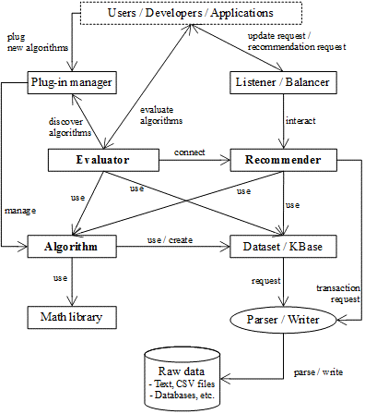
2. General description
General architecture of Hudup
Algorithm, Evaluator and Recommender are main modules. Algorithm, the most important module, defines and implements abstract model of recommendation algorithms. Evaluator is responsible for evaluating algorithms according to built-in evaluation metrics. Recommender is the simulation environment called simulator which helps users to test feasibility of their algorithms in real-time applications.
Plugin manager, an auxiliary module, is responsible for discovering and managing registered recommendation algorithms.
Parser, which is an auxiliary module, is responsible for processing raw data

Slide 10
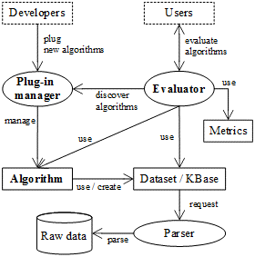
2. General description
Sub-architecture of Evaluator
Developer implements a recommendation algorithm A based on specifications defined by Algorithm module.
Developer plugs algorithm A into Plugin manager.
Scientist requires to evaluate algorithm A by calling Evaluator.
Evaluator discovers algorithm A via Plugin manager. Consequently, Evaluator loads and feeds Dataset or KBase to algorithm A.
Evaluator executes and evaluates algorithm A according to built-in metrics.
Evaluator sends evaluation results to scientist.

Slide 11
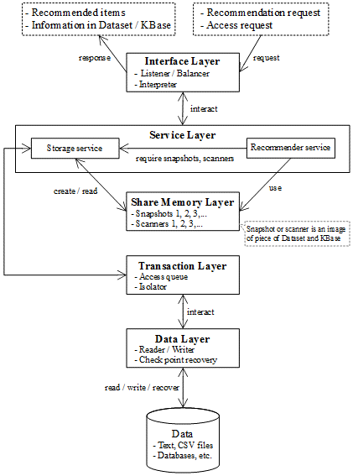
2. General description
Sub-architecture of Recommender - a recommendation server includes five layers such as interface layer, service layer, share memory layer, transaction layer, and data layer.

Slide 12
2. General description
Sub-architecture of Recommender - a recommendation server includes five layers such as interface layer, service layer, share memory layer, transaction layer, and data layer.

Slide 13
2. General description
Data layer is responsible for manipulating recommendation data organized into two following formats:
Low-level format is structured as rating matrix. Another low-level format is Dataset which consists of rating matrix and other information such as user profile, item profile and contextual information.
High-level format structure is called knowledge base or KBase in short, contains fine-grained information and knowledge extracted from Dataset.
Transaction layer is responsible for managing concurrence data accesses.
Share memory layer is responsible for creating snapshot and scanner according to requirement of storage service. Snapshot or Scanner is defined as an image of piece of Dataset and KBase at certain time point.
Service layer is the heart of architecture when it realizes two goals of recommendation server: giving the list of recommended items in accordance with client request and supporting users to retrieve and update database. Such two goals are implemented by two respective services: recommender service and storage service.
Interface layer interacts with both clients (users and application) and service layer.

Slide 14
2. General description
Recommendation scenario
User (or client application) specifies her / his request in text format. Typical client application is the Evaluator module. Interpreter component in interface layer parses such text into JSON format request. Listener component in interface layer sends JSON format request to service layer.
Service layer receives JSON request from interface layer. There are two occasions:
Request is to get favorite items. In this case, request is passed to recommender service. Recommender service applies appropriate strategy into producing a list of favorite items.
Request is to retrieve or update data such as querying item profile, querying average rating on specified item, rating an item, and modifying user profile. In this case, request is passed to storage service.
Transaction layer analyzes update requests and retrieval requests from service layer and parses them into transactions. Each transaction is a bunch of read and write operations.
Data layer processes read and write operations and sends back raw result to transaction layer. Transaction layer collects and sends back the raw result to service layer. Service layer translates raw result into JSON format result and sends such translated result to interface layer in succession.
The interpreter component in interface layer receives and translates JSON format result into text format result easily understandable for users.

Slide 15
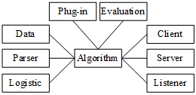
2. General description
The general architecture of Hudup is decomposed into 9 packages as follows:
Data package is responsible for standardizing and modeling data in abstract level. Dataset and KBase are built in Data package.
Parser package is responsible for analyzing and processing data.
Algorithm package is responsible for modeling recommendation algorithm in abstract level. Algorithm package supports mainly Algorithm module.
Evaluation package implements built-in evaluation mechanism of the framework. It also establishes common evaluation metrics. Evaluation package supports mainly Evaluator module.
Client package, Server package and Listener package provide Recommender module (recommendation server) in client-server network with essential support of Algorithm package.
Logistic package provides computational and mathematic utilities.
Plugin package manages algorithms and evaluation metrics. It supports mainly Plugin manager module.

Slide 16
2. General description
Suppose you want to set up a new recommendation algorithm called Green Fall, instead of writing a big and complicated software; you need to follow three simple steps below:
Inheriting Recommender class in Algorithm package and hence, implementing your idea in two methods estimate() and recommend() of this class.
Starting up the Evaluator module so as to evaluate and compare Green Fall with other algorithms via pre-defined evaluation metrics.
Configuring the Recommender module (recommendation server) in order to embed Green Fall into such service. After that starting up Recommender so as to test the feasibility of Green Fall in real-time applications.

Slide 17
3. Core classes and interfaces
As aforementioned, Hudup is constituted of three main modules Algorithm, Evaluator, and Recommender which, in turn, are decomposed into 9 packages. Each package includes many programming components but there is the limited number of core classes and interfaces on which this section focuses. Although Hudup is now implemented by Java language, it is convenient to describe classes and interfaces by UML language (Duong, 2008).
Class and interface are denoted as Class, Interface, Package::Class, Package::Interface. Attribute is denoted as attribute or Class::attribute.
Method is denoted as method(), method(parameters), Class::method (parameters), or Class::method(parameters):returned.

Slide 18
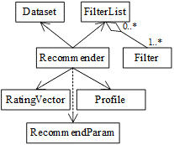
3. Core classes and interfaces
Algorithm package
The most important class of Algorithm package is Recommender class. It is abstract model of all recommendation algorithms. Recommender class has two most important methods which researchers must realize, as follows:
Method estimate(RecommendParam, int []): RatingVector whose input parameters are a recommendation parameter and a set of item identifiers. Its output result is a set of predictive or estimated rating values of items specified by the second input parameter.
Method recommend(RecommendParam, int): RatingVector whose input parameters are a recommendation parameter and a user identifier. Its output result is a list of recommended items.
RecommendParam class includes user profile represented by Profile interface, user rating vector represented by RatingVector class , context information, etc. RatingVector contains rating values of items are predicted (estimated).

Slide 19
3. Core classes and interfaces
Algorithm package
Recommender class realizes directly Alg interface which represents any algorithm. Every algorithm has a unique name as returned value of getName() method of Alg. Plugin manager discovers automatically all algorithms via their names.
Recommender class is executed on the dataset represented by Dataset which is the core interface of Data package.
If programmer needs to do some pre-filtering operations before Recommender class makes recommendation task, she/he can take advantages of Recommender::getFilterList() method which returns a list of filters. Each filter is represented by Filter interface. In general, Recommender class associates closely with classes and interfaces: Dataset, RecommendParam, RatingVector, Profile, Filter.

Slide 20
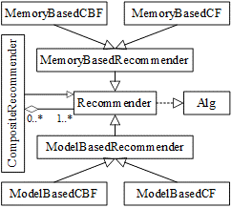
3. Core classes and interfaces
Algorithm package
There are two common trends such as content-based filtering (CBF) and collaborative filtering (CF) and so, Recommender class is derived directly by two abstract classes MemoryBasedRecommender and ModelBasedRecommender.
CompositeRecommender, which is also derived directly from Recommender, is combination of other Recommender algorithms in order to produce the best recommendation.

Slide 21
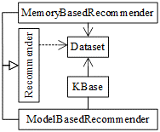
3. Core classes and interfaces
Algorithm package
ModelBasedRecommender applies knowledge database represented by KBase interface into performing recommendation task.
Recall that Kbase, which is the high-level format, is a significant aspect of Algorithm package. Followings are essential methods of KBase:
Method setConfig(DataConfig) is responsible for setting configurations for KBase.
Methods load() and save() are used to read/write KBase from/to storage system, respectively.
Method learn(Dataset, Alg) is responsible for creating KBase from Dataset.

Slide 22
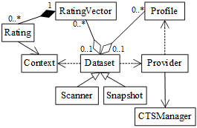
3. Core classes and interfaces
Data package
Dataset, which is the core interface of Data package, is composed of rating matrix, user profiles, item profiles, and context information. Two common implementations of Dataset are Snapshot and Scanner.
Each row in rating matrix is a user rating vector represented by RatingVector class. Each rating in RatingVector represented by Rating class.
Both user profile and item profile are represented by Profile class.
Dataset only provides read-only operations. Thus, Provider interface and its implementations support storage service to do writing operations.
Context, modeled by Context class, is additional information relevant to users’ activities. Context type, considered as context template, is modeled by the ContextTemplate interface.
A set of many ContextTemplate (s) compose a context template schema which is specified by ContextTemplateSchema interface which, in turn, is managed by the CTSManager interface.

Slide 23
3. Core classes and interfaces
Data package
Rating class includes three attributes as follows:
The rating value that a user gives on an item.
The timestamp identifies when such user rates on such item.
The context information is represented by Context class, for example, the place where user makes a purchase.
RatingVector provides many methods to extract and update Rating.
User Profile is transcript of personal information: demographic information, career, etc. Item Profile contains attributes of given item: name, item type, price, etc.
Dataset has important methods as follows:
Methods getUserRating(int) and getUserProfile(int) retrieve user rating vector RatingVector and user Profile, respectively given user identifier. Methods getItemRating(int) and getItemProfile(int) have similar use for item.
Methods fetchUserIds() and fetchItemIds() allow us to get a set of user identifiers and a set of item identifiers, respectively.
Method profileOf(Context) retrieves profile information of a specified context.

Slide 24
3. Core classes and interfaces
Data package
Context class, which is necessary to context-aware recommendation, has some basic methods as follows:
Method getTemplate() returns the template of current context.
Method getValue() returns the value of current context.
Constructor Context(ContextTemplate, ContextValue) creates a context from a template and a value.
Method canInferFrom(Context) indicates whether or not the current context can be inferred from the context specified by the input parameter. Method canInferTo(Context) indicates whether or not the current context can lead to the context specified by the input parameter.
Context can be categorized into three main types in order to answer three questions “when, where and who” as follows (Ricci et al., 2011, pp. 224-225):
Time type indicates the time when user makes a purchase, for example: date, day of week, month, year.
Location type indicates the place where user makes a purchase, for example: shop, market, theater, coffee house.
Companion type indicates the persons with whom user makes a purchase, for example: alone, friends, girlfriend/boyfriend, family, co-workers.

Slide 25
3. Core classes and interfaces
Data package
Contextual information is organized in two structures such as hierarchical and multi-dimensional (Ricci et al., 2011, pp. 225-228). The default implementation of ContextTemplate interface is HierContextTemplate class which conforms hierarchical structure, as seen in figure below.
A set of many ContextTemplate (s) compose a context template schema which is specified by ContextTemplateSchema interface. ContextTemplateSchema defines methods to manipulate its ContextTemplate members, as follows:
Method getRoot() returns the root template. Method addRoot(ContextTemplate) adds a new root template.
Method getTemplateByName(String) retrieves a ConextTemplate given a name.
ContextTemplateSchema is then managed by CTSManager. CTSManager has some main methods as follows:
Method setup(DataConfig) initializes ContextTemplateSchema according to data configuration.
Method commitCTSchema() verifies and saves ContextTemplateSchema to database.
Method getCTSchema() returns ContextTemplateSchema.
Each Context is always associated with a ContextTemplate and a ContextValue. So a Context is stored in database as a Profile which contains a ContextTemplate and a ContextValue. Therefore, CTSManager provides method profileOf(ContextTemplate, ContextValue) to retrieve a Context.

Slide 26
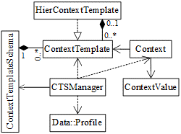

3. Core classes and interfaces
An example of Hierarchical context templates
Context information diagram

Slide 27
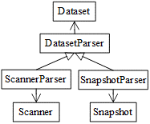
3. Core classes and interfaces
Parser package
Parser package aims to support Data package. Concretely, Dataset is created from database by DatasetParser which is the core interface of Parser package. Followings are basic methods of DatasetParser:
Method parse(DataConfig):Dataset takes database configurations as input parameter to create Dataset.
Method support(DataDriver) checks whether or not a given DatasetParser supports the kind of database.
Snapshot and Scanner, two common implementations of Dataset, are parsed by SnapshotParser and ScannerParser which are two inherited interfaces of DatasetParser, respectively.

Slide 28
3. Core classes and interfaces
Evaluation package
Evaluator is the core class of Evaluation package. Evaluator class configures and feeds Dataset to Recommender class. After that Evaluator activates two main methods of Recommender, namely Recommender::estimate() and Recommender::recommend().
Evaluator is the bridge between Dataset and Recommender and it has six roles:
It is a loader which loads and configures Dataset.
It is an executor which calls methods Recommender::estimate() and Recommender::recommend().
It is an analyzer which analyzes and translates the result of algorithm execution into the form of evaluation metrics. The execution result is output of method Recommender::estimate() or Recommender::recommend(). Evaluation metric is represented by Metric interface.
It is a registry. If external applications require receiving result from Evaluator, they need to register with it and implement EvaluatorListener interface.
Whenever it finishes a call of method Recommender::estimate() or Recommender::recommend(), it issues a so-called evaluation event and send back evaluation metrics to external applications after executing algorithm. So it is also a provider. The evaluation event is wrapped by EvaluatorEvent class.
It works as a service which allows scientists to start, pause, resume, and stop the evaluation process.

Slide 29
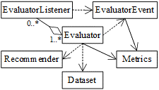
3. Core classes and interfaces
Evaluation package
Evaluator has four most important methods:
Method evaluate () performs main tasks, which loads Dataset and activates method Recommender::estimate() or Recommender::recommend().
Method analyze() is responsible for analyzing the result returned by method Recommender::estimate() or Recommender::recommend() so as to translate such result into evaluation metric.
Method issue() issues an evaluation event and sends back evaluation metrics to external applications.
Evaluator is associated tightly with Recommender, Dataset, Metrics, and EvaluationListener.
Evaluator diagram

Slide 30
3. Core classes and interfaces
Evaluation package
Metric interface specifies the final result of algorithm evaluation. Recall that there are two kinds of result:
Recommendation result is represented by the output of method Recommender::estimate() or Recommender::recommend().
Evaluation result is represented by Metric interface which is the output of Evaluator::analyze().
Followings are essential methods of Metric:
Method recalc(Object[]) is the most important one expressing how to calculate a concrete Metric. It is called by Evaluator::analyze().
Methods getAccumValue() and getCurrentValue() return accumulative value and current value of metric.

Slide 31
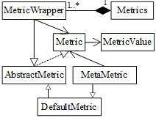
3. Core classes and interfaces
Evaluation package
The abstract class of Metric interface is AbstractMetric. Three implemented classes of Metric which inherit from AbstractMetric are DefaultMetric, MetaMetric, and MetricWrapper.
The Metrics class manages a list of Metric (s). It uses MetricWrapper for sophisticated management tasks.
Metrics diagram

Slide 32
3. Core classes and interfaces
Evaluation package
Two default metrics inherited from DefaultMetric class are TimeMetric class and Accuracy class. TimeMetric measures the speed of algorithm.
Accuracy reflects goodness and efficiency of recommendation algorithms. There are three types of accuracy (Herlocker et al., 2004, pp. 20-33):
Predictive accuracy, represented by PredictiveAccuracy class, measures how close predicted ratings returned from methods Recommender::estimate() and Recommender::recommend() are to the true user ratings. MAE, MSE, RMSE are typical predictive accuracy metrics.
Classification accuracy, represented by ClassificationAccuracy class, measures the frequency that methods Recommender::estimate() and Recommender::recommend() make correct or incorrect recommendation. Precision and Recall are typical classification accuracy metrics.
Correlation accuracy, represented by CorrelationAccuracy class, measures the ability that method Recommender::recommend() makes the ordering of recommended items which is similar to the ordering of user’s favorite items. NDPM, Spearman, Pearson are typical correlation accuracy metrics.

Slide 33
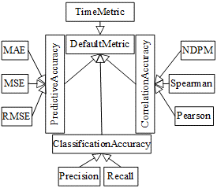
3. Core classes and interfaces
Default metrics diagram

Slide 34
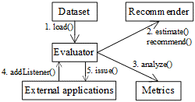
3. Core classes and interfaces
Evaluator calls Evaluator::evaluate() method to load and feed Dataset to Recommender.
Method Recommender::estimate() or Recommender::recommend() is executed by Evaluator::evaluate() method to perform recommendation task.
Method Evaluator::analyze() analyzes the result returned by method Recommender::estimate() or Recommender::recommend() and translates such result into Metric. The Metrics class manages a list of Metric (s).
External applications that implement EvaluatorListener interface register with Evaluator by calling Evaluator::addListener() method.
Method Evaluator::issue() sends Metrics to external applications.
Evaluation process

Slide 35
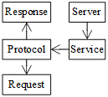
3. Core classes and interfaces
Client package defines classes and interfaces necessary to client-server network:
Request class represents user request. User request includes recommendation request, retrieval request, update request.
Response class represents result of recommendation process.
Protocol interface specifies methods to create Request in many possible cases. Protocol establishes an interaction protocol of Hudup client-server network, which is named “hdp”.
Service interface specifies methods to serve user requests. Storage service and recommender service implement Service interface.
Server interface defines abstract model of recommendation server. Server is responsible for creating Service to serve user requests. Both Server and Service constitute a proper recommendation server.

Slide 36
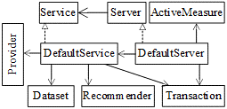
3. Core classes and interfaces
Server package focuses on implementing recommendation server:
DefaultService class is default implementation of Client::Service interface. DefaultService uses Recommender and Data::Provider for processing recommendation request and update request, respectively.
DefaultServer class is default implementation of Client::Server interface. DefaultServer creates and manages DefaultService.
Transaction interface represents transaction layer. Transaction is responsible for managing concurrence data accesses.
ActiveMeasure interface specifies how to measure the active degree of DefaultServer to support balancing.

Slide 37
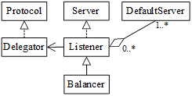
3. Core classes and interfaces
Listener package focuses on implementing listener and balancer:
Listener class represents a listener, which is deployed in interface layer to distributed environment. Listener is responsible for dispatching user requests to its proper binding Server::DefaultServer.
Delegator class implements Client::Protocol. Each time Listener receives a user request, it creates a respective Delegator and passes such request to Delegator. Then, Delegator handles and processes such request.
Balancer class represents a balancer to support balancing function while it inherits all other functions of Listener.

Slide 38
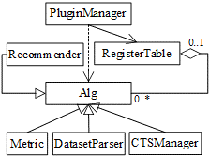
3. Core classes and interfaces
Plugin package has two main interfaces such as PluginManager and RegisterTable. Method discover() of PluginManager is executed at starting time of Hudup, which automatically discovers all algorithms that implement Alg interface and registers such algorithms in RegisterTable.
RegisterTable provides two important methods as follows:
Method register(Alg) registers a given algorithm.
Method query(String) retrieves an algorithm by its name. This method is often called by Evaluation::Evaluator and Client::Service.

Slide 39
4. Tutorial on Hudup
Suppose you want to set up Green Fall algorithm - a collaborative filtering algorithm based on mining frequent itemsets. You save a lot of efforts and resources when taking advantages of the proposed framework.
This tutorial has three simple steps to implement, evaluate, and deploy your custom algorithm, corresponding to three stages aforementioned in section such as base stage, evaluation stage, and simulation stage.

Slide 40
4.1. Tutorial on Hudup – Implementing algorithm
You create the Java project named Green Fall and import the core Java library package “hudup-core.jar” into Green Fall project.
You create the GreenFall class inheriting from ModelBasedCF class because Green Fall is model-based recommendation algorithm.
You create the knowledge base GreenFallKB derived directly from KBase. GreenFallKB will contains frequent itemsets and so you must override the GreenFallKB::learn() method to mine frequent itemsets from Dataset.
You implement your idea in two methods estimate() and recommend() of GreenFall.
Two next slides shows abstract code of GreenFallKB and GreenFall.

Slide 41
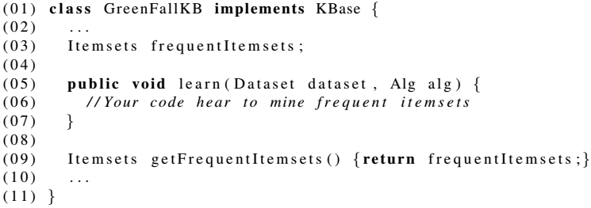
4.1. Tutorial on Hudup – Implementing algorithm
GreenFallKB.java

Slide 42
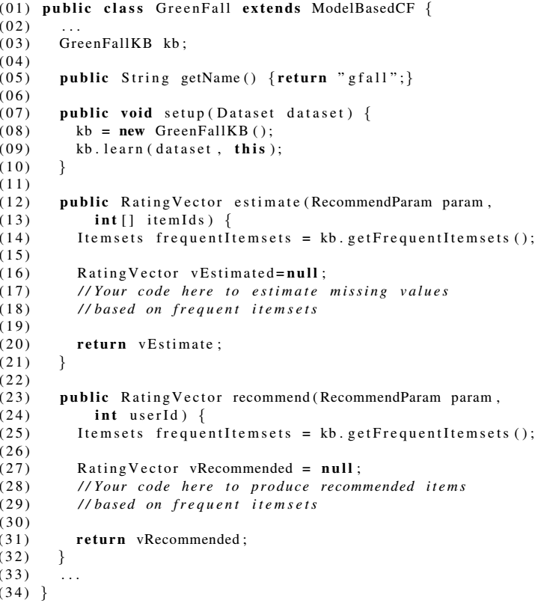
4.1. Tutorial on Hudup – Implementing algorithm
GreenFall.java

Slide 43
4.1. Tutorial on Hudup – Implementing algorithm
Methods GreenFall::estimate() and GreenFall::recommend() apply frequent itemsets resulted from GreenFallKB into estimating rating values of given items and producing recommended items of given user, respectively. All things you do manually are to implement these two methods.
The short name of Green Fall algorithm is “gfall” as the returned value of getName() method.
Now you compile the Green Fall project and compress it into the Java package “gfall.jar”.
Subsequently, you put the package “gfall.jar” into library directory of Hudup so that PluginManager can discover and register Green Fall algorithm in RegisterTable.

Slide 44
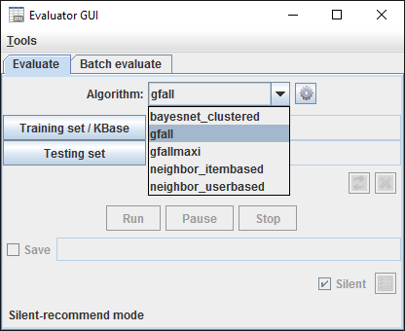
4.2. Tutorial on Hudup – Evaluating algorithm
Secondly, you open Evaluator GUI to assess Green Fall algorithm.
The Evaluator discovers the Green Fall algorithm via the name “gfall” by calling RegisterTable::query(“gfall”).

Slide 45
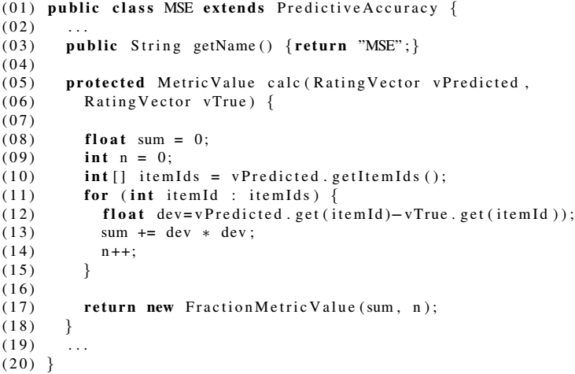
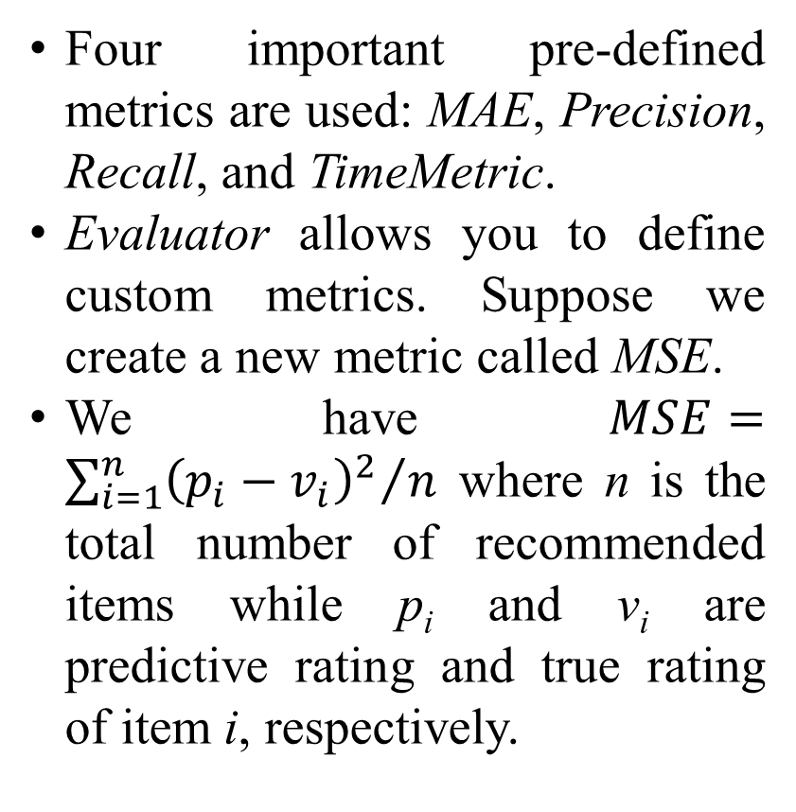
4.2. Tutorial on Hudup – Evaluating algorithm
Four important pre-defined metrics are used: MAE, Precision, Recall, and TimeMetric.
Evaluator allows you to define custom metrics. Suppose we create a new metric called MSE.
We have $MSE={\sum_{i=1}^{n}{{\left(p_{i}−v_{i}\right)}^{2}}}/n$ where n is the total number of recommended items while p_{i} and v_{i} are predictive rating and true rating of item i, respectively.

Slide 46
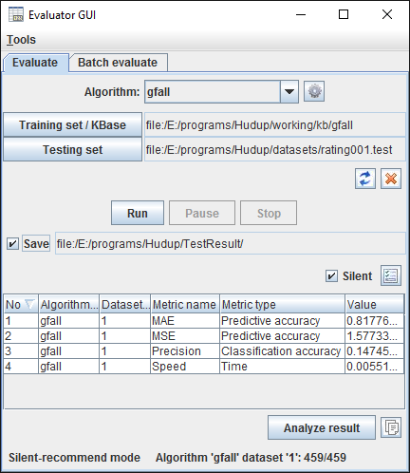
4.2. Tutorial on Hudup – Evaluating algorithm
Evaluator lists evaluation result of Green Fall algorithm

Slide 47
4.2. Tutorial on Hudup – Evaluating algorithm
Evaluator lists evaluation result of
Green Fall algorithm

Slide 48
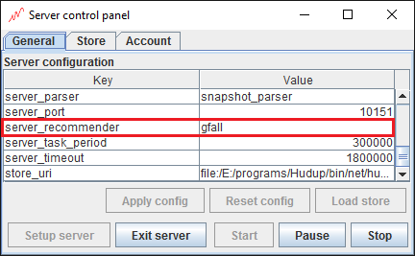
4.3. Tutorial on Hudup – Deploying algorithm
Recommender module, a recommendation server, supports you to deploy and test Green Fall algorithm in real-time application.
When you put the package “gfall.jar” into library directory of Hudup, Recommender automatically discovers and deploys Green Fall on server.
Recommender allows you to configure Green Fall for particular purposes. Recommender serves client requests at server port 10151.

Slide 49
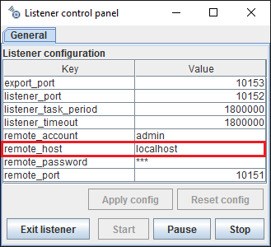
4.3. Tutorial on Hudup – Deploying algorithm
You start up and configure Listener to connect with Recommender.
Listener connects with Recommender through server port 10151 and it serves client requests at listener port 10152.

Slide 50
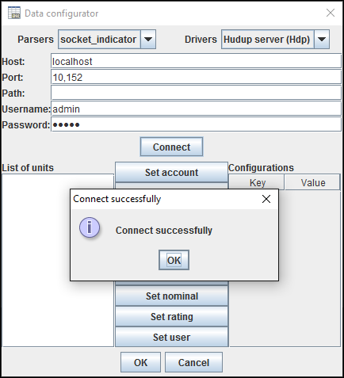
4.3. Tutorial on Hudup – Deploying algorithm
Consequently, you configure Evaluator to connect with Listener through listener port 10152, complied with basic socket protocol.
Now Listener becomes a bridge between Evaluator and Recommender, which allows Evaluator to call Green Fall algorithm deployed remotely in Recommender.

Slide 51
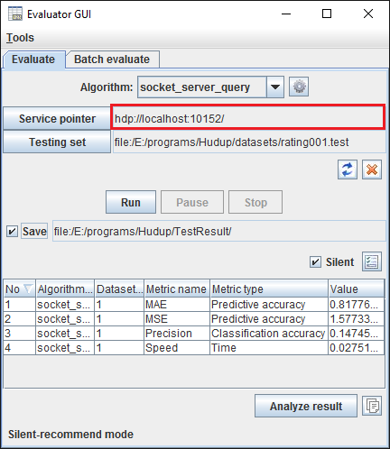
4.3. Tutorial on Hudup – Deploying algorithm
Now you use Evaluator to test Green Fall algorithm via client-server environment with cooperation of Evaluator, Listener, and Recommender.
Next figure shows again the evaluation result of Green Fall algorithm from remote execution.
Evaluator interacts with Listener through listener port 10152 and Listener, in turn, interacts with Recommender through server port 10151. Due to network transportation, the speed of Green Fall algorithm is decreased.

Slide 52
5. Conclusions
In general, it is easy for you to implement, evaluate and deploy your solution by taking advantages of the proposed framework. Most tasks are configured via friendly GUI. Complicated operations are processed by services and you only focus on realizing your ideas. Moreover, Hudup is not only used for e-commercial software but also applied into any application in which recommendation is necessary.
The framework has 6 most essential components (classes and interfaces) such as Algorithm::Recommender, Data::Dataset, Data::KBase, Evaluation::Evaluator, Evaluation::Metric, and Client::Service. Each component has individual aspects and roles. They are both strongly interactive and independent so that the general architecture achieves two goals:
Coherency: The algorithm execution and evaluation are processed continuously and completely.
Flexibility: The framework provides the high level of customization to researchers so that they realize easily their ideas.

Slide 53
5. Conclusions
In recommendation domain, there is the problem that experimental rating databases such as Movielens (GroupLens, 1998), Jester Joke, and Book Crossing are heterogeneous. This problem makes researchers into trouble; they cannot focus on their creative ideas.
Dataset gives the solution to this problem when it proposes an abstract model of heterogeneous rating database. Researchers don’t need to consider what Dataset and how to read it. The infrastructure is responsible for building up dataset from physical devices.
Similarly, Recommender is abstract model of any recommendation algorithm. Researchers only need to implement their ideas in methods Recommender::estimate() and Recommender::recommend().
The flexibility also leads to ability of high customization. For instance, Evaluation::Metric interface represents any evaluation metric. Researchers can totally define their own metrics following specifications of Evaluation::Metric.

Slide 54
5. Conclusions
Finally, in this abstract architecture, we aim to normalize such 6 components as 6 standards for recommendation study. Such standards are used for study of software engineering. For instance, the manifest of KBase has following aspects:
The methods load() and save() indicate that KBase can be loaded from and saved to storage system. They don’t specify how to load and store KBase. They are rules with which the infrastructure must comply.
Similarly, method learn() tells us that KBase can be learned by any approaches: machine learning, data mining, artificial intelligence, statistics, etc.
Hudup framework is ongoing; more features and utilities are supported in future but its two goals, coherency and flexibility, are keeping constant.

Slide 55
Thank you for attention

Slide 56
References
Brozovsky, L. (2006). Colfi - recommender system for a dating service.
Caraciolo, M., Melo, B., and Caspirro, R. (2011). Crab - recommender systems in python.
Chen, T., Zhang, W., Lu, Q., Chen, K., Zheng, Z., Yu, Y., and Yang, D. (2012). Svdfeature: A toolkit for feature-based collaborative filtering.
Dato-Team (2013). Graphlab create tm.
Duong, T. Q. (2008). UML 2 and Rational Rose 2003, volume 8 of Analyzing and Designing Enterprise Information System. SAHARA, Ho Chi Minh, Vietnam.
ECMA (2013). The JSON Data Interchange Format. Geneva, Swiss, 1 edition.
Ekstrand, M., Kluver, D., He, L., Kolb, J., Ludwig, M., and He, Y. (2013). Lenskit - open-source tools for recommender systems.
Gantner, Z., Rendle, S., Drumond, L., and Freudenthaler, C. (2013). Mymedialite recommender system library.
GroupLens (1998). Movielens datasets.
Hahsler, M. (2014). recommenderlab: Lab for developing and testing recommender algorithms.
Herlocker, J. L., Konstan, J. A., Terveen, L. G., and Riedl, J. T. (2004). Evaluating collaborative filtering recommender systems. ACM Transactions on Information Systems (TOIS), 22(1):5–53.
Lemire, D. (2003). Cofi: A java-based collaborative filtering library.
Lew, D. and Sowell, B. (2007). Carleton recommender systems.
Mahout-Team (2013). Apache mahout tm.
Microsoft, MyMediaPC, RichHanbidge, MyMediaWp2Lead, MyMediaWp3Lead, MyMediaWp4Lead, and MyMediaWp5Lead (2013). Mymedia dynamic personalization and recommendation software framework toolkit.
Oracle (2014). Java language.
Ricci, F., Rokach, L., Shapira, B., and Kantor, P. B. (2011). Recommender Systems Handbook. Springer.
Smart-Agent-Technologies (2013). easyrec.
Telematica-Instituut (2007). Duine framework.
Vogoo-Team and DROUX, S. (2008). Vogoo php lib.

