Slide 1

A NEW APPROACH FOR COLLABORATIVE FILTERING
BASED ON MINING FREQUENT ITEMSETS
Sunflower Soft Company http://www.sunflowersoft.vn

Slide 2
Contents
1
Introduction
2
New CF algorithm
3
Mining frequent itemsets
4
Evaluation
5
Conclusion

Slide 3
INTRODUCTION

Slide 4
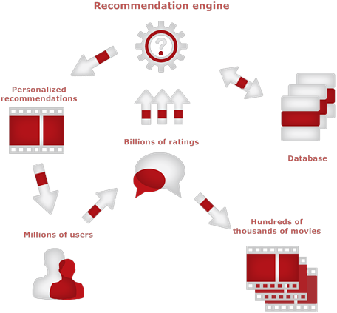
INTRODUCTION
The recommendation system is a system which recommends to the users, all the items which are those among a large number of existing items in database

Slide 5
doesn't tend towards community
=> hasn't been capable of discovering implicit items
INTRODUCTION
focus on the item's contents and user personality's interests
recommend different items to different users
recommends an item to a user if such item is similar to other items that he like most in the past
CBF approach
consume less system resources and the processing time
Only works on the users' ratings of the items
Recommendation
system
recommends an items to user if his neighbors (the other users that are identical to him) are interested in such item
can also do some unexpected recommendations when facing with too many items which aren't rated
CF approach

Slide 6
INTRODUCTION
Alleviate the weakness
of the CF type
Model-based
CBF with CF
CBF
CF
Recommendation
Compressing the rating matrix into a representative model
setting up a complete rating matrix
making predictions for recommendations

Slide 7


INTRODUCTION
Collaborative filtering (CF) is one of the most popular algorithms
Surveying outcomes
Items
recommended
community
users

Slide 8
INTRODUCTION
CF approach
Memory-based
Adv: Simple
Disavd: encounter with problems when processing data is huge
Model-based
Adv: Faster and solving the problem of huge or sparse data
Disavd: complicated

Slide 9
NEW CF ALGORITHM

Slide 10
NEW CF ALGORITHM (IDEA)
Basing on mining frequent itemsets technique => The database is mined to extract frequent itemsets.
New
model-based CF
offline process-mode
=> no negative effect on the recommendation task.
=> better when providing the recommendations with an immediate response.

Slide 11
NEW CF ALGORITHM (IDEA)
Roller algorithm for mining frequent itemsets
"The larger the support of an item is, the higher it’s likely that this item will occur in some frequent itemsets, is".
heuristic algorithm
the roller algorithm model itself which is to roll a roller on a wall in such a way that would be capable of picking the frequent itemsets

Slide 12
NEW CF ALGORITHM
 | Item 1 | Item 2 | Item 3
Rating values | 3 | 5 | 2
Recommendation
process
Rating vector
Modeling
process
Frequent itemset s is chosen from S
Perform in offline process mode
CF
algorithm
Set of frequent itemsets S
Perform in offline process mode

Slide 13
NEW CF ALGORITHM
Executed in offline mode
=> won’t be causing any negative-time consuming impact
CF algorithm based on mining frequent itemsets
Disadvantage
Advantage
Sometimes, the rating vector u and the frequent itemset s don’t match exactly
=> impossible when launching an attempt to compute predictive values + missing ratings for rating vector
Binary
transformation

Slide 14
NEW CF ALGORITHM
BINARY TRANSFORMATION
 | Item 1 | Item 2 | Item 3 | Item 4
User 1 | 3 | 5 | 2 | 1
User 2 | 3 | 5 | 2 | 1
User 3 | 1 | 5 | 4
Row
Users
Rating matrix
table
Column
Items
Each item is “stretched” into 5 sub-items which are respective to 5 possible rating values {1…5}.
Each sub-item is symbolized as item_j_k carrying two binary-states 1 and 0 (user rates on item j with concrete value k)

Slide 15
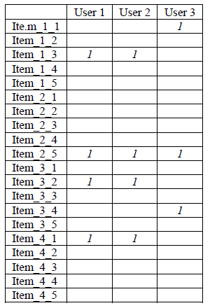
NEW CF ALGORITHM
Bit rating matrix table
Each frequent itemset will carry a so-called binary form, s = (item_j₁_k₁, item_j₂_k₂,…)
Each component item_j_k, has been defined as binary sub-item
Rating vector u is also to be transformed into binary rating vector u = (item_j₁_k₁, item_j₂_k₂,…)

Slide 16


NEW CF ALGORITHM
Example:
Rating vector u
Frequent itemset
s
Not match exactly
Item 1 = 3
Item 2
Item 2 = 5
Item 1
Item 3
Item 4
Transformed to binary
Item 3 = 2
s1 = (item_1_3, item_2_5, item_3_2, item_4_1)
s1 match most
match
exactly
u = (item_1_3, item_2_5, item_3_2)
s2 = (item_1_1, item_2_5, item_3_4)
item 4 is recommended

Slide 17
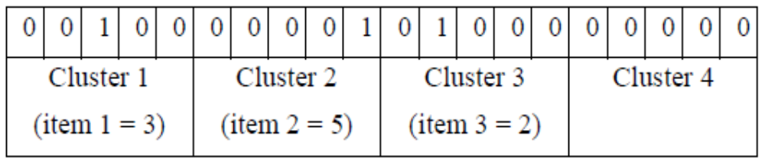
NEW CF ALGORITHM
BIT REPRESENTATION and BIT MATCHING
4 items - 5 rating value/item => the bit set whose length 20 bits (called 20-length bit set) to represent rating vectors and frequent itemsets
The bit set is divided into many clusters or groups – 5 rating value/item -> 5 bit/cluster
Each cluster represents a sub-item and the position of a bit in its cluster indicates the rating value of corresponding sub-item.
Example:

Slide 18
NEW CF ALGORITHM
u = (item_1_3, item_2_5, item_3_2)
If s1 AND u = u => s1 matches with u
If s1 AND u ≠ u => s1 doesn’t match with u
The recommended item is denoted r_item:
r_item = s1 AND (NOT u) = (00000 00000 00000 10000)
=> Item 4 is recommended
u = (00100 00001 01000 00000)
s1 = (item_1_3, item_2_5, item_3_2, item_4_1)
s1 = (00100 00001 01000 10000)
s2 = (item_1_1, item_2_5, item_3_4)
s2 = (10000 00001 00010 00000)

Slide 19
NEW CF ALGORITHM
CF algorithm will be consisted into 3 steps:
Rating matrix is transformed into binary rating matrix.
Step 1
Binary rating matrix is mined, as well as to extract frequent itemsets.
Step 2
Step 3
Rating vector and frequent itemsets are represented as bit sets.
Bit matching operations are performed to find out the appropriate frequent itemset.

Slide 20
NEW CF ALGORITHM
Pseudo-code like C for new CF algorithm:
D, B, S: rating matrix, binary rating matrix and the set of frequent itemsets
Matched_itemset and r_item: matched itemset and recommended item
bitset(…), count(…): functions that transforms item into bit set and counts the number of bit 1 (s) in bit se
binary_transform: the function which transforms rating matrix into binary rating matrix
mining_frequent_itemset: the mining function which extracts frequent itemsets from binary rating matrix
B = binary_transform(D)
S = mining_frequent_itemset(B)
matched_itemset = null
max_count = -1
For each s S
bs = bitset(u) AND bitset(s)
If bs = bitset(u) && count(bs) max_count then
matched_itemset = s
max_count = count(bs)
End If
End For
r_item = bitset(matched_itemset) AND (NOT bitset(u))

Slide 21
MINING FREQUENT
ITEMSETS

Slide 22
MINING FREQUENT ITEMSETS
Our mining frequent itemsets method
Roller algorithm
“The larger the support of an item is, the higher it’s likely that, this item occurs in some itemsets”

Slide 23
MINING FREQUENT ITEMSETS
Step 1
Computing the supports of all items and arranging these items on the wall, according to the descending ordering of their supports
Step 2
The i^{th} itemset is initialized by the first item in this descending ordering. The support of i^{th} itemset is initialized as the support of this first item.
Step 3
If current item is the last one -> items in the i^{th} itemset are removed from the descending ordering, i = i + 1. Go to step 2
Step 4
If current item is NOT the last in descending ordering, the next item is picked, the current item now is the next item
The support of current item satisfies min_sup: the support of the i^{th} itemset support(it^{th} itemset) is accumulated by current item, If support(ith itemset) is equal to or larger than min_sup, this item is added to the ith itemset. Go back step 3.
The support of current item doesn’t satisfy min_sup: Go back step 3

Slide 24
O = sort (I). i = 1;
While (true) c = first(O) si = si {c}
O = O / {c}
If O = then return S;
While (true)
If c = last(O) then
S = S si
O = O / S i = i +1 break
MINING FREQUENT ITEMSETS
Let I = (i1, i2,…, im) and S be a set of item and a set of frequent itemset, respectively.
Let O = (o1, o2,…, on) be the list of items whose supports are sorted according to descending ordering, O I.
Let si be the ith itemset. Let c be the current item
Let support(…) be the function calculating the support of item or itemset.
Let sort(…), first(…), next(…), last(…) be sorting, getting first item, getting next item, getting last item functions, respectively.
The pseudo-code like C for Roller algorithm (function mining_frequent_itemset):
Else
c = next (O, c)
If support(c) < min_sup continue;
b = bitset(S) AND bitset (c)
If count(b) min_sup then
si = si {c}
End If
End If
End While
End While

Slide 25
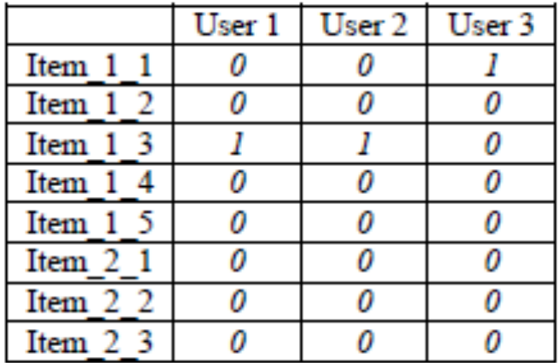
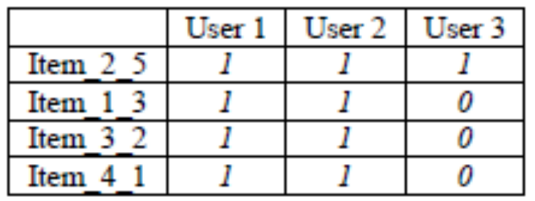
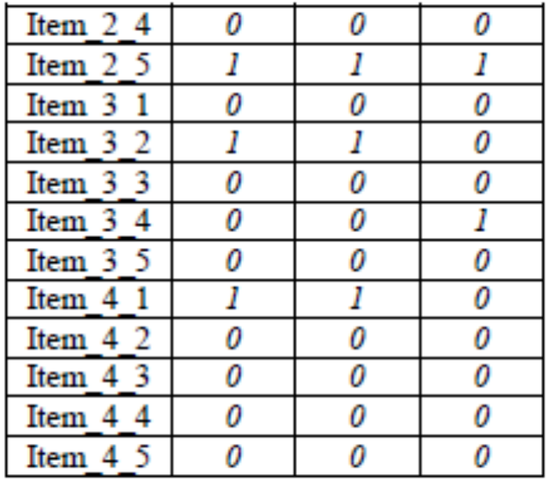
BIT MINING
Binary rating matrix
Step 1: sub-items are sorted according to descending ordering and some sub-items not satisfying min_sup are removed given the min_sup is 2
Now sub-items are represented as bit cluster: Item_2_5 = (111), Item_1_3 = (110), Item_3_2 = (110), Item_4_1 = (110).
Step 2, the first itemset s1 is initialized as Item_1_1
s1 = (111) and support(s1) = count (111) = 3
Where count (…) indicate the number of bits whose values are 1 (s) in bit set (…).

Slide 26
BIT MINING
Step 4, sub-items (clusters) such as Item_1_3, Item_3_2, Item_4_1 are picked in turn and all of them satisfy min_sup.
Picking Item_1_3: s1 = s1 AND Item_1_3 =(111) AND (110) = (110) → support(s1) = 2
Picking Item_3_2: s1 = s1 AND Item_3_2 = (110) AND (110) = (110) → support(s1) = 2
Picking Item_4_1: s1 = s1 AND Item_4_1 = (110) AND (110) = (110) → support(s1) = 2
The frequent itemset is s1 = (110) which includes Item_2_5, Item_1_3, Item_3_2, Item_4_1

Slide 27
THE IMPROVEMENT OF ROLLER ALGORITHM
Some frequent items don’t have so high a support and are in the last of descending ordering => they don’t have many chances to join to frequent itemsets
The Roller algorithm is modified so that such useful items are not ignored

Slide 28
THE IMPROVEMENT OF ROLLER ALGORITHM
In step 3, instead of choosing the next item as the current item, we can look up an item whose support is pseudo-maximum and choose such item as the current item
Step 1
Computing the supports of all items and arranging these items on the wall according to the descending ordering of their supports.
Step 2
  The i^{th} itemset is initialized by the first item in this descending ordering. The support of i^{th} itemset is initialized as the support of this first item. The current item now is the first item and it is removed from descending ordering.
Step 3
If current item is the last one -> items in the ith itemset are removed from the descending ordering, i = i + 1. Go to step 2
If the current item is NOT the last, look up the item which is combined (AND operation) with ith itemset.
Step 4
The support of the i^{th} itemset support(ith itemset) is accumulated by current item, it is the count of total transactions that contains all items in the i^{th} itemset and current item. If support(i^{th} itemset) is equal to or larger than min_sup, then this item is added to the ith itemset. Go back step 3

Slide 29
The pseudo-code like C for improved Roller algorithm (function mining_frequent_itemset):
THE IMPROVEMENT OF ROLLER ALGORITHM
O = sort (I).
i = 1;
While (true)
c = first(O)
si = si {c}
O = O / {c}
If O = then return S;
While (true)
If c = last(O) then
S = S si
O = O / S
i = i +1
break
Else
c = null
pseudo_maximum = -1
For each item o O
temp = bitset(S) AND bitset (o)
If count(temp) min_sup &&
count(temp) pseudo_maximum then
c = o
pseudo_maximum = count(temp)
End If
End For
c = next (O, c)
If support(c) < min_sup continue;
b = bitset(S) AND bitset (c)
If count(b) min_sup then
S = S {c}
End If
End If
End While
End While

Slide 30
EVALUATION

Slide 31
EVALUATION
Error measure
Measures to evaluate our CF algorithm
Response measure

Slide 32

EVALUATION
Response measure:
D be the rating matrix (rating database)
u_{i} D be the rating vector as each row in D
t_{i} be the time in seconds that the algorithm runs for row u_{i}
So the measure R is the sum of all ti (s) when iterating over D:
Database Movielens [2] is used to evaluate error measure. Database Movielens has two versions such as 100K and 1M.
+ Version 100K with 1.88 MB capacity including 100,000 ratings of 943 users on 1682 movies.
+ Version 1M with 23.4 MB capacity including 1,000,209 ratings of 6040 users on 3900 movies.

Slide 33
EVALUATION
Our
method
memory-based CF algorithm in which the Pearson measure is used
simplest memory-based CF algorithm
compare
Pearson
method
Simple
method

Slide 34
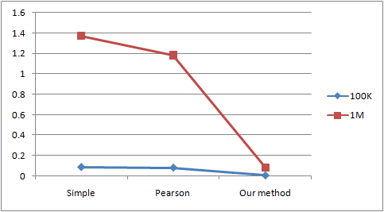
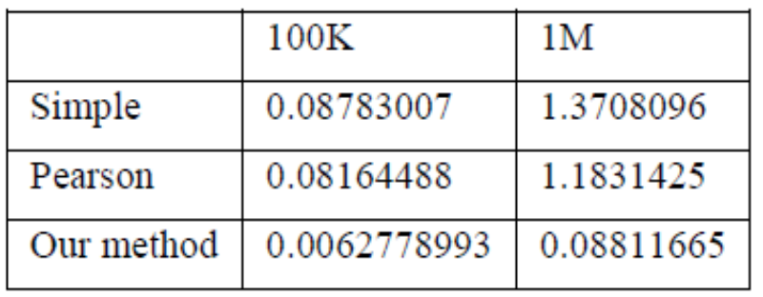
EVALUATION
Response evaluation
Our method is 13 – 15 times faster than Pearson and Simple methods. Following is the line chart of response evaluation.

Slide 35
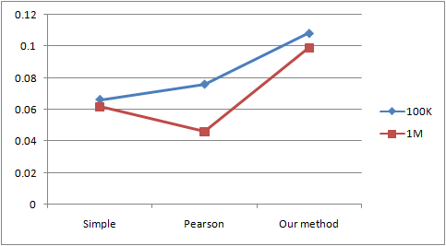
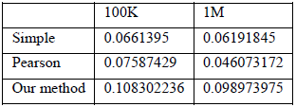
EVALUATION
Error measure
Database Movielens [2] is used to evaluate error measure. Our CF method is also compared to two other methods: simple method, Pearson method.
Although our method gets higher error measure, it runs faster than other methods. Moreover it can tolerate sparse matrix

Slide 36

CONCLUSION

Slide 37
CONCLUSION
Our CF approach is different from other model-based CF methods when trying to discover user interests.
The mining technique is important for extracting frequent itemsets considered as patterns of user interests.
Roller is proved as reliable algorithm with high performance, fast speed, consuming less time and resources.
In the future, we will propose another new model-based CF method which uses Bayesian network in inferring user interests.

Slide 38
REFERENCES
[1][Su, Khoshgoftaar 2009]. Xiaoyuan Su and Taghi M. Khoshgoftaar. A Survey of Collaborative Filtering Techniques. Hindawi Publishing Corporation, Advances in Artificial Intelligence, Volume 2009, Article ID 421425, 19 pages, doi:10.1155/2009/421425.
[2][Movielens dataset 2011]. Home page is http://www.movielens.org. Download dataset from http://www.grouplens.org/node/12.

Slide 39
Thank You!
Click to edit company slogan
www.themegallery.com

