Slide 1
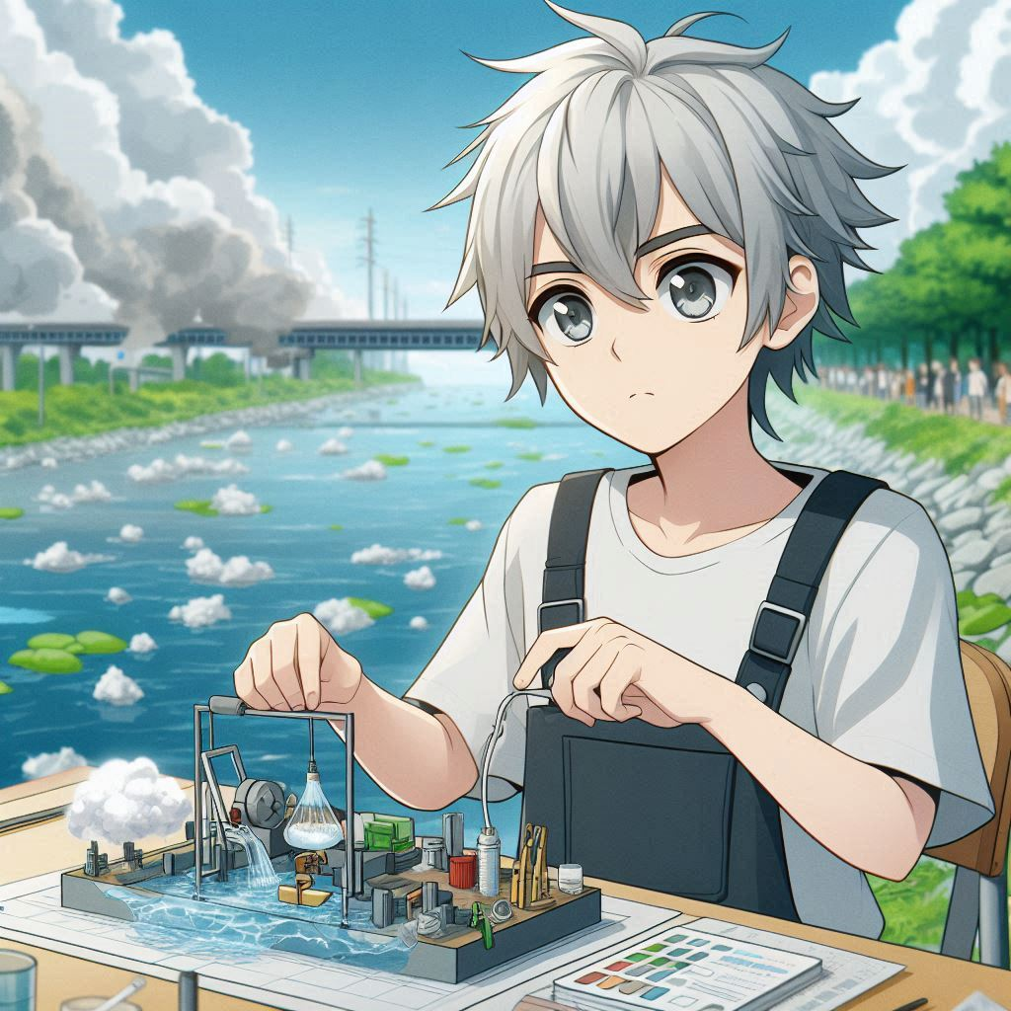
冒險故事
(NIZIMA LIVE)

Slide 2
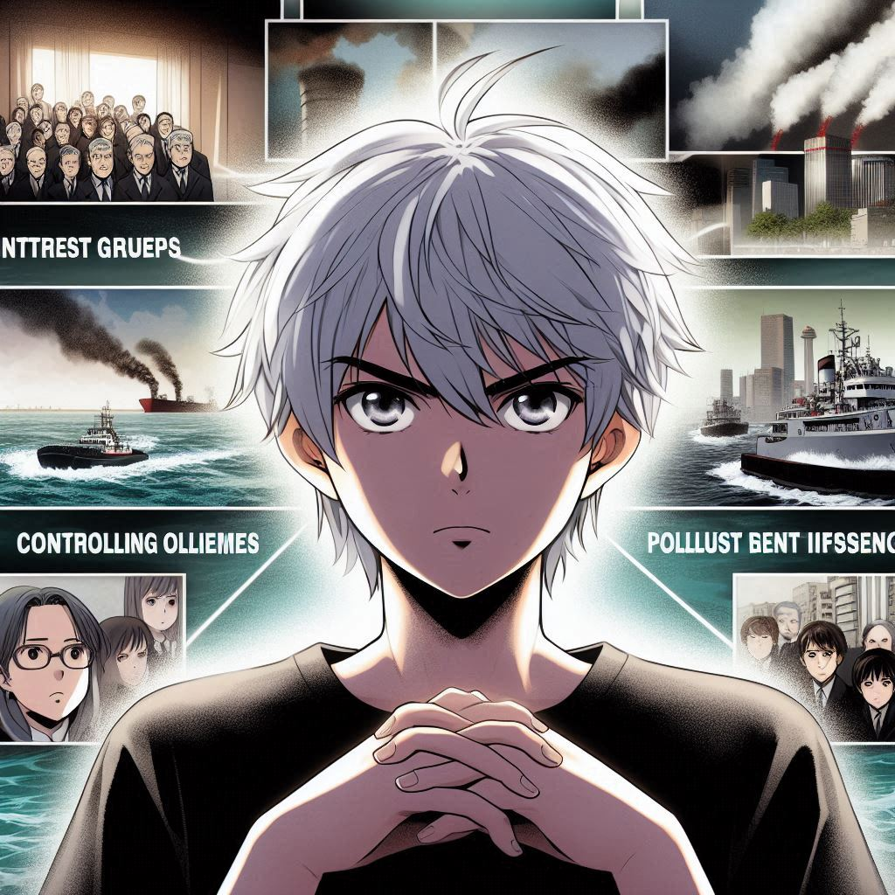
1.目標
Notes:
Create a image, a teenage boy with white hair and gray eyes in Japanese anime style, he working on a new device to reduce water pollution, with a polluted river in the background.

Slide 3
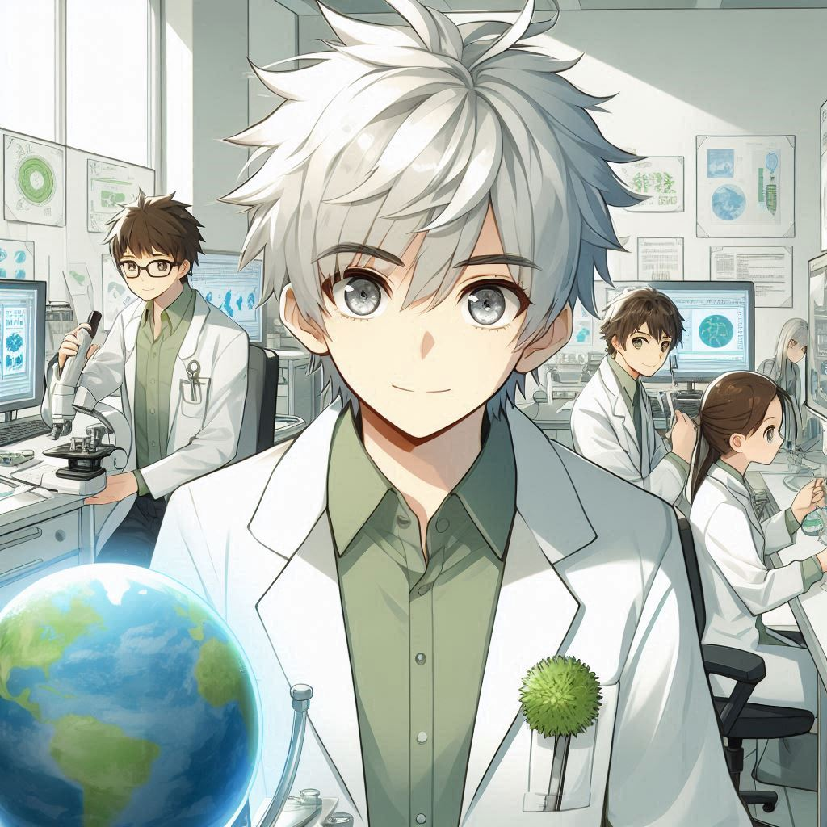
2.阻礙
Notes:
Create 4 images, a teenage boy with white hair and gray eyes in Japanese anime style, he facing more powerful interest groups controlling pollution sources, with scenes showing their influence and threats.

Slide 4

3.努力
Notes:
Create a image, a teenage boy with white hair and gray eyes in Japanese anime style, he and his team working tirelessly in a lab, using various resources and collaborating with global environmental organizations.

Slide 5
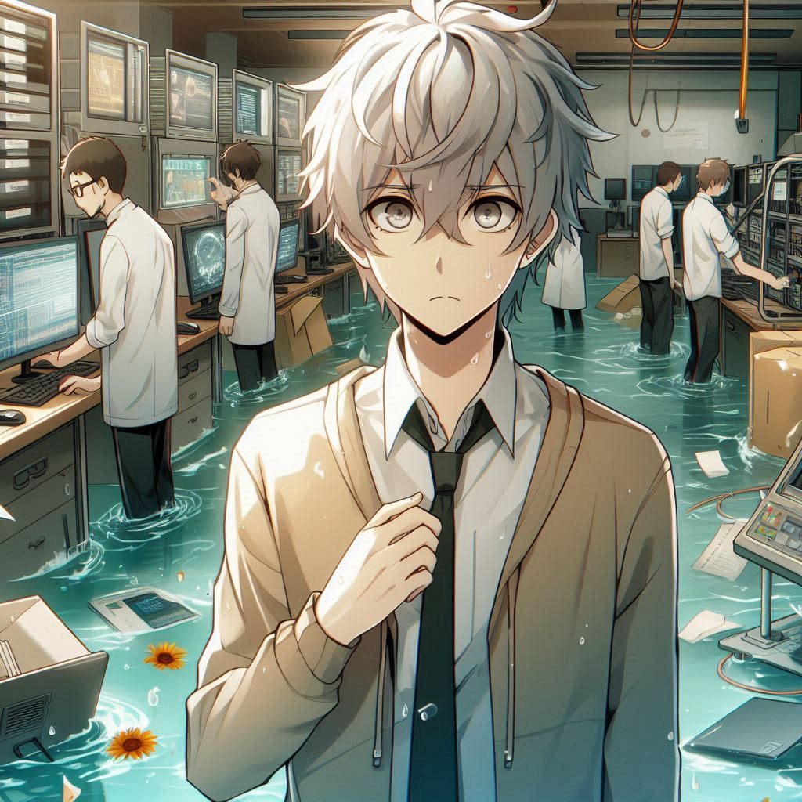
4.結果
Notes:
Create a image, a teenage boy with white hair and gray eyes in Japanese anime style, depict his team successfully creating an effective water purification device, with expressions of relief and accomplishment.

Slide 6
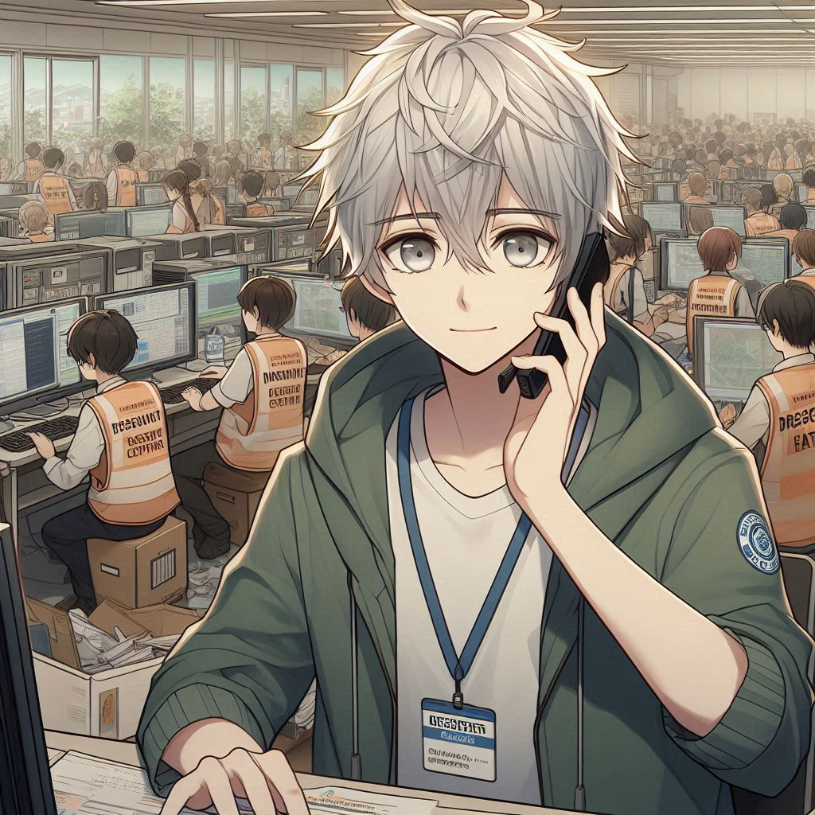
5.意外
Notes:
Create a image, a teenage boy with white hair and gray eyes in Japanese anime style, a flood hitting his research center, destroying equipment and data, with the team trying to salvage what they can.

Slide 7
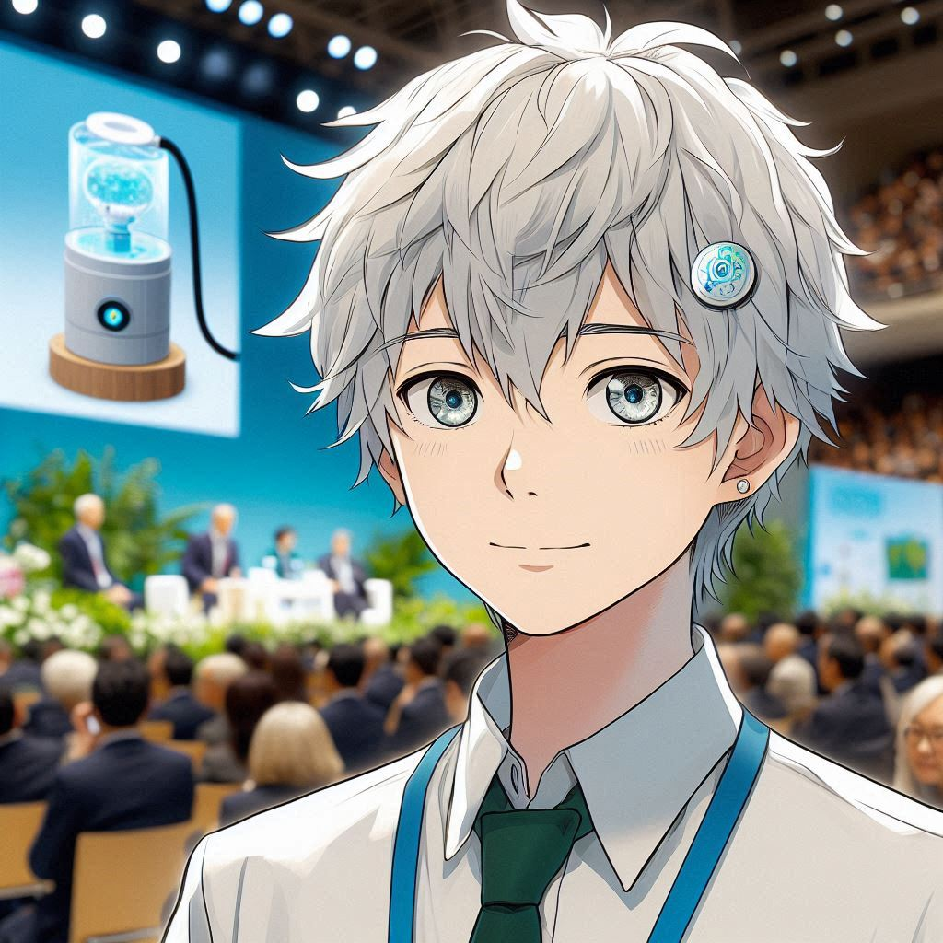
6.轉彎
Notes:
Create a image, a teenage boy with white hair and gray eyes in Japanese anime style, Show a resident from the disaster area contacting , organizing a volunteer team to help rebuild the research center and recover data.

Slide 8
7.結局
Notes:
Create a image, a teenage boy with white hair and gray eyes in Japanese anime style, Depict his water purification device being presented at an international environmental conference, receiving wide recognition and support.

