Slide 1
自我介紹
(NIZIMA LIVE)

Slide 2
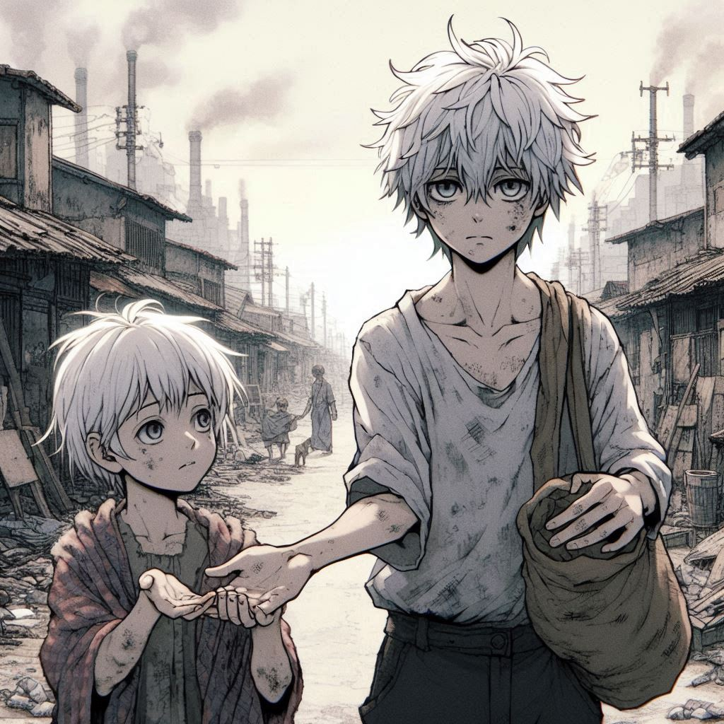
1.目標
Notes:
創造一個白髮、灰眼的少年穿著破舊的衣服，背景是在一個貧困的地方生活著，有很高的汙染，天空更加昏暗，並且確保手只有五根手指頭，還牽著妹妹，在撿拾東西，風格偏日系動畫。

Slide 3
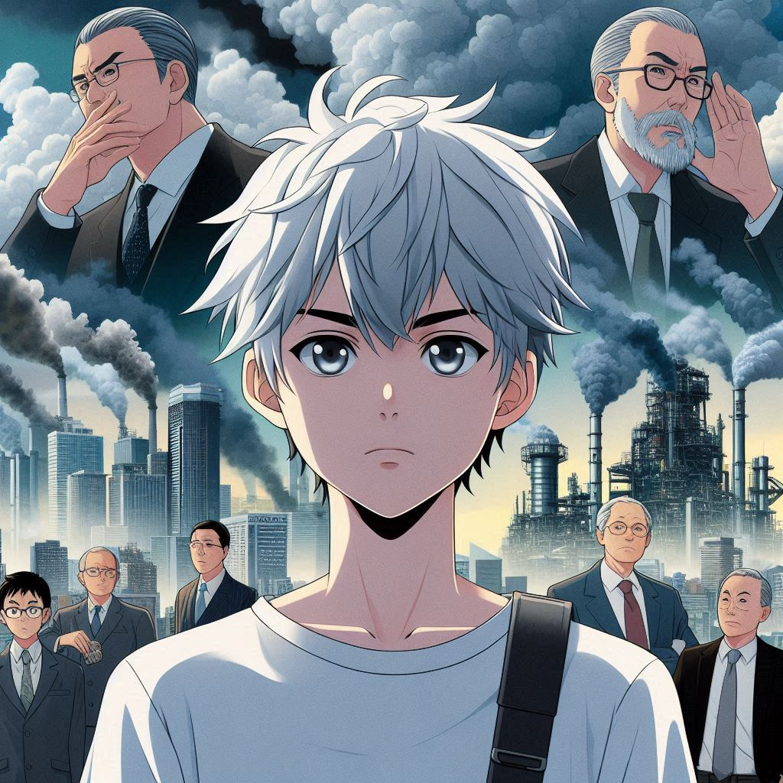
2.阻礙
Notes:
A teenage boy with white hair and gray eyes in Japanese anime style, facing powerful industrialists who control the pollution in the city, with scenes showing their influence and wealth.

Slide 4
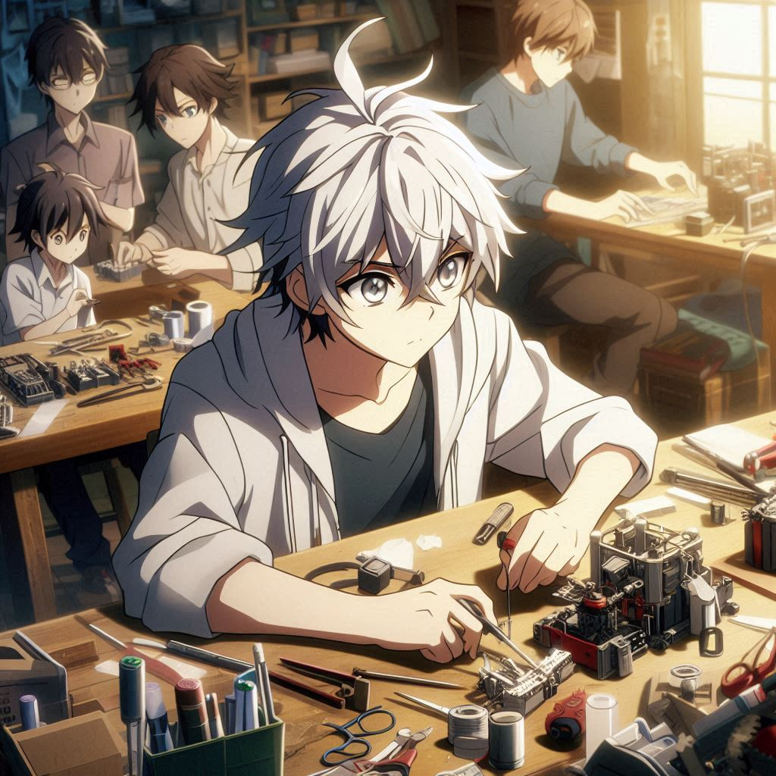
3.努力
Notes:
A teenage boy with white hair and gray eyes in Japanese anime style, working tirelessly in a small, cluttered workshop, using discarded materials to create prototypes, with a small team of friends assisting.

Slide 5
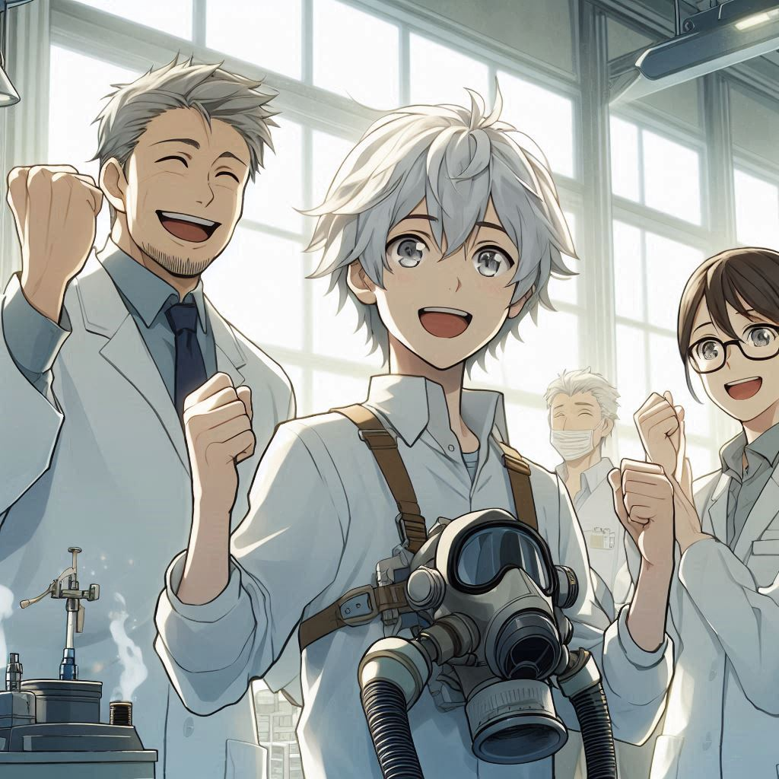
4.結果
Notes:
A teenage boy with white hair and gray eyes in Japanese anime style, alongside his adult science team, celebrating the successful creation of a large air purification device prototype, with expressions of joy and relief.

Slide 6

5.意外
Notes:
A teenage boy with white hair and gray eyes in Japanese anime style, at a press conference during a public demonstration, where a large air purification device is damaged by agents sent by the industrialists. The scene depicts the boy and his science team trying to protect the device amidst the disruption.

Slide 7
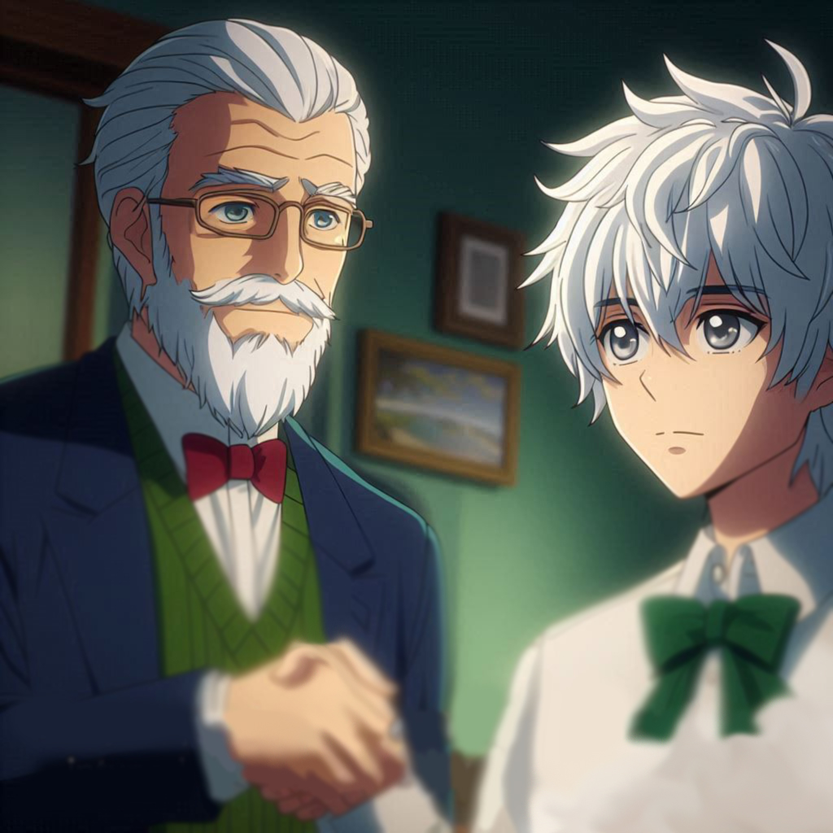
6.轉彎
Notes:
A mysterious benefactor, a former environmental expert turned wealthy entrepreneur, in Japanese anime style, offering support to a teenage boy with white hair and gray eyes, impressed by his dedication to environmental causes. No subtitles should be included.

Slide 8
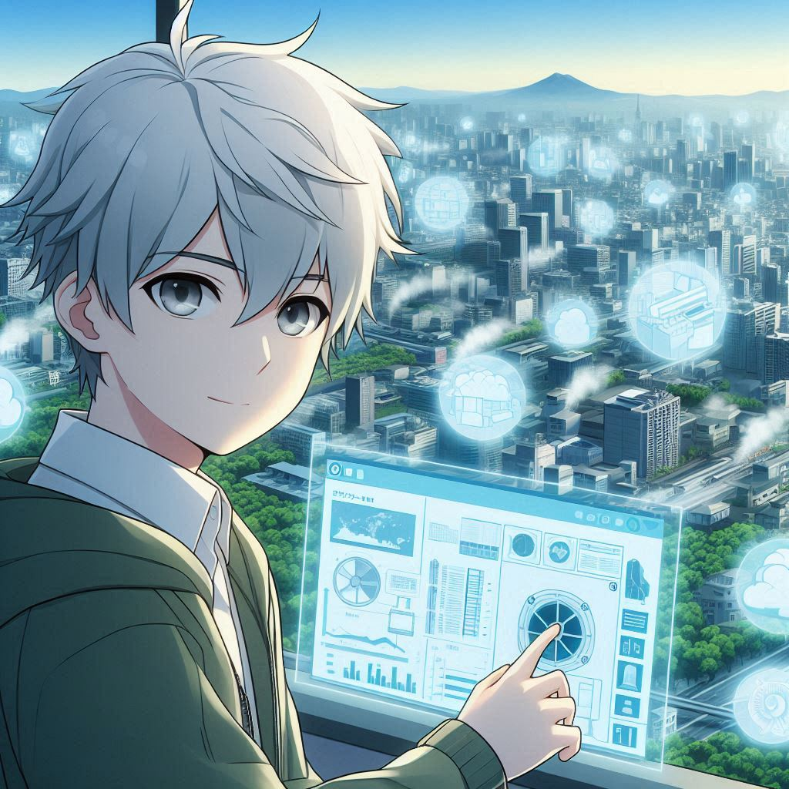
7.結局
Notes:
A teenage boy with white hair and gray eyes in Japanese anime style, overseeing the mass production and deployment of his air purification device across various locations, resulting in improved air quality and a clear blue sky returning to his hometown.

