Slide 1
Enhancing user web availability through
web isolation using RBI (Remote Browser Isolation)

Slide 2
Zero Trust ? Availability?
Enhancing user web availability through Remote Browser Isolation (RBI)
What if an allowed site is actually infected with undetected malware?
Is there a way to safely view web pages users access without blocking them?
At the very least, is there a secure way to access sites in the “Unknown” category?
Is there a way to preview vulnerable web applications offered as SaaS by websites?
Can we simplify the complex exception policies for blocked sites?
Can we apply DLP (Data Loss Prevention) functions while using web isolation?

Slide 3
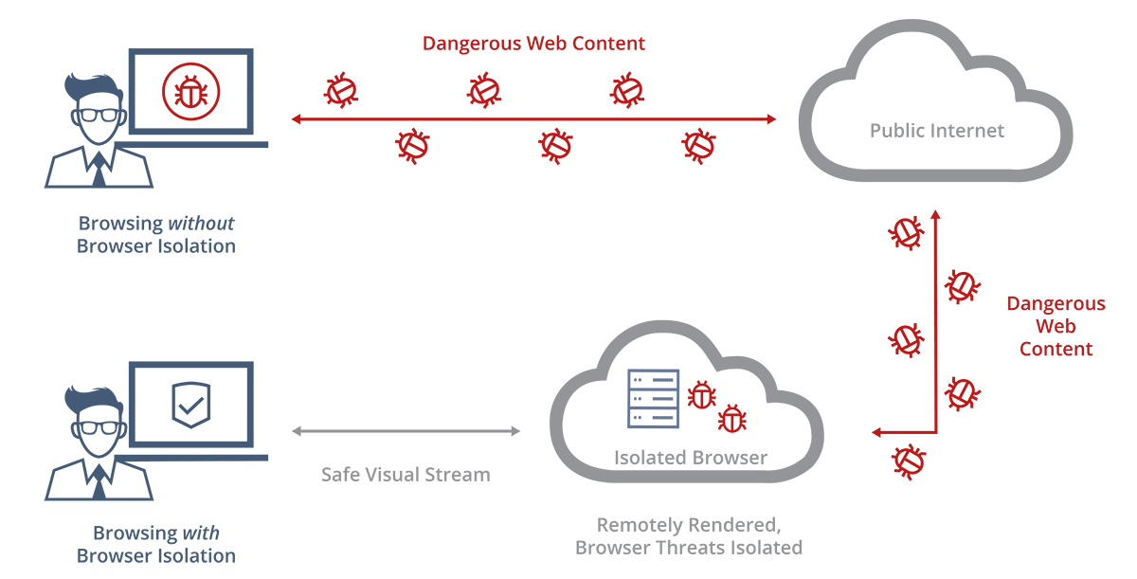
Application of Web Isolation Technology
Enhancing user web availability through Remote Browser Isolation (RBI)
※ Web Isolation Architecture

Slide 4
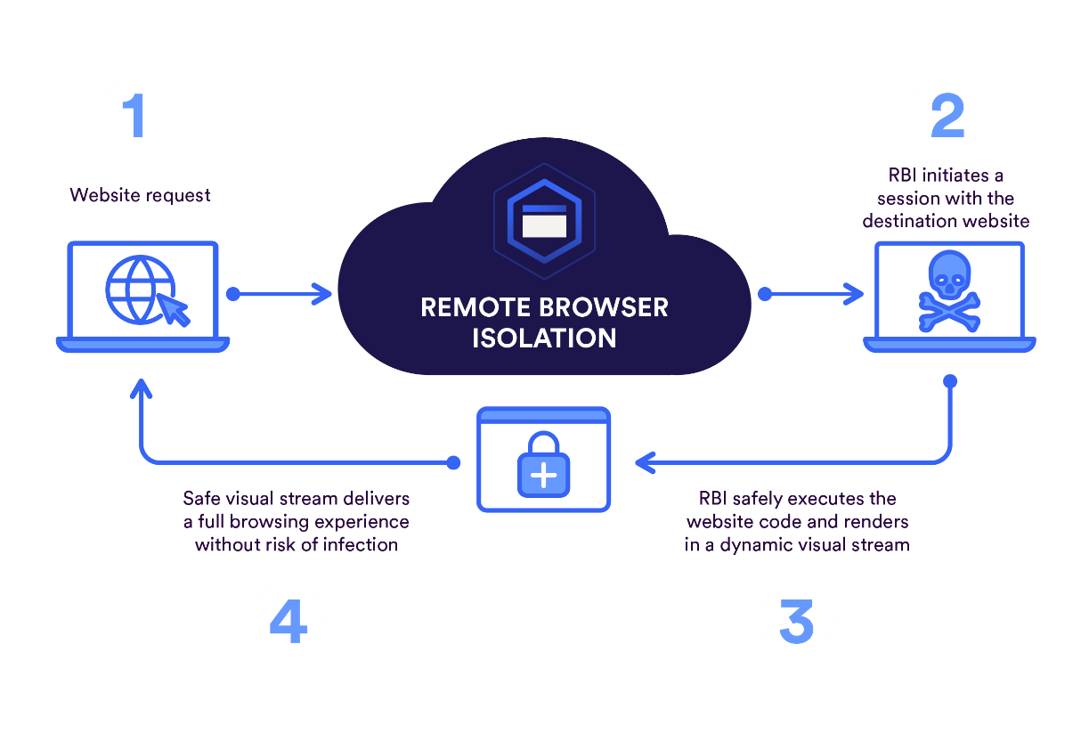
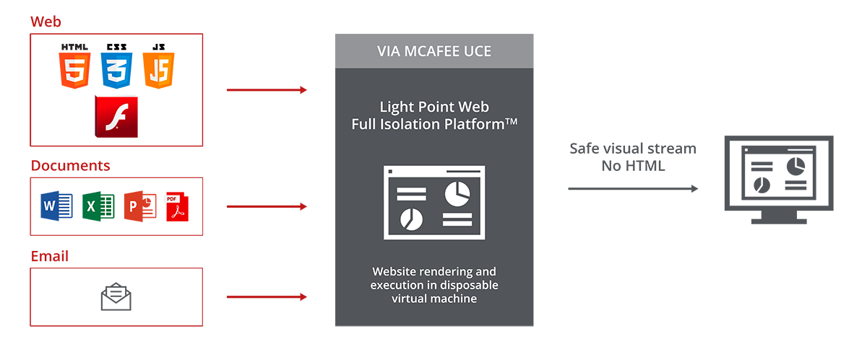
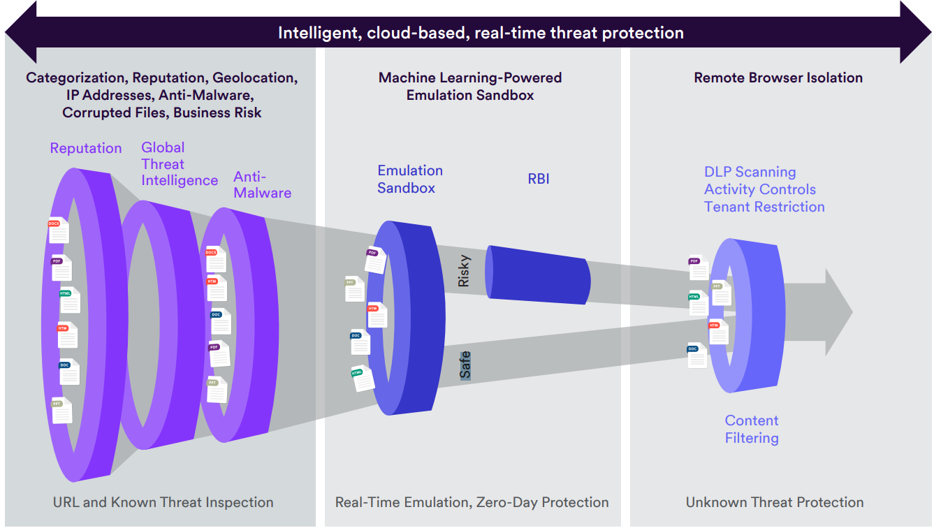
Enhancing user web availability through Remote Browser Isolation (RBI)
Application of Web Isolation Technology
※ Integration of SWG with Web Isolation Technology
Applying Web Isolation Action in SWG Policy for Specific Categories
- Allow access to blacklisted websites through web isolation
- Configure web isolation policy (e.g., read-only, no download, etc.)
- Restrict uploads using DLP functionality simultaneously with web
isolation
Applying Web Isolation Action for Unknown Category Sites
- Ensure availability by applying web isolation to suspicious sites
Detailed Control over File Downloads in Isolated Browser
- Granular control over all downloadable files
- Scan all allowed downloads in advance to eliminate threats

Slide 5
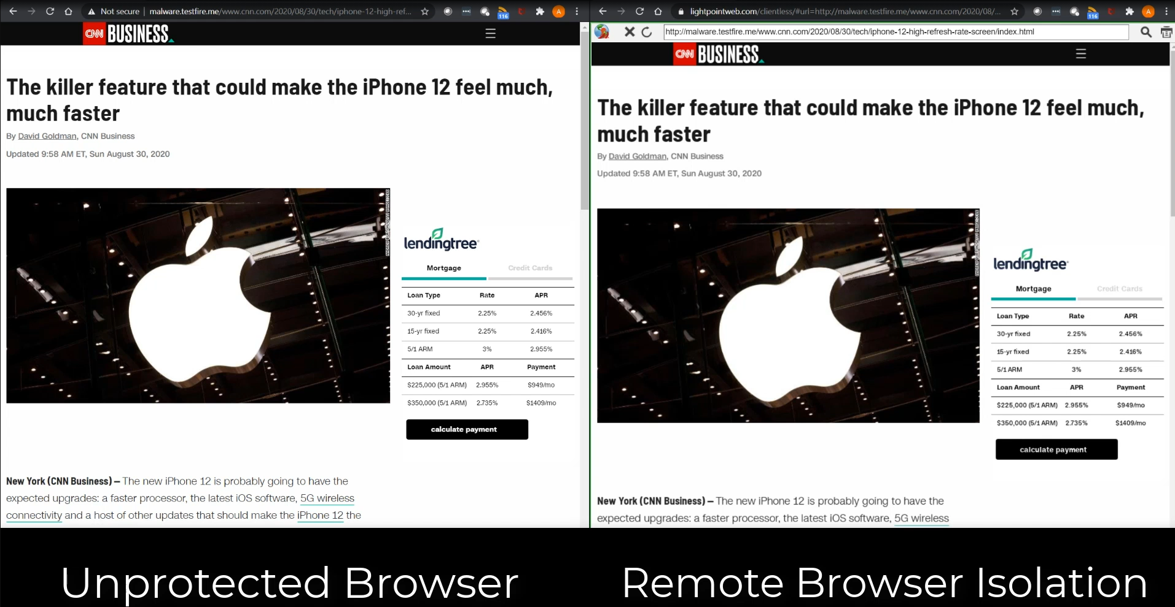
Web Isolation Solution Implementation Screen (User Experience)
Enhancing user web availability through Remote Browser Isolation (RBI)

Slide 6
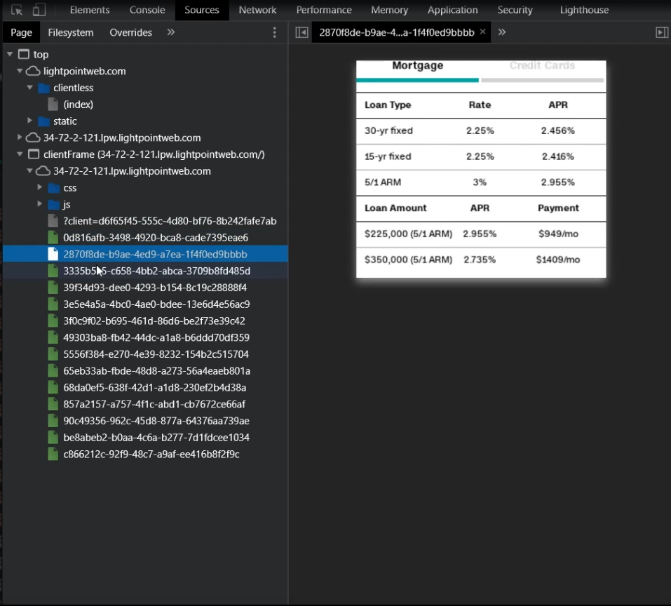
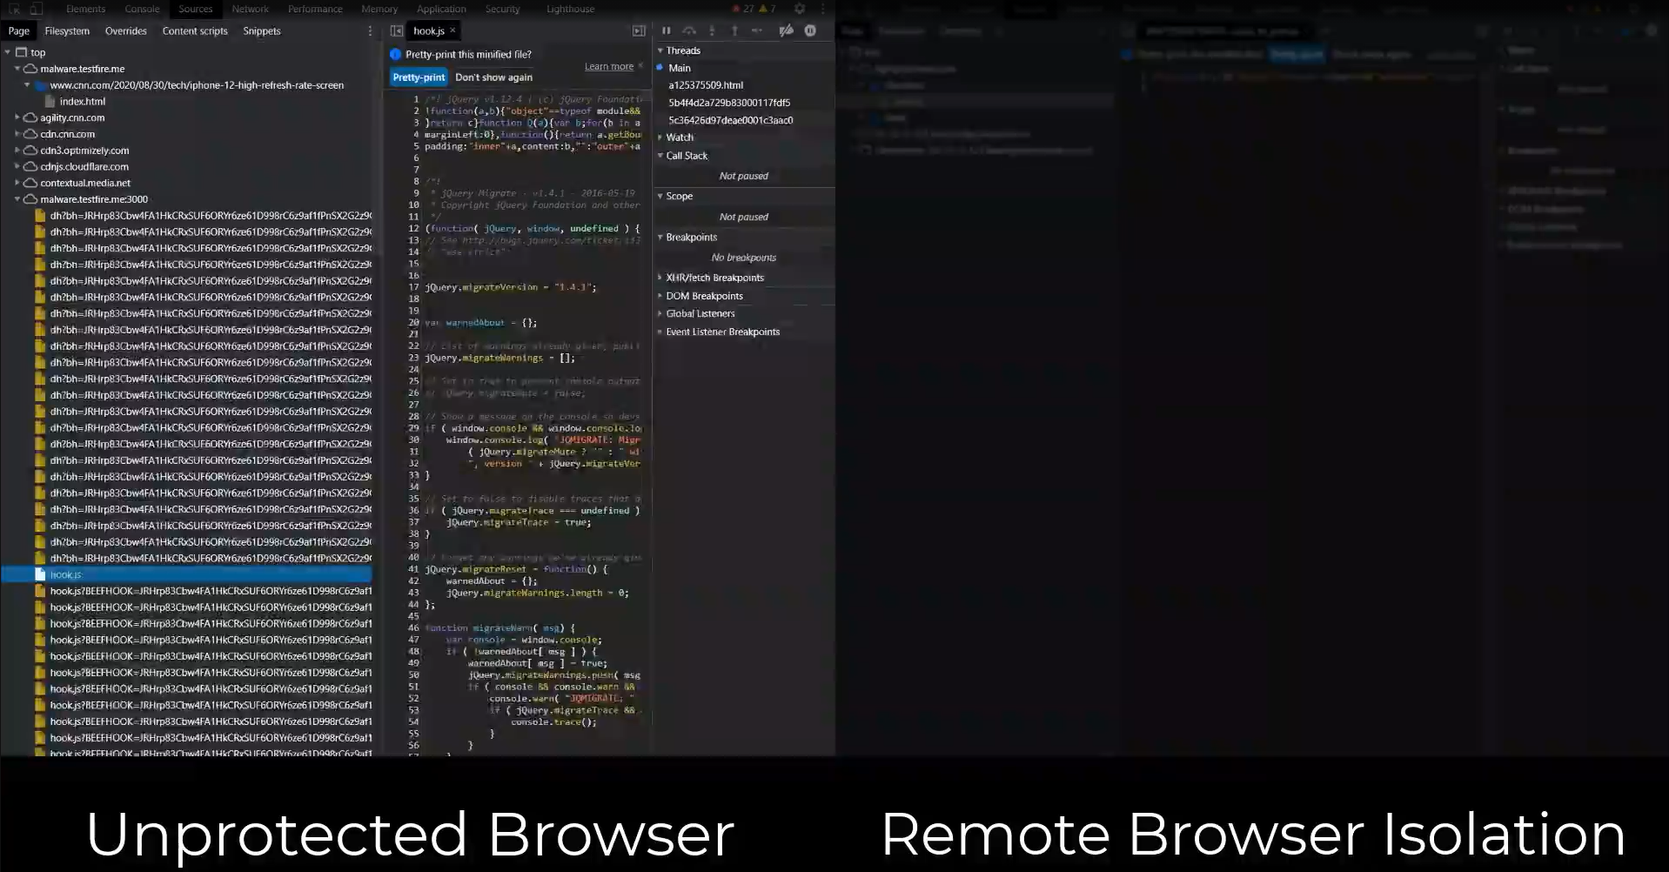
Web Isolation Solution Implementation Screen (Webpage Source Code Comparison)
Enhancing user web availability through Remote Browser Isolation (RBI)

Slide 7







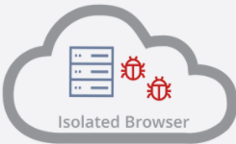








SWG + SSE (RBI) Function Integration Reference Architecture
Enhancing user web availability through Remote Browser Isolation (RBI)
Expected Effects of SWG + Web Isolation Function Integration
※ Customer References
Expected Effects on Performance and Cost
- Provides performance and cost advantages compared to traditional web
security methods
- Saves resources of internal security devices (utilizes cloud resources)
Protects users from potential malware
- Prevents ransomware infection by not executing code on user PCs
- Blocks infection even when accessing malicious sites (Zero Trust)
- Delivers sanitized pages when accessing sites through web isolation
Reduces operational resource burden due to exception requests
- Eliminates the need for frequent operational handling of block exception
requests (Allows access to blocked sites via web isolation)
- Provides document file preview in the web browser for files to be
downloaded from websites
Provides simultaneous application of web security and availability of users' access to websites
RBI
SSE(RBI)
SWG
MCP
MCP
Inside the Company
Outside the Company

